Slide 1

Static
Dynamic

Slide 2
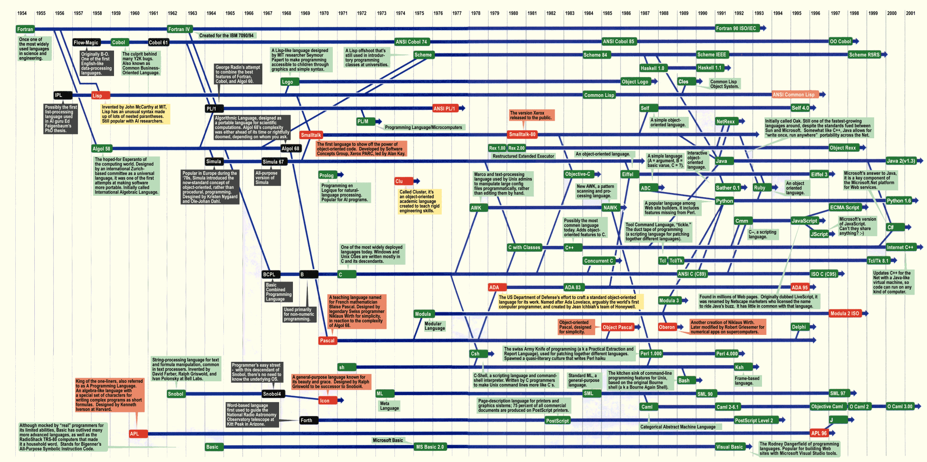

Slide 5
Static Typing
…
http://wiki.c2.com/?StaticTyping
(Explicit typing vs type inference)

Slide 6
Dynamic Typing
…

Slide 7
Static vs Dynamic Typing
Static | Dynamic
… | …

Slide 8

Time for SCIENCE!
Split into groups: Static & Dynamic
Within each group, split into pairs
Solve a problem
See, inconclusively, which approach is best*

Slide 9
The Problem: Bowling
10-Pin Bowling Scorer
10 pins to knock down, worth one point each
10 frames, each consisting of up to two attempts
‘Strike’ – all 10 pins down on first attempt
No second attempt
Score for this frame is 10 + pins from next two balls
‘Spare’ – all 10 pins knocked down on second attempt
Score for this frame is 10 + pins from next ball
If you get a Strike or Spare on the last frame, you get an additional 1 or 2 balls
See handouts for end game cases

Slide 10
The Problem: Bowling
Examples
Frame 1: [3,5] 8
Frame 2: [2,4] 6
Score: 14
Frame 1: [10,-] 13
Frame 2: [2,1] 3
Score: 16
Frame 1: [5,5] 16
Frame 2: [6,3] 9
Score: 25
Frames: [10,-] [10,-] [10,-] [10,-] [10,-] [10,-] [10,-] [10,-] [10,-] [10,-] 10 10 <- extra balls to calculate Frame 10 score
Score: 300

Slide 11
The Problem: Bowling
Write a program which takes a partial or full set of frames and calculates the score.
Input will always be full frames (+ bonus balls if needed)
Assume input always valid
Input will be no more than one game*
Input format is up to you
Prepare to accept different inputs during scoring
* Note functional rules RE infinite sequences

Slide 12
Go!
FAQ

Slide 13
Scoring the solutions
Swap with a pair in the other group
Give a mark for each successful test case passed
Deduct a mark for each case of a broken rule
Any uncertainly, ask a Judge
Scores will be aggregated
See handouts for details

Slide 14


Slide 15
Remember!
Put your solutions here:
https://github.com/LeedsCodeDojo/StaticVsDynamic
Next Dojo:
Wednesday 7th Feb - TBD

