Slide 1
ModB-Sem1-Davis-week5
Dave Davis

Slide 2
200+ Financial Indicators of US stocks (2014-2018)
5 Datasets
255 Columns
Various Columns with Empty Data
Questions:
Market Trends: Are the markets trending upward or downward?
Economic Health: What is the overall economic health of a country (GDP growth, unemployment rates)?
Company Performance: How are companies performing within an industry (earnings reports, balance sheets)?

Slide 3
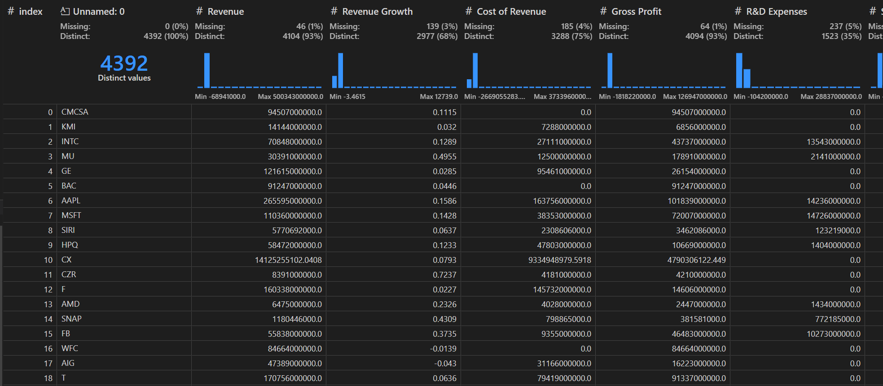
https://www.kaggle.com/datasets/cnic92/200-financial-indicators-of-us-stocks-20142018

Slide 4
Financial Statements of Major Companies(2009-2023)
23 Data Columns
No missing data
Questions:
Market Trends: Are the markets trending upward or downward?
Economic Health: What is the overall economic health of a country (GDP growth, unemployment rates)?
Company Performance: How are companies performing within an industry (earnings reports, balance sheets)?

Slide 5
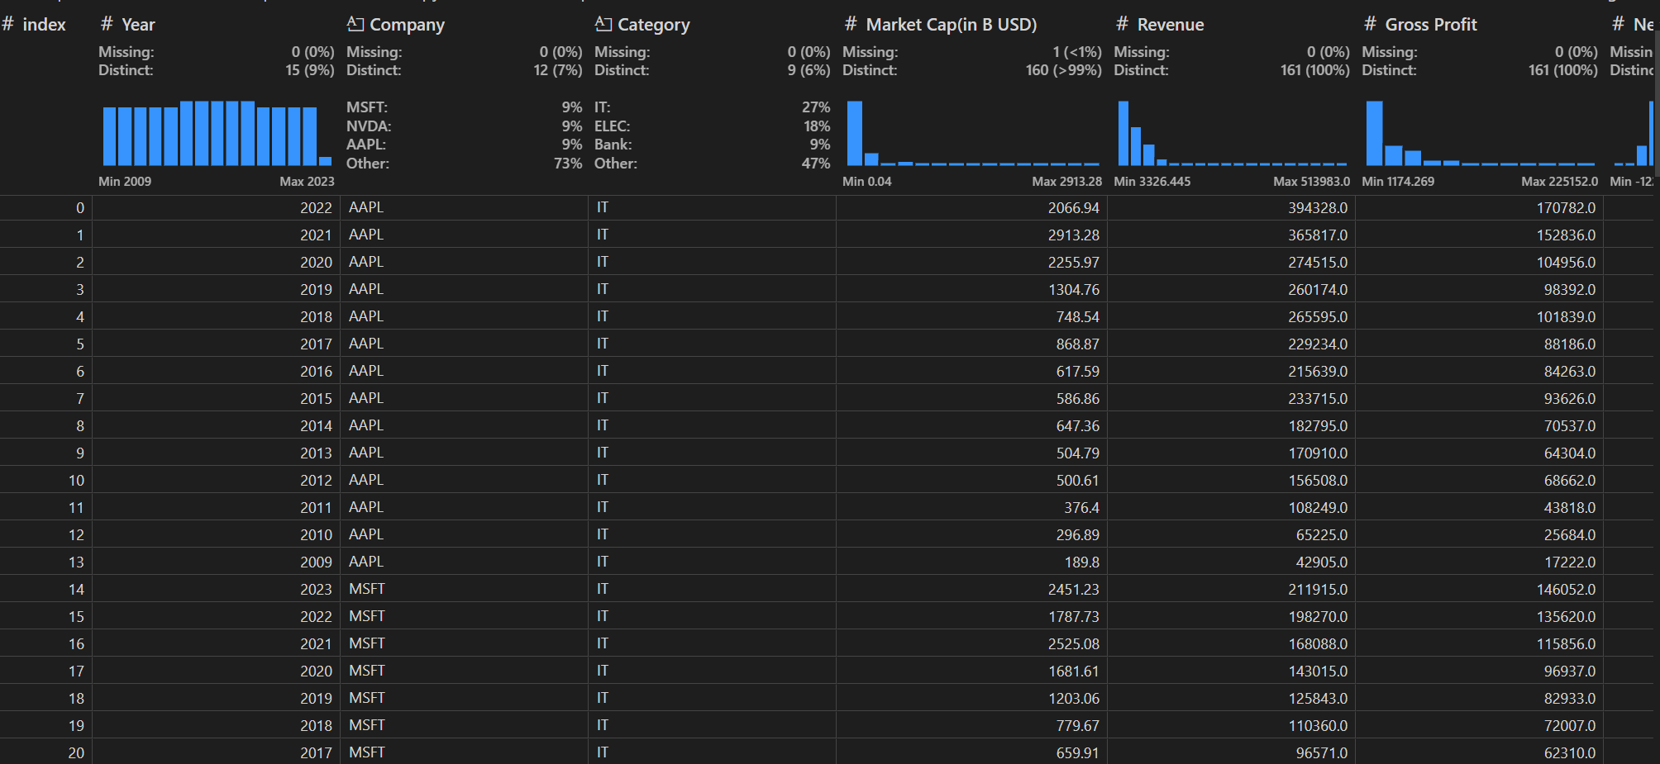
https://www.kaggle.com/datasets/rish59/financial-statements-of-major-companies2009-2023

Slide 6
US historical stock prices with earnings data
3 Datasets
Earnings
Stock Price
Dividends
https://www.kaggle.com/datasets/tsaustin/us-historical-stock-prices-with-earnings-data

Slide 7
Earnings
Earnings data for each stock with earnings date, estimated EPS and reported EPS.
6 Columns 168603 Rows Some columns with missing data
Questions:
Profitability: Is the company making a profit? What are its earnings per share (EPS)?
Growth: How has the company's earnings grown over the past quarters or years?
Revenue Streams: What are the major sources of the company's revenue?
Margins: What are the company’s profit margins? Is it improving or declining?
Cost Management: How well is the company managing its costs?

Slide 8
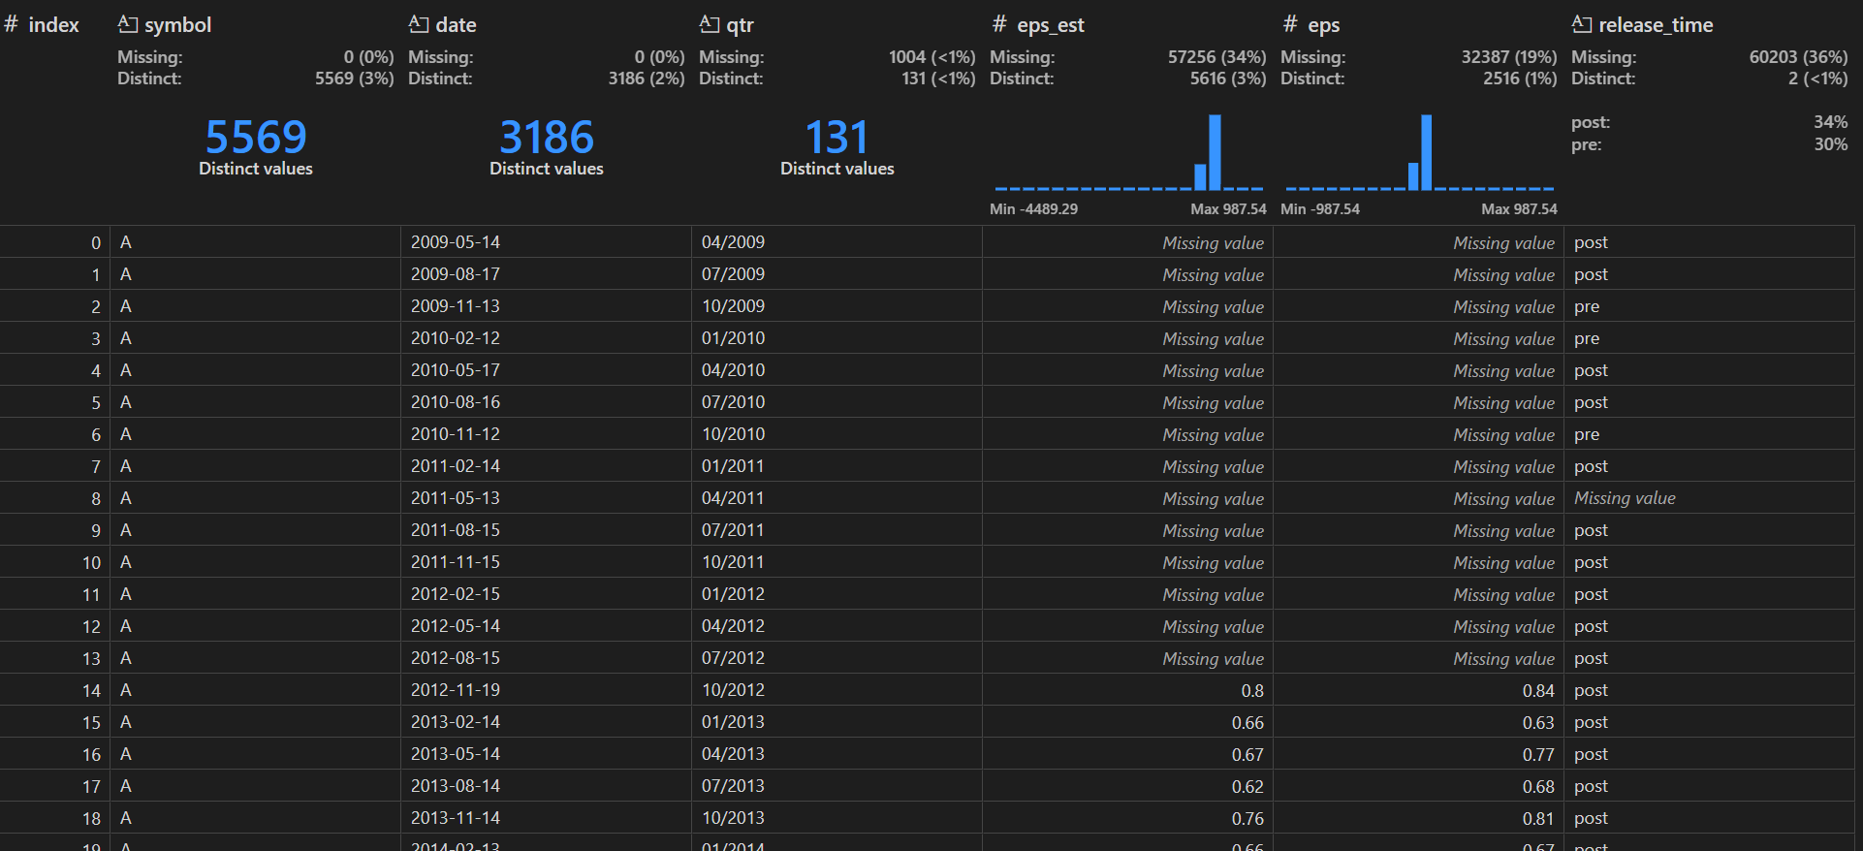

Slide 9
Stock Price
Daily stock price data with open, close, low, and high trading volumes and adjusted closing prices as well as a stock split coefficient.
9 Columns 24395016 Rows no missing data
Questions:
Performance Trends: How has the company's stock price changed over time?
Market Sentiment: What do investors think about the company (price volatility, trading volume)?
Comparative Performance: How does the stock perform relative to industry peers or market indices?
Reaction to News: How does the stock price react to company news, earnings reports, or economic events?

Slide 10
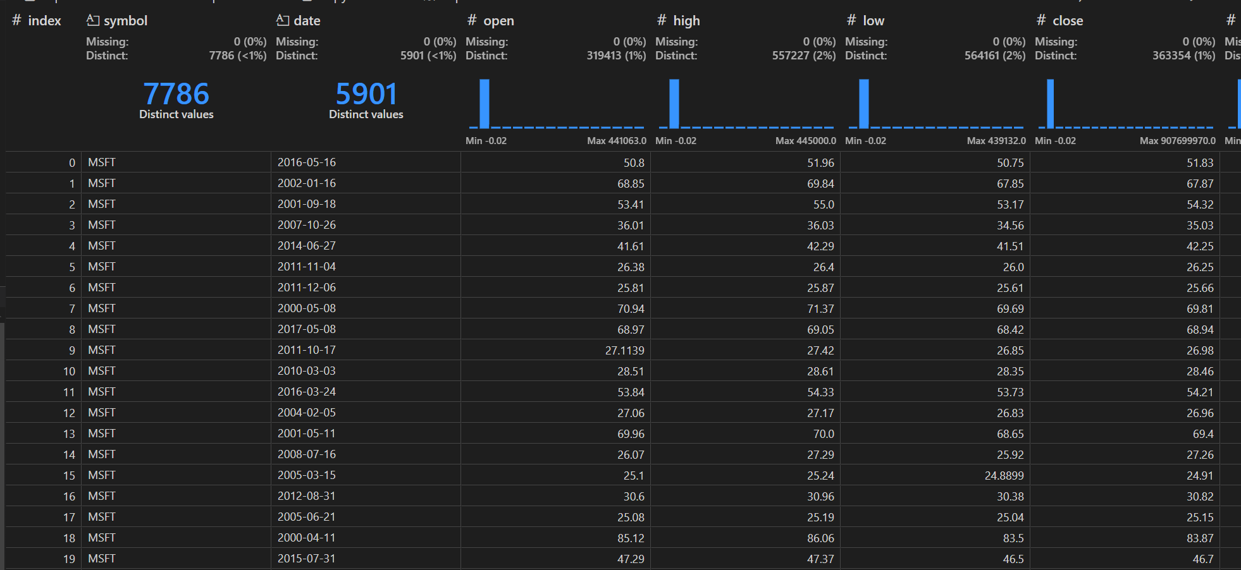

Slide 11
Dividend
Dividend data for each stock with dividend date.
3 Columns 258,917 Rows. No missing data
Question:
Income Generation: How much income can investors expect from dividends?
Dividend Yield: What is the return on investment from dividends relative to the stock price?
Payout Ratio: Is the company paying a sustainable percentage of its earnings as dividends?
Dividend Growth: Has the company consistently increased its dividend payments over time?
Financial Health: Does the company have the cash flow to sustain its dividend payments?

Slide 12
