Slide 1
Predicting Property Tax Value Using Zillow Dataset
Xiaohai Chen and David Davis
Notes:
This presentation was automatically generated by PowerPoint Copilot based on content found in this document: https://1drv.ms/w/s!

Slide 2
Executive Summary
Project Goal
Predict assessed tax value of properties using Zillow dataset
Approach as a real estate data science problem
Data Preparation
Extensive data cleaning and imputation
Feature engineering to improve data quality
Model Evaluation
Multiple models evaluated including linear regressions and ensemble methods
Gradient Boosting Regressor emerged as top-performing model
Key Findings
Square footage and location-based variables were most predictive
Business Applications
Notes:
This project aimed to predict property tax values using Zillow data. We cleaned and engineered the dataset, evaluated multiple models, and found Gradient Boosting Regressor to be the best. Key predictors included square footage and location. The project has applications in real estate valuation and investment tools. Original Content: The goal of this project was to predict the assessed tax value of properties using a cleaned and engineered subset of the Zillow housing dataset. By approaching this as a real estate data science problem, we aimed to build a regression model that could accurately forecast property value based on structural and geographic attributes. We performed extensive data cleaning, imputation, and feature engineering to improve data quality. Multiple models were evaluated, including linear regressions and ensemble methods. Gradient Boosting Regressor emerged as the top-performing model with a log-transformed RMSE of 0.6121 and a final test RMSE of $287,882.76. We found that square footage and location-based variables were the most predictive, while engineered features such as sqft_per_bedroom and latitude-longitude interactions enhanced performance. Overall, this project showcases a reproducible and scalable pipeline for tax value prediction, with potential business applications in real estate valuation tools and property investment recommendations.

Slide 3
Introduction
Importance of Accurate Valuation Models
Crucial for internal analytics
Essential for customer-facing tools
Project Objective
Enhance accuracy of property tax value predictions
Utilize raw Zillow dataset
Dataset Features
Structural features
Geographical features
Categorical property features
Data Science Team Tasks
Primary Business Goals
Notes:
In the competitive real estate market, accurate valuation models are vital for analytics and customer tools. Our data science team aimed to improve property tax value predictions using a Zillow dataset. The project involved cleaning, preprocessing, and applying regression techniques to create a reliable model. The goal was to identify high-value homes, correct errors, and support marketing and pricing strategies. Original Content: In the competitive landscape of real estate, accurate valuation models are crucial for both internal analytics and customer-facing tools. Our in-house data science team was tasked with enhancing the accuracy of property tax value predictions, based on a raw Zillow dataset containing structural, geographical, and categorical property features. The project’s objective was to clean and preprocess this dataset, explore its structure, and apply modern regression techniques to create a reliable, interpretable prediction model. The primary business goal was to identify high-value homes, correct valuation errors, and support strategic marketing and pricing decisions.

Slide 4

Data Description
Dataset Source and Size
Sourced from 2017 Zillow Million Dollar Prize dataset by Boston University
Contains 77,613 property records
Features and Variables
55 features including numeric, categorical, and geographic variables
Examples: bedroomcnt, yearbuilt, propertycountylandusecode, latitude, longitude
Target Variable
Taxvaluedollarcnt is numeric with a skewed distribution
Mean value: $490,151
Maximum value: $49M
Missing Values
Preprocessing Results
Notes:
The dataset from Boston University contains 77,613 property records with 55 features. The target variable, taxvaluedollarcnt, has a skewed distribution. Missing values were prevalent in some features. After preprocessing, the dataset was reduced to 75,969 samples and 33 features, with no missing values. Original Content: The dataset, sourced from a condensed version of the 2017 Zillow Million Dollar Prize dataset provided by Boston University, contains 77,613 property records with 55 features, including numeric (e.g., bedroomcnt, yearbuilt), categorical (e.g., propertycountylandusecode), and geographic (e.g., latitude, longitude) variables. The target, taxvaluedollarcnt, is numeric with a skewed distribution (mean $490,151, max $49M). Missing values were prevalent, with features like basementsqft (99.94% missing) and fireplacecnt (89.32% missing) posing challenges. After preprocessing, the dataset was reduced to 75,969 samples and 33 features (including engineered ones), with no missing values, ensuring suitability for regression modeling.

Slide 5
Methodology
Regression Modeling Framework
RMSE used as primary error metric
Sensitivity to large errors
Cross-Validation Technique
5 folds, 5 repeats
Ensures reliable performance estimates
Mitigates overfitting risks
Hyperparameter Tuning
Guided by validation curves
GridSearchCV used
Parameters like learning_rate and n_estimators
Balances bias and variance
Notes:
We used regression modeling with RMSE as the error metric for property valuation. Cross-validation with 5 folds and 5 repeats ensured reliable performance and reduced overfitting. Hyperparameter tuning was guided by validation curves using GridSearchCV, balancing bias and variance for optimal results. Original Content: We adopted a rigorous analytical framework centered on regression modeling, using RMSE as the primary error metric due to its sensitivity to large errors, crucial for property valuation. Repeated cross-validation (5 folds, 5 repeats) ensured reliable performance estimates, mitigating overfitting risks. Validation curves, generated via GridSearchCV, guided hyperparameter tuning by visualizing the impact of parameters like learning_rate and n_estimators on model performance, balancing bias and variance for optimal generalization

Slide 6
Data Cleaning and Preprocessing
Issues in Raw Dataset
High missingness in features like basementsqft
Outliers in taxvaluedollarcnt
Feature Removal
Dropped features with >80% missing values
Removed samples with null targets or >50% missing features
Outlier Removal
Applied milder outlier removal (0.5th–99.5th percentiles)
Preserved high-value properties
Imputation Techniques
Label Encoding
Adjustments
Notes:
The raw dataset had issues like high missingness and outliers. We removed features with >80% missing values and applied milder outlier removal. Imputation techniques and label encoding were used to maintain data integrity. Adjustments were made to improve predictive range for luxury homes. Original Content: The raw dataset presented issues like high missingness (e.g., basementsqft 99.94% missing) and outliers in taxvaluedollarcnt (max $49M vs. median $358K). We dropped features with >80% missing values to avoid unreliable imputation, removed samples with null targets or >50% missing features, and applied milder outlier removal (0.5th–99.5th percentiles) to preserve high-value properties. Median imputation for numeric features and most-frequent for categorical features addressed skewness and maintained data integrity. Label encoding transformed categorical features like propertycountylandusecode. These steps worked well to create a clean dataset, though strict outlier removal initially reduced predictive range for luxury homes, later adjusted.

Slide 7
Feature Engineering
Non-linear and contextual relationships
bath_bed_interaction for livability
yearbuilt_squared for non-linear age effects
sqft_per_bedroom for space efficiency
lat_lon_interaction for location synergy
EDA insights and domain knowledge
High F-values for finishedsquarefeet12
Understanding property value drivers
Feature performance
sqft_per_bedroom and yearbuilt_squared retained in top features
bath_bed_interaction less impactful, possibly redundant
Log-transforming the target
Notes:
We engineered features to capture non-linear and contextual relationships, such as bath_bed_interaction and yearbuilt_squared. EDA insights and domain knowledge guided our choices. While some features proved valuable, others were less impactful. Log-transforming the target improved model stability. Original Content: We engineered features to capture non-linear and contextual relationships: bath_bed_interaction (bathroomcnt * bedroomcnt) for livability, yearbuilt_squared for non-linear age effects, sqft_per_bedroom for space efficiency, and lat_lon_interaction for location synergy. These were chosen based on EDA insights (e.g., high F-values for finishedsquarefeet12) and domain knowledge of property value drivers. sqft_per_bedroom and yearbuilt_squared proved valuable (retained in top features), but bath_bed_interaction was less impactful, possibly redundant with raw features. Log-transforming the target addressed skewness, improving model stability, though further geographic interactions could enhance performance.

Slide 8
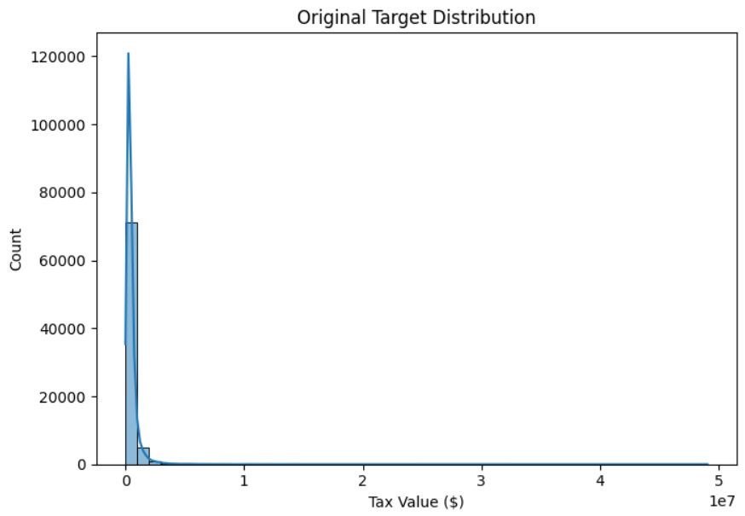
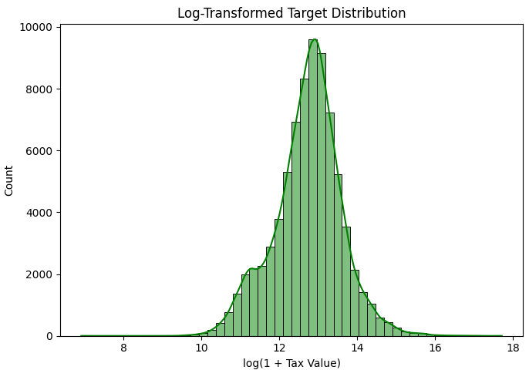
Model Selection Process
Project Goal
Predict assessed tax value of properties using Zillow dataset
Approach as a real estate data science problem
Data Preparation
Extensive data cleaning and imputation
Feature engineering to improve data quality
Model Evaluation
Multiple models evaluated including linear regressions and ensemble methods
Gradient Boosting Regressor emerged as top-performing model
Key Findings
Square footage and location-based variables were most predictive
Business Applications
Notes:
This project aimed to predict property tax values using Zillow data. We cleaned and engineered the dataset, evaluated multiple models, and found Gradient Boosting Regressor to be the best. Key predictors included square footage and location. This pipeline has business applications in real estate valuation and investment. Original Content: The goal of this project was to predict the assessed tax value of properties using a cleaned and engineered subset of the Zillow housing dataset. By approaching this as a real estate data science problem, we aimed to build a regression model that could accurately forecast property value based on structural and geographic attributes. We performed extensive data cleaning, imputation, and feature engineering to improve data quality. Multiple models were evaluated, including linear regressions and ensemble methods. Gradient Boosting Regressor emerged as the top-performing model with a log-transformed RMSE of 0.6121 and a final test RMSE of $287,882.76. We found that square footage and location-based variables were the most predictive, while engineered features such as sqft_per_bedroom and latitude-longitude interactions enhanced performance. Overall, this project showcases a reproducible and scalable pipeline for tax value prediction, with potential business applications in real estate valuation tools and property investment recommendations.

Slide 9
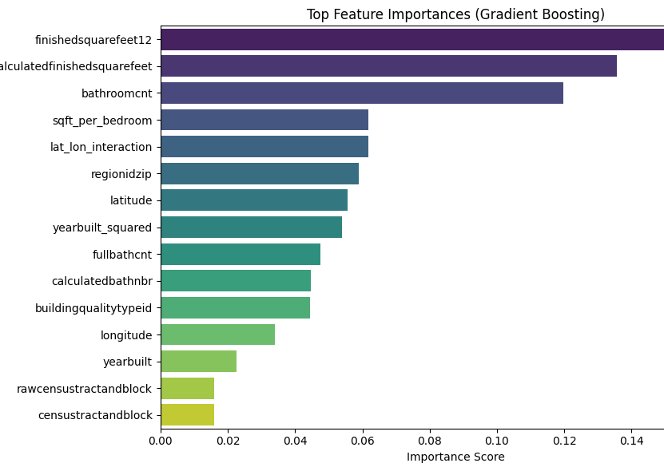
Feature Importance
Key Predictive Features
finishedsquarefeet12
calculatedfinishedsquarefeet
latitude
longitude
sqft_per_bedroom
Importance of Square Footage and Location
Square footage remains highly predictive
Spatial location is a significant factor
Validation of Engineered Features
sqft_per_bedroom ranked high
Inclusion of engineered features is validated
Notes:
The key predictive features include finished square feet, calculated finished square feet, latitude, longitude, and square footage per bedroom. Square footage and spatial location are highly predictive, and engineered features like square footage per bedroom are validated. Original Content: - finishedsquarefeet12 - calculatedfinishedsquarefeet - latitude - longitude - sqft_per_bedroom These results suggest square footage and spatial location remain the most predictive. Engineered features like sqft_per_bedroom also ranked high, validating their inclusion.

Slide 10

Cross-Validation Performance
Model: Gradient Boosting Regressor
RMSE (Log-Transformed): 0.6121 ± 0.0044
Parameters:
n_estimators: 470
learning_rate: 0.1
max_depth: 3
max_features: 9
Test Set Performance (Original Scale)
Test RMSE: 287,882.76
Notes:
The Gradient Boosting Regressor model has a log-transformed RMSE of 0.6121 ± 0.0044. Key parameters include 470 estimators, a learning rate of 0.1, a max depth of 3, and 9 max features. Original Content: - Gradient Boosting Regressor - RMSE (Log-Transformed): 0.6121 ± 0.0044 - Parameters: n_estimators=470, learning_rate=0.1, max_depth=3, max_features=9

Slide 11
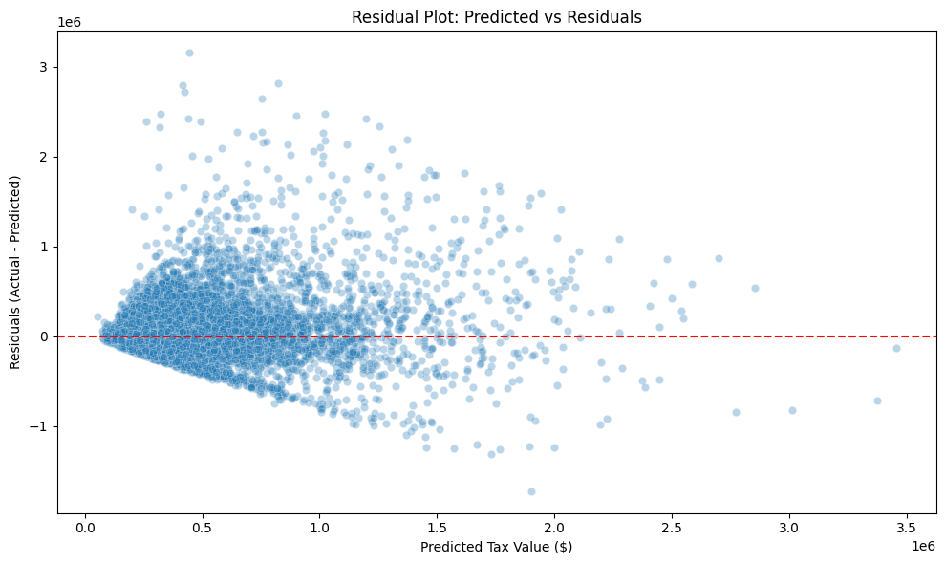
Error Analysis
Residuals and Errors
Higher errors for properties above $2M
Fewer training examples in high-value range
Log Transformation helped mitigate skewed distributions and reduce RMSE
Noise in Zip Codes
Less representation in certain zip codes
Potential for grouped encoding or smoothing techniques
Notes:
Our team aimed to improve property tax value predictions using a Zillow dataset. We focused on reducing errors, especially for high-value properties, and addressing noise in less represented zip codes. Accurate valuation models are vital for analytics and customer tools, helping identify high-value homes and support strategic decisions. Original Content: - Residuals showed slightly higher errors for properties above $2M, consistent with the presence of fewer training examples in that range. - Some noise remains in zip codes with less representation, indicating a potential for grouped encoding or smooth techniques In the competitive landscape of real estate, accurate valuation models are crucial for both internal analytics and customer-facing tools. Our in-house data science team was tasked with enhancing the accuracy of property tax value predictions, based on a raw Zillow dataset containing structural, geographical, and categorical property features. The project’s objective was to clean and preprocess this dataset, explore its structure, and apply modern regression techniques to create a reliable, interpretable prediction model. The primary business goal was to identify high-value homes, correct valuation errors, and support strategic marketing and pricing decisions.

Slide 12
Conclusion
Successful Development of Regression Model
Achieved test RMSE of $287,882.76
Predicts tax-assessed property values
Workflow Emphasis
Strong preprocessing
Engineered feature design
Thoughtful model selection
Foundation for Zillow-like Systems
Supports better pricing strategies
Enhances consumer tools
Limitations
Future Improvements
Notes:
We developed a regression model to predict property values, achieving a test RMSE of $287,882.76. Our workflow included strong preprocessing, feature design, and model selection. This model supports better pricing strategies and consumer tools. Limitations include noise in high-end properties and lack of temporal features. Future improvements could involve spatial clustering, ensemble blending, and explainable AI tools. Original Content: We successfully developed a high-performing regression model to predict tax-assessed property values, achieving a test RMSE of $287,882.76. Our workflow emphasized strong preprocessing, engineered feature design, and thoughtful model selection. This work provides a foundation for Zillow-like valuation systems, supporting better pricing strategies and consumer tools. Limitations include persistent noise in high-end properties and lack of temporal features (e.g., sales year). Future improvements could include incorporating spatial clustering (e.g., KNN or region embeddings), using ensemble blending, or deploying explainable AI tools like SHAP to refine feature insights and improve stakeholder trust.

