Slide 1
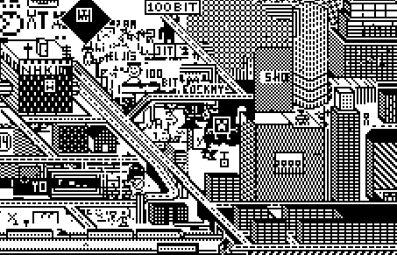
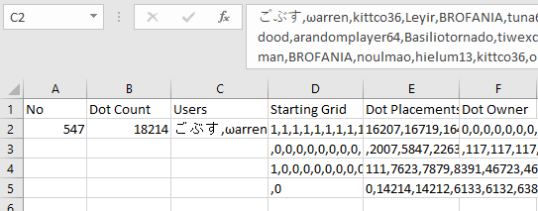
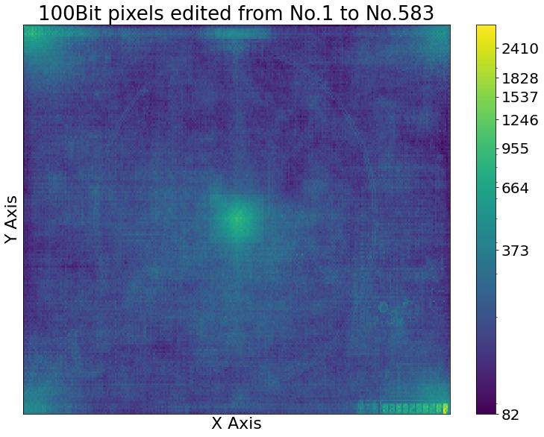
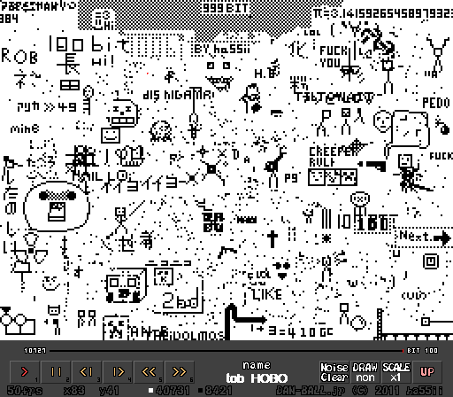
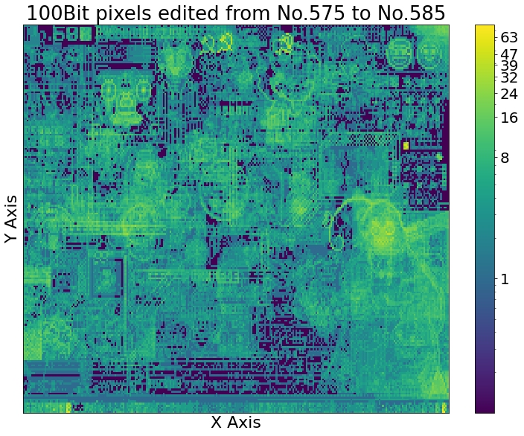
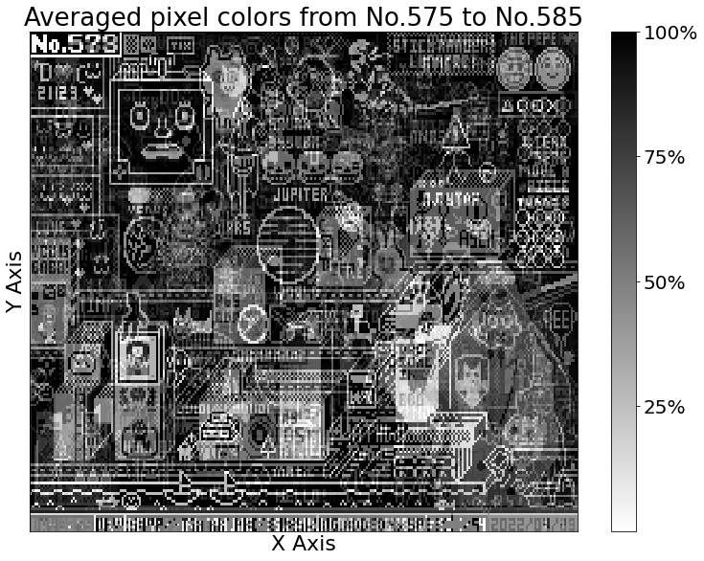
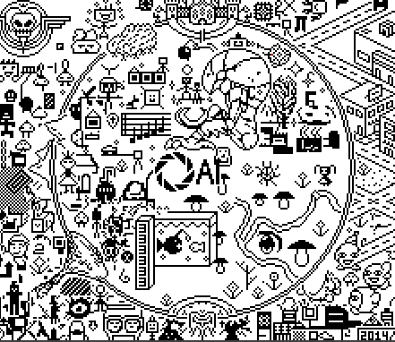
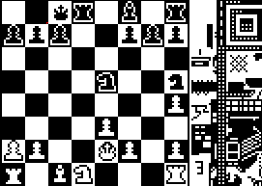
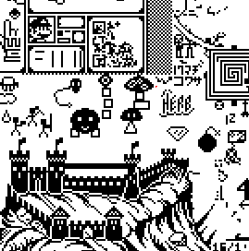
100bit Analysis – Drawing Together with Limitations
David Butler
Background
A 1-bit drawing game
Players toggle up to 100 pixels’ color every 6 hours
Limited Canvas = frequent interaction between players
  Grid - The 256*192-pixel area of the game that players slowly change over time
No. – A specific range of changes to the grid (~20K changes)
Upload – up to 100 changes player made to grid
Methodology
  Scraped desired webpages, stored JavaScript variables into .xlsx file
  Stored edits made for each No., order of users who made edits, etc.
Results
  Change heatmaps highlight which structures were frequently drawn/erased
  Averaged color heatmap useful for finding stagnant drawings
One of the first of many cities that come-and-go from 100bit. Some have jokingly compared cities in 100bit with carcinization. [1]
  Tested if scraped dataset was what I expected
  End of No. K must equal No. (K + 1)’s starting grid
  Iterated over dataset
  Counted changes per pixel
  Tracked changes per user
  Tracked average color of pixel over time
  Created heatmaps
  Changes per pixel heatmaps (Viridis), scaled logarithmically
  Average color heatmaps (Grayscale)
  Can filter by No. range/specific users
Problem Definition
Need to crawl & scrape JavaScript variables from 500+ webpages
Need to display crawled data in unique & interesting way
Must be able to handle lots of data
Related Work
Selenium: Library which allows Python to crawl JavaScript webpages [3]
Matplotlib: Useful for creating heatmaps
Pandas: Handy for manipulating large datasets
Conclusion
  Project was successful in experimenting with displaying large dataset in a compact way
  Sharing project with 100Bit’s community allowed players to discover old drawings they had made
The end of 100 Bit’s first No., which began with a white background. [2]
Motivation
100Bit is a decade old!
Over 10 Million changes made
Goal: use data analysis to help uncover/showcase the game’s story
Wanted to make heatmaps to track frequent changes & average pixel color (to showcase conflict/agreement)
A circle, chessboard, and castle from various No.s [1]
Sources:
[1] https://dan-ball.jp/en/javagame/bit/
[2] https://danball.fandom.com/wiki/100bit
[3] https://www.scrapingbee.com/blog/selenium-python/cover.png

