Slide 1
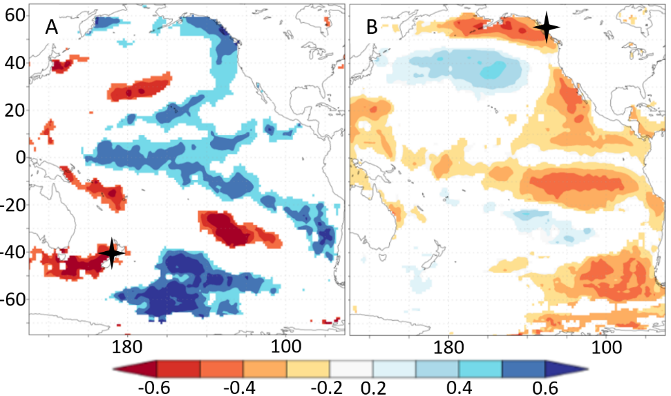

Individual Simulated Shell Series

