Slide 1
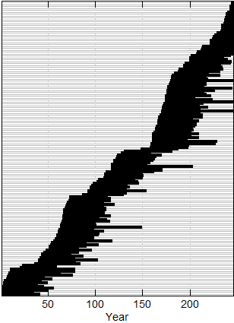
Individual Simulated Shell Series

