Slide 1
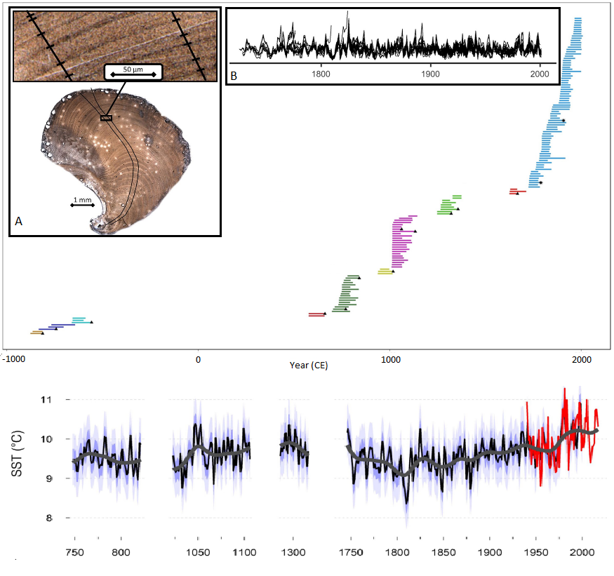
Individual Shell Series
-1000
11
1000
2000
11
10
10
SST (˚C)
9
8
750
850
1050
1100
1300
1750
1800
1850
1900
1950
2000
Year (CE)
Year (CE)

