Slide 1
Graph Database: Neo4J
Dave Gerson, Sam Cole, Ashwin Manohar

Slide 2

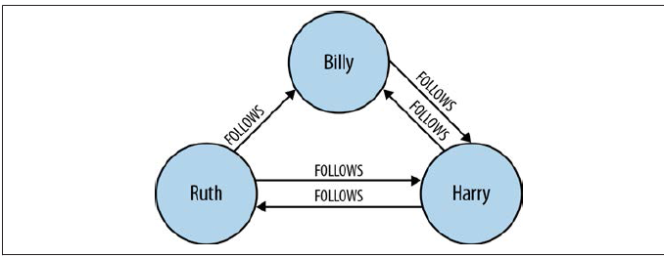
Graph Database
What is a Graph?
Graph is a set of nodes and the relations that connect them
Nodes contains properties
Relations can also contain properties
Relations are directed and have a start and end node
Graphs are everywhere?
The real world is rich and related – unlike the form based model in the relational database

Slide 3
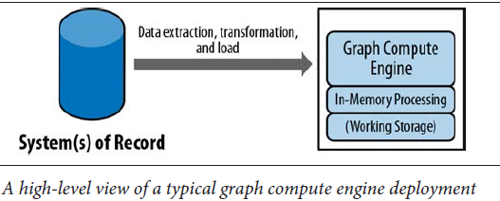
Graph Database
Database management system with CRUD methods that expose a graph data model
Underlying Storage for storing and managing graphs
Processing engine
Index free adjacency, Connected nodes physically point to each other in the database
Broad perspective any database from the users perspective behaves as a graph database

Slide 4
Power of Graph Database
Performance
Performance remains constant even as dataset grows because queries are localized to a portion of the graph.
Flexibility
We can add new nodes, relations and new graphs without disturbing existing queries and existing functionality
Agility
Frictionless development
Easy mantainence

Slide 5
Graph Database: Facebook Graph Search
What is a Graph Search?
What problem did it solve?
What has it done for Facebook?
Why does it matter?

Slide 6
Facebook Graph Search
What is a Graph Search?

Slide 7
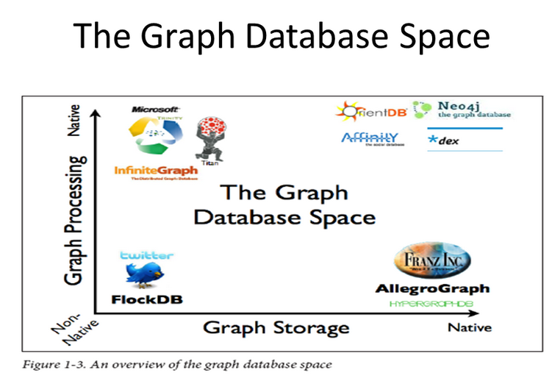

Slide 8
Vendor Selection
Name | Version | License | Language | Description
AllegroGraph | 4.11 (June 2013) | Proprietary, Clients - Eclipse Public License v1 | C#, C, Common Lisp, Java, Python | A RDF and graph database.
Neo4j | 1.9.2 (July 2013) | GPLv3 Community Edition. Commercial & AGPLv3 options for Enterprise and Advanced editions[6] | Java | A highly scalable open source graph database that supports ACID, has high-availability clustering for enterprise deployments, and comes with a web-based administration tool that includes full transaction support and visual node-link graph explorer.
DEX/Sparksee[4] | 5.0.0 (2014) | evaluation, research or developent use (free) / commercial use | C++ | A high-performance and scalable graph database management system from Sparsity Technologies, a technology transition company from DAMA-UPC. Its main characteristics is its query performance for the retrieval & exploration of large networks. Sparksee 5 mobile is the first graph database for mobile devices.
OrientDB | 1.6.1 (November 2013) | Apache 2 | Java | A distributed Graph Database with a hybrid model taken from Document Database.
Titan | 0.4.1 (2013) | Apache 2 | Java | A distributed, real-time, transactional graph database developed by Aurelius.

Slide 9
Id | Name | Type |  | Id | Name | Type |  | Id | Name | Type |  | Id | Name | Type |  | Id | Name | Type
1 | Bad Tom | Brewery |  | 21 | Paycheck Porter | Beer |  | 41 | Chickow! | Beer |  | 61 | 4.4 | ABV |  | 81 | Session IPA | Beer_Type
2 | Blank Slate | Brewery |  | 22 | Punch you in the EyePA | Beer |  | 42 | 6.8 | ABV |  | 62 | 7.2 | ABV |  | 82 | Witbier | Beer_Type
3 | E8ght Ball | Brewery |  | 23 | Planetary | Beer |  | 43 | 5.8 | ABV |  | 63 | 5.1 | ABV |  | 83 | American Brown Ale | Beer_Type
4 | Fifty West | Brewery |  | 24 | Black Forest | Beer |  | 44 | 10.4 | ABV |  | 64 | American Wheat | Beer_Type |  | 84 | Wheat | Beer_Type_Super
5 | Listermann | Brewery |  | 25 | Mac the Willis | Beer |  | 45 | 7 | ABV |  | 65 | Stout | Beer_Type |  | 85 | Stout | Beer_Type_Super
6 | MadTree | Brewery |  | 26 | Padunkadunk | Beer |  | 46 | 5.4 | ABV |  | 66 | Black IPA | Beer_Type |  | 86 | IPA | Beer_Type_Super
7 | Moerlein | Brewery |  | 27 | PsycHOPathy | Beer |  | 47 | 4.2 | ABV |  | 67 | American IPA | Beer_Type |  | 87 | Ale | Beer_Type_Super
8 | Mt. Carmel | Brewery |  | 28 | Rounding Third | Beer |  | 48 | 5.5 | ABV |  | 68 | Spice | Beer_Type |  | 88 | Bock | Beer_Type_Super
9 | Rhinegeist | Brewery |  | 29 | Barbarossa | Beer |  | 49 | 8.5 | ABV |  | 69 | English Brown | Beer_Type |  | 89 | Trappist | Beer_Type_Super
10 | Rivertown | Brewery |  | 30 | Nitro Porter | Beer |  | 50 | 7.1 | ABV |  | 70 | Golden Ale | Beer_Type |  | 90 | Porter | Beer_Type_Super
11 | Triple Digit | Brewery |  | 31 | Zeppelin | Beer |  | 51 | 6.1 | ABV |  | 71 | Bock | Beer_Type |  | 91 | German | Beer_Type_Super
12 | Brother Clement | Beer |  | 32 | IPA | Beer |  | 52 | 10 | ABV |  | 72 | Biere de gaurde | Beer_Type |  | 92 | Belgian | Beer_Type_Super
13 | Black Kettle | Beer |  | 33 | Springtime Ale | Beer |  | 53 | 6.2 | ABV |  | 73 | Porter | Beer_Type |  | 93 | Light | Beer_Color
14 | Long Way Home | Beer |  | 34 | Cougar | Beer |  | 54 | 5 | ABV |  | 74 | Double IPA | Beer_Type |  | 94 | Dark | Beer_Color
15 | Fork In the Road | Beer |  | 35 | Hustle | Beer |  | 55 | 7.8 | ABV |  | 75 | Irish Red | Beer_Type
16 | Fume | Beer |  | 36 | Luck | Beer |  | 56 | 6.9 | ABV |  | 76 | Dunkelweizen | Beer_Type
17 | Moving On | Beer |  | 37 | Truth | Beer |  | 57 | 5.2 | ABV |  | 77 | India Pale Ale | Beer_Type
18 | Tarnished | Beer |  | 38 | Lil SIPA | Beer |  | 58 | 4.5 | ABV |  | 78 | Belgian Pale Ale | Beer_Type
19 | Michael J. Bocks | Beer |  | 39 | Nitro Roebling Porter | Beer |  | 59 | 4.8 | ABV |  | 79 | Scotch Ale | Beer_Type
20 | Biere De Guarde Rail | Beer |  | 40 | Wit | Beer |  | 60 | 5.7 | ABV |  | 80 | Amber Ale | Beer_Type

Slide 10



Create Example Intro to Nodes and Edges
CREATE (n:Brewery{Name: 'Rhinegiest', Id :9 })
CREATE (n:Beer{Name: 'Truth', Id :34 })
CREATE (source:Brewery {Id:9})-[:Brews]->(target:Beer{Id:37})

Slide 11
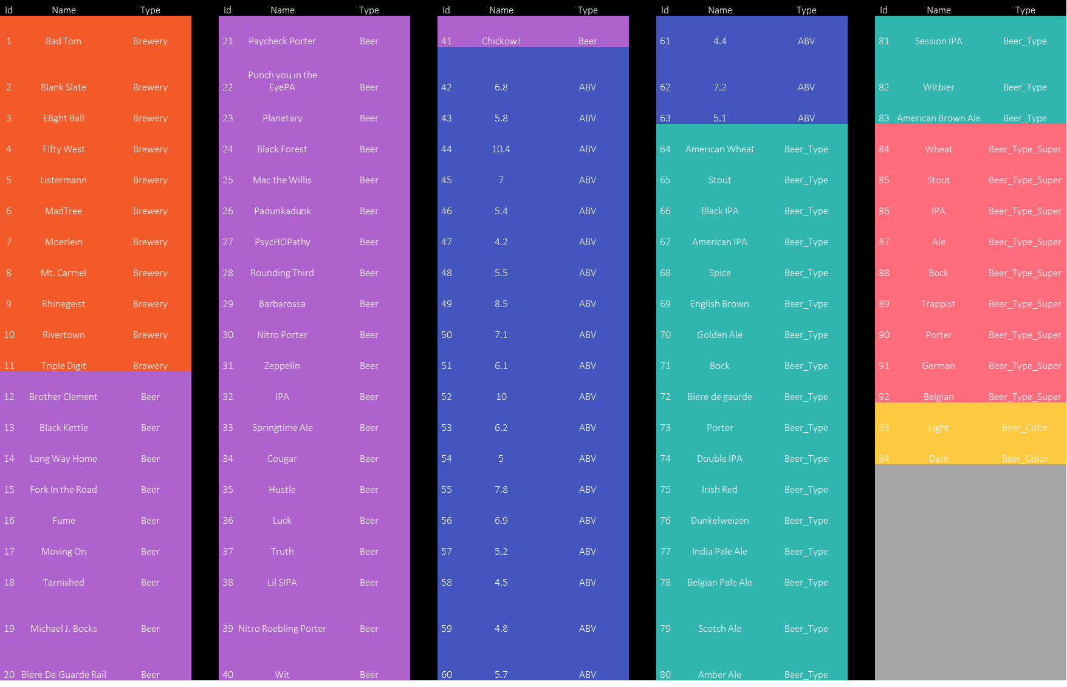
Node List

Slide 12

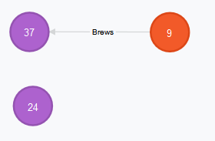
Map of Nodes: Matches Optional and Standard
START
Rhinegiest=node:node_auto_index(Id="9"), Truth=node:node_auto_index(Id="37"),
BlackForest=node:node_auto_index(Id=“24")
MATCH
Rhinegiest-[:Brews]->Truth, Rhinegiest-[:Brews]->BlackForest
return *;
START
Rhinegiest=node:node_auto_index(Id="9"), Truth=node:node_auto_index(Id="37"),
BlackForest=node:node_auto_index(Id=“24")
OPTIONAL MATCH
Rhinegiest-[:Brews]->Truth, Rhinegiest-[:Brews]->BlackForest
return *;

Slide 13
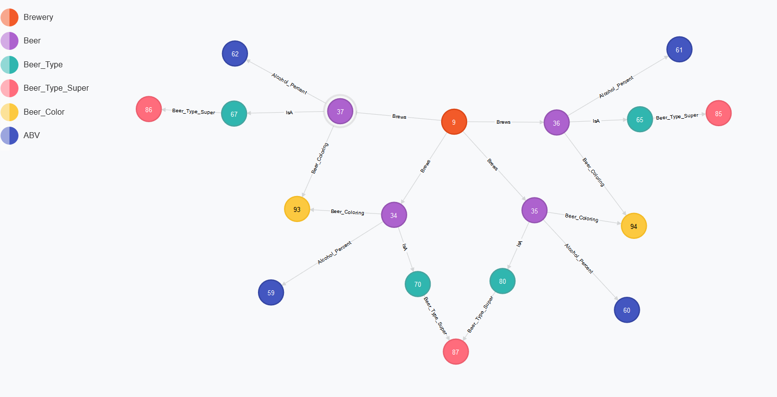
START
Rhinegiest=node:node_auto_index(Id="9")
MATCH
Rhinegiest-[:Brews]->
(Beer)-[:Beer_Coloring]->(Beer_Color),
(Beer)-[:Alcohol_Percent]->(ABV),
(Beer)-[:IsA]->(Beer_Type),
(Beer_Type)-[:Beer_Type_Super]->(Super_Type)
return *
limit 100;
Map of Nodes: Explicit Traversal

Slide 14
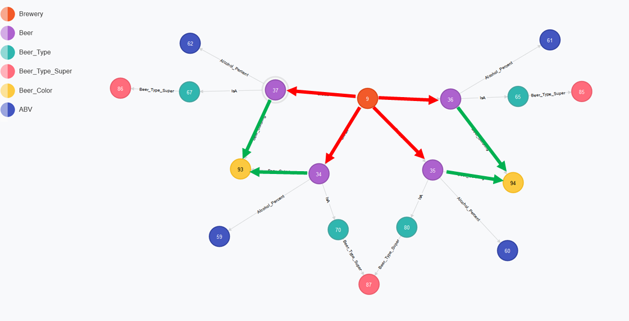
Map of Nodes: Explicit Traversal
Relation Identifiers
START
Rhinegiest=node:node_auto_index(Id="9")
MATCH
Rhinegiest-[r1:Brews]->
(Beer)-[r2:Beer_Coloring]->(Beer_Color),
(Beer)-[:Alcohol_Percent]->(ABV),
(Beer)-[:IsA]->(Beer_Type),
(Beer_Type)-[:Beer_Type_Super]->(Super_Type)
return *
limit 100;

Slide 15
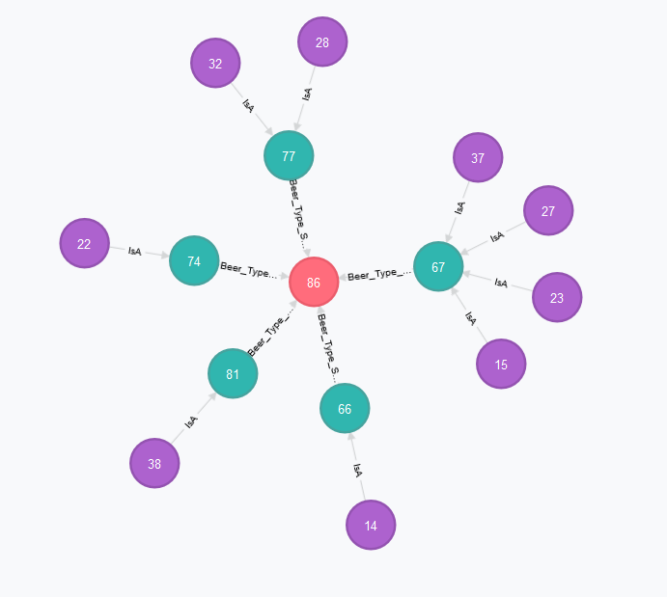
START
IPA=node:node_auto_index(Id="86")
MATCH
IPA<--(Beer_Type)<--(Beers) RETURN *;
Map of Nodes: Pattern Traversal

Slide 16
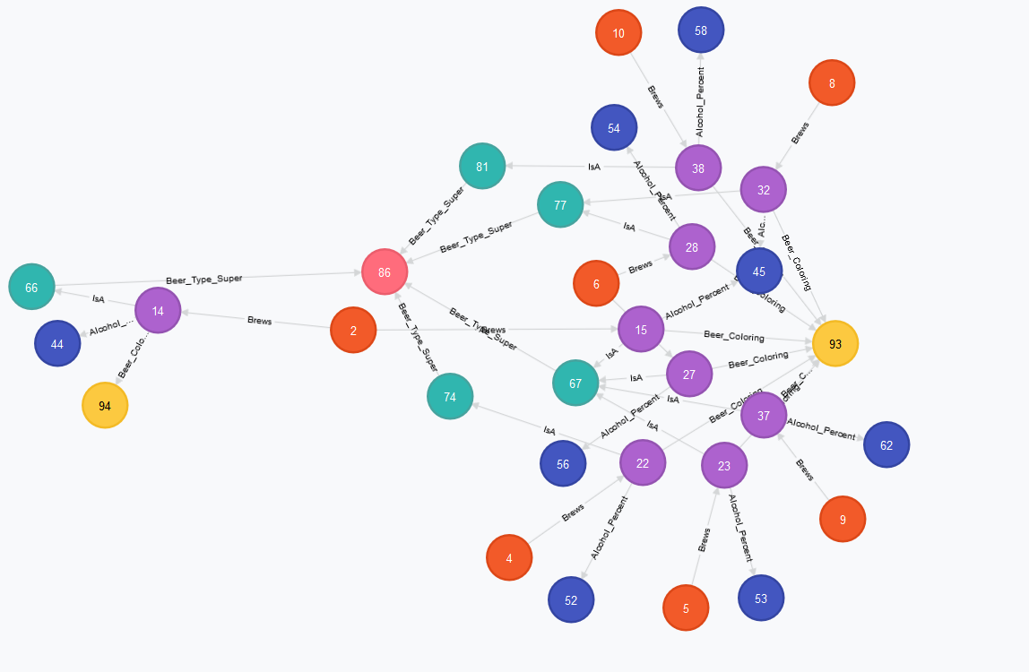
START
IPA=node:node_auto_index(Id="86")
MATCH
IPA<--(Beer_type)<--(Beers)<--(Attributes_to_beer),
(Beers)-->(Attributes_from_beer)
return *
Map of Nodes: Pattern Traversal

Slide 17
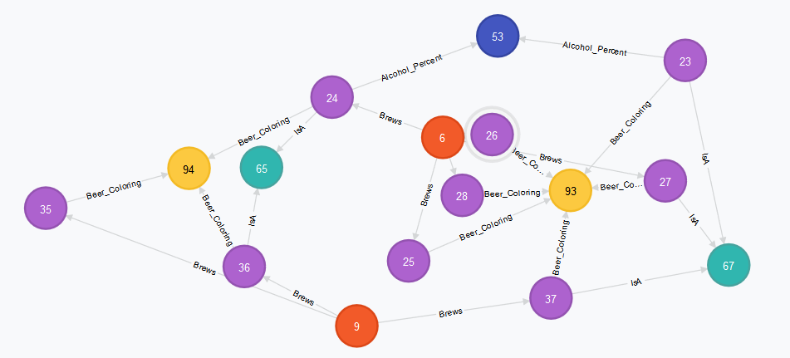
START
Truth=node:node_auto_index(Id="37"),
BlackForest=node:node_auto_index(Id=“24")
MATCH
p = AllshortestPaths(Truth-[*]-BlackForest )
RETURN
p;
Beer To Beer Traversal
START
Truth=node:node_auto_index(Id="37"),
BlackForest=node:node_auto_index(Id="24")
MATCH
p = (Truth-[*3..5]-BlackForest )
RETURN
p;

Slide 18



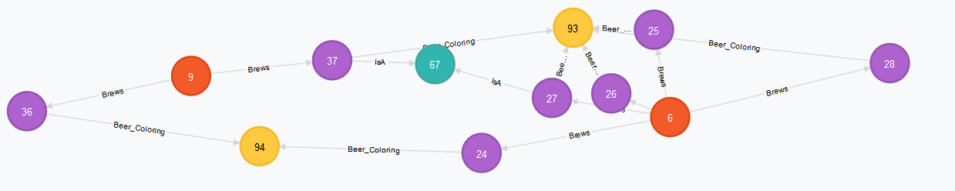
START
Truth=node:node_auto_index(Id="37"),
BlackForest=node:node_auto_index(Id="24")
MATCH
p = AllshortestPaths(Truth-[*]-BlackForest )
RETURN
p
LIMIT 1
Beer To Beer Traversal Trims
Skip 1;
Skip 2;
Skip 3;
Skip 4 (remove limit)

Slide 19
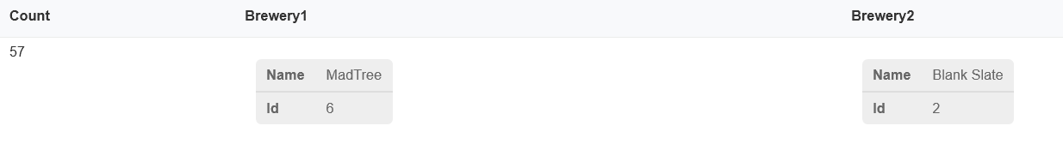
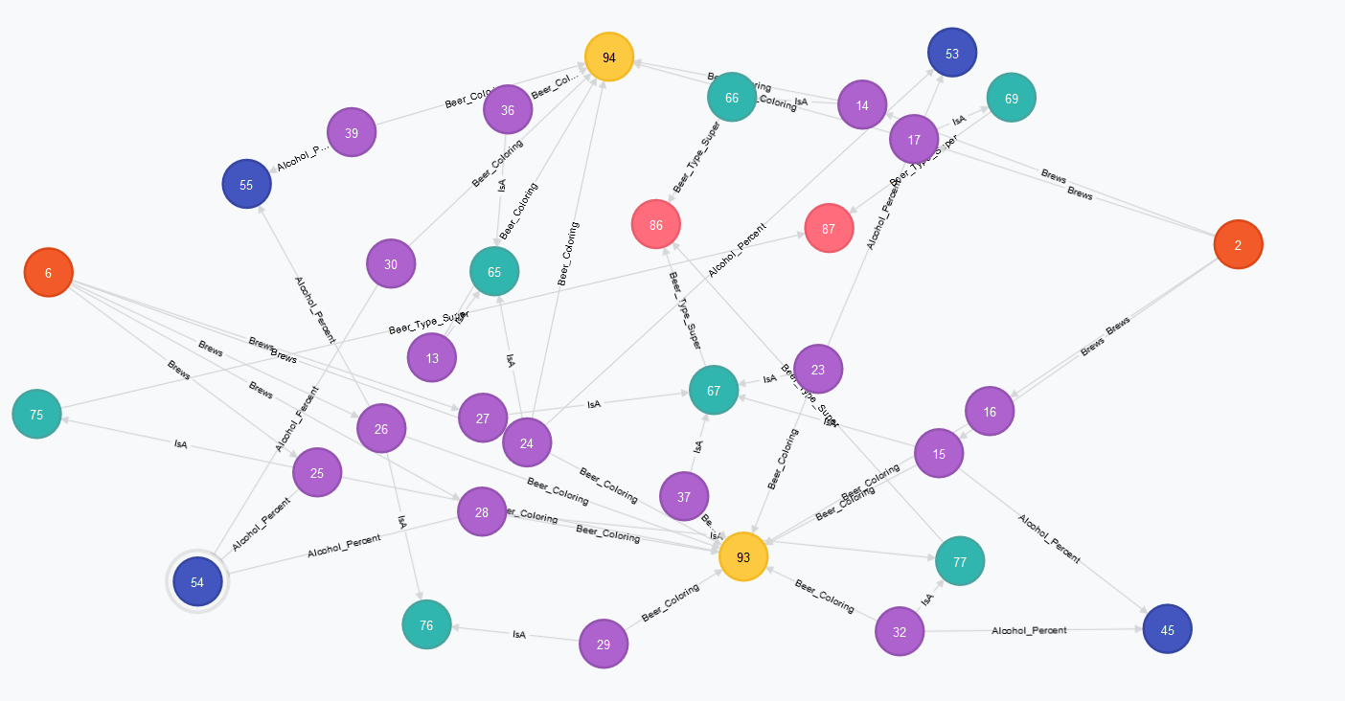
MATCH
p=((a:Brewery)-[*..6]-(b:Brewery))
WHERE (a) <> (b)
RETURN
count(p) AS Count,a AS Brewery1 ,b AS Brewery2
ORDER BY Count DESC
Brewery to Brewery Connections

Slide 20
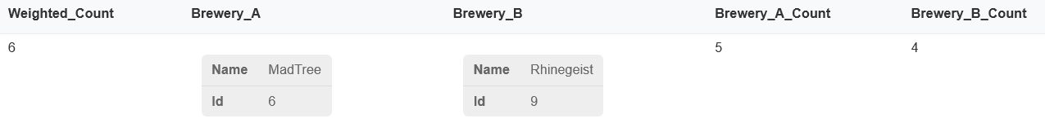
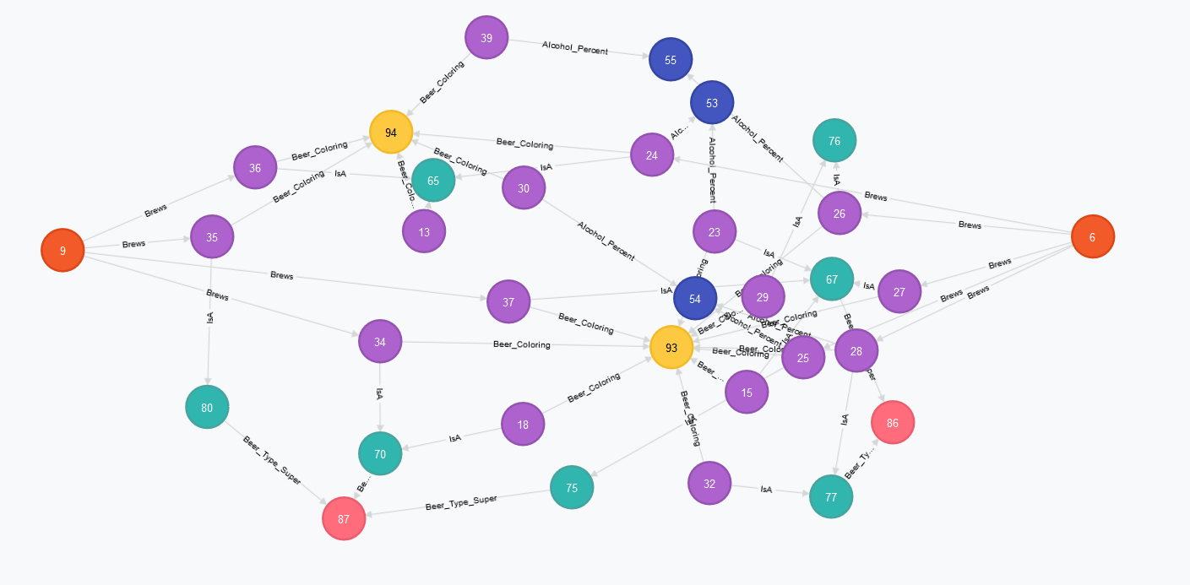
Brewery to Brewery Connections
MATCH
p=((a1:Brewery)-[*..6]-(b1:Brewery)),
(a1)-[:Brews]->(a2),
(b1)-[:Brews]->(b2)
WHERE (a1) <> (b1)
RETURN
(count(distinct p)/(count(distinct a2)+count(distinct b2))) AS Weighted_Count, a1 AS Brewery_A ,b1 AS Brewery_B,count(distinct a2) AS Brewery_A_Count, count(distinct b2) AS Brewery_B_Count
ORDER BY Weighted_Count DESC, Brewery_A_Count DESC, Brewery_B_Count DESC

Slide 21
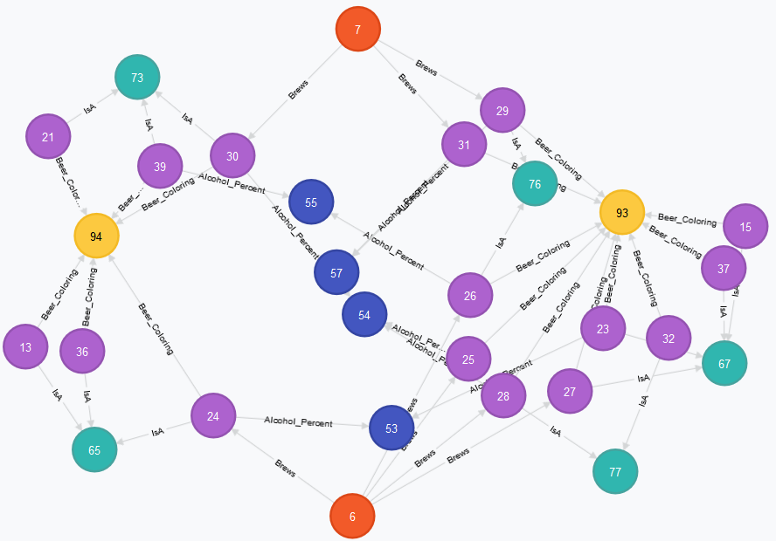
Brewery to Brewery Connections
MATCH
p=((a1:Brewery)-[*..6]-(b1:Brewery)),
(a1)-[:Brews]->(a2),
(b1)-[:Brews]->(b2)
WHERE (a1) <> (b1)
RETURN
(count(distinct p)/(count(distinct a2)+count(distinct b2))) AS Weighted_Count, a1 AS Brewery_A ,b1 AS Brewery_B,count(distinct a2) AS Brewery_A_Count, count(distinct b2) AS Brewery_B_Count, (count(distinct a2) + count(distinct b2)) as Beer_total
ORDER BY Weighted_Count DESC, Beer_total

Slide 22





Beer Recommender Weights
MATCH (a)-[r1:IsA]->(b)
SET r1.weight=40
MATCH (a)-[r1:IsA]->(b)
SET r1.weight=40
MATCH (a)-[r1:Brews]->(b)
SET r1.weight=20
MATCH (a)-[r1:Alcohol_Percent]->(b)
SET r1.weight=6
MATCH (a)-[r1:Beer_Coloring]->(b)
SET r1.weight=6

Slide 23
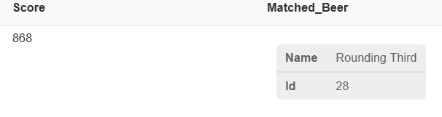
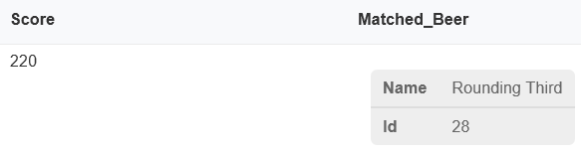
Beer Recommender Final Algorithm
START
Truth=node:node_auto_index(Id="37")
MATCH
p=(Truth-[r*..4]-(b1:Beer))
WHERE Truth <> b1
RETURN
sum(reduce(acc=0, n in r| acc + n.weight)/length(r)) AS Score,
b1 AS Matched_Beer ORDER BY Score DESC
Without Diminishing Length
With Diminishing Length

Slide 24
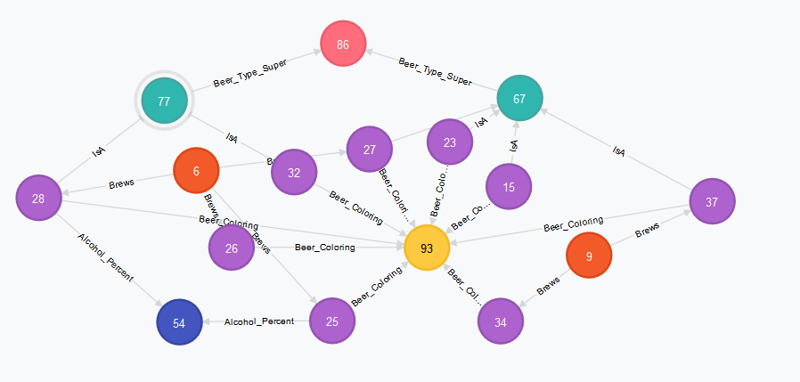
Beer Recommender Final Algorithm High Score
START
Truth=node:node_auto_index(Id="37"), RoundingThird=node:node_auto_index(Id="28")
MATCH
p=(Truth-[*..4]-RoundingThird) Return p

Slide 25
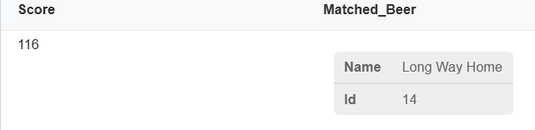
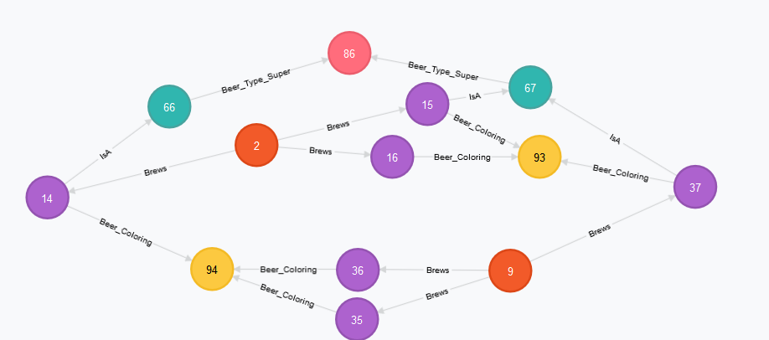
Beer Recommender Final Algorithm Moderate Connection
START
Truth=node:node_auto_index(Id="37"), LongWayHome=node:node_auto_index(Id="14")
MATCH
p=(Truth-[*..4]-LongWayHome) Return p
With Diminishing Length

Slide 26
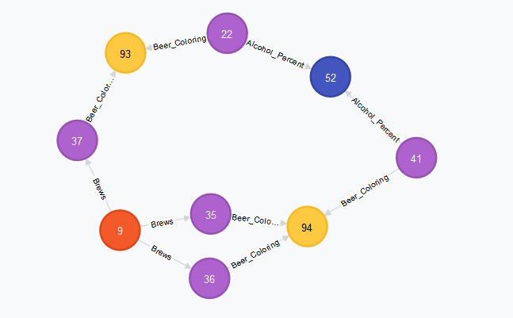
Beer Recommender Final Algorithm Least Recommended
START
Truth=node:node_auto_index(Id="37"), Chickow=node:node_auto_index(Id="30")
MATCH
p=(Truth-[*..4]-Chickow) Return p

