Slide 1
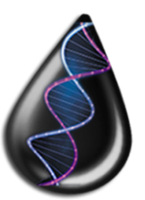
















Metagenomics for Greener Production and Extraction of Hydrocarbon Energy:
Creating Opportunities for Enhanced Recovery with Reduced Environmental Impact

