Slide 1
Pathway Analysis
Niels W. Hanson
Ph.D. Candidate Bioinformatics
Tuesday, February 11 2014
Hallam Laboratory
Hydrocarbon MetaPathways Workshop
The University of British Columbia, Vancouver
https://github.com/nielshanson/mp_tutorial/wiki/Pathway-Analysis

Slide 2
Prerequisites
Install Pathway Tools http://biocyc.org/download-bundle.shtml
Perl v5.0 http://www.perl.org/
Downloads
Presentation Slides: MetaPathways_Tutorial_Pathway_Analysis.pdf
HOT Fosmid-end ePGDBs: HOT_Sanger_ePGDBs.zip
Perl Pathway Extractor Script: extract_pathway_table_from_pgdb.pl
ORF Abundance Tables: 1_upper_euphotic_rxn.wide.txt, HOT_Sanger_rxn.wide.txt

Slide 3
Goals of Tutorial
Give a brief overview of the Pathway Tools and the Pathologic Algorithm
Load processed Environmental Pathway Genome Databases (ePGDBs) into Pathway Tools
Explore predicted Pathways in Pathway Tools in the Cellular Overview, Pathway, and Reaction pages.
Highlight predicted pathways on the cellular overview and compare samples
Extract pathway and associated ORFs into long and wide formats.
Understand how the 'Omics Tools' feature to overlay quantitative metadata about pathways, e.g., ORF abundance.

Slide 4

1. Pathway Tools & PathoLogic
Pathway Tools
Genes operate within structure of metabolism
Pathway tools a software framework to integrate genomic annotations with MetaCyc pathways
Data structure of Genes + Pathways: Pathway/Genome Database (PGDB)
Pathologic
rule-based model on on pathways class and completeness

Slide 5
1. Pathway Tools & PathoLogic

Slide 6
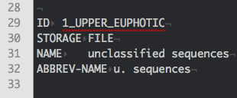
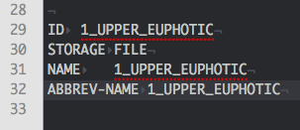
2. Loading ePGDBs into Pathway Tools
Two Operations:
Place completed ePGDB <sample>cyc/ folder into ptools-local/pgdbs/user/
Update organism.dat in each ePGDB <sample>cyc/1.0/input/organism.dat

Slide 7
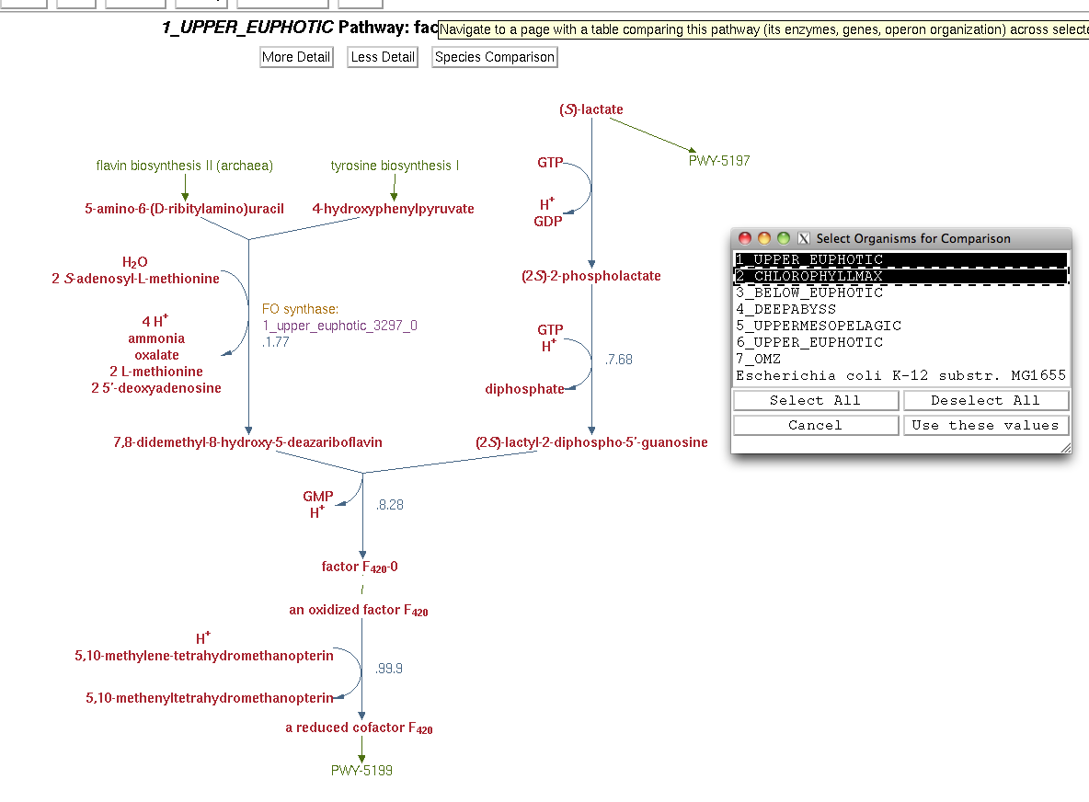
3. Cellular Overview, Pathway, and Reaction Pages

Slide 8
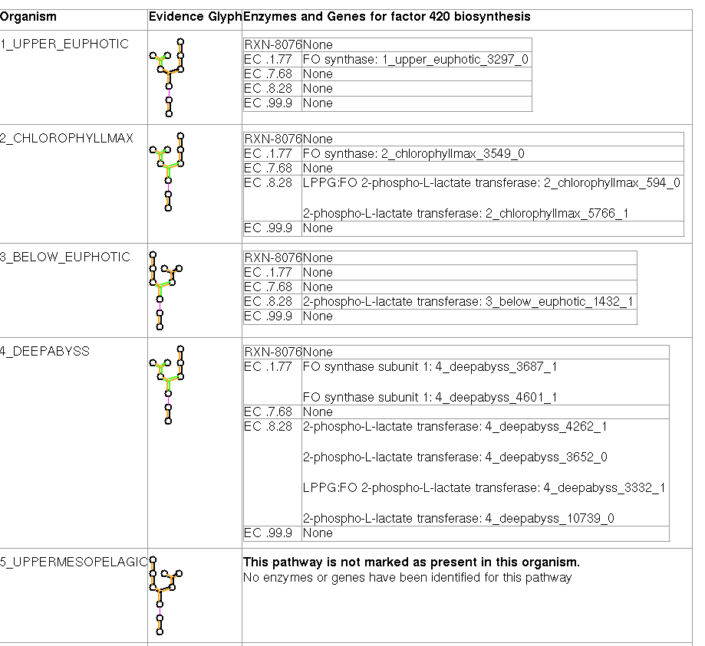
3. Cellular Overview, Pathway, and Reaction Pages

Slide 9
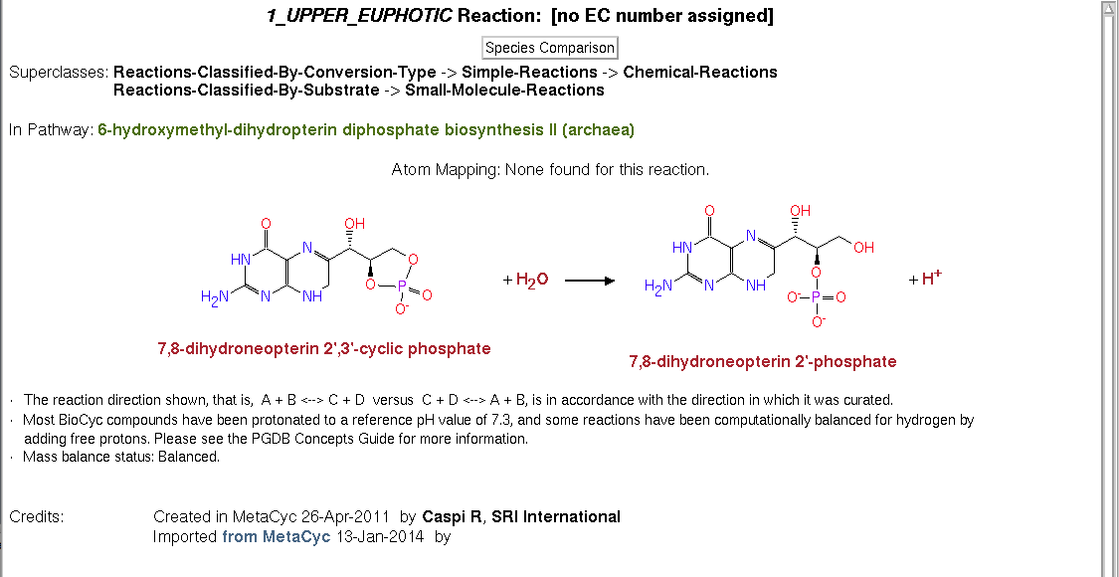
3. Cellular Overview, Pathway, and Reaction Pages

Slide 10
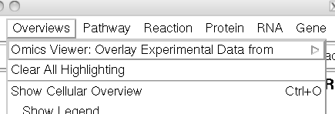
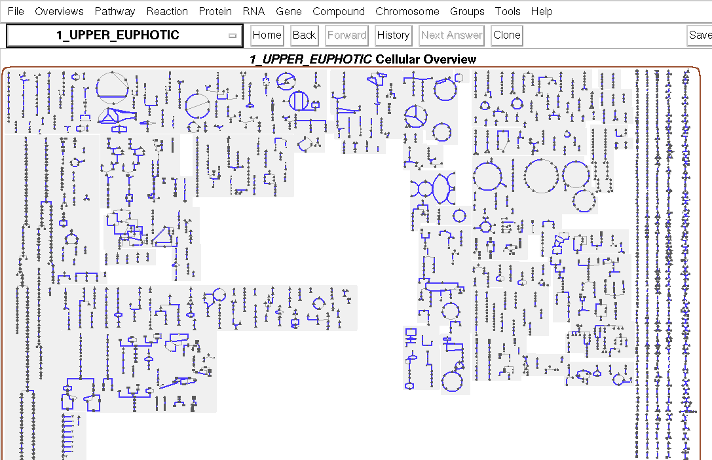
4. Highlight predicted pathways to compare

Slide 11
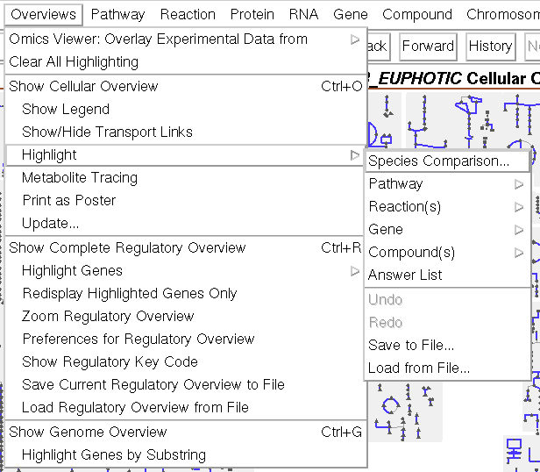
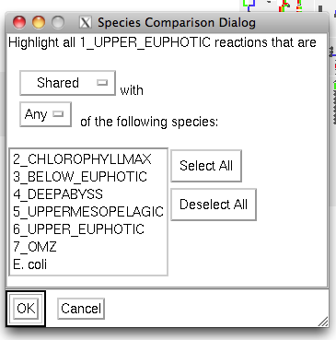
4. Highlight predicted pathways to compare

Slide 12
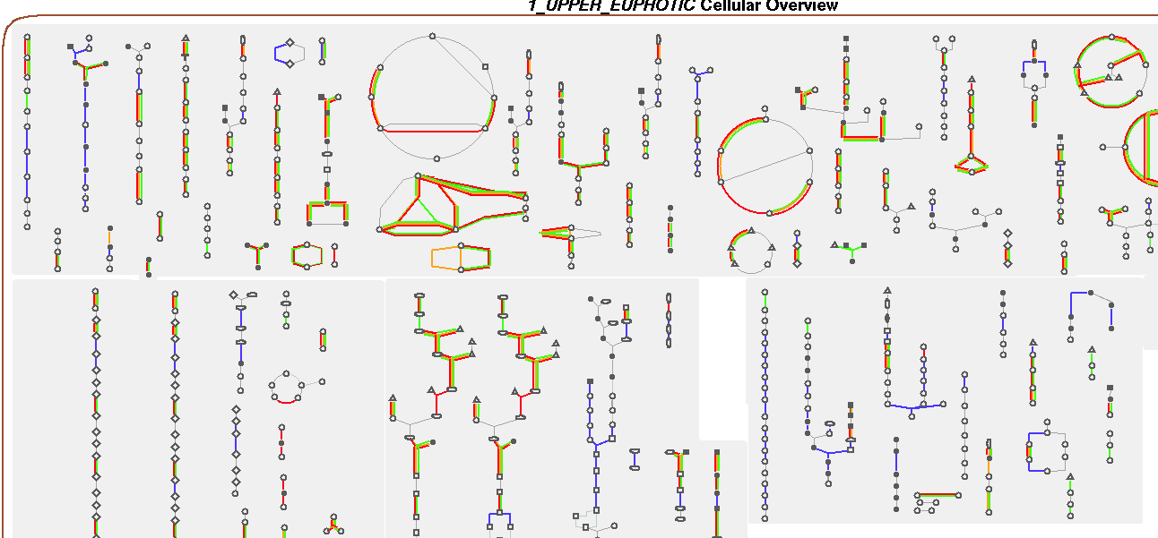
4. Highlight predicted pathways to compare

Slide 13
5. Extract pathways and ORFs
extract_pathway_table_from_pgdb.pl
Start Pathway Tools in –api mode: pathway-tools/pathway-tools –api
In another shell run extract_pathway_table_from_pgdb.pl to extract pathways:
# List Available ePGDBs in Pathway Tools
perl extract_pathway_table_from_pgdb.pl -l
# Extract pathways from pathway tools
perl extract_pathway_table_from_pgdb.pl
-f [list of samples]
-out [output file]
-c [pathway coverage] <0.0-1.0>
-s [pathway support] <1-100>
-t [type of output table] <lookup, long, or wide>
-orfs [output orfs in lookup mode]
-rxn [output reactions in wide mode]

Slide 14
5. Extract pathways and ORFs
perl extract_pathway_table_from_pgdb.pl -f 1_upper_euphotic -out 1_upper_euphotic.lookup.txt -t lookup
head 1_upper_euphotic.lookup.txt
SAMPLE PWY_NAME PWY_COMMON_NAME NUM_REACTIONS NUM_COVERED_REACTIONS ORF_COUNT
1_upper_euphotic PWY-5913 TCA cycle VI (obligate autotrophs) 11 10 65
1_upper_euphotic REDCITCYC TCA cycle III (helicobacter) 9 8 33
1_upper_euphotic PWY-5690 TCA cycle II (eukaryotic) 9 8 42
1_upper_euphotic TCA TCA cycle I (prokaryotic) 10 9 43
1_upper_euphotic ANARESP1-PWY respiration (anaerobic) 13 10 44
Only output pathways with more than 50% reactions covered and at least 7 ORFs:
perl extract_pathway_table_from_pgdb.pl -f 1_upper_euphotic -out 1_upper_euphotic.lookup.c05.s7.txt -t lookup -c 0.5 -s 7

Slide 15
5. Extract pathways and ORFs
the -t long table format displays each each ORF in each pathway:
perl extract_pathway_table_from_pgdb.pl -f 1_upper_euphotic -out 1_upper_euphotic.long.txt -t long
head 1_upper_euphotic.long.txt
SAMPLE PWY_NAME PWY_COMMON_NAME NUM_REACTIONS NUM_COVERED_REACTIONS ORF_COUNT ORF
1_upper_euphotic PWY-5913 TCA cycle VI (obligate autotrophs) 11 10 65 1_upper_euphotic_3417_1
1_upper_euphotic PWY-5913 TCA cycle VI (obligate autotrophs) 11 10 65 1_upper_euphotic_5953_0
1_upper_euphotic PWY-5913 TCA cycle VI (obligate autotrophs) 11 10 65 1_upper_euphotic_7270_0
1_upper_euphotic PWY-5913 TCA cycle VI (obligate autotrophs) 11 10 65 1_upper_euphotic_643_1
1_upper_euphotic PWY-5913 TCA cycle VI (obligate autotrophs) 11 10 65 1_upper_euphotic_14_0
1_upper_euphotic PWY-5913 TCA cycle VI (obligate autotrophs) 11 10 65 1_upper_euphotic_670_0
the -t wide with multiple samples creates a “master” table:
# - wide table format of pathways from multiple samples
perl extract_pathway_table_from_pgdb.pl -f 1_upper_euphotic 6_upper_euphotic 2_chlorophyllmax 3_below_euphotic 5_uppermesopelagic 7_omz 4_deepabyss -out HOT_Sanger_pwy.wide.txt -t wide
head 1_upper_euphotic.long.txt
PWY 1_upper_euphotic 6_upper_euphotic 2_chlorophyllmax 3_below_euphotic 5_uppermesopelagic 7_omz 4_deepabyss
SUCSYN-PWY 0 16 10 8 17 13 16
PWY-6733 0 1 0 0 0 0 0
PWY-5274 0 0 0 1 0 0 0
PWY-6728 0 0 0 46 0 59 0
PWY-241 12 6 8 6 7 12 7

Slide 16
5. Extract pathways and ORFs
the -t wide -rxn options produce a list of reactions and abundance:
perl extract_pathway_table_from_pgdb.pl -f 1_upper_euphotic -out 1_upper_euphotic_rxn.wide.txt -t wide –rxn
head 1_upper_euphotic_rxn.wide.txt
RXN 1_upper_euphotic
RXN1G-617 1
RXN-6641 1
RXN0-2381 2
DTDPGLUCOSEPP-RXN 2
RXN0-6479 3
DADPKIN-RXN 4
the -t wide -rxn with multiple samples creates a “master” rxn table:
perl extract_pathway_table_from_pgdb.pl -f 1_upper_euphotic 6_upper_euphotic 2_chlorophyllmax 3_below_euphotic 5_uppermesopelagic 7_omz 4_deepabyss -out HOT_Sanger_rxn.wide.txt -t wide -rxn
head HOT_Sanger_rxn.wide.txt
PWY 1_upper_euphotic 6_upper_euphotic 2_chlorophyllmax 3_below_euphotic 5_uppermesopelagic 7_omz 4_deepabyss
SUCSYN-PWY 0 16 10 8 17 13 16
PWY-6733 0 1 0 0 0 0 0
PWY-5274 0 0 0 1 0 0 0
PWY-6728 0 0 0 46 0 59 0
PWY-241 12 6 8 6 7 12 7

Slide 17
5. Extract pathways and ORFs
the -t wide -rxn options produce a list of reactions and abundance:
perl extract_pathway_table_from_pgdb.pl -f 1_upper_euphotic -out 1_upper_euphotic_rxn.wide.txt -t wide –rxn
head 1_upper_euphotic_rxn.wide.txt
RXN 1_upper_euphotic
RXN1G-617 1
RXN-6641 1
RXN0-2381 2
DTDPGLUCOSEPP-RXN 2
RXN0-6479 3
DADPKIN-RXN 4
**Use these two to highlight ORF counts on the Cellular Overview**
the -t wide -rxn with multiple samples creates a “master” rxn table:
perl extract_pathway_table_from_pgdb.pl -f 1_upper_euphotic 6_upper_euphotic 2_chlorophyllmax 3_below_euphotic 5_uppermesopelagic 7_omz 4_deepabyss -out HOT_Sanger_rxn.wide.txt -t wide -rxn
head HOT_Sanger_rxn.wide.txt
RXN 1_upper_euphotic 6_upper_euphotic 2_chlorophyllmax 3_below_euphotic 5_uppermesopelagic 7_omz 4_deepabyss
1.7.7.2-RXN 0 0 2 0 0 1 1
PPGPPSYN-RXN 0 1 0 0 0 0 0
RXN-6641 1 0 1 0 1 3 2
RXN3DJ-170 1 0 0 0 0 0 2

Slide 18
6. 'Omics Tools’ feature for Metadata

Slide 19
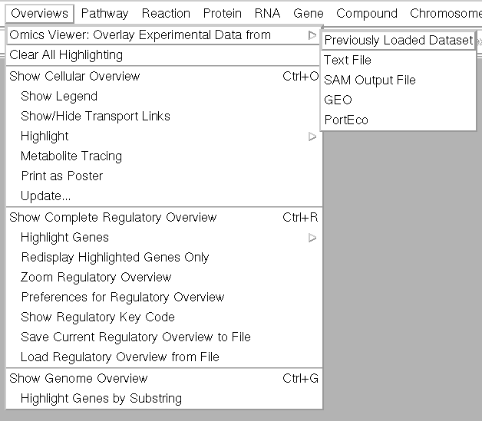
6. 'Omics Tools’ feature for Metadata
Load 1_upper_euphotic_rxn.wide.txt

Slide 20
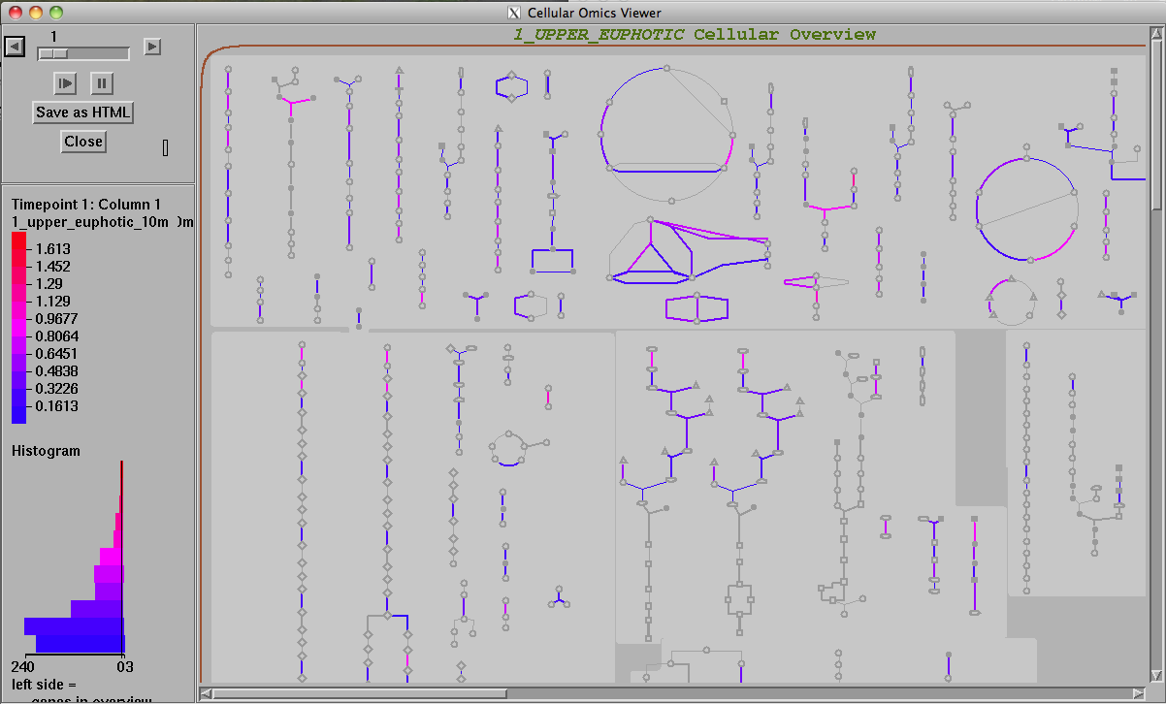
6. 'Omics Tools’ feature for Metadata

Slide 21
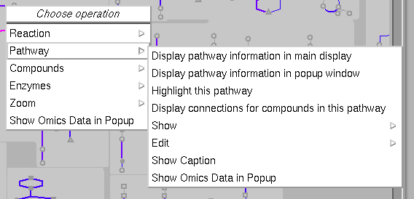
6. 'Omics Tools’ feature for Metadata

Slide 22
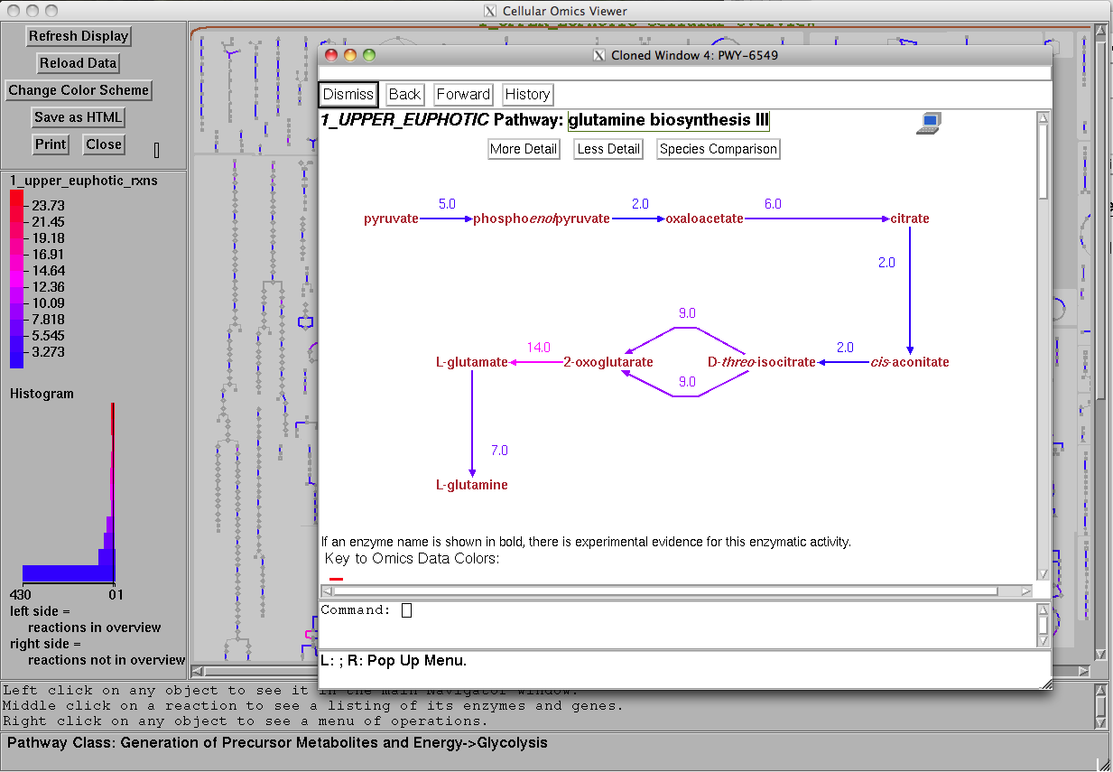
6. 'Omics Tools’ feature for Metadata

Slide 23
6. 'Omics Tools’ feature for Metadata

Slide 24
6. 'Omics Tools’ feature for Metadata

Slide 25
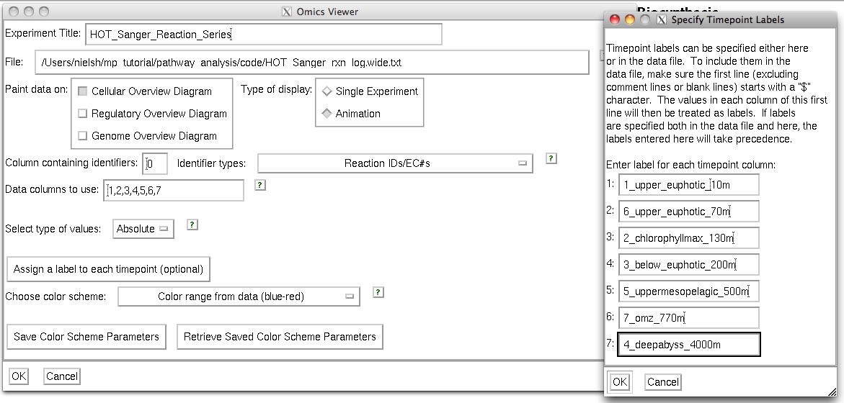
6. 'Omics Tools’ feature for Metadata

Slide 26
6. 'Omics Tools’ feature for Metadata

Slide 27
6. 'Omics Tools’ feature for Metadata

Slide 28
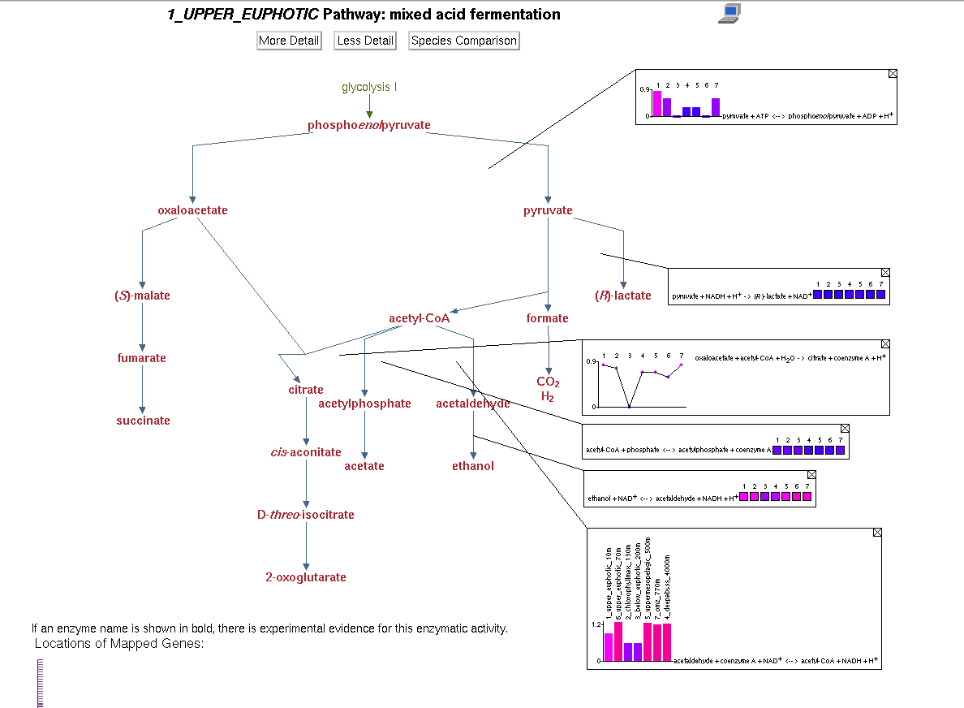
6. 'Omics Tools’ feature for Metadata

Slide 29
Questions?

