Slide 1

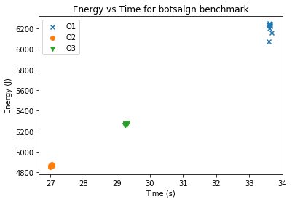
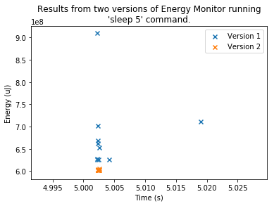
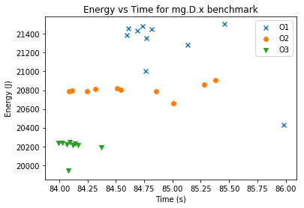
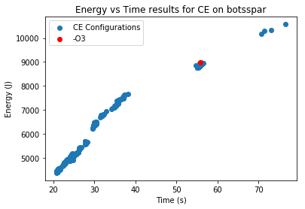
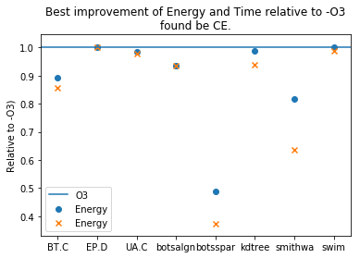
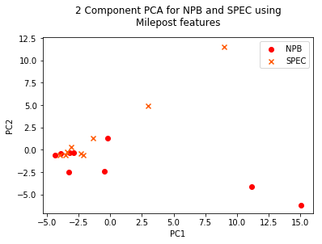
Decoupling Energy Consumption and Execution Time in High Performance Computing
Department of Computer Science
Overview
Energy Measurements
Benchmark Programs
Supercomputers use an enormous amount of energy which
is expensive
has an environmental impact
is a limiting factor in scaling of HPC systems.
The aim of this project is to reduce energy consumption in multi-threaded, HPC programs using compiler optimisations.
The project focuses on the GCC compiler and follows the method of the Milepost study [1] but focussing on energy consumption not just execution time.
Hypothesis: optimising for energy consumption will yield greater reductions than optimising for execution time.
Energy measurements available through the Intel Running Average Power Limit (RAPL) feature.
Measures processor package and DRAM energy consumption.
Energy monitoring tool written in C.
Multiple versions of monitoring tool developed and tested for stability:
Using OpenMP benchmark suites
NAS Parallel Benchmarks
SPEC OMP2012
Subset of benchmarks chosen based on stability of runtime and energy:
Iterative Compilation
Energy vs Time
Machine Learning
Iterative compilation algorithm Combined Elimination [2] used to search compiler optimisation space.
Space is very large (195 optimisations in GCC 7.2). Cannot exhaustively search.
Explores the how compiler optimisations affect energy and time.
Provides training data for machine learning techniques.
Energy vs Time relationship currently unknown in multi-threaded applications.
Previous work has shown strong linear correlation in single threaded applications [3].
Results of this project indicate
a linear correlation between energy and time
energy reduction not always equal to time reduction
Use the 1-Nearest-Neigbour (1NN) technique to predict good compiler configurations.
Use 65 features identified in Milepost study [1] extracted from source code.
Explore a new feature using the Seven Dwarfs classification system [4].
Benchmarks analysed for suitability to use in 1-NN:
References
[1] G. Fursin, Kashnikov, Y., and A. Memon, “Milepost GCC: Machine Learning Enabled Self-tuning Compiler,” Int J Parallel Prog, vol. 39, no. 3, pp. 296–327, 2011.
[2] Z. Pan and R. Eigenmann, “Fast and Effective Orchestration of Compiler Optimizations for Automatic Performance Tuning,” in Proceedings of the International Symposium on Code Generation and Optimization, ser. CGO ’06. New York, USA: IEEE Computer Society, 2006, pp. 319–332. [3] J. Pallister, S. Hollis, and J. Bennett, “Identifying Compiler Options to Minimise Energy Consumption for Embedded Platforms,” The Computer Journal, vol. 58, no. 1, 2013.
[4] K. Asanovic et. Al. “The Landscape of Parallel Computing Research: A View from Berkeley,” Electrical Engineering and Computer Sciences, University of California at Berkeley, Technical Report UCB/EECS-2006-183, Dec. 2006.
David Greasley
Supervisor: Dr. Oliver Ray

