Slide 1



Huang 2017 Journal Club
David “Delightful” Halvorsen

Slide 2
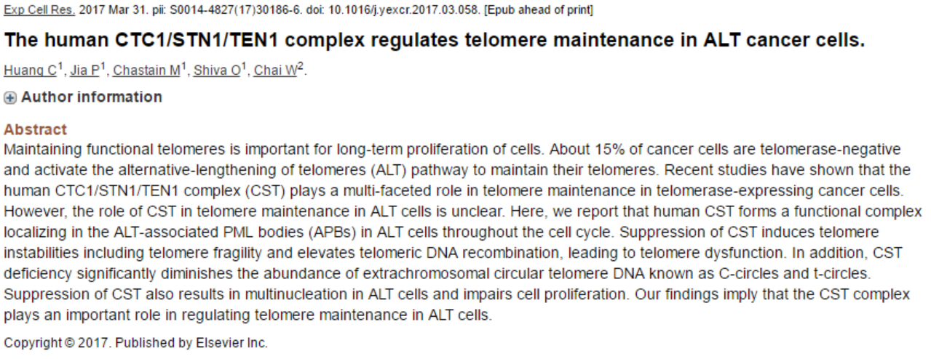
Huang 2017
CST is the trimeric complex CTC1/STN1/TEN1
CST foci are found in APBs
CST deficiency leads to vCCs, vGrowth, & ^FTs

Slide 3
Background
CST complex binds to single-stranded DNA
Invovled in C-strand fill-in
Facilitates replication of telomeric DNA (GC-rich)
CST depletion yields long G-overhangs
~15% of cancers use ALT to maintain telomeres
ALT involves homologous recombination
APBs appear to be sites of telomere synthesis
^T-SCE, heterogenous telomere lengths, ECTRs, 5’ C-rich overhangs
Is CST involved in ALT?

Slide 4
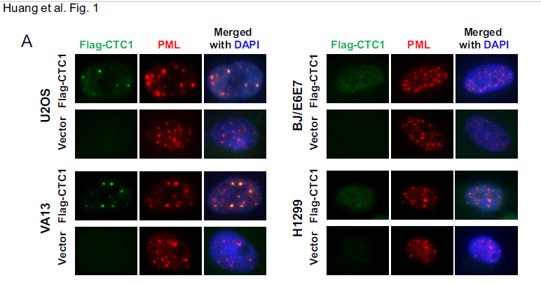
CTC1 Colocalizes with PML
CTC1 colocalizes with PML in ALT+ cells
Is it found in APBs?

Slide 5
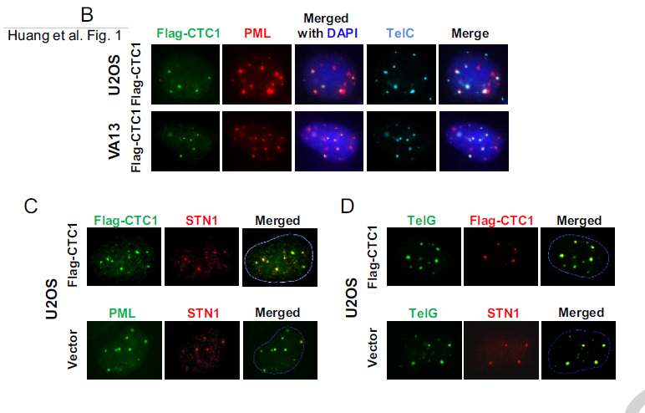
CTC1/STN1 Found in APBs
CTC1, STN1, PML and Telomeres Colocalize

Slide 6
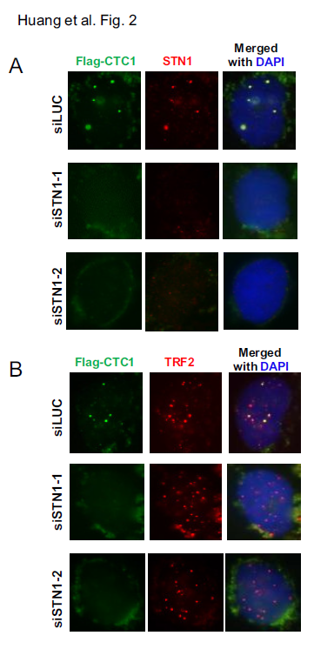
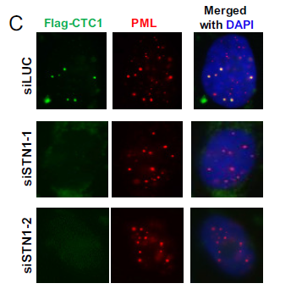
STN1 KD Eliminated CTC1 Foci
aaaaa
STN1 depletion did not impact TRF2 or PML
STN1 or CST complex is required for CTC1 foci

Slide 7
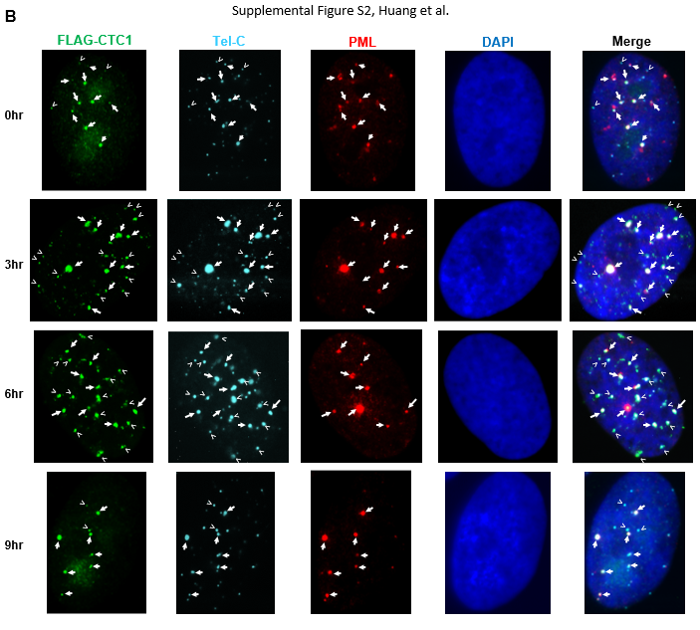
CST @Telomeres Throughout Cell Cycle
Cells synchronized @G1/S (0 hr)
CTC1/PML/ Telomere (block arrows) in G1&G2
CTC1/TEL (arrowheads) in S phase
CST always @Telo

Slide 8
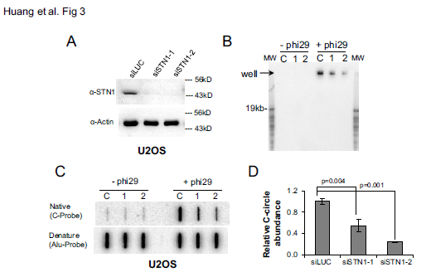
STN-1 siRNA Reduces CCs
STN-1 siRNA reduces CC signal
What about long term?

Slide 9
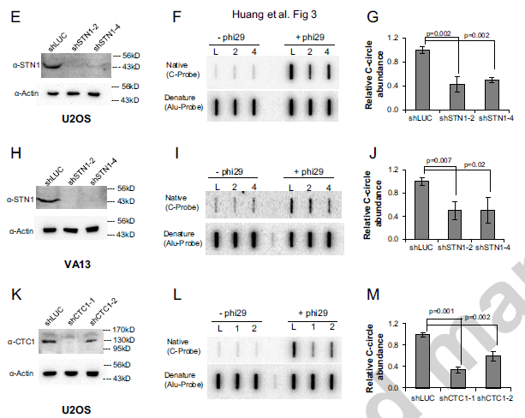
LT STN-1 or CTC1 Depletion Reduces CCs
Stable depletion reduced CCs in U2OS &VA13

Slide 10
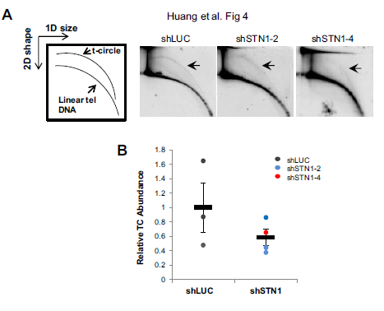
STN-1 Suppression Reduced T-circles
CCs might be a degraded T-circle
Does STN-1 reduction reduce TCs?
CST likely regulates CC and TC # in ALT cells

Slide 11
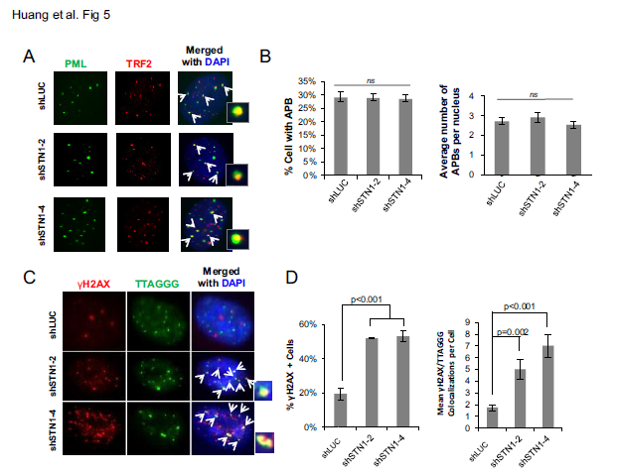
STN1 Reduction Increases DNA Damage
APBs do not change
STN1 suppression increases DNA damage

Slide 12
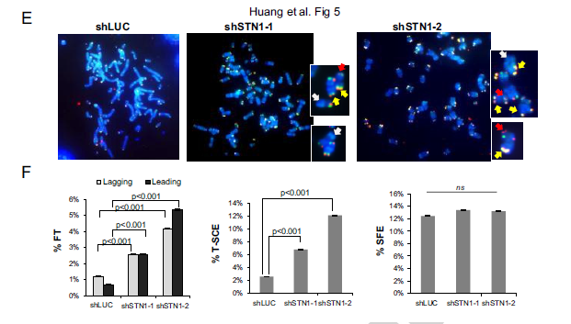
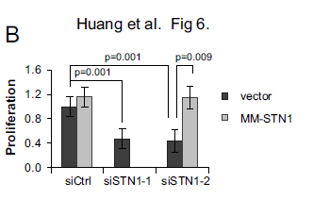
STN1 Reduction Induced Telomere Damage
STN1 suppression increased fragile telomeres & T-SCE, decreased proliferation
No change in signal free ends

Slide 13
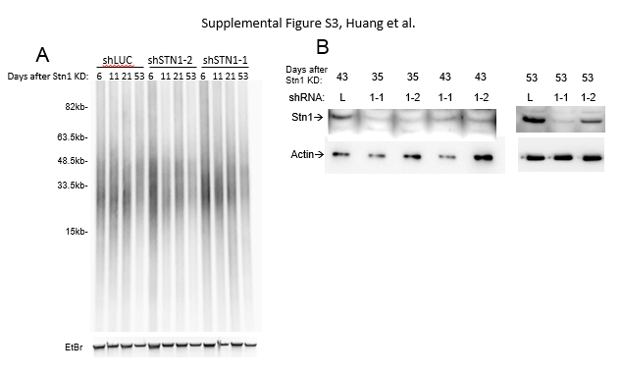
STN1 Depletion Didn’t Shorten Telomeres
7 weeks of STN1 shRNA culture
Western blotting showed STN1 inhibited
Increased T-SCE might be why

Slide 14
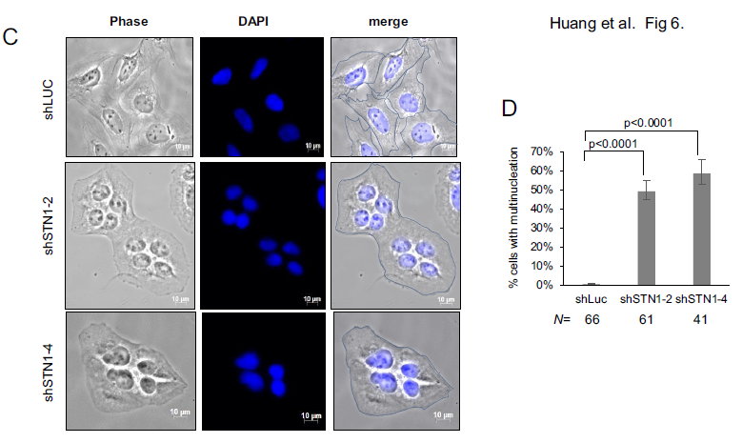
STN1 Depletion Caused Multinucleation
~50% of cells multinucleated
Telomere dysfunction may be promoting this

Slide 15
Author Conclusions
CTC1 and STN1 form a complex @APBs
CST deficiency increases T-SCE, induces telomere dysfunction, decreases CCs & TCs
STN1 KD limits cell proliferation and induces multinucleation
Elevated T-SCE and CC are ALT hallmarks
Why T-SCE increased w/ CC decreased?
Authors think it’s linked to telomere replication

Slide 16
Author Conclusions
MUS81 depletion lowers T-SCE, but doesn’t change ECTR or telomere length
XRCC3 and NBS1 are required for ECTR, BUT KD does not change telo length or proliferation
A better understanding of genes and ALT characteristics is required to discover therapies
***Targeting CST may provide a novel approach to inhibit ALT cancer cell growth***

Slide 17
My Thoughts
Why was 40 ng of gDNA used for CC assay?
40 ng Nanodrop read is probably okay to use
Something more quantitative than the TRF blot would be helpful … heterogeneity reduction?
APB data was done by eye … more quant pls
You can’t delete CTC1 or STN1 … mutations in those genes cause Coats Plus syndrome and dyskeratosis congenita

