Slide 1
Internet Research Project
By: David Mann Jr.

Slide 2
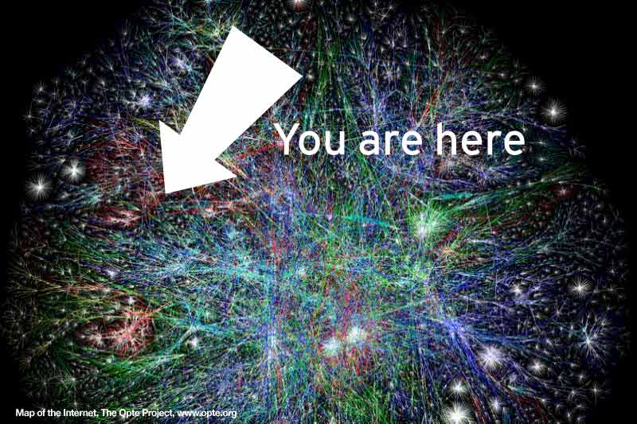
Invention of the Internet
The Birth of ARPAnet:
In 1965, a M.I.T. scientist developed a way of sending information from one computer to another that he called “packet switching.” Packet switching breaks data down into blocks, or packets, before sending it to its destination. That way, each packet can take its own route from place to place.
Without packet switching, the government’s computer network—now known as the ARPAnet—would have been just as vulnerable to enemy attacks as the phone system
The Network Grows:
By the end of the 1970s, a computer scientist named Vinton Cerf had begun to solve this problem by developing a way for all of the computers on all of the world’s mini-networks to communicate with one another. He called his invention “Transmission Control Protocol,” or TCP. (Later, he added an additional protocol, known as “Internet Protocol.” The acronym we use to refer to these today is TCP/IP.)
The World Wide Web:
Cerf’s protocol transformed the Internet into a worldwide network. Throughout the 1980s, researchers and scientists used it to send files and data from one computer to another.
However, in 1991 the Internet changed again. That year, a computer programmer in Switzerland named Tim Berners-Lee introduced the World Wide Web: an Internet that was not simply a way to send files from one place to another but was itself a “web” of information that anyone on the Internet could retrieve. Berners-Lee created the Internet that we know today.

Slide 3
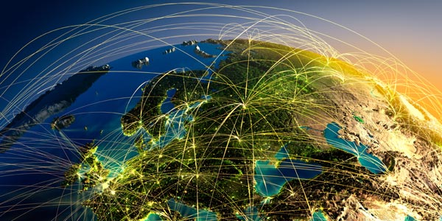
Future of the Internet
Speed:
One thing that seems certain is that data transmission speeds will increase globally. According to Akamai Technologies, which publishes a quarterly state of the Internet report, the average global data transmission speed in late 2009 was 1.7 megabits per second.
Compare that to the record for data transmission speed set by Bell Labs: 100 petabits per second. That's equivalent to 100 billion megabits per second. At that speed, you could transmit 400 DVDs worth of data every second.
Eventually, the average consumer will be able to download a high-definition movie in a second or play cloud-based video games without a hint of lag.

Slide 4
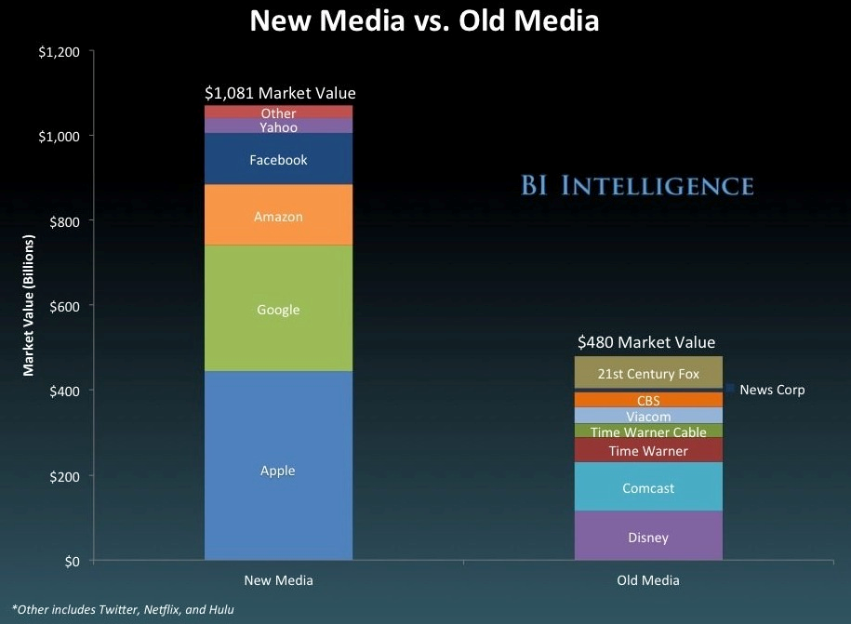
4 Surprising Facts about the future of the internet.
1. News media is killing old media

Slide 5
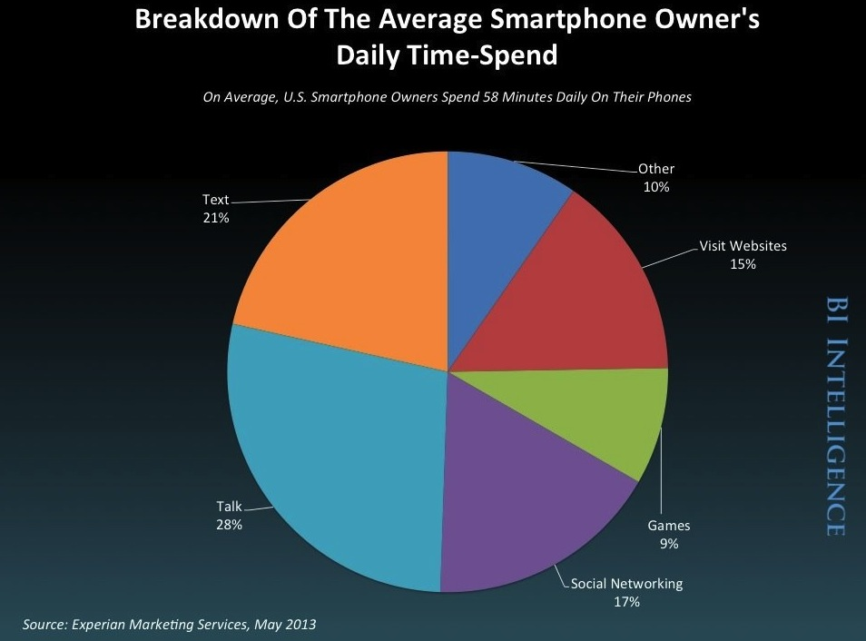
2. Smartphone users are spending more of their time texting and social networking (combined), than talking or browsing the web.

Slide 6
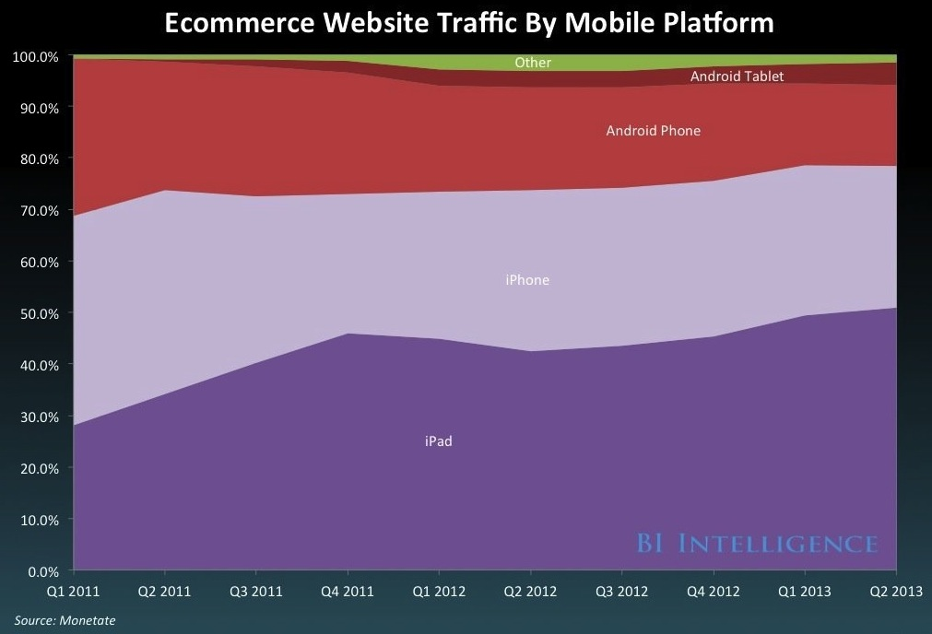
3. iOS is driving the overwhelming majority of e-commerce website traffic.

Slide 7
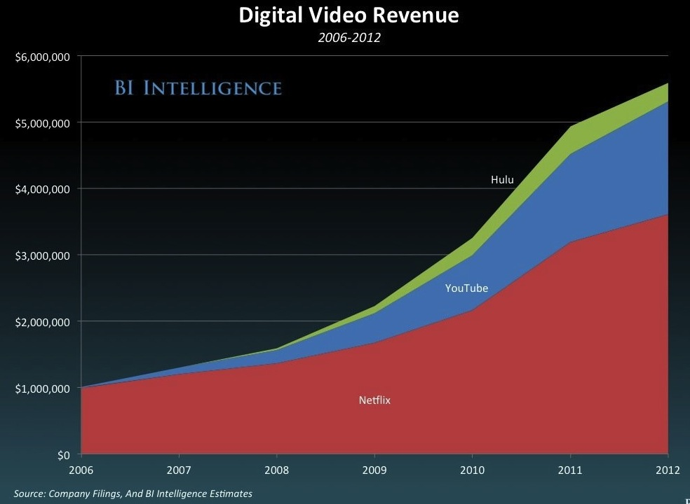
4. Digital video revenue is dominated by on demand services.

Slide 8
Ports and Protocols
Basically a port is an access channel and a protocol is a standardized way for computers to exchange information.
We have them because computers in a network must send and receive data to communicate. Data on the internet is sent and received by software that automatically organizes such data to be transferred into packets.
These packets are made in a standardized way (a protocol) so other computers can recognize them as data and decode them.
Network clients use different ports or channels (that are given standardized numbers)to transfer this data.
Generally one port is used to send data and another to receive it, so packets don't collide. The port number (and the destination IP address) is included as part of the header each packet is given.
Ports range from 1 to 65535 for TCP and UDP.
The Three ranges of Port Numbers:
The Well Known ports: 0 to 1023
The Registered ports: 1024 to 49151
The Dynamic and/or Private ports: 49152 to 65535

Slide 9





Web Browsers
A web browser is the software used to download and display web pages on your computer.
A web browser can communicate with a web server using the http protocol to download the pages you request, usually by clicking on a hyperlink.
A browser can translate HTML, the language used to create web pages, into the content you see displayed in the browser window.

Slide 10
Why does a Layout engine affect speed?
After the HTML text you see above has been downloaded, the order of display of different components and rendering speeds are decided by the layout engine. This varies between the engines, hence the difference in when the user starts to see the page.
This engine also results in the difference in how different images, SVG files and visual elements are handled. For example, IE has limited/no SVG support, while Opera has the best support for interactive SVGs.
The apparent differences in HTML5 support are also handled by this part of the browser. That is the reason this same HTML above shows up differently in older browsers like IE8.

Slide 11
Why does a JavaScript engine affects speed?
When the user interacts with the page, (e.g. presses a button, types some text in the search bar etc.), the JavaScript engine processes the request, and fills the search information back into the text box.
All AJAX calls, jQuery, DOM manipulation etc. done in programs are also handled by this part of the browser.
The way the JavaScript is handled by each of these engines is different. Due to the JavaScript compiler and handling of JSON data. Hence the difference in speed.
For example, Apple reserves the Nitro JavaScript engine for Safari alone, and other developers are forced to use a different, slower engine. This is the reason why Safari will always be the fastest browser in iOS.

Slide 12
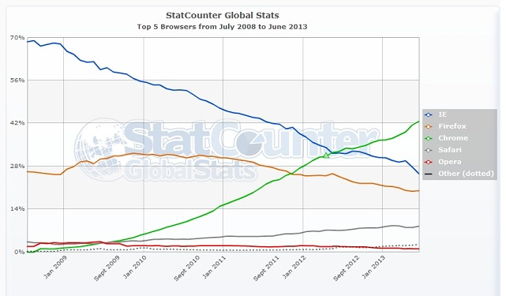
The Top Five Browsers: By the percentage internet users use each browser
1.Chrome: 42.63%
2.IE: 25.54%
3.Firefox: 19.97%
4.Safari: 8.4%
5.Opera: 1.03%
Top 5 Browsers for High Speed:
1.Chrome
2.Mozilla Firefox
3.Safari
4.Opera
5.Internet Explorer

Slide 13
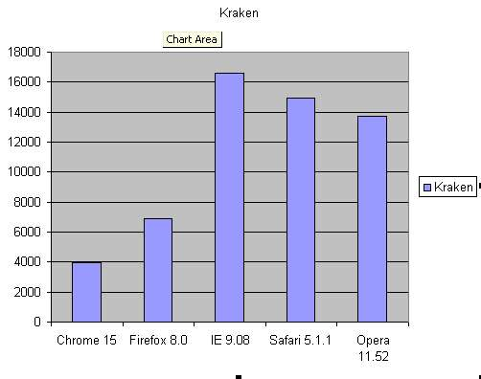
Which Browsers are better than others?
Kraken 1.1 Benchmark Test: Lowe the Better

Slide 14
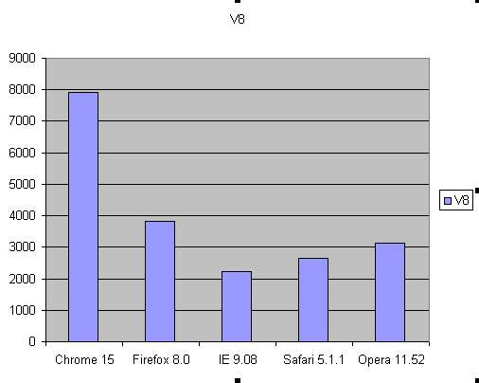
JavaScript V8 Benchmark Suite: Higher the Better

Slide 15

Features of the Internet
What is RSS:
RSS (Rich Site Summary) is a format for delivering regularly changing web content. Many news-related sites, weblogs and other online publishers syndicate their content as an RSS Feed to whoever wants it.
Why use RSS:
RSS solves a problem for people who regularly use the web. It allows you to easily stay informed by retrieving the latest content from the sites you are interested in. You save time by not needing to visit each site individually. You ensure your privacy, by not needing to join each site's email newsletter. The number of sites offering RSS feeds is growing rapidly and includes big names like Yahoo News.

Slide 16

Streaming
Generally speaking, streamed data can be any information/data that is delivered from a server to a host where the data represents information that must be delivered in real time. This could be video, audio, graphics, slide shows, web tours, combinations of these, or any other real time application.
Streaming can probably best be looked at from an educator's perspective as no more than a broadcast, whether live (synchronous, or stored (asynchronous).
One benefit that streaming provides is the enabling of a broadcast from nearly any location that is served by the Texas A&M Network, or any capable device with an IP address, and then delivering that broadcast to anyone, anywhere, at anytime, depending upon course requirements and student needs, of course.

Slide 17
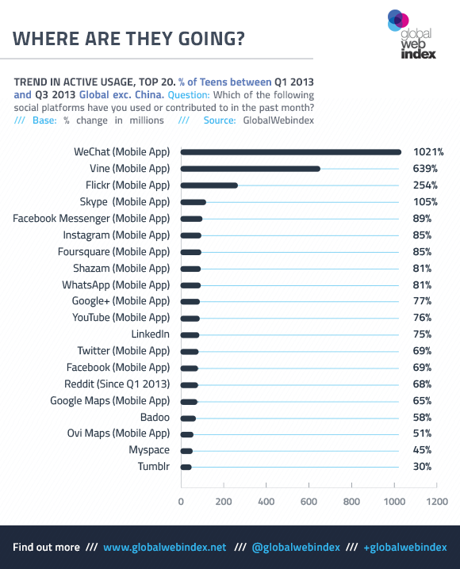
Teen Social Networking
Growth between quarter one and three of 2013 in percentage. By teens age 16 through 19.
Right now, Facebook is losing teen’s interest!

Slide 18

Remote Computer Access
A remote computer is a computer to which a user does not have physical access, but which he or she can access or manipulate via some kind of network.
Remote desktop software allows a person to control a computer from another computer; this allows the user to change anything on the linear computer, and access all of the file contents.
Popular Remote Access Programs
Top VNC Free Software
Symantec
GoToMyPC
Log Mein Free and Pro
Laplink Gold 2008
My Personal Choice:
Teamviewer

Slide 19



E-Mail
What is E-Mail:
Messages distributed by electronic means from one computer user to one or more recipients via a network.
Top Free E-Mail Providers:
G-Mail
Hotmail
Yahoo
AOL
MSN

Slide 20
Virtual Computing
Virtual computing allows computer users remote access to software applications and processes when they need it. Users gain access via the Internet through a wireless or network server. For a fee, users can boost their computers' capabilities, size, performance, processes and/or software applications whenever they need it. This real-time technology offers:
Operating and utility systems
Storage
Memory
Software
Allocation and reassignment of input/output and other processes
Data backup
Automated problem solving and troubleshooting
Tools for monitoring and managing systems

Slide 21
Cloud Computing
In a cloud computing system, there's a significant workload shift. Local computers no longer have to do all the heavy lifting when it comes to running applications.
Hardware and software demands on the user's side decrease. The only thing the user's computer needs to be able to run is the cloud computing system's interface software.
If you use web based E-mail, you already have experience with Cloud Computing
Instead of running an e-mail program on your computer, you log in to a web e-mail account remotely.
The software and storage for your account doesn't exist on your computer, it's on the service's computer cloud.

Slide 22
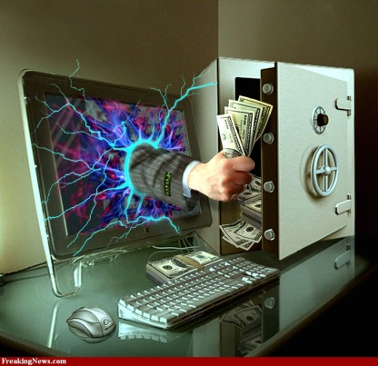
Types of Cybercrime
Malware: Any “malicious software” designed to secretly access your computer. Virus: Malware that copies itself and infects your computer and files. Worm: Malware that self-replicates and sends itself to other computers in your network. Trojan horse: Software that pretends to be useful but is really malware. Hacking: When someone breaks into a computer or network. Phishing: When cybercriminals try to get sensitive information from you, like credit card numbers and passwords. Some specific techniques include spear phishing (targets specific people or departments), whale phishing(targets important people like CEOs), and SMiShing (phishing via text messages). Spoofing: When cybercriminals try to get into your computer by masquerading as trusted source. Examples include email spoofing, IP spoofing and address bar spoofing. Pharming: When website traffic is redirected to a bogus website, usually an ecommerce or banking site. Phreaking: When phone networks are hacked into in order to make free calls or have calls charged to a different account.

Slide 23

Identity Theft on the Internet
Here’s how they do it:
Spyware travels over the Internet and infects your computer.
You can encounter spyware and other forms of malware in many ways, including:
Downloading files or software
Opening email attachments or clicking on pop-ups
Visiting devious Web sites
Operating silently, spyware collects your information.
Without your knowledge, spyware runs in the background while it records your Internet browsing habits and keystrokes, monitors the programs you use and collects your personal information, which can lead to credit card fraud and online identity theft.

Slide 24
Identity Theft: Part 2
Spyware uses your Internet connection to transmit your information to identity thieves.
While your computer is connected to the Internet, spyware quietly transmits your personal information, which can include:
Credit card numbers
Bank account numbers
Social Security numbers
Usernames and passwords
Address books, including email addresses
Spyware villains use your information for illicit or illegal activities.
The villain who placed spyware on your computer receives your information and can now:
Steal money and open credit card and bank accounts in your name
Sell it to other parties who will use it for illicit or illegal purposes
Pummel your PC with pop ups, spam and unwanted messages as well as direct you to Web sites you never intended to visit.

Slide 25
Works Cited
Curley, Nina. "6 Surprising Facts about the Future of the Internet." Wamda. N.p., 11 Nov. 2013. Web. 09 Dec. 2013.
Dragon13304. "Best Web Browsers." - Top Ten List. The Top Tens, n.d. Web. 09 Dec. 2013.
"Internet Fraud." FBI. FBI, 17 Mar. 2010. Web. 09 Dec. 2013.
"The Invention of the Internet." History.com. A&E Television Networks, 2013. Web. 08 Dec. 2013.
"Knowledgebase." Top 5 Web Browsers Worldwide June 2013. Parachat, 2013. Web. 09 Dec. 2013.
McKenna, Patti. "How Virtual Computing Works." HowStuffWorks. N.p., 2013. Web. 09 Dec. 2013.
Olson, Parmy. "Here's Where Teens Are Going Instead Of Facebook." Forbes. Forbes Magazine, 12 Nov. 2013. Web. 08 Dec. 2013.
"Online Identity Theft." Online Identity Theft. Webroot, 2013. Web. 09 Dec. 2013.
Prabhu, Amar. "Web Browsers: What Makes One Web Browser Faster than Another?" Quora. N.p., 8 Mar. 2013. Web. 09 Dec. 2013.

Slide 26
Works Cited
Stern, JOANNA. "Teens Are Leaving Facebook And This Is Where They Are Going." ABC News. ABC News Network, 31 Oct. 2013. Web. 09 Dec. 2013.
Strickland, Jonathan. "How Cloud Computing Works." HowStuffWorks. N.p., 2013. Web. 08 Dec. 2013.
Strickland, Jonathan. "What Is the Future of the Internet?" HowStuffWorks. How Stuff Works, 2013. Web. 09 Dec. 2013.
"Tech Ease." What Is a Web Browser? » Internet » Windows ». Tech Ease, 2011. Web. 09 Dec. 2013.
"Top 15 Most Popular Social Networking Sites | December 2013." Top 15 Most Popular Social Networking Sites. Ebizmba, 2013. Web. 06 Dec. 2013.
Vaughan-Nichols, Steven J. "Which of the Big Five Web Browsers Is the Best? (Review)." ZDNet. N.p., 7 Nov. 2011. Web. 09 Dec. 2013.
"What Are Ports and Protocols ?" :: SG FAQ. Speed Guide, 2013. Web. 09 Dec. 2013.
"What Is RSS? RSS Explained." What Is RSS? RSS Explained. Whatisrss, n.d. Web. 09 Dec. 2013.
"What Is Streaming?" — Internet Media Services. Texas A&M University, 2013. Web. 09 Dec. 2013.
"Worm, Virus, Malware, Phishing, Spoofing, Hacking, Phreaking, Spyware ... What's What? Cybercrime Lingo - Deciphered!" Leapfrog Extraordinary IT Services. N.p., Jan. 2011. Web. 09 Dec. 2013.
Zukerman, Erez. "The Top 6 Popular Free Email Providers Online Other Than Gmail & Yahoo." MakeUseOf. N.p., 1 Dec. 2011. Web. 09 Dec. 2013.

