Slide 1
Game playing AI for Catan

Slide 2
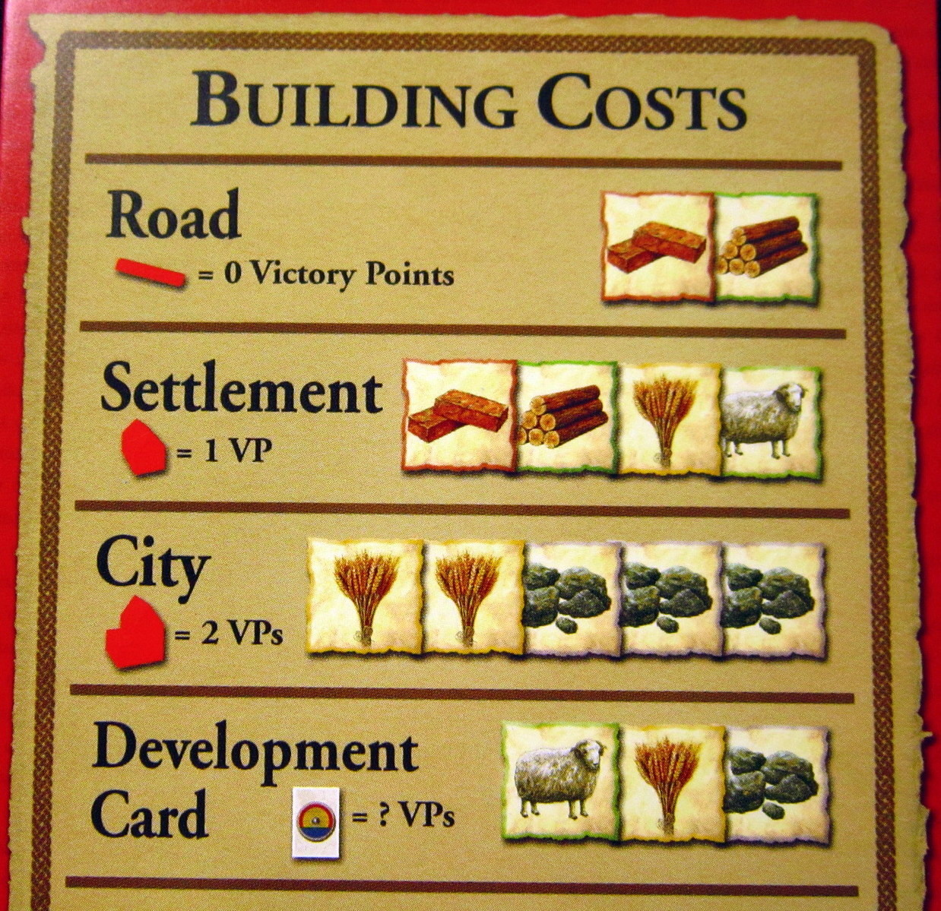
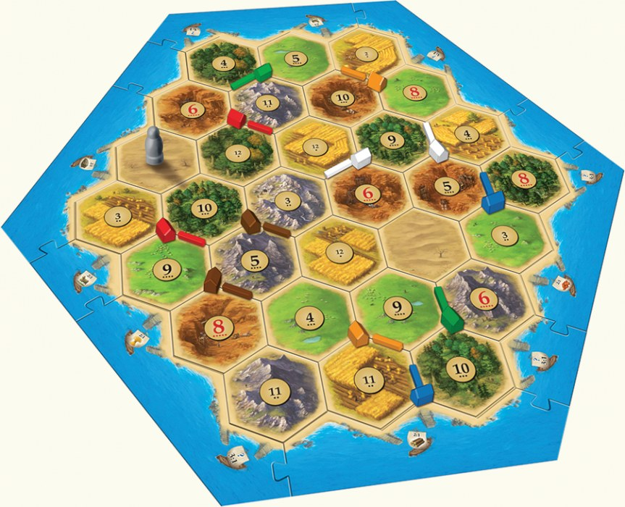
Catan

Slide 3
Rules
Get to 10 Victory points to win the game
Victory points comes from several sources
Resources generated by settlements are crucial
Distribution of resources is dice driven

Slide 4
Aims
Produce an artificial intelligence that can play the game to a strong level

Slide 5
Why Catan?
Non-Deterministic
Multi-player
Imperfect Knowledge
Variable branching factor - at times very large

Slide 6
Move generation
Turns in Catan are made up of several moves
We will have different numbers of move available to us depending on:
  The state of the board
  The resources we have

Slide 7
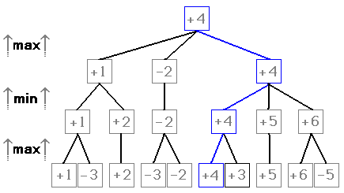
Move generation
This can lead to a very large branching factor.
Minimax search becomes infeasible very quickly for the game
Even more when we consider the uncertainty of the dice rolls

Slide 8
How will we solve this problem?
A combination of heuristics and monte-carlo tree search (MCTS).
MCTS has been used on several other games with large branching factors with good results.

Slide 9
Implementation
Game engine provided by a 3rd party server - JSettlers2
This server comes with bots built in which can be used for testing purposes as a baseline
Our game client interfaces with this server using messages sent over sockets.
No Player-to-Player trading

Slide 10
Game Opening
The opening in Catan is different to the rest of the game.
MCTS would not be particularly effective in this scenario due to extreme branching presented.
Heuristics can be applied – the value of the hexes analysed and a decision made.

Slide 11
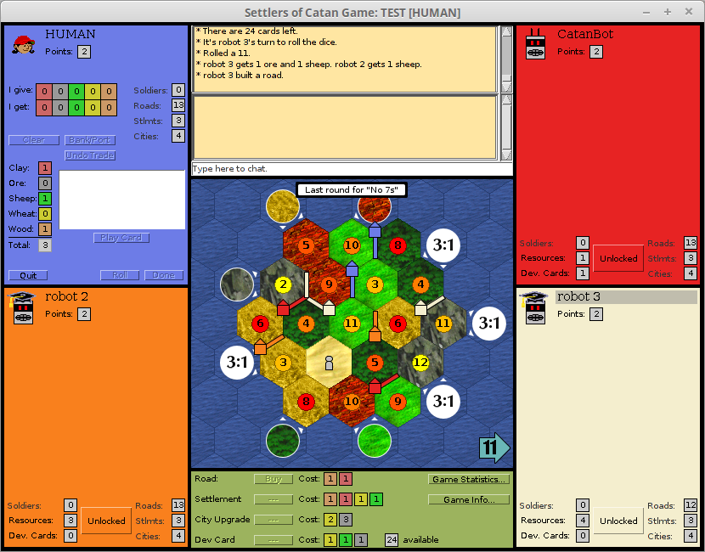
Game Opening

Slide 12
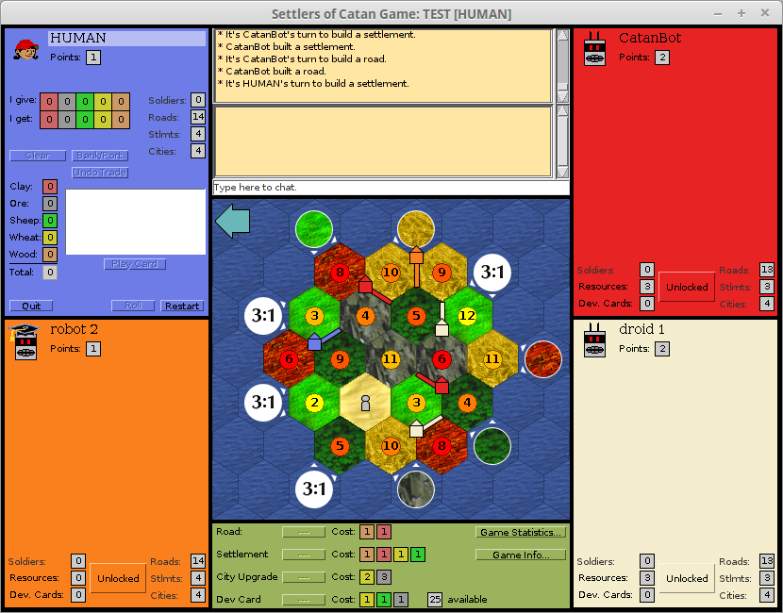
Game Opening

Slide 13
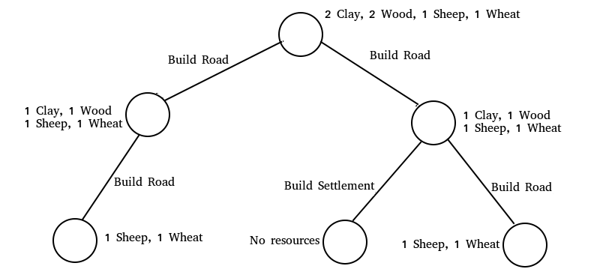
Generating Moves
We need to a do a search to work out all the moves

Slide 14
Generating Moves
Some moves can be pruned from the search to reduce the size of the search tree
Search space varies
A lightweight representation of the game created to perform these searches

Slide 15
Decision Making
Past methods for Catan commonly involved a wholly heuristic process
Given a list of available moves for each turn we need to decide which of these will be the “best”

Slide 16
MCTS
With MCTS we use simulations of the game in order to influence decisions
4 Stages:
  Selection
  Expansion
  Simulation
  Backpropagation

Slide 17
MCTS
We have 2 types of nodes
  Decision Nodes
  Chance Nodes
We choose Chance nodes randomly..
Decision nodes are chosen with the UCT formula

Slide 18
UCT
EXPLOITATION
EXPLORATION
Wi – Wins at node i
Ni – Total simulations at node i
C – Exploration coefficient
T – Total Number of Simulations

Slide 19
MCTS - SELECTION
UCT
RANDOM ROLL
UNEXPLORED CHILDREN

Slide 20
MCTS - EXPANSION

Slide 21
MCTS - SIMULATION
SIMULATOR
RESULT
SIMULATED GAME FROM STATE

Slide 22
MCTS - BACKPROPAGATION
2/3
1/1
2/2

Slide 23
MCTS - BACKPROPAGATION
2/4
1/2
2/2
0/1
0/1

Slide 24
MCTS
Simulation on the game API would be too slow.
A bespoke simulator was created to play the game.
A reasonably high level of fidelity
Decision in the simulator made using a heuristic decision maker with an emphasis on fast decisions

Slide 25
MCTS
MCTS can work with no expert knowledge
Incorporating some can however be beneficial
We introduce some in the form of “fake wins” where we make a node more attractive.

Slide 26
MCTS
We continue searching until a certain number of simulations are reached.
More simulations results in a more effective search

Slide 27
Demonstration Video

Slide 28
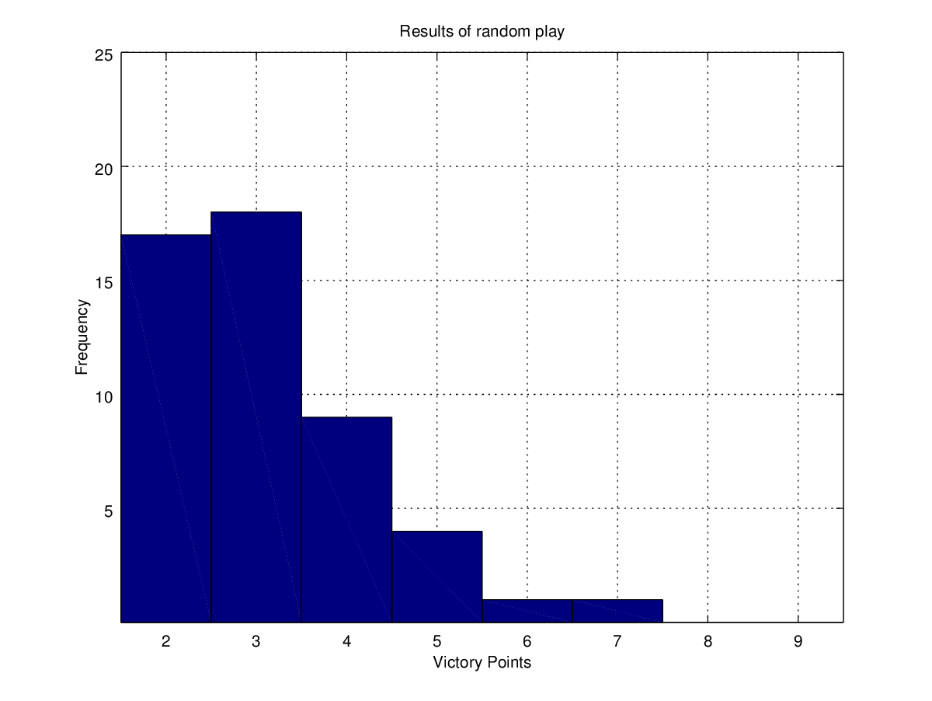
Results
Random Move Selection
Mean: 3.140
Standard
Deviation: 1.161

Slide 29
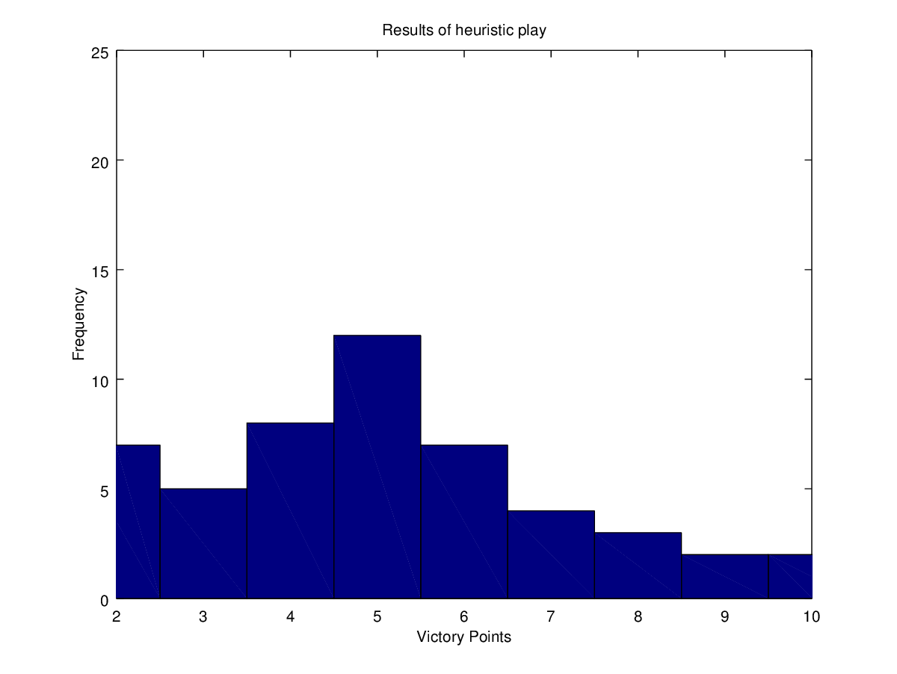
Results
Heuristics Only (Simulator AI)
Mean: 5.060
Standard
Deviation: 2.132

Slide 30
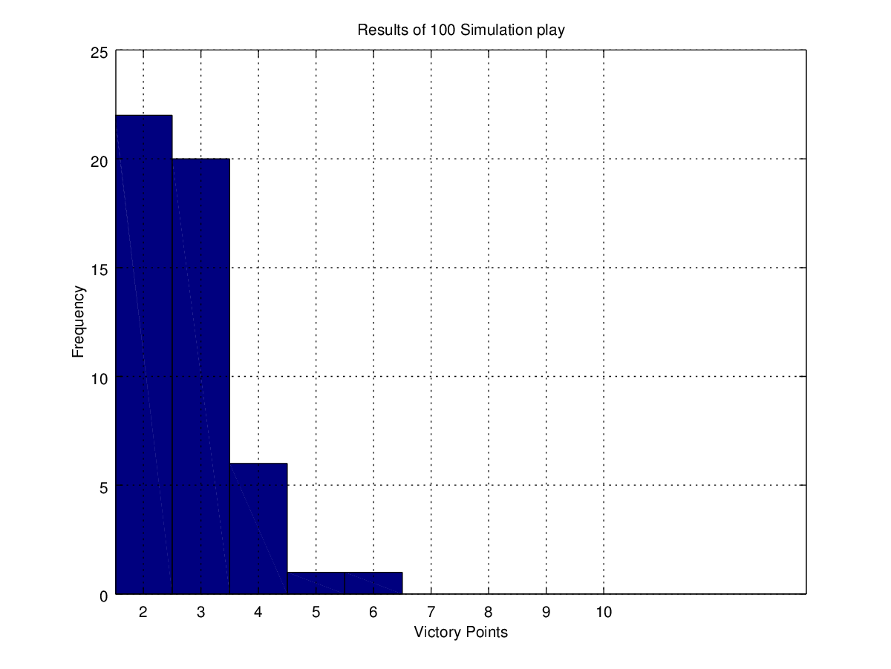
Results
MCTS with 100 Simulations
Mean: 2.780
Standard
Deviation: 0.887

Slide 31
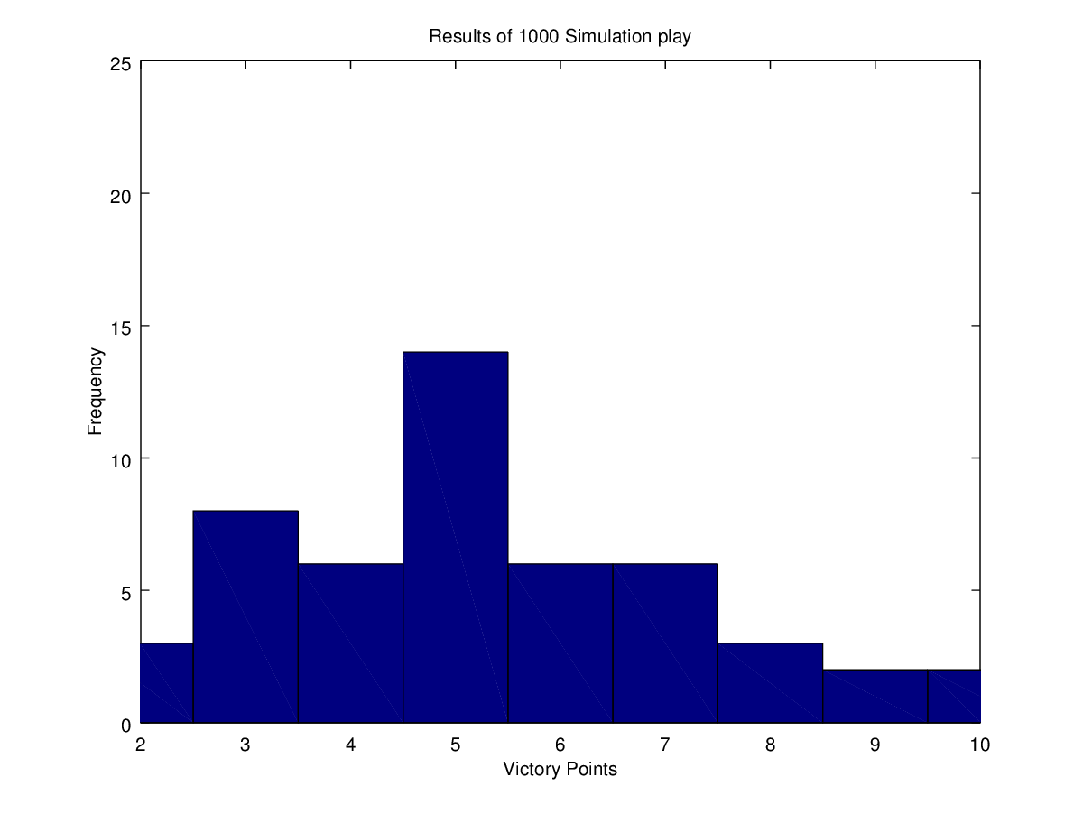
Results
MCTS with 1000 Simulations
Mean: 5.280
Standard
Deviation: 2.027

Slide 32
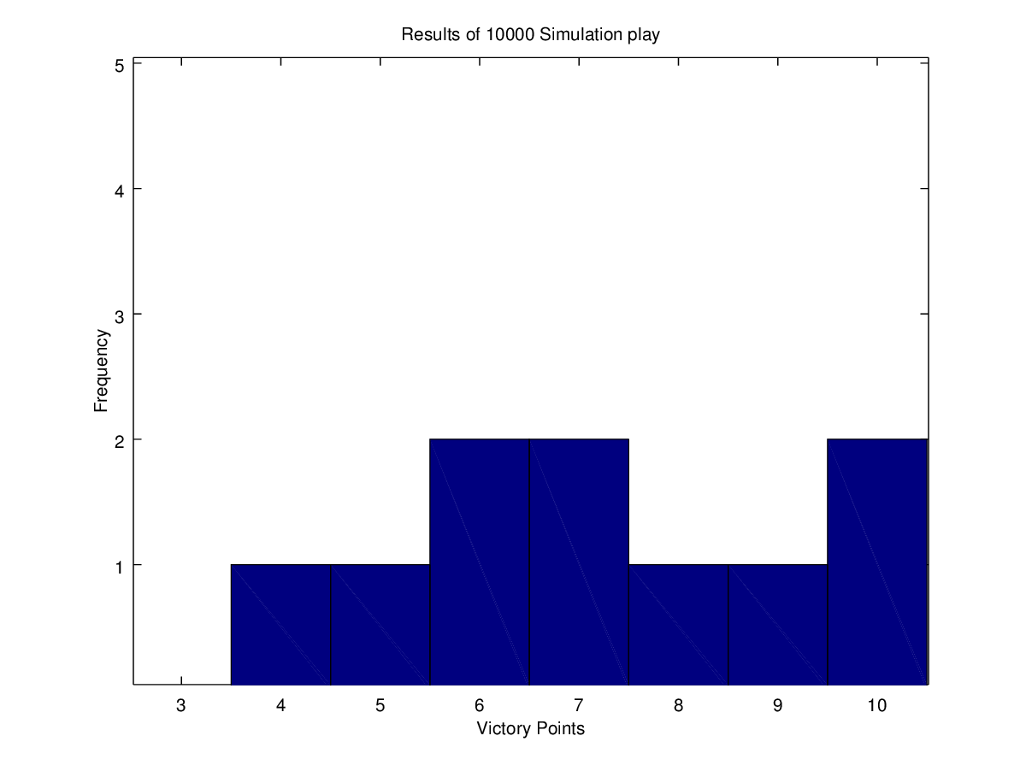
Results
MCTS with 10000 Simulations
ONLY 10 SAMPLES!
Mean: 7.2
Standard
Deviation: 2.044

Slide 33
Conclusions
MCTS shows signs of being an effective way in which to play the game.
MCTS Performance must be balanced against execution time
Performance increases in the simulator and better heuristics will further improve the standard of gameplay.

