Slide 1
Social Networks Analysis
EU Email Network Analysis

Slide 2
Dataset Information
Source: Large European Research Institution
Timeframe: October 2003 – May 2005 (18 Months)
Structure: Directed Graph (Edge i → j if i sent email to j)
--- Key Statistics ---
Nodes (Email Addresses): 265,214
Edges (Sent Emails): 420,045
Avg Clustering Coefficient: 0.067
Reciprocity: Only ~13% of nodes are in the largest Strongly Connected Component (SCC)

Slide 3
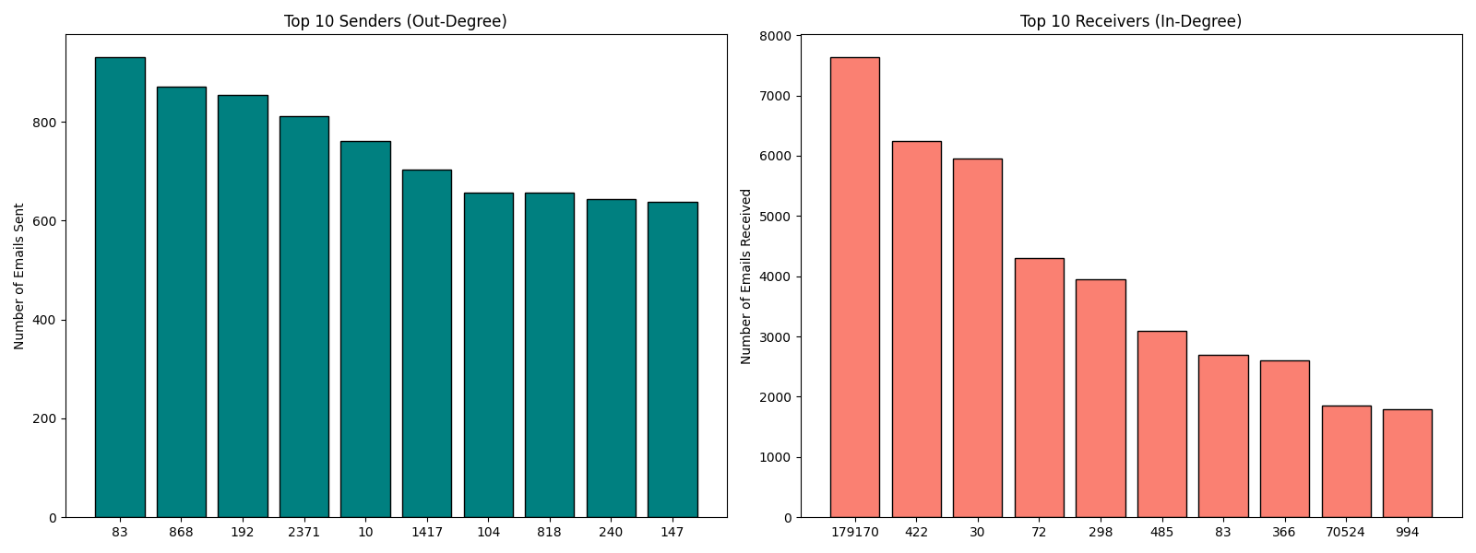
Top Senders vs. Top Receivers
OBSERVATION:
We separated 'Broadcasters' (Senders) from 'Authorities' (Receivers).
Top Senders:
- High Out-Degree
- Likely automated systems or announcements.
Top Receivers:
- High In-Degree
- Likely Managers or Helpdesk.

Slide 4
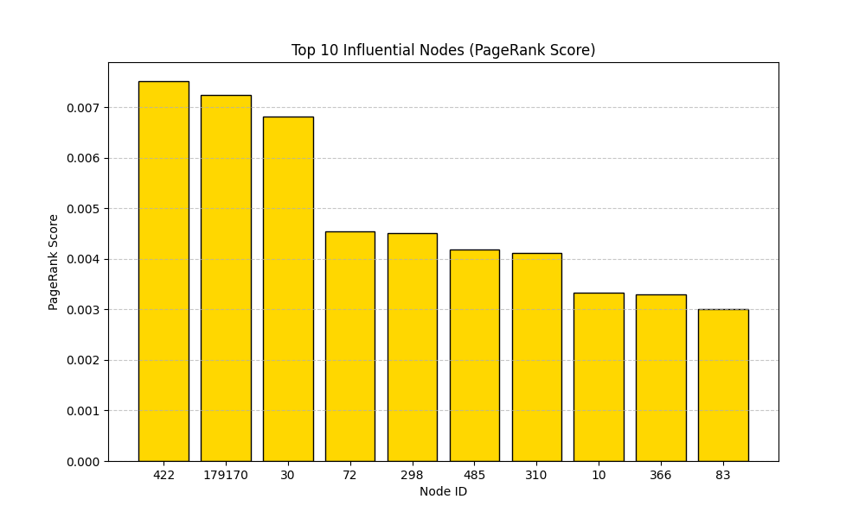
Influence Analysis (PageRank)
WHAT IS PAGERANK?
It measures influence, not just volume. A node is important if other important nodes email it.
RESULTS:
- The top influencers are often different from the top spammers.
- These nodes represent the 'Social Capital' of the network.

Slide 5
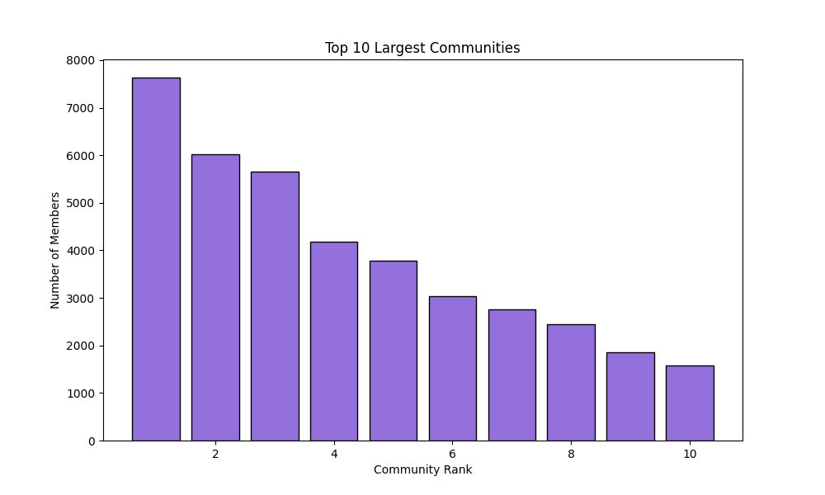
Community Detection
WHAT IS A COMMUNITY?
A group of nodes densely connected internally but sparsely connected to the outside.
CONTEXT:
These likely represent departments, project teams, or research labs working together.

Slide 6
Network Resilience Test
Hypothesis: Does the network break if the Top Sender (Hub) is removed?
Experiment:
1. Measured size of the Core (Largest Strongly Connected Component).
2. Removed Node #0 (Top Sender).
3. Recalculated Core size.
Result:
The Core size remained stable.
Conclusion:
The network is ROBUST. Communication relies on multiple pathways, not just one central figure.

Slide 7
Conclusion
The network is 'Scale-Free': A few hubs dominate, but the majority have few connections.
Clear Hierarchy: Distinct separation between information sources (Senders) and sinks (Receivers).
Robustness: The institution's communication flow survives the loss of key players.
Communities: Distinct subgroups exist, reflecting the departmental structure of the organization.

