Slide 1
Quandary
quan·da·ry
ˈkwänd(ə)rē/
noun
noun: quandary; plural noun: quandaries
a state of perplexity or uncertainty over what to do in a difficult situation.
"Kate is in a quandary"
synonyms: predicament, plight, difficult situation, awkward situation

Slide 2
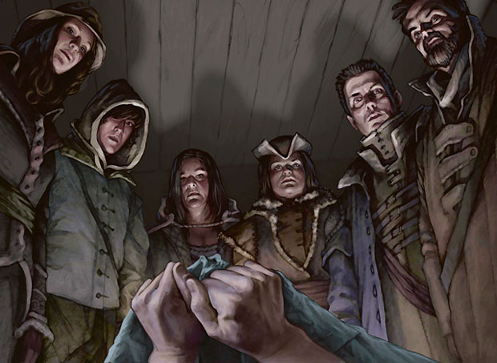
Concept Pitch
Survival , Strategy and Management
Post-Apocalypse
Play as leader of a group of survivors
Dilemma: Not enough food.
“Do we eat one of our own?”

Slide 3
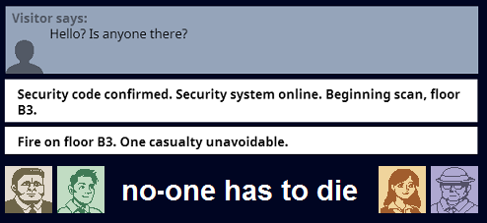
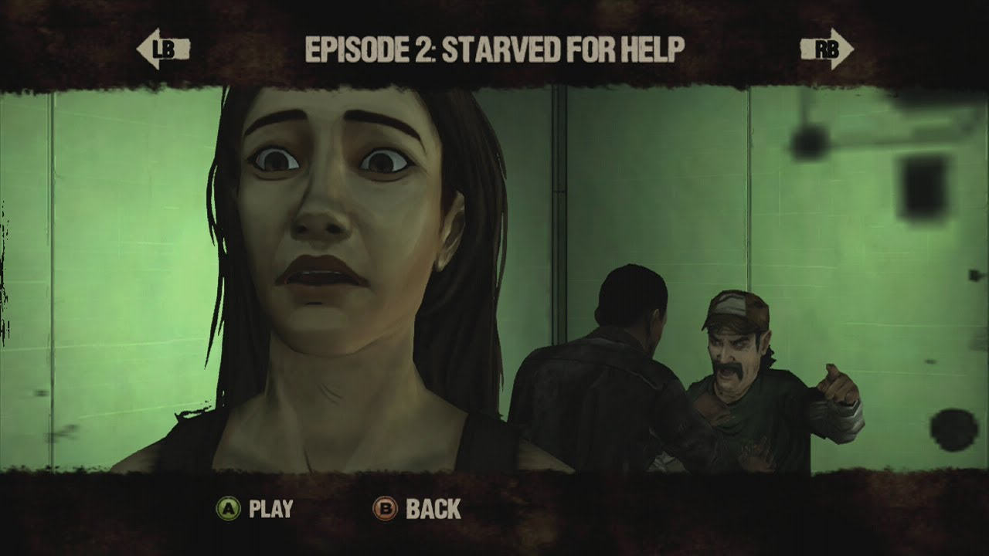
Research and Inspiration
Decision making

Slide 4
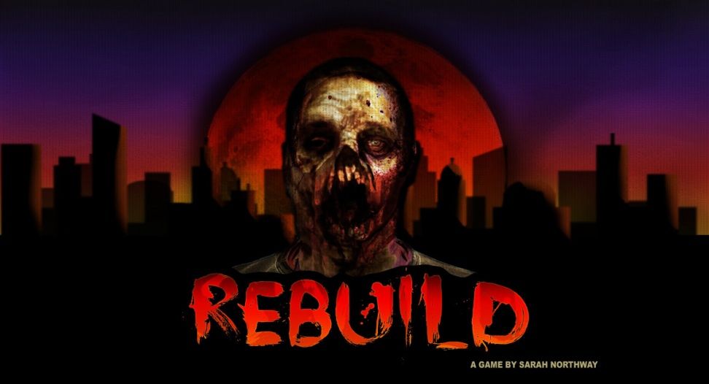
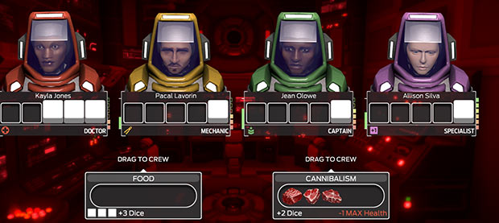
Research and Inspiration
Stategy and Management

Slide 5

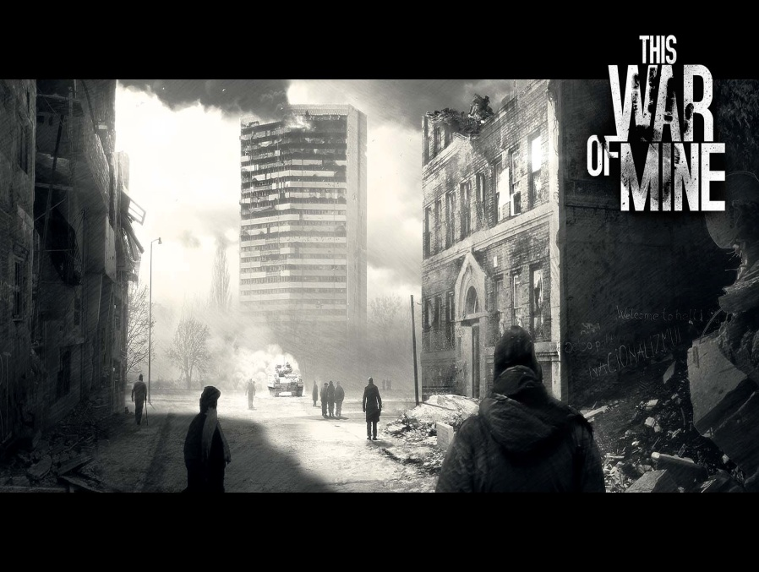
Research and Inspiration
Art Style

Slide 6
Project Scope
A Modular Approach
Base Skeleton, Open possibility of adding more
Time given for details and polish

Slide 7
Class Diagram

Slide 8
Sources
Image: Wizards of the Coast, “Village Cannibals” from Magic the Gathering: Innistrad
StuStuTheBloo, “no-one has to die” , http://www.newgrounds.com/portal/view/615863
Telltale’s “The Walking Dead” ,
http://store.steampowered.com/app/207610/
Sarah Northway, “Rebuild 2”,
http://www.kongregate.com/games/sarahnorthway/rebuild-2
Choice Provisions, “Tharsis”,
https://totallychoice.com/games/tharsis

Slide 9
Sources
Molleindustria, “Every Day the Same Dream”,
http://www.molleindustria.org/everydaythesamedream/everydaythesamedream.html
11 Bit Studios, “This War of Mine” ,
http://store.steampowered.com/app/282070/

