Slide 1

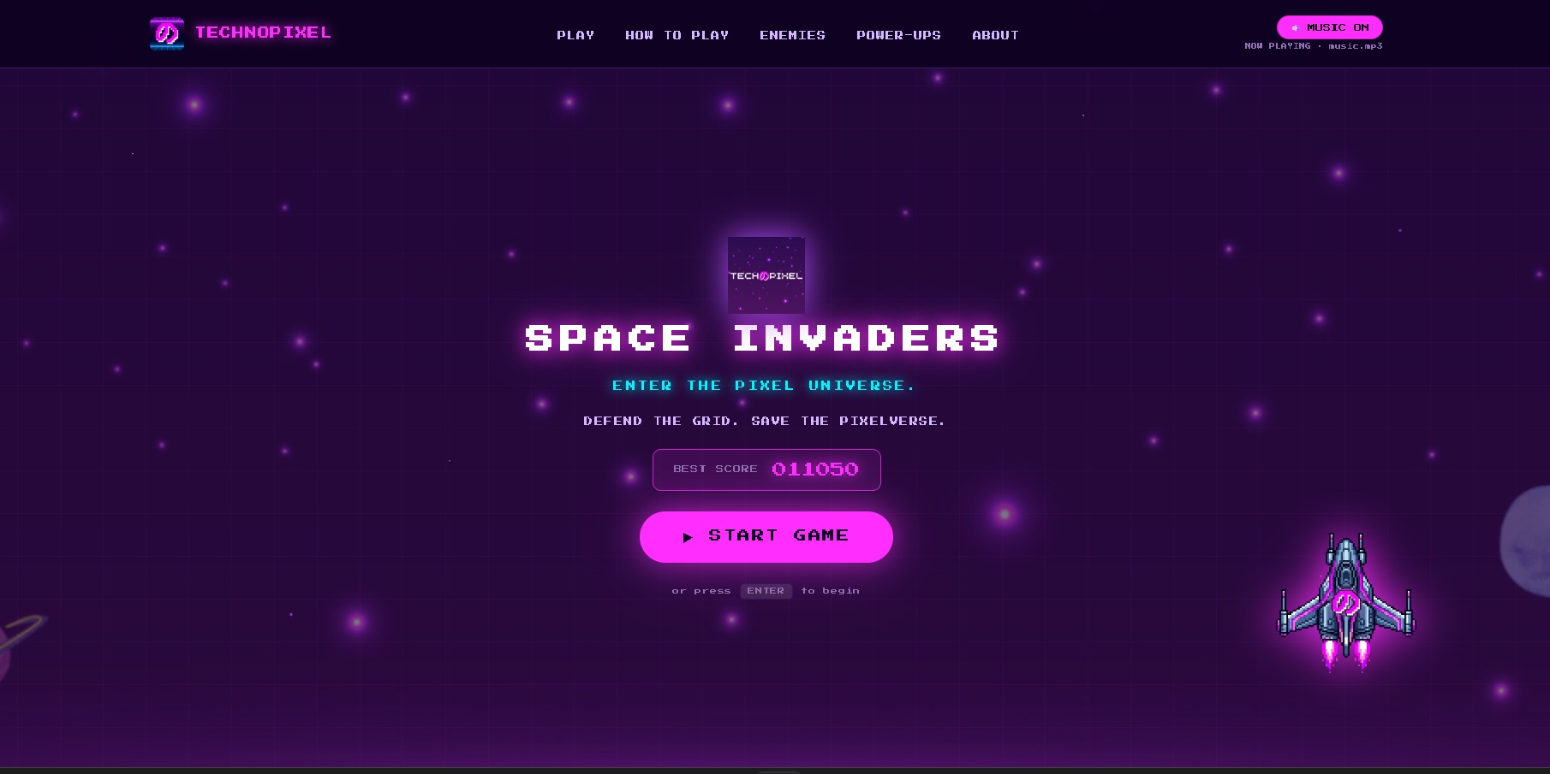
WEB GAME DEVELOPMENT WORKSHOP
TECHNOPIXEL
SPACE
INVADERS
FOUNDATIONS & CORE GAME LOGIC
DAY 1 • DECEMBER 10, 2026
DEFEND THE GRID. SAVE THE PIXELVERSE.
A step-by-step introduction to building a browser arcade game.
HTML5 CANVAS
VANILLA JS
PIXEL ARCADE
DAVE PUNZALAN / TECHNOPIXEL
TECHNOPIXEL • SPACE INVADERS • DAY 1
01

Slide 2

01 / START HERE
Today’s mission
We will turn a browser page into a playable arcade game — one small mechanic at a time.
01
02
03
04
Set up the project
Move & shoot
Build the invasion
Make it a game
Open the existing game in VS Code and run it locally in a browser.
Read keyboard input, update the player position, and fire projectiles.
Create enemy formations, movement rules, and side invaders.
Detect collisions, award points, manage lives, and track game states.
FINISH LINE
A working Space Invaders game you can explain, test, and customize.
No prior JavaScript experience required — curiosity and patience are enough.
TECHNOPIXEL • DAY 1 WORKSHOP
02

Slide 3
02 / THE BIG PICTURE
Anatomy of a browser game
Four parts work together. Each has a different job.
HTML
STRUCTURE
The page’s skeleton: buttons, sections, labels, and the canvas.
THE MENTAL MODEL
HTML
CSS
APPEARANCE
The outfit: layout, colors, spacing, glow, and responsive screens.
↓
CSS
↓
JAVASCRIPT
BEHAVIOR
The rules: input, timing, movement, score, collision, and states.
JavaScript + Canvas
The browser brings the pieces together.
CANVAS
PLAYFIELD
The drawing board where ships, bullets, aliens, and effects appear.
TECHNOPIXEL • DAY 1 WORKSHOP
03

Slide 4
03 / GET READY
First: run the project
Your first checkpoint is not coding — it is getting the same working game on every computer.
01
02
Open VS Code
Find index.html
File → Open Folder → choose the project folder (Samplegame/).
Notice how it links styles.css and game.js.
03
04
Start Live Server
Confirm the screen
Right-click index.html → Open with Live Server.
Wait for loading to finish and check that the landing page appears.
READY CHECK
Can every student see the TechNoPixel loading screen and reach the landing page?
Tip: if the page is blank, check the browser console and verify every file path.
TECHNOPIXEL • DAY 1 WORKSHOP
04

Slide 5
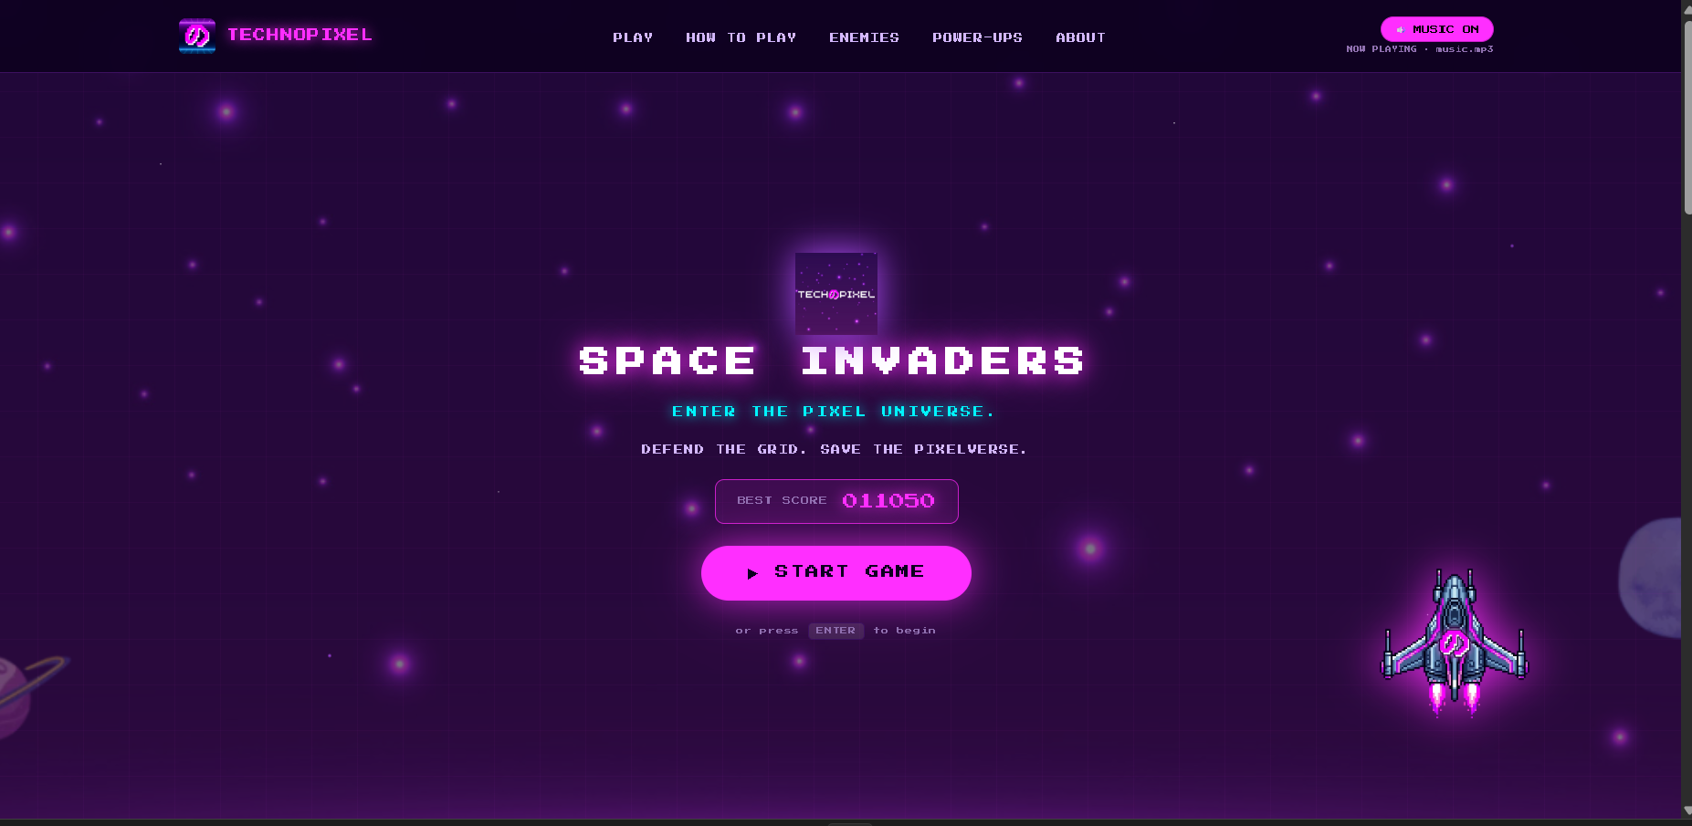
04 / PROJECT MAP
One game, three screens
Each screen is a different view of the same experience.
LOADING
Loads image assets; shows progress and the falling katakana animation.
↓
LANDING
Shows title, controls, enemy types, power-ups, story, and music toggle.
↓
GAME CANVAS
Runs the arcade loop and shows pause, wave-cleared, victory, and game-over overlays.
index.html = structure styles.css = appearance game.js = rules
The same game state controls what updates and what the player sees.
TECHNOPIXEL • DAY 1 WORKSHOP
05

Slide 6
05 / ASSETS
Load before you draw
Images and audio are resources. Load them once, then reuse them throughout the game.
SCENE
PLAYER
ENEMIES
POWER-UPS
Background.png
newLogo.png • TEXT.png
technospaceship.png
bullet.png
enemy1–4.png
sidenemy1–4.png
heart • shield • multishot
big bullet • rapid shot
Background + brand art
Ship + projectile
Formation + side sprites
Five pickup effects
ASSET-LOADING IDEA
ASSET-LOADING IDEA
ASSET-LOADING IDEA
ASSET CHECK
const img = new Image();
img.onload = () => {
imgs[key] = img;
updateLoadingProgress();
};
img.src = url;
const img = new Image();
img.onload = () => imgs[key] = img;
img.onerror = () => imgs[key] = null;
img.src = url;
const img = new Image();
img.onload = () => imgs[key] = img;
img.onerror = () => imgs[key] = null;
img.src = url;
The actual Big Bullet file is bigbulletmoto.png — verify the path before debugging the drawing code.
Set the source once; use the loaded image later.
Load once, save the image, and handle missing files.
If an image fails, the game should use a fallback instead of crashing.
TECHNOPIXEL • DAY 1 WORKSHOP
06

Slide 7
06 / MECHANIC 01
Move the player ship
Input is recorded first; the game checks that input while it updates each frame.
KEYBOARD STATE
KEYBOARD STATE
MOVEMENT RULE
MOVEMENT RULE
const keys = {};
window.addEventListener('keydown', e => {
keys[e.code] = true;
});
window.addEventListener('keyup', e => {
keys[e.code] = false;
});
const keys = {};
window.addEventListener('keydown', e => {
keys[e.code] = true;
});
window.addEventListener('keyup', e => {
keys[e.code] = false;
});
let dx = 0;
if (keys['ArrowLeft'] || keys['KeyA']) dx = -1;
if (keys['ArrowRight'] || keys['KeyD']) dx = 1;
player.x += dx * player.speed;
player.x = Math.max(0,
Math.min(CONFIG.CANVAS_W - player.w, player.x)
);
const left = keys['ArrowLeft'] || keys['KeyA'];
const right = keys['ArrowRight'] || keys['KeyD'];
const dx = left ? -1 : right ? 1 : 0;
player.x += dx * player.speed;
player.x = Math.max(0, Math.min(
CONFIG.CANVAS_W - player.w, player.x
));
Pressed = true. Released = false. Think of a light switch.
Clamp the position so the ship stays on screen.
Pressed = true. Released = false — like a light switch.
Clamp the position so the ship stays on screen.
A / ←
MOVE LEFT
D / →
MOVE RIGHT
x = horizontal position • speed = distance per update
TECHNOPIXEL • DAY 1 WORKSHOP
07

Slide 8
07 / MECHANIC 02
Shoot — and clean up after the shot
A bullet is a small object in an array: create it, move it, detect hits, then remove it.
CREATE A BULLET
MOVE + REMOVE
const bx = player.x + player.w / 2 - bulletW / 2;
const by = player.y - bulletH;
bullets.push({
x: bx, y: by,
w: bulletW, h: bulletH
});
for (let i = bullets.length - 1; i >= 0; i--) {
bullets[i].y -= CONFIG.BULLET_SPEED;
if (bullets[i].y + bullets[i].h < 0) {
bullets.splice(i, 1);
}
}
The x-coordinate centers the bullet on the ship.
Loop backward when removing items from an array.
CREATE
→
UPDATE
→
COLLIDE
→
CLEAN
push into bullets
move upward
check enemies
remove off-screen
A firing cooldown limits how quickly bullets can be created, even while Space is held.
TECHNOPIXEL • DAY 1 WORKSHOP
08

Slide 9
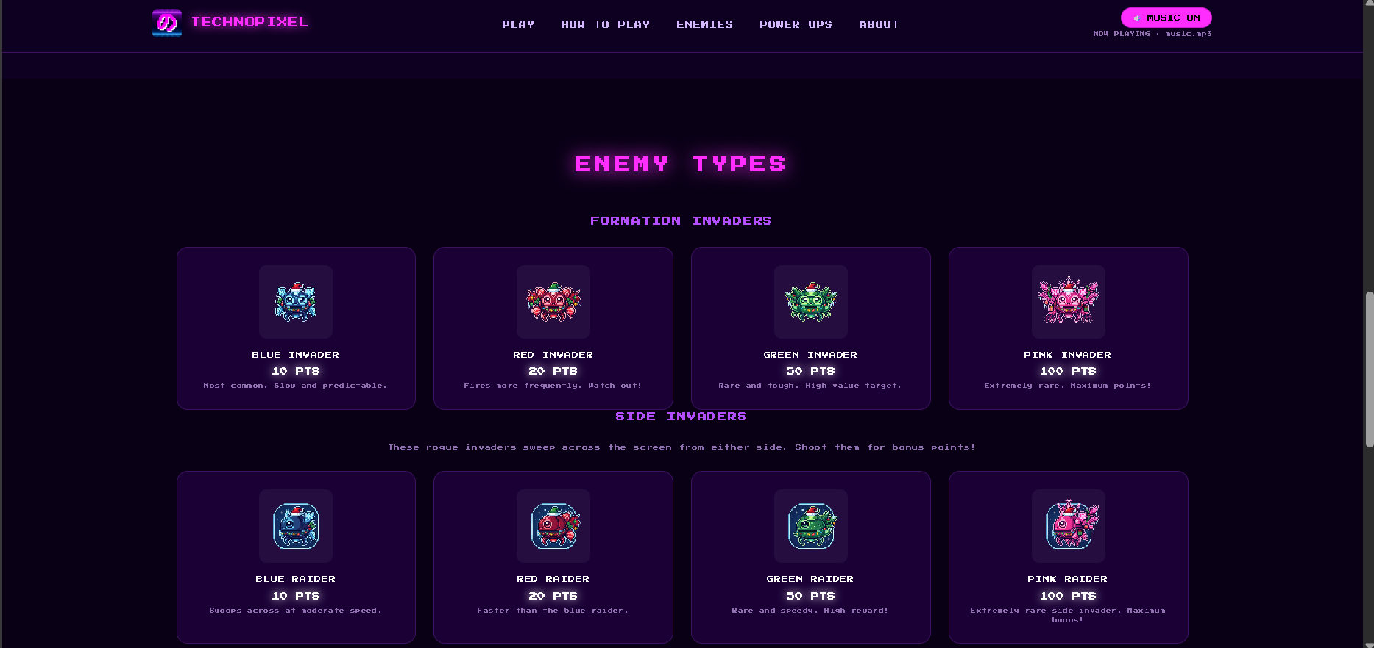
08 / MECHANIC 03
Build the invasion
A nested loop creates rows and columns. The formation reverses direction when it reaches a wall.
FORMATION PATTERN
for (let row = 0; row < rows; row++) {
for (let col = 0; col < cols; col++) {
enemies.push({
x: startX + col * (W + gap),
y: startY + row * (H + gap),
type: typeIndex,
alive: true
});
}
}
Rows create vertical layers; columns fill each row.
ENEMY POINT VALUES
BLUE
10 PTS
RED
20 PTS
GREEN
50 PTS
PINK
100 PTS
Side invaders use their own sprites and sweep across the screen for bonus points.
TECHNOPIXEL • DAY 1 WORKSHOP
09

Slide 10
09 / MECHANIC 04
Collision detection: did the bullet hit?
AABB checks whether two axis-aligned rectangles overlap.
RECTANGLE A
THE OVERLAP RULE
return ax < bx + bw &&
ax + aw > bx &&
ay < by + bh &&
ay + ah > by;
PLAYER BULLET
ENEMY
All four comparisons must be true.
RECTANGLE B
OVERLAP = HIT
When hit: remove the bullet → defeat the enemy → add points.
Player damage also checks invulnerability and shield state before removing a life.
TECHNOPIXEL • DAY 1 WORKSHOP
10

Slide 11
10 / REWARDS
Score, lives & power-ups
A clear feedback loop makes every hit meaningful: detect → update state → show the result.
SCORING
♥
HEART
⬡
SHIELD
⑂
MULTISHOT
10 / 20 / 50 / 100
Restore one life
Absorb a hit
Three-shot spread
Each enemy type awards a different point value.
✦
BIG BULLET
ϟ
RAPID SHOT
LIVES & HIT FEEDBACK
Larger shots
Faster firing
Three starting lives. A brief invulnerability window prevents one collision from draining several lives at once.
Collect a drop by flying into it. Timed upgrades expire; hearts respect the life cap.
TECHNOPIXEL • DAY 1 WORKSHOP
11

Slide 12
11 / CONTROL FLOW
Game states keep the experience organized
One STATE value decides which interactions and overlays should be active.
LOADING
→
MENU
→
PLAYING
→
PAUSED
WAVE CLEARED
VICTORY
GAME OVER
Brief transition before the next formation.
Wave 5 cleared
Lives reach zero
Analogy: STATE is a traffic light. The game should only be in one mode at a time.
Paused means the simulation stops updating; the current frame can remain visible behind the overlay.
TECHNOPIXEL • DAY 1 WORKSHOP
12

Slide 13
12 / FEEL & POLISH
The loop: update, then draw
The game repeats a small cycle before the browser paints the next frame.
ONE ANIMATION CYCLE
function gameLoop(timestamp) {
update(timestamp); // move + check rules
render(); // draw the current scene
requestAnimationFrame(gameLoop);
}
INPUT
→
UPDATE
→
RENDER
Repeat while the game runs.
requestAnimationFrame schedules the next frame.
SOUND & MUSIC
music.mp3
Web Audio API
User gesture
Looping soundtrack
Lightweight sound effects
Start or unmute to play
TECHNOPIXEL • DAY 1 WORKSHOP
13

Slide 14
13 / BUILD-ALONG
Your 150-minute coding roadmap
Each checkpoint ends with a visible result — run the game often, not only at the end.
10m
15m
20m
25m
Setup
Assets
Movement
Bullets + enemies
Open project + run page
Load and draw sprites
Keyboard input + boundaries
Shoot and move formation
20m
20m
20m
20m
Collisions
Power-ups
States + audio
Test + challenge
Score + lives + hit rules
Drops + effects + timers
Waves, pause, win/lose, sound
Debug and customize
TOTAL 150 MINUTES
Keep advanced polish optional. The core mechanics come first.
Facilitator note: the event plan has separate setup, opening, keynote, demo, and wrap-up blocks around this coding session.
TECHNOPIXEL • DAY 1 WORKSHOP
14

Slide 15
14 / DEBUGGING
When something breaks, debug in layers
A bug is information. Test one small thing at a time.
BLANK / MISSING ART
SHIP DOES NOT MOVE
BULLETS NEVER STOP
Check image paths, exact spelling, and filename case. Open DevTools → Console.
Confirm keydown/keyup handlers, expected key codes, and STATE === "playing".
Remove bullets after they leave the canvas; check the firing cooldown.
NO SCORE / COLLISION
MUSIC DOES NOT PLAY
PORT 5500 IS TAKEN
Compare x, y, width, and height. Confirm the bullet is removed after a hit.
Start via a user click; confirm music.mp3 path and audio promise handling.
Stop the other Live Server instance or use a different port.
MINI CHALLENGE
Change one value — ship speed, bullet speed, or a point value — and predict what will happen before running it.
EXIT TICKET: What checks whether two game objects overlap? What does the game loop do every frame?
TECHNOPIXEL • DAY 1 WORKSHOP
15

Slide 16
TECHNOPIXEL • DAY 1
YOU BUILT
A BROWSER GAME.
Remember the loop:
INPUT
UPDATE
RENDER
Read the player’s intent.
Apply movement and rules.
Draw the current state.
TECHNOPIXEL SPACE INVADERS
Created by Dave Punzalan
Keep experimenting. Keep debugging. Make the game yours.
Use the Notion workshop guide after the session for the complete code walkthrough, exercises, and troubleshooting.
Questions & reflection
TECHNOPIXEL • SPACE INVADERS • DECEMBER 10, 2026
16

