Slide 1
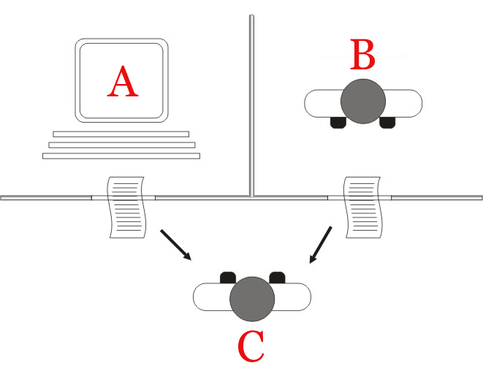

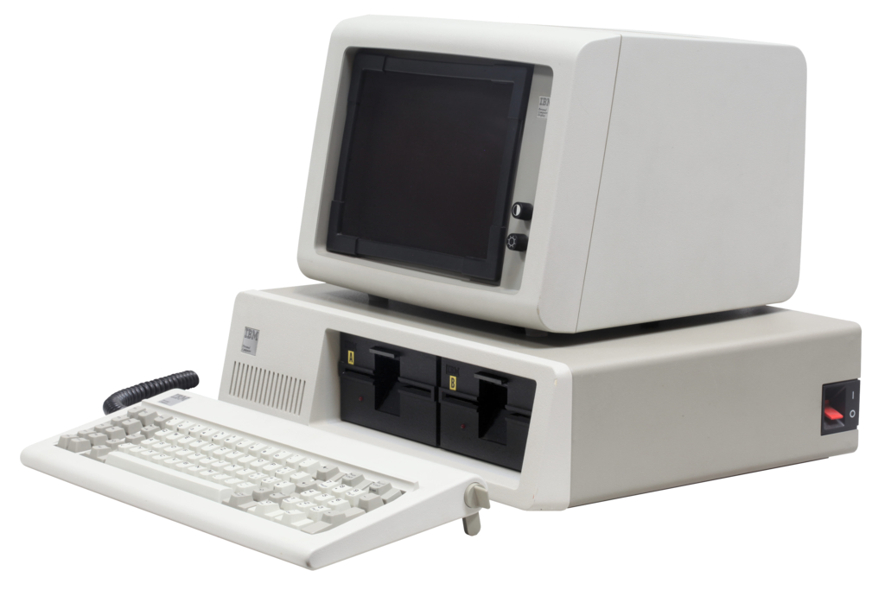
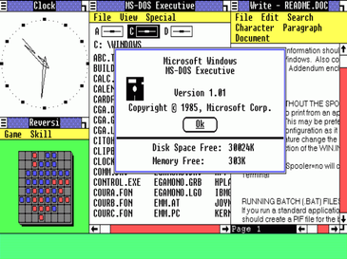
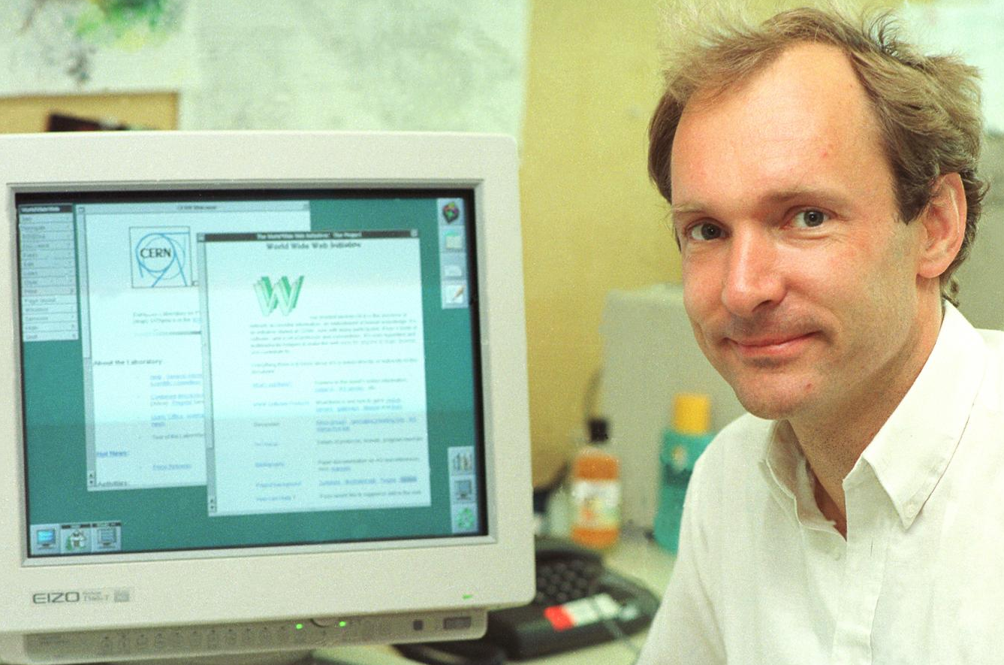
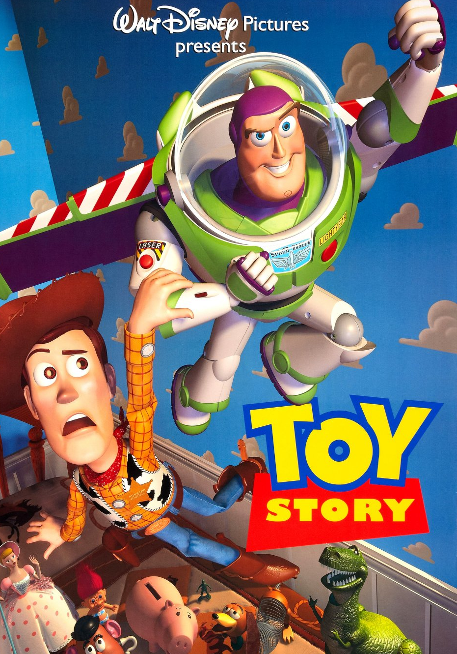

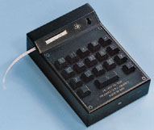
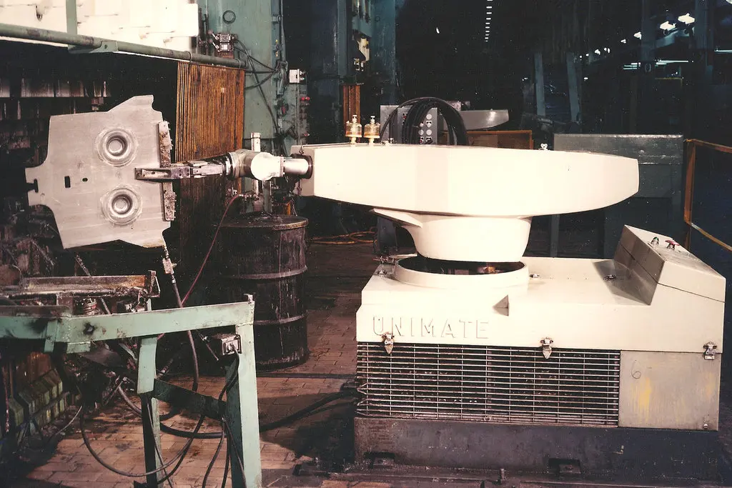
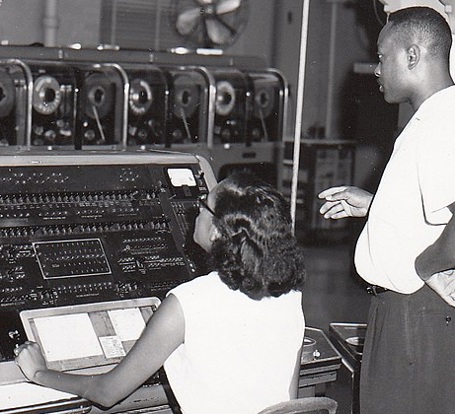
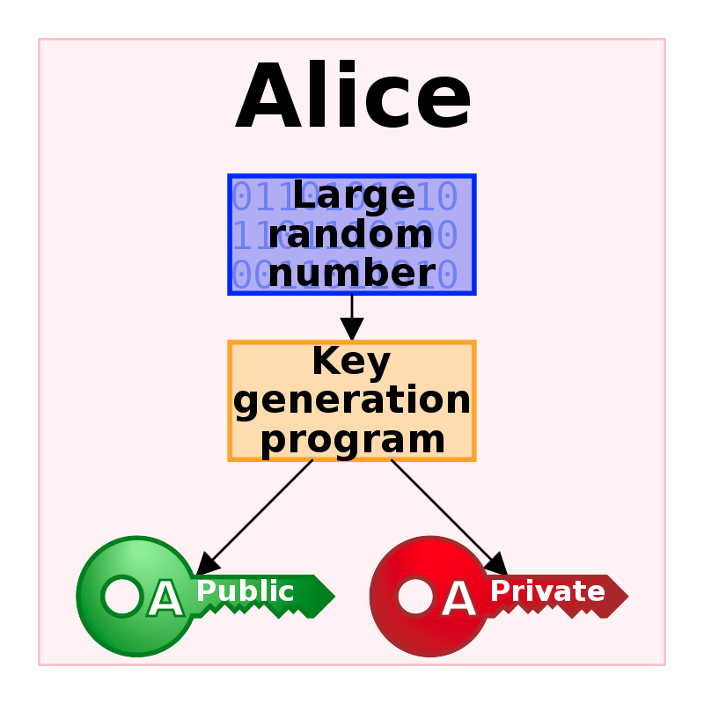

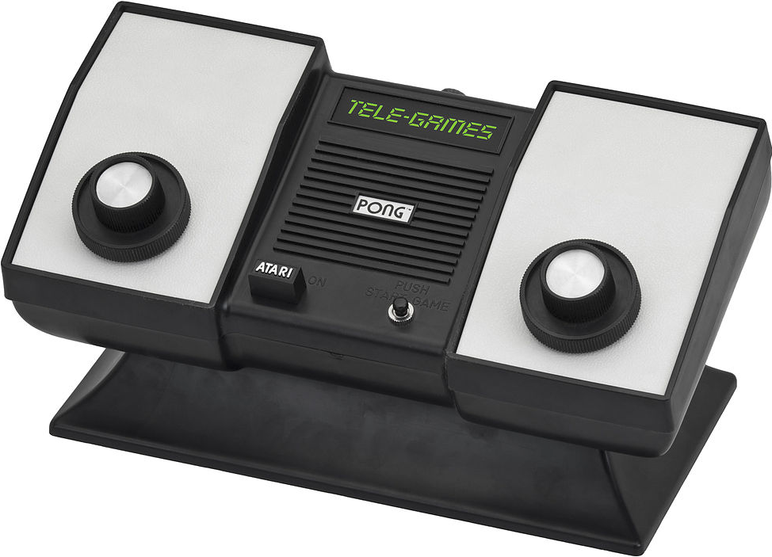
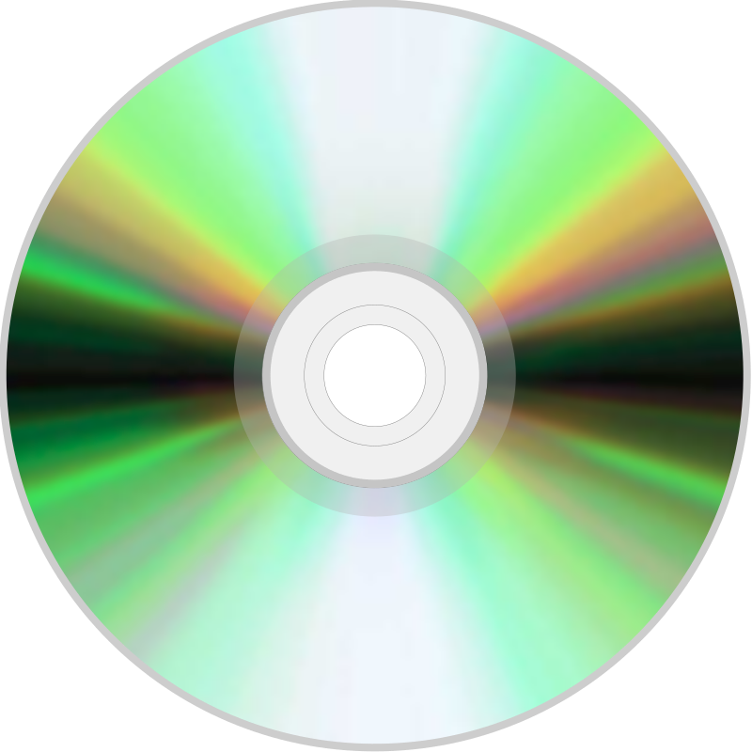
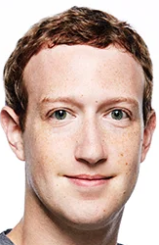
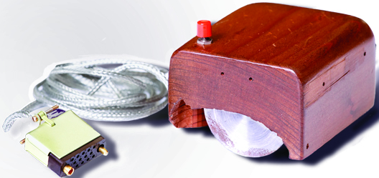
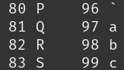
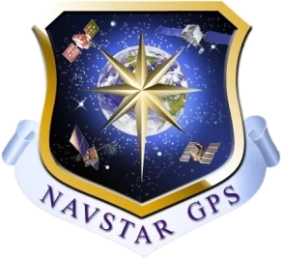
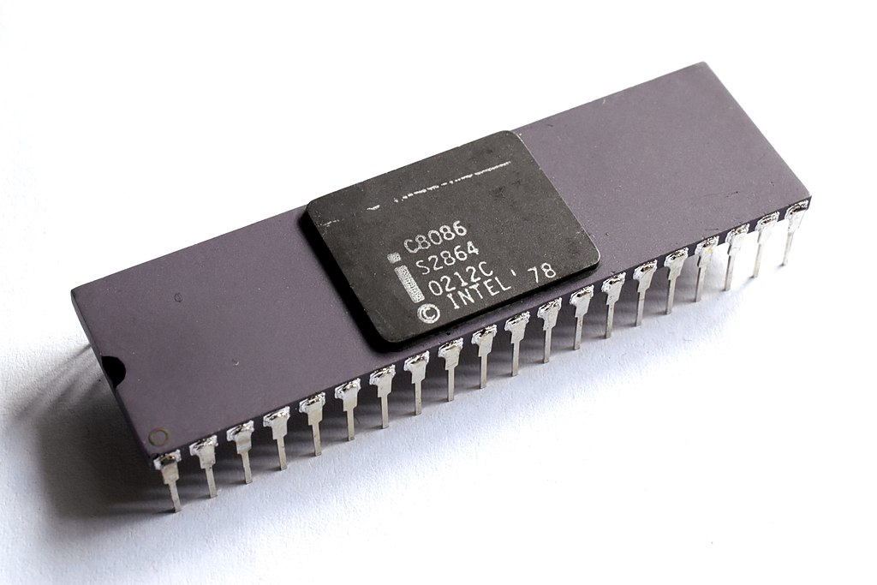
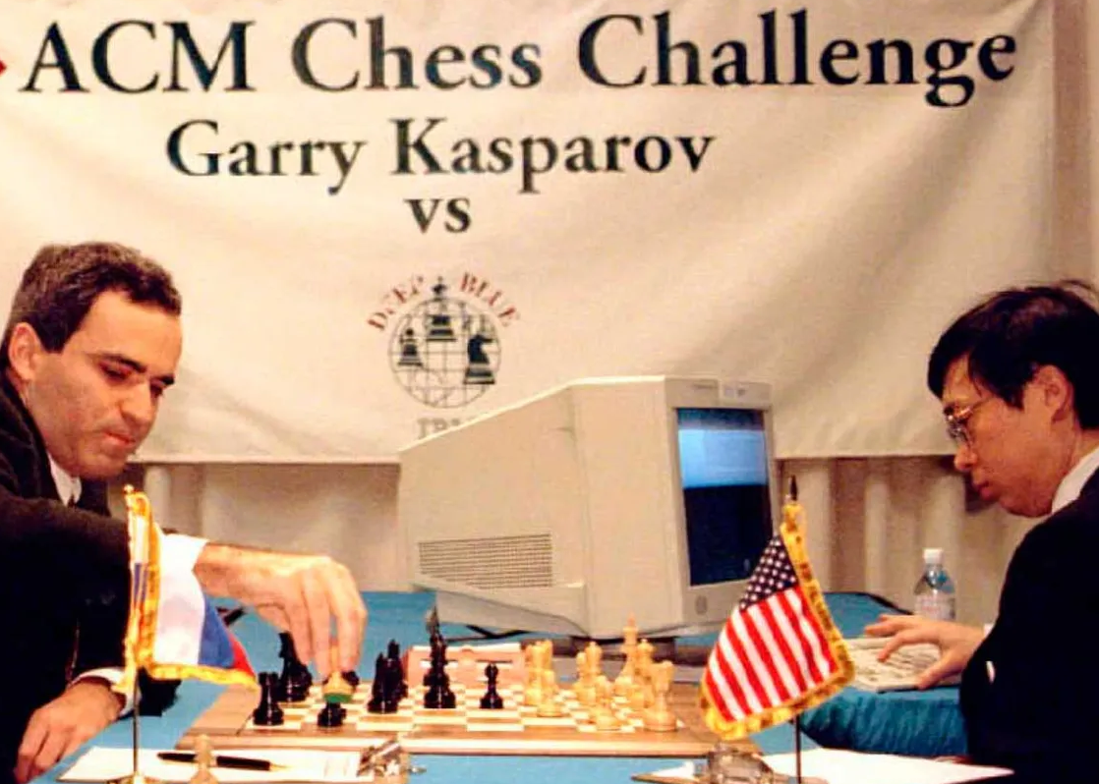
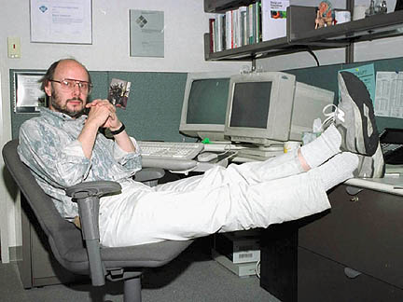
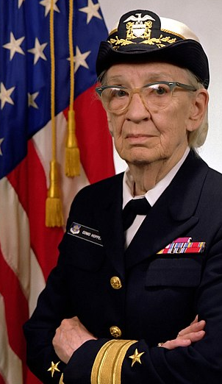
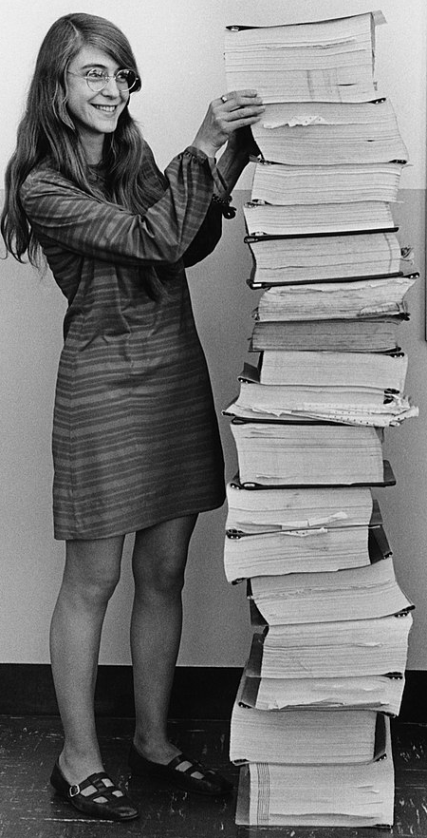
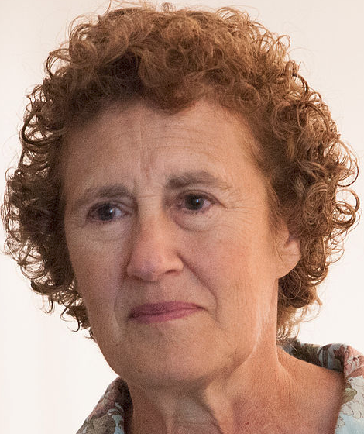
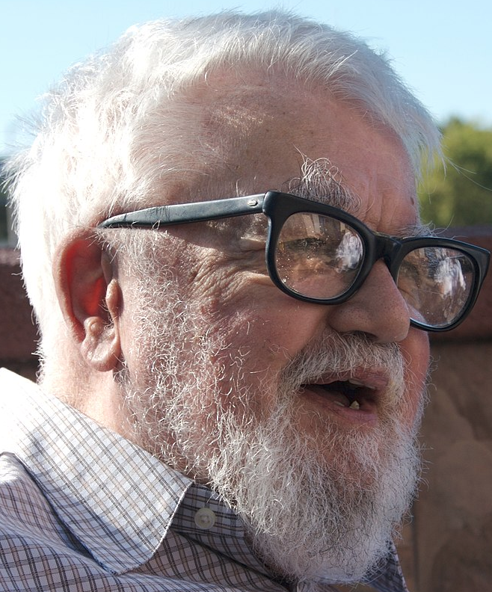
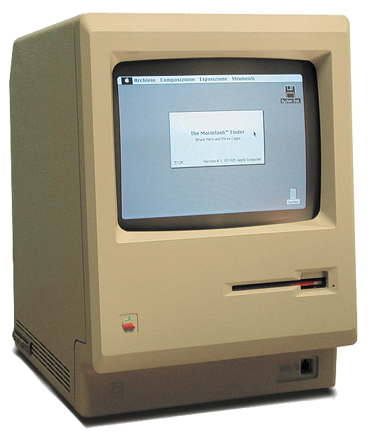
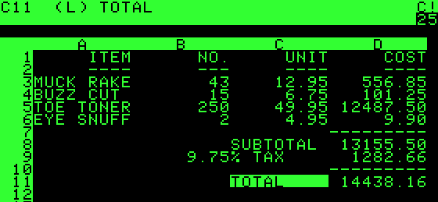

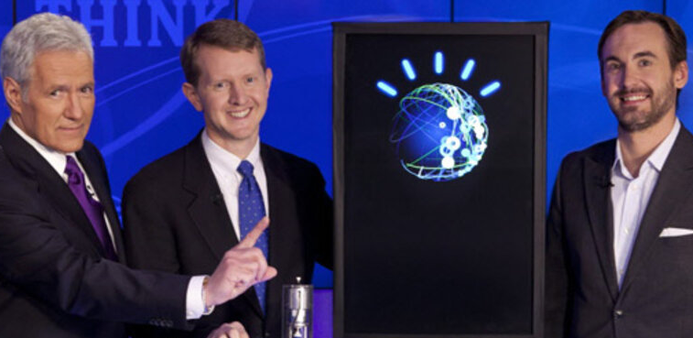
1950
Alan Turing proposes the AI turing test
1956
First AI conference held at Dartmouth
Kurt Gödel poses the P vs. NP problem
MIT builds the TX-0, first transistor-based computer
IBM creates the hard drive
1960
Quicksort algorithm
1965
Moore’s Law
1970
John Conway creates Game of Life
1975
TCP/IP first tested on a network
1981
IBM PC released running
MS-DOS
1985
Microsoft Windows debuts.
Richard Stallman publishes the GNU Manifesto, beginning the free software movement
1990
Tim Berners-Lee creates the WWW
1995
Toy Story, first CGI feature film
Match.com, first major online dating service
Amazon.com launched
2000
CAPTCHA debuts
1961
UNIMATE, first industrial robot installed at GM factory
Spacewar!, first computer game
1966
TI Cal Tech, first handheld calculator
1977
Rivest, Shamir and Adleman release RSA Public Key Encryption system, a core part of Internet security protocols
2001
Wikipedia launched
1971
First email sent across ARPANET
1951
UNIVAC I, 1st commercial electronic computer
1982
Compact disc (CD) becomes available
1991
Linus Torvalds releases the
Linux kernel
2004
Mark Z. releases thefacebook
1967
Patent filed for first mouse
1972
Atari releases Pong
1955
1960
1965
1970
1975
1980
1985
1990
1995
2000
1951
Adm. Grace Murray Hopper creates A-O, considered the first programming language compiler
1957
John Backus creates FORTRAN, first high-level prog. language
1963
ASCII published
1969
ARPANET, precursor to the Internet, links several universities and DOD
Thompson & Ritchie develop UNIX and C at Bell Labs
Apollo 11 moon landing guidance software created by Margaret Hamilton’s team at MIT
1978
Intel 8086 released, first of the x86 processor family
1983
Bjorn Stroustrup creates
C++, a dominant object-oriented language
1988
Robert Morris cripples the Internet with a computer worm and is the first person convicted under the Computer Fraud and Abuse Act
1993
GPS enabled through 24 satellites
2005
YouTube launched
1973
Xerox PARC: 1.Altos: first GUI computer w/ mouse
2. Ethernet protocol
1997
IBM’s Deep Blue defeats chess champion Garry Kasparov
2007
Apple
iPhone released
1964
BASIC prog. language created at Dartmouth
1974
Barbara Liskov develops CLU, early OO language
1958
John McCarthy proposes LISP and functional languages
2011
IBM’s Watson computer defeats all-time human champions Ken Jennings and Brad Rutter on Jeopardy
1979
VisiCalc released, first personal spreadsheet, “killer app” for Apple II sales
1994
Quantum computing becomes an active field of research once Peter Shor’s prime factors algorithm is published
1984
Apple McIntosh released, first consumer PC with mouse & windowing interface
1998
Google founded

Slide 2
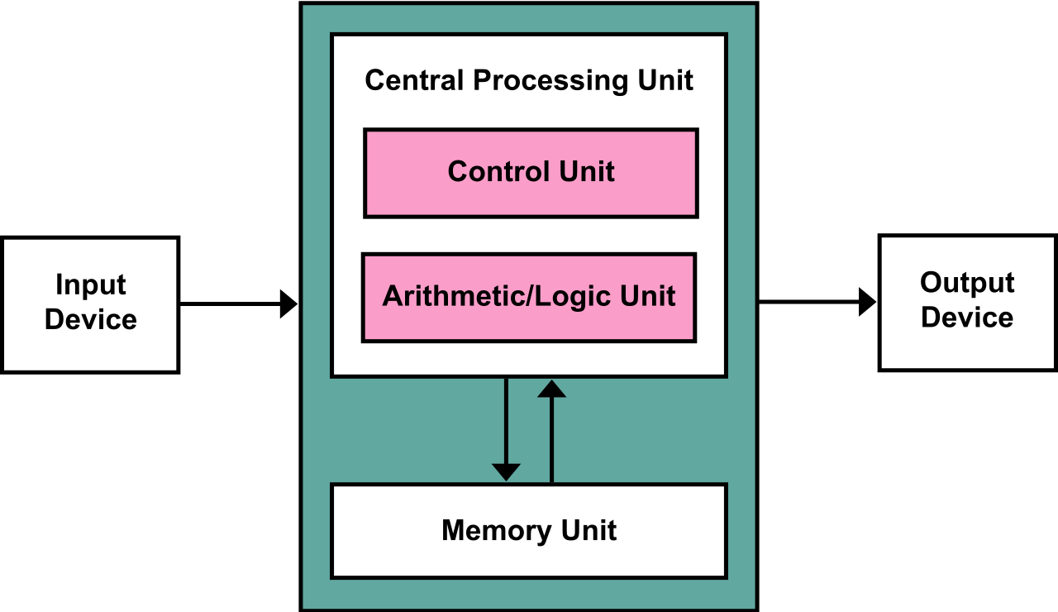
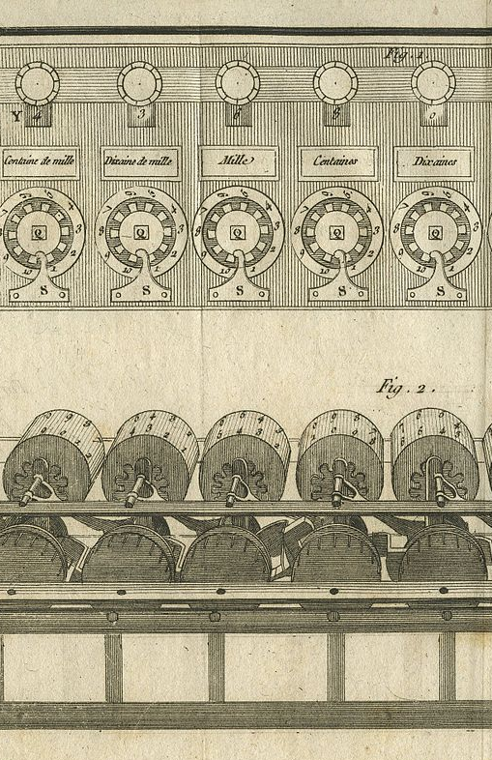
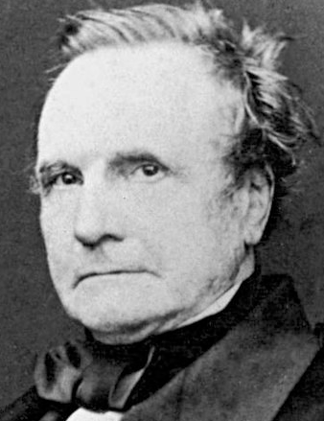
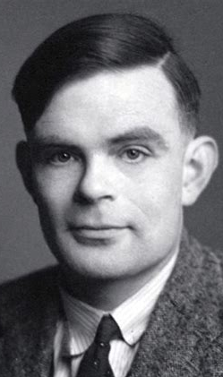
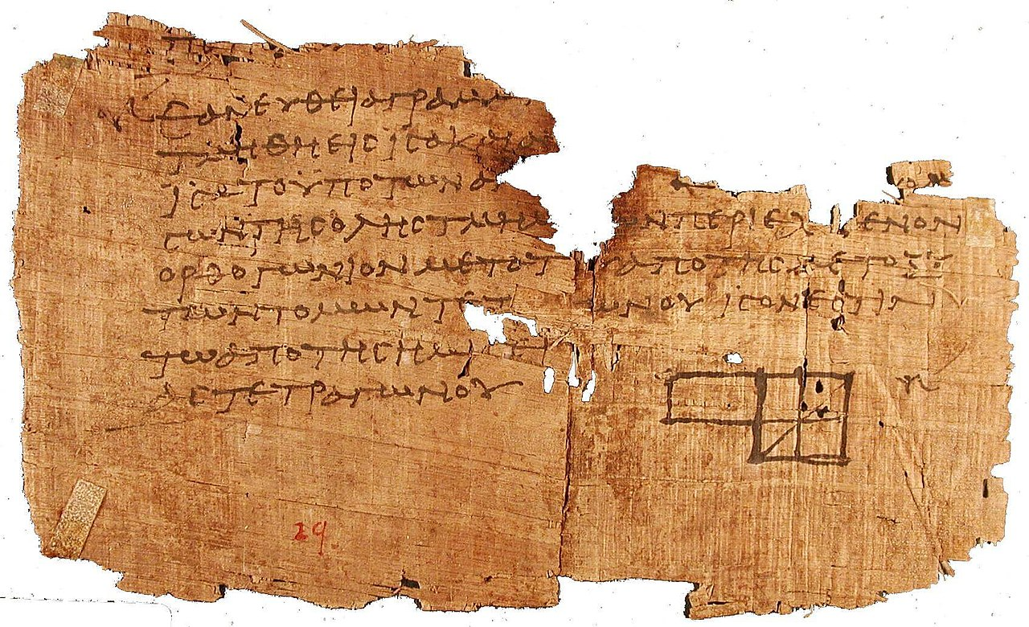
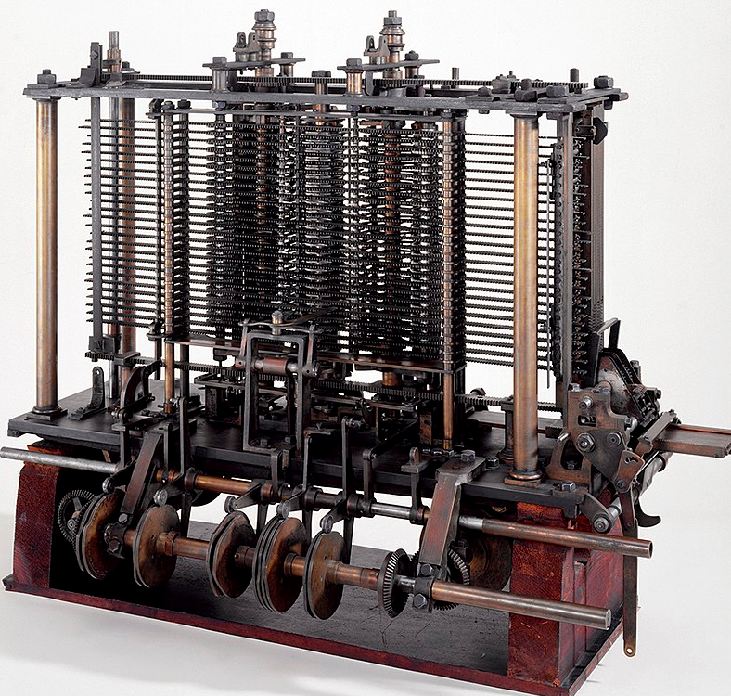
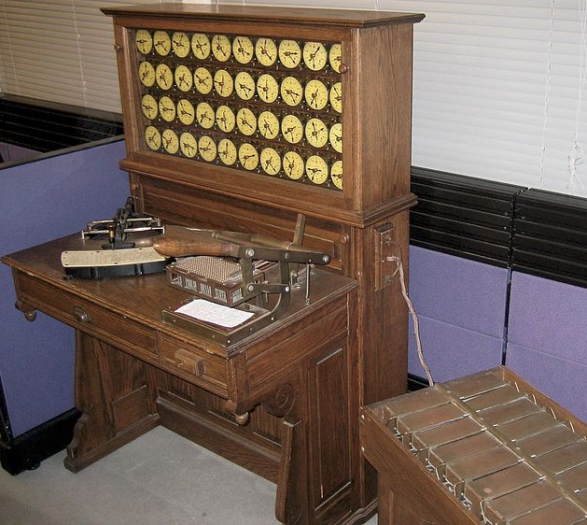
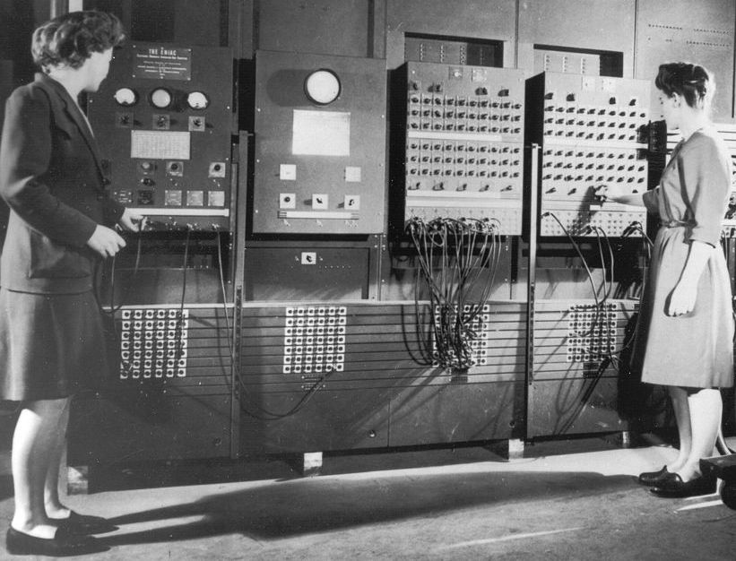
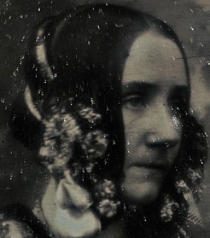
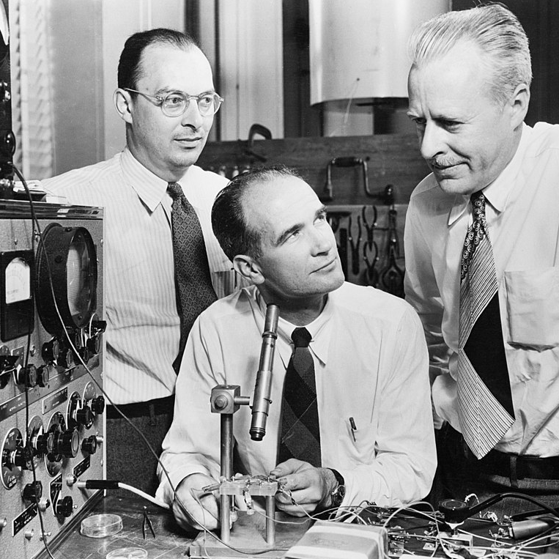
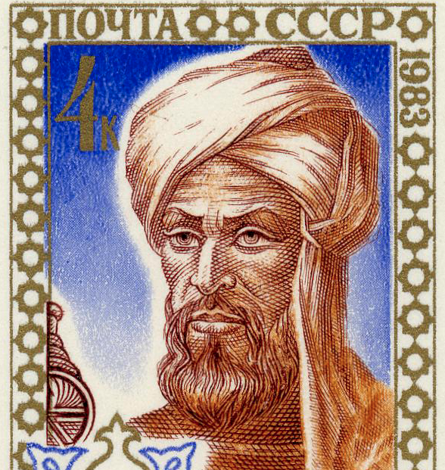
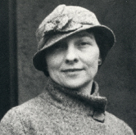
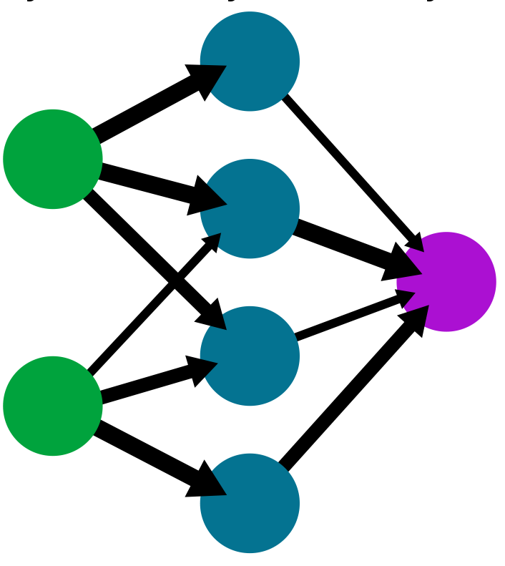
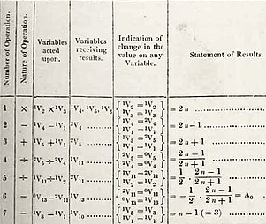
1837
Charles Babbage describes the Analytical Engine, a mechanical, Turing-complete, computer
1936
Alan Turing published “On computable numbers,” considered the founding document of computer science, defining a universal Turing machine
1940
Alan Turing builds computer to break the German Enigma code, helping the Allies win WWII
1945
John von Neumann designs the architecture for a stored memory computer
Vannevar Bush predicts a global hypertext information network
1642
Blaise Pascal builds a mechanical calculator for addition and subtraction
300 BCE
Euclid’s Elements describes nontrivial algorithms (for problems such as Greatest Common Divisor) that are still used today
1890
Herman Hollerith builds first tabulating machine – it uses punched cards; US gov’t buys it to complete the census
BCE CE
1600
1800
1935
1940
1945
825
Muhammad ibn Musa al-Khwarizmi writes “On the Calcula-tion with Hindu Numerals,” the work primarily responsible for spreading decimal notation in the West. The word “algorithm” will be named for al-Khwarizmi
1842
Ada Lovelace writes the first computer program, to calculate Bernoulli numbers; no computer exists (yet) to run it
1915
Elizebeth Smith Friedman, “America’s first female cryptanalyst,” begins work for the US Navy during WW I, she develops techniques still in use today
1942
Issac Asimov’s Three Laws of Robotics
1946
ENIAC completed
1943
McCulloch and Pitts propose neural networks and finite automata
1947
Transistor invented at Bell Labs
1948
The word ‘bit’ is coined

Slide 3
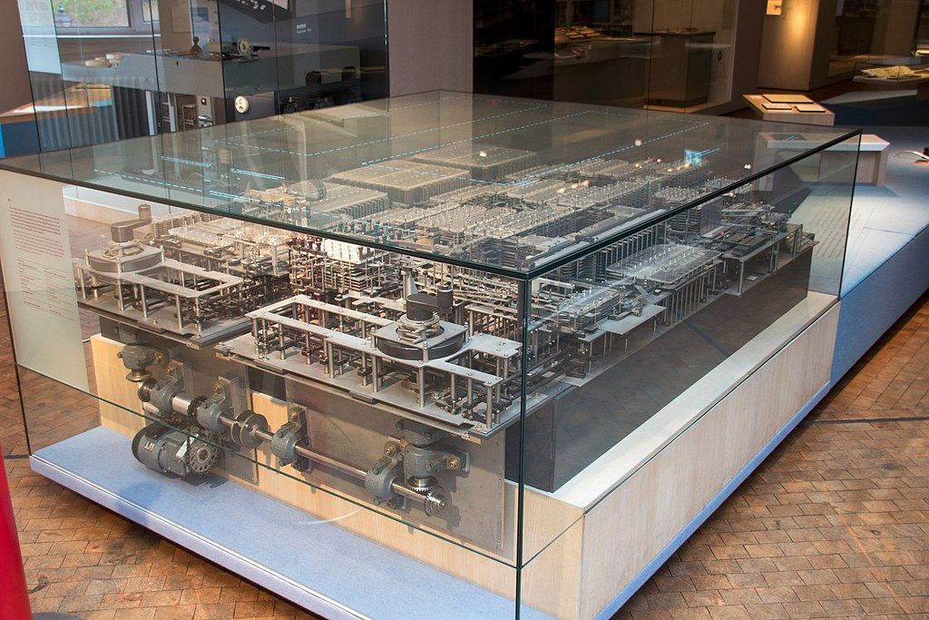
1950
Alan Turing proposes the AI turing test
1956
First AI conference held at Dartmouth
Kurt Gödel poses the P vs. NP problem
MIT builds the TX-0, first transistor-based computer
IBM creates the hard drive
1960
Quicksort algorithm
1965
Moore’s Law
1970
John Conway creates Game of Life
1975
TCP/IP first tested on a network
1981
IBM PC released running
MS-DOS
1985
Microsoft Windows debuts.
Richard Stallman publishes the GNU Manifesto, beginning the free software movement
1936
Alan Turing published “On computable numbers,” considered the founding document of computer science, defining a universal Turing machine
1940
Alan Turing builds computer to break the German Enigma code, helping the Allies win WWII
1945
John von Neumann designs the architecture for a stored memory computer
Vannevar Bush predicts a global hypertext information network
1961
UNIMATE, first industrial robot installed at GM factory
Spacewar!, first computer game
1966
TI Cal Tech, first handheld calculator
1977
Rivest, Shamir and Adleman release RSA Public Key Encryption system, a core part of Internet security protocols
1971
First email sent across ARPANET
1951
UNIVAC I, 1st commercial electronic computer
1982
Compact disc (CD) becomes available
1967
Patent filed for first mouse
1972
Atari releases Pong
1955
1960
1965
1970
1975
1980
1985
1935
1940
1945
1951
Adm. Grace Murray Hopper creates A-O, considered the first first programming language compiler
1957
John Backus creates FORTRAN, first high-level prog. language
1963
ASCII published
1969
ARPANET, precursor to the Internet, links several universities and DOD
Thompson & Ritchie develop UNIX and C at Bell Labs
Apollo 11 moon landing guidance software created by Margaret Hamilton’s team at MIT
1973
Xerox PARC: 1.Altos: first GUI computer w/ mouse
2. Ethernet protocol
1978
Intel 8086 released, first of the x86 processor family
1983
Bjorn Stroustrup creates
C++, a dominant Object-Oriented language
1988
Robert Morris cripples the Internet with a computer worm and is the first person convicted under the Computer Fraud and Abuse Act
1936
Konrad Zuse builds the Z1, the first working electro-mechanical stored-program computer
1942
Issac Asimov’s Three Laws of Robotics
1946
ENIAC completed
1943
McCulloch and Pitts propose neural networks and finite automata
1964
BASIC prog. language created at Dartmouth
1974
Barbara Liskov develops CLU, early OO language
1947
Transistor invented at Bell Labs
1958
John McCarthy proposes LISP and functional languages
1979
VisiCalc released, first personal spreadsheet, “killer app” for Apple II sales
1984
Apple McIntosh released, first consumer PC with mouse & windowing interface
1948
The word ‘bit’ is coined

Slide 4
CS through History
A brief timeline
1872
Victoria Claflin Woodhull first female candidate US president
Susan B. Anthony casts vote, convicted of "unlawful voting.”
1988
Robert Morris cripples the Internet with a computer worm and is the first person convicted under the Computer Fraud and Abuse Act
1981
IBM PC released running
MS-DOS
1985
Microsoft Windows debuts.
Richard Stallman publishes the GNU Manifesto, beginning the free software movement
1990
Tim Berners-Lee creates the WWW
1995
Toy Story, first CGI feature film
Match.com, first major online dating service
Amazon.com launched
2000
CAPTCHA debuts
2001
Wikipedia launched
1777
All states pass laws which take away women’s right to vote.
1839
The first state (Mississippi) grants women the right to hold property in their own name, with their husbands’ permission.
1991
Linus Torvalds releases the
Linux kernel
1982
Compact disc (CD) becomes available
2004
Mark Z. releases thefacebook
Female federal employees guaranteed equal pay for equal work
1775
1800
1825
1850
1975
1980
1985
1990
1995
2000
1769
American colonies based their laws on the English common law, summarized in the Blackstone Commentaries. It said, “By marriage, the husband and wife are one person in the law? The very being and legal existence of the woman is suspended during the marriage”
1848
At Seneca Falls, New York, 300 women and men sign the Declaration of Sentiments, a plea for the end of discrimination against women in all spheres of society.
1983
Bjorn Stroustrup creates
C++, a dominant Object-Oriented language
1988
Robert Morris cripples the Internet with a computer worm and is the first person convicted under the Computer Fraud and Abuse Act
1993
GPS online
2005
YouTube launched
1997
IBM’s Deep Blue defeats chess champion Garry Kasparov
2007
Apple
iPhone release.
1866
The 14th Amendment is passed by Congress, with "citizens" and "voters" defined as "male" in the Constitution.
1994
Quantum computing becomes an active field of research once Peter Shor’s prime factors algorithm is published
2011
IBM’s Watson computer defeats all-time human champions Ken Jennings and Brad Rutter on Jeopardy
1984
Apple McIntosh released, first consumer PC with mouse & windowing interface
1998
Google founded

