Slide 1
Grantor Retained
Interest Trusts
GRATs & GRUTs — Planning Insights & Modeling
Simone · Dave · Sean | Chapter 29

Slide 2
What is a Grantor Retained Interest Trust?
GRAT
GRUT
Grantor Retained Annuity Trust
Grantor Retained Unitrust
Fixed annuity
Grantor receives same $ amount each year
Growth above IRS 7520 rate passes tax-free
Best for: high-growth assets, low-rate environments
Percentage-based payout (% of trust value annually)
Payout fluctuates with asset value
Harder to benefit in declining markets
Better suited for stable, income-producing assets
Both pass excess growth to heirs gift-tax free · IRC §2702

Slide 3
Important for Clients
Advantages
Risks
Flexibility
Assets can be exchanged
Removes high-growth assets from estate
Flexible payment options
Payments don't have to be the same each year
Income tax benefits
Grantor pays income tax — assets grow tax-free inside trust
Mortality Risk
If client dies before term ends, assets may be pulled back into estate
No Asset Appreciation
If assets don't grow past hurdle rate, trust simply returns them
Legislative Change
Estate law changes could reduce or eliminate advantages

Slide 4
Important for Advisors / Planners
Valuation Challenges — Closely Held or Hard-to-Value Stock
IRS valuation disputes can diminish benefits via gift tax implications, penalties, and interest
Work closely with a qualified appraiser before transferring illiquid or closely held interests
Trust Drafting — IRC §2702 Compliance
Trust must be carefully drafted — grantor relinquishes control of assets
Any structural error can trigger §2702 penalties and collapse the gift tax advantage

Slide 5
Implementing GRATs & GRUTs in Practice
Client Selection
Hurdle Rate & Timing
Rolling GRAT Strategy
High-net-worth clients with taxable estate
Assets expected to significantly appreciate
Good health / long life expectancy
Liquidity to receive annuity payments
IRS §7520 rate sets the hurdle
Assets must grow above hurdle for benefit
Low-rate environments = greater GRAT benefit
Monitor rate monthly for optimal timing
Seed new GRAT each year ('rolling')
Failed GRATs just return principal — no downside
Winning GRATs lock in gains estate-tax free
Used widely in tech IPO planning

Slide 6
Real-World GRAT Use Cases
$37B+
~0%
3–20 yrs
Estimated value transferred via
GRATs by Zuckerberg pre-IPO
Gift tax paid on gains
that exceed the hurdle rate
Typical GRAT term
for estate planning
Tech Founder / IPO Planning
Rolling GRAT — Heads I Win, Tails I Tie
Pre-IPO shares placed in GRAT at low valuation
IPO-driven appreciation passes to heirs gift-tax free
Widely used by tech billionaires to transfer wealth during company growth
New short-term GRAT created each year
If market rises: gains locked in estate-tax free
If market falls: principal returned, no gift tax cost
Compound many winning years across rolling series

Slide 7
GRAT
Modeling
10-Year Grantor Retained Annuity Trust Analysis

Slide 8
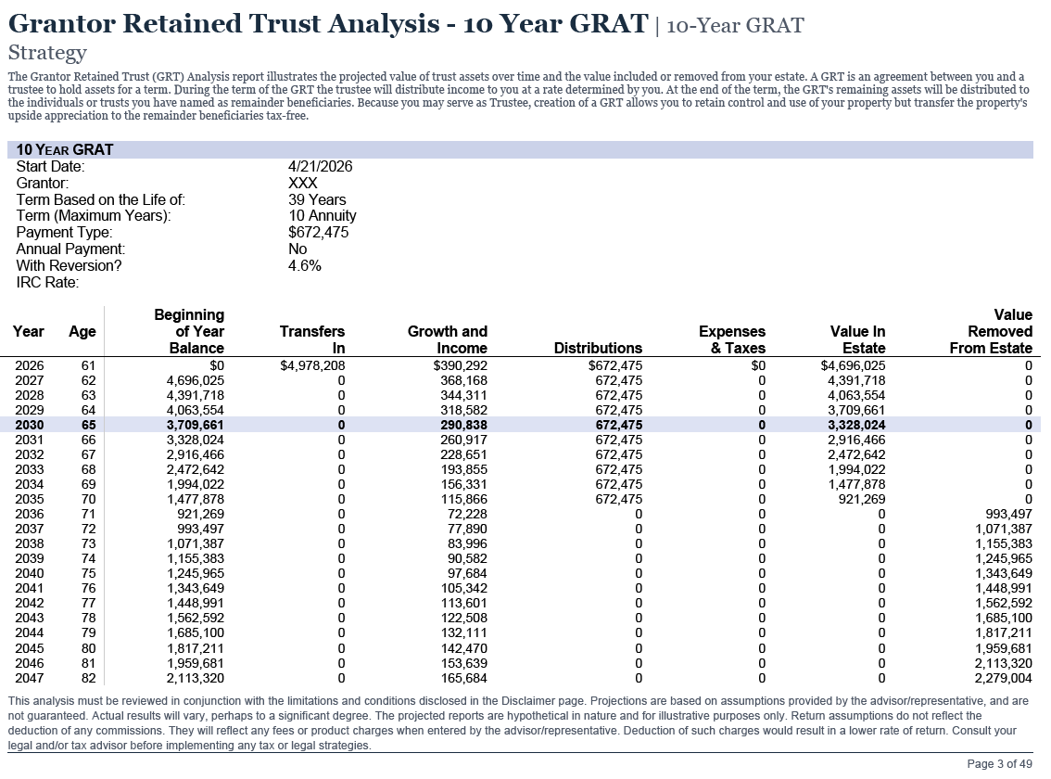
GRAT Analysis — 10-Year Model

Slide 9
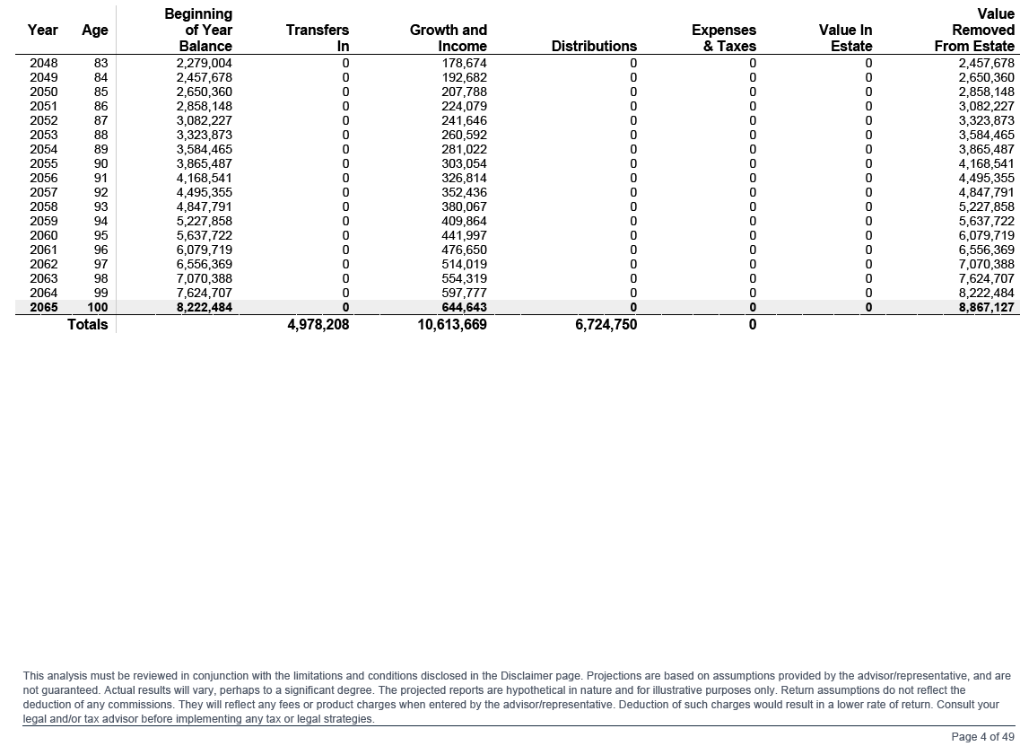
GRAT Summary Table

Slide 10
GRUT
Modeling
10-Year Grantor Retained Unitrust Analysis

Slide 11
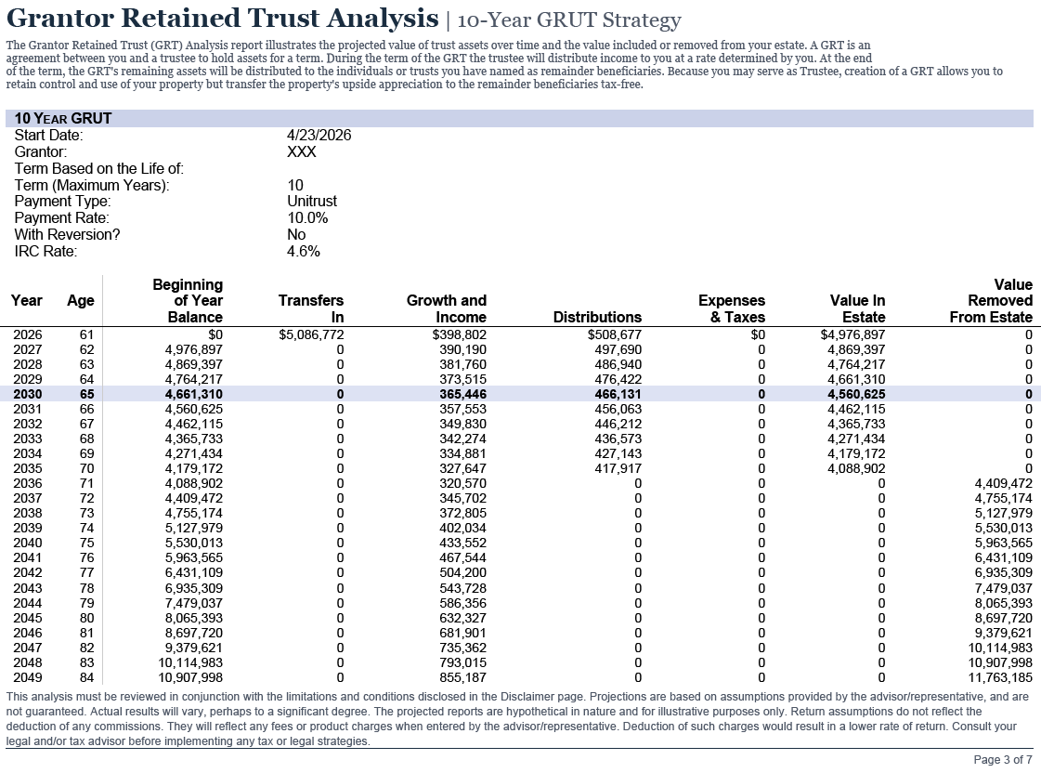
GRUT Analysis — 10-Year Model

Slide 12
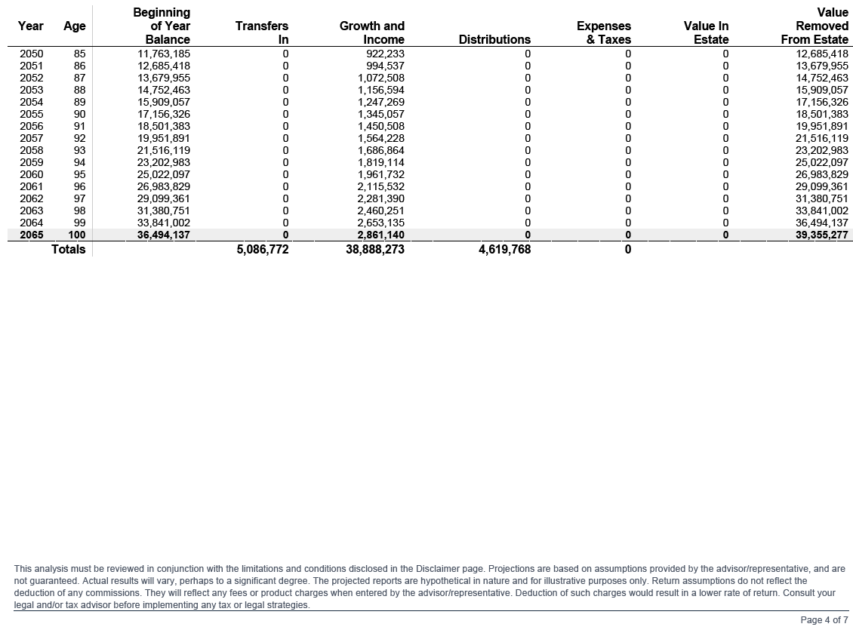
GRUT Summary Table

Slide 13
Discussion
As interest rates rise, how should planners adjust GRAT strategy — and at what point does a GRUT become the stronger tool?
Which clients in your practice might benefit most from a GRAT right now?
How would you explain the mortality risk tradeoff to a client who is hesitant?
Would a rolling GRAT strategy make sense for a client with concentrated equity positions?
Simone · Dave · Sean

