Slide 1

What’s important this week

Slide 2
TOP PERFORMERS
[Fill in before Monday meeting] 1. [Agent Name] — [Achievement] 2. [Agent Name] — [Achievement] 3. [Agent Name] — [Achievement] Weekly Production: $[Amount] Life Cases: [#] Bonus Eligible: [#] agents Council Credits: $[Amount]

Slide 3
MARKET WEEK OVERVIEW Week Ended: July 2, 2026
• Dow Jones: 52,900.07 (+1.14% for week) • S&P 500: 7,483.24 (Flat for week) • Nasdaq Composite: 25,832.67 (-0.80% for week) • Russell 2000: 2,996.11 (-0.55% for week) Key Themes: → Record Dow divergence from tech weakness → June jobs show labor market cooling → Fed remains patient on rates → Oil stabilizes around $68/barrel

Slide 4
KEY ECONOMIC DATA
June Jobs Report (Released July 3): • Nonfarm Payrolls: +150K (est. +190K) • Unemployment Rate: 4.0% (est. 4.0%) • Avg Hourly Earnings: +0.2% MoM Other Data Points: • ISM Manufacturing: 48.7 (contraction) • Consumer Confidence: 100.2 (steady) • PCE Inflation: +2.6% YoY (Fed's target) Takeaway: Labor market softening, inflation progress continues

Slide 5
NOTABLE EARNINGS
This Week's Standouts: • Tesla (TSLA): -12% on delivery miss Q2 deliveries: 438K vs est. 445K • Lockheed Martin (LMT): +8% on defense demand Backlog hits record $161B • Constellation Brands (STZ): +5% on beer strength Modelo continues market share gains • Micron (MU): -4% on memory price concerns

Slide 6
ECONOMIC CALENDAR Week of July 6-10, 2026
Monday, July 6: • ISM Services Index: 10:00 AM ET • Markets reopen after holiday Tuesday, July 7: • JOLTS Job Openings: 10:00 AM ET • Fed's Bowman speaks: 12:30 PM ET Wednesday, July 8: • Consumer Credit: 3:00 PM ET Thursday, July 9: • Initial Jobless Claims: 8:30 AM ET Friday, July 10: • PPI Final Demand: 8:30 AM ET • Consumer Sentiment: 10:00 AM ET

Slide 7
EARNINGS CALENDAR Week of July 6-10, 2026
Tuesday, July 7: • PepsiCo (PEP): Before market open • JPMorgan Chase (JPM): Before market open Wednesday, July 8: • Citigroup (C): Before market open • Wells Fargo (WFC): Before market open • Delta Air Lines (DAL): Before market open Thursday, July 9: • UnitedHealth (UNH): Before market open • BlackRock (BLK): Before market open Focus: Bank earnings for consumer health signals

Slide 8
FED, RATES & MACRO WATCH
Current State: • Fed remains 'data dependent' • No immediate rate cuts expected • PCE inflation at 2.6% (Fed's target) • Higher rates = fixed annuity opportunity Market Levels: • 10Y Treasury yield: 4.32% • Mortgage rates: ~6.5% • Dollar index: 104.5 (moderately strong) NYLIM View: Diversification across asset classes remains key

Slide 9
CLIENT TALKING POINTS
For client conversations this week: 1. 'The Dow hit a record high while tech stocks cooled off. That's market rotation, not a market problem.' 2. 'The Fed is being patient with rates. Higher rates still make guaranteed income products worth a serious look.' 3. 'This is a good time to check if your plan is on track. We review, we adjust if needed, but we stick to the plan.' 4. 'Remember: The plan is the point. We don't make long-term decisions based on one week's headlines.'

Slide 10
New Org: What’s important week of July 6
Notes:
New Org Section: For SPs and Partners presenting to New Org agents. These slides are visible to EPs and MPs.

Slide 11

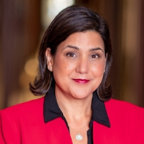
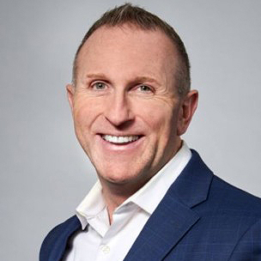
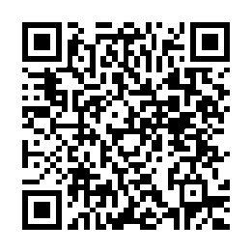
Start 3Q with timely reasons to connect
A national PLAN webinar for a solid Council start
Featured speakers:
Date: Wednesday, July 8, 2026
Time: 3 pm ET*
Build momentum early in the third quarter with practical strategies, timely updates and resources you can use to support meaningful client conversations.
Timely information to support client outreach
Strategies and resources to help build 3Q activity
Latest DCA updates for client conversations
DCA strategies and language from an expert DCA agent
Sonali Virendra
Senior Vice President and
Head of Agency
Daryl Havrish
Executive Council
Chicago North Shore GO
Register today
Scan the QR code to reserve your spot.
*2 pm CT, 1 pm MT, 12 pm PT, 11 am Alaska, 9 am Hawaii
Notes:
Start 3Q with Timely Reasons to Connect
This national PLAN webinar is designed to help agents build momentum early in the third quarter through purposeful activity and relevant reasons to connect with clients. Attendees will gain practical strategies, timely updates and valuable resources that can support client outreach and meaningful conversations.
The session will highlight ideas for identifying opportunities, increasing 3Q activity, important DCA updates and positioning strategies, and leveraging available resources in client discussions. Agents will also receive important updates and actionable next steps to help maintain momentum and support a strong start to the quarter.
Contact: PLAN@newyorklife.com
Registration link: https://nylife.zoom.us/webinar/register/WN_orBUFdlRQqCo8q-UoIxNBA

Slide 12


NEW ORG AGENTS
Tier 1
July Growth Bonus
Initial Bonus Level
Bonus
$250
Pay for 3 life cases in the month of July.
Qualify for a cash bonus based on paid life cases in the month of July¹.
Tier 2
Double Your Bonus
Includes
Life (EWL 3:1)
Double
$500
Grow by 1 life case over July 2025, with a minimum of 5 life cases to double your bonus.
Excludes
VUL/MWP
COLI/BOLI
Policies issued in New York State
New York State Provision: Agents who meet the qualifications with paid life cases issued in New York State will receive bonus Council Credits in lieu of a cash bonus.
¹Agents eligible to enroll in the Life and Annuity Expense Allowance Program must enroll by July 31, 2026, to receive a cash bonus.
Pending NYS Dept. of Financial Services approval.
Notes:
Contact: PLAN@newyorklife.com
Info Central Page: https://www.today.newyorklife.com/agencyportal/s/article/July-Growth-Bonus

Slide 13

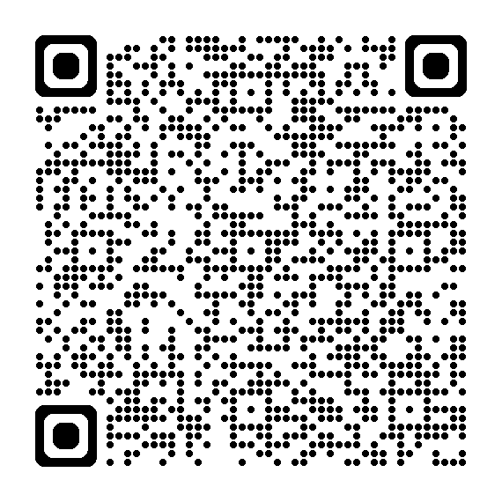
Executive Council Rocky Mountain Crocs™ Giveaway Experience
COUNCIL PERKS
Exclusive Denver giveaway for top-performing Executive Council agents
Be among the top 200 agents on the paid insurance solution cases¹ leaderboard and qualify for an exclusive invitation to the Executive Council Rocky Mountain Crocs™ Giveaway Experience at the Executive Council Meeting on Tuesday, August 25.
Highlights
Qualification period: July 1 – August 14
Open to 2026 Executive Council qualifiers
Rank in the top 200 on the paid insurance solution cases¹ leaderboard
Must attend 2026 Executive Council meeting to receive prize
Registered guests may attend
Choose a complimentary Crocs bag adorned with a custom NYL JibbitzTM charm. Personalize it with your choice of two additional charms!
Scan the QR code for complete rules, requirements, qualifying products, and official incentive details.
Notes:
¹ Includes Life (EWL 3:1) LTCi, and DI. Excludes VUL/Market Wealth Plus, Annuity and COLI/BOLI products, DIOP and Group Insurance cases. LTCi excluded in Delaware State.
=============================================================
Executive Council Rocky Mountain Crocs™ Giveaway Experience – Open to 2026 Executive Council agent qualifiers.
Compete with your Executive Council peers from July 1 through August 14.
Agents who finish in the top 200 on the paid insurance solution cases leaderboard will qualify for an exclusive invitation for themselves and their registered guests to the Rocky Mountain Crocs Giveaway Experience at the Executive Council Meeting on Tuesday, August 25 in Denver, Colorado
Incentive-eligible solutions Include: Life (EWL 3:1) LTCi, and DI cases paid between July 1 and August 14.
Excludes: annuities, VUL/Market Wealth Plus and DIOP. LTCi excluded in Delaware State.
The experience encompasses your choice of one complimentary Crocs bag, either a tote or backpack, a custom New York Life Jibbitz charm, and two additional charms selected from the Jibbitz Bar. Registered guest are invited to participate in the experience.
Qualifying agents must attend the Executive Council Meeting to patriciate.
Contact: PLAN@newyorklife.com
Info Central Page: https://www.today.newyorklife.com/agencyportal/s/article/Council-Perks-Executive-Council-Rocky-Mountain-Crocs-Giveaway-Experience

Slide 14
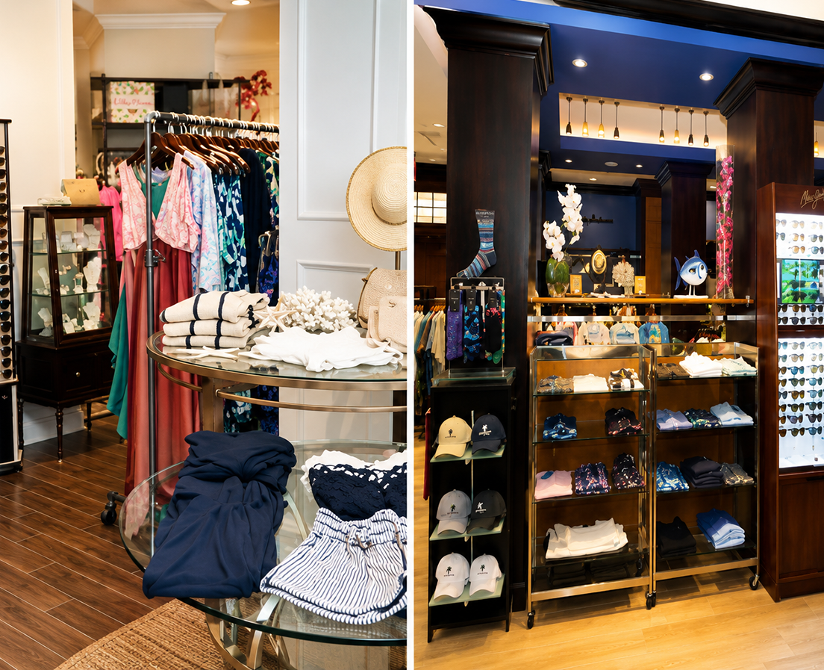
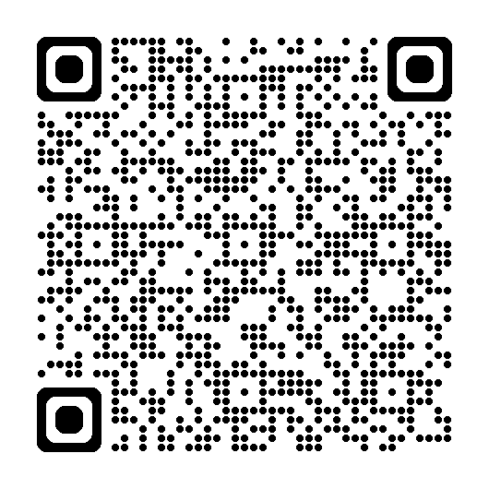
President's Council Beachfront Boutique Experience
COUNCIL PERKS
Private shopping event for top-performing President's Council agents
Be among the top 100 President's Council agents on the 3Q paid insurance solution premium¹ leaderboard and qualify to receive a retail credit² to spend at a private New York Life shopping event at the President’s Council meeting on October 6 and 7. Top 10 will also qualify for a Balinese-inspired premium chickee hut rental on October 7!
Highlights
Qualification period: July 1 – September 30
Open to 2026 President's Council qualifiers
Rank in the top 100 on the paid insurance solution premium¹ leaderboard
Must attend 2026 President's Council meeting to receive prize
Must be prorata proactive by September 30
Registered guests may attend
Top 10 also qualify for a premium Balinese-inspired chickee beach hut rental*
Scan the QR code for complete rules, requirements, qualifying products, and official incentive details.
*Pending NYS Dept. of Financial Services approval.
Notes:
¹ Includes Life, LTCi, and DI. Recurring base premium and riders are calculated at 100%; OPP and single premium policies are calculated at 10%. Excludes premium from Annuity and COLI/BOLI products, DIOP and Group Insurance cases and LTC in DE state.
² $300 retail credit
====================================================
President's Council Beachfront Boutique Experience – Open to 2026 President’s Council agent qualifiers
Compete with your President’s Council peers during the Third Quarter of 2026 (July 1 – September 30)
Agents who finish in the 100 on the 3Q paid insurance solution premium leaderboard will qualify to receive a retail credit to spend at a private New York Life shopping event at the President’s Council meeting on October 6 & 7.
The top 10 will also qualify for a premium chickee hut rental on October 7!
Includes Life, LTCi, and DI. Recurring base premium and riders are calculated at 100%; OPP and single premium policies are calculated at 10%
Excludes premium from Annuity and COLI/BOLI products, DIOP and Group Insurance cases and LTC in DE state.
Agents must be prorata proactive by September 30.
The experience encompasses an elevated retail shopping event with a $300 retail credit, complete with refreshments and private access to the resort's premier ladies and gentlemen’s boutiques, Sweet Waters and Cross Winds. Browse stylish women's apparel, swimwear, and accessories from brands such as Lilly Pulitzer®, lululemon®, Versace®, and Gucci®, or explore the latest men's fashion and accessories from designers including BUGATCHI®, Tommy Bahama®, Maui Jim®, Ray-Ban®, and lululemon®. Personal shoppers will also be available to help agents make the most of their experience.
The top 10 leaderboard agents will also qualify for a premium chickee hut rental on the JW Marriott’s breathtaking beach on Wednesday, October 7. This Balinese-inspired shaded retreat accommodates up to six guests and is ideally located between the beach and pool. Rental includes a queen daybed, chairs, and towel service.
Qualifying agents must attend the President’s Council Meeting to receive the retail credit and chickee hut rental.
Contact: PLAN@newyorklife.com
Info Central Page: https://www.today.newyorklife.com/agencyportal/s/article/Council-Perks-President-s-Council-Beachfront-Boutique-Experience

Slide 15
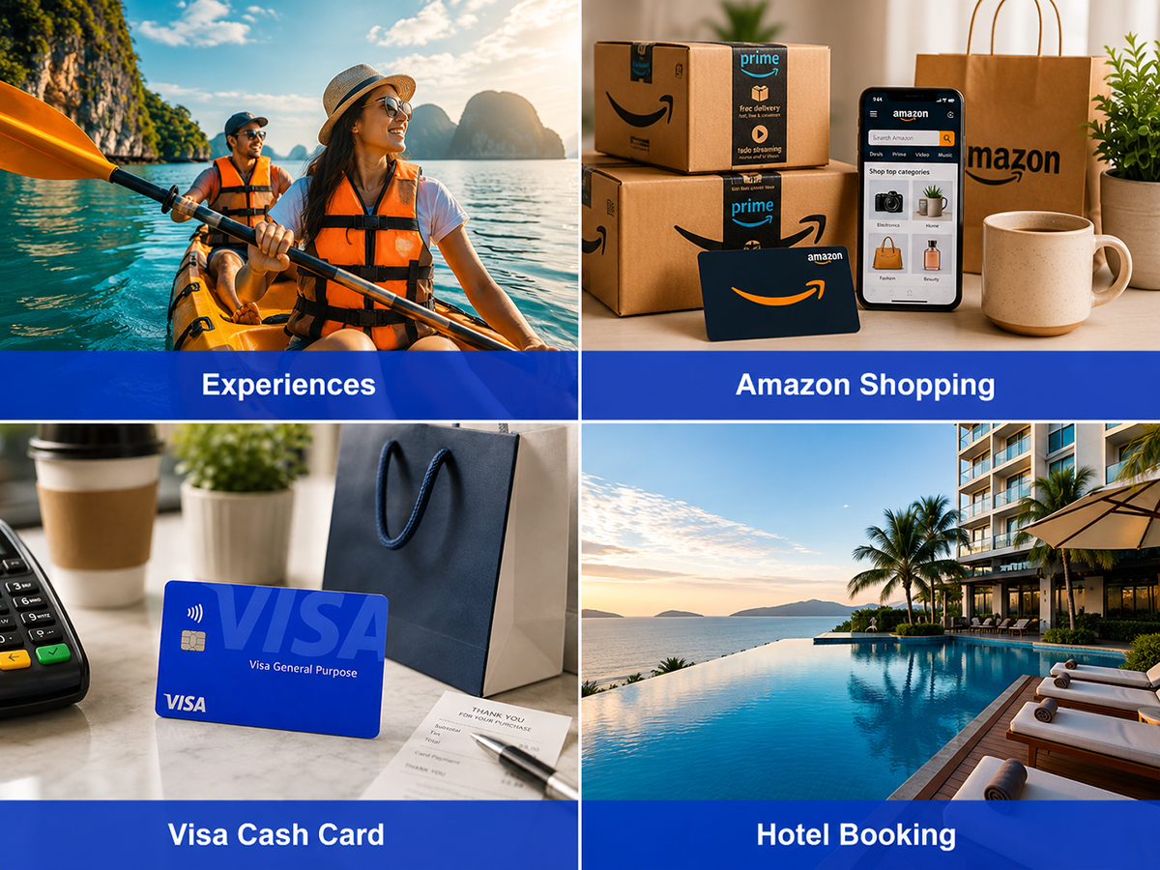
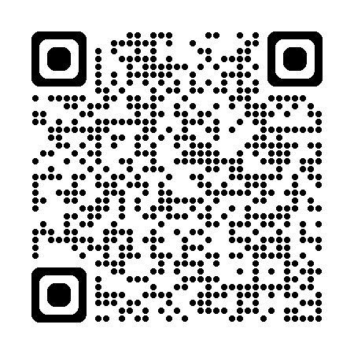
Awards Your Way
A new choice-based incentive program for Council agents
Open to 2026 Council agents (QC & higher)¹
Qualification period: July 1 – December 31, 2026
A digital rewards marketplace where agents choose from travel, merchandise, gift cards, tickets, and experiences.
Points are awarded through insurance production, growth and designations.
Agents must opt in by September 30, 2026.
Scan the QR code to learn more about the new Awards Your Way recognition program on Info Central.
¹Agents eligible to enroll in the Life and Annuity Expense Allowance Program must enroll by July 31, 2026.
Pending NYS Dept. of Financial Services approval.
15
Notes:
Contact: PLAN@newyorklife.com
Info Central Page: https://www.today.newyorklife.com/agencyportal/s/article/Awards-Your-Way

Slide 16


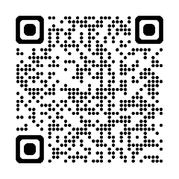

EWL Momentum Maker continues through July 31
Qualify for up to $3,000 for Employee’s Whole Life (EWL) new group activity!
Agents will receive a $600 credit for each EWL group that receives an arrangement number between May 1 and July 31, capped at 5 new groups
Dormant SI groups that convert to GI between May 1 – July 31, 2026, will be eligible
Group credit is awarded to the primary agent of record
Only groups that enroll and meet EWL application strength requirements by 9/30/26 will contribute to an agent’s EWL new group count
Growth Requirements Based on EWL new group activity during the prior-year period (May 1 – July 31, 2025)
0 new groups: Must establish a minimum of 2 new groups
1–4 new groups: Must establish at least 1 additional group
5+ new groups: Must establish 5 new groups during the incentive period
Requirements
Must be enrolled in EAP by 5/31/26
Bonuses credited via Life & Annuity Expense Allowance Plan (subject to NYS limits)
TAS Agents in AZ, CA, IL, IA, MT, NV, NH, ND, SD may qualify for TAS bonus
Scan the QR code to learn more about the EWL Momentum Maker sales incentive on Info Central.
Notes:
Cash bonuses are credited as part of the L&A Expense Allowance Plan (EAP) and subject to Conditional Check. In some instances, cash bonuses may be withheld when an agent has reached the maximum legal allowance under the Conditional Check formula. For more information, see Life and Annuity Expense Allowance Plan on Info Central.
TAS agents on the Allowance Builder XP TAS Plan in GOs located in AZ, CA, IL, IA, MT, NV, NH, ND, and SD who are not eligible to enroll in EAP may be eligible for a cash bonus as a one-time payment through TAS, subject to TAS limits.
Contact: PLAN@newyorklife.com
Info Central Page: https://www.today.newyorklife.com/agencyportal/s/article/EWL-Momentum-Maker

Slide 17

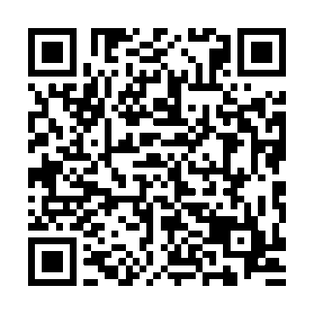
3Q 2026 Registered Rep MasterClass
Session 1 NYLIFE Securities and Mutual Funds July 14
Session 2 Variable Annuities, What You Need to Know July 21
Session 3 Positioning IndexFlex July 28
Session 4 Variable Annuity Riders August 4
Session 5 Working in the Rollover Market August 11
Session 6 Positioning VUL August 18
Session 7 Understanding IRA Opportunities August 25
Session 8 Annuity New Business and Suitability September 1
Session 9 Small Business Solutions September 8
Session 10 Morningstar: Researching Funds September 15
Strengthening the foundation
10-part quarterly series - Tuesdays at 3pm EST
Educates on NYL products
Interactive sessions with product experts
Provides ongoing education
Register today to ensure prompt access to these highly anticipated events.
Events start at 3pm ET and run 60 minutes.
Notes:
3Q 2026 Registered Rep MasterClass
Starting Tuesday July 14 at 3pm EST running for 10 weeks
Contact: PLAN@newyorklife.com
Registration link: https://nylife.zoom.us/webinar/register/WN_Wm0kOIhQTUG-ZypKnrJrVQ#/registration

Slide 18

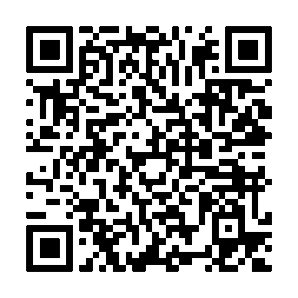
3Q Life Fundamentals Series
Strengthening the foundation for confident life insurance conversations
Life Insurance
7/14 | Session 1 | Term Life Overview and Key Concepts
7/21 | Session 2 | Integrating WL into Planning Guest Speaker: Allen Hensley
7/28 | Session 3 | Whole Life Product Overview & Riders
8/4 | Session 4 | Whole Life Key Sales Concepts: SLIRP, BOWL, & FIR
8/11 | Session 5 | Variable Universal Life Product Overview & Key Concepts
8/18 | Session 6 | Universal Life Product Overview & Key Concepts
8/25 | Session 7 | Universal Life Product Case Study Live Demonstration
7-part quarterly series (Tuesdays)
Educates on NYL life products
Interactive sessions with product experts
Provides ongoing education
Open to agents and managers
Register today to ensure prompt access to these highly anticipated events.
Events start at 1 pm ET* and run for 60 minutes.
*12 pm CT, 11 am MT, 10 am PT, 9 am Alaska, 7 am Hawaii
Notes:
3Q Life Fundamentals Series
The 3Q Life Fundamentals Series is a seven-session program designed to build confidence and strengthen foundational life insurance knowledge. Sessions are held every Tuesday at 1:00 PM ET and cover key product concepts, sales strategies, and practical applications across the life insurance portfolio.
Led by product experts, the series is open to agents and managers looking to expand their product expertise and enhance client conversations. Each session is 60 minutes, and registration is available through the QR code.
Registration link: https://nylife.zoom.us/webinar/register/WN_4__InmH2QIqT5801tAJuKg

Slide 19

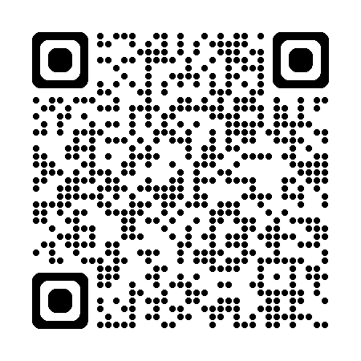
Target Markets Upcoming Webinars
Chinese Market Monthly SIE Study Group Sessions
Monday, July 6, 4 pm ET
Chinese Market will conduct a series of SIE tutorial sessions based on STC study material. All sessions will be conducted primarily in Mandarin Chinese and English.
Scan the QR code to register for Monthly SIE Study Group Sessions
Notes:
Chinese Market Monthly SIE Study Group Sessions
(for New Org, Estab and Second Line Managers)
Chinese Market will conduct a series of SIE tutorial sessions based on STC study material. All sessions will be conducted primarily in Mandarin Chinese and English.
Contact: targetmarkets@newyorklife.com
Register: https://nylife.zoom.us/meeting/register/a4UI1WqPQOKCBm1JCZqQoA
Submitted by: John Macchia

Slide 20
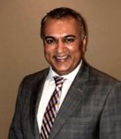
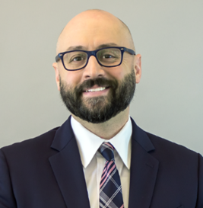
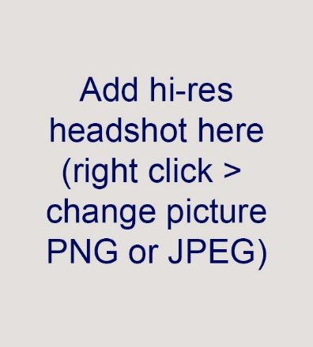
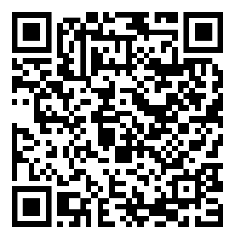
NYLIFE Securities Essentials Webinar
"Introduction to Wealthscape"
Date: Wed., July 15, 2026 Time: 2 pm ET
Featured speakers
Join Product Experts to learn how to navigate Wealthscape's basic features and tools to effectively service your clients' brokerage accounts. Live Q&A included.
Samir Parikh
Investor Relations
NYLIFE Securities
Brian Davis
Product
NYLIFE Securities
Add QR code here
Scan the QR code to register for this event or webinar.
Notes:
NYLIFE Securities Essentials webinar: “Introduction to Wealthscape”
Join Product experts to earn how to navigate Wealthscape's basic features and tools to effectively service your clients’ brokerage accounts.
All agents welcome and webinar replay included.
Wed., July 15th, 2-3pm ET
Register Here:
Contact: anna_m_fidz@newyorklife.com or nylsecproduct@newyorklife.com
SMRU: 8706133.1 One time Use Only.

Slide 21
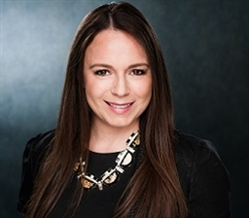
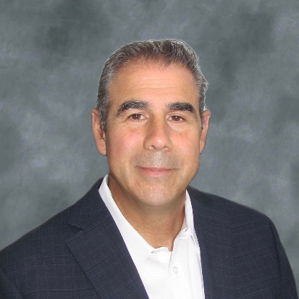
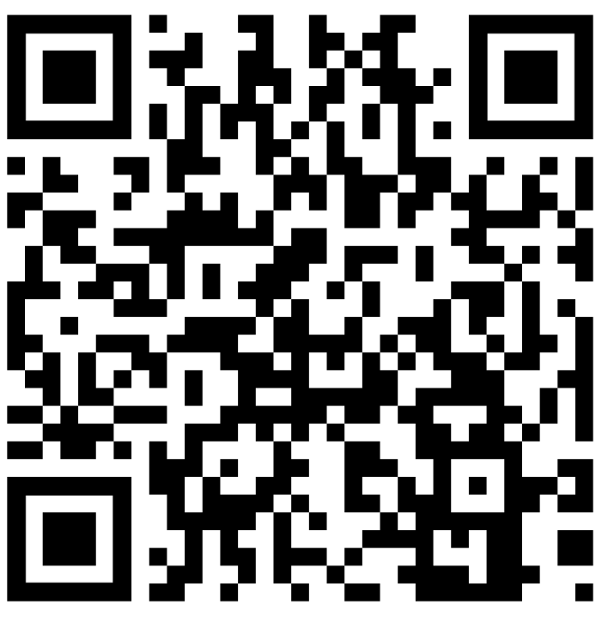
Join us July 8 for the new agent educational call
How to present solutions and handle objections
Featured speakers
Date: Wednesday, July 8, 2026 Time: 1 pm ET
Learn how to:
present recommendations clearly and concisely
support solutions with data and examples
listen carefully to objections
respond with confidence and professionalism
focus on solutions, not challenges
Lyndsey Jackson, MBA
RICP®, ChFC®, CLU®, CLTC® Senior Associate
National Development Faculty​
Nicola (Nick) D’Ambrosio
Registered Representative
Nassau GO
Scan the QR code to register for this event or webinar.
Notes:
Your name and email address 1-2 sentences about the slide. Hyperlinks

Slide 22

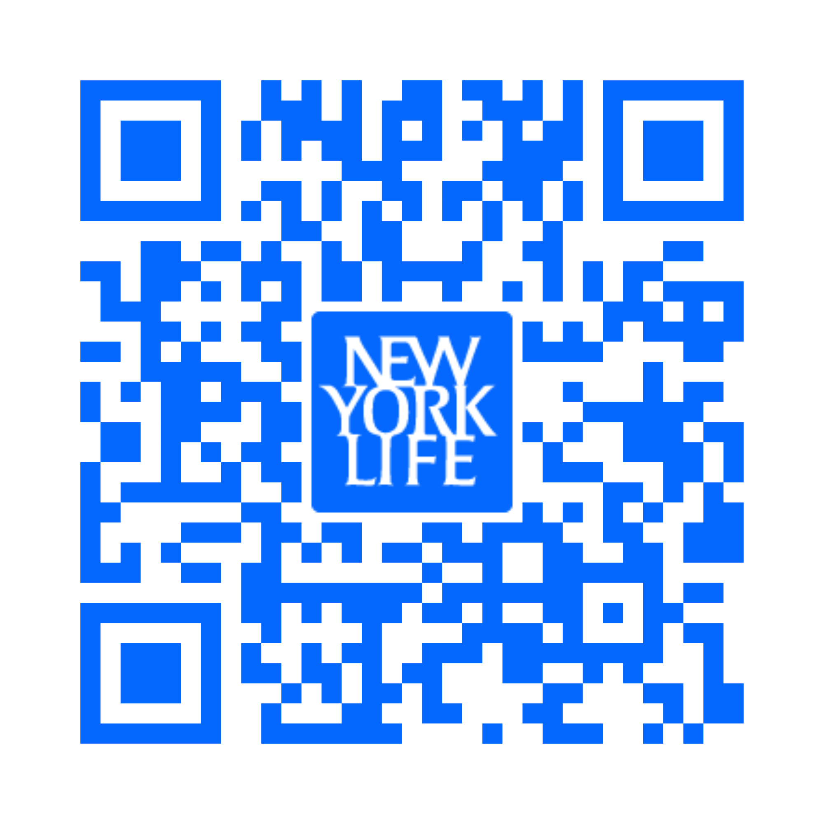
Golden Futures Awards Program
Deadline is July 31, 2026
Use Marketing Central to promote the Golden Future Awards today through July 31st:
Email (ID: 3246498)
Social Post (ID: 3184567)
$100,000 in awards available for kids ages 5 through 16 nationwide:
50 $1,000 awards for kids 5-10
50 $1,000 awards for kids 11-16
Scan the QR code for more details on Info Central.
Notes:
Contact: Debbie Gassaway debra_Gassaway@newyorklife.com Message: Last chance to promote the Golden Futures Awards program.
Deadline 7/31/26
Info Central: https://www.today.newyorklife.com/agencyportal/s/sales-and-marketing/marketing-and-branding/local-event-marketing

Slide 24
THIS WEEK'S TRAINING

Slide 25
What is a Center of Influence?
Professionals who: • Have access to people who need financial advice • Already have the trust of their clients or contacts • Can refer business without 'selling' Common COIs for financial advisors: → Attorneys (estate planning, business) → Accountants and CPAs → Real estate agents → Business brokers → Other financial advisors → Doctors and medical professionals → Community leaders

Slide 26
The 5-Step COI Framework
Step 1: IDENTIFY Make a list of 20 potential COIs in your area Step 2: RESEARCH Learn about their business before reaching out Step 3: CONNECT Offer value first (not a pitch) Step 4: NURTURE Build the relationship over 2-3 touchpoints Step 5: ASK Then — and only then — ask for referrals Success Metric: Maintain 10 active COI relationships

Slide 27
Step 1: Identify Your COIs
Where to find potential COIs: • Local bar association — Estate planning attorneys • CPA society — Tax accountants • Real estate agent associations • Business networking groups (Rotary, Lions, etc.) • Chamber of Commerce • LinkedIn searches by industry and location Your Assignment This Week: Write down 20 potential COIs with: • Name • Profession • How you know them (or could be introduced)

Slide 28
Step 2: Research Before Connecting
Before you reach out, learn about them: • Visit their website — What services do they offer? • Check their LinkedIn — What content do they share? • Read their bio — What's their background? • Look for common ground — Same college? Same community? • Find recent news — Did they win an award? Why it matters: 'I read your article about...' stands out from 'Hey, wanna partner up?'

Slide 29
Step 3: Connect with Value
Never lead with a pitch. Lead with value: Option A: Share useful information 'I saw your post about estate planning. I work with clients on similar issues and thought this article might be helpful for your clients.' Option B: Offer a free resource 'We put together a retirement planning guide that your clients might find useful. Happy to drop off a few copies.' Option C: Suggest a meeting 'I'm building relationships with professionals in the area. Would you be open to a 15-minute coffee chat?'

Slide 30
Step 4: Nurture the Relationship
Relationships aren't built in one meeting. Nurture them: • Connect on LinkedIn — Engage with their posts • Send relevant articles — 'Saw this and thought of you' • Invite to events — Webinars, lunch-and-learns • Personal notes — Birthday, holiday cards • Refer business to them — Before you ask for anything Rule: Give 3 times before you ask once. Make referrals to them without expecting anything in return.

Slide 31
Step 5: Ask for Referrals
When to ask: • After a positive interaction • When they've mentioned a client with a need • After you've referred business to them The exact words: 'I've really enjoyed getting to know you. I'm looking to help more [business owners / families / retirees] in the area. Do you know anyone who might benefit from a conversation about [specific need]?' Get two names: 'Who else do you know who might find this helpful? I'd be happy to handle the introduction.'

Slide 32
Common COI Mistakes to Avoid
Mistake #1: Asking too soon → Don't ask for referrals in the first meeting Mistake #2: Being vague → Say exactly who you're looking for Mistake #3: Not following up → Set a specific follow-up date Mistake #4: Taking without giving → Refer to them first. Be a source, not just a taker. Mistake #5: Giving up too fast → COI relationships take 3-6 months to mature

Slide 33
Participant Exercise
Your Assignment This Week: 1. IDENTIFY: Write down 20 potential COIs in your area (Attorneys, CPAs, real estate agents, business owners) 2. RESEARCH: Pick 5 to start. Learn about their business. 3. CONNECT: Reach out to at least 3 this week with value. 4. SCHEDULE: Set up at least 1 coffee meeting. Be specific: Write down names, how you'll reach out, and when.

Slide 34
Coach's Takeaway
'Your network is your net worth. The advisors who build strong COI relationships never have to worry about where their next lead is coming from.' Your next action: Open LinkedIn right now and send connection requests to 5 potential COIs in your area.

