Slide 1
Discovering Hidden Musical Era Patterns from 100 Years of Audio Data
Using PySpark, MLlib, PCA & K-Means Clustering
CS-649 Big Data Tools and Methods
Rucha Dave | 131752956
577,018 Songs | 1922 – 2020 | 9 Audio Features

Slide 2
Can a Machine Rediscover Music History?
"Without any knowledge of culture, history, or genre, can an algorithm discover how music has evolved over 100 years using only audio features?"
Historical Scale
Audio Features
Music has 100+ years of recorded history, impossible to analyze manually at scale
Spotify provides measurable audio features for each song, including danceability, energy, acousticness, tempo, and valence
Big Data Processing
Real-World Applications
PySpark enables distributed processing of 577,018 songs across 11 decades, allowing scalable analysis of large audio datasets
Spotify recommendation systems, music licensing platforms, record label analytics, and cultural trend analysis

Slide 3
Dataset & PySpark Distributed Pipeline
Dataset Overview
Audio Features
Source: Spotify Tracks Dataset (1921–2020, Kaggle)
Danceability
Energy
Loudness
Speechiness
Acousticness
Instrumentalness
Liveness
Valence
Tempo
Raw rows: 586,672 tracks
Clean rows: 577,018 tracks
Year range: 1922 – 2020
Decades covered: 11
Features used: 9 audio features per song
PySpark Pipeline
01
02
03
04
PySpark Read CSV
Year Extraction
Data Cleaning
Feature Engineering
tracks.csv
regexp_extract + try_cast
dropna() + Year Filter
VectorAssembler + StandardScaler
05
06
07
Dimensionality Reduction
K-Means Clustering
Analysis & Visualizations
PCA

Slide 4
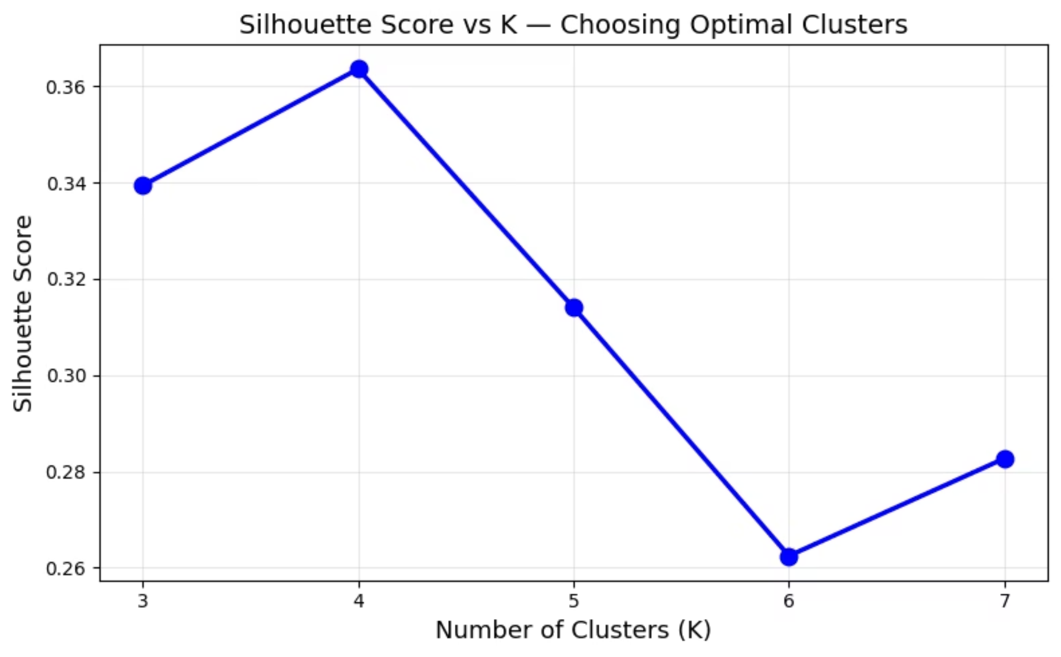
Feature Engineering & Model Selection
StandardScaler + PCA
All 9 features are standardized to zero mean and unit standard deviation using PySpark MLlib StandardScaler
PCA captures ~48% variance in 2D (used only for visualization)
Clustering is performed on full 9D feature space
Choosing K (Silhouette Score Method) : Measures how well each point fits within its cluster. Higher score = better separation.
K = 4 → Optimal (Highest silhouette score = 0.3635)

Slide 5
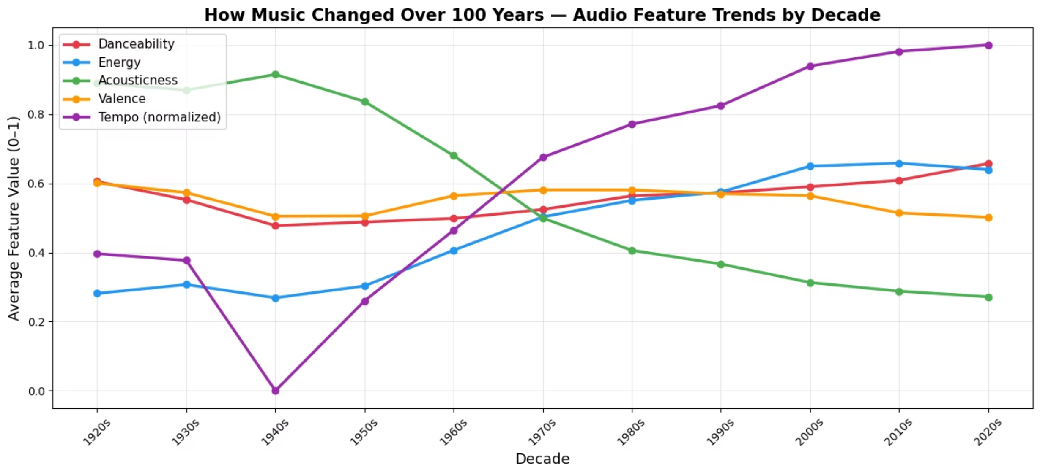
How Music Changed Over 100 Years
Key Findings from 100 Years of Data
Acousticness Decline
Energy Rise
Danceability Growth
Acousticness decreased significantly over time as electric instruments became dominant over acoustic ones
Energy increased steadily, reflecting louder and more intense modern production
Danceability increased as rhythm-driven genres became dominant
Acousticness decreases while energy increases, showing a major shift in music style over time.

Slide 6
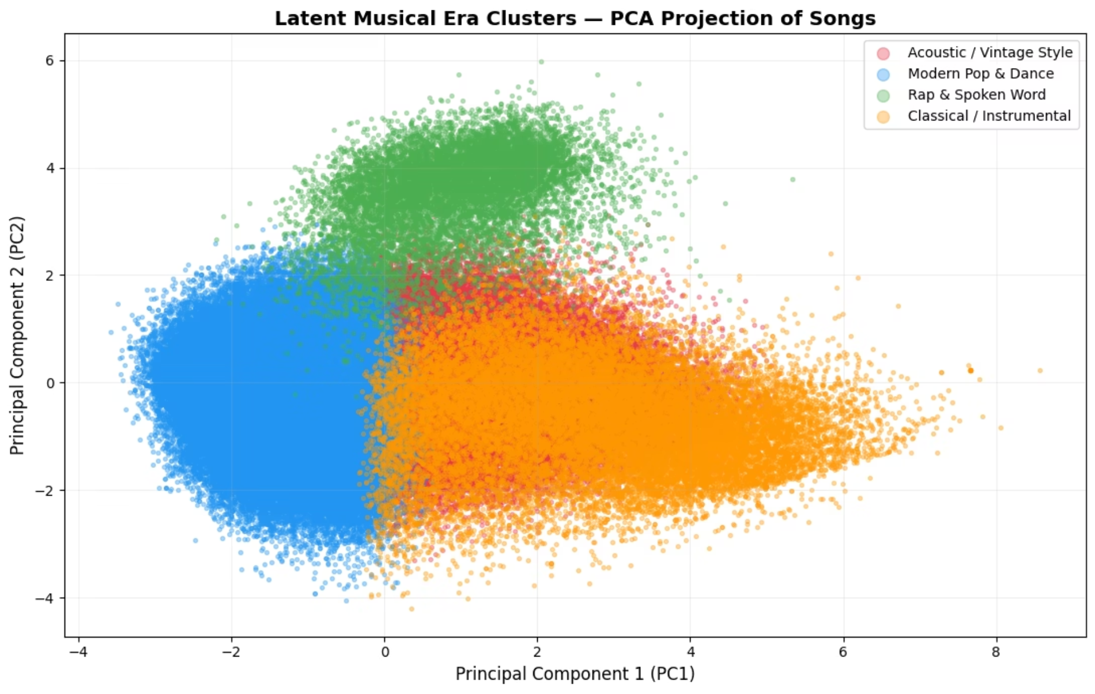

K-Means Clustering - 4 Musical Profiles
Acoustic / Vintage Style (32.5%)
Modern Pop & Dance (53.5%)
Rap & Spoken Word (4.6%)
Classical / Instrumental (9.4%)
High acousticness, low energy
High energy, danceable
High speechiness
High instrumental
Clusters are distinguishable but partially overlapping, reflecting gradual transitions in music styles.

Slide 7
The Algorithm Rediscovered Music History (Without Labels)
1920s
1
Acoustic / Vintage Style
2
1930s
Acoustic / Vintage Style
1940s
3
Acoustic / Vintage Style
4
1950s
Acoustic / Vintage Style
1960s
5
Acoustic / Vintage Style
6
1970s
Modern Pop & Dance ← THE SHIFT
1980s
7
Modern Pop & Dance
8
1990s
Modern Pop & Dance
2000s
9
Modern Pop & Dance
10
2010s
Modern Pop & Dance
2020s
11
Modern Pop & Dance
Key Finding: "The algorithm identified a major shift in music style between the 1960s and 1970s using only audio features."

Slide 8
Cluster Profiles and Real Song Validation
Each Cluster Validated by Real Songs Ranked by Spotify Popularity
Acoustic / Vintage Style
Modern Pop and Dance
Heartbreak Anniversary - Giveon (2020)
Someone You Loved – Lewis Capaldi (2019)
Save Your Tears - The Weeknd (2020)
telepatía - Kali Uchis (2020)
Modern songs with acoustic-style sound
High-energy mainstream pop
Rap and Spoken Word
Classical / Instrumental
Yes Indeed - Lil Baby and Drake (2018)
Carry On - XXXTENTACION (2017)
Experience - Ludovico Einaudi (2013)
Clean White Noise - Erik Eriksson (2017)
Speech-dominant audio patterns
Instrumental / minimal sound

Slide 9
Conclusions and Key Takeaways
1
Distributed Processing at Scale (PySpark)
Processed 577K songs using PySpark ML pipeline.
2
K=4 Clusters Selected Objectively
Silhouette score identified optimal clustering structure.
3
Music Shows a Major Structural Shift
Transition from acoustic to high-energy music after 1970s.
4
Two Persistent Niches Across All Decades
Rap/Spoken and Instrumental styles exist across all eras.
5
Algorithm Validated Real Music History
1970s shift discovered purely from audio data.
"Music trends are not random - they follow patterns that can be discovered using data. Big Data tools reveal these patterns at a scale impossible to analyze manually."

