Slide 1
አድዋ

Slide 2
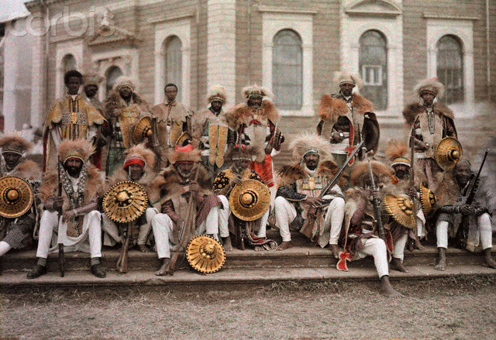
የጨዋታው ታሪክ
Story of the game

Slide 3
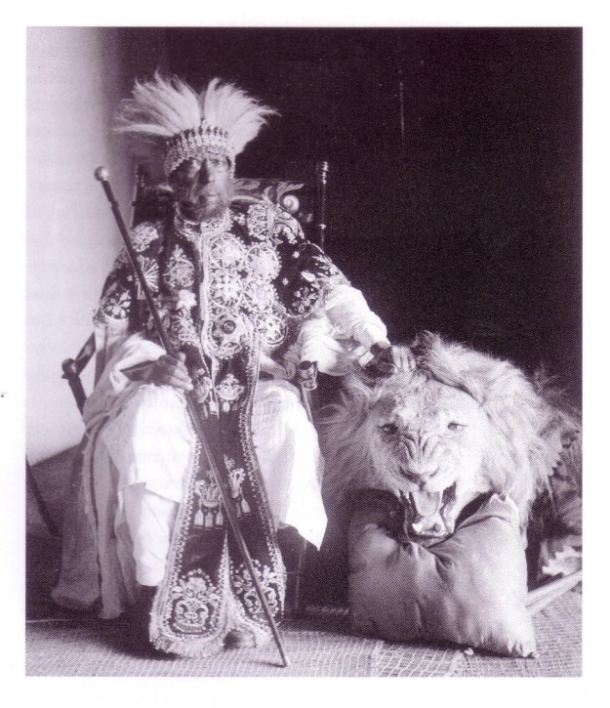
የኋላ ታሪክ Background history
In 1889, the Italians signed the Treaty of Wuchale with then Negus Menelik of Shewa.

Slide 4
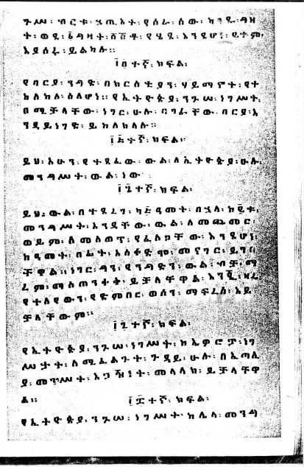
ሰበበኛው ፲፯ተኛ ክፍል The disputed Article 17
The Ethiopian version states that the Ethiopian government can use the services of the Italian government during its foreign dealings. While the Italian version states it must

Slide 5
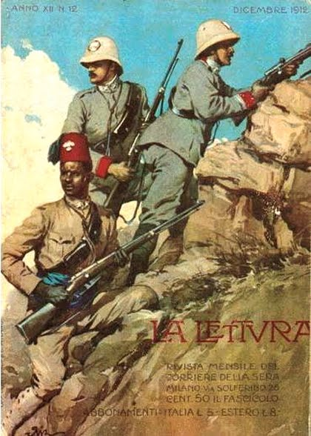
የጣልያን ምላሽ
The Italian government decided on a military solution to force Ethiopia to abide by the Italian version of the treaty

Slide 6
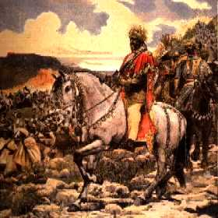
As a result, Italy and Ethiopia faced off in what was later to be known as the First Italo-Ethiopian War.

Slide 7
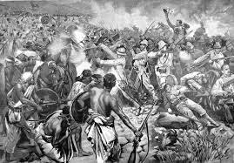
አይቀሬው አድዋ መጣ!
Hence, the battle of Adwa came to pass.

Slide 8
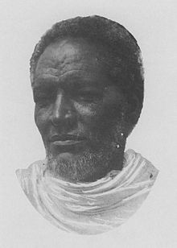
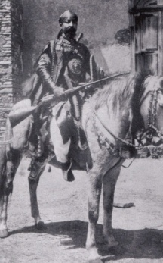
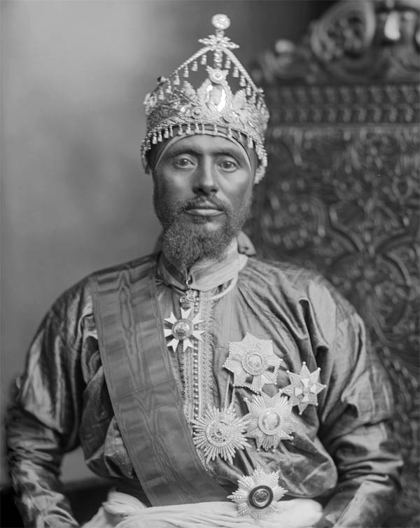
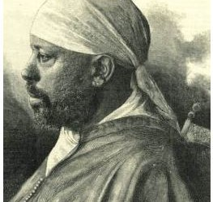
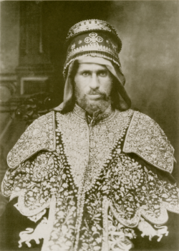
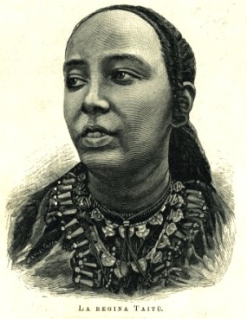
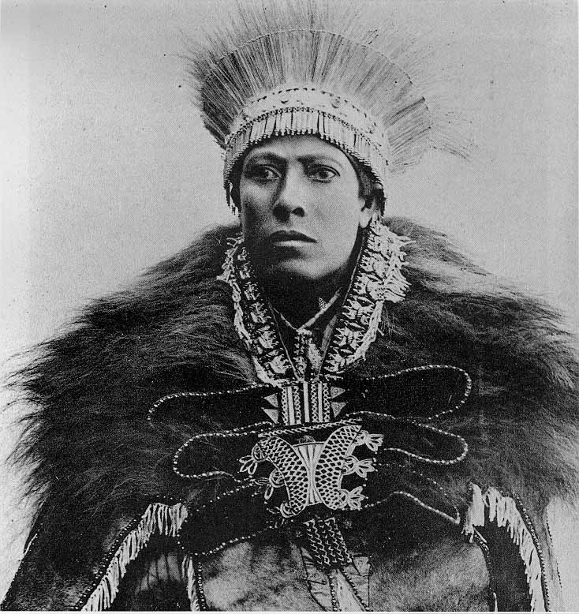
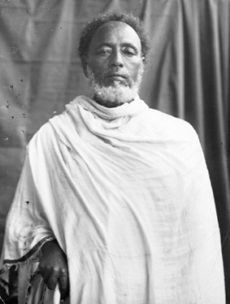
የታሪኩ ዋኖች
Key figures in the history of the battle
Bahta Hagos Ras Mengesha Ras Mekonen Minilik
Atse Teklehaimanot Taitu Balcha Abba Nefso Nigus Mikael

Slide 9
ደረጃዎች Levels
Level 1 – Battle of Halai
Level 2 – Battle of Coatit
Level 3 – Battle of Amba Alagi
Level 4 – The Ethiopian with their mountain artillery vs. Albertone’s askari birgade
Level 5 - Arimondi's brigade vs. the Shewans
Level 6 - Dabormida vs. the Oromo cavalry
Level 7- Baratieri vs. Gojjam forces

Slide 10
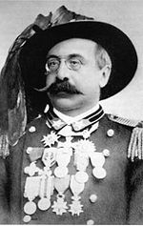
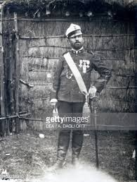
Toselli`s troop movement towards halai
Bahata`s troop besiged the Italian's troop (castellazzi) 220men
Toselli`s force araival and attacked from rear ,bahta die and his force fell apart
On Italian side 11 were killed and 22 wounded

Slide 11
Level 1: Battle of Halai
Bahta Hagos
Born in mid 19th in segeneiti
Dejazmach of Akkele Guzay (provinceof Eretria until 1996)
Major events
Telegram termination
Toselli`s move to segeneiti
Bahta`s retreat to halai

Slide 12
Toselli`s troop movement towards halai
Bahata`s troop besiged the Italian's troop (castellazzi) 220men
Toselli`s force araival and attacked from rear ,bahta die and his force fell apart
On Italian side 11 were killed and 22 wounded

Slide 13
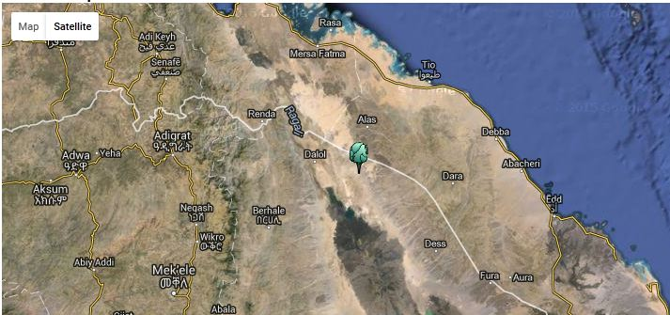
Place Description
La 14° 10' 34" N
Lo 40° 33' 22" E
Lake karum
Dalol 130 meters below sea level

Slide 14
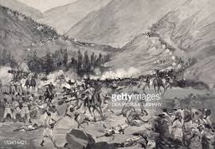
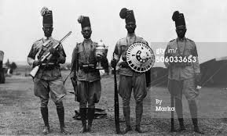
LEVEL 2
BATTLE OF COATIT
BRIEF HISTORY : The Battle of Coatit was fought on January 13, 1895 between Italy and Ethiopian proxies led by Tigrian warlord Ras Mengesha Yohannaes in what is now present day Eritrea. It was the opening battle of the First Italo–Ethiopian War, and was a significant victory for the Italians, as they rebuffed an invasion force.
PLAYER MISSION/OBJECTIVE: The player’s mission on this level is to is to counterattack the Italian armies and help Ras Mengesha and his forces to slip away unharmed

Slide 15
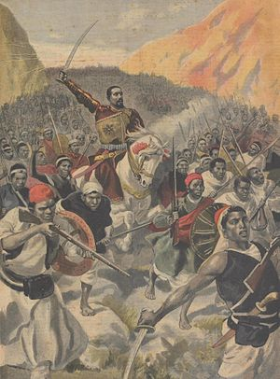
LEVEL 3
BATTLE OF AMBA ALAGI
BRIEF HISTORY: By late 1895, Italian forces led by Major Toselli had advanced deep into Ethiopian territory and were annihilated by the forces of Ras Mekonnen, Ras Welle Betul and Ras Mengesha Yohannes and were then forced to withdraw to more defensible positions in Tigray.
PLAYER MISSION/OBJECTIVE: The player on this level has to use the different weapons gained from previous levels and work with the Ethiopian vanguards to force the Italian army to retreat to Tigray.

Slide 16
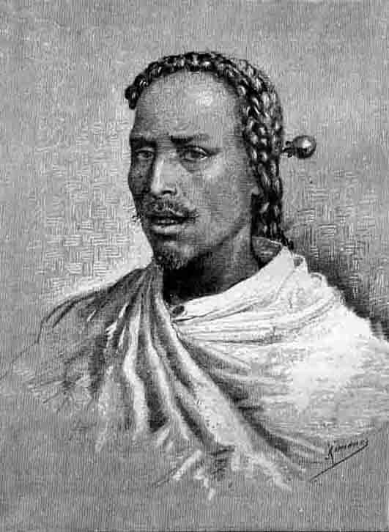
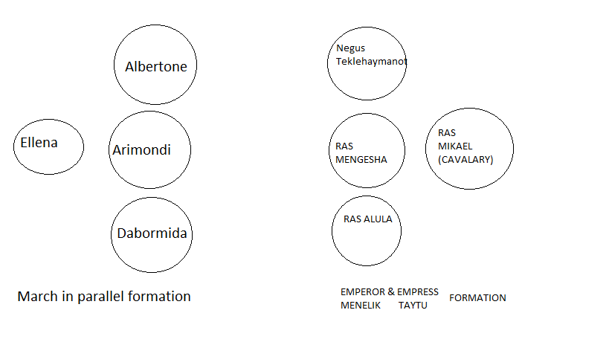
Level 4: The Ethiopian with their mountain artillery vs. Albertone’s askari birgade

Slide 17
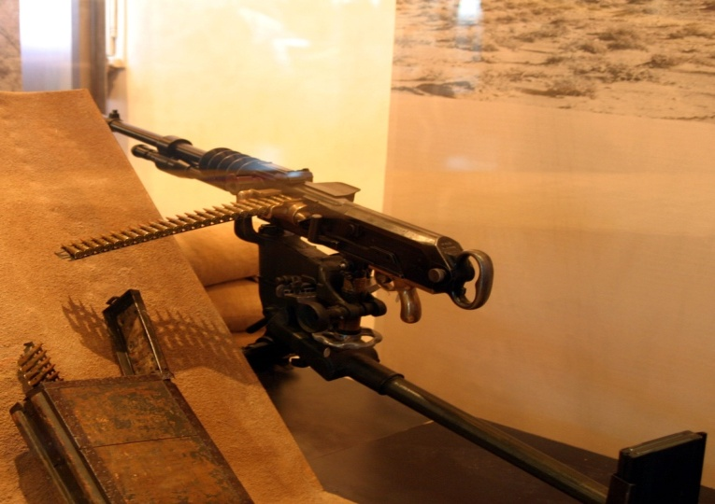
Continued
Weapons used
Russian historians:- 42 Russian mountain guns
British historians:- Hotchkiss from Egyptians or purchased from European suppliers
Heavily outnumbered
Albertone’s brigade only lasted 2 hours until Albertone’s capture

Slide 18
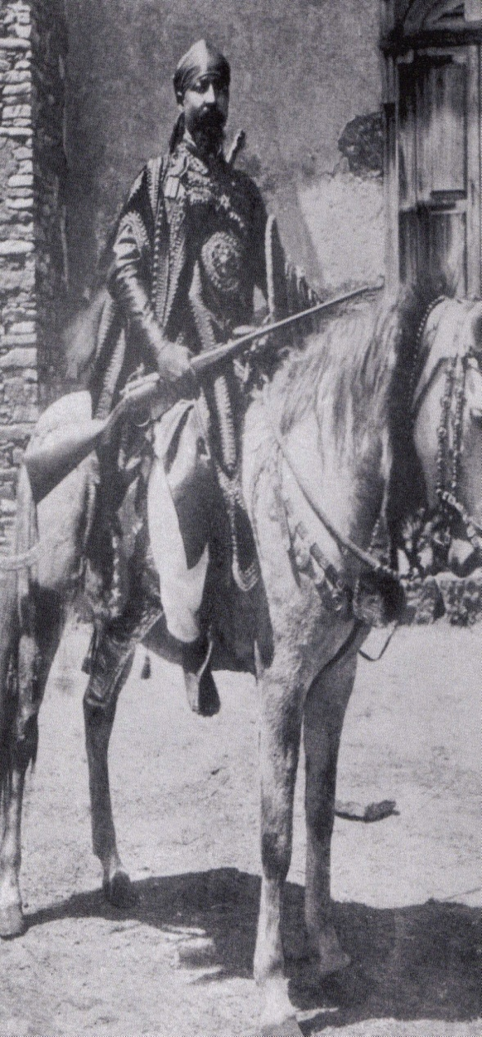
Level 5 Arimondi's brigade vs. the Shewans
Survivors from level 4 were refuges of Arimondi
Gained some ground on Ethiopians
Fought for 3 hours
Menelik released 25,000 shewans
Swamped the Italians

Slide 19

LEVEL 6 DIBORIMIDA VS THE OROMO CAVLARY
Dabormida's Italian brigade had moved to support Albertone but was unable to reach him in time.
Menelik became informed of the diborimida’s position.
Menelik ordered ras Michael and the entire left wing of 20,000 warriors supported by 8000 cavilary to move on and destroy it before it escape.
Sensing the enemy was to collapse , Ras Mikael ordered 8000 cavalry to charge.
Slash down the Italian’s and herd them into defenseless pocket

Slide 20
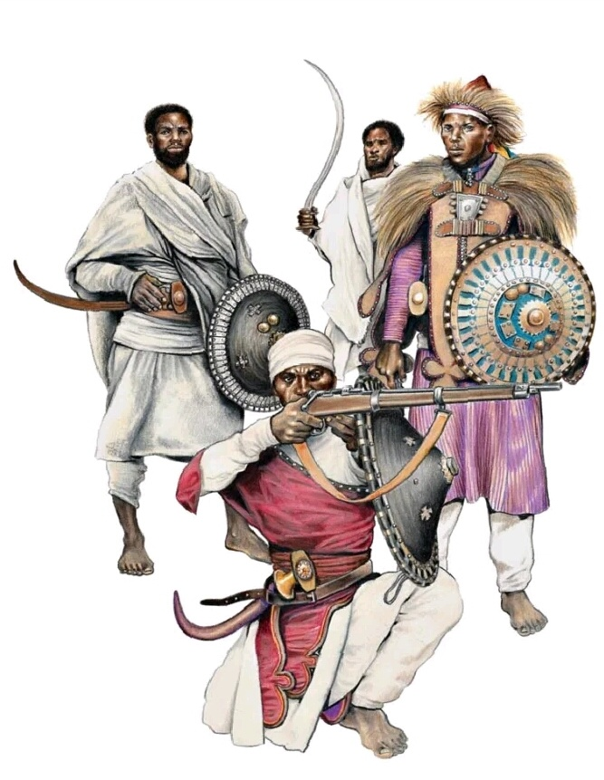
The Gojjam force & Mount Belah

Slide 21
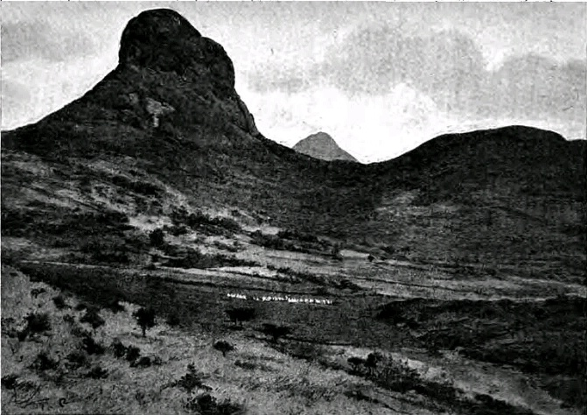
Mount Belah
At Mount Belah, the time the war of Adwa came to an end the last two brigades under a Baratieri were outflanked and destroyed.

Slide 22
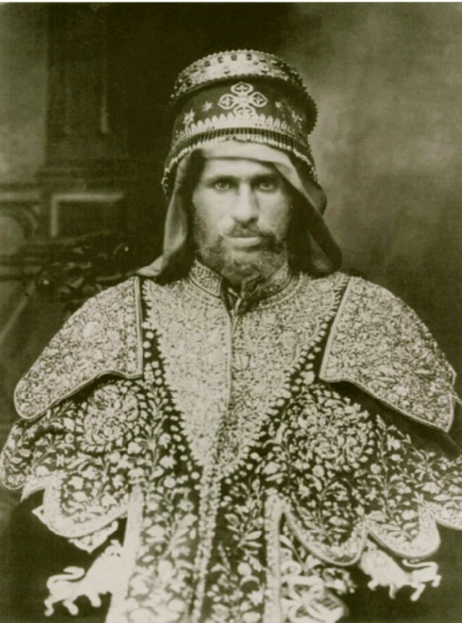
Gojjam Forces
The Gojjam Forces was under command by Negus Tekle Haymonot.
Negus Tekle Haymonot of the Gojjam
First name Adal Tessemma.
Time of kingdom (1847 to January 10 1901)
After 1901 he serve his country as army commander and a member of the nobility of the Ethiopian Empire.

Slide 23
Motivations for Negus Tekle Haymonot troops
In a landmark speech made to the nation, Emperor Menelik II made this declaration:
“Enemies have now come upon us to ruin our country and to change our religion.Our enemies have begun the affair by advancing and digging into the country like moles. With the help of GOD, I will not deliver my country to them. Today, you who are strong, give me you strength, and you who are weak, help me by prayer”.

Slide 24
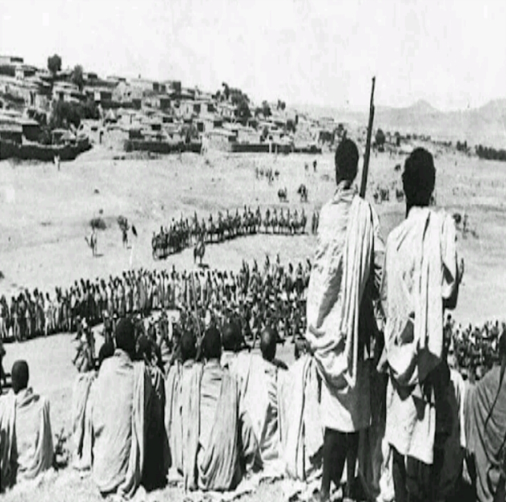
Gojjam force tactics have been described as ”Skimishing” for the most part ; There was no real technical order, but the individual and small groups tended to stay fairly well dispersed when shooting at range . However, the hand-to-hand pre-industrial war traditions still kicked in when imperial troopes closed in and all the accounts report that this was often disastrous for them – the bolt- action rifles of the Italian troupers cut them down in swathes. By noon, the survivors of Italian army were in full retreat and the battle was over.

Slide 25
አድዋ

Slide 26
1 INTRODUCTION
1.1 Purpose
This document specifies all the requirements for the “The Battle of Adwa”
gaming application. These requirements relate to the functionality, constraints,
performance, and the system interface.
1.2 Scope
This document describes the software requirements for the
“The Battle of Adwa” 3D action gaming application
1.3 Overview
The remainder of this document includes four chapters and appendixes.
The second one provides an overview of the system functionality and
system interaction with other systems.

Slide 27
OVEALL DESCRIPTION
2.1 PRODUCT PERSPECTIVE
The game will be a 3D interactive game to simulate and
narrate the historic battle of Adwa in a very engaging way.
2.2 Product functions
This game will be a very interactive and engaging way to narrate the story
of the battle of Adwa.
2.3 User Characteristics
This game is not be developed for a specific range of ages of users.
But it may contain graphic events and shocking scenes
for kids. It is not advised for kids under the age of 10.

Slide 28
OVEALL DESCRIPTION
2.4 General Constraints
Due to limited resources we may not create an exact replica of
the environment and the event.

Slide 29
3 DETAILED REQUIREMENTS
3.1 External Interface Requirements
3.1.1 User interfaces
The game will be a 3D game representing different
scenarios in the battle of Adwa. The main character of the game will
enter the arena of war with limited resources and will gain different
war arms as it progresses through different stages of the game.
3.1.2 Hardware interfaces
The game will not require any special hardware to play the game

Slide 30
3 DETAILED REQUIREMENTS
3.1.3 Software interfaces
The game will not require any additional software.
3.1.4 Communication interfaces
The game can only be played in single player mode.
It doesn’t require any connectivity.

Slide 31
3 DETAILED REQUIREMENTS
3.2 Functional Requirements
3.2.1 Game controls and Actions
The main character of the game will be able to perform
different combat actions. These actions will enable the player to
progress through the game stages by killing and conquering enemy troops.
Jogging, Jumping, Sprint, Swing etc..
3.2.2 Progress and Promotion
The main character will initially have limited resources to attack or defend.
As the game progresses, additional more powerful weapons and promotions
will be issued to the player as a reward for its accomplishments.

Slide 32
3 DETAILED REQUIREMENTS
3.2.3 Life (Health)
This feature indicates the amount of hit (damage) the player has taken
so far in the game. It starts off at 100 (Green) and decreases
as the player takes more hits.
3.2.4 Fellow Warriors
The main character is going to fight alongside other fellow patriots
to defeat the colonialist army.
These fellow warriors will not be controlled by the player.
3.2.5 Commands
As part of a big army, the player needs to be aware of the battle strategy.
This enables the player to make the best
out of the fellow warriors fighting alongside.

Slide 33
3 DETAILED REQUIREMENTS
3.2.6 Interactivity
The game characters will interact with both the environment and each other.
These interactions include killing one another,
colliding with static objects, and jumping.
These interactions only reflect the realistic interactions of war scenes.
3.3 Performance Requirements
The game environment will be a simulation of a battle arena.
These scenes need to be realistic and need to be very responsive for user input.
In addition, these scenes need to have a very good rendering speed
to provide the player with a very good gaming experience

Slide 34
3 DETAILED REQUIREMENTS
3.4 Design Constraints
3.4.1 Time
Due to the short development time we have, some characters and
feature of the war scene may be omitted.
These omitted characters and features may include
basic elements like animals like horses, visual effects like blood and other features.
3.4.2 Lack of information
Due to lack of accurate information regarding the exact strategies and
location of the battles,
we will not be able to recreate the exact replica of the landscape and
environment variables

Slide 35
3 DETAILED REQUIREMENTS
3.4.3 Story
To create coherence between each levels of the game, we may include fictitious
events at certain points of the game without altering the main story.
These modifications will enable us
to create a better gaming experience for the player.

