Slide 1
Deep Learning Institute Robotics Workshop Prework LAB WALKTHROUGH
http://aka.ms/dliprework

Slide 2
What is the prework lab?
Complete this BEFORE a Deep Learning Institute (DLI) Workshop event
Use the resources created here DURING a DLI Workshop event
Delete the resources AFTER a DLI Workshop event

Slide 3

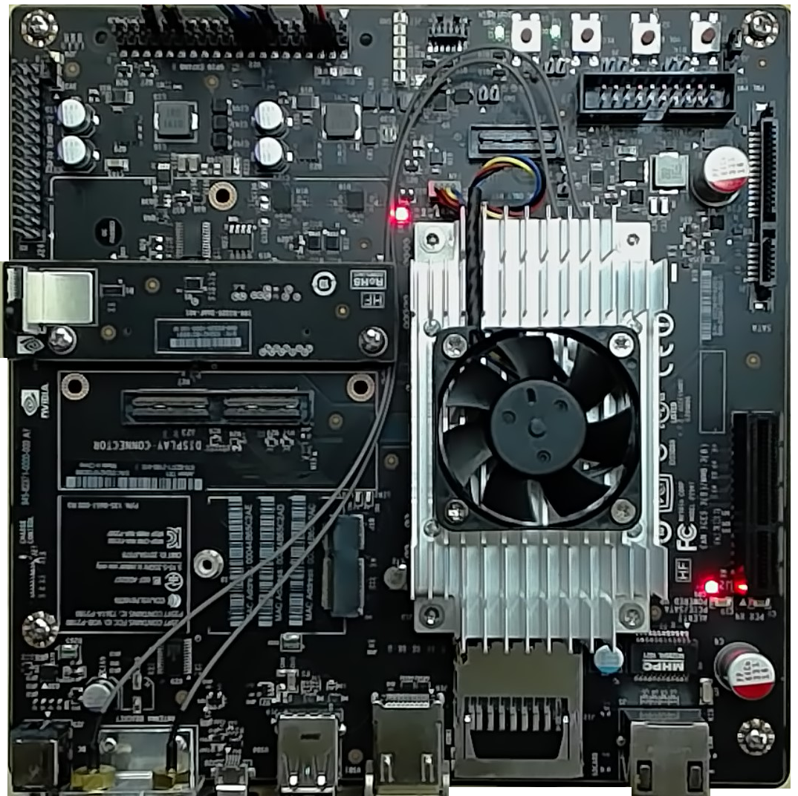
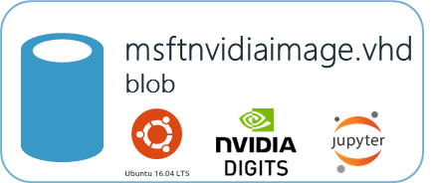


Deep Learning Workshop Architecture
eastus Location
<name>group
Resource Group
LOCAL NETWORK
<name>nsg Network Secruity Group
<name>vm
YOUR AZURE SUBSCRIPTION
NC6 w/ NVidia Tesla K80 GPU
Allow ports 22, 80 & 8888
Login: dliuser
Password: Pwd@234567890 Digts URL: http://<fqdn>:8888
Jupyter URL: http://<fqdn>:80
Installed Items
nodejs 6.9.4+
Azure-CLI
Web Browser
Assigned
<name>vnet Virtual Network
<name>nic Network Interface
Attached
ssh to public ip port 22 or http to ports 80, 8888
<name>ip Public IP address / FQDN
Attached
Your Laptop
<name>storage storage account
vhds blob container
msftnvidia.vhd blob
Based On
We’ll use the Azure CLI command line tools to create a new storage account and container in your subscription, copy the source vhd over to your account, and provision the VM with that pre-configured vhd.
msftnvidiaimage.vhd blob
SOURCE
Jetson TX1 caffe models deployed for testing

Slide 4
Deep Learning Workshop Architecture
LOCAL NETWORK
Installed Items
nodejs 6.9.4+
Azure-CLI
Web Browser
Your Laptop
Jetson TX1 caffe models deployed for testing

Slide 5
Deep Learning Workshop Architecture
LOCAL NETWORK
Installed Items
nodejs 6.9.4+
Azure-CLI
Web Browser
Your Laptop
msftnvidiaimage.vhd blob
SOURCE
Jetson TX1 caffe models deployed for testing

Slide 6
Deep Learning Workshop Architecture
LOCAL NETWORK
YOUR AZURE SUBSCRIPTION
Installed Items
nodejs 6.9.4+
Azure-CLI
Web Browser
Your Laptop
msftnvidiaimage.vhd blob
SOURCE
Jetson TX1 caffe models deployed for testing

Slide 7
Deep Learning Workshop Architecture
eastus Location
LOCAL NETWORK
YOUR AZURE SUBSCRIPTION
Installed Items
nodejs 6.9.4+
Azure-CLI
Web Browser
Your Laptop
We’ll use the Azure CLI command line tools to create a new storage account and container in your subscription, copy the source vhd over to your account, and provision the VM with that pre-configured vhd.
msftnvidiaimage.vhd blob
SOURCE
Jetson TX1 caffe models deployed for testing

Slide 8
Deep Learning Workshop Architecture
eastus Location
<name>group
Resource Group
LOCAL NETWORK
YOUR AZURE SUBSCRIPTION
Installed Items
nodejs 6.9.4+
Azure-CLI
Web Browser
Your Laptop
We’ll use the Azure CLI command line tools to create a new storage account and container in your subscription, copy the source vhd over to your account, and provision the VM with that pre-configured vhd.
msftnvidiaimage.vhd blob
SOURCE
Jetson TX1 caffe models deployed for testing

Slide 9
Deep Learning Workshop Architecture
eastus Location
<name>group
Resource Group
LOCAL NETWORK
YOUR AZURE SUBSCRIPTION
Installed Items
nodejs 6.9.4+
Azure-CLI
Web Browser
Your Laptop
<name>storage storage account
We’ll use the Azure CLI command line tools to create a new storage account and container in your subscription, copy the source vhd over to your account, and provision the VM with that pre-configured vhd.
msftnvidiaimage.vhd blob
SOURCE
Jetson TX1 caffe models deployed for testing

Slide 10
Deep Learning Workshop Architecture
eastus Location
<name>group
Resource Group
LOCAL NETWORK
YOUR AZURE SUBSCRIPTION
Installed Items
nodejs 6.9.4+
Azure-CLI
Web Browser
Your Laptop
<name>storage storage account
vhds blob container
We’ll use the Azure CLI command line tools to create a new storage account and container in your subscription, copy the source vhd over to your account, and provision the VM with that pre-configured vhd.
msftnvidiaimage.vhd blob
SOURCE
Jetson TX1 caffe models deployed for testing

Slide 11
Deep Learning Workshop Architecture
eastus Location
<name>group
Resource Group
LOCAL NETWORK
YOUR AZURE SUBSCRIPTION
Installed Items
nodejs 6.9.4+
Azure-CLI
Web Browser
Your Laptop
<name>storage storage account
vhds blob container
We’ll use the Azure CLI command line tools to create a new storage account and container in your subscription, copy the source vhd over to your account, and provision the VM with that pre-configured vhd.
msftnvidiaimage.vhd blob
SOURCE
Jetson TX1 caffe models deployed for testing

Slide 12
Deep Learning Workshop Architecture
eastus Location
<name>group
Resource Group
LOCAL NETWORK
<name>vm
YOUR AZURE SUBSCRIPTION
NC6 w/ NVidia Tesla K80 GPU
Login: dliuser
Password: Pwd@234567890 Digts URL: http://<fqdn>:8888
Jupyter URL: http://<fqdn>:80
Installed Items
nodejs 6.9.4+
Azure-CLI
Web Browser
Attached
Your Laptop
<name>storage storage account
vhds blob container
msftnvidia.vhd blob
Based On
We’ll use the Azure CLI command line tools to create a new storage account and container in your subscription, copy the source vhd over to your account, and provision the VM with that pre-configured vhd.
msftnvidiaimage.vhd blob
SOURCE
Jetson TX1 caffe models deployed for testing

Slide 13
Deep Learning Workshop Architecture
eastus Location
<name>group
Resource Group
LOCAL NETWORK
<name>vm
YOUR AZURE SUBSCRIPTION
NC6 w/ NVidia Tesla K80 GPU
Login: dliuser
Password: Pwd@234567890 Digts URL: http://<fqdn>:8888
Jupyter URL: http://<fqdn>:80
Installed Items
nodejs 6.9.4+
Azure-CLI
Web Browser
<name>vnet Virtual Network
<name>nic Network Interface
Attached
<name>ip Public IP address / FQDN
Attached
Your Laptop
<name>storage storage account
vhds blob container
msftnvidia.vhd blob
Based On
We’ll use the Azure CLI command line tools to create a new storage account and container in your subscription, copy the source vhd over to your account, and provision the VM with that pre-configured vhd.
msftnvidiaimage.vhd blob
SOURCE
Jetson TX1 caffe models deployed for testing

Slide 14
Deep Learning Workshop Architecture
eastus Location
<name>group
Resource Group
LOCAL NETWORK
<name>nsg Network Secruity Group
<name>vm
YOUR AZURE SUBSCRIPTION
NC6 w/ NVidia Tesla K80 GPU
Allow ports 22, 80 & 8888
Login: dliuser
Password: Pwd@234567890 Digts URL: http://<fqdn>:8888
Jupyter URL: http://<fqdn>:80
Installed Items
nodejs 6.9.4+
Azure-CLI
Web Browser
Assigned
<name>vnet Virtual Network
<name>nic Network Interface
Attached
ssh to public ip port 22 or http to ports 80, 8888
<name>ip Public IP address / FQDN
Attached
Your Laptop
<name>storage storage account
vhds blob container
msftnvidia.vhd blob
Based On
We’ll use the Azure CLI command line tools to create a new storage account and container in your subscription, copy the source vhd over to your account, and provision the VM with that pre-configured vhd.
msftnvidiaimage.vhd blob
SOURCE
Jetson TX1 caffe models deployed for testing

Slide 15
Getting the content…
http://aka.ms/dliprework

Slide 16
Choosing a good <name>
Use only lower case alphanumeric (a-z,0-9) characters.
Possibly your first, middle and last initials & today’s date in mmdd format. For example, if it were February 18th, John Q. Doe might use: jqd0218
You can use any sequence that is likely to generate globally unique names. It should however be at least four characters long.
For this video I’ll use the following as my <name> dli000

Slide 17
Clone the repo…
From your development workstation:
git clone http://github.com/dxcamps/DLI_RoboWorkshop_1
Then, change into the DLI_RoboWorkshop_1/prework/deploy folder
cd ./DLI_RoboWorkshop_1/prework/deploy
Open the commands.txt file and do a search and replace on <name>

Slide 18
Open & edit commands.txt
From the /deploy folder:
open the commands.txt file in the text editor of your choice
Do a global search and replace of the <name> place holder with your chosen name prefix

