Slide 1
Azure, Deep Learning & Intelligent Robots
Presenter
Twitter
Blob/Website

Slide 2
Expectations
Provide Guidance and Understanding
Open Q&A
Notebooks Walk Through
Explanation and guidance through
Image Classification
Object Detection
Impact and Effectiveness
Focused on practicality
From the perspective of making it work
Notes:
Forming data into a fashion that delivers particular insights.
These can be numerical or to push into a format to drive charts or portions of charts.

Slide 3
Important to Know
Microsoft Azure
IaaS: Virtual Machines, Networking, Storage, Containers etc.
PaaS: Communications, Machine Learning, Web, Streaming etc.
SaaS: Office, Email, Skype, Chat etc.
Deep Learning
Caffe: From Berkley Vision Center.
Networks: Image Classification, Object Detection, Pattern Matching, Generation etc.
Digits: No need for a PhD; effective common algorithms on GPU out of the box
Robotics
Brains: TX-1, Raspberry Pi. High order embedded controllers.
Control Hubs: Arduinos, PICs. Low order real time embedded controllers.
Actuary: Servos, DC Motors, Stepper Motors etc. Moving Parts
Sensory: Cameras, Gyroscopes, Infrared, Distance etc. Senses the world around it.

Slide 4

What is a Robot?
Decisions
Sensors
Judgement + Memory
World inputs such as cameras
Controls
Actuators
Signals to maintain sensors
and actuators
Things that move.

Slide 5
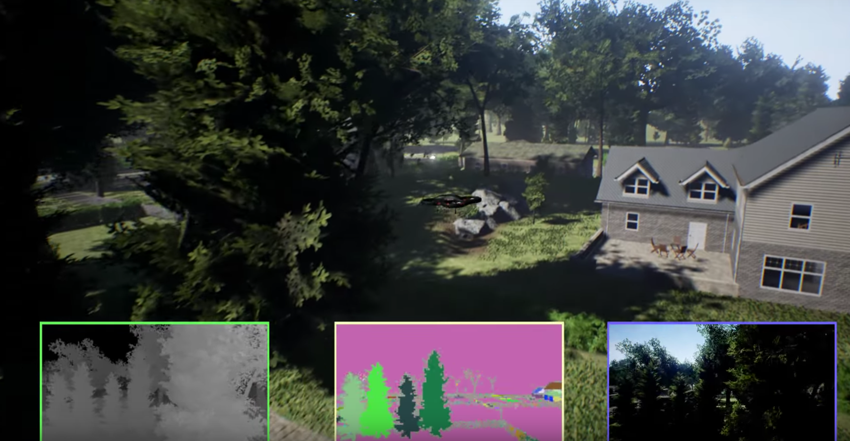
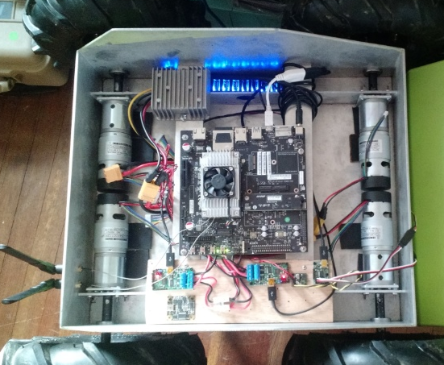
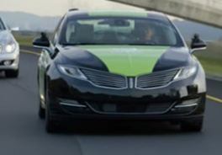
Intelligent Robot Lifecycle
Simulate
Work through A.I. and hardware quickly in a pre-prototype phase. Produces a ton of data. Record simulated telemetry streams for development of necessary models.
Prototype
Physical application of simulation. Produces more data. Work data in with simulated data to fine tune algorithms for the real world. Continually push these boundaries with the physical prototype.
Produce
Produce a real product for broad distribution. There will still be data collected for fine tuning. This data will help adjunct the previous data as well as design simulations as a further test bed.

Slide 6

The Robot Data Life Cycle
experiences
intelligence
repeat
Notes:
Experiences are the raw telemetry data we get from the robot
Intelligence is the improved models we develop based on the data collected from the robot.
We repeat as the robots will continue to have more experiences.

Slide 7
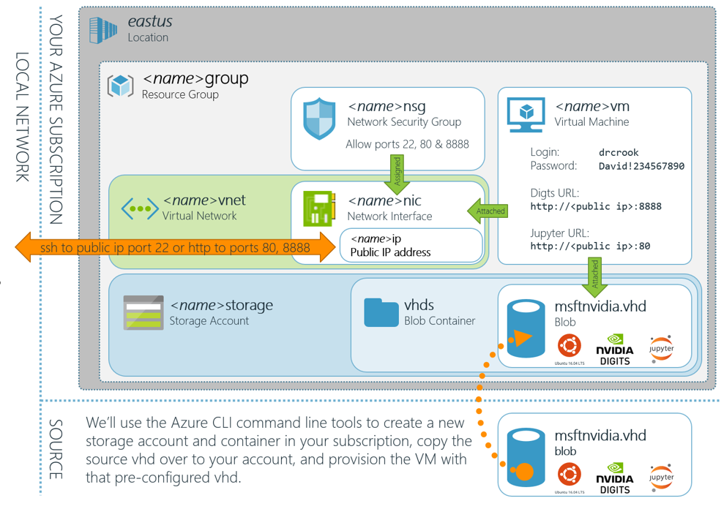
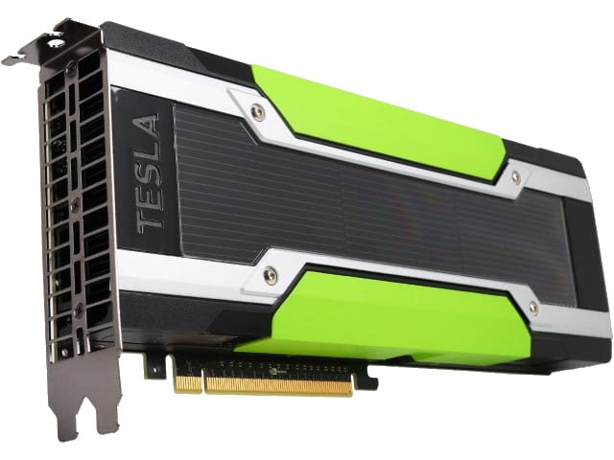
Azure Transforms Experiences into Intelligence

Slide 8
The Robot Data Life Cycle (Review it again)
experiences
intelligence
repeat
Notes:
Experiences are the raw telemetry data we get from the robot
Intelligence is the improved models we develop based on the data collected from the robot.
We repeat as the robots will continue to have more experiences.

Slide 9
Image Classification Review
What is deep learning?
Why convolutional networks?
Creating a database
Label Files
Exploring the data set
Creating the model
Discussion Points

Slide 10
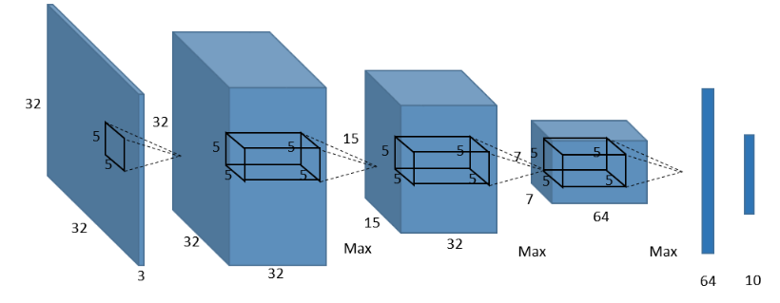
Deep Learning – Convolutional Networks
Predict 10 classes
Reduced features to most
Important representations
32x32 RGB Image input
64 5x5 features created
Flatten and mix
(normal network)
32 5x5 features created
Notes:
If attendee asks: “How did we go from 15x15 to 7x7 -> Because there is another max pooling layer in the middle which reduces the features to the most important representations just like from the 32x32 did to the 15x15.
It is an RGB image, because it is 32x32x3 (the 3 is Red Green Blue)
Important Notes:
1. Convolutional Networks takes into account localized patterns and reduces computation through pooling and is therefor faster and more accurate than traditional fully connected networks.
2. Digits makes it so you don’t actually need to know this stuff to get good results.

Slide 11
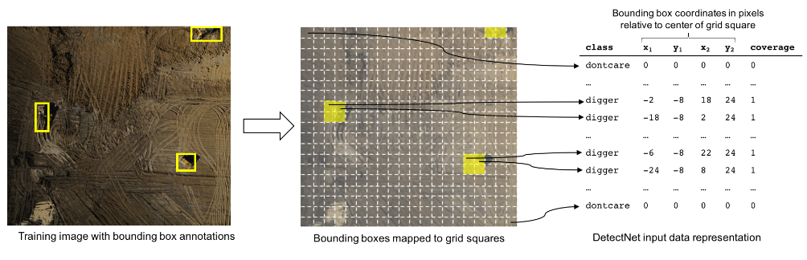
Object Detection Review
Make sure folks used right settings.
Review Label File Formats and Questions
How it works
Basically sliding a box over the image classifying things.
Grab the location of the box
Merge Boxes together
Who cares? Its out of the box with Digits!

Slide 12
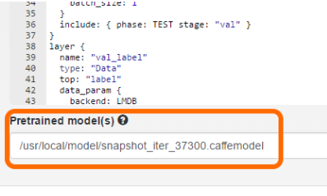
Settings
Training
Trained against correct model in path
Testing
Tested against correct model “mscoco_bottle”
Bounding Boxes Selected
Image path used /usr/local/db/coco/bottle/val/images

Slide 13
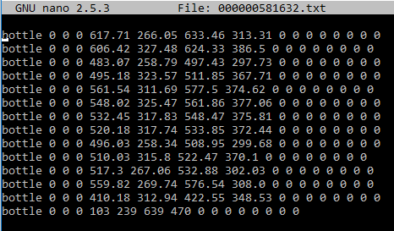
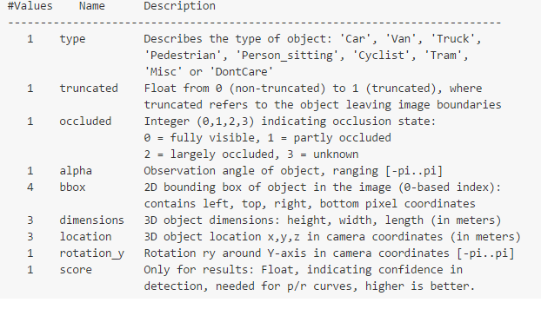
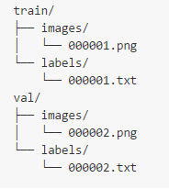
Use Your Data - Label Files
https://github.com/tzutalin/labelImg
Generates XML in wrong format
Works great though
Write Code
Get it into right format
Place into correct folders
Watch Digits work.
Notes:
Digits uses the Kitti format which is built for the Berkley CV center; so many labels are not used in object detection, but rather in more advanced scenarios.

Slide 14
Open Q&A ---------------- Open Lab Time

Slide 15
@Data4Bots
www.dacrook.com

