Slide 1
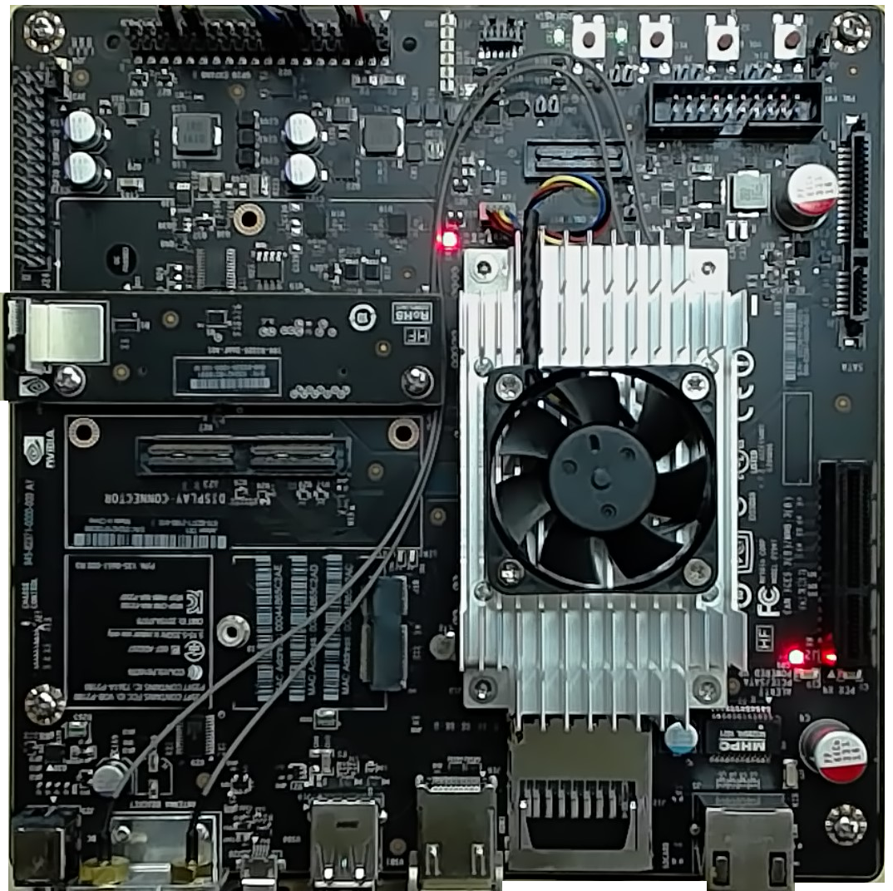


Deep Learning Workshop Architecture
eastus Location
<name>group
Resource Group
LOCAL NETWORK
<name>nsg Network Secruity Group
<name>vm
YOUR AZURE SUBSCRIPTION
Allow ports 22, 80 & 8888
Login: dliuser
Password: Pwd@234567890 Digts URL: http://<fqdn>:8888
Jupyter URL: http://<fqdn>:80
Installed Items
nodejs 6.9.4+
Azure-CLI
Web Browser
Assigned
<name>vnet Virtual Network
<name>nic Network Interface
Attached
ssh to public ip port 22 or http to ports 80, 8888
<name>ip Public IP address
Attached
Your Laptop
<name>storage storage account
vhds blob container
msftnvidiaimage.vhd blob
We’ll use the Azure CLI command line tools to create a new storage account and container in your subscription, copy the source vhd over to your account, and provision the VM with that pre-configured vhd.
msftnvidiaimage.vhd blob
SOURCE
Jetson TX1 caffe models deployed for testing

Slide 2
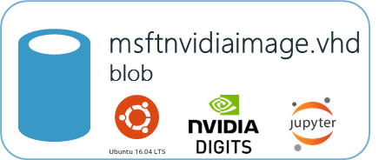
Deep Learning Workshop Architecture
eastus Location
<name>group
Resource Group
LOCAL NETWORK
<name>nsg Network Secruity Group
<name>vm
YOUR AZURE SUBSCRIPTION
Allow ports 22, 80 & 8888
Login: dliuser
Password: Pwd@234567890 Digts URL: http://<fqdn>:8888
Jupyter URL: http://<fqdn>:80
Installed Items
nodejs 6.9.4+
Azure-CLI
Web Browser
Assigned
<name>vnet Virtual Network
<name>nic Network Interface
Attached
ssh to public ip port 22 or http to ports 80, 8888
<name>ip Public IP address
Attached
Your Laptop
<name>storage storage account
vhds blob container
msftnvidia.vhd blob
Based On
We’ll use the Azure CLI command line tools to create a new storage account and container in your subscription, copy the source vhd over to your account, and provision the VM with that pre-configured vhd.
msftnvidiaimage.vhd blob
SOURCE
Jetson TX1 caffe models deployed for testing

