Slide 1
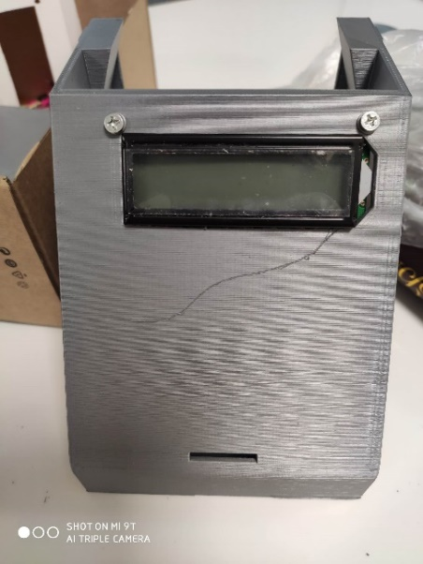
Timer with Light Gate Project
David Ispiryan
SuperViser – Bilor kurghinyAN

Slide 2
Project Description with background
Our main goal is to build a timer of millisecond precision. The main component of the timer is the light gate that will record the instants of crossing its line of sight.
Measuring periods of the oscillations
Determining free fall acceleration with the use of our timer

Slide 3
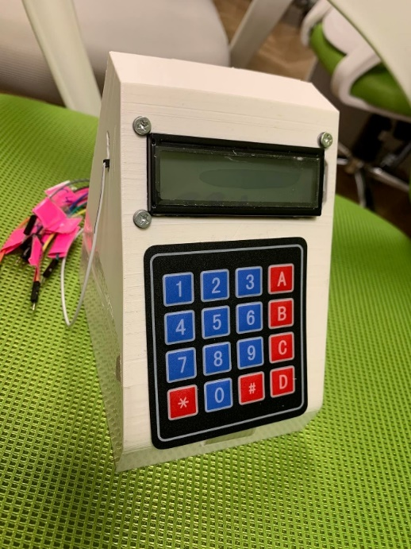
Stages For The Execution
Learning Arduino environment
Research for the methods of the execution of the project.
Building and testing the circuit of the device.
Construction of the mechanical parts of the device
Developing the software part of the project
Testing the device and comparing the results with the results obtained with traditional methods of measuring the period of oscillations.

Slide 4
Assumptions & Constraints
Finding an appropriate protocol for IR remote communication that will be suitable for our device
Providing an accuracy of 1 millisecond, further testing will show does it make sense to improve the accuracy of time measurment (up to 0.1 ms, 0.01 ms or microseconds
The alternative approach is based on the laser beam and a receiver based in the photo resistor
The device has to be developed and tested till the May

Slide 5
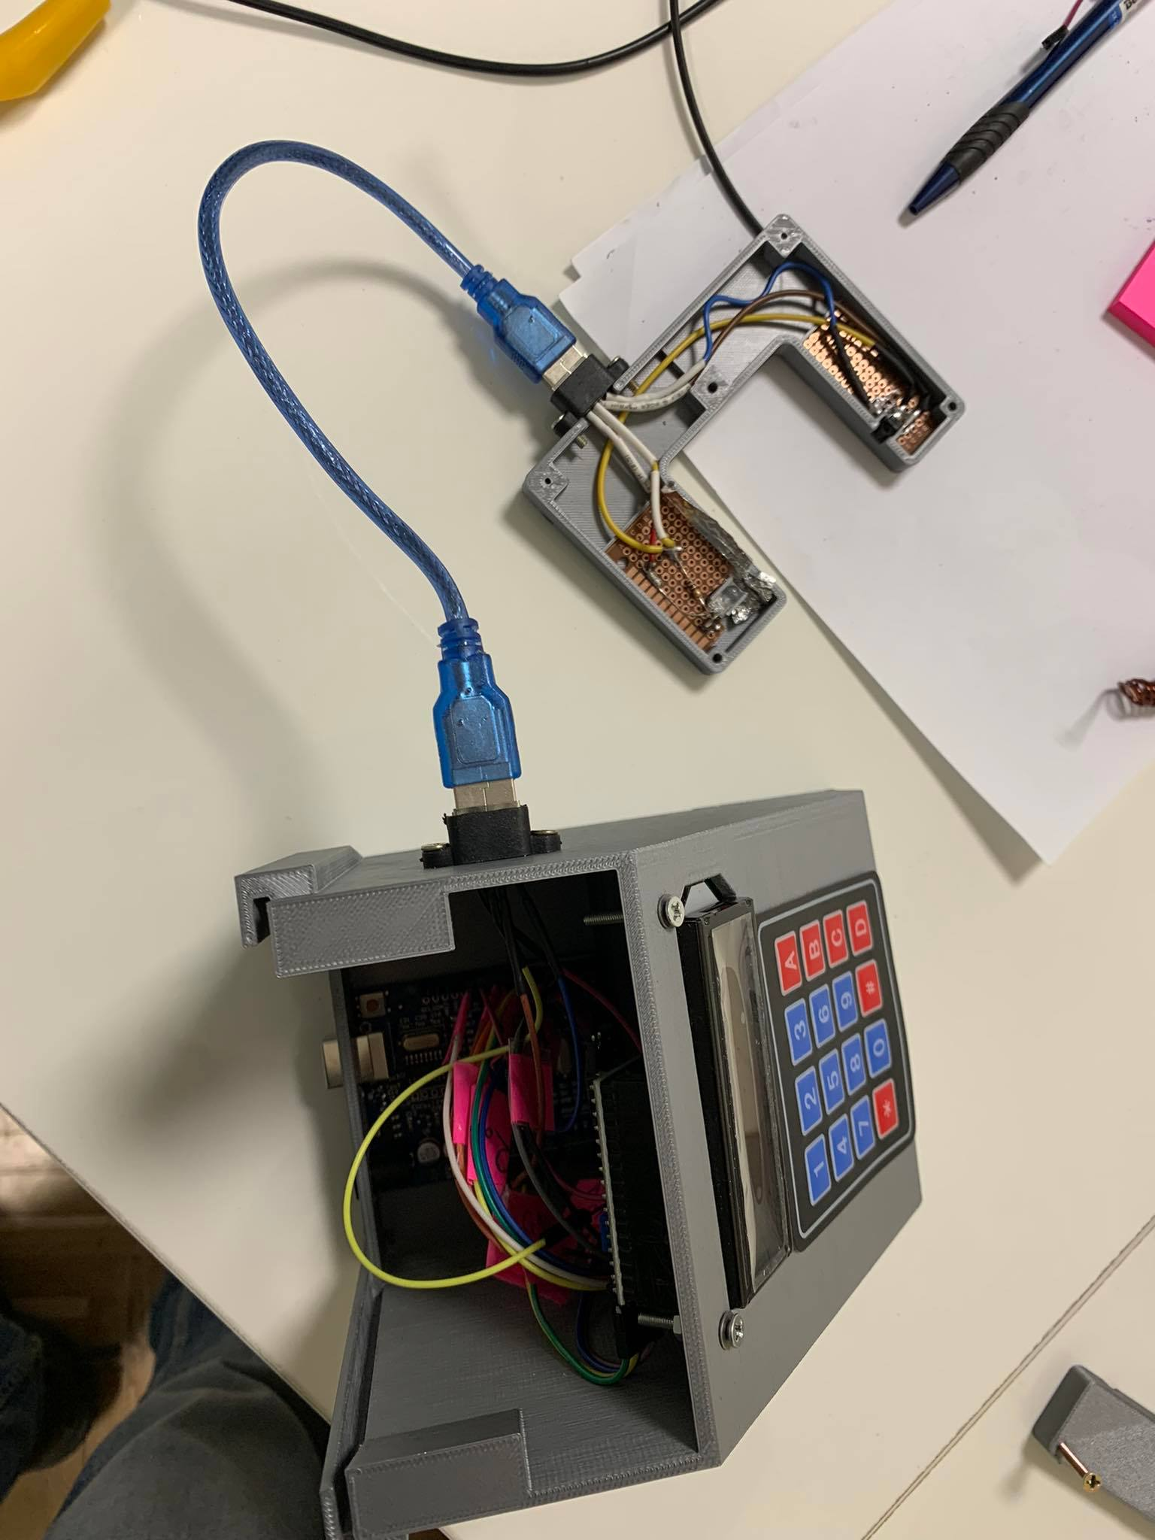
Main Components (Transmitter & Receiver)
The transmitter should send signal of a certain carrying frequency and modulation
As the receiver is sensitive to that carrying frequency, it will “ignore” background radiation such as IR part in the spectrum of the sun rays, bulb lights and etc.
Object crossing the line
The microcontroller operates the IR emitter to send signals with the desired carrying frequency and modulation.

Slide 6
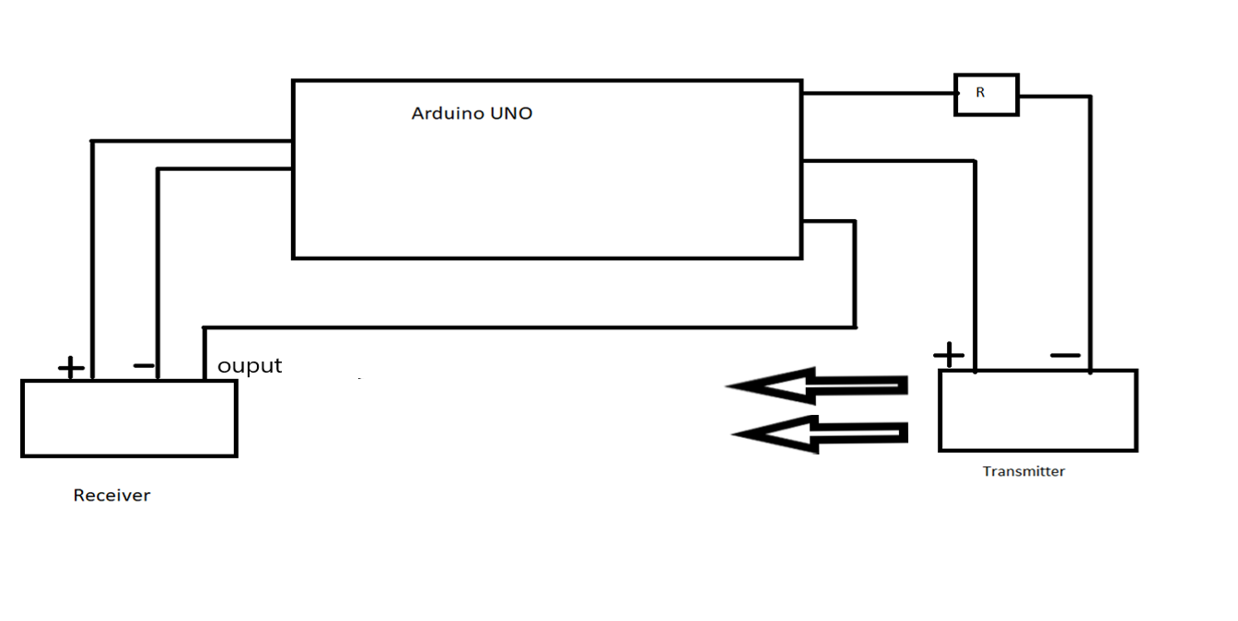
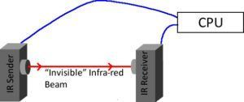
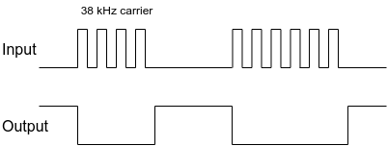

Slide 7
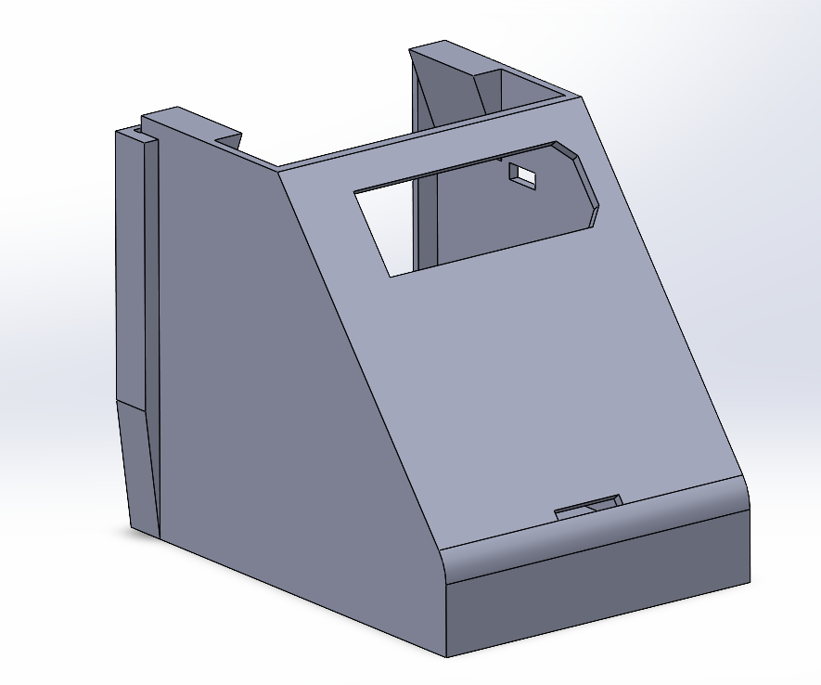
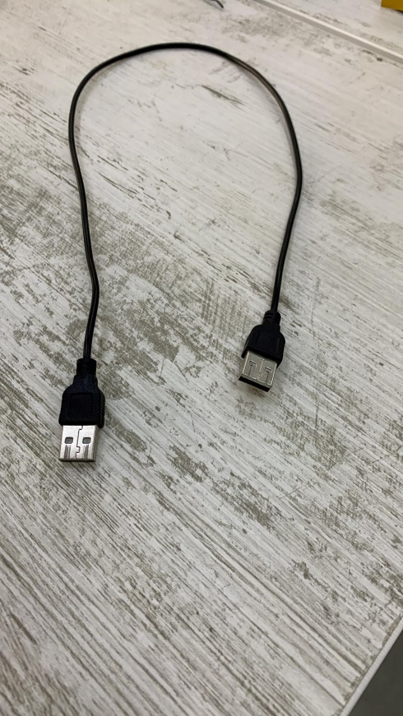
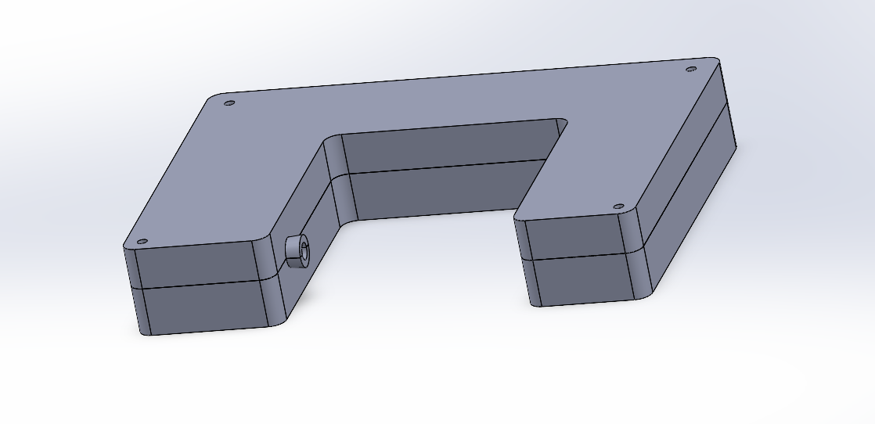
The transition time delay of the IR receiver is also a source of errors and its impact on the precision of time detection should be estimated (less than in 60 microseconds)

Slide 8
Physical Environment
The operating supply voltage for the device is 5 V. The voltage may be supplied by the USB cable.
The background IR radiation frequency must have low intensity at frequency close to 35-37 kHz bandwidth.
The device will be suited to the conditions provided in the university or school lab. The environment in which the system is expected to work during its lifecycle is room temperature, normal pressure.
The system relies on a low cost materials and requires an educational practice

Slide 9
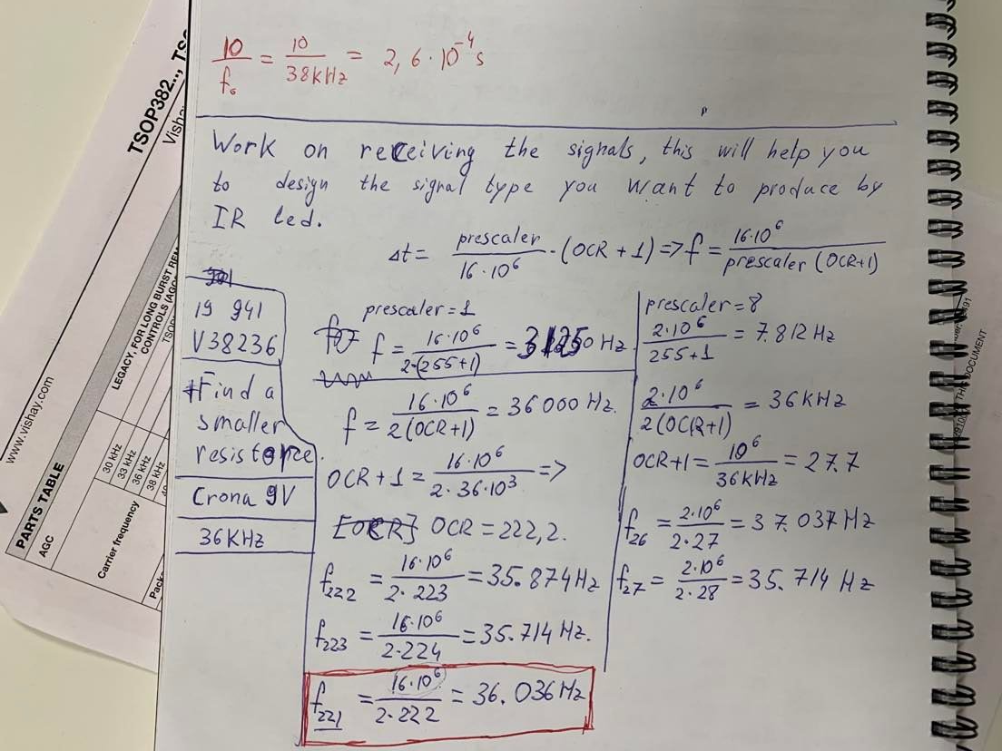
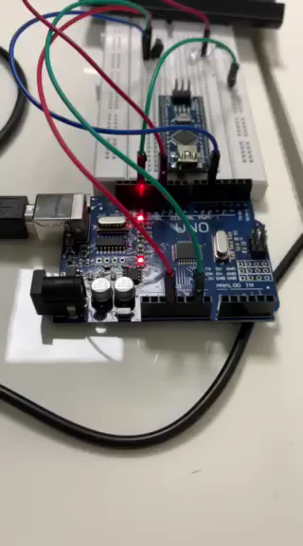
Calculation of the prescaler

Slide 10
Support Environment/Use cases
The user must avoid applying high voltages to the systems input (out of the range 5V-12 V)
And the use of this device will rise the accuracy of the measurements of the free fall acceleration may be used for measuring the instantaneous speeds, for measuring the period of various oscillating systems.

Slide 11
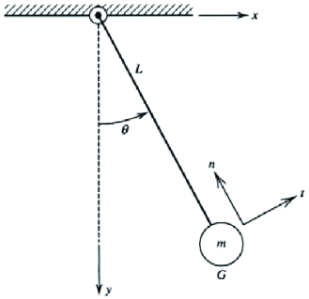
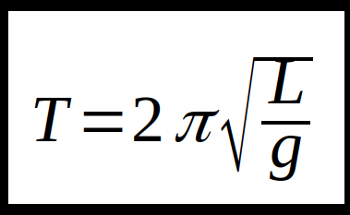
Final Part Testing the device
As we have everything we need, we can input in our formula
As a result, we got 9.81 ± 0.005 m/s^2 for g ( (N-1)/2 = cycle measure)

Slide 12
(N-1)/2 = cycle measure

Slide 13
Thank you

