Slide 1

Murach’s C# 2010, C11
© 2010, Mike Murach & Associates, Inc.
Slide <number>

Slide 2
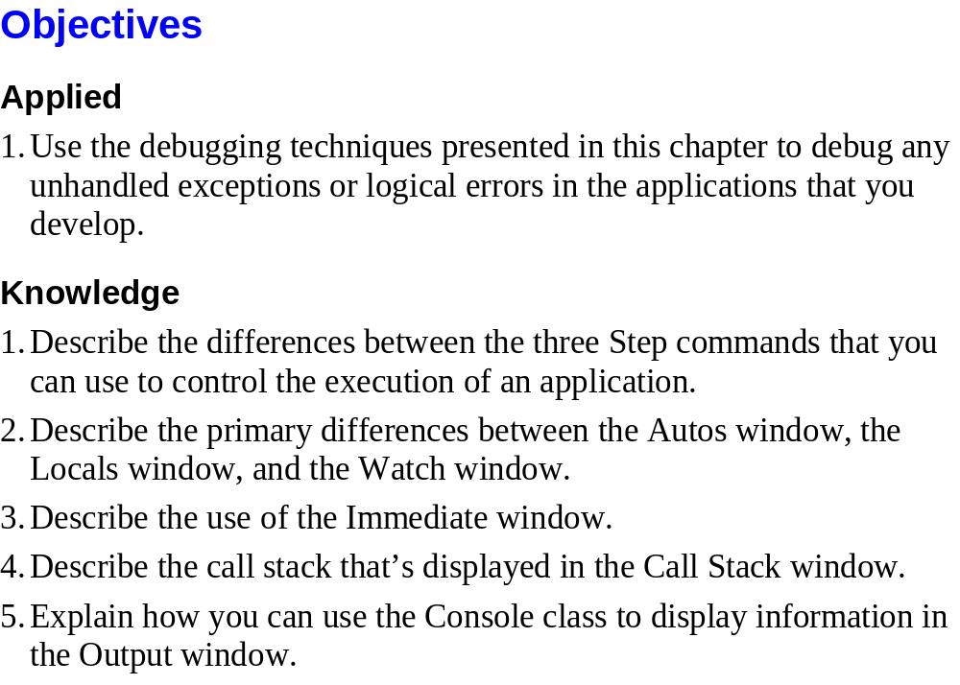
Murach’s C# 2010, C11
© 2010, Mike Murach & Associates, Inc.
Slide <number>

Slide 3
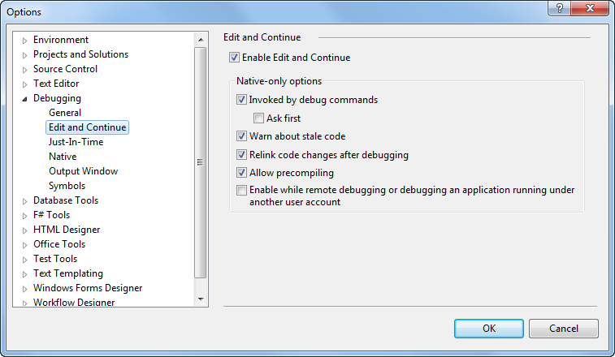
Murach’s C# 2010, C11
© 2010, Mike Murach & Associates, Inc.
Slide <number>

Slide 4
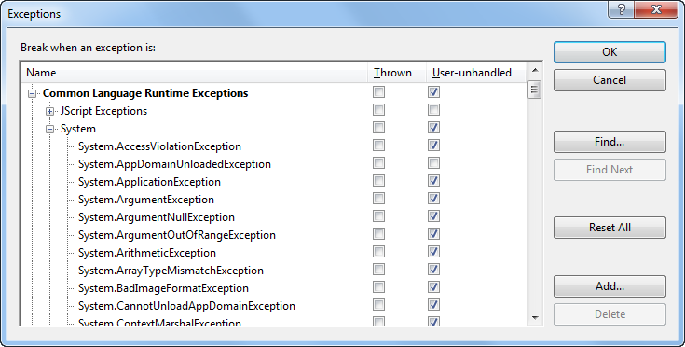
Murach’s C# 2010, C11
© 2010, Mike Murach & Associates, Inc.
Slide <number>

Slide 5
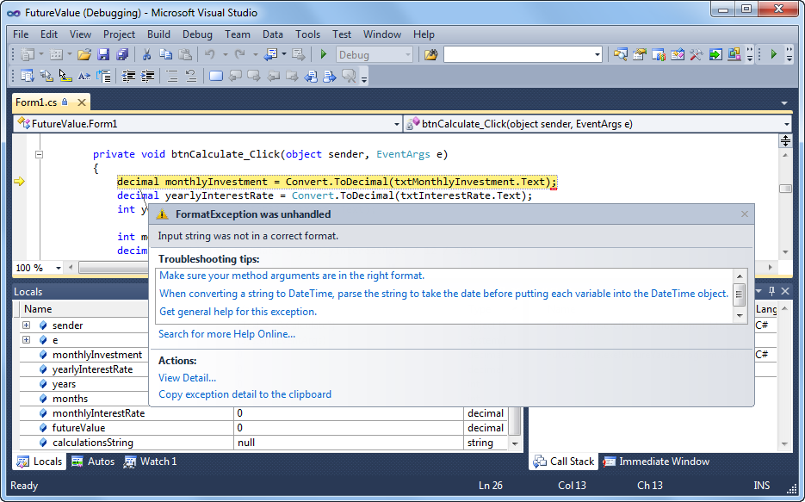
Murach’s C# 2010, C11
© 2010, Mike Murach & Associates, Inc.
Slide <number>

Slide 6
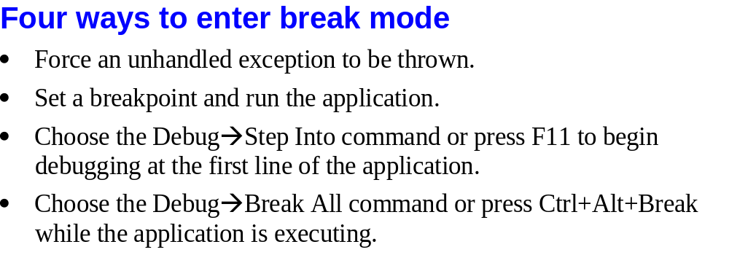
Murach’s C# 2010, C11
© 2010, Mike Murach & Associates, Inc.
Slide <number>

Slide 7

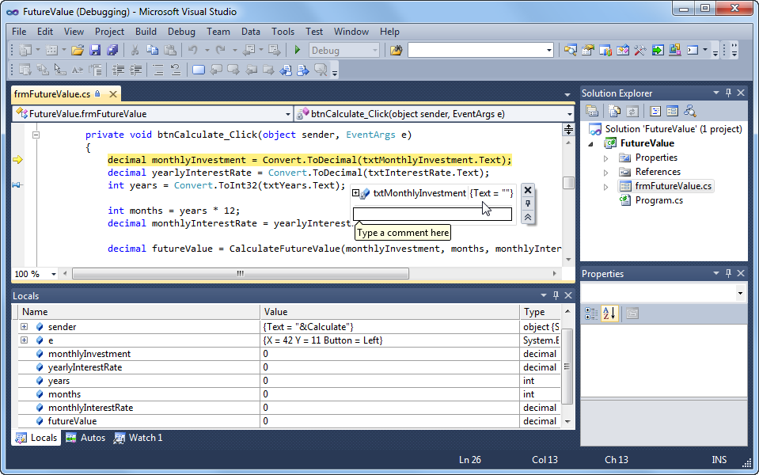
Murach’s C# 2010, C11
© 2010, Mike Murach & Associates, Inc.
Slide <number>

Slide 8
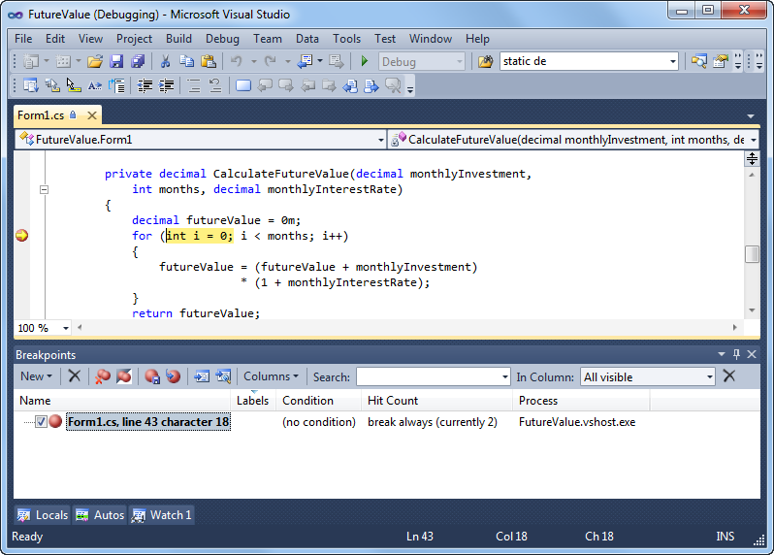
Murach’s C# 2010, C11
© 2010, Mike Murach & Associates, Inc.
Slide <number>

Slide 9
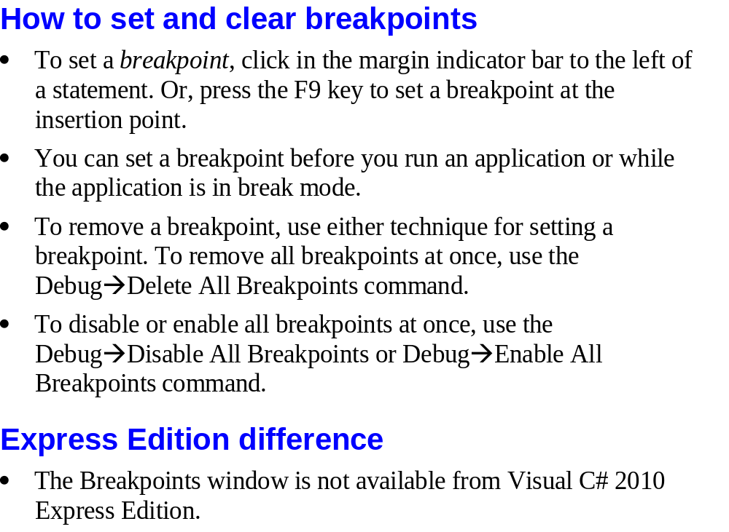
Murach’s C# 2010, C11
© 2010, Mike Murach & Associates, Inc.
Slide <number>

Slide 10
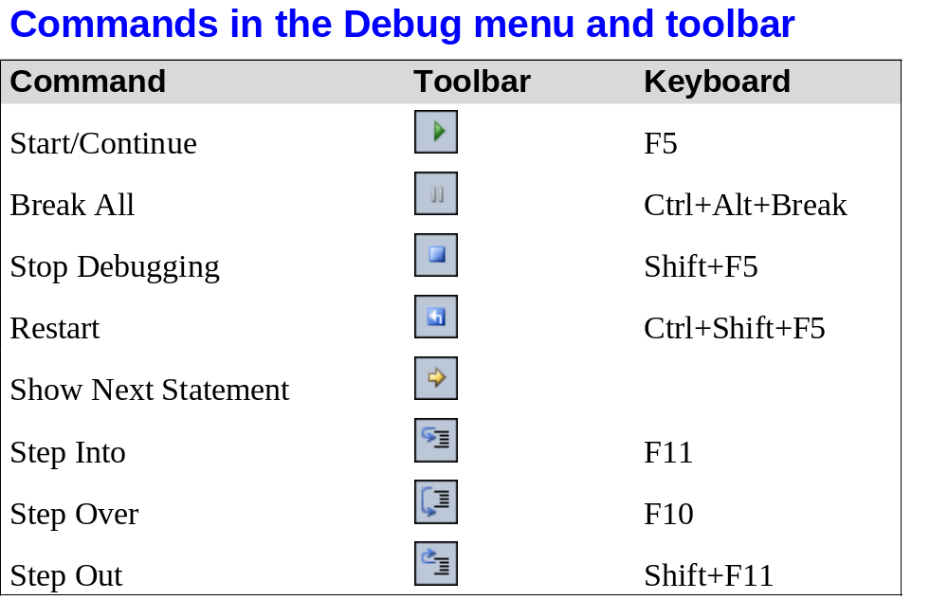
Murach’s C# 2010, C11
© 2010, Mike Murach & Associates, Inc.
Slide <number>

Slide 11
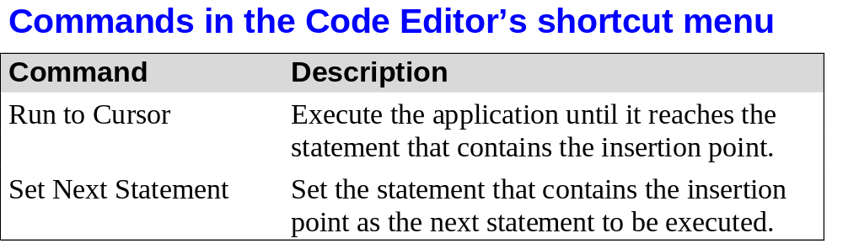
Murach’s C# 2010, C11
© 2010, Mike Murach & Associates, Inc.
Slide <number>

Slide 12
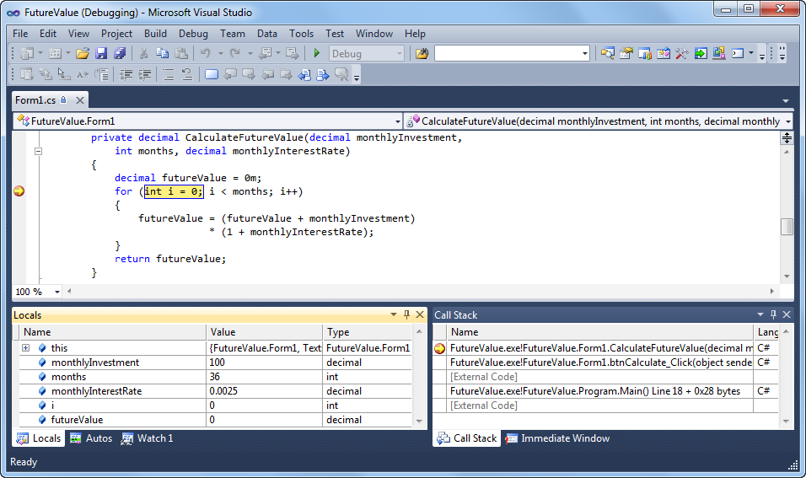
Murach’s C# 2010, C11
© 2010, Mike Murach & Associates, Inc.
Slide <number>

Slide 13
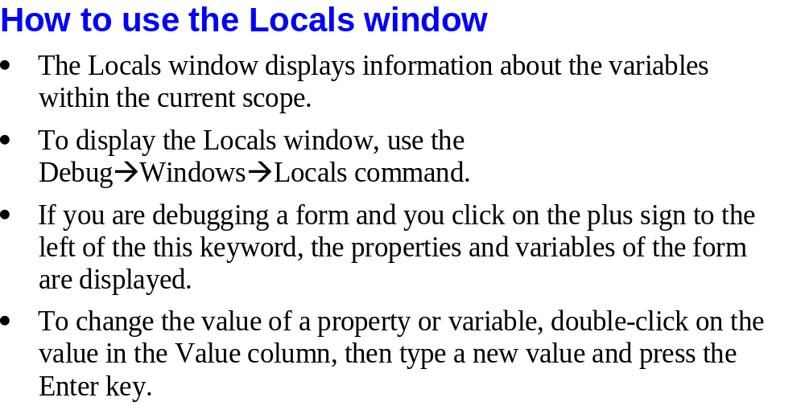
Murach’s C# 2010, C11
© 2010, Mike Murach & Associates, Inc.
Slide <number>

Slide 14
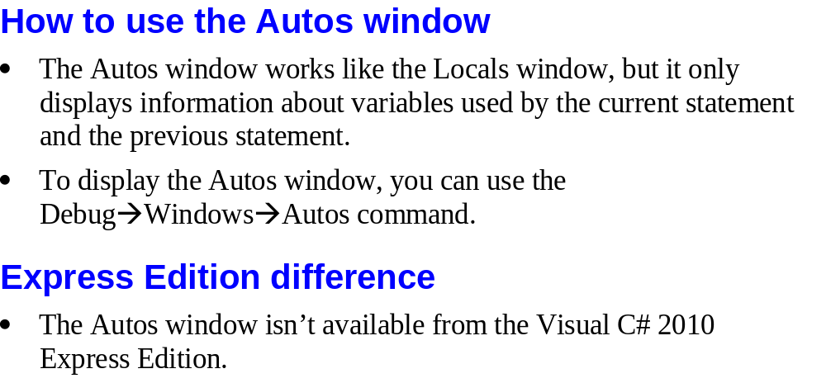
Murach’s C# 2010, C11
© 2010, Mike Murach & Associates, Inc.
Slide <number>

Slide 15
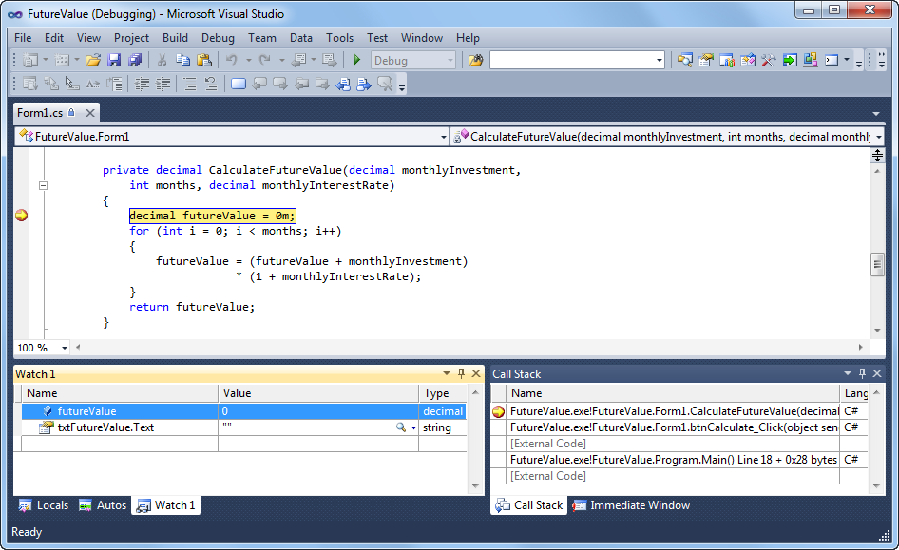
Murach’s C# 2010, C11
© 2010, Mike Murach & Associates, Inc.
Slide <number>

Slide 16
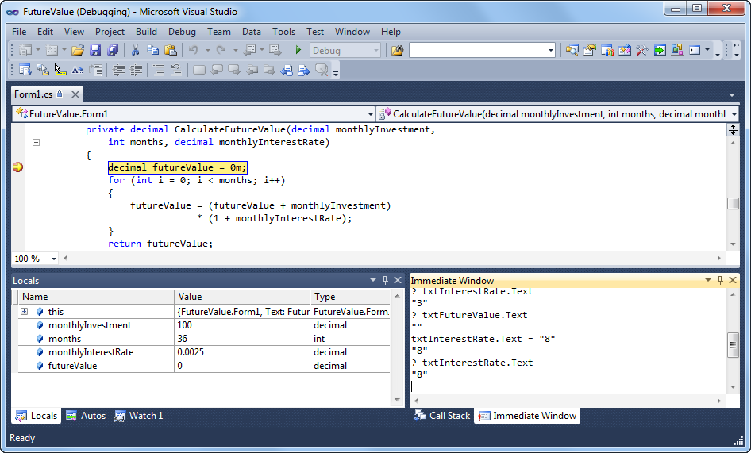
Murach’s C# 2010, C11
© 2010, Mike Murach & Associates, Inc.
Slide <number>

Slide 17
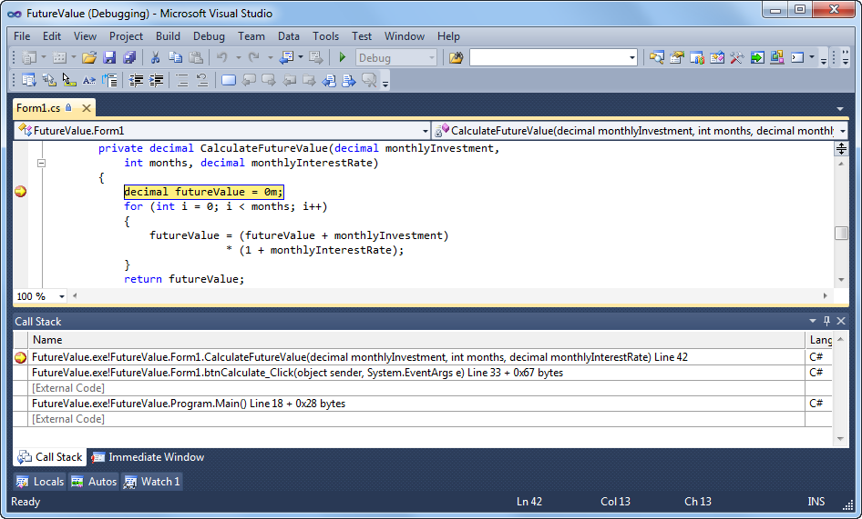
Murach’s C# 2010, C11
© 2010, Mike Murach & Associates, Inc.
Slide <number>

Slide 18

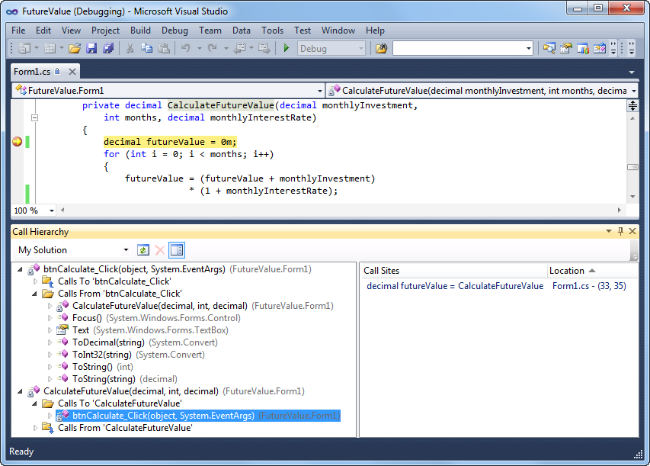
Murach’s C# 2010, C11
© 2010, Mike Murach & Associates, Inc.
Slide <number>

Slide 19
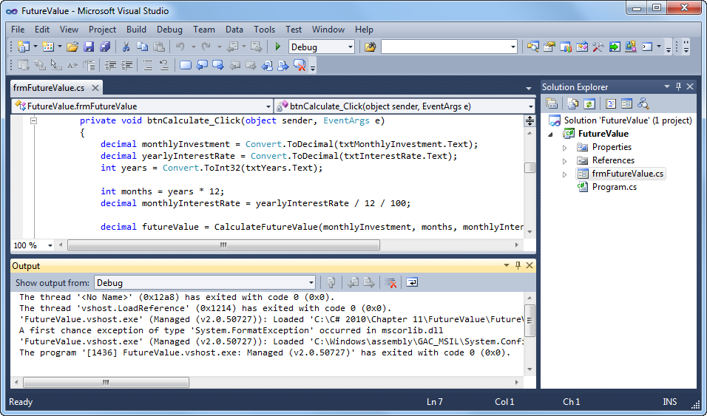
Murach’s C# 2010, C11
© 2010, Mike Murach & Associates, Inc.
Slide <number>

Slide 20
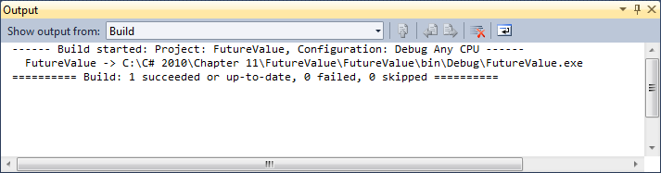
Murach’s C# 2010, C11
© 2010, Mike Murach & Associates, Inc.
Slide <number>

Slide 21

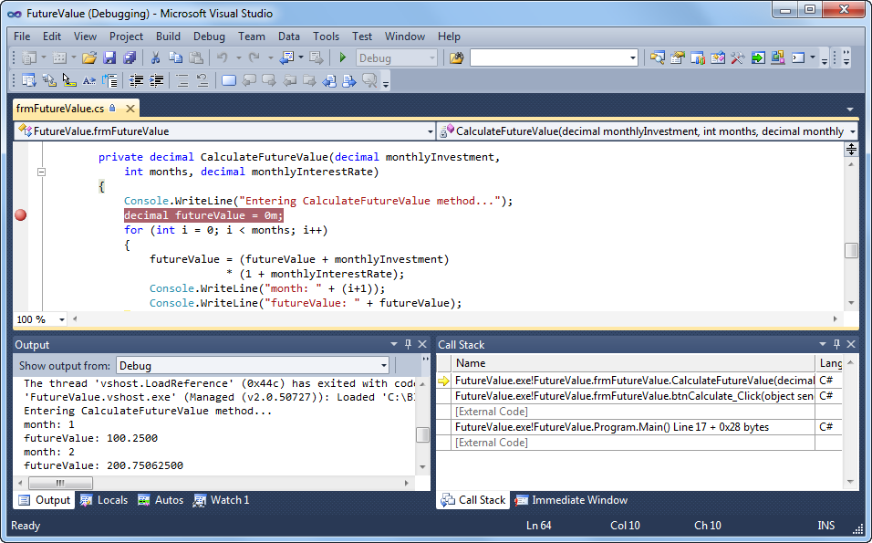
Murach’s C# 2010, C11
© 2010, Mike Murach & Associates, Inc.
Slide <number>

Slide 22
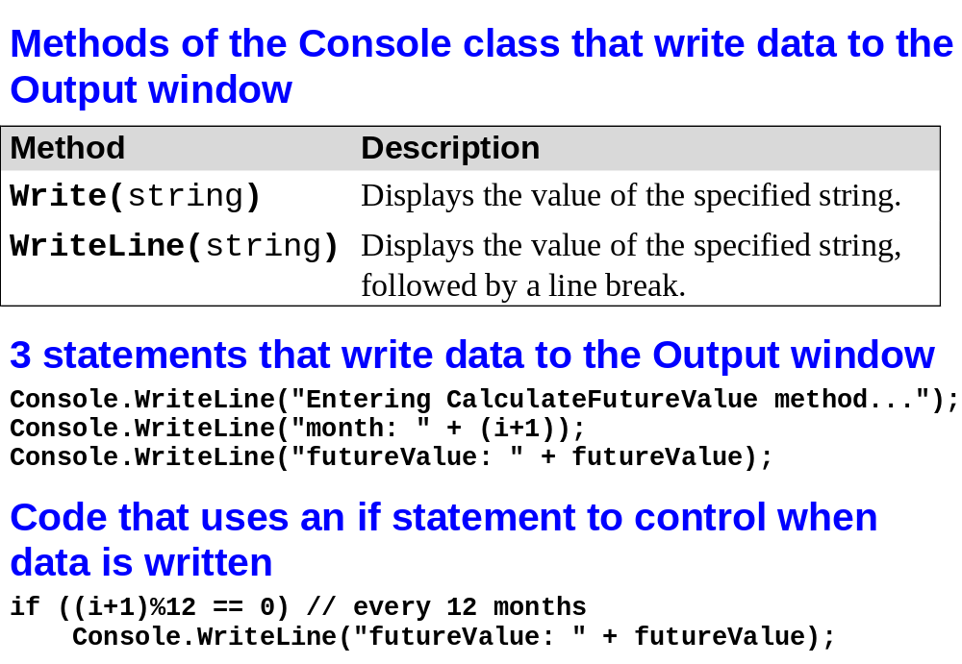
Murach’s C# 2010, C11
© 2010, Mike Murach & Associates, Inc.
Slide <number>

Slide 23

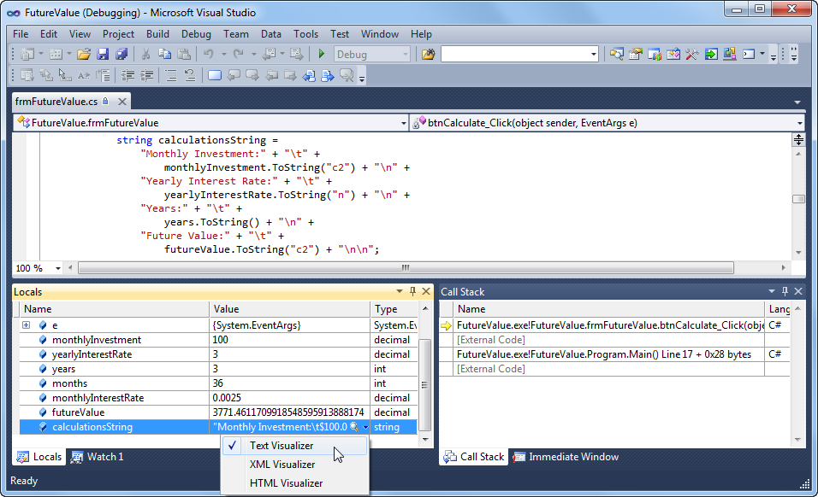
Murach’s C# 2010, C11
© 2010, Mike Murach & Associates, Inc.
Slide <number>

Slide 24
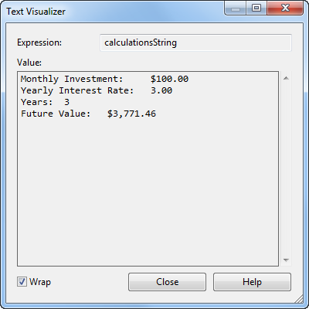
Murach’s C# 2010, C11
© 2010, Mike Murach & Associates, Inc.
Slide <number>

