Slide 1
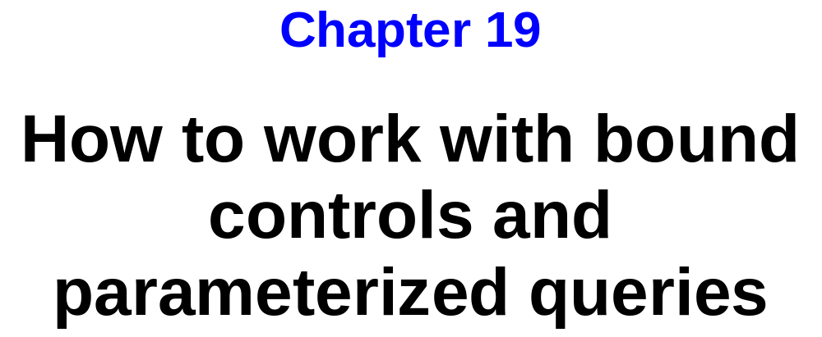
Murach’s C# 2010, C19
© 2010, Mike Murach & Associates, Inc.
Slide <number>

Slide 2
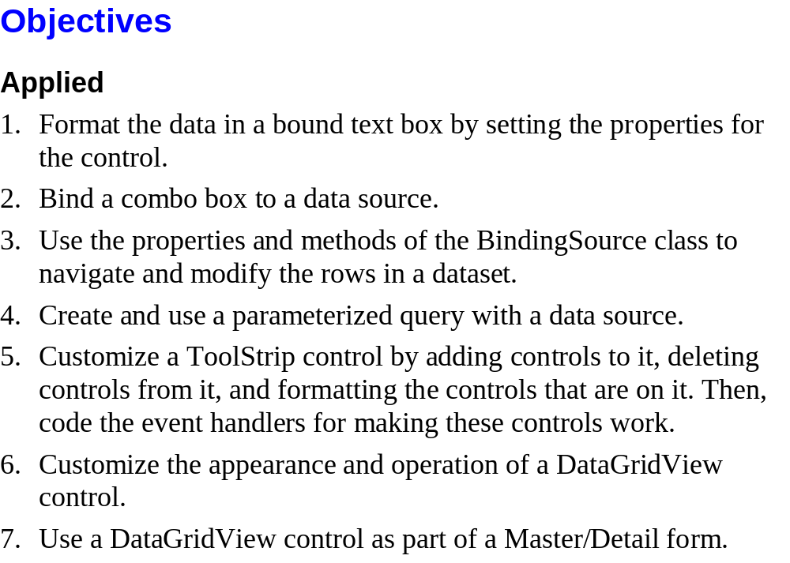
Murach’s C# 2010, C19
© 2010, Mike Murach & Associates, Inc.
Slide <number>

Slide 3
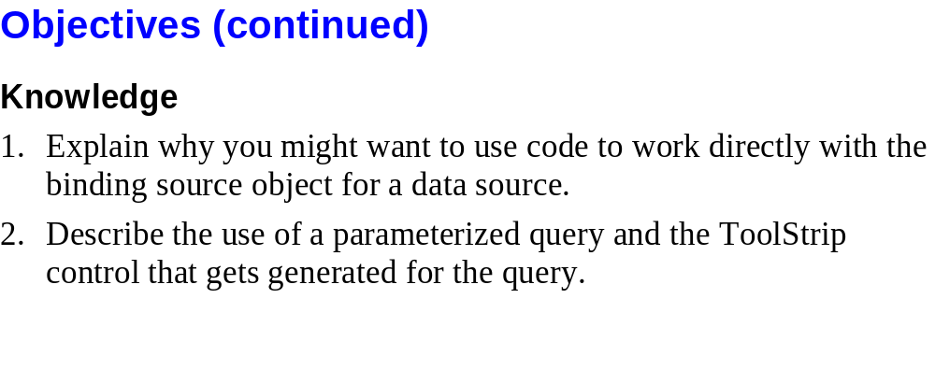
Murach’s C# 2010, C19
© 2010, Mike Murach & Associates, Inc.
Slide <number>

Slide 4
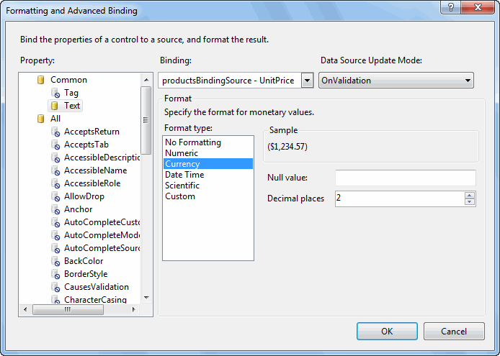
Murach’s C# 2010, C19
© 2010, Mike Murach & Associates, Inc.
Slide <number>

Slide 5
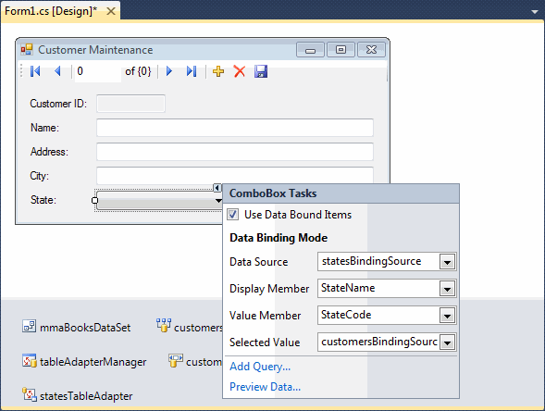
Murach’s C# 2010, C19
© 2010, Mike Murach & Associates, Inc.
Slide <number>

Slide 6
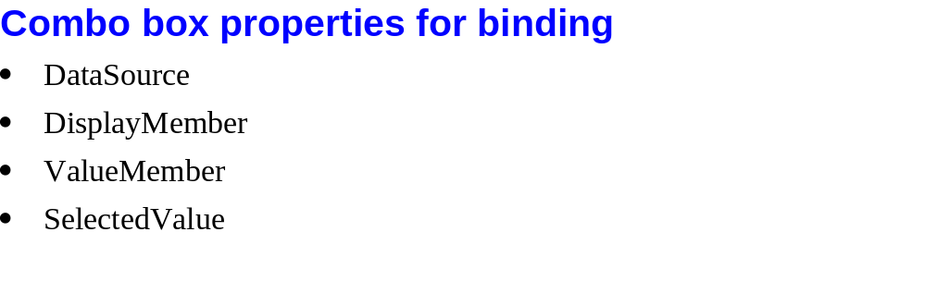
Murach’s C# 2010, C19
© 2010, Mike Murach & Associates, Inc.
Slide <number>

Slide 7
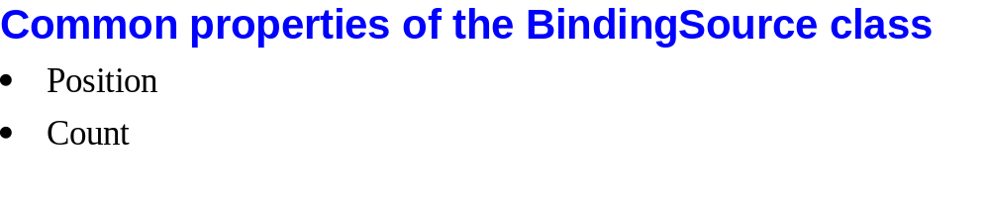
Murach’s C# 2010, C19
© 2010, Mike Murach & Associates, Inc.
Slide <number>

Slide 8
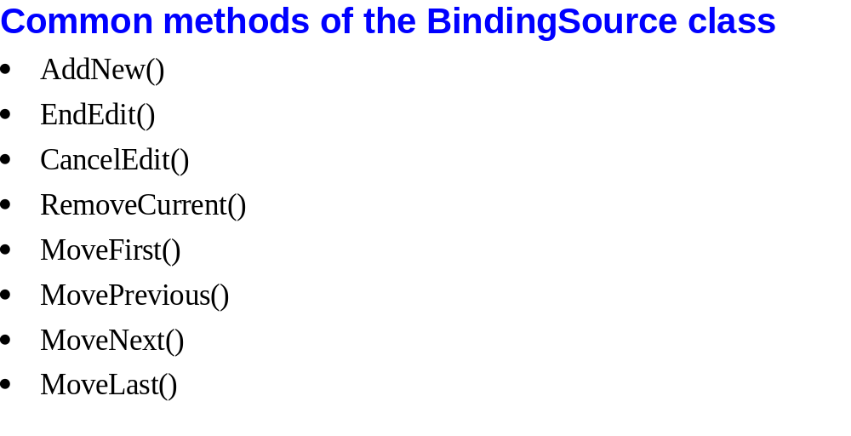
Murach’s C# 2010, C19
© 2010, Mike Murach & Associates, Inc.
Slide <number>

Slide 9
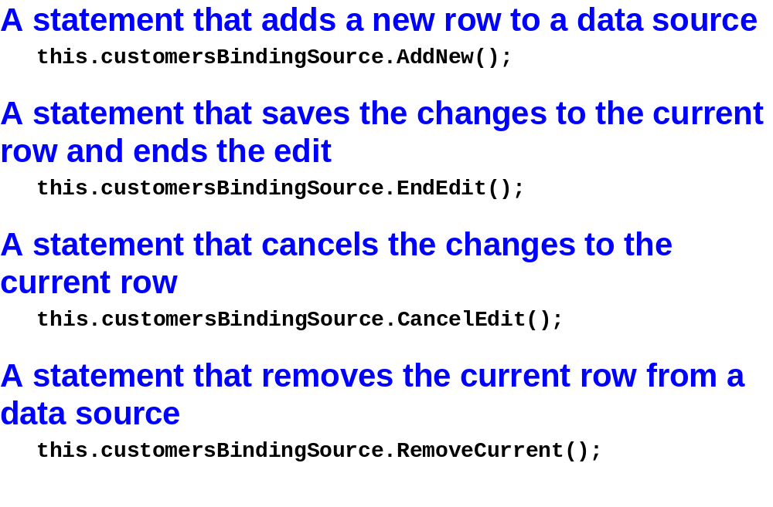
Murach’s C# 2010, C19
© 2010, Mike Murach & Associates, Inc.
Slide <number>

Slide 10
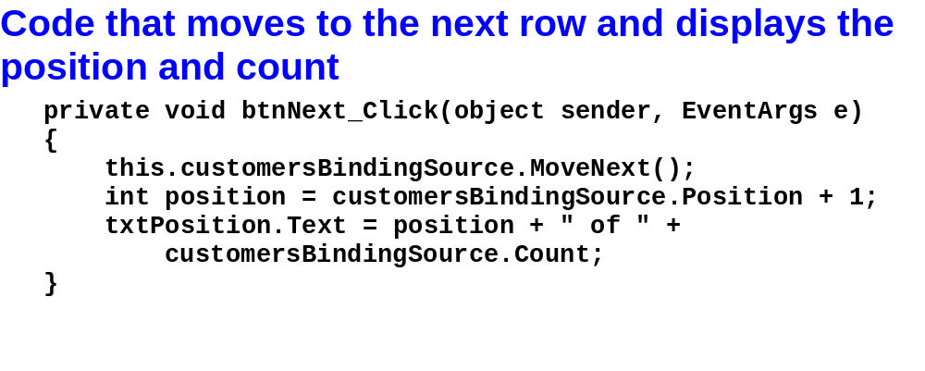
Murach’s C# 2010, C19
© 2010, Mike Murach & Associates, Inc.
Slide <number>

Slide 11

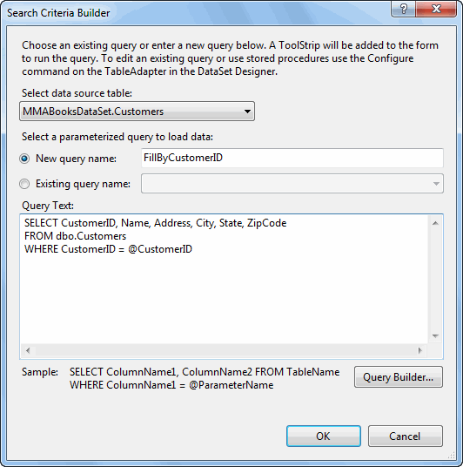
Murach’s C# 2010, C19
© 2010, Mike Murach & Associates, Inc.
Slide <number>

Slide 12

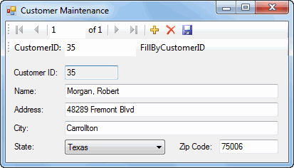
Murach’s C# 2010, C19
© 2010, Mike Murach & Associates, Inc.
Slide <number>

Slide 13
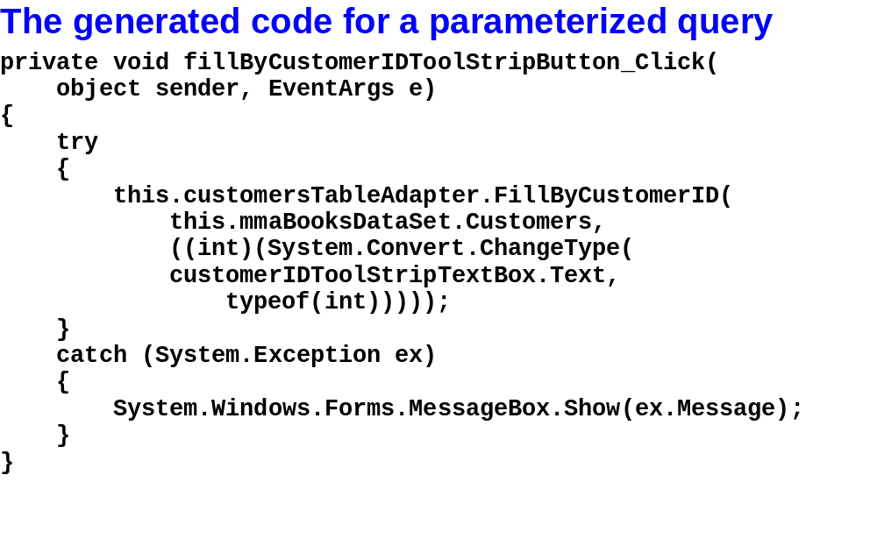
Murach’s C# 2010, C19
© 2010, Mike Murach & Associates, Inc.
Slide <number>

Slide 14
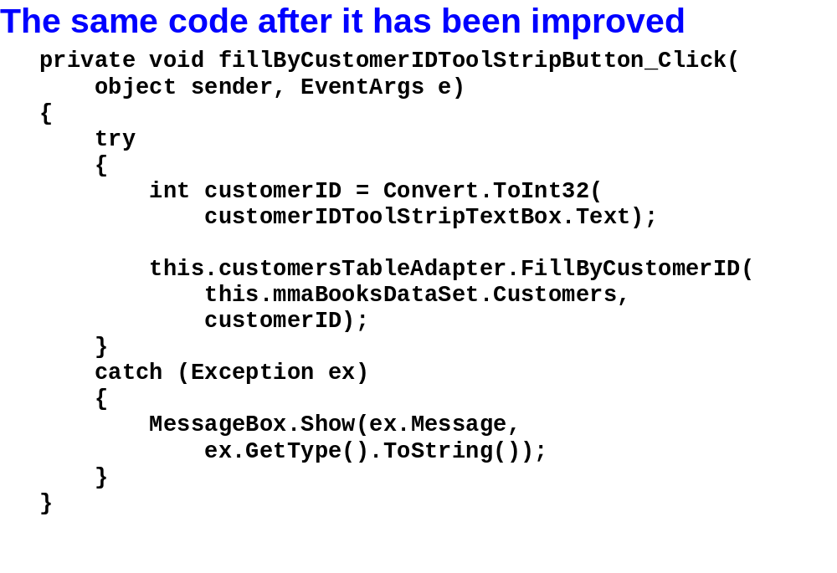
Murach’s C# 2010, C19
© 2010, Mike Murach & Associates, Inc.
Slide <number>

Slide 15
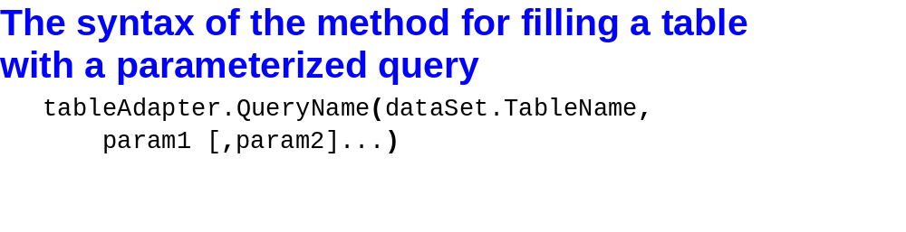
Murach’s C# 2010, C19
© 2010, Mike Murach & Associates, Inc.
Slide <number>

Slide 16
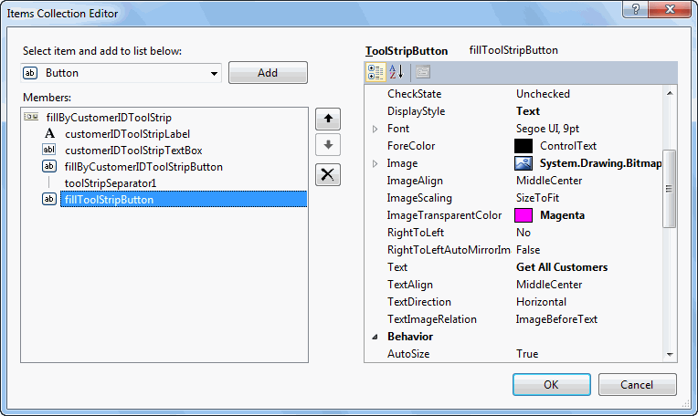
Murach’s C# 2010, C19
© 2010, Mike Murach & Associates, Inc.
Slide <number>

Slide 17
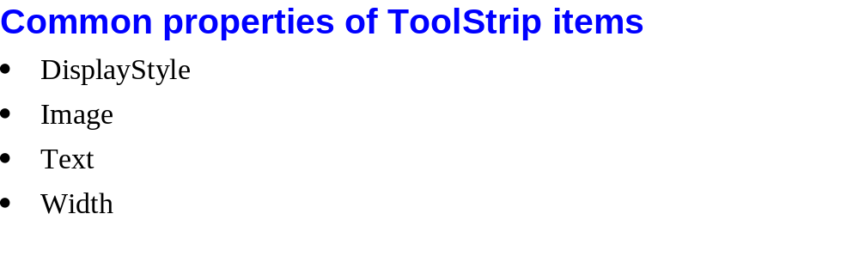
Murach’s C# 2010, C19
© 2010, Mike Murach & Associates, Inc.
Slide <number>

Slide 18

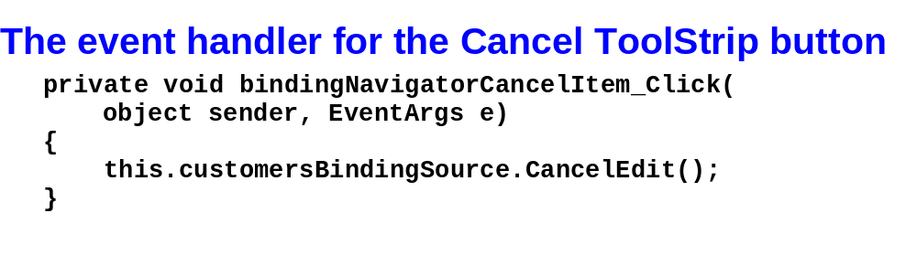
Murach’s C# 2010, C19
© 2010, Mike Murach & Associates, Inc.
Slide <number>

Slide 19
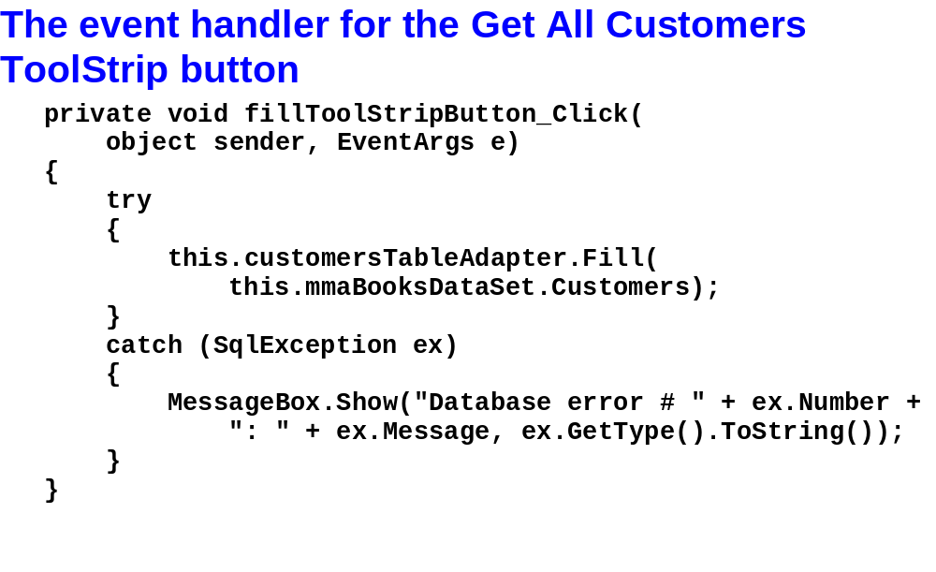
Murach’s C# 2010, C19
© 2010, Mike Murach & Associates, Inc.
Slide <number>

Slide 20
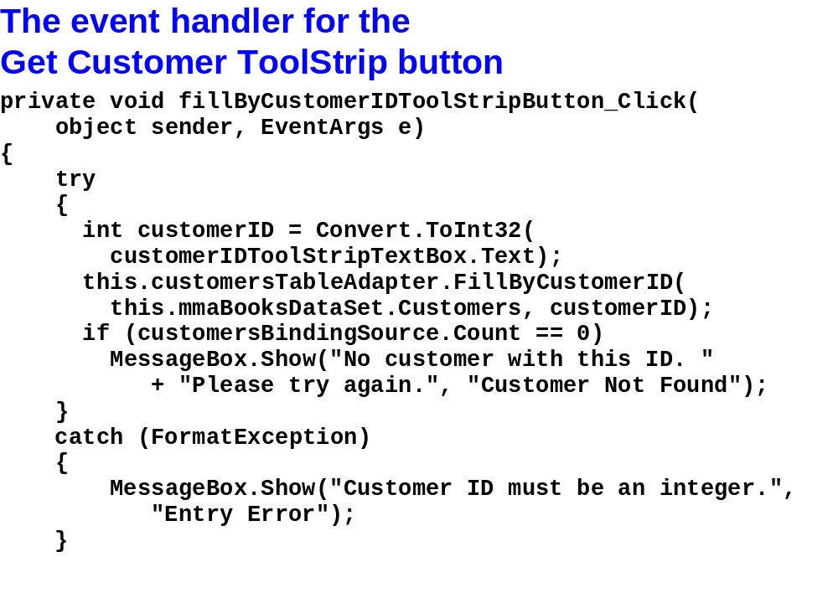
Murach’s C# 2010, C19
© 2010, Mike Murach & Associates, Inc.
Slide <number>

Slide 21
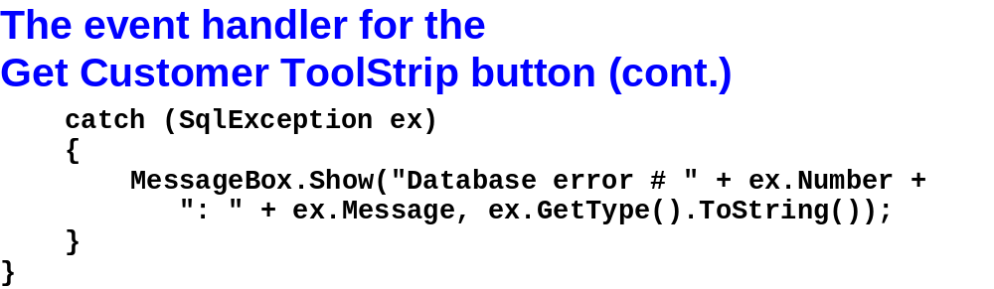
Murach’s C# 2010, C19
© 2010, Mike Murach & Associates, Inc.
Slide <number>

Slide 22

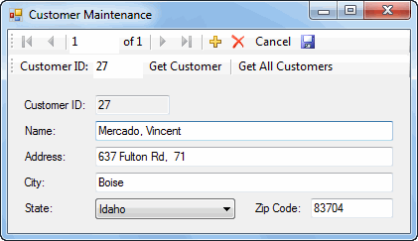
Murach’s C# 2010, C19
© 2010, Mike Murach & Associates, Inc.
Slide <number>

Slide 23
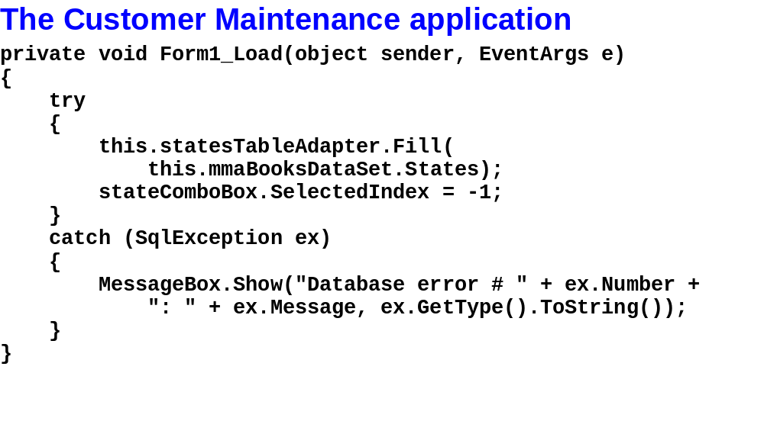
Murach’s C# 2010, C19
© 2010, Mike Murach & Associates, Inc.
Slide <number>

Slide 24
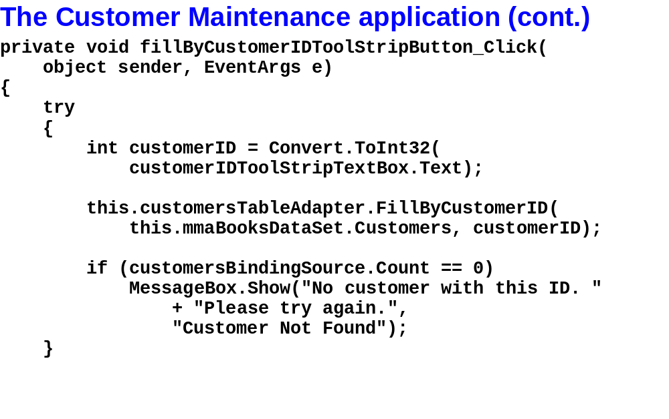
Murach’s C# 2010, C19
© 2010, Mike Murach & Associates, Inc.
Slide <number>

Slide 25
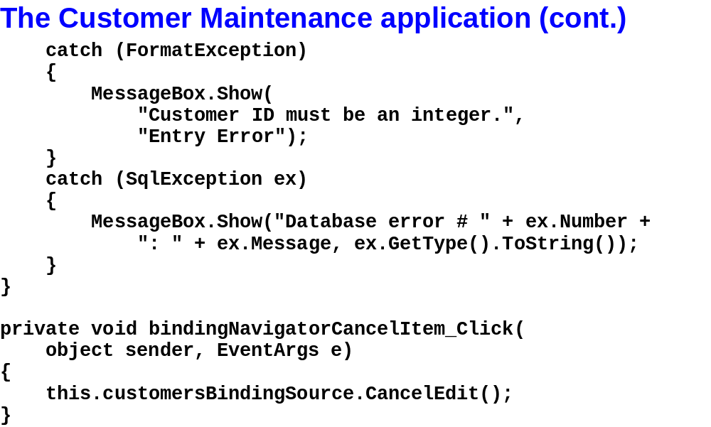
Murach’s C# 2010, C19
© 2010, Mike Murach & Associates, Inc.
Slide <number>

Slide 26
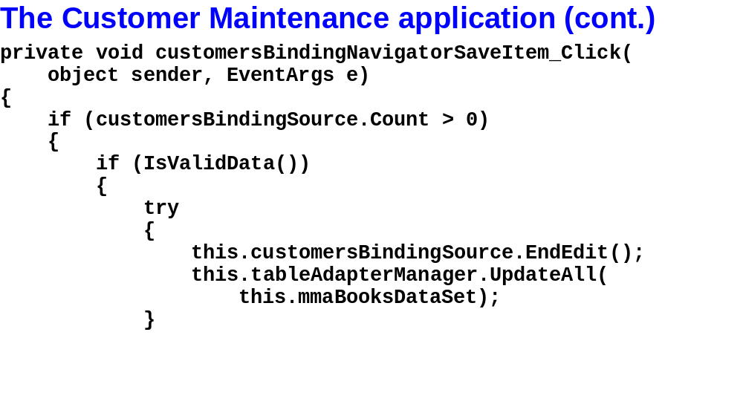
Murach’s C# 2010, C19
© 2010, Mike Murach & Associates, Inc.
Slide <number>

Slide 27
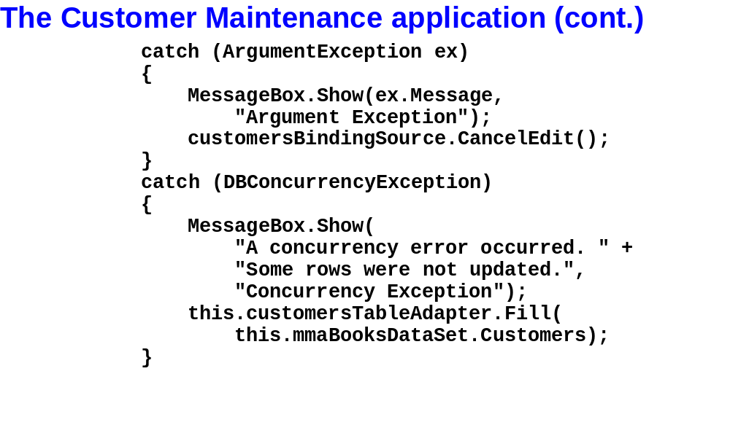
Murach’s C# 2010, C19
© 2010, Mike Murach & Associates, Inc.
Slide <number>

Slide 28
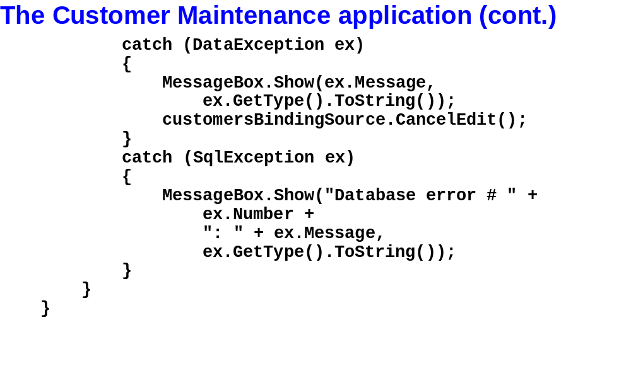
Murach’s C# 2010, C19
© 2010, Mike Murach & Associates, Inc.
Slide <number>

Slide 29
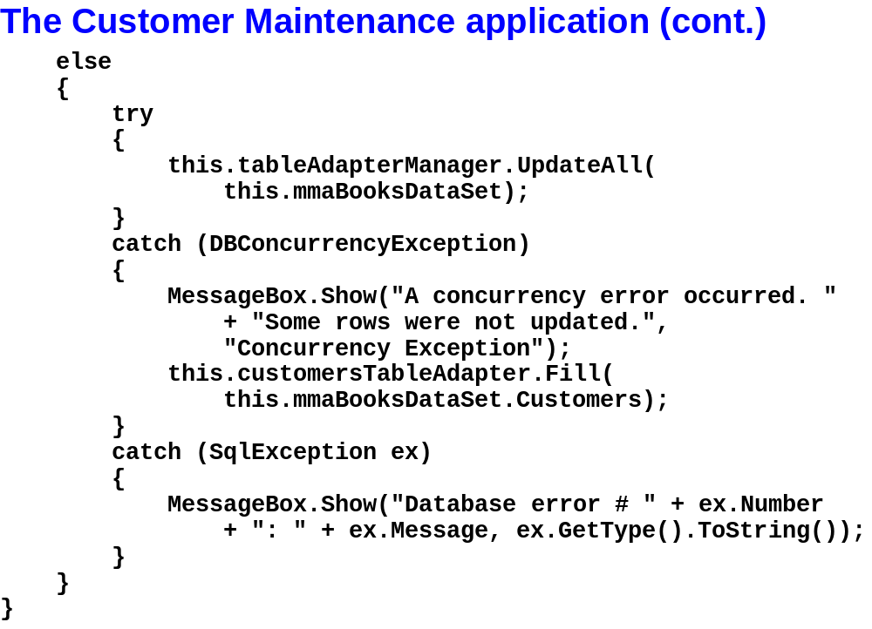
Murach’s C# 2010, C19
© 2010, Mike Murach & Associates, Inc.
Slide <number>

Slide 30
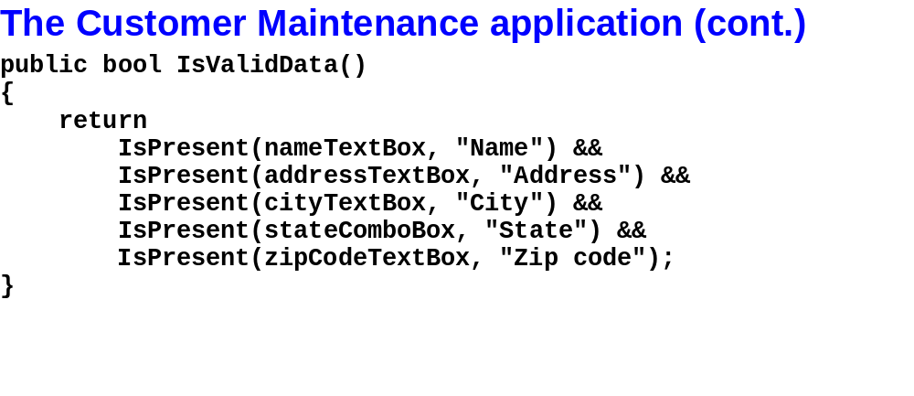
Murach’s C# 2010, C19
© 2010, Mike Murach & Associates, Inc.
Slide <number>

Slide 31
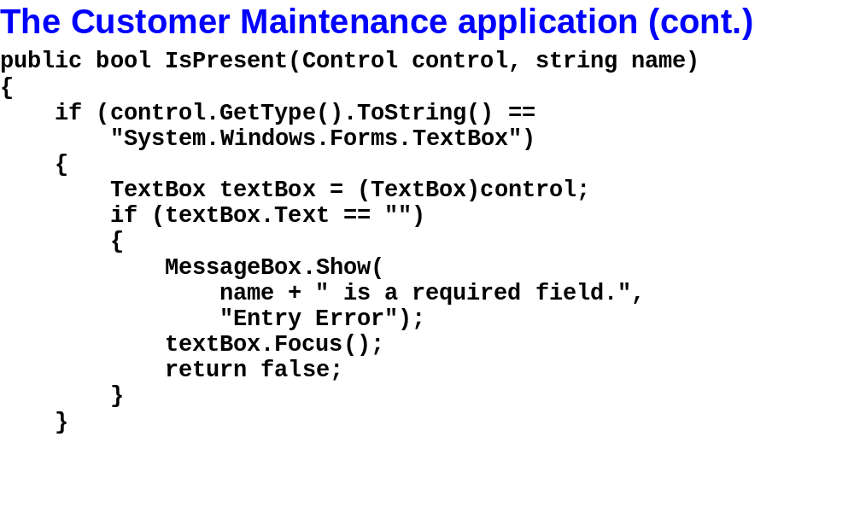
Murach’s C# 2010, C19
© 2010, Mike Murach & Associates, Inc.
Slide <number>

Slide 32
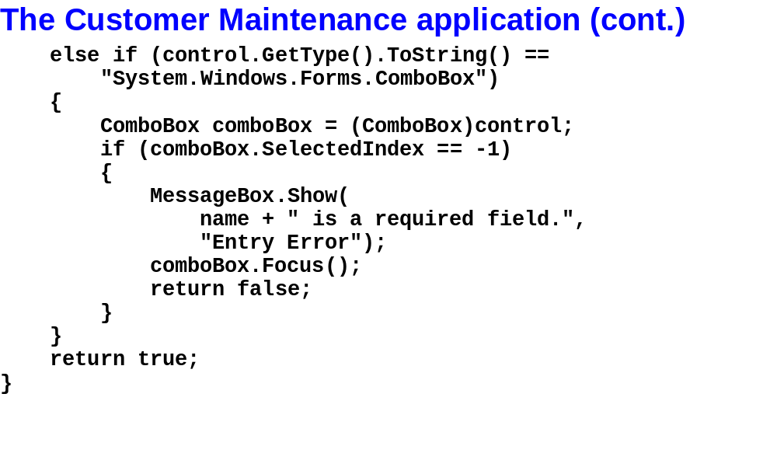
Murach’s C# 2010, C19
© 2010, Mike Murach & Associates, Inc.
Slide <number>

Slide 33
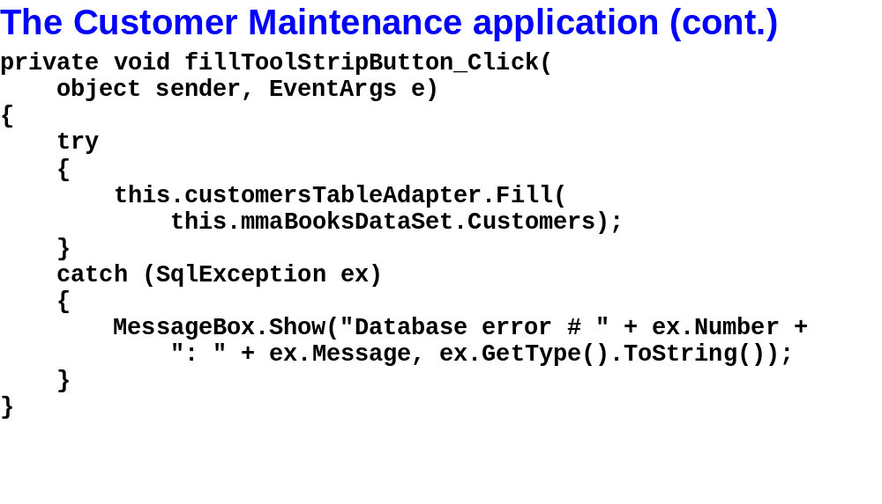
Murach’s C# 2010, C19
© 2010, Mike Murach & Associates, Inc.
Slide <number>

Slide 34

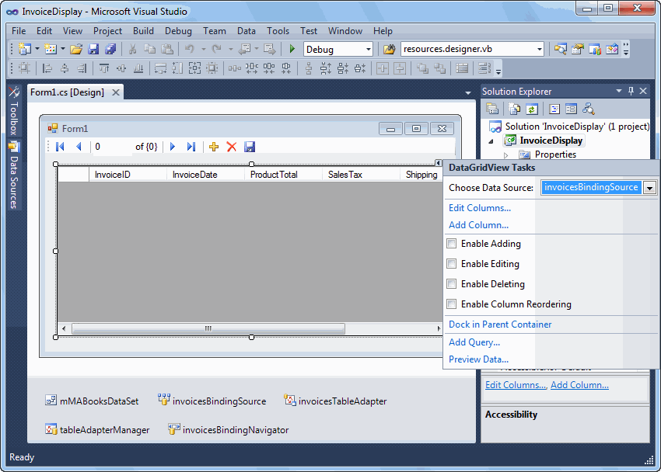
Murach’s C# 2010, C19
© 2010, Mike Murach & Associates, Inc.
Slide <number>

Slide 35
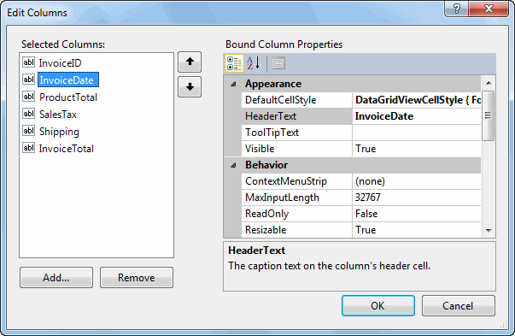
Murach’s C# 2010, C19
© 2010, Mike Murach & Associates, Inc.
Slide <number>

Slide 36
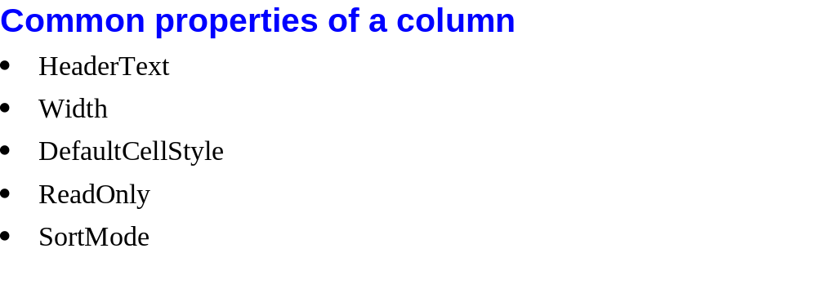
Murach’s C# 2010, C19
© 2010, Mike Murach & Associates, Inc.
Slide <number>

Slide 37

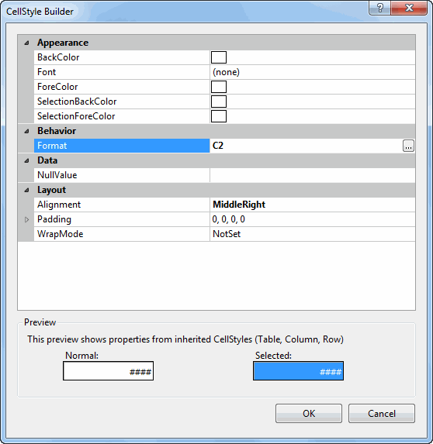
Murach’s C# 2010, C19
© 2010, Mike Murach & Associates, Inc.
Slide <number>

Slide 38

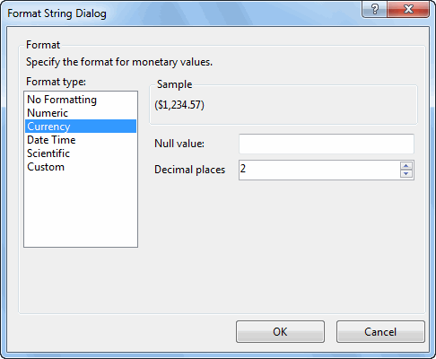
Murach’s C# 2010, C19
© 2010, Mike Murach & Associates, Inc.
Slide <number>

Slide 39
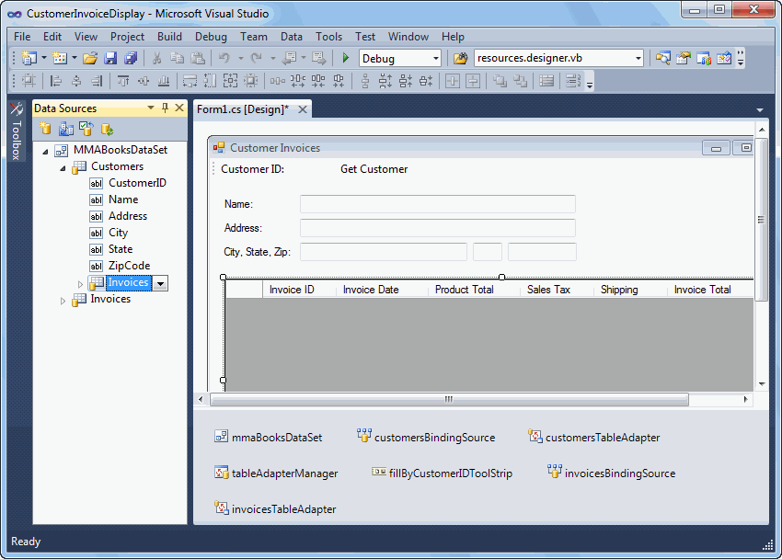
Murach’s C# 2010, C19
© 2010, Mike Murach & Associates, Inc.
Slide <number>

Slide 40
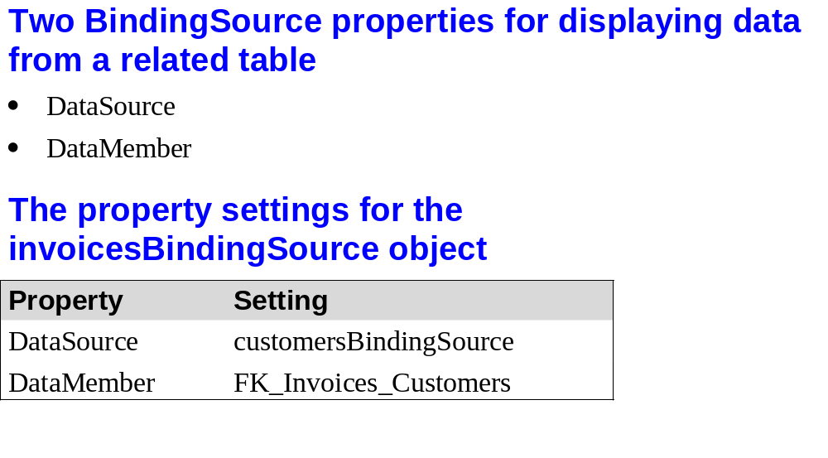
Murach’s C# 2010, C19
© 2010, Mike Murach & Associates, Inc.
Slide <number>

Slide 41

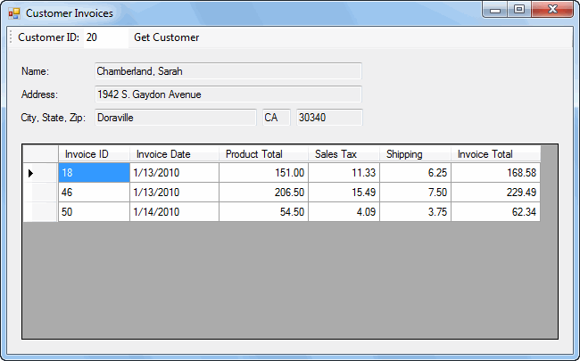
Murach’s C# 2010, C19
© 2010, Mike Murach & Associates, Inc.
Slide <number>

Slide 42

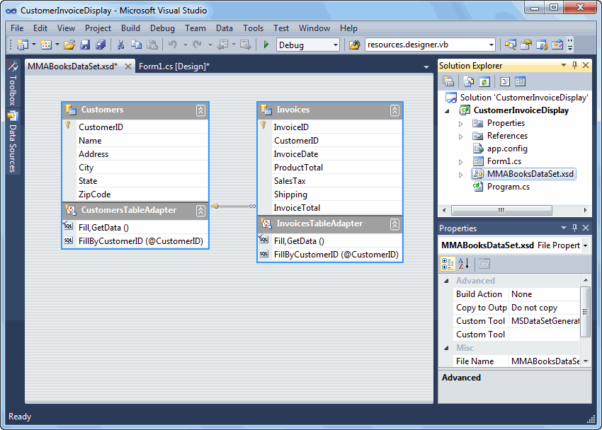
Murach’s C# 2010, C19
© 2010, Mike Murach & Associates, Inc.
Slide <number>

Slide 43
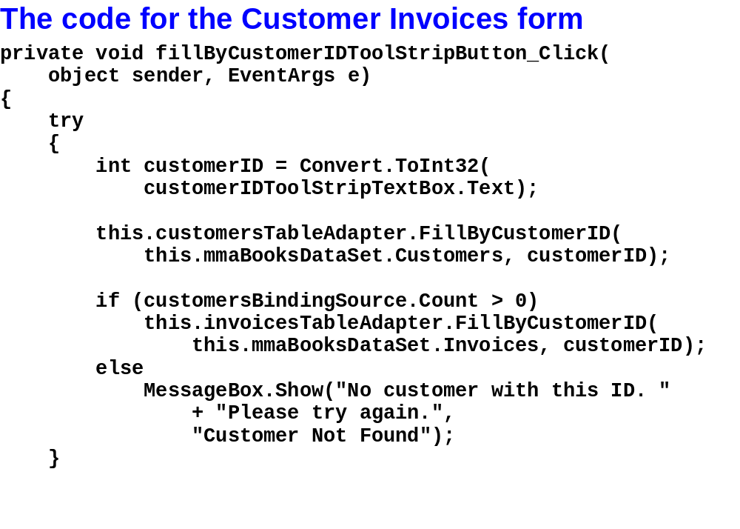
Murach’s C# 2010, C19
© 2010, Mike Murach & Associates, Inc.
Slide <number>

Slide 44
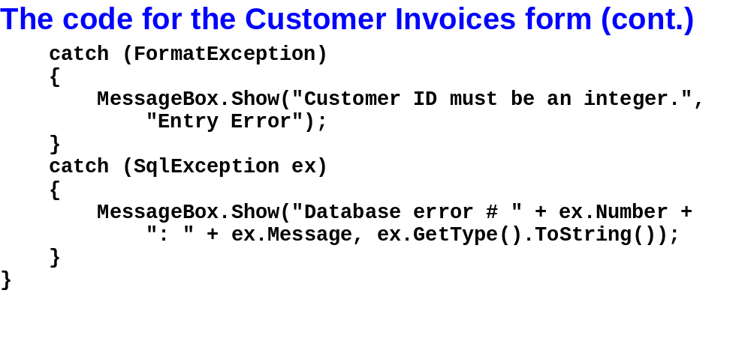
Murach’s C# 2010, C19
© 2010, Mike Murach & Associates, Inc.
Slide <number>

