Slide 1

Course: Java programming i
Mr. Chenda Sovisal

Slide 2
Chapter 13 SWING in Java

Slide 3

Agenda
Introduction to SWING
Create Java SWING
Layout Manager
SWING Components
SWING Event Handling

Slide 4
SWING Components in Java

Slide 5
SWING Components in Java JFrame

Slide 6
IV. SWING Components in Java
JFrame
Constructor | Descriptions
JFrame() | Creates a new, initially invisible Frame.
JFrame(String title) | Creates a new, initially invisible Frame with the specified title.

Slide 7
IV. SWING Components in Java (con.)
JFrame
Methods | Descriptions
setTitle(String title) | Set title of the frame
setDefaultCloseOperation(int operation) | Exit out of application. There are options for this such as: DO_NOTHING_ON_CLOSE HIDE_ON_CLOSE DISPOSE_ON_CLOSE EXIT_ON_CLOSE
setIconImage(ImageIcon image) | Change icon of frame
getContentPane() | Change color of background
dispose() | Close frame

Slide 8


Slide 9
SWING Components in Java JLabel

Slide 10
IV. SWING Components in Java
JLabel
Constructor | Descriptions
JLabel() | Creates a JLabel instance with no image and with an empty string for the title.
JLabel(Icon image) | Creates a JLabel instance with the specified image.
JLabel(Icon image, int horizontalAlignment) | Creates a JLabel instance with the specified image and horizontal alignment.
JLabel(String text) | Creates a JLabel instance with the specified text.
JLabel(String text, Icon icon, int horizontalAlignment) | Creates a JLabel instance with the specified text, image, and horizontal alignment.
JLabel(String text, int horizontalAlignment) | Creates a JLabel instance with the specified text and horizontal alignment.

Slide 11
IV. SWING Components in Java (con.)
JLabel
Methods | Descriptions
void setText(String text) | Set text of label
void setIcon(ImageIcon icon) | Set image in label
void setHorizontalTextPosition(int textPosition) | Sets the horizontal position of the label's text, relative to its image such as: LEFT CENTER RIGHT LEADING TRAILING (the default)

Slide 12
IV. SWING Components in Java (con.)
JLabel
Methods | Descriptions
void setVerticalTextPosition(int textPosition) | Sets the vertical position of the label's text, relative to its image such as: TOP CENTER (the default) BOTTOM
void setForeground(Color color) | Set font color of text
void setIconTextGap(int iconTextGap) | Set gap of text to image
void setBackground(Color color) | Set background color
void setOpaque(boolean status) | Display background color

Slide 13
IV. SWING Components in Java (con.)
JLabel
Methods | Descriptions
void setVerticalAlignment (int alignment) | Set vertical position of icon+text within label
void setHorizontalAlignment(int alignment) | Set horizontal position of icon+text within label

Slide 14


Slide 15
SWING Components in Java JButton

Slide 16
IV. SWING Components in Java
JButton
Constructor | Descriptions
JButton() | Creates a button with no set text or icon.
JButton(ImageIcon icon) | Creates a button with an icon.
JButton(String text) | Creates a button with text.
JButton(String text, ImageIcon icon) | Creates a button with initial text and an icon.

Slide 17
IV. SWING Components in Java (con.)
JButton
Methods | Descriptions
setText(String text) | Set text in button
setFocusable(boolean focusable) | Sets the focusable state of this Component to the specified value. This value overrides the Component's default focusability.
setIcon(Image icon) | Set icon for Button
setHorizontalTextPosition(int textPosition) | Sets the horizontal position of the button’s text, relative to its image such as: LEFT CENTER RIGHT LEADING TRAILING (the default)

Slide 18
IV. SWING Components in Java (con.)
JButton
Methods | Descriptions
setVerticalTextPosition(int textPosition) | Sets the vertical position of the button’s text, relative to its image such as: TOP CENTER (the default) BOTTOM
setEnable(boolean status) | Disable or enable button

Slide 19
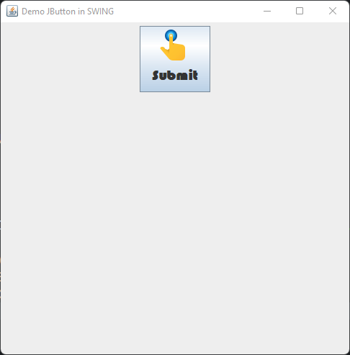

Slide 20
SWING Components in Java JTextField

Slide 21
IV. SWING Components in Java
JTextField
Constructor | Descriptions
JTextField() | Creates a new TextField
JTextField(String text) | Creates a new TextField initialized with the specified text.
JTextField(String text, int columns) | Creates a new TextField initialized with the specified text and columns.
JTextField(int columns) | Creates a new empty TextField with the specified number of columns.

Slide 22
IV. SWING Components in Java (con.)
JTextField
Methods | Descriptions
setFont(Font font) | Set specific font, size and style for textfield
setForeground(Color color) | Set font color for textfield
setBackground(Color color) | Set color for textfield background
setCaretColor(Color color) | Set cursor color in textfield
setEditable(boolean status) | Disable or enable textfield

Slide 23
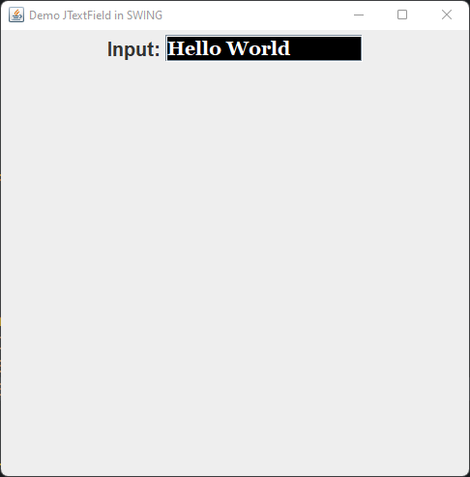

Slide 24
SWING Components in Java JTextArea

Slide 25
IV. SWING Components in Java
JTextArea
Constructor | Descriptions
JTextArea(String s) | Creates a text area that displays specified text initially.
JTextArea(int row, int column) | Creates a text area with the specified number of rows and columns that displays no text initially.
JTextArea(String s, int row, int column) | Creates a text area with the specified number of rows and columns that displays specified text.
JTextArea(String s) | Creates a text area that displays specified text initially.

Slide 26
IV. SWING Components in Java (con.)
JTextArea
Methods | Descriptions
setRows(int rows) | It is used to set specified number of rows.
setColumns(int cols) | It is used to set specified number of columns.
getText() | Get text from textarea.
setText() | Set text to textarea.
append(String s) | It is used to append the given text to the end of the document.

Slide 27
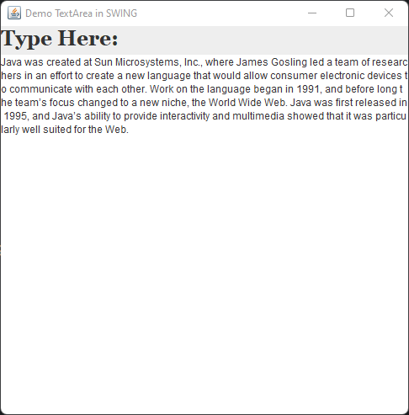

Slide 28
SWING Components in Java JPasswordField

Slide 29
IV. SWING Components in Java
JPasswordField
Constructor | Descriptions
JPasswordField() | Constructs a new JPasswordField, with a default document, null starting text string, and 0 column width.
JPasswordField(int columns) | Constructs a new empty JPasswordField with the specified number of columns.
JPasswordField(String text) | Constructs a new JPasswordField initialized with the specified text.
JPasswordField(String text, int columns) | Construct a new JPasswordField initialized with the specified text and columns.

Slide 30
IV. SWING Components in Java (con.)
JPasswordField
Methods | Descriptions
getPassword() | Returns the text contained in this JPasswordField.

Slide 31
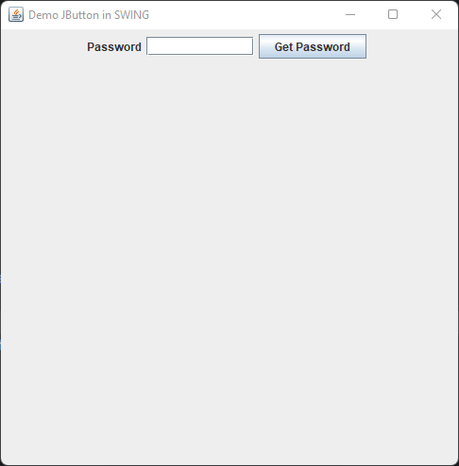

Slide 32
SWING Components in Java JCheckBox

Slide 33
IV. SWING Components in Java
JCheckBox
Constructor | Descriptions
JCheckBox() | Creates an initially unselected check box button with no text, no icon.
JChechBox(String s) | Creates an initially unselected check box with text.
JCheckBox(String text, boolean selected) | Creates a check box with text and specifies whether or not it is initially selected.

Slide 34
IV. SWING Components in Java (con.)
JCheckBox
Methods | Descriptions
setFocus(boolean status) | Disable or enable focus on checkbox
setFont(Font font) | Set font for checkbox
setIcon(ImageIcon image) | Set default icon for checkbox rather than the default checkbox icon.
setSelectedIcon(ImageIcon image) | Set icon for selected checkbook.

Slide 35
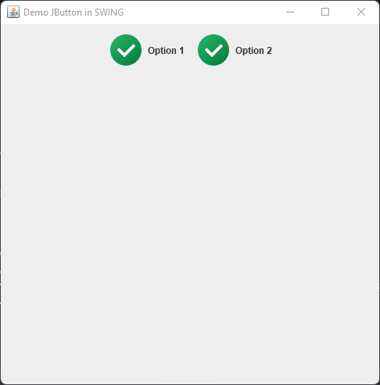

Slide 36
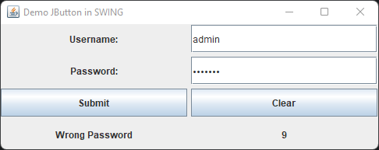

Slide 37
SWING Components in Java JRadioButton

Slide 38
IV. SWING Components in Java
JRadioButton
Constructor | Descriptions
JRadioButton() | Creates an unselected radio button with no text.
JRadioButton(String s) | Creates an unselected radio button with specified text.
JRadioButton(String s, boolean selected) | Creates a radio button with the specified text and selected status.

Slide 39
IV. SWING Components in Java (con.)
JRadioButton
Methods | Descriptions
setIcon(ImageIcon image) | Set default icon for radio button.
getText() | Get string text from radio button.
ButtonGroup()
add(JRadioButton radiobutton) | Add Radio buttons into a group

Slide 40
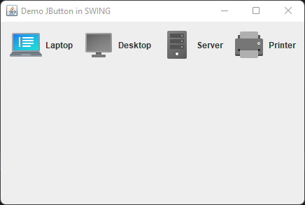

Slide 41
SWING Components in Java ButtonGroup

Slide 42
IV. SWING Components in Java
ButtonGroup
Constructor | Descriptions
ButtonGroup() | Creates an object for group.

Slide 43
IV. SWING Components in Java (con.)
ButtonGroup
Methods | Descriptions
add(JRadioButton radiobutton) | Add Radio buttons into a group

Slide 44
SWING Components in Java JComboBox

Slide 45
IV. SWING Components in Java
JComboBox
Constructor | Descriptions
JComboBox() | Creates a JComboBox with a default data model.
JComboBox(Object[] items) | Creates a JComboBox that contains the elements in the specified array.

Slide 46
IV. SWING Components in Java (con.)
JComboBox
Methods | Descriptions
addItem(String string) | It is used to add an item to the item list.
removeItem(String string) | It is used to delete an item to the item list.
getItemCount() | Get number of all item in combobox.
setEditable(boolean status) | It is used to determine whether the JComboBox is editable.
setSelectedIndex(int index) | Set default selected item.
getSelectedItem() | Get item that is selected.
getSelectedIndex() | Get index item that is selected.

Slide 47
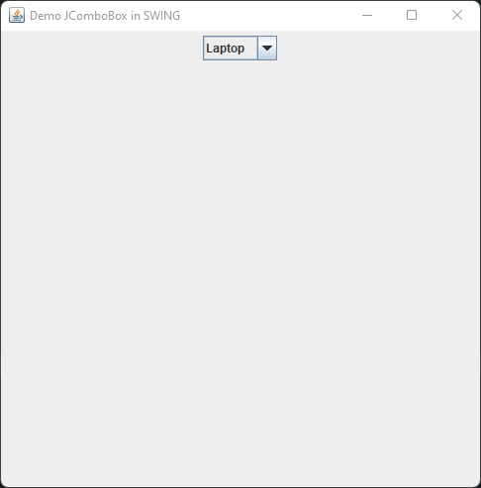

Slide 48
SWING Components in Java JSlider

Slide 49
IV. SWING Components in Java
JSlider
Constructor | Descriptions
JSlider() | creates a slider with the initial value of 50 and range of 0 to 100.
JSlider(int min, int max) | creates a horizontal slider using the given min and max.
JSlider(int min, int max, int value) | creates a horizontal slider using the given min, max and value.
JSlider(int orientation, int min, int max, int value) | creates a slider using the given orientation set by either JSlider.HORIZONTAL or JSlider.VERTICAL, min, max and value.

Slide 50
IV. SWING Components in Java (con.)
JSlider
Methods | Descriptions
setMinorTickSpacing(int n) | is used to set the minor tick spacing to the slider.
setMajorTickSpacing(int n) | is used to set the major tick spacing to the slider.
setPaintTicks(boolean status) | is used to determine whether tick marks are painted.
setPaintLabels(boolean status) | is used to determine whether labels are painted.
getValue() | Get value of slider
addChangeListener() | Register change state event

Slide 51
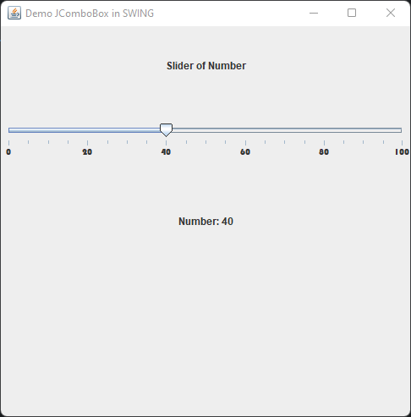

Slide 52
SWING Components in Java JProgressBar

Slide 53
IV. SWING Components in Java
JProgressBar
Constructor | Descriptions
JProgressBar() | It is used to create a progress bar.
JProgressBar(int min, int max) | It is used to create a progress bar minimum and maximum value.
JProgressBar(int orient, int min, int max) | It is used to create a progress bar with the specified orientation can be either Vertical or Horizontal by using SwingConstants.VERTICAL and SwingConstants.HORIZONTAL constants, minimum and maximum value.

Slide 54
IV. SWING Components in Java (con.)
JProgressBar
Methods | Descriptions
setStringPainted(boolean status) | It is used to determine whether string should be displayed.
setString(String s) | It is used to set value to the progress string.
setValue(int value) | It is used to set the current value on the progress bar.

Slide 55
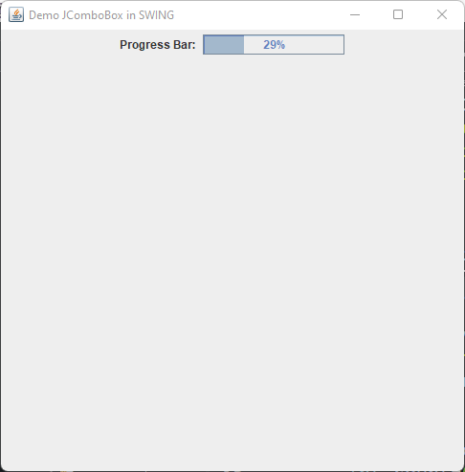

Slide 56
SWING Components in Java JOptionPane

Slide 57
IV. SWING Components in Java (con.)
JOptionPane
Note: We can store its value in a variable to do something after get confirm from user.
Methods | Descriptions
showMessageDialog(Component parentComponent, Object message, String title, int messageType) | It is used to create a message dialog with given title and messageType such as ERROR_MESSAGE INFORMATION_MESSAGE WARNING_MESSAGE QUESTION_MESSAGE PLAIN_MESSAGE.
showConfirmDialog(Component parentComponent, Object message, String title, int messageType) | It is used to create a message dialog with given title and the set of option buttons that appear at the bottom of the dialog such as DEFAULT_OPTION YES_NO_OPTION YES_NO_CANCEL_OPTION OK_CANCEL_OPTION.
showOptionDialog(Component parentComponent, Object message, String title, int messageType, ImageIcon icon, String[] options, int initialValue) | It is used to create a fully customize message dialog.

Slide 58
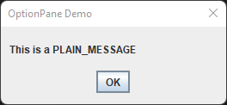
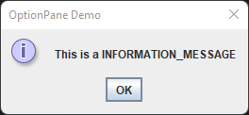
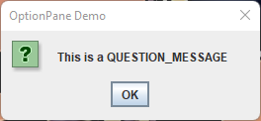
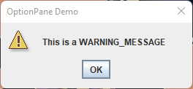
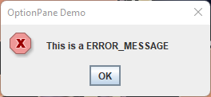

Slide 59
SWING Components in Java JMenuBar

Slide 60
IV. SWING Components in Java
JMenuBar
Constructor | Descriptions
JMenuBar() | creates a menu bar object.

Slide 61
IV. SWING Components in Java (con.)
JMenuBar
Methods | Descriptions
add(Menu menu) | Add object of menu into menu bar.

Slide 62
SWING Components in Java JMenu

Slide 63
IV. SWING Components in Java
JMenu
Constructor | Descriptions
JMenu() | creates a menu object.

Slide 64
IV. SWING Components in Java (con.)
JMenu
Methods | Descriptions
add(Menu menu) | Add object of menu items.
setMnemonic(KeyEvent key) | Set shortcut for menu or menuitem. For menu, you need to hold alt plus shortcut.
setIcon(ImageIcon icon) | Set icon for menu item.

Slide 65
SWING Components in Java JMenuItem

Slide 66
IV. SWING Components in Java
JMenuItem
Constructor | Descriptions
JMenuItem() | creates a menu object.

Slide 67
IV. SWING Components in Java (con.)
JMenuItem
Methods | Descriptions
add(String s) | Add item as menu.
setMnemonic(KeyEvent key) | Set shortcut for menu or menuitem. For menu, you need to hold alt plus shortcut.
setIcon(ImageIcon icon) | Set icon for menu item.

Slide 68
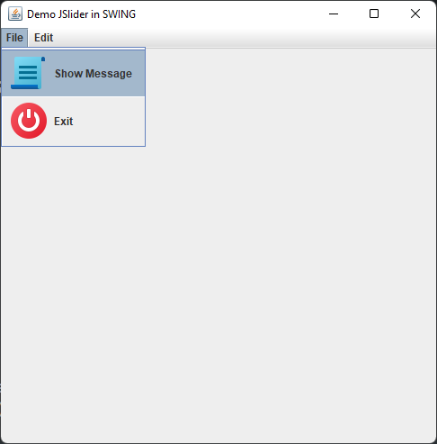

Slide 69
SWING Components in Java JPanel

Slide 70
IV. SWING Components in Java
JPanel
Constructor | Descriptions
JPanel() | Creates a new JPanel with a double buffer and a flow layout.
JPanel(LayoutManager layout) | Create a new buffered JPanel with the specified layout manager

Slide 71
IV. SWING Components in Java (con.)
JPanel
Methods | Descriptions
setBackground(Color color) | Set background color of Panel
setBounds(int x, int y, int width, int height) | Set position and size of Panel
setLayout(LayoutManager mgr) | Set the layout manager for this panel.

