Slide 1

Course: Java programming i
Mr. Chenda Sovisal

Slide 2
Chapter 14 Java Database Connectivity

Slide 3

Agenda
Introduction to Java Database Connectivity
JDBC Drives
JAVA Database Connectivity steps
Register the Driver class
Create connection
Create statement
Execute queries
Close connection

Slide 4
Introduction to Java Database Connectivity

Slide 5
I. Introduction to JDBC
Java Database Connectivity (JDBC) is a Java API to connect and execute the query with the database.
JDBC API uses JDBC drivers to connect with the database.
There are four types of JDBC drivers:
JDBC-ODBC Bridge Driver
Native Driver
Network Protocol Driver
Thin Driver

Slide 6
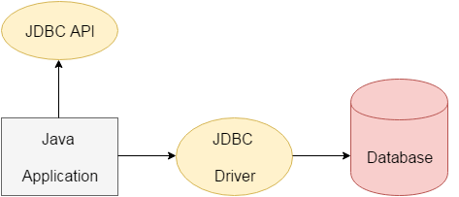
I. Introduction to JDBC (Cont)

Slide 7
I. Introduction to JDBC (Cont)
Before JDBC, ODBC API was the database API to connect and execute the query with the database.
But, ODBC API uses ODBC driver which is written in C language (i.e. platform dependent and unsecured).
That is why Java has defined its own API (JDBC API) that uses JDBC drivers (written in Java language).

Slide 8
I. Introduction to JDBC (Con.)
We can use JDBC API to handle database using Java program and can perform the following activities:
Connect to the database
Execute queries and update statements to the database
Retrieve the result received from the database.

Slide 9
JDBC Driver

Slide 10
II. JDBC Driver
JDBC Driver is a software component that enables java application to interact with the database. There are 4 types of JDBC drivers:
JDBC-ODBC bridge driver
Native-API driver (partially java driver)
Network Protocol driver (fully java driver)
Thin driver (fully java driver)

Slide 11
II. JDBC Driver (Con.)
JDBC-ODBC bridge driver
The JDBC-ODBC bridge driver uses ODBC driver to connect to the database.
The JDBC-ODBC bridge driver converts JDBC method calls into the ODBC function calls.
**This is now discouraged because of thin driver**

Slide 12
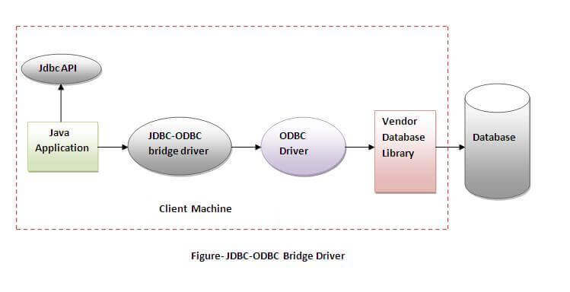
II. JDBC Driver (Con.)

Slide 13
II. JDBC Driver (Con.)
JDBC-ODBC bridge driver
Easy to use.
Can be easily connected to any database.
Performance degraded because JDBC method call is converted into the ODBC function calls.
The ODBC driver needs to be installed on the client machine.

Slide 14
II. JDBC Driver (Con.)
Native-API driver
The Native API driver uses the client-side libraries of the database.
The driver converts JDBC method calls into native calls of the database API.
It is not written entirely in java.

Slide 15
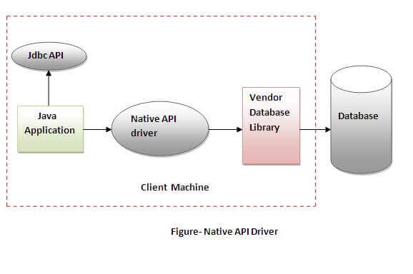
II. JDBC Driver (Con.)

Slide 16
II. JDBC Driver (Con.)
Native-API driver
performance upgraded than JDBC-ODBC bridge driver.
The Native driver needs to be installed on the each client machine.
The Vendor client library needs to be installed on client machine.

Slide 17
II. JDBC Driver (Con.)
Network Protocol driver
The Network Protocol driver uses middleware (application server) that converts JDBC calls directly or indirectly into the vendor-specific database protocol.
It is fully written in java.

Slide 18
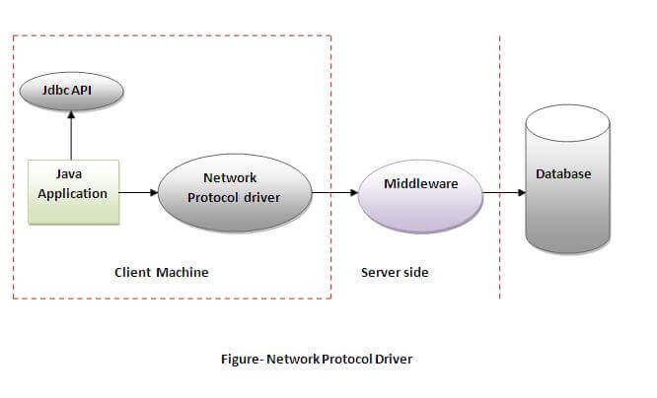
II. JDBC Driver (Con.)

Slide 19
II. JDBC Driver (Con.)
Network Protocol driver
No client side library is required because of application server that can perform many tasks like auditing, load balancing, logging etc.
Network support is required on client machine.
Requires database-specific coding to be done in the middle tier.
Maintenance of Network Protocol driver becomes costly.

Slide 20
II. JDBC Driver (Con.)
Thin driver
The thin driver converts JDBC calls directly into the vendor-specific database protocol.
It is fully written in Java language.

Slide 21
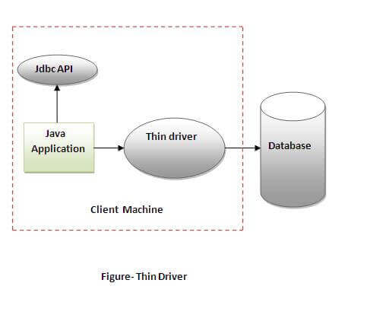
II. JDBC Driver (Con.)

Slide 22
II. JDBC Driver (Con.)
Thin driver
Better performance than all other drivers.
No software is required at client side or server side.
Drivers depend on the Database.

Slide 23
Java Database Connectivity Step

Slide 24
III. Database Connectivity Step
There are 5 steps to connect any java application with the database using JDBC. These steps are as follows:
Register the Driver class
Create connection
Create statement
Execute queries
Close connection

Slide 25
III. Database Connectivity Step (Con.)
1. Register the Driver class
The forName() method of Class is used to register the driver class. This method is used to dynamically load the driver class.
Syntax:
DriverManager.registerDriver(Object driverClass);
Or
Class.forName(driverName);

Slide 26
III. Database Connectivity Step (Con.)
1. Register the Driver class (con.)
However, that is not required since JDBC 4.0 (JDK 6.0) because the driver manager can detect and load the driver class automatically as long as a suitable JDBC driver present in the classpath.

Slide 27
III. Database Connectivity Step (Con.)
2. Create the connection object
The getConnection() method of DriverManager class is used to establish connection with the database.
Syntax:
Connection con=DriverManager.getConnection(driverURL,user,password);

Slide 28
III. Database Connectivity Step (Con.)
2. Create the connection object (con.)
con is the Object of our Connection
driverURL is the url for our database and it will change depend on what database that we are using.
user is username in our database.
password is password in our database.

Slide 29
III. Database Connectivity Step (Con.)
List of Driver name and Driver URL
https://docs.google.com/document/d/13gu5fmMnrXNaWUJr9egPYgDxuwUH7tk07MzoRskHZjI/edit?usp=sharing

Slide 30
III. Database Connectivity Step (Con.)
3. Create the Statement object
The createStatement() method of Connection interface is used to create statement. The object of statement is responsible to execute queries with the database.
Syntax:
Statement stmt=con.createStatement();

Slide 31
III. Database Connectivity Step (Con.)
4. Execute the query
The executeQuery() method of Statement interface is used to execute queries to the database. This method returns the object of ResultSet that can be used to get all the records of a table.
Syntax:
ResultSet rs=stmt.executeQuery(SQLStatment);

Slide 32
III. Database Connectivity Step (Con.)
5. Close the connection object
By closing connection object statement and ResultSet will be closed automatically. The close() method of Connection interface is used to close the connection.
Syntax:
con.close();

Slide 33
The End

