Slide 1

Murach’s C# 2010, C5
© 2010, Mike Murach & Associates, Inc.
Slide <number>

Slide 2
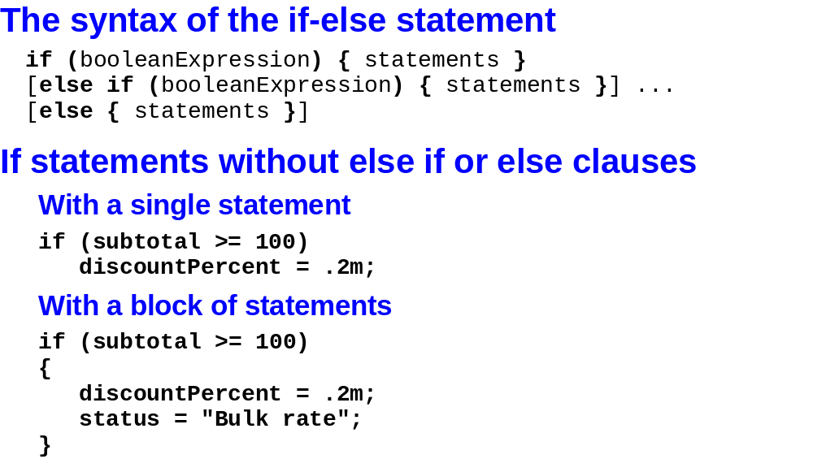
Murach’s C# 2010, C5
© 2010, Mike Murach & Associates, Inc.
Slide <number>

Slide 3
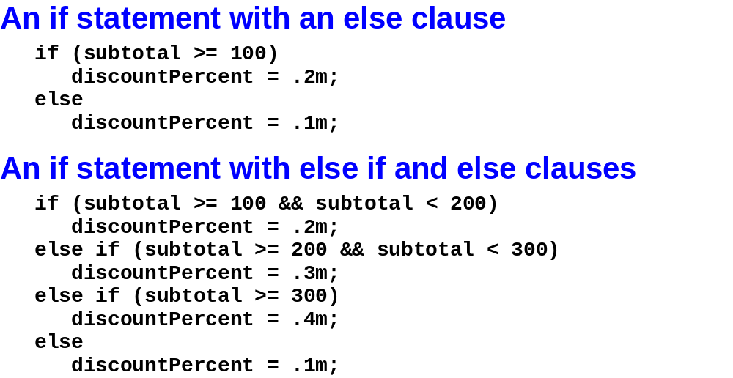
Murach’s C# 2010, C5
© 2010, Mike Murach & Associates, Inc.
Slide <number>

Slide 4
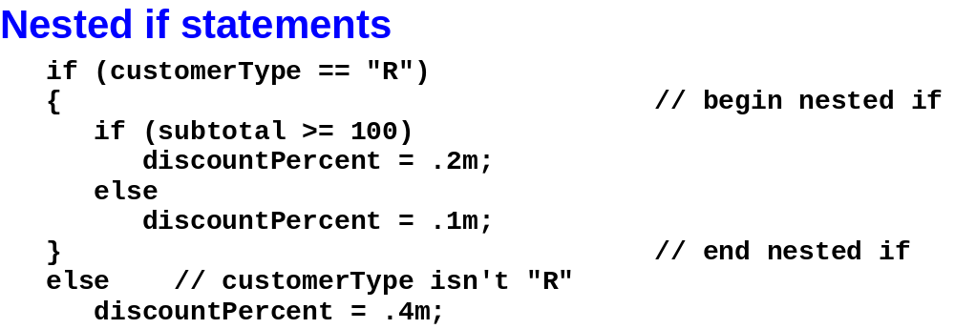
Murach’s C# 2010, C5
© 2010, Mike Murach & Associates, Inc.
Slide <number>

Slide 5
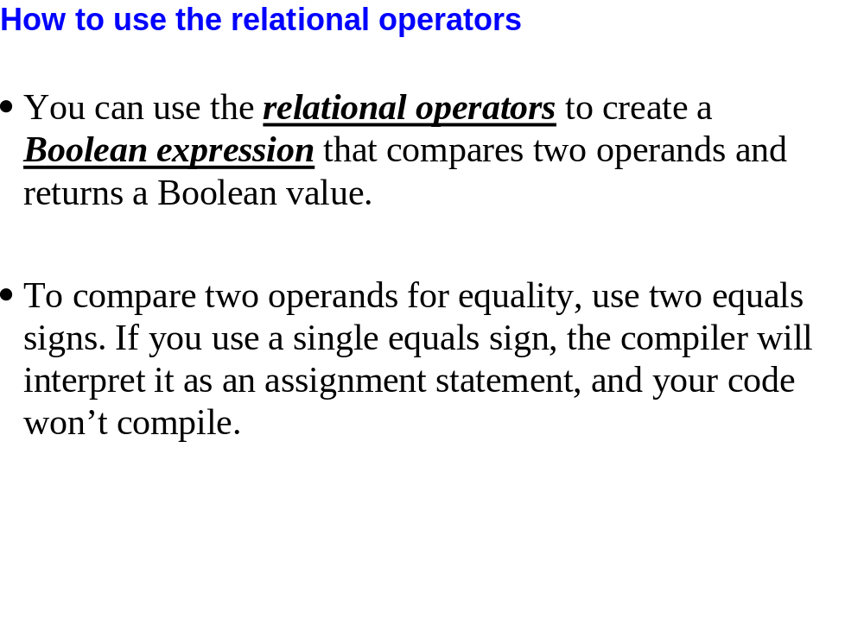
Slide <number>

Slide 6
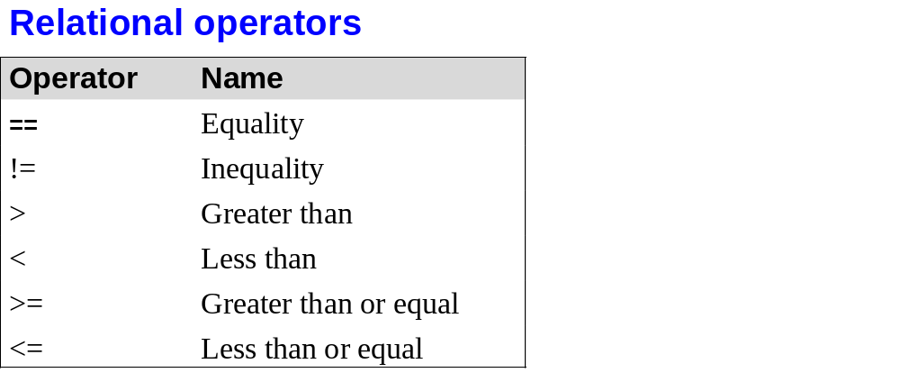
Murach’s C# 2010, C5
© 2010, Mike Murach & Associates, Inc.
Slide <number>

Slide 7
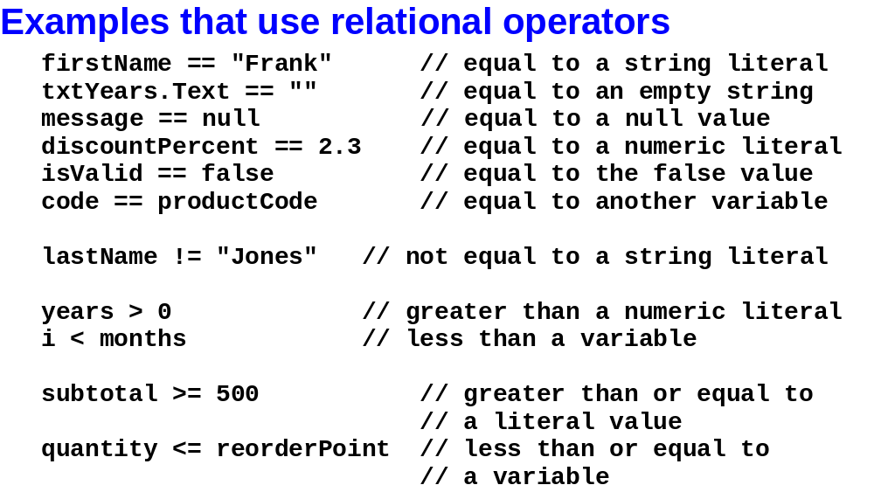
Murach’s C# 2010, C5
© 2010, Mike Murach & Associates, Inc.
Slide <number>

Slide 8
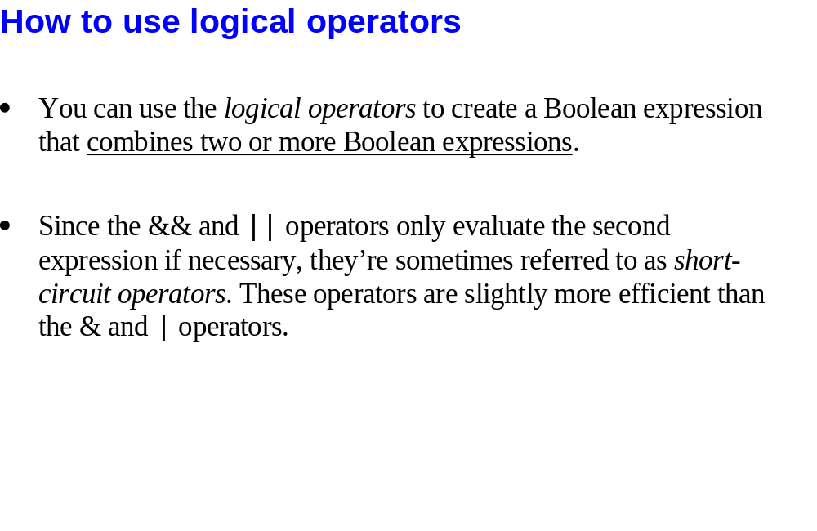
Slide <number>

Slide 9
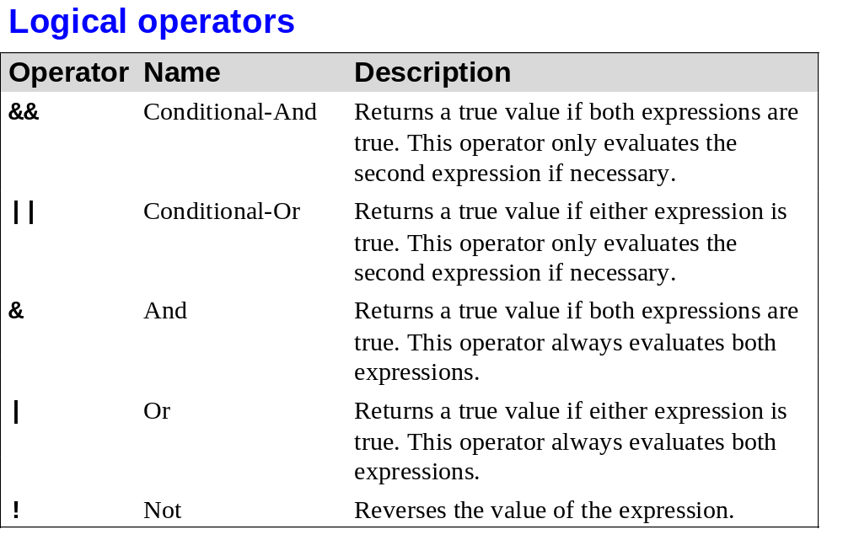
Murach’s C# 2010, C5
© 2010, Mike Murach & Associates, Inc.
Slide <number>

Slide 10
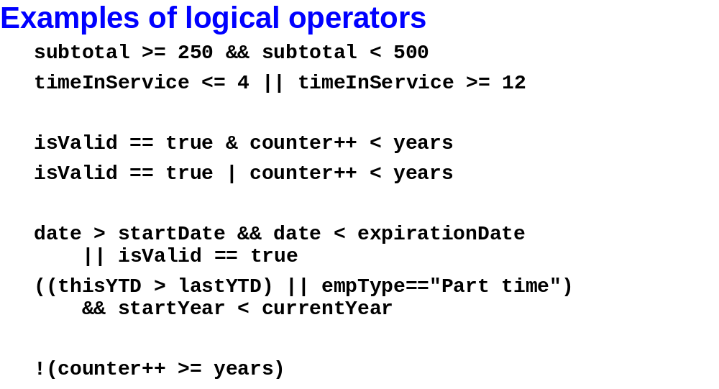
Murach’s C# 2010, C5
© 2010, Mike Murach & Associates, Inc.
Slide <number>

Slide 11
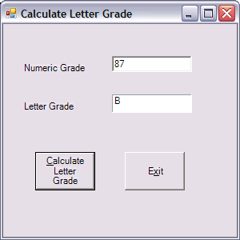
In-Class Activity
Can you
  Code the “Calculate..” to
    Access txtNumericGrade.Text
    Convert it to a decimal and store it in a variable
    Use If-else construct to determine the letter grade and display it in lblLetterGrade.txt
Numeric Grade | Letter Grade
90-100 | A
80-89 | B
70-79 | C
60-69 | D
< 60 | F

Slide 12
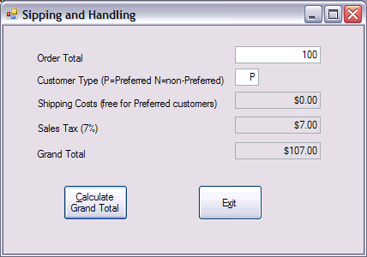
In-Class Activity
Can you
  Code the “Exit” button
  Code the “Calculate..” button to
    If the customer is “Preferred”, they always get free shipping
    Shipping cost for non-Preferred is a function of the Order Total
      $0.00-$25.00 = $5.00
      $25.01-$500.00 = $8.00
      $500.01-$1,000.00 = $10.00
      $1,000.01-$5,000.00 = $15.00
      $5,000.01 and up = $20.00
    Sales tax is 7% of Order Total + Shipping (if any)
    Display the shipping cost, sales tax, and grand total all formatted as currency
Slide <number>

Slide 13
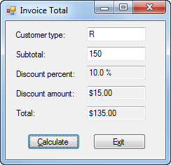
Refer to page 144 to see what is going on with this enhanced form…
Murach’s C# 2010, C5
© 2010, Mike Murach & Associates, Inc.
Slide <number>

Slide 14
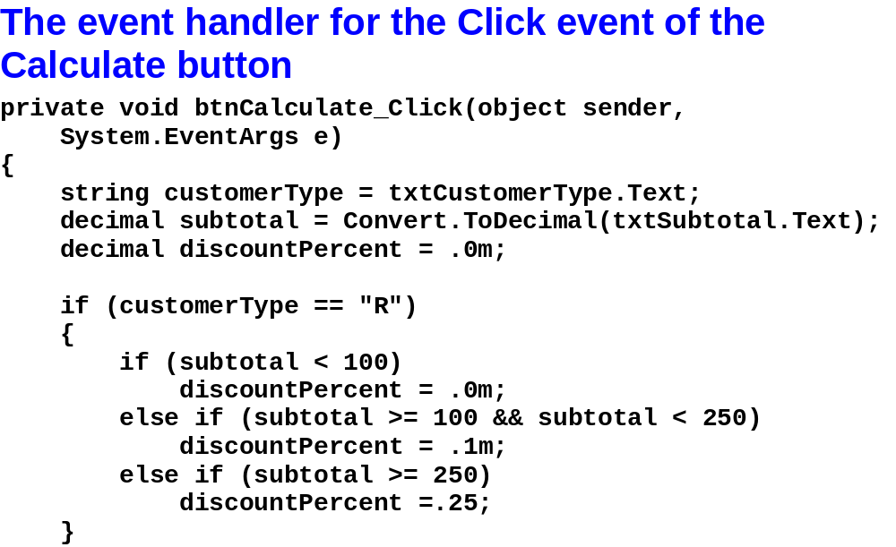
Murach’s C# 2010, C5
© 2010, Mike Murach & Associates, Inc.
Slide <number>

Slide 15
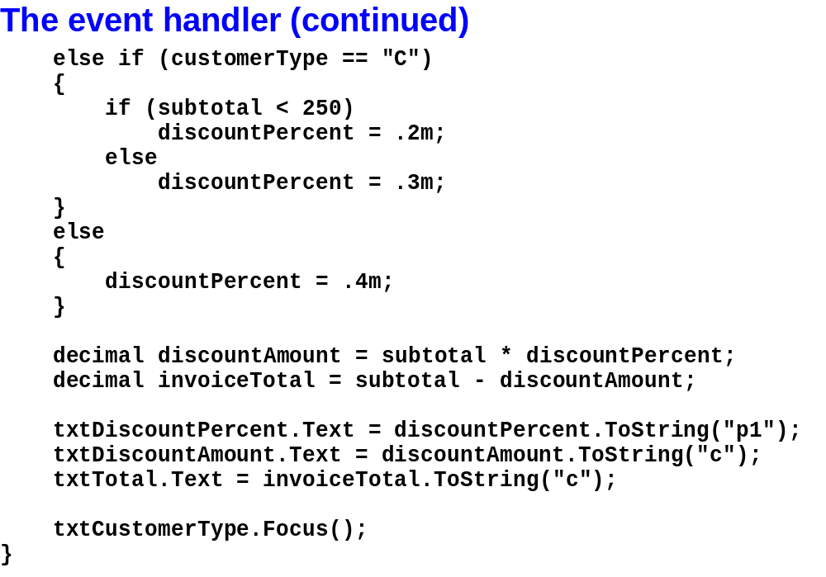
Murach’s C# 2010, C5
© 2010, Mike Murach & Associates, Inc.
Slide <number>

Slide 16
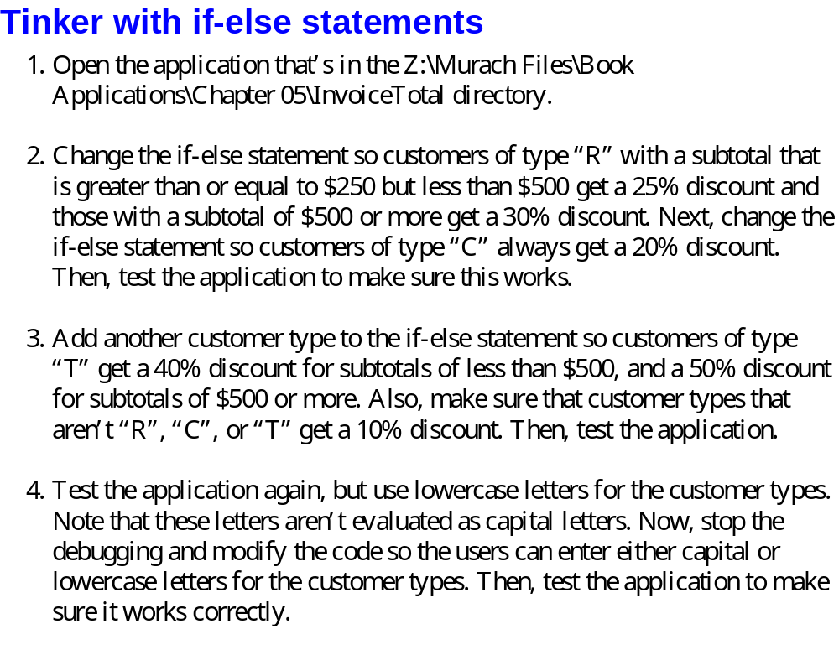
Slide <number>

Slide 17
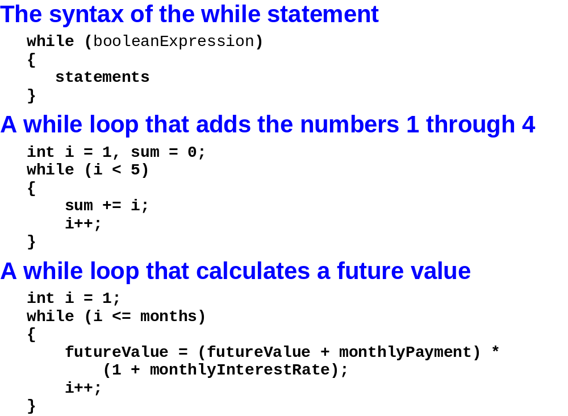
Murach’s C# 2010, C5
© 2010, Mike Murach & Associates, Inc.
Slide <number>

Slide 18
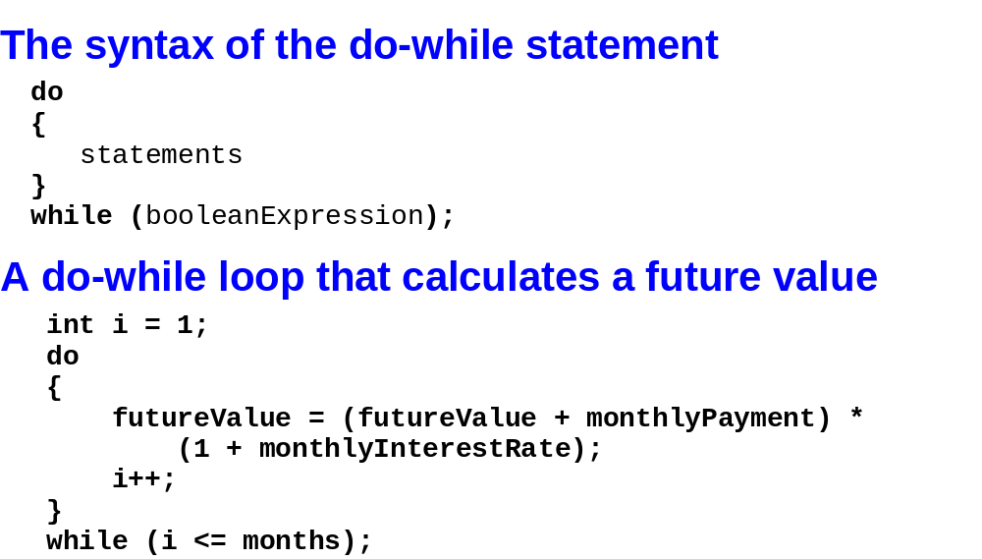
Murach’s C# 2010, C5
© 2010, Mike Murach & Associates, Inc.
Slide <number>

Slide 19
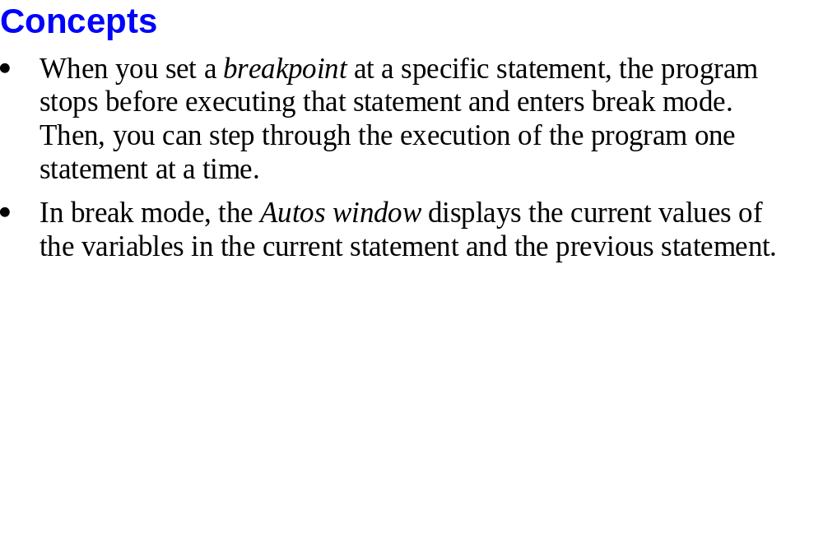
Slide <number>

Slide 20
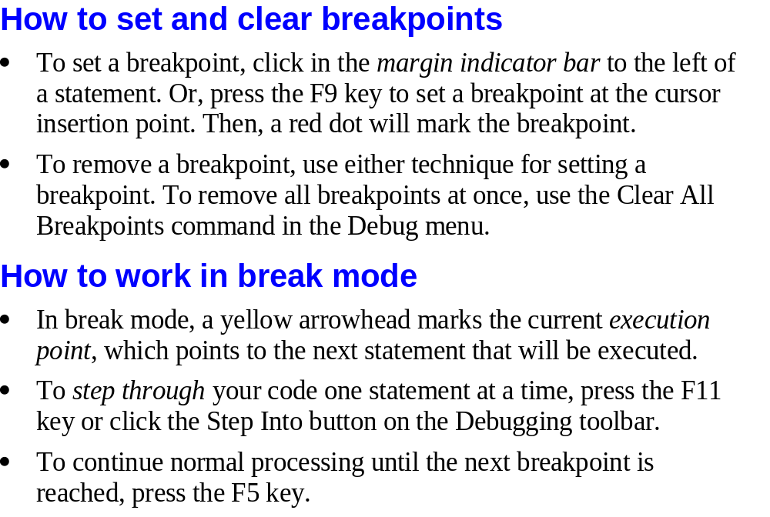
Murach’s C# 2010, C5
© 2010, Mike Murach & Associates, Inc.
Slide <number>

Slide 21

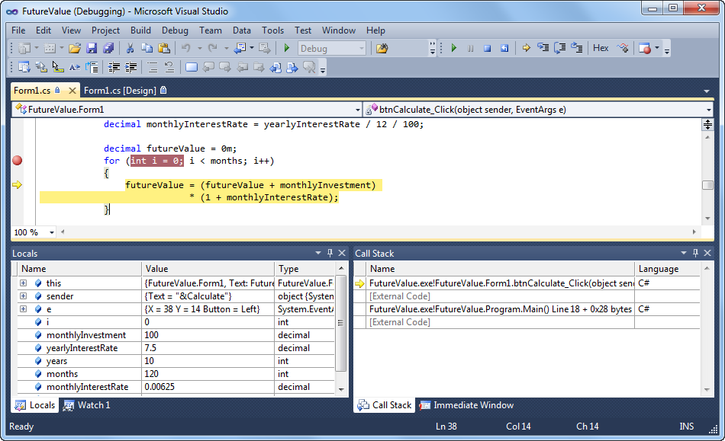
Murach’s C# 2010, C5
© 2010, Mike Murach & Associates, Inc.
Slide <number>

Slide 22
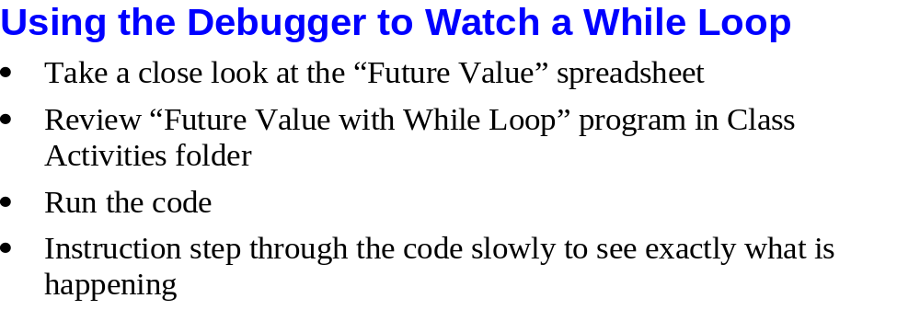
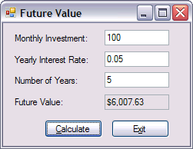
Slide <number>

Slide 23
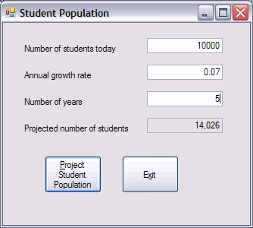
In-Class Activity
Text boxes
Can you
  Get the number of students today.
  Using a loop, calculate the number of students each year for the number of years, adding in the number of new students each year.
  Don’t forget about compounding.
Read Only Text Box
Slide <number>

Slide 24
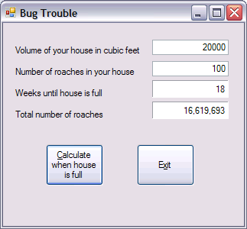
In-Class Activity
Each roach is 0.002 cubic feet & has a weekly growth rate of 95%
Playing with While loops
  Meaningless activity
  Forces you to use While loop
  Encourage use of debugger
    Debugger…get it…sorry
  Look through my solution in the “In Class Exercises” folder on the Z-drive and then see if you can code this loop on your own

Slide 25
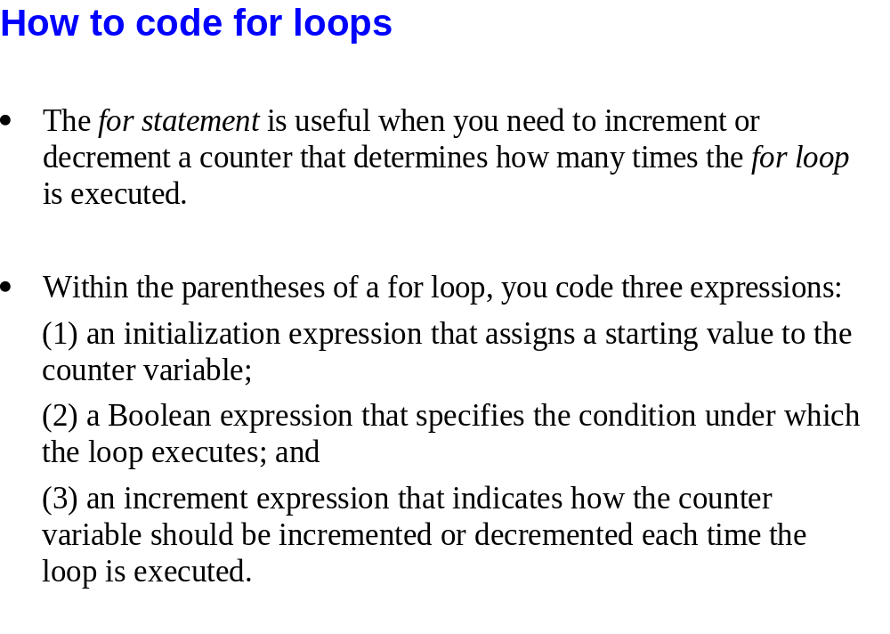
Slide <number>

Slide 26
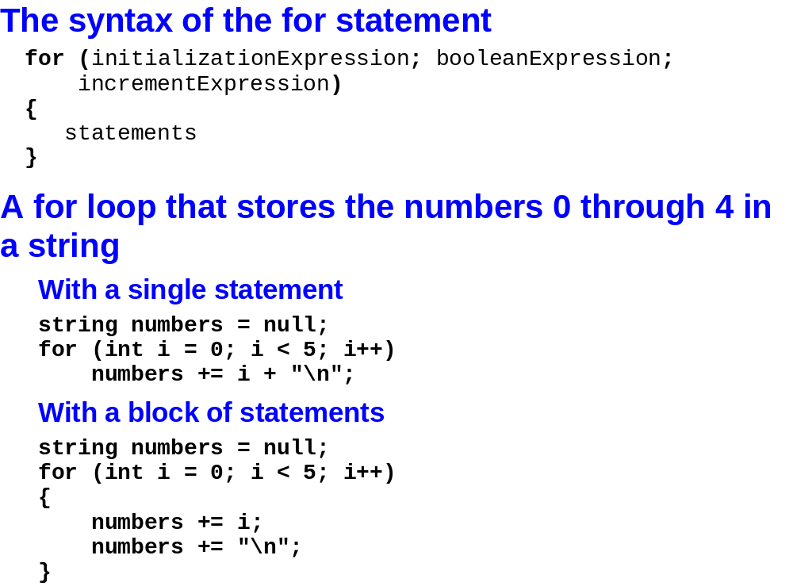
Murach’s C# 2010, C5
© 2010, Mike Murach & Associates, Inc.
Slide <number>

Slide 27
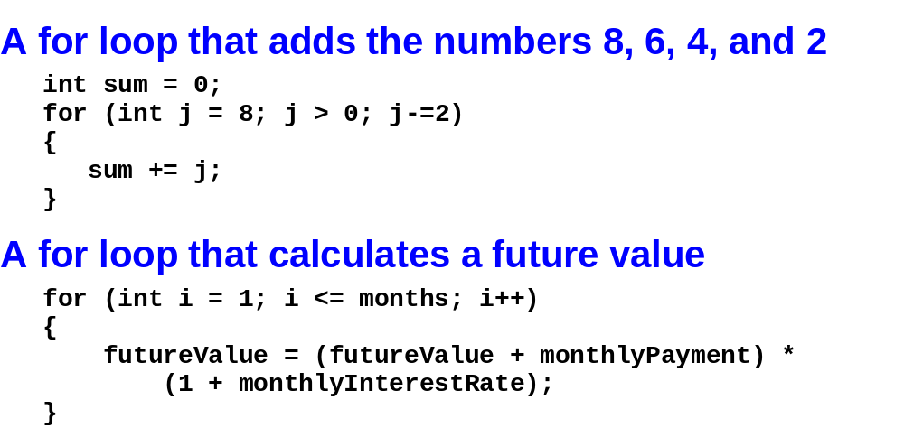
Murach’s C# 2010, C5
© 2010, Mike Murach & Associates, Inc.
Slide <number>

Slide 28
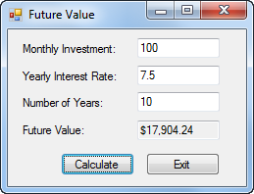
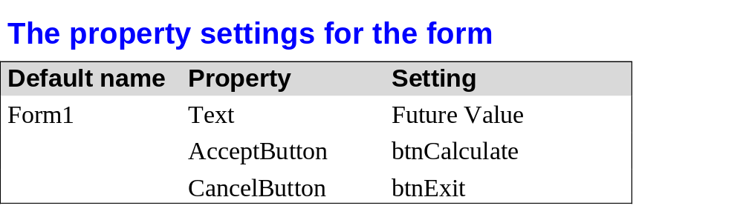
Murach’s C# 2010, C5
© 2010, Mike Murach & Associates, Inc.
Slide <number>

Slide 29
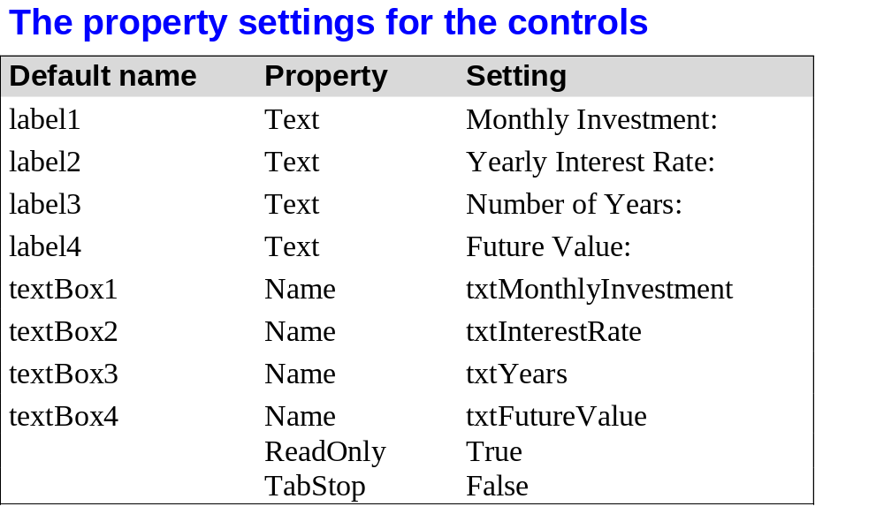
Murach’s C# 2010, C5
© 2010, Mike Murach & Associates, Inc.
Slide <number>

Slide 30
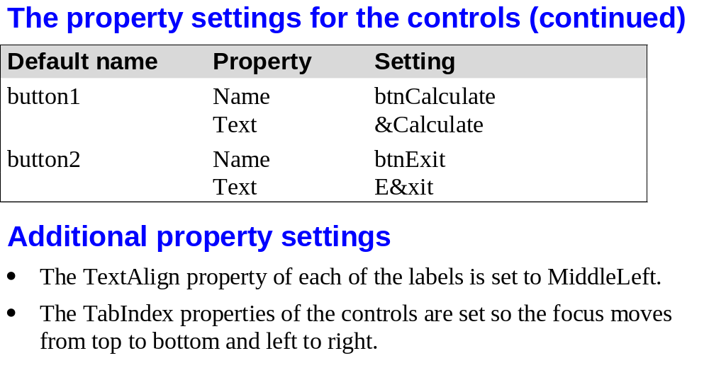
Murach’s C# 2010, C5
© 2010, Mike Murach & Associates, Inc.
Slide <number>

Slide 31
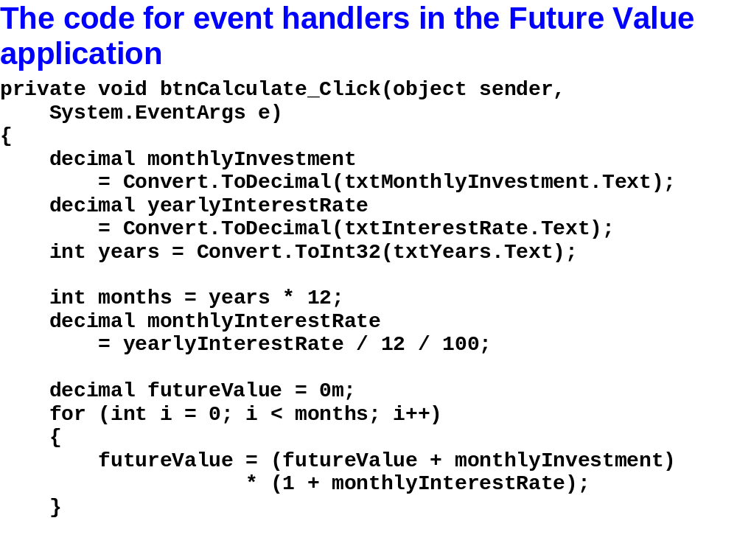
Murach’s C# 2010, C5
© 2010, Mike Murach & Associates, Inc.
Slide <number>

Slide 32
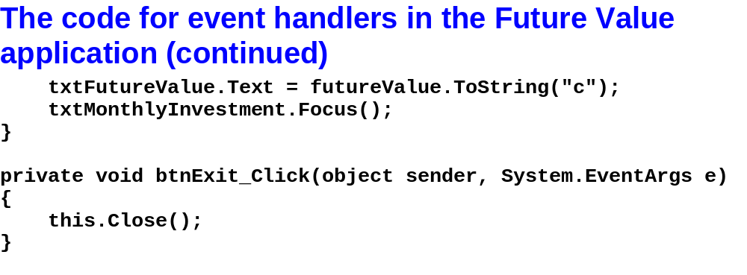
Murach’s C# 2010, C5
© 2010, Mike Murach & Associates, Inc.
Slide <number>

Slide 33
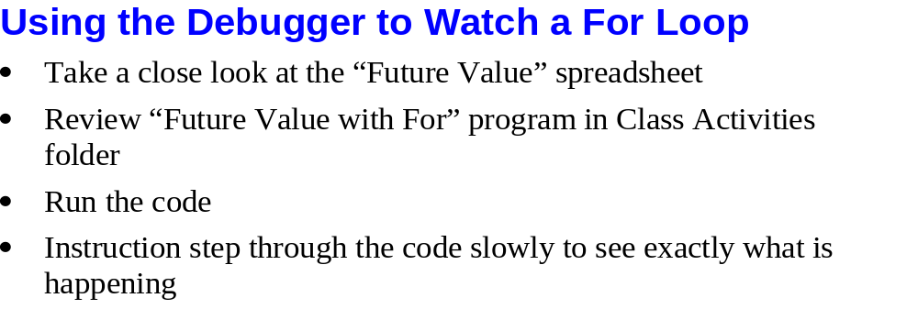
Slide <number>

Slide 34
In-Class Activity
Text boxes
Can you convert this loop from a while loop to a for loop?
Read Only Text Box
Slide <number>

Slide 35
In-Class Activity
Can you change this loop from a while loop to a for loop?

Slide 36
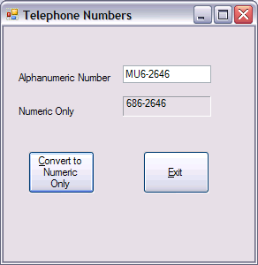
In-Class Activity
This will be a tricky one!
  Blank out txtNumericOnly.Text
  Store the alphanumeric number in a string
  Use the .Length method to figure out how many characters are in the string
  Create a loop that will be used to step through the characters in the string
    Extract a character using the .Substring method
    If it is a letter that is on your phone keypad, translate it to the corresponding number.
    If it is not a letter on your telephone keypad, don’t translate it to anything else
    Use the + operator to concatenate this one character string onto the end of txtNumericOnly.Text
Slide <number>

