Slide 1

Murach’s C# 2010, C20
© 2010, Mike Murach & Associates, Inc.
Slide <number>

Slide 2
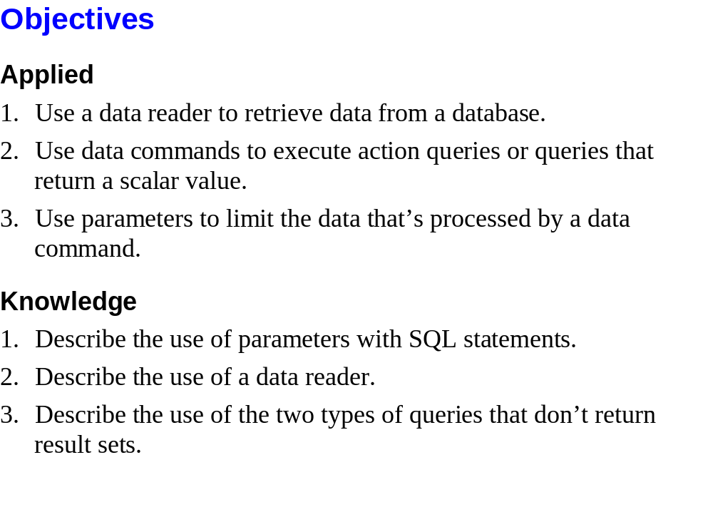
Murach’s C# 2010, C20
© 2010, Mike Murach & Associates, Inc.
Slide <number>

Slide 3
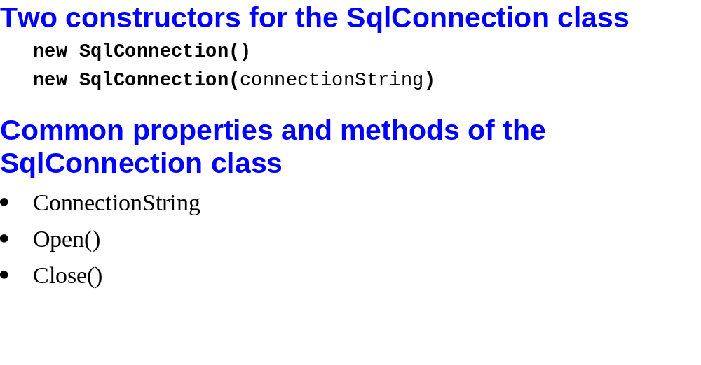
Murach’s C# 2010, C20
© 2010, Mike Murach & Associates, Inc.
Slide <number>

Slide 4
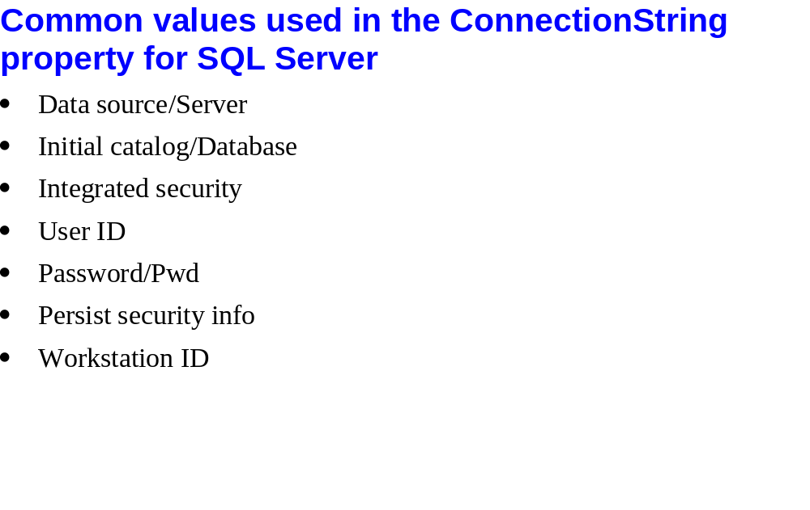
Murach’s C# 2010, C20
© 2010, Mike Murach & Associates, Inc.
Slide <number>

Slide 5
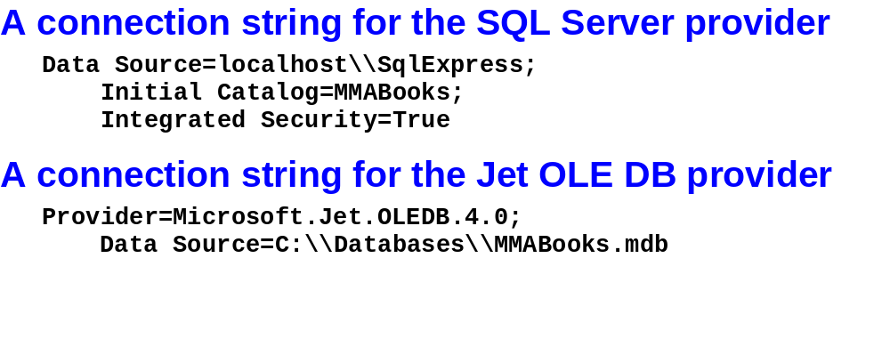
Murach’s C# 2010, C20
© 2010, Mike Murach & Associates, Inc.
Slide <number>

Slide 6
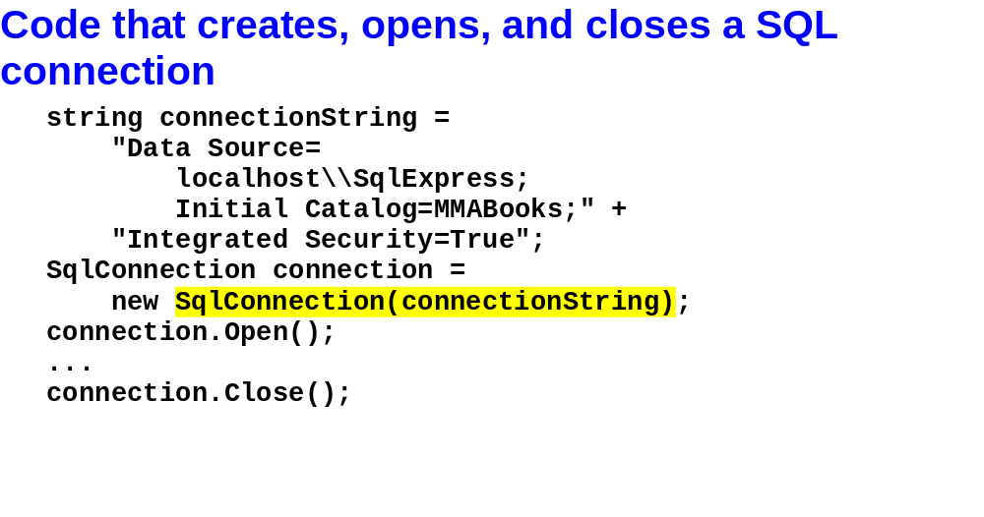
Murach’s C# 2010, C20
© 2010, Mike Murach & Associates, Inc.
Slide <number>

Slide 7
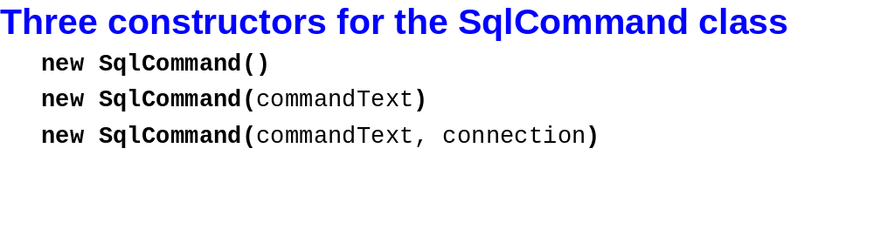
Murach’s C# 2010, C20
© 2010, Mike Murach & Associates, Inc.
Slide <number>

Slide 8
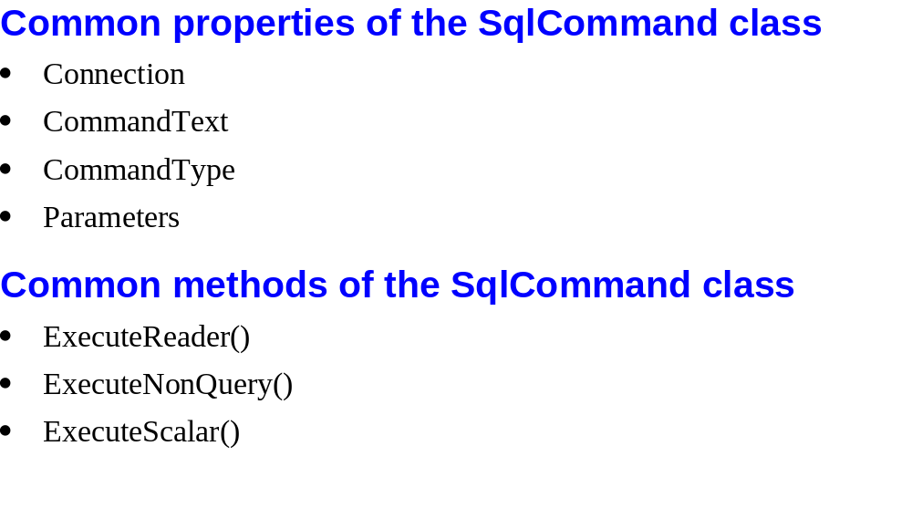
Murach’s C# 2010, C20
© 2010, Mike Murach & Associates, Inc.
Slide <number>

Slide 9
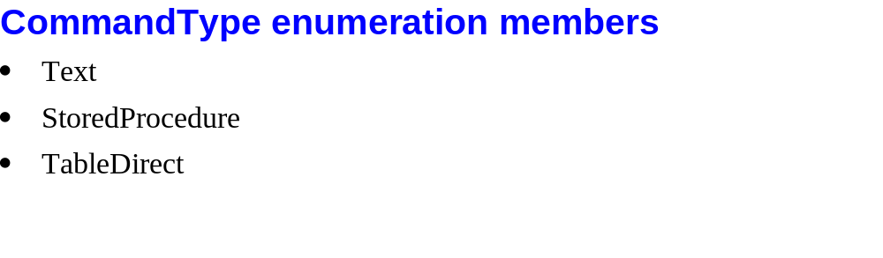
Murach’s C# 2010, C20
© 2010, Mike Murach & Associates, Inc.
Slide <number>

Slide 10
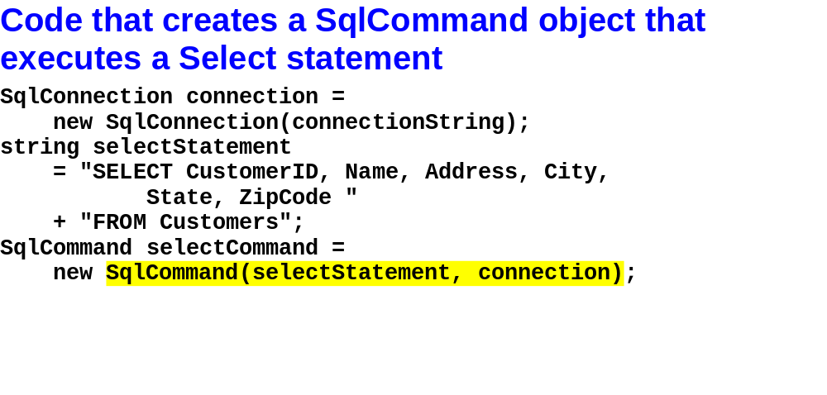
Murach’s C# 2010, C20
© 2010, Mike Murach & Associates, Inc.
Slide <number>

Slide 11
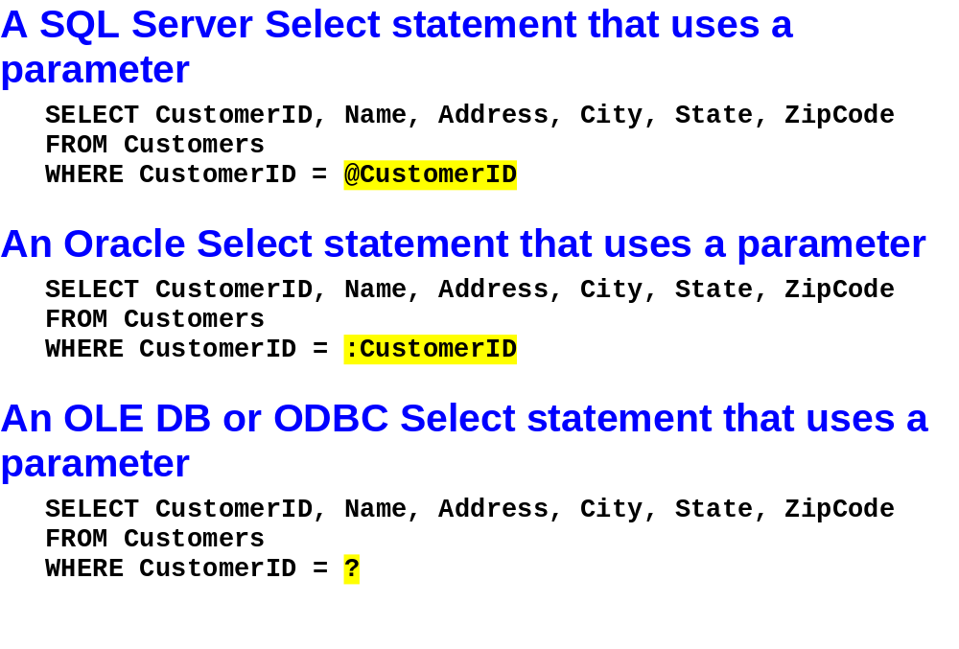
Murach’s C# 2010, C20
© 2010, Mike Murach & Associates, Inc.
Slide <number>

Slide 12
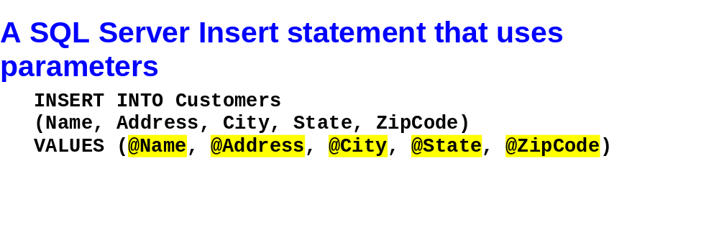
Murach’s C# 2010, C20
© 2010, Mike Murach & Associates, Inc.
Slide <number>

Slide 13
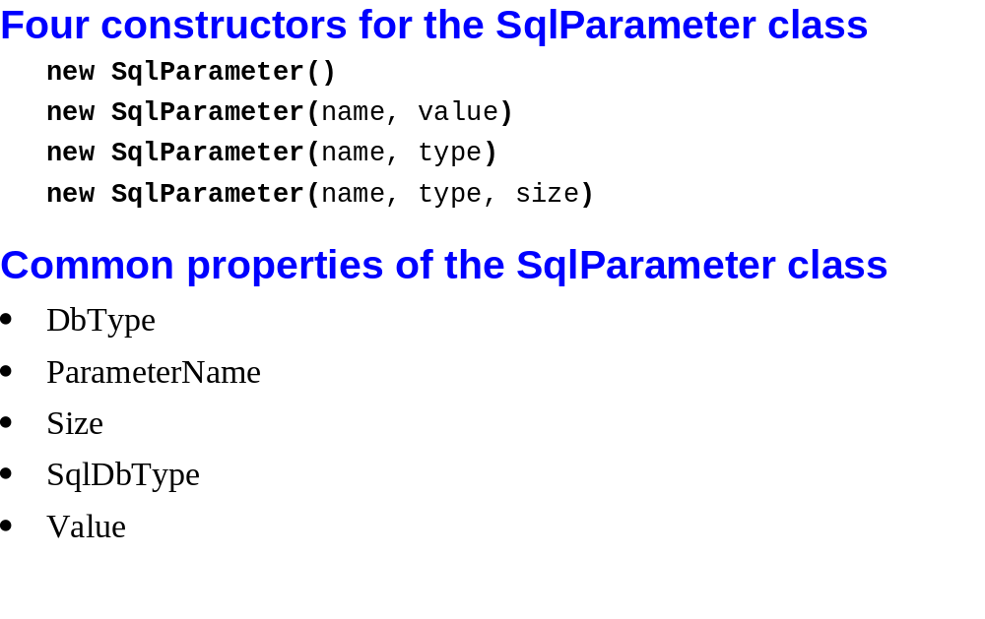
Murach’s C# 2010, C20
© 2010, Mike Murach & Associates, Inc.
Slide <number>

Slide 14
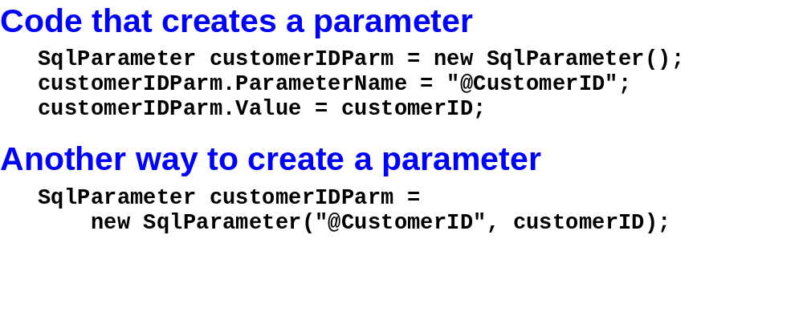
Murach’s C# 2010, C20
© 2010, Mike Murach & Associates, Inc.
Slide <number>

Slide 15
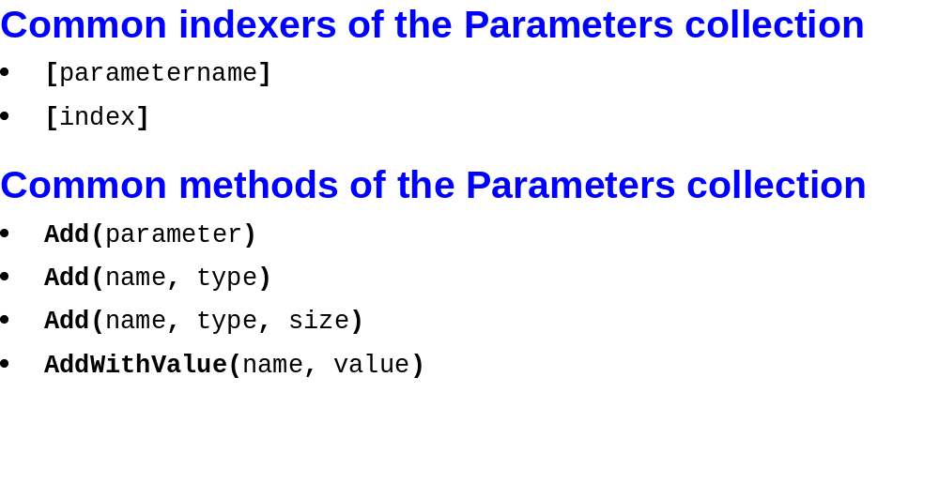
Murach’s C# 2010, C20
© 2010, Mike Murach & Associates, Inc.
Slide <number>

Slide 16
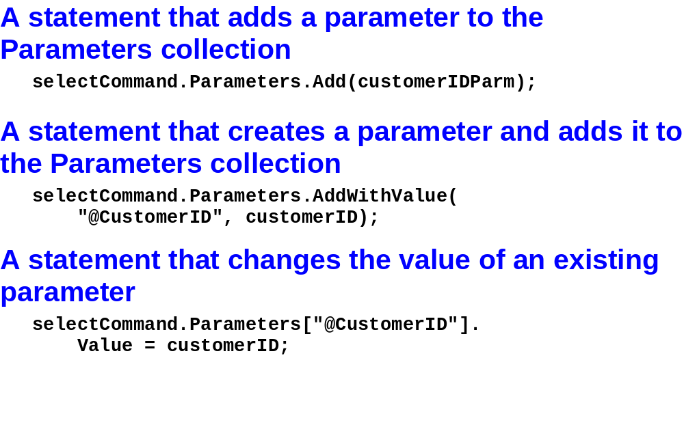
Murach’s C# 2010, C20
© 2010, Mike Murach & Associates, Inc.
Slide <number>

Slide 17
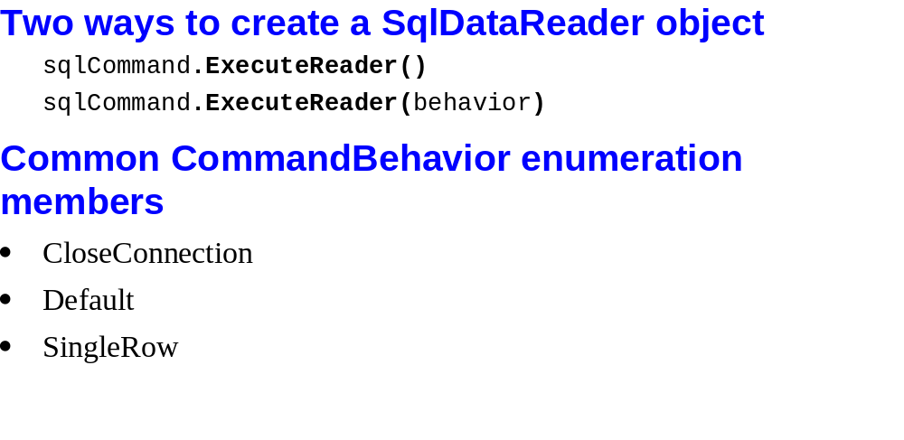
Murach’s C# 2010, C20
© 2010, Mike Murach & Associates, Inc.
Slide <number>

Slide 18
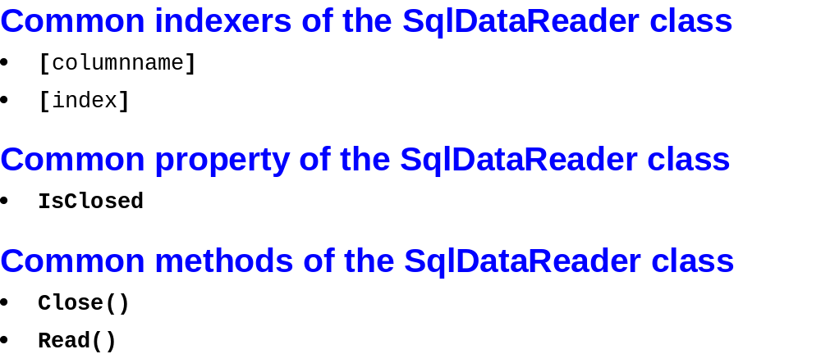
Murach’s C# 2010, C20
© 2010, Mike Murach & Associates, Inc.
Slide <number>

Slide 19
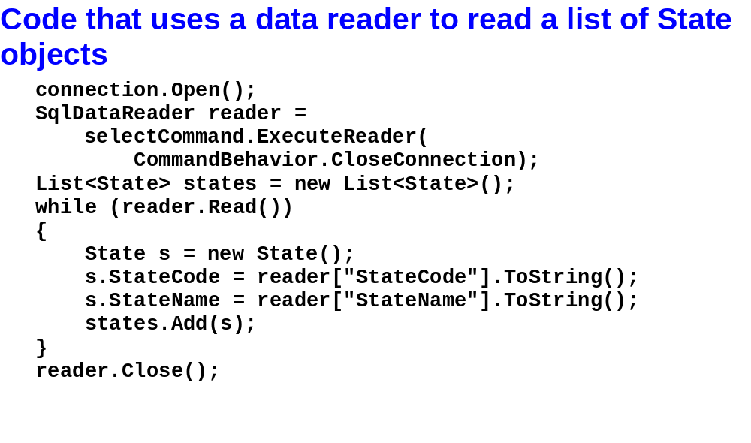
Murach’s C# 2010, C20
© 2010, Mike Murach & Associates, Inc.
Slide <number>

Slide 20
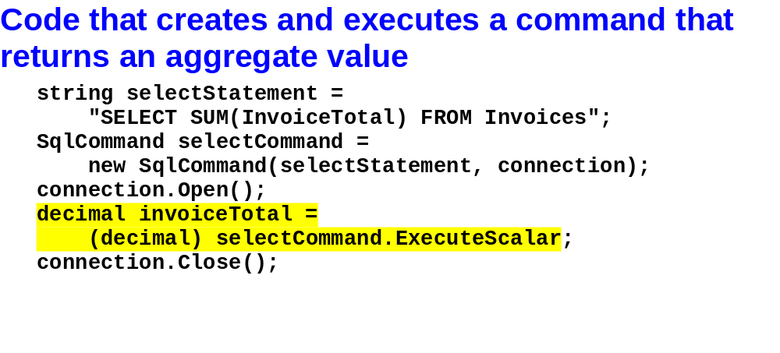
Murach’s C# 2010, C20
© 2010, Mike Murach & Associates, Inc.
Slide <number>

Slide 21
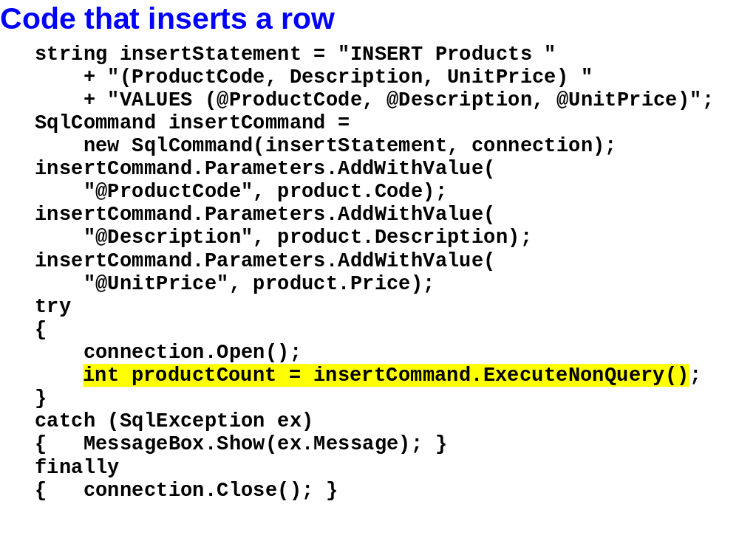
Murach’s C# 2010, C20
© 2010, Mike Murach & Associates, Inc.
Slide <number>

Slide 22

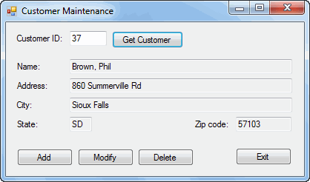
Murach’s C# 2010, C20
© 2010, Mike Murach & Associates, Inc.
Slide <number>

Slide 23

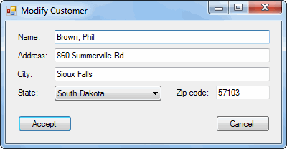
Murach’s C# 2010, C20
© 2010, Mike Murach & Associates, Inc.
Slide <number>

Slide 24

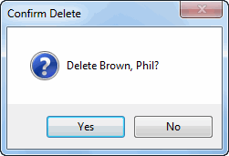
Murach’s C# 2010, C20
© 2010, Mike Murach & Associates, Inc.
Slide <number>

Slide 25

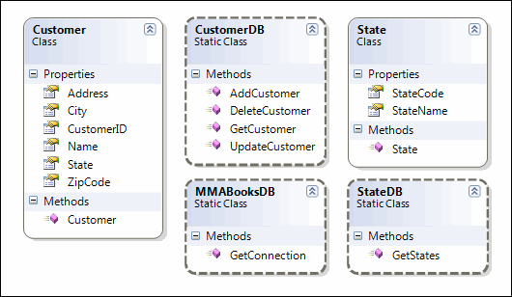
Murach’s C# 2010, C20
© 2010, Mike Murach & Associates, Inc.
Slide <number>

Slide 26
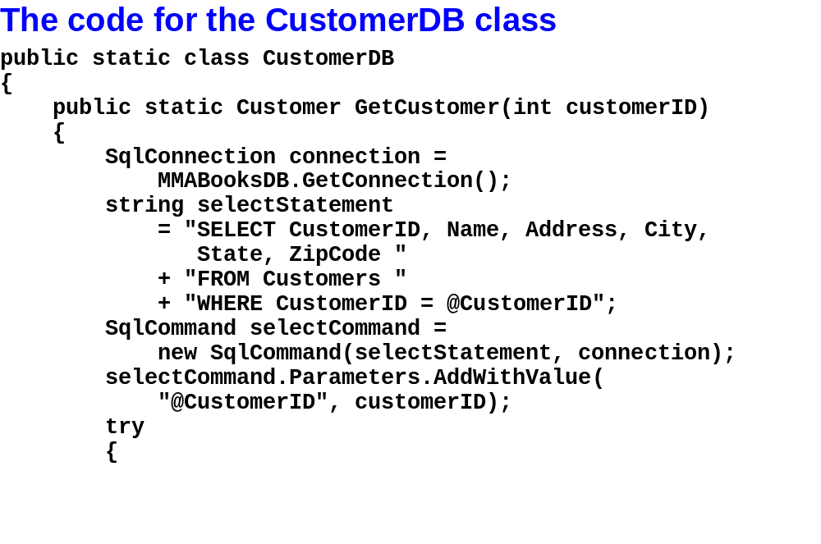
Murach’s C# 2010, C20
© 2010, Mike Murach & Associates, Inc.
Slide <number>

Slide 27
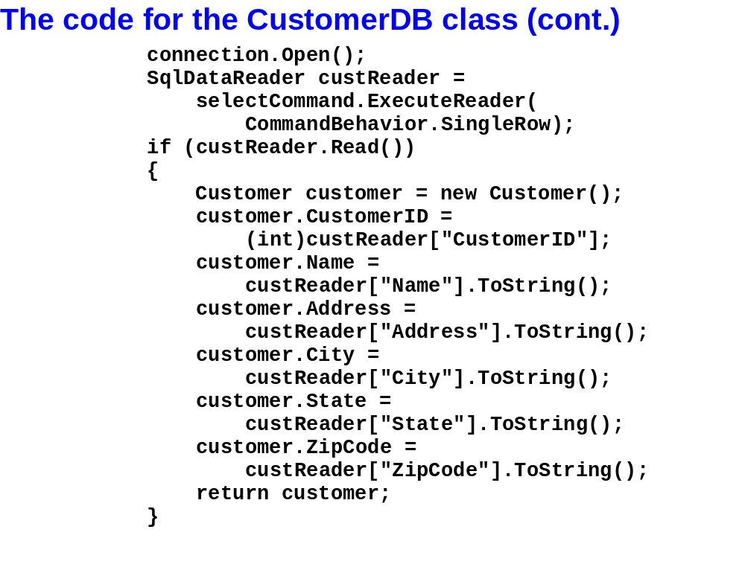
Murach’s C# 2010, C20
© 2010, Mike Murach & Associates, Inc.
Slide <number>

Slide 28
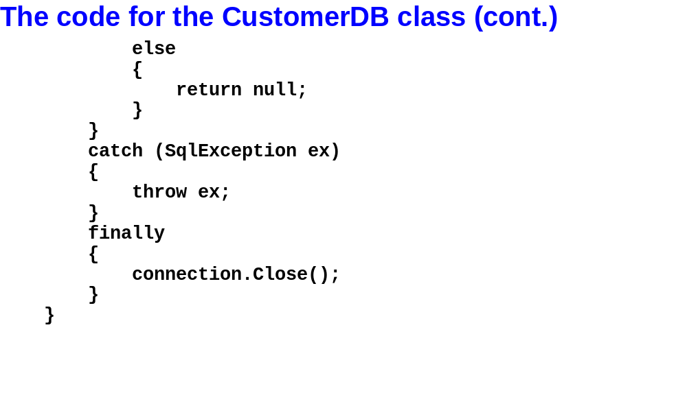
Murach’s C# 2010, C20
© 2010, Mike Murach & Associates, Inc.
Slide <number>

Slide 29
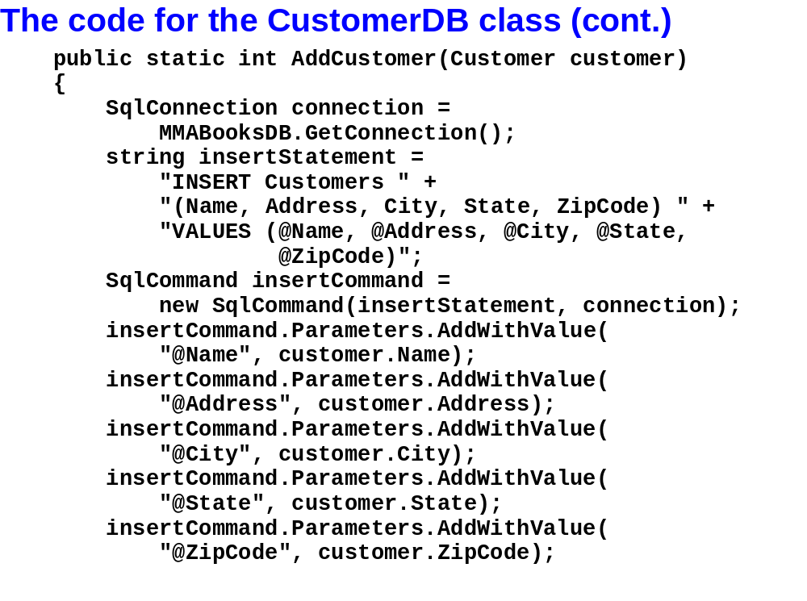
Murach’s C# 2010, C20
© 2010, Mike Murach & Associates, Inc.
Slide <number>

Slide 30
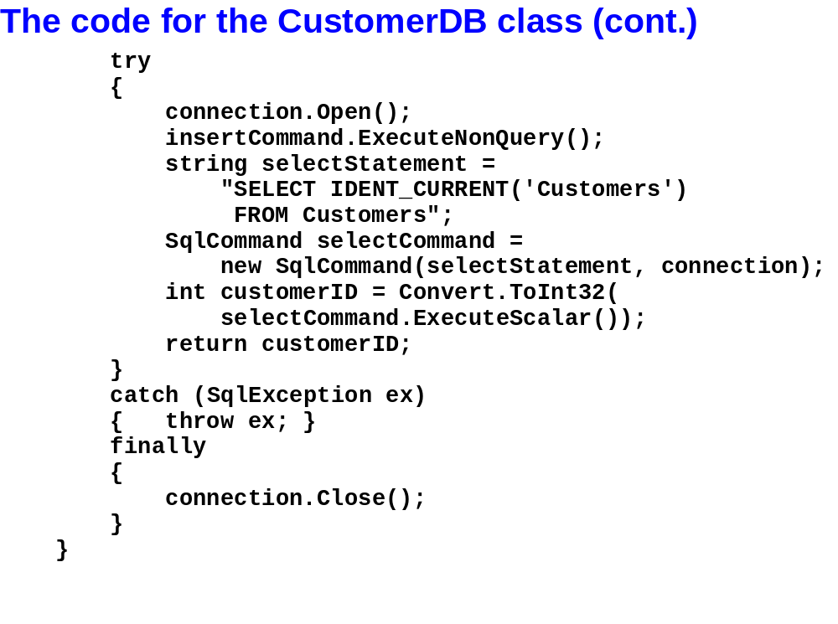
Murach’s C# 2010, C20
© 2010, Mike Murach & Associates, Inc.
Slide <number>

Slide 31
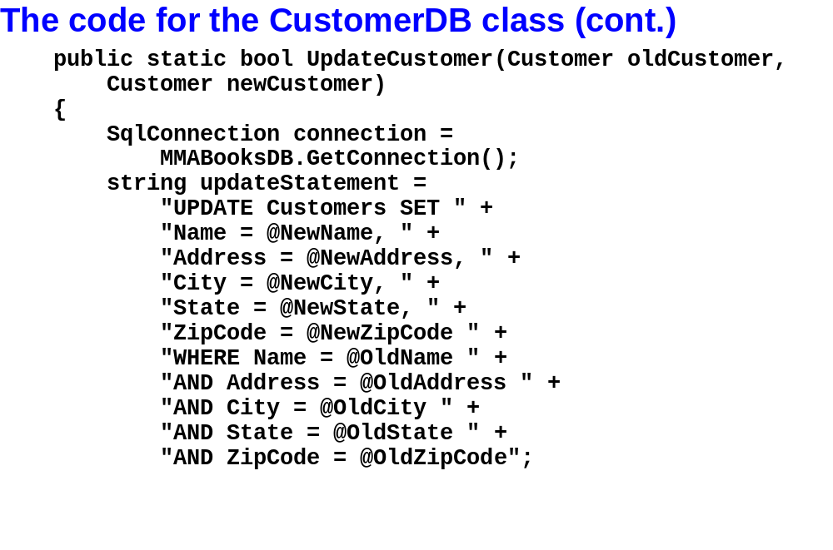
Murach’s C# 2010, C20
© 2010, Mike Murach & Associates, Inc.
Slide <number>

Slide 32
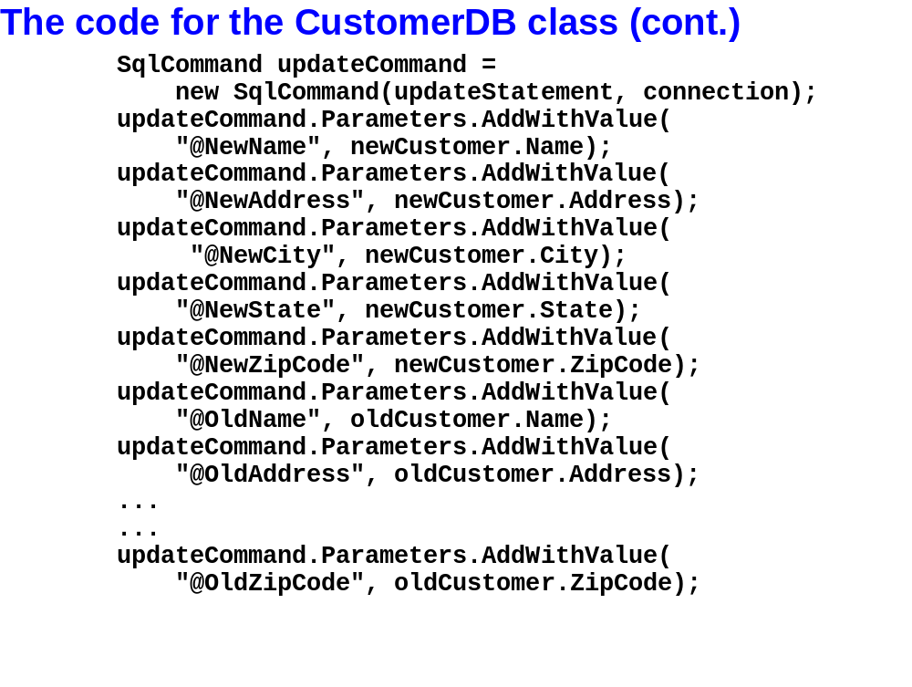
Murach’s C# 2010, C20
© 2010, Mike Murach & Associates, Inc.
Slide <number>

Slide 33
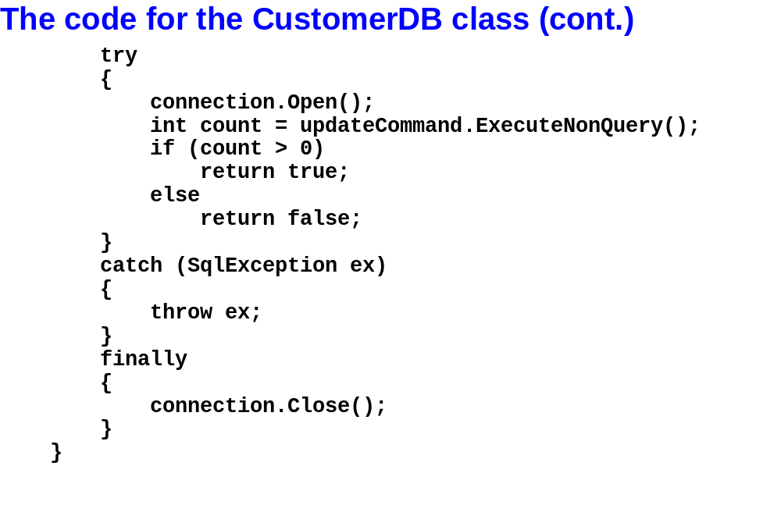
Murach’s C# 2010, C20
© 2010, Mike Murach & Associates, Inc.
Slide <number>

Slide 34
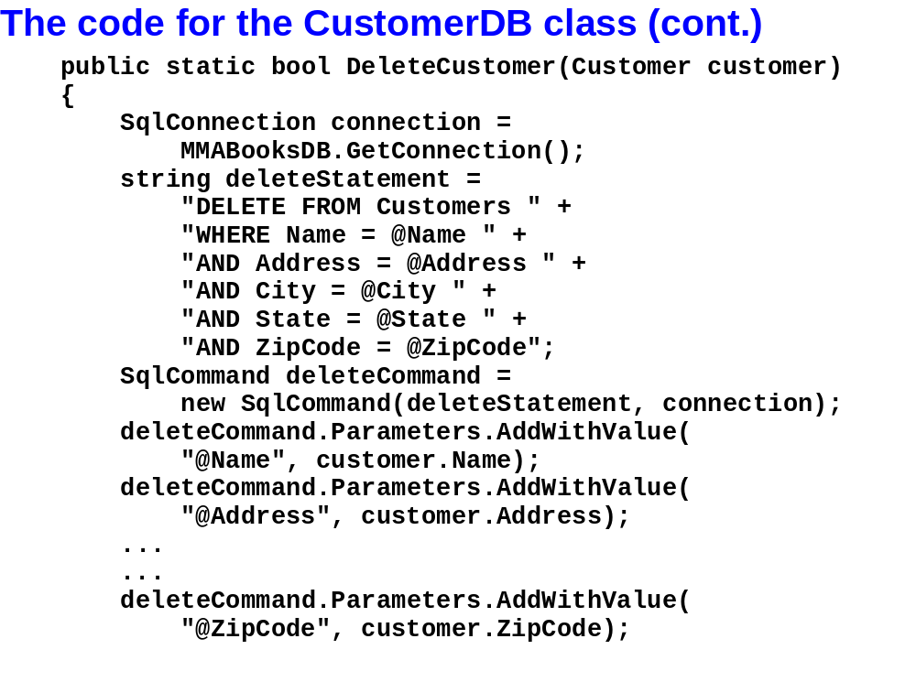
Murach’s C# 2010, C20
© 2010, Mike Murach & Associates, Inc.
Slide <number>

Slide 35
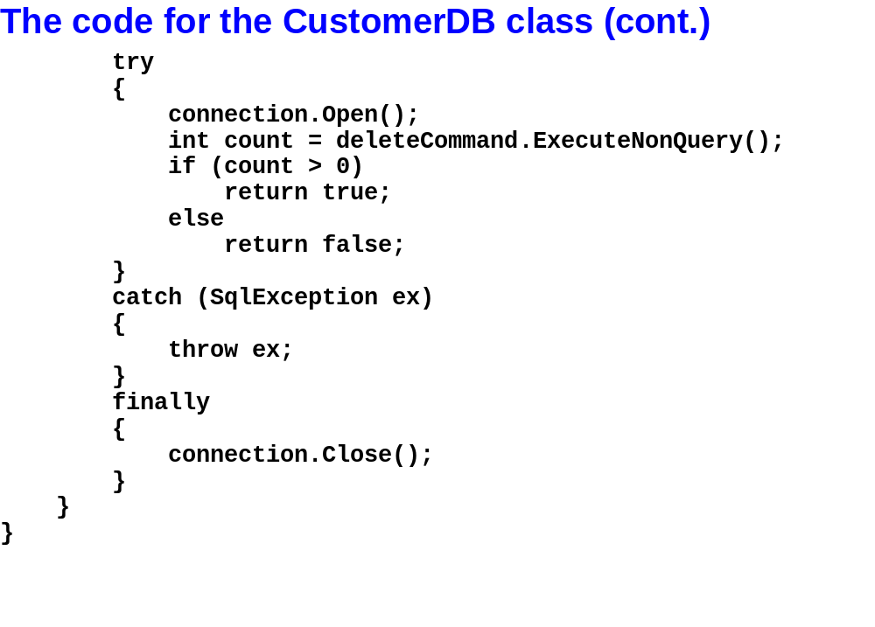
Murach’s C# 2010, C20
© 2010, Mike Murach & Associates, Inc.
Slide <number>

Slide 36
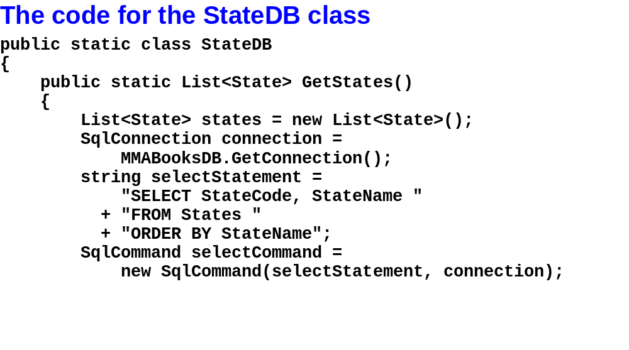
Murach’s C# 2010, C20
© 2010, Mike Murach & Associates, Inc.
Slide <number>

Slide 37
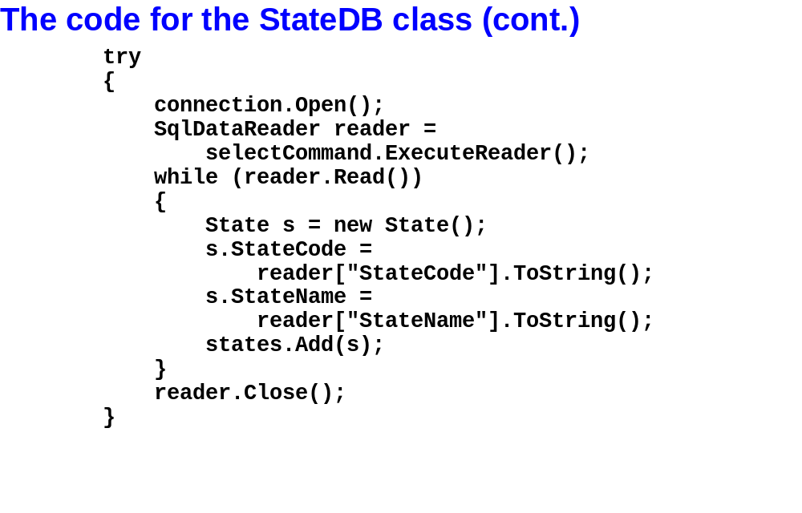
Murach’s C# 2010, C20
© 2010, Mike Murach & Associates, Inc.
Slide <number>

Slide 38
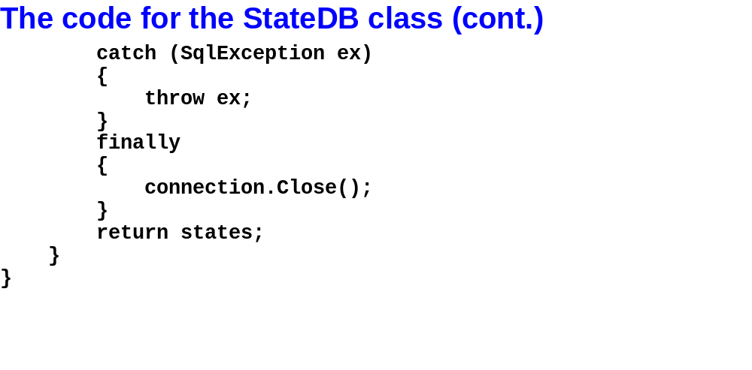
Murach’s C# 2010, C20
© 2010, Mike Murach & Associates, Inc.
Slide <number>

Slide 39
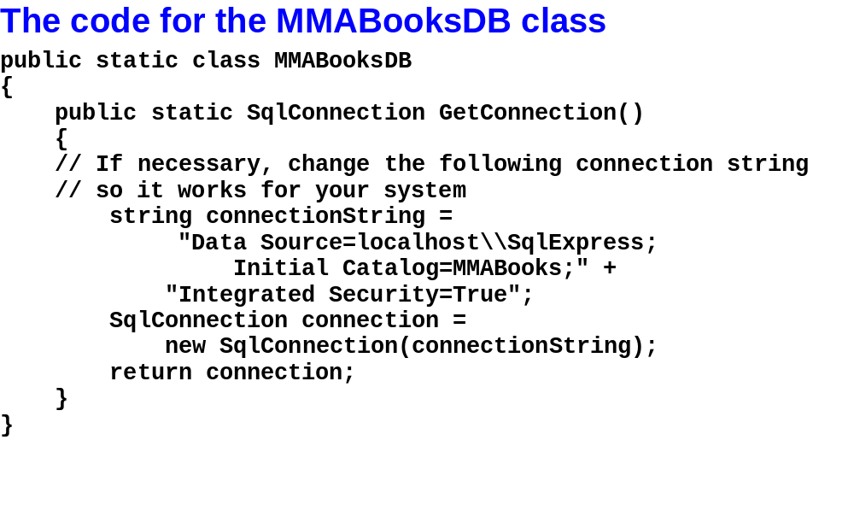
Murach’s C# 2010, C20
© 2010, Mike Murach & Associates, Inc.
Slide <number>

Slide 40
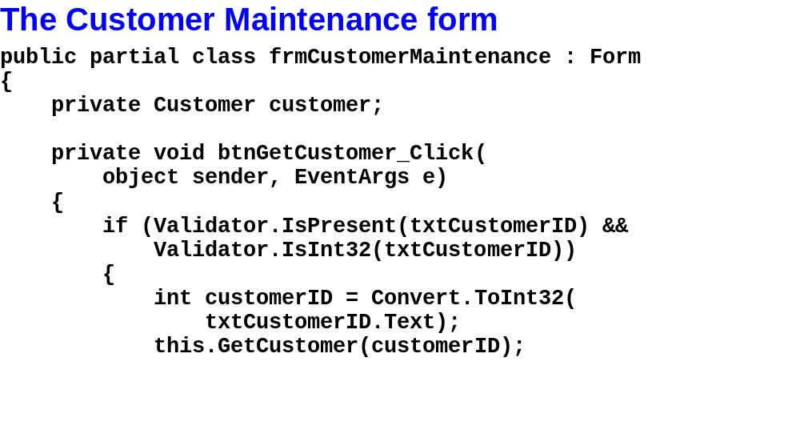
Murach’s C# 2010, C20
© 2010, Mike Murach & Associates, Inc.
Slide <number>

Slide 41
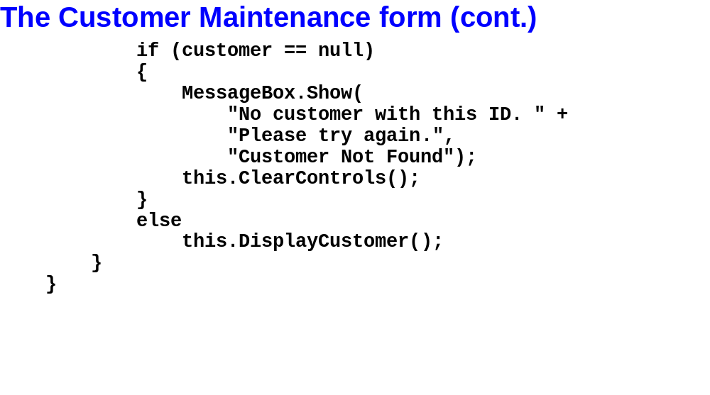
Murach’s C# 2010, C20
© 2010, Mike Murach & Associates, Inc.
Slide <number>

Slide 42
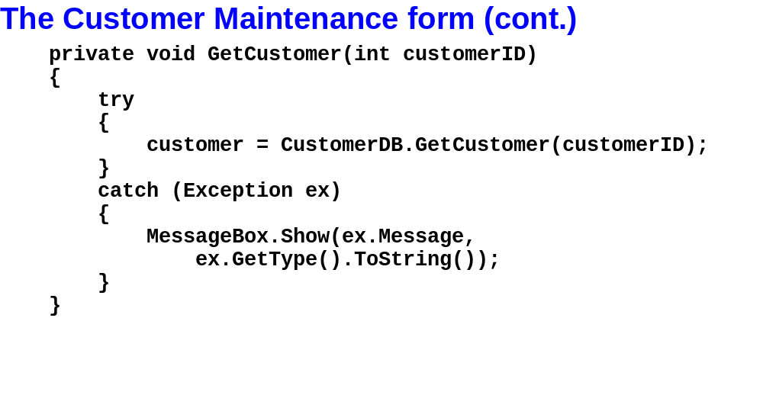
Murach’s C# 2010, C20
© 2010, Mike Murach & Associates, Inc.
Slide <number>

Slide 43
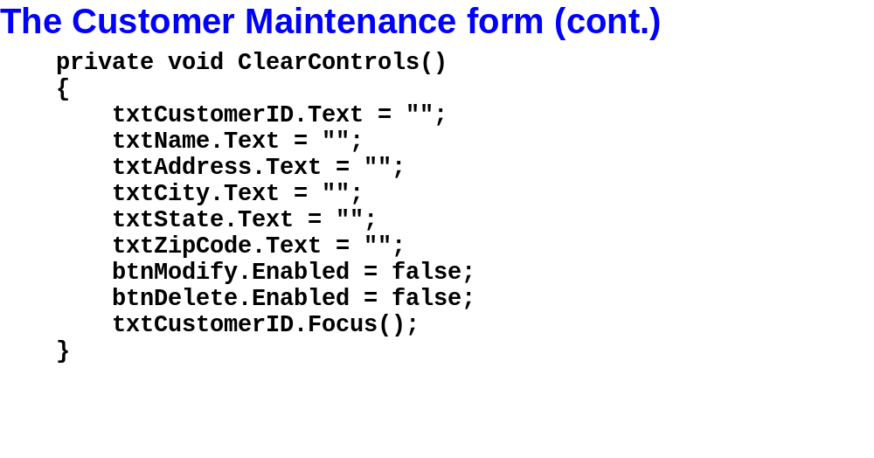
Murach’s C# 2010, C20
© 2010, Mike Murach & Associates, Inc.
Slide <number>

Slide 44
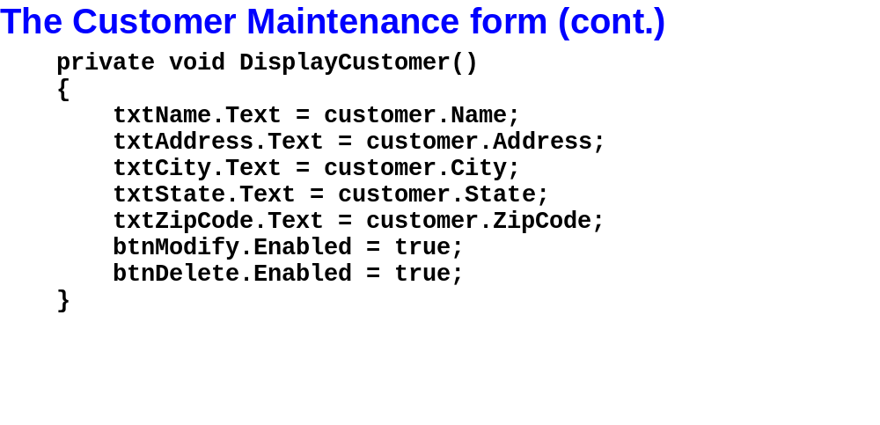
Murach’s C# 2010, C20
© 2010, Mike Murach & Associates, Inc.
Slide <number>

Slide 45
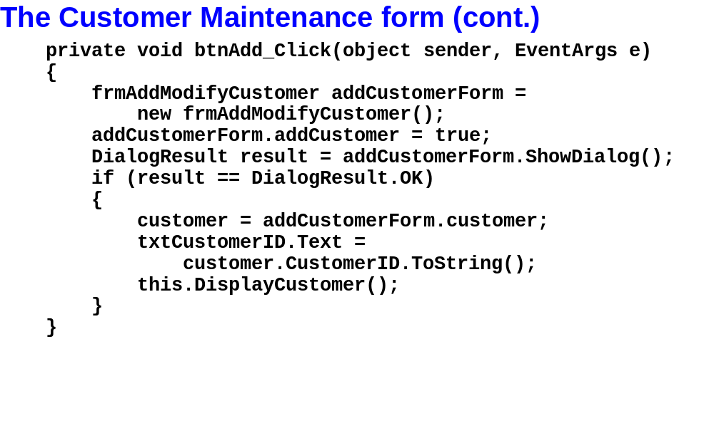
Murach’s C# 2010, C20
© 2010, Mike Murach & Associates, Inc.
Slide <number>

Slide 46
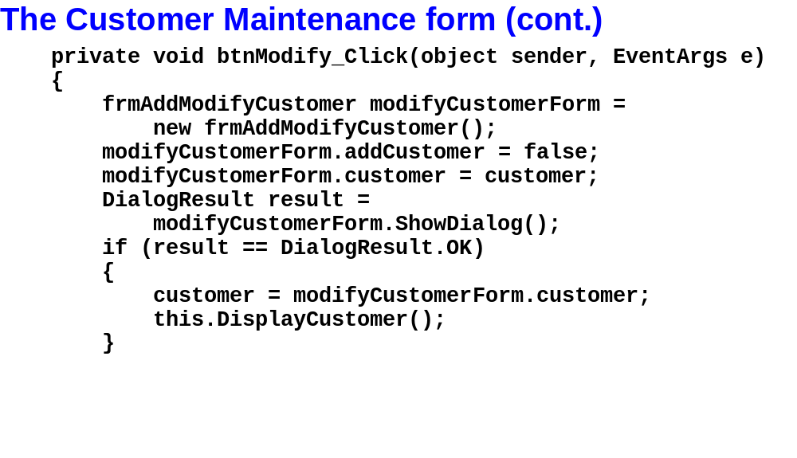
Murach’s C# 2010, C20
© 2010, Mike Murach & Associates, Inc.
Slide <number>

Slide 47
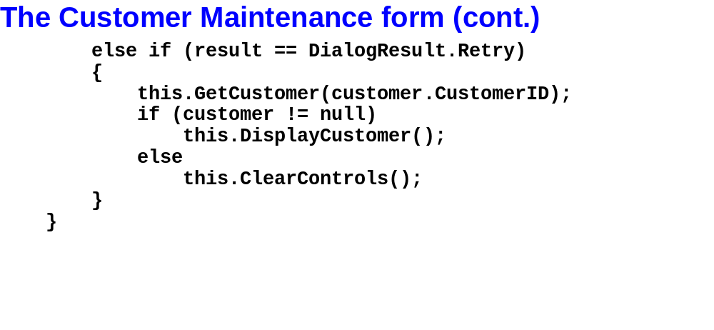
Murach’s C# 2010, C20
© 2010, Mike Murach & Associates, Inc.
Slide <number>

Slide 48
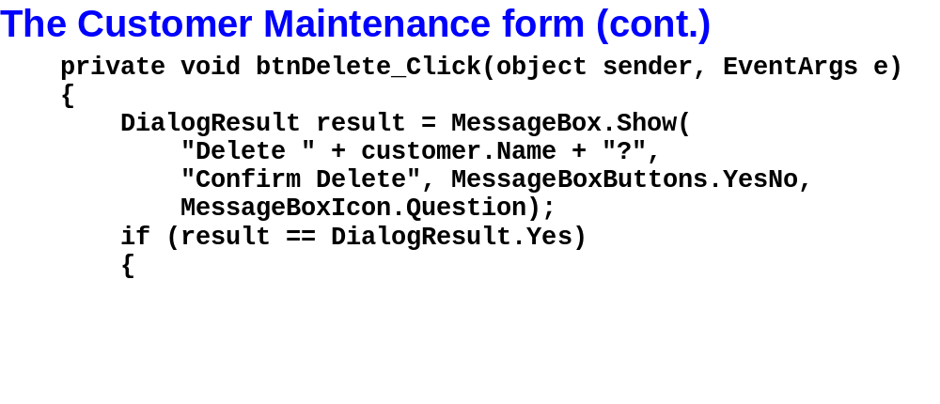
Murach’s C# 2010, C20
© 2010, Mike Murach & Associates, Inc.
Slide <number>

Slide 49
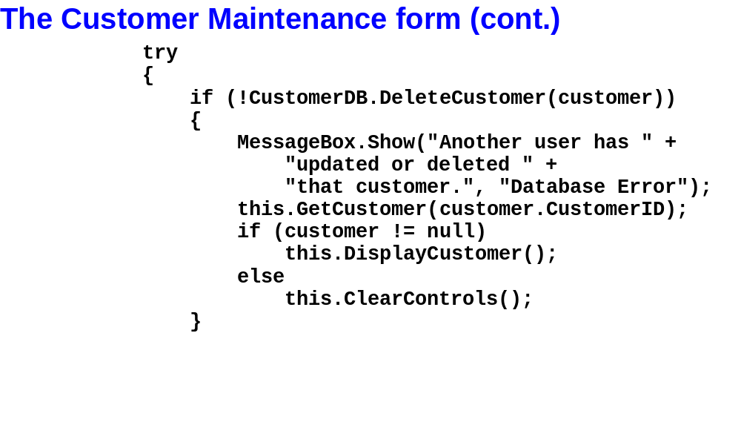
Murach’s C# 2010, C20
© 2010, Mike Murach & Associates, Inc.
Slide <number>

Slide 50
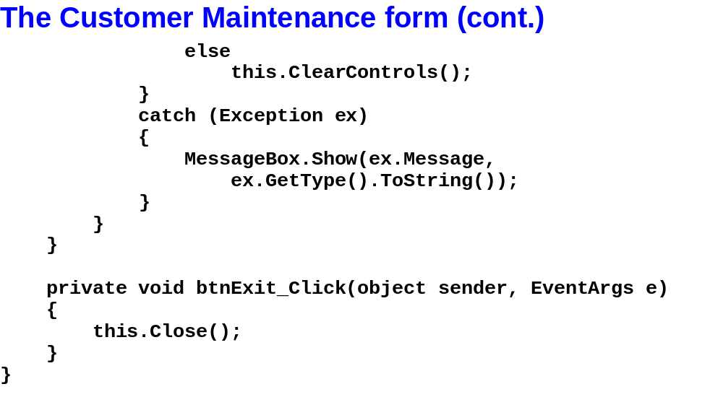
Murach’s C# 2010, C20
© 2010, Mike Murach & Associates, Inc.
Slide <number>

Slide 51
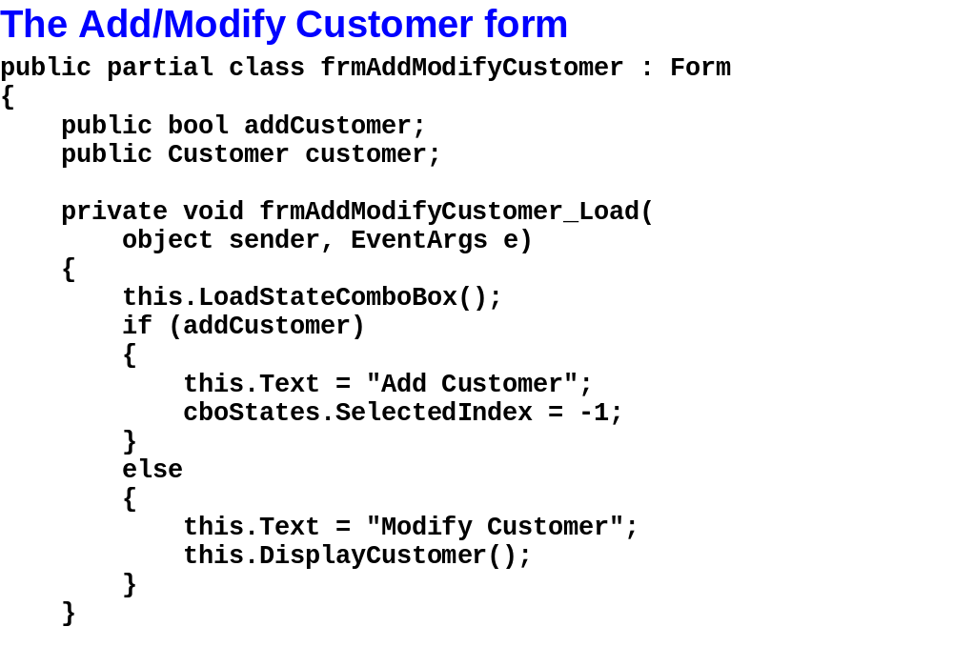
Murach’s C# 2010, C20
© 2010, Mike Murach & Associates, Inc.
Slide <number>

Slide 52

Murach’s C# 2010, C20
© 2010, Mike Murach & Associates, Inc.
Slide <number>

Slide 53

Murach’s C# 2010, C20
© 2010, Mike Murach & Associates, Inc.
Slide <number>

Slide 54

Murach’s C# 2010, C20
© 2010, Mike Murach & Associates, Inc.
Slide <number>

Slide 55

Murach’s C# 2010, C20
© 2010, Mike Murach & Associates, Inc.
Slide <number>

Slide 56

Murach’s C# 2010, C20
© 2010, Mike Murach & Associates, Inc.
Slide <number>

Slide 57

Murach’s C# 2010, C20
© 2010, Mike Murach & Associates, Inc.
Slide <number>

