Slide 1
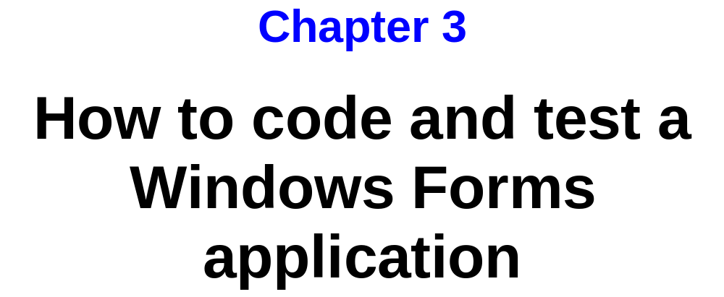
Murach’s C# 2010, C3
© 2010, Mike Murach & Associates, Inc.
Slide <number>

Slide 2
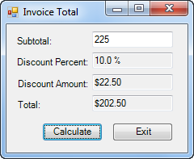
Murach’s C# 2010, C3
© 2010, Mike Murach & Associates, Inc.
Slide <number>

Slide 3
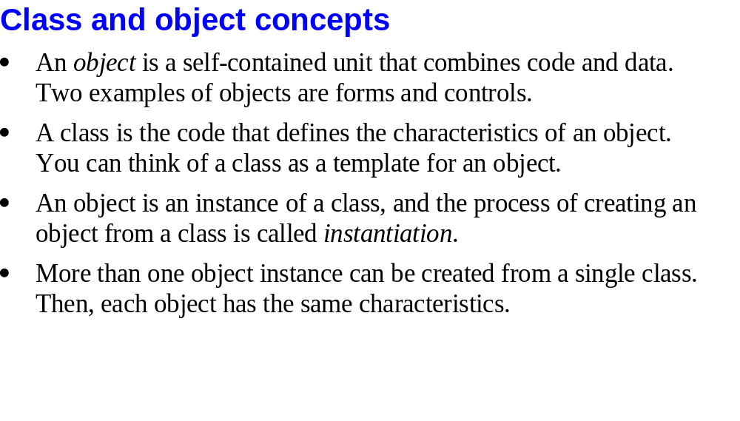
Murach’s C# 2010, C3
© 2010, Mike Murach & Associates, Inc.
Slide <number>

Slide 4
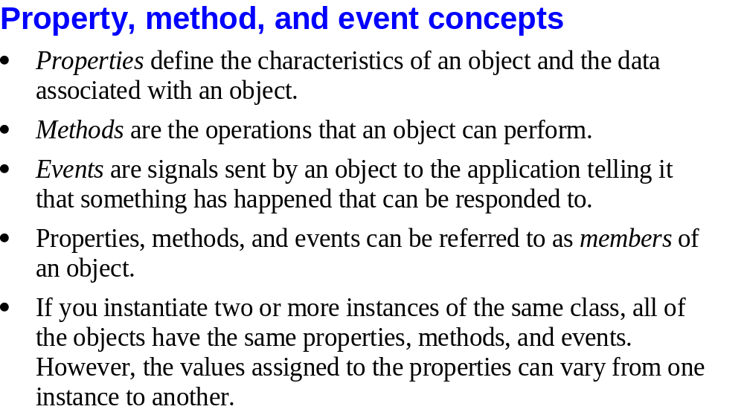
Murach’s C# 2010, C3
© 2010, Mike Murach & Associates, Inc.
Slide <number>

Slide 5
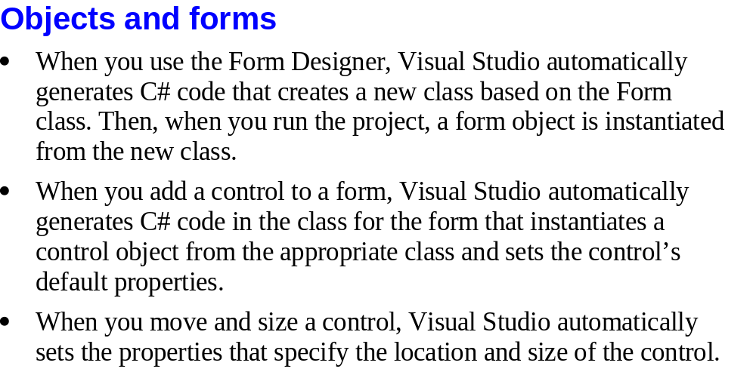
Murach’s C# 2010, C3
© 2010, Mike Murach & Associates, Inc.
Slide <number>

Slide 6
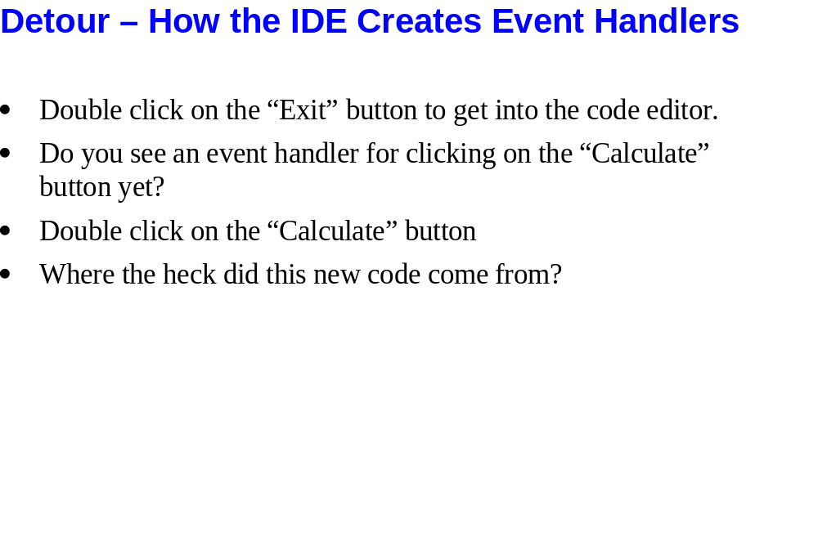
Slide <number>

Slide 7
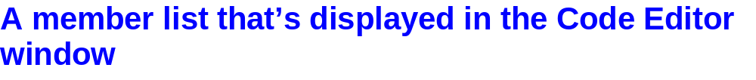
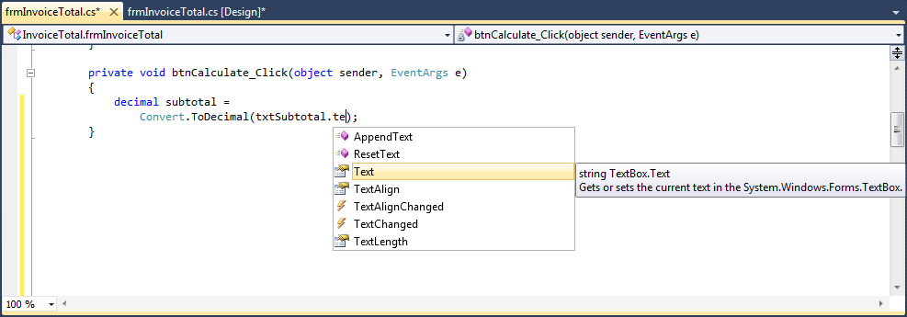
Murach’s C# 2010, C3
© 2010, Mike Murach & Associates, Inc.
Slide <number>

Slide 8
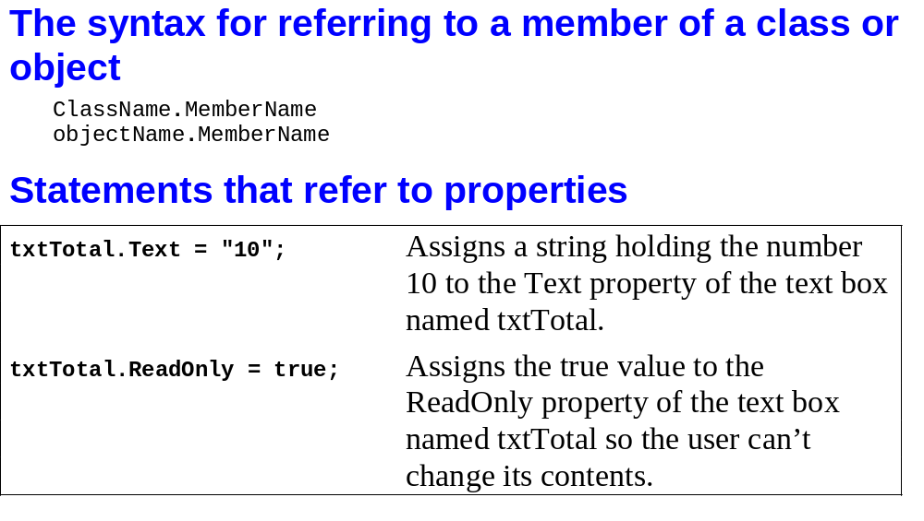
Murach’s C# 2010, C3
© 2010, Mike Murach & Associates, Inc.
Slide <number>

Slide 9
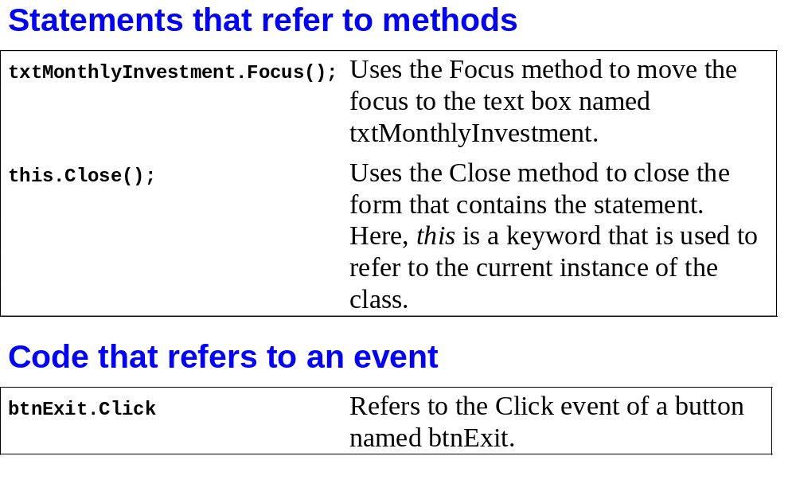
Murach’s C# 2010, C3
© 2010, Mike Murach & Associates, Inc.
Slide <number>

Slide 10
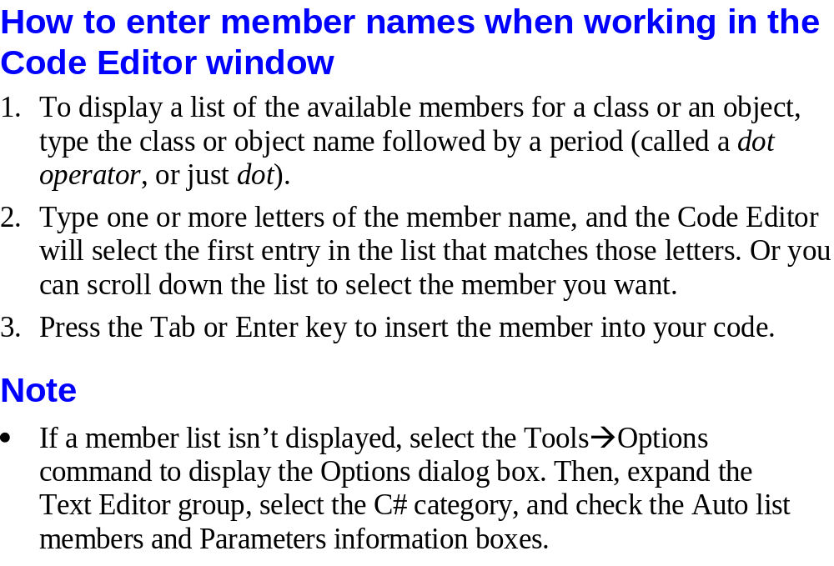
Murach’s C# 2010, C3
© 2010, Mike Murach & Associates, Inc.
Slide <number>

Slide 11
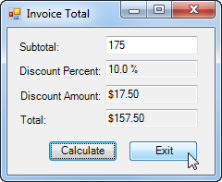
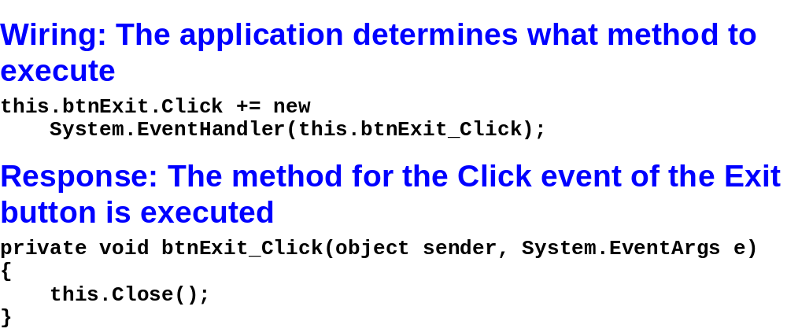
Wiring is hidden for a reason but we can find it if we want!
Murach’s C# 2010, C3
© 2010, Mike Murach & Associates, Inc.
Slide <number>

Slide 12
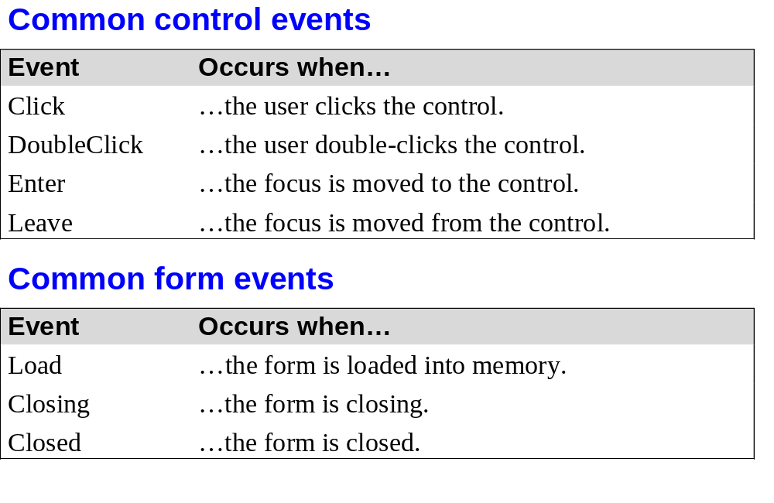
Murach’s C# 2010, C3
© 2010, Mike Murach & Associates, Inc.
Slide <number>

Slide 13
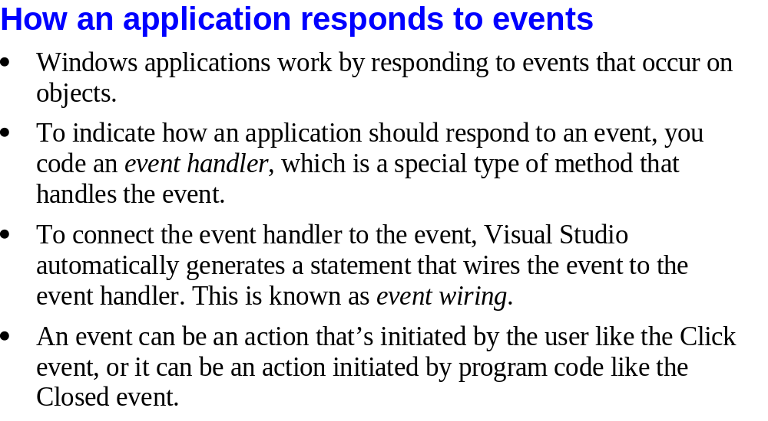
Murach’s C# 2010, C3
© 2010, Mike Murach & Associates, Inc.
Slide <number>

Slide 14
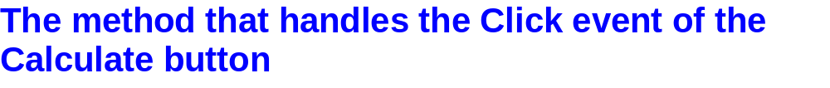
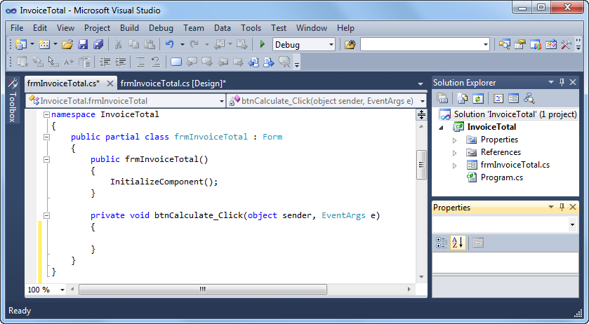
Object
Event
Murach’s C# 2010, C3
© 2010, Mike Murach & Associates, Inc.
Slide <number>

Slide 15
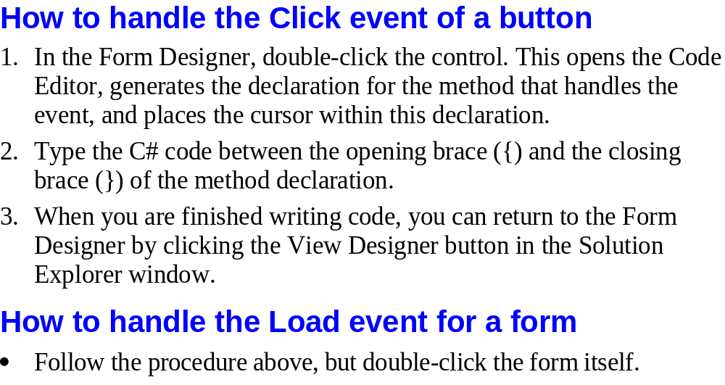
Murach’s C# 2010, C3
© 2010, Mike Murach & Associates, Inc.
Slide <number>

Slide 16

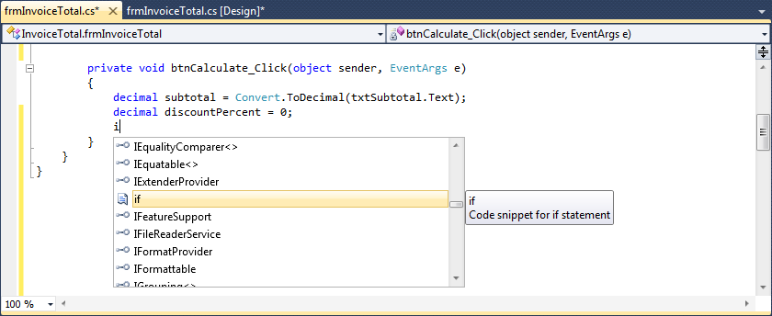
Murach’s C# 2010, C3
© 2010, Mike Murach & Associates, Inc.
Slide <number>

Slide 17
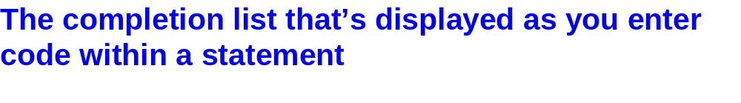
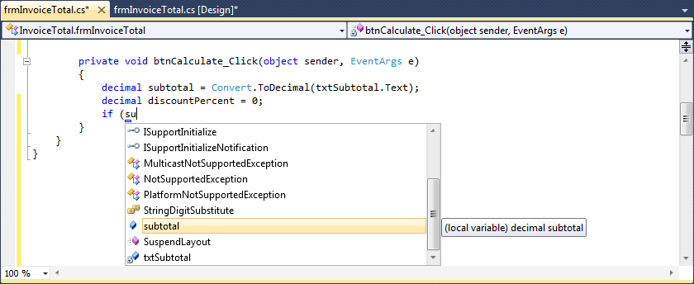
Murach’s C# 2010, C3
© 2010, Mike Murach & Associates, Inc.
Slide <number>

Slide 18
Business Rules
Assume discount = 0%
If the Subtotal is $500 or more then the discount = 20%
If the Subtotal is $250 or more but less than $500 then the discount = 15%
If the Subtotal is $100 or more but less than $250 then the discount = 10%
Go through a few examples by hand of calculating the discount percent, discount amount, and total
Slide <number>

Slide 19
Subtotal ← ___________
Discount Percentage ← _______ >= $500 – 20%
$250-$499.99 – 15%
$100-$249.99 – 10%
Discount Amount ← Subtotal X Discount Percentage
_______X_________________
Total ← Subtotal – Discount Amount
_______ - ______________
Slide <number>

Slide 20
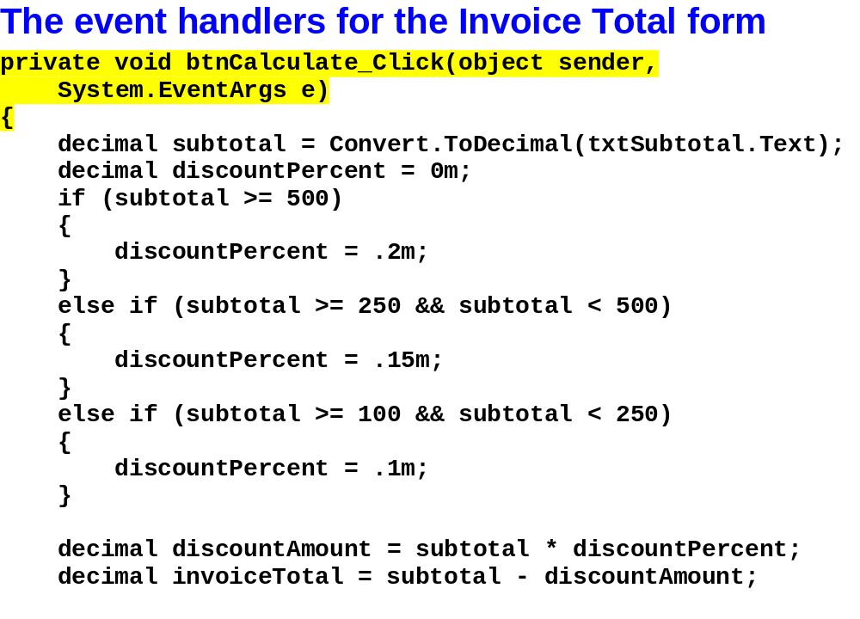
Murach’s C# 2010, C3
© 2010, Mike Murach & Associates, Inc.
Slide <number>

Slide 21
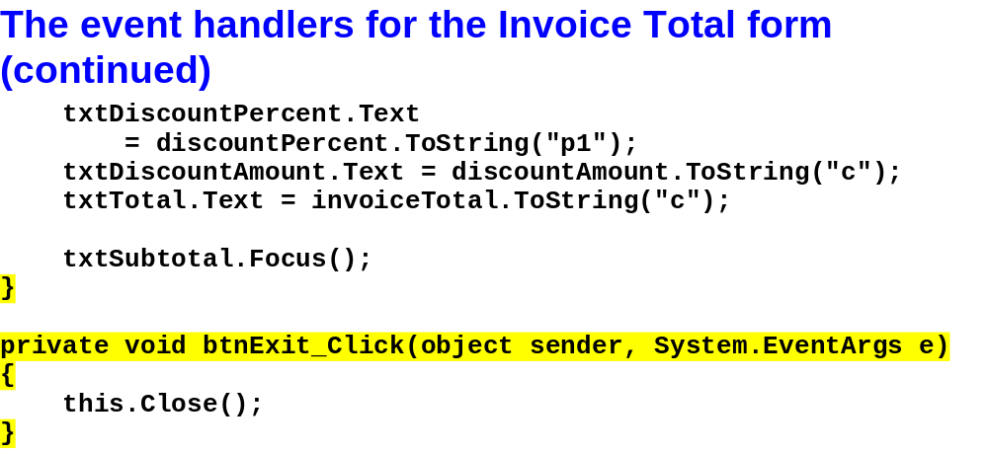
Murach’s C# 2010, C3
© 2010, Mike Murach & Associates, Inc.
Slide <number>

Slide 22
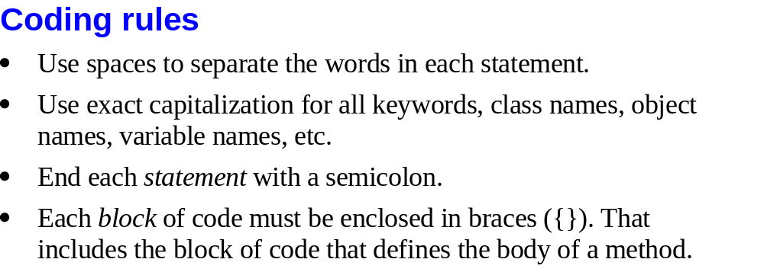
Murach’s C# 2010, C3
© 2010, Mike Murach & Associates, Inc.
Slide <number>

Slide 23

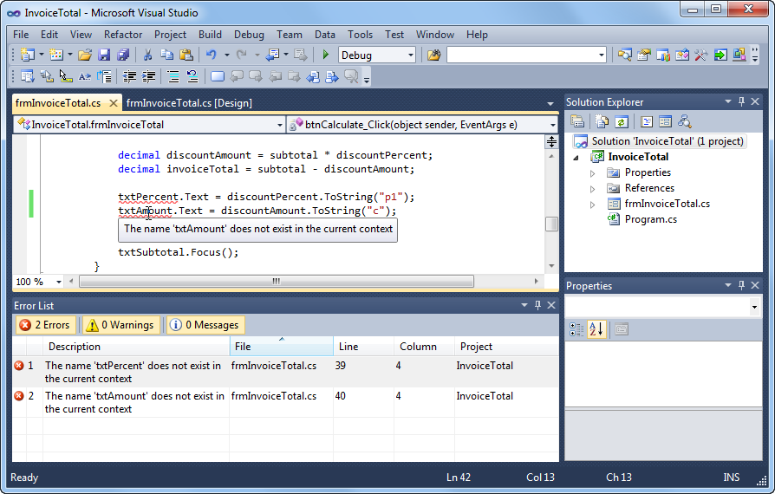
Murach’s C# 2010, C3
© 2010, Mike Murach & Associates, Inc.
Slide <number>

Slide 24
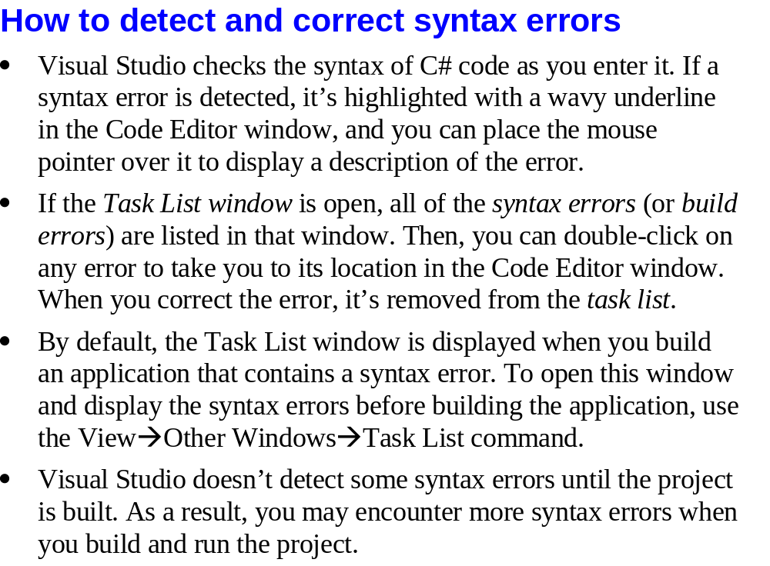
Slide <number>

Slide 25
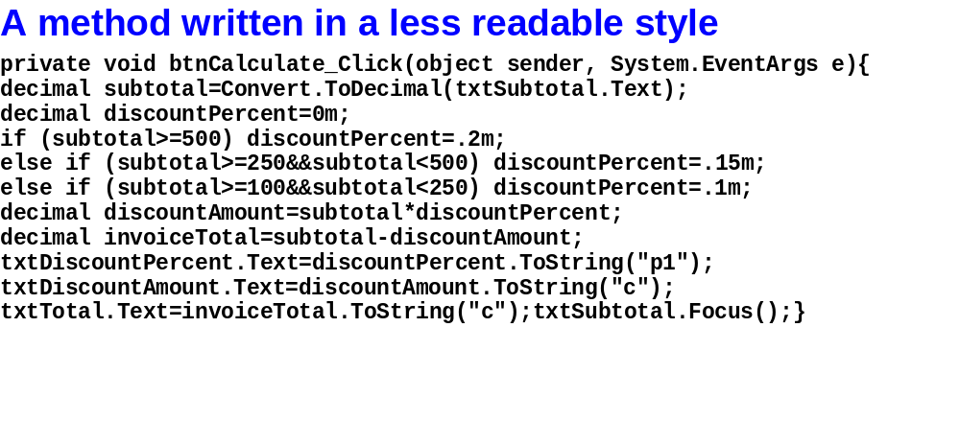
Murach’s C# 2010, C3
© 2010, Mike Murach & Associates, Inc.
Slide <number>

Slide 26
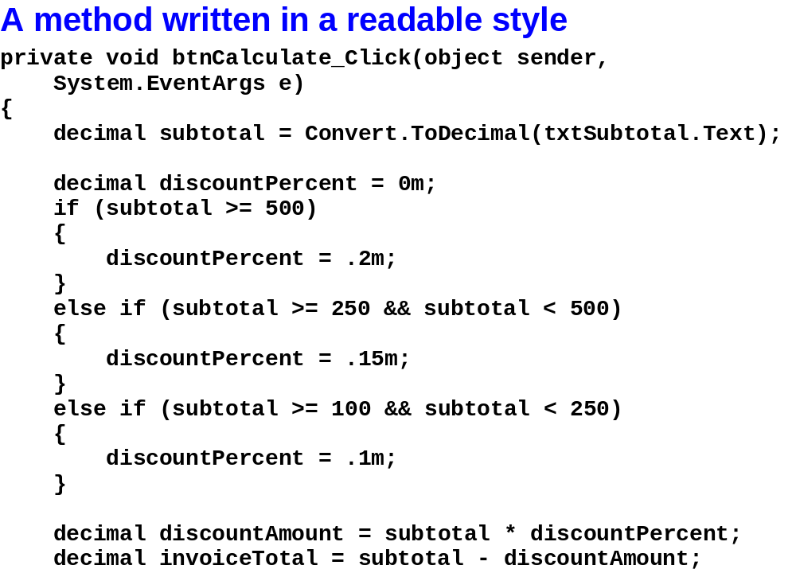
Murach’s C# 2010, C3
© 2010, Mike Murach & Associates, Inc.
Slide <number>

Slide 27
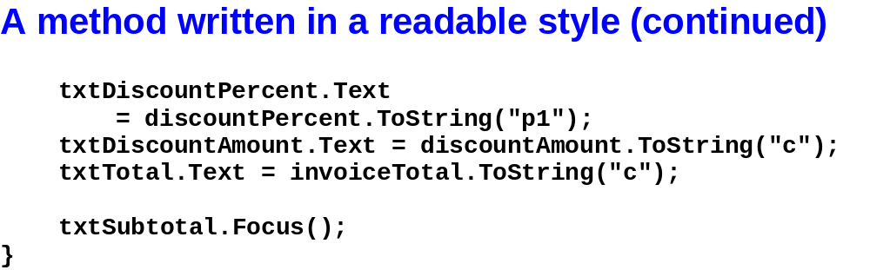
Murach’s C# 2010, C3
© 2010, Mike Murach & Associates, Inc.
Slide <number>

Slide 28
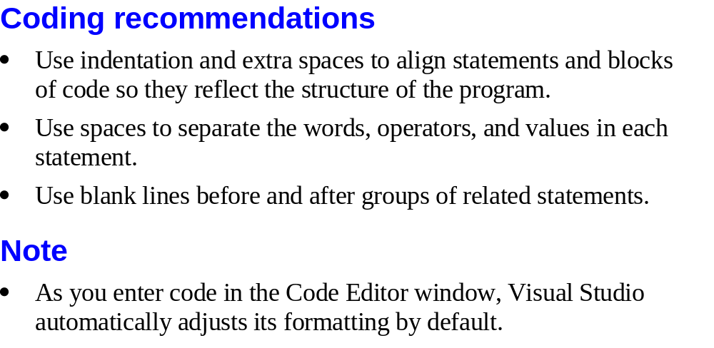
Murach’s C# 2010, C3
© 2010, Mike Murach & Associates, Inc.
Slide <number>

Slide 29
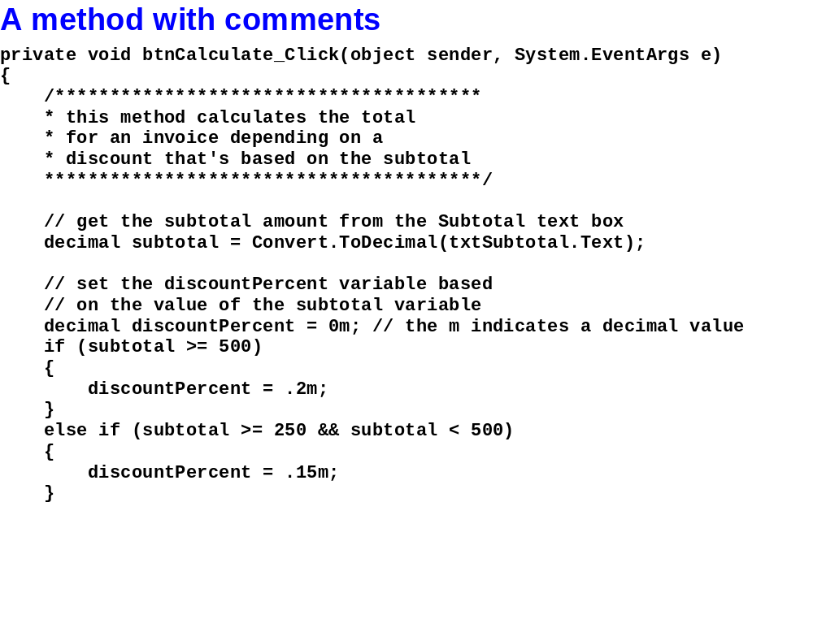
Murach’s C# 2010, C3
© 2010, Mike Murach & Associates, Inc.
Slide <number>

Slide 30
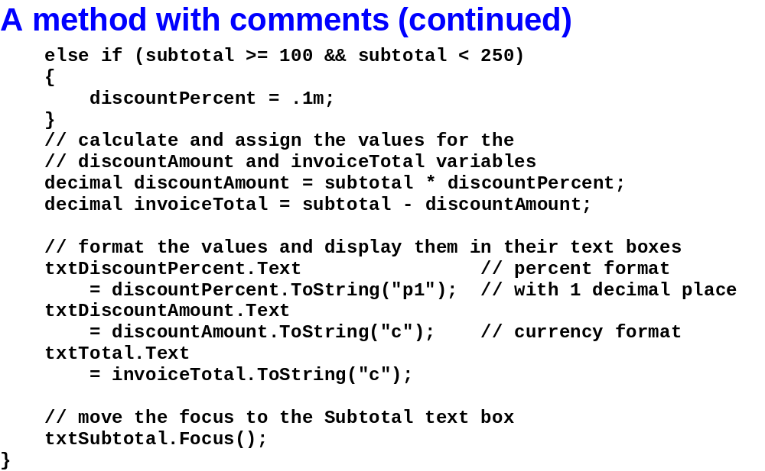
Murach’s C# 2010, C3
© 2010, Mike Murach & Associates, Inc.
Slide <number>

Slide 31
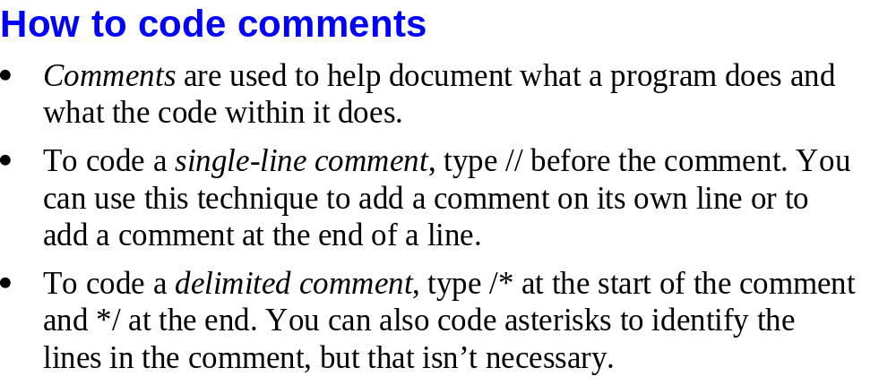
Murach’s C# 2010, C3
© 2010, Mike Murach & Associates, Inc.
Slide <number>

Slide 32

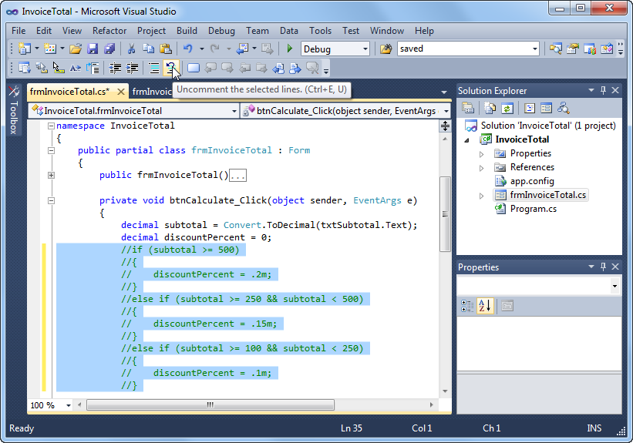
Murach’s C# 2010, C3
© 2010, Mike Murach & Associates, Inc.
Slide <number>

Slide 33
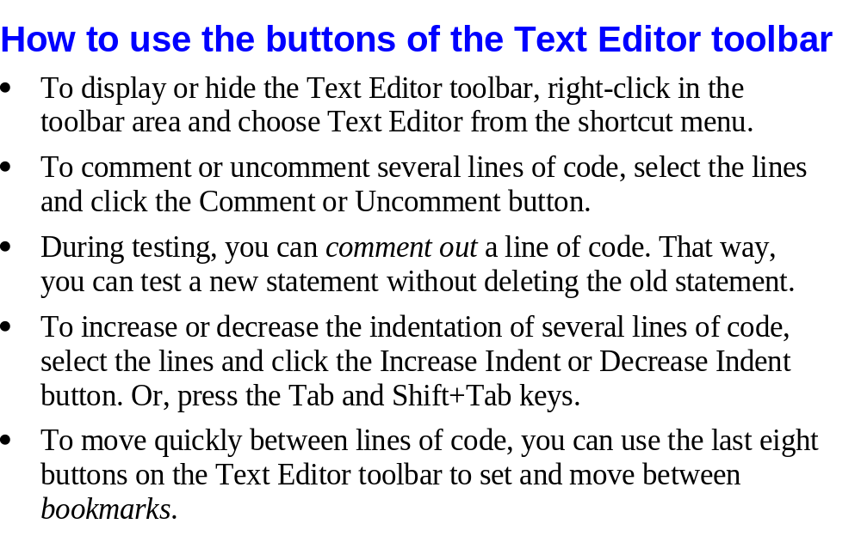
Murach’s C# 2010, C3
© 2010, Mike Murach & Associates, Inc.
Slide <number>

Slide 34
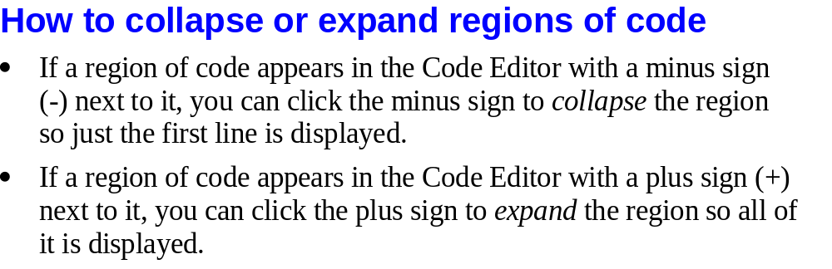
Murach’s C# 2010, C3
© 2010, Mike Murach & Associates, Inc.
Slide <number>

Slide 35

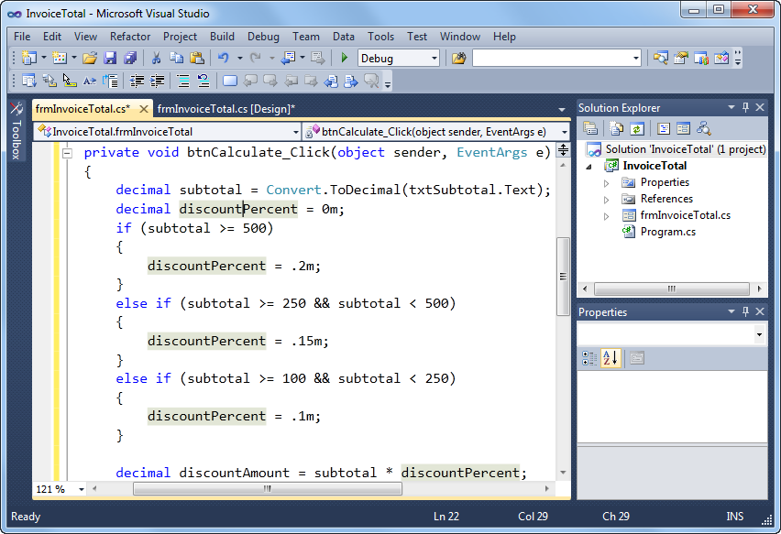
Murach’s C# 2010, C3
© 2010, Mike Murach & Associates, Inc.
Slide <number>

Slide 36
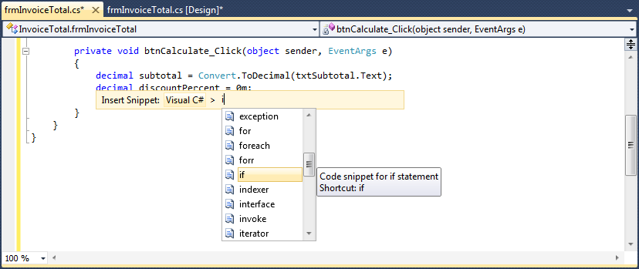
Murach’s C# 2010, C3
© 2010, Mike Murach & Associates, Inc.
Slide <number>

Slide 37
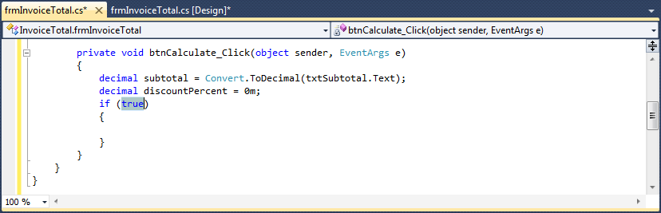
Murach’s C# 2010, C3
© 2010, Mike Murach & Associates, Inc.
Slide <number>

Slide 38
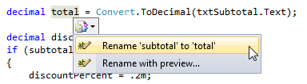
Murach’s C# 2010, C3
© 2010, Mike Murach & Associates, Inc.
Slide <number>

Slide 39
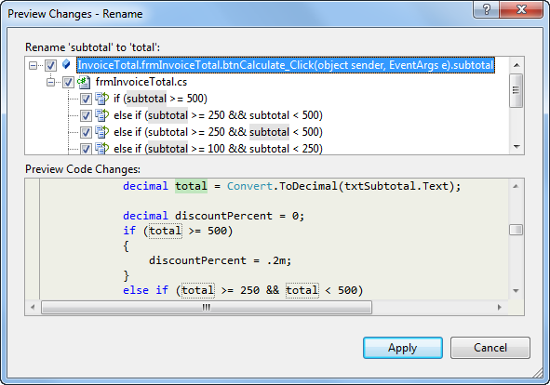
Murach’s C# 2010, C3
© 2010, Mike Murach & Associates, Inc.
Slide <number>

Slide 40
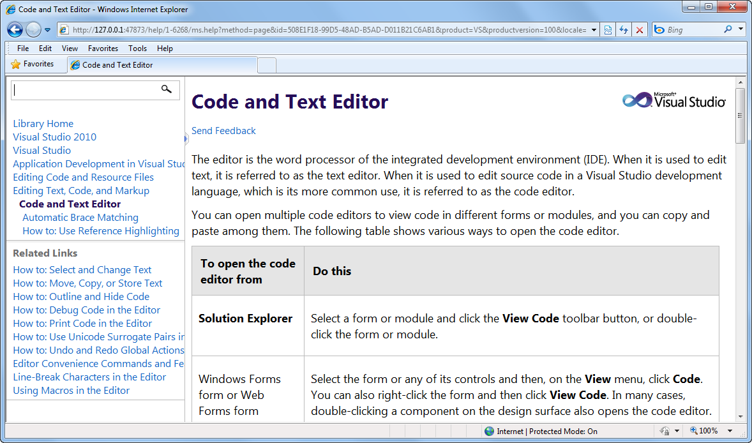
Murach’s C# 2010, C3
© 2010, Mike Murach & Associates, Inc.
Slide <number>

Slide 41
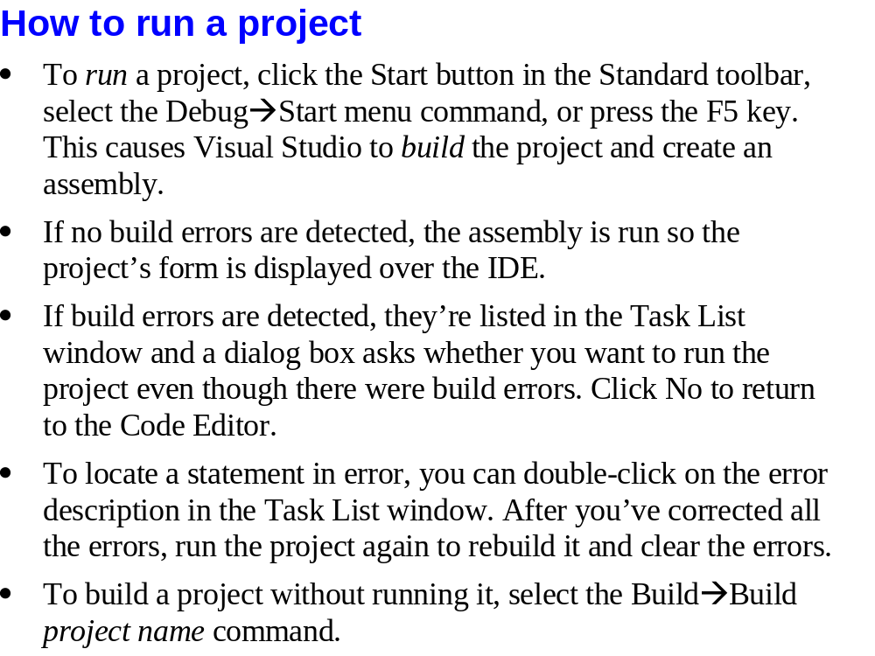
Slide <number>

Slide 42

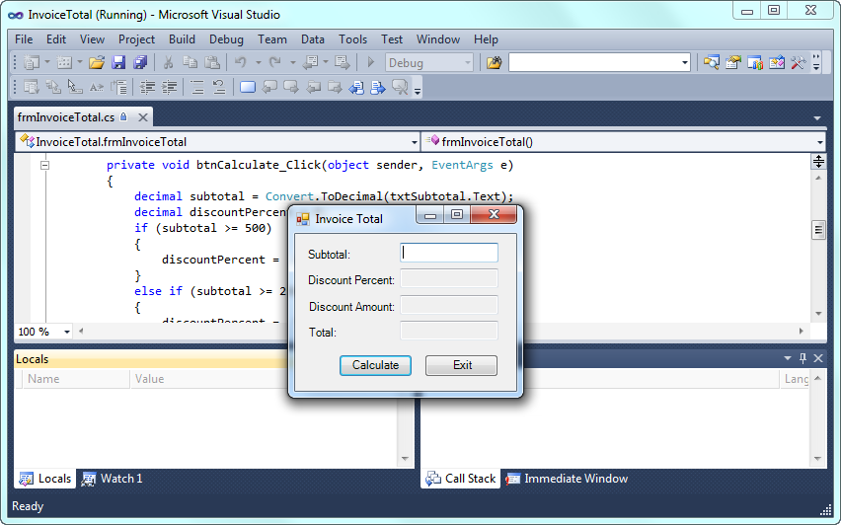
Murach’s C# 2010, C3
© 2010, Mike Murach & Associates, Inc.
Slide <number>

Slide 43

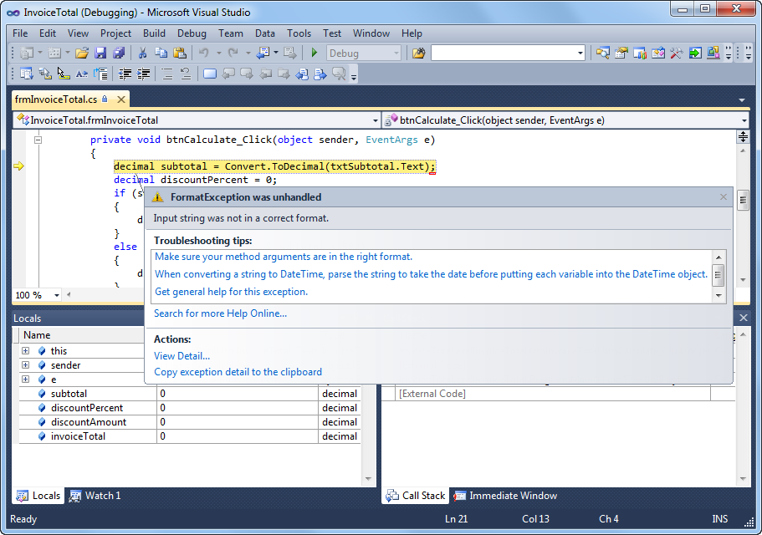
Murach’s C# 2010, C3
© 2010, Mike Murach & Associates, Inc.
Slide <number>

Slide 44
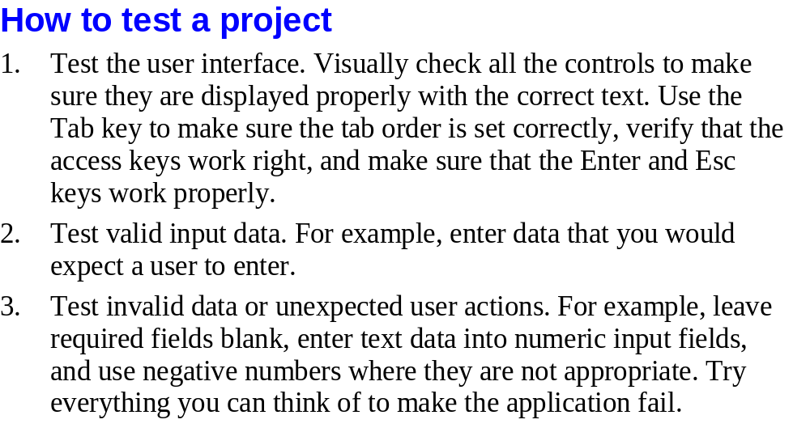
Murach’s C# 2010, C3
© 2010, Mike Murach & Associates, Inc.
Slide <number>

Slide 45
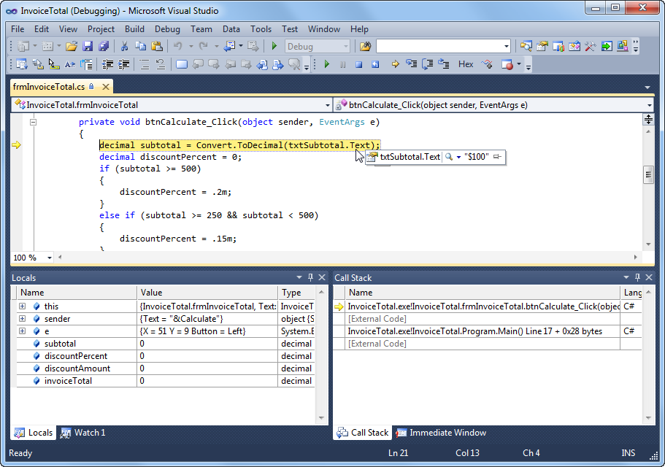
Murach’s C# 2010, C3
© 2010, Mike Murach & Associates, Inc.
Slide <number>

Slide 46
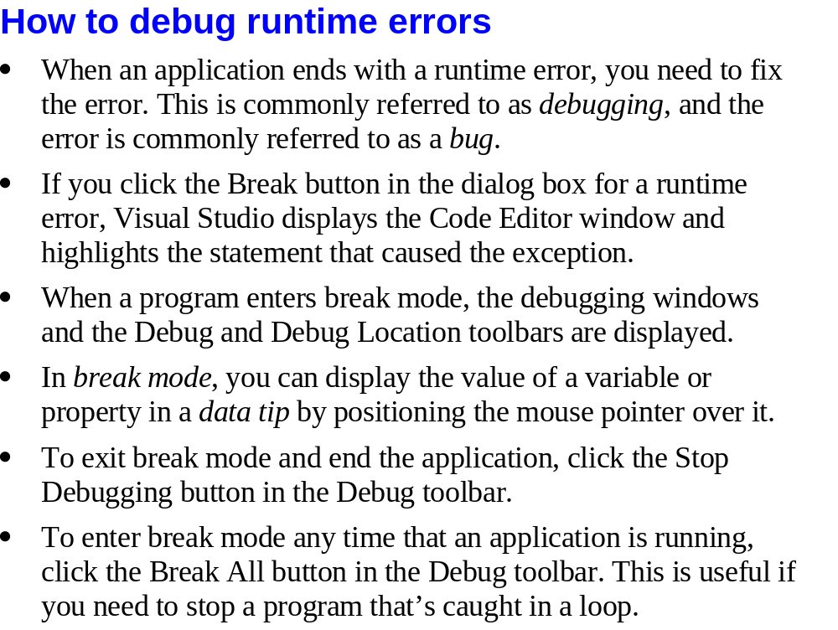
Slide <number>

Slide 47
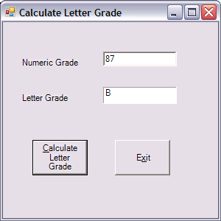
In-Class Activity
Text box
Label
Can you
  Code the “Exit” button
  Code the “Calculate..” to
    Access txtNumericGrade.Text
    Convert it to a decimal and store it in a variable
    Add 10 to this variable
    Convert this into a string and store it in the Text property of lblLetterGrade
  Yes, I know this is a silly thing but I just want to get you accessing & working with the Text property of controls
Slide <number>

Slide 48
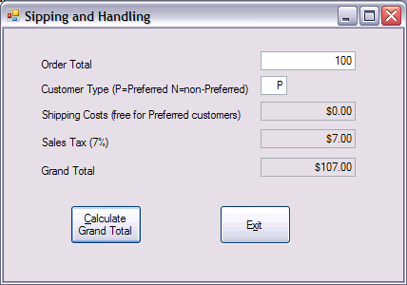
In-Class Activity
Text boxes
Can you
  Code the “Exit” button
  Code the “Calculate..” button to
    Access txtOrderTotal.Text
    Convert it to a decimal and store it in a variable
    Add 10 to this variable
    Convert this into a string and store it in the Text property of txtGrandTotal
  Yes, I know this is a silly thing but I just want to get you accessing & working with the Text property of controls
Read Only Text Boxes
Slide <number>

Slide 49

In-Class Activity
Text boxes
Can you
  Code the “Exit” button
  Code the “Project..” button to
    Access txtNumberOfStudentsToday.Text
    Convert it to a decimal and store it in a variable
    Double this number
    Convert this into a string and store it in the Text property of txtNumberOfProjectedStudents
  Yes, I know this is a silly thing but I just want to get you accessing & working with the Text property of controls
Read Only Text Box
Slide <number>

Slide 50

In-Class Activity
Can you
  Code the “Exit” button
  Code the “Convert..” button to
    Access txtAlphanumericNumber.Text
    Store it in text property of txtNumericOnly
  Yes, I know this is a silly thing but I just want to get you accessing & working with the Text property of controls
Slide <number>

