Slide 1

Course: Java programming i
Mr. Chenda Sovisal

Slide 2
Chapter I
Introduction to Core Java Programming

Slide 3

Agenda
Introduction to Java
Usage of Java
Features of Java
Components of Java
Installing Java

Slide 4
Introduction to Java

Slide 5

I. Introduction to Java
Java was developed by Mr. James Gosling, Mike Sheridan, and Patrick Naughton at Sun Microsystems In 1991, and publish in 1995.
James Gosling
Patrick Naughton
Mike Sheridan

Slide 6
I. Introduction to Java (con.)
Firstly, Java was called “GreenTalk” project.
Later in publishing, it was Java.
Why Java?

Slide 7
I. Introduction to Java (con.)
Java was later brought by Oracle.
Simple and Easy to use
Write Once and Run anywhere

Slide 8
Usage of Java

Slide 9

II. Usage of Java

Slide 10
Features of Java

Slide 11
III. Features of Java (con.)
It is simple and use to code:
Java is easy to learn and its syntax is quite simple, clean and easy to understand.The confusing and ambiguous concepts of C++ are either left out in Java or they have been re-implemented in a cleaner way.
Ex : Pointers and Operator Overloading are not there in java but were an important part of C++.

Slide 12
III. Features of Java (con.)
It is Platform Independent:
Unlike other programming languages such as C, C++ etc which are compiled into platform specific machines. Java is guaranteed to be write-once, run-anywhere language.
On compilation Java program is compiled into bytecode. This bytecode is platform independent and can be run on any machine, plus this bytecode format also provide security. Any machine with Java Runtime Environment can run Java Programs.

Slide 13
III. Features of Java (con.)
It is Platform Independent:
Linux OS
Java Program
compile
Bytecode
Windows OS
Mac OS

Slide 14
III. Features of Java (con.)
It is Multi Threading:
Java multithreading feature makes it possible to write program that can do many tasks simultaneously. Benefit of multithreading is that it utilizes same memory and other resources to execute multiple threads at the same time, like While typing, grammatical errors are checked along.

Slide 15

III. Features of Java (con.)
It is Multi Threading:

Slide 16
III. Features of Java (con.)
It is Open Sources:
There are a lot of resourceful of Java. From free unit test to a complete project.

Slide 17
III. Features of Java (con.)
It is Object Oriented Programming:
In java, everything is an object which has some data and behavior. Java can be easily extended as it is based on Object Model. Following are some basic concept of OOP's.
Object
Class
Inheritance
Polymorphism
Abstraction
Encapsulation

Slide 18
Components of Java

Slide 19
IV. Components of Java
Java Development Kit (JDK)
Java Runtime Environment (JRE)
Java Virtual Machine (JVM)
Class Libraries
Other Libraries

Slide 20
Installing Java

Slide 21
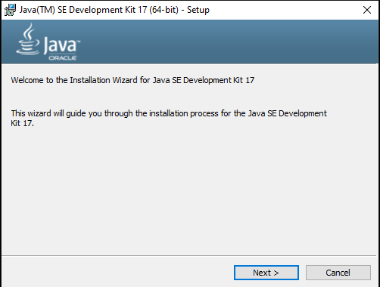
V. Installing Java
Install JDK

Slide 22
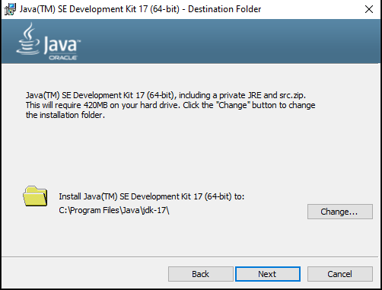
V. Installing Java (con.)
Install JDK (con.)

Slide 23
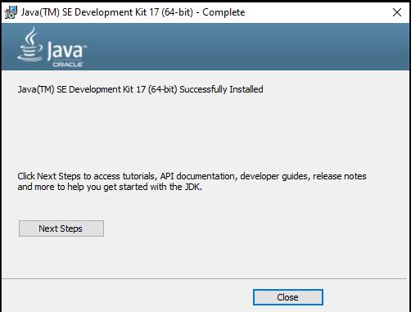
V. Installing Java (con.)
Install JDK (con.)

Slide 24
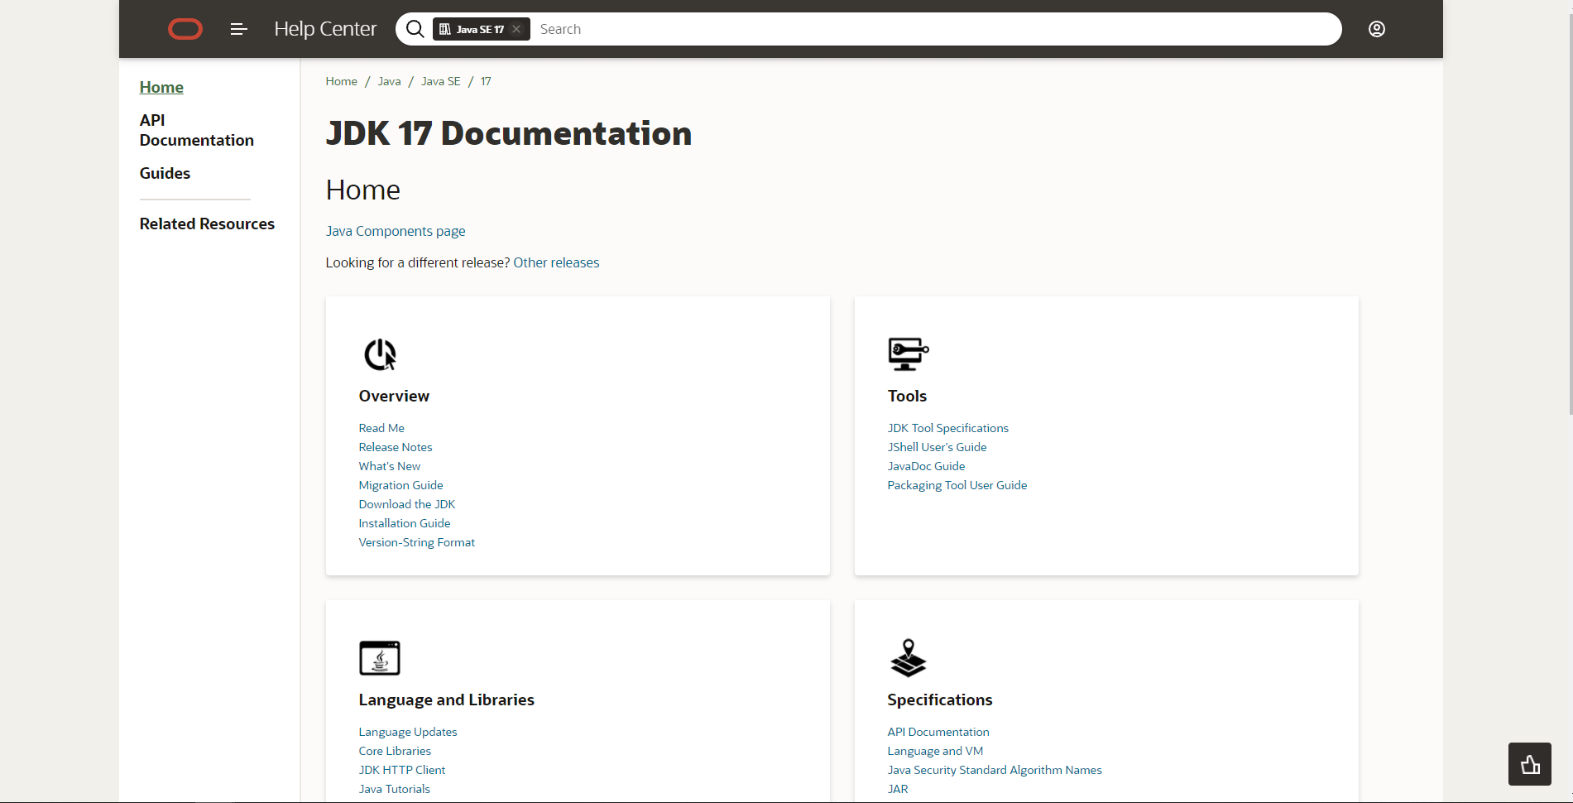
V. Installing Java (con.)
Install JDK (con.)

Slide 25
V. Installing Java (con.)
Install JDK (con.)

Slide 26
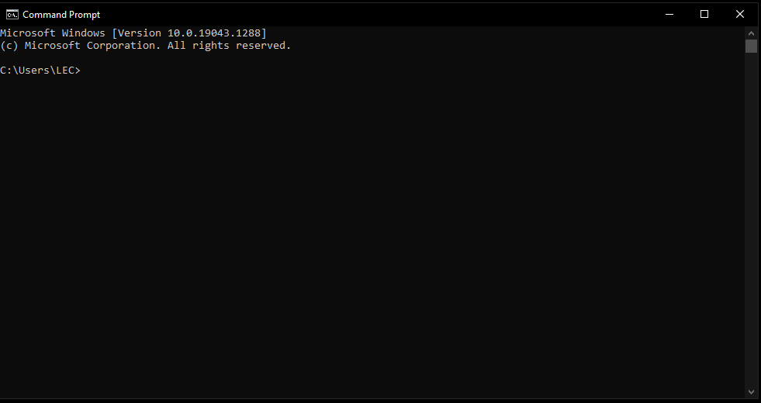
V. Installing Java (con.)
Checking Java have installed yet
In cmd, type java -version

Slide 27
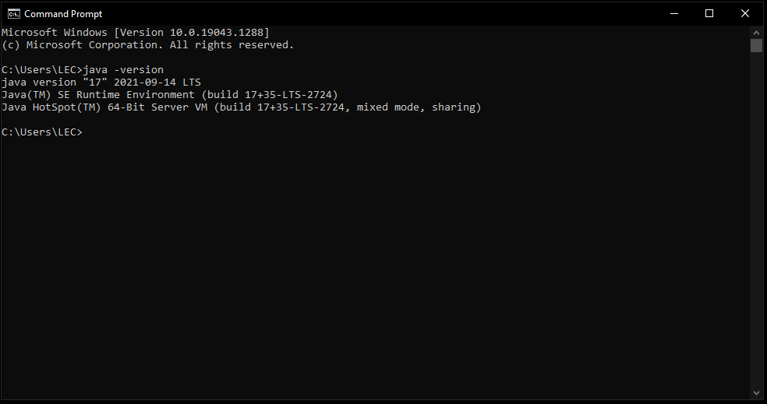
V. Installing Java (con.)
Checking Java have installed yet

Slide 28
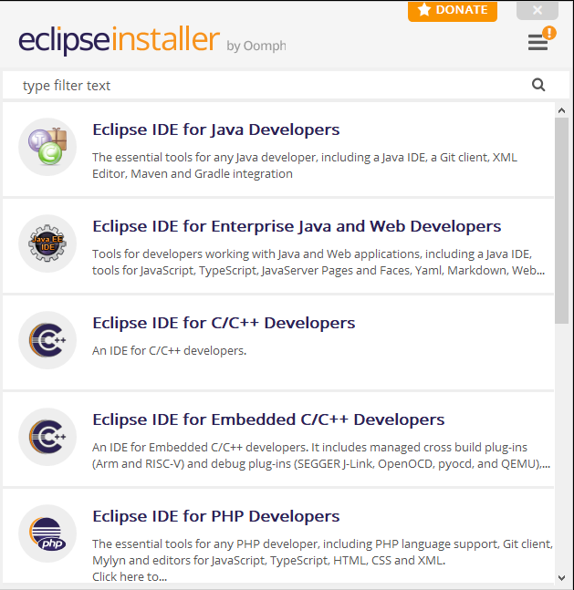
V. Installing Java (con.)
Install Java IDE Eclipse

Slide 29
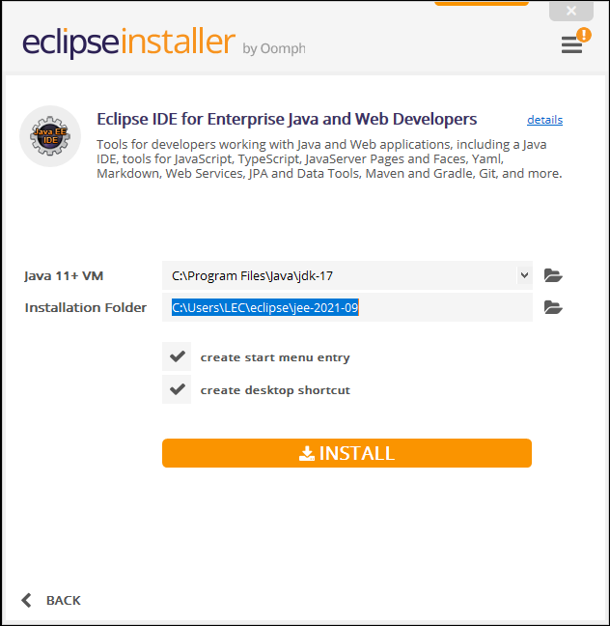
V. Installing Java (con.)
Install Java IDE Eclipse (con.)

Slide 30
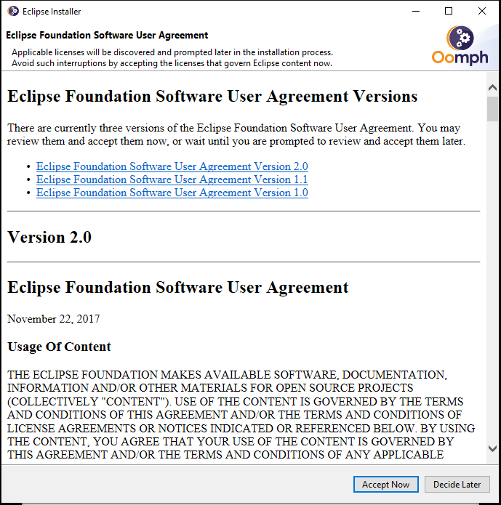
V. Installing Java (con.)
Install Java IDE Eclipse (con.)

Slide 31
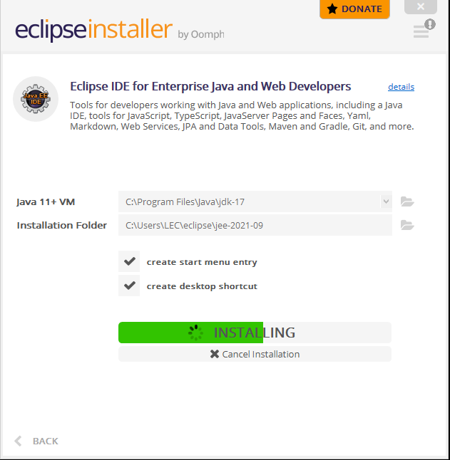
V. Installing Java (con.)
Install Java IDE Eclipse (con.)

Slide 32
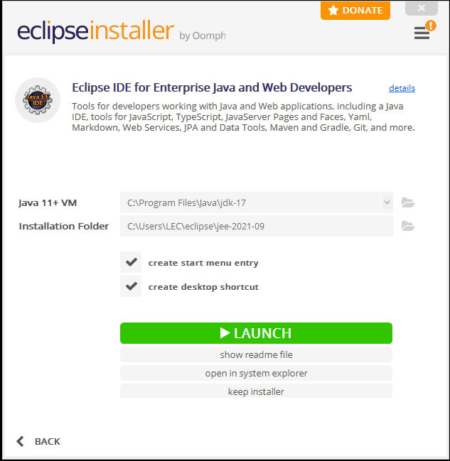
V. Installing Java (con.)
Install Java IDE Eclipse (con.)

Slide 33
The End of Chapter I
Let go for the first Demo!!!

