Slide 1
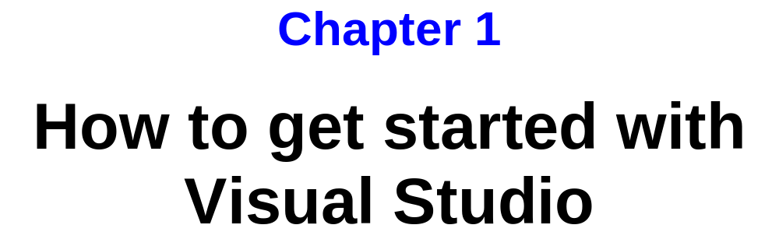
Murach’s C# 2010, C1
© 2010, Mike Murach & Associates, Inc.
Slide <number>

Slide 2
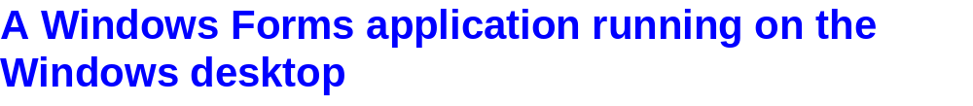
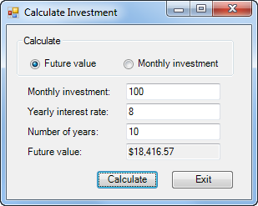
Radio Button
Text Box
Label
Button
Form and Controls
Murach’s C# 2010, C1
© 2010, Mike Murach & Associates, Inc.
Slide <number>

Slide 3

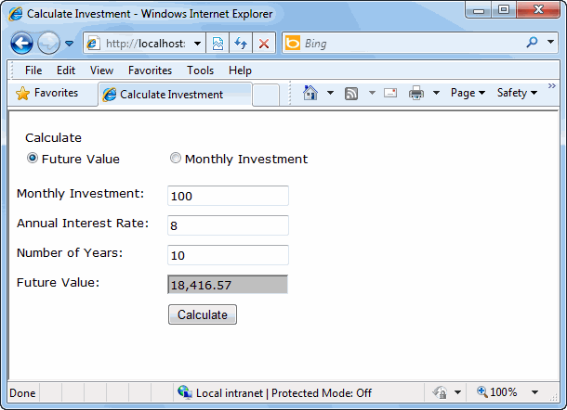
Murach’s C# 2010, C1
© 2010, Mike Murach & Associates, Inc.
Slide <number>

Slide 4
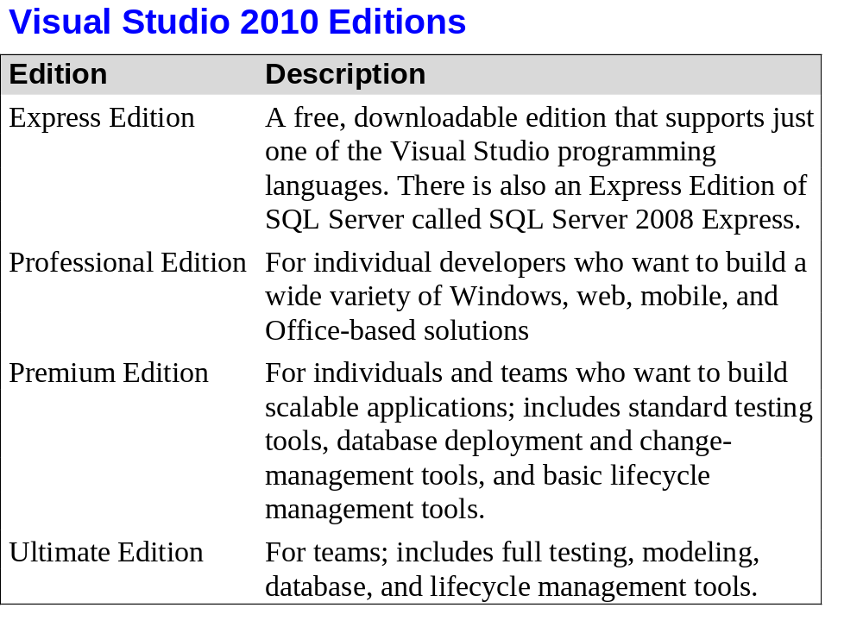
Murach’s C# 2010, C1
© 2010, Mike Murach & Associates, Inc.
Slide <number>

Slide 5
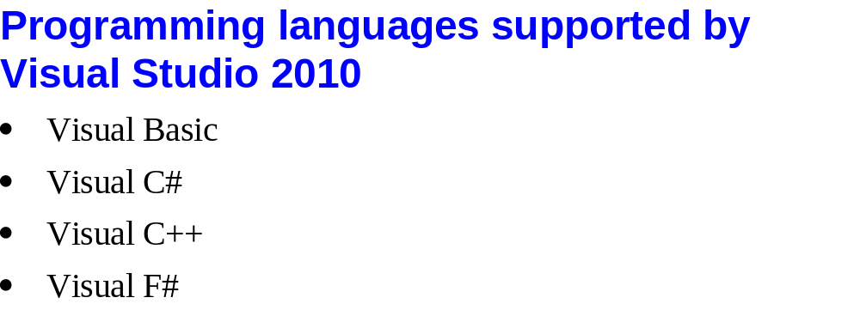
Murach’s C# 2010, C1
© 2010, Mike Murach & Associates, Inc.
Slide <number>

Slide 6
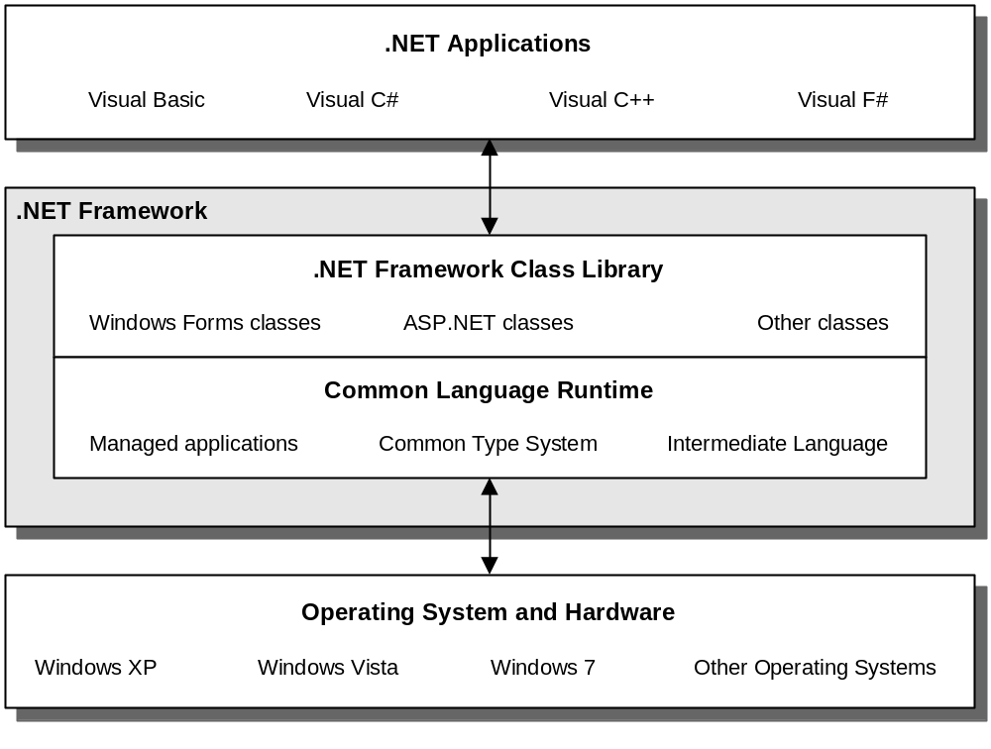
Murach’s C# 2010, C1
© 2010, Mike Murach & Associates, Inc.
Slide <number>

Slide 7
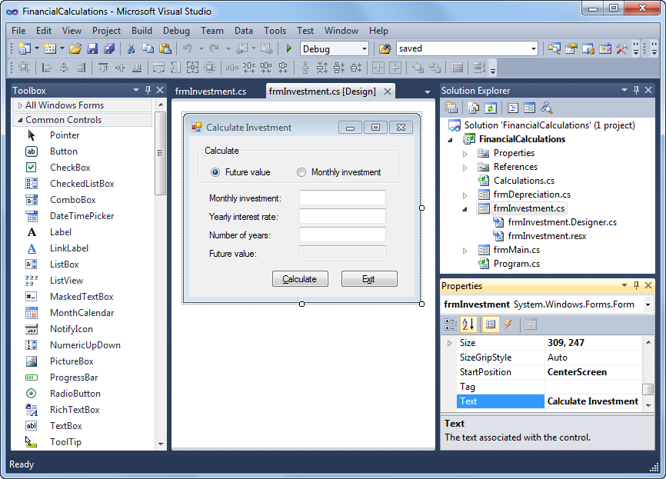
Murach’s C# 2010, C1
© 2010, Mike Murach & Associates, Inc.
Slide <number>

Slide 8
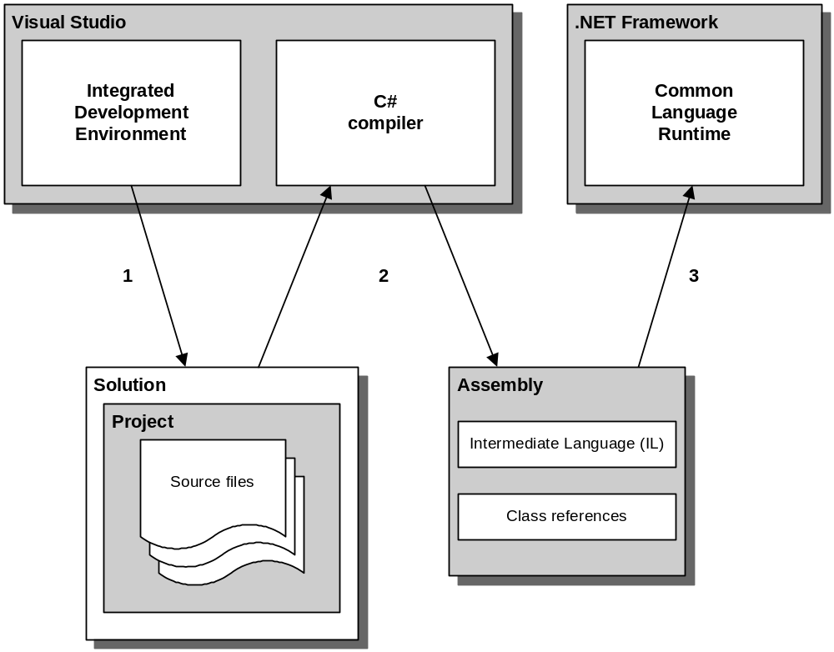
Murach’s C# 2010, C1
© 2010, Mike Murach & Associates, Inc.
Slide <number>

Slide 9

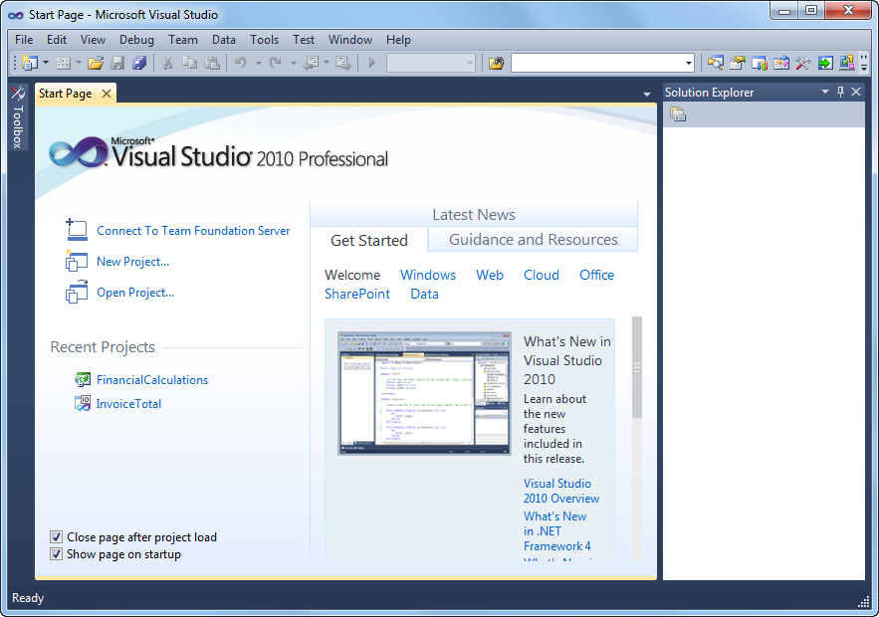
Murach’s C# 2010, C1
© 2010, Mike Murach & Associates, Inc.
Slide <number>

Slide 10
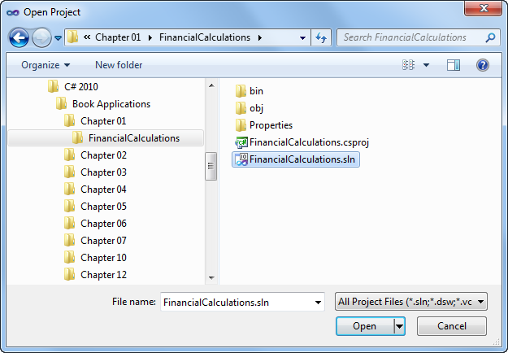
Murach’s C# 2010, C1
© 2010, Mike Murach & Associates, Inc.
Slide <number>

Slide 11
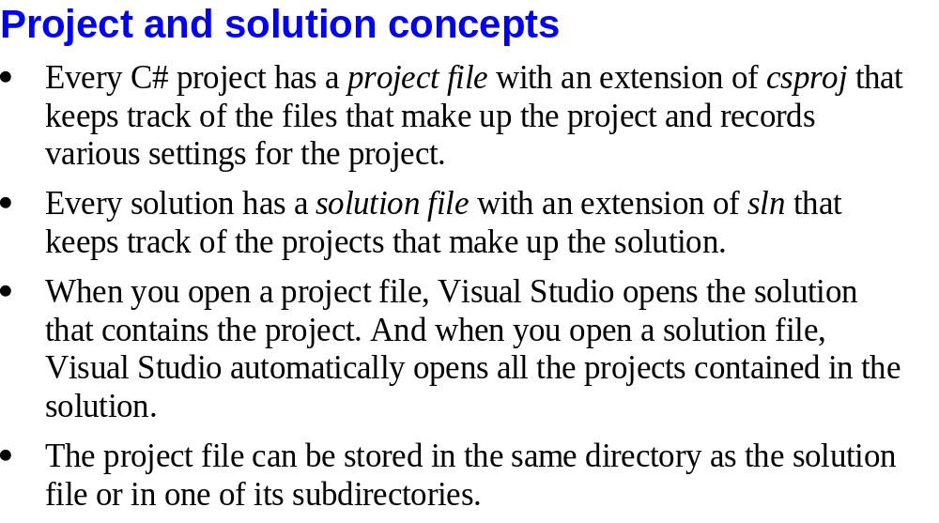
Murach’s C# 2010, C1
© 2010, Mike Murach & Associates, Inc.
Slide <number>

Slide 12

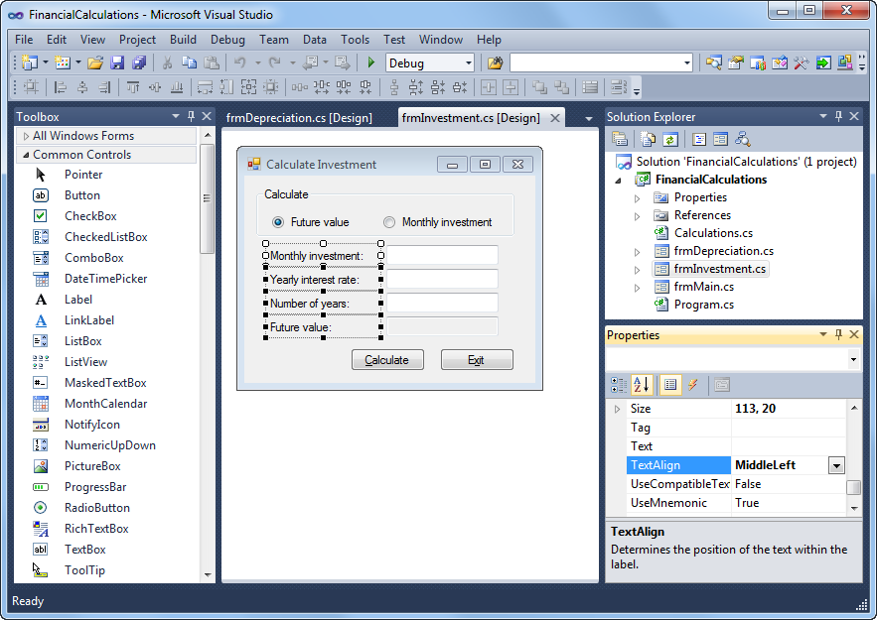
Murach’s C# 2010, C1
© 2010, Mike Murach & Associates, Inc.
Slide <number>

Slide 13

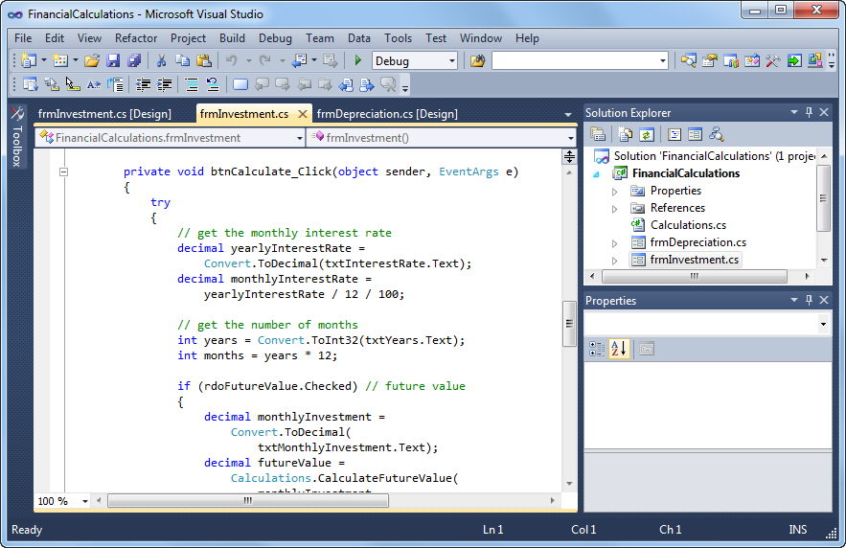
Murach’s C# 2010, C1
© 2010, Mike Murach & Associates, Inc.
Slide <number>

Slide 14
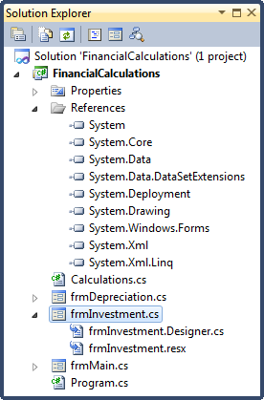
Murach’s C# 2010, C1
© 2010, Mike Murach & Associates, Inc.
Slide <number>

Slide 15
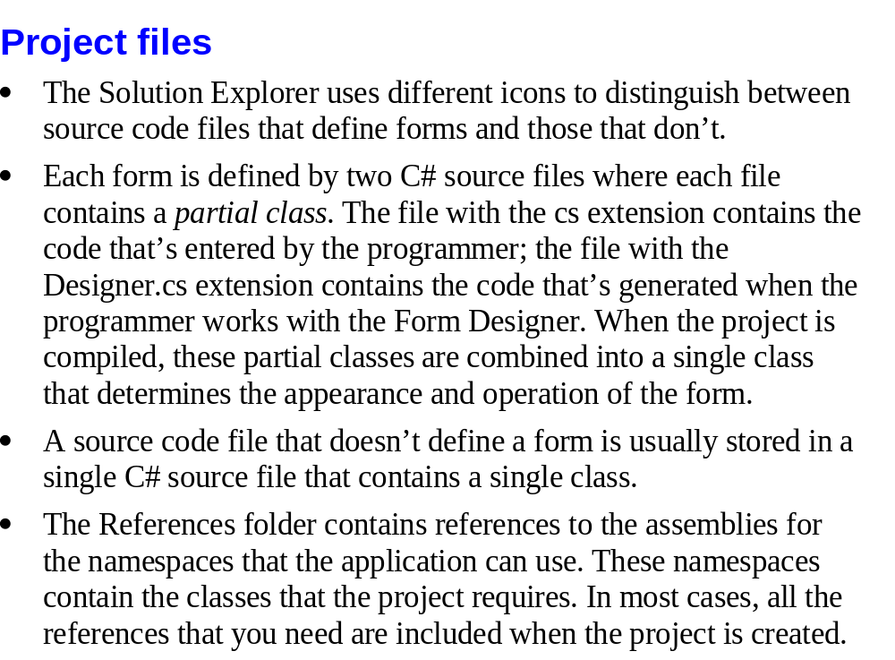
Murach’s C# 2010, C1
© 2010, Mike Murach & Associates, Inc.
Slide <number>

Slide 16

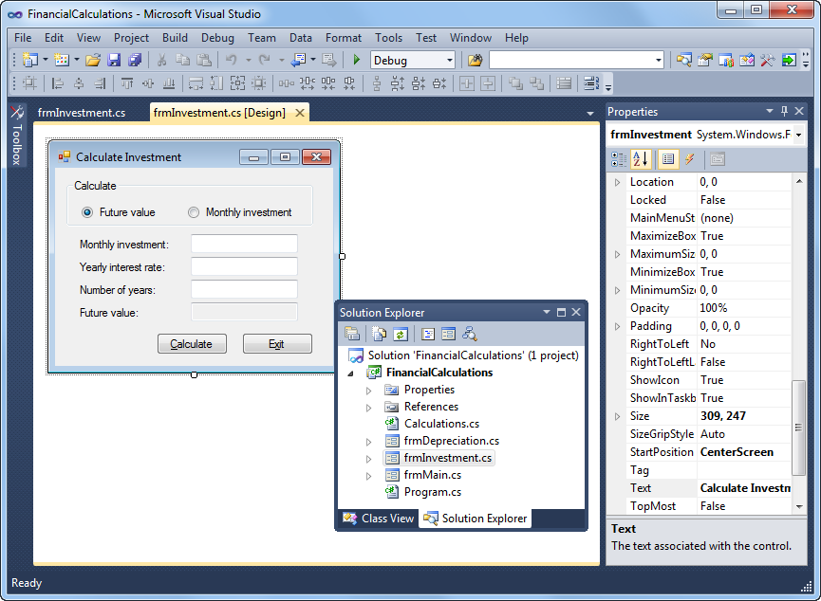
Murach’s C# 2010, C1
© 2010, Mike Murach & Associates, Inc.
Slide <number>

Slide 17
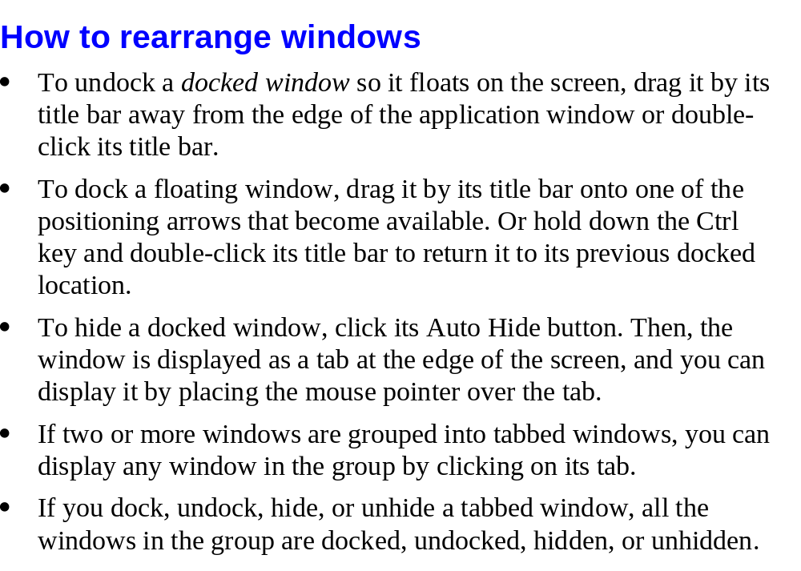
Murach’s C# 2010, C1
© 2010, Mike Murach & Associates, Inc.
Slide <number>

Slide 18
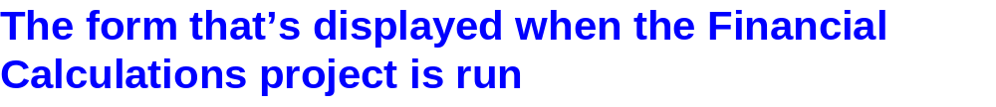
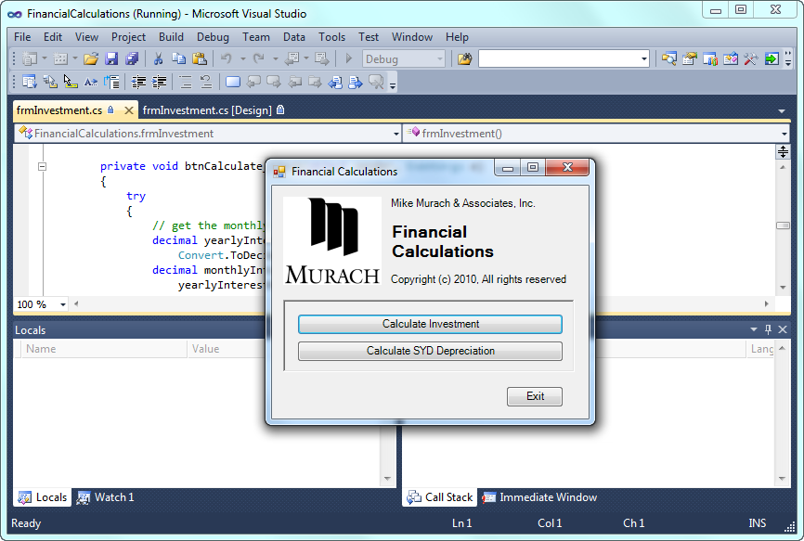
Murach’s C# 2010, C1
© 2010, Mike Murach & Associates, Inc.
Slide <number>

Slide 19
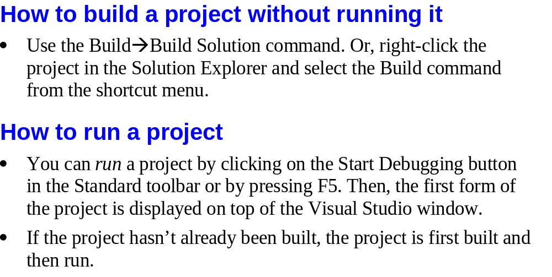
Murach’s C# 2010, C1
© 2010, Mike Murach & Associates, Inc.
Slide <number>

Slide 20
Activity
Use the information in Appendix A to download sample files from Murach’s web site
Work your way through the exercises at the end of chapter 1
Murach’s C# 2010, C1
© 2010, Mike Murach & Associates, Inc.
Slide <number>

