Slide 1
Initializing A Max Heap
1
2
3
4
5
6
7
8
9
7
11
7
8
10
input array = [-, 1, 2, 3, 4, 5, 6, 7, 8, 9, 10, 11]

Slide 2
Initializing A Max Heap
1
2
3
4
5
6
7
8
9
7
11
7
8
10
Start at rightmost array position that has a child.
Index is n/2.

Slide 3
Initializing A Max Heap
1
2
3
4
11
6
7
8
9
7
5
7
8
10
Move to next lower array position.

Slide 4
Initializing A Max Heap
1
2
3
4
11
6
7
8
9
7
5
7
8
10

Slide 5
Initializing A Max Heap
1
2
3
9
11
6
7
8
4
7
5
7
8
10

Slide 6
Initializing A Max Heap
1
2
3
9
11
6
7
8
4
7
5
7
8
10

Slide 7
Initializing A Max Heap
1
2
7
9
11
6
3
8
4
7
5
7
8
10

Slide 8
Initializing A Max Heap
1
2
7
9
11
6
3
8
4
7
5
7
8
10

Slide 9
Initializing A Max Heap
1
11
7
9
6
3
8
4
7
5
7
8
10
Find a home for 2.

Slide 10
Initializing A Max Heap
1
11
7
9
10
6
3
8
4
8
7
7
5
Find a home for 2.

Slide 11
Initializing A Max Heap
1
11
7
9
10
6
3
8
4
7
7
8
2
5
Done, move to next lower array position.

Slide 12
Initializing A Max Heap
1
11
7
9
10
6
3
8
4
2
7
7
8
5
Find home for 1.

Slide 13
Initializing A Max Heap
11
7
9
10
6
3
8
4
2
7
7
8
5
Find home for 1.

Slide 14
Initializing A Max Heap
11
10
7
9
6
3
8
4
2
7
7
8
5
Find home for 1.

Slide 15
Initializing A Max Heap
11
10
7
9
5
6
3
8
4
2
7
7
8
Find home for 1.

Slide 16
Initializing A Max Heap
11
10
7
9
5
6
3
8
4
2
7
7
8
1
Done.

Slide 17
public void initialize(Comparable [] theHeap, int theSize)
{
heap = theHeap;
size = theSize;
// heapify
for (int root = size / 2; root >= 1; root--)
{
Comparable rootElement = heap[root];
// find place to put rootElement
int child = 2 * root; // parent of child is target
// location for rootElement
while (child <= size)
{
// heap[child] should be larger sibling
if (child < size &&
heap[child].compareTo(heap[child + 1]) < 0) child++;
// can we put rootElement in heap[child/2]?
if (rootElement.compareTo(heap[child]) >= 0)
break; // yes

Slide 18
while (child <= size)
{
// heap[child] should be larger sibling
if (child < size &&
heap[child].compareTo(heap[child + 1]) < 0) child++;
// can we put rootElement in heap[child/2]?
if (rootElement.compareTo(heap[child]) >= 0)
break; // yes
// no
heap[child / 2] = heap[child]; // move child up
child *= 2; // move down a level
}
heap[child / 2] = rootElement;
}
}

Slide 19

Time Complexity
11
9
7
8
5
6
3
1
4
7
7
8
10
2
Height of heap = h.
Number of subtrees with root at level j is <= 2 ^{j-1}.

Slide 20
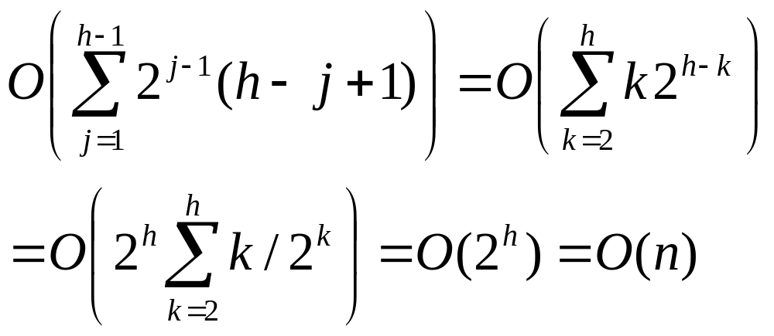
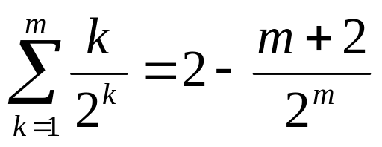
Complexity
Thus at most 2^{j-1} nodes will have height h-(j-1) or h-j+1
The time for each subtree is O(h-j+1).
Time for level j subtrees is <= 2^{j-1}(h-j+1) = t(j).
Total time is:
Since:

Slide 21
Leftist Trees
Linked binary tree.
Can do everything a heap can do and in the same asymptotic complexity.
Can meld two leftist tree priority queues in O(log n) time.

Slide 22
Extended Binary Trees
Start with any binary tree and add an external node wherever there is an empty subtree.
Result is an extended binary tree.

Slide 23
A Binary Tree

Slide 24
An Extended Binary Tree
number of external nodes is n+1

Slide 25
The Function s()
For any node x in an extended binary tree, let s(x) be the length of a shortest path from x to an external node in the subtree rooted at x.

Slide 26
s() Values Example

Slide 27
s() Values Example
2
2
1
2
1
1
0
1
1
0
0
1
0
0
0
0
0
0
0

Slide 28
Properties Of s()
If x is an external node, then s(x) = 0.
Otherwise,
  s(x) = min {s(leftChild(x)),
    s(rightChild(x))} + 1
Notes:
s() values may be computed easily using a postorder traversal.

Slide 29
Height Biased Leftist Trees
A binary tree is a (height biased) leftist tree iff for every internal node x, s(leftChild(x)) >= s(rightChild(x))

Slide 30
A Height Biased Leftist Tree
2
2
1
2
1
1
0
1
1
0
0
1
0
0
0
0
0
0
0

Slide 31
Leftist Trees--Property 1
In a leftist tree, the rightmost path is a shortest route to external node path and the length of this path is s(root).

Slide 32
A Leftist Tree
2
2
1
2
1
1
0
1
1
0
0
1
0
0
0
0
0
0
0
Length of rightmost path is 2.

Slide 33
Leftist Trees—Property 2
The number of internal nodes is at least
  2^{s(root)} - 1
Because levels 1 through s(root) have no external nodes.

Slide 34
A Leftist Tree
2
2
1
2
1
1
0
1
1
0
0
1
0
0
0
0
0
0
0
Levels 1 and 2 have no external nodes.

Slide 35
Leftist Trees—Property 3
Length of rightmost path is O(log n), where n is the number of nodes in a leftist tree.
Follows from Property 2.

Slide 36
Leftist Trees As Priority Queues
Min leftist tree … leftist tree that is a min tree.
  Used as a min priority queue.
Max leftist tree … leftist tree that is a max tree.
  Used as a max priority queue.

Slide 37
A Min Leftist Tree
2
4
3
6
8
5
8
6
9

Slide 38
Some Min Leftist Tree Operations
put
remove()
meld()
initialize()
put() and remove() use meld().

Slide 39
Put Operation
put(7)
2
4
3
6
8
5
8
6
9

Slide 40
Put Operation
put(7)
2
4
3
6
8
5
8
6
9
Create a single node min leftist tree.
7

Slide 41
Put Operation
put(7)
2
4
3
6
8
5
8
6
9
Create a single node min leftist tree.
Meld the two min leftist trees.
7

Slide 42
Remove Min
2
4
3
6
8
5
8
6
9

Slide 43
Remove Min
2
4
3
6
8
5
8
6
9
Remove the root.

Slide 44
Remove Min
2
4
3
6
8
5
8
6
9
Remove the root.
Meld the two subtrees.

Slide 45
Meld Two Min Leftist Trees
4
3
6
8
5
6
8
6
9
Traverse only the rightmost paths so as to get logarithmic performance.

Slide 46
Meld Two Min Leftist Trees
4
3
6
8
5
6
8
6
9
Meld right subtree of tree with smaller root and all of other tree.

Slide 47
Meld Two Min Leftist Trees
4
3
6
8
5
6
8
6
9
Meld right subtree of tree with smaller root and all of other tree.

Slide 48
Meld Two Min Leftist Trees
4
6
6
8
8
6
Meld right subtree of tree with smaller root and all of other tree.

Slide 49
Meld Two Min Leftist Trees
8
6
Meld right subtree of tree with smaller root and all of other tree.
Right subtree of 6 is empty. So, result of melding right subtree of tree with smaller root and other tree is the other tree.

Slide 50
Meld Two Min Leftist Trees
8
6
Make melded subtree right subtree of smaller root.
6
8
Swap left and right subtree if s(left) < s(right).
6
8

Slide 51
Meld Two Min Leftist Trees
4
4
6
6
6
6
8
8
6
8
8
6
Make melded subtree right subtree of smaller root.
Swap left and right subtree if s(left) < s(right).

Slide 52
Meld Two Min Leftist Trees
3
5
1
4
2
9
6
6
8
6
8
Make melded subtree right subtree of smaller root.
Swap left and right subtree if s(left) < s(right).

Slide 53
Meld Two Min Leftist Trees
3
4
5
6
6
9
8
6
8

Slide 54
Complexity Analysis of Meld
Meld only moves to the right of the two trees x and y that are being melded.
Thus complexity is O(s(x) + s(y))
s(x) and s(y) are at most log₂(m+1) and log₂(n+1) where m and n are the number of elements in the max HBLTs with roots x and y.
Result: O(log₂m + log₂n) = O(log₂mn)

Slide 55
Initializing In O(n) Time
create n single node min leftist trees and place them in a FIFO queue
repeatedly remove two min leftist trees from the FIFO queue, meld them, and put the resulting min leftist tree into the FIFO queue
the process terminates when only 1 min leftist tree remains in the FIFO queue

Slide 56
Initializing In O(n) Time
analysis is the same as for heap initialization
Assume that the number of nodes, n is a power of 2.
The first n/2 melds involve max HBLTs with one element each.
The next n/4 melds involve max HBLTs with two elements each
The next n/8 melds involve max HBLTs with four elements each

Slide 57
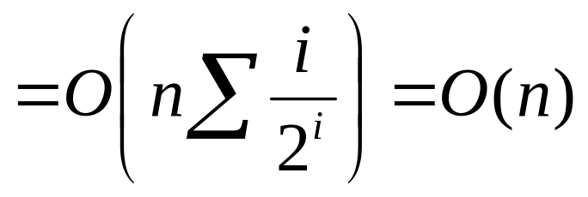
Initializing In O(n) Time
The time needed to meld two trees with 2^{i} elements each is O(i + 1)
  Since log ₂2^{i} is just i.
Total time taken by initialize is:
O(n/2 + 2*(n/4) + 3*(n/8) + …
Since we know:

