Slide 1
Data Structures and Algorithms
Graphs
Single-Source Shortest Paths
(Dijkstra’s Algorithm)
PLSD210(ii)

Slide 2
Graphs - Shortest Paths
Application
  In a graph in which edges have costs ..
  Find the shortest path from a source to a destination
  Surprisingly ..
    While finding the shortest path from a source to one destination,
    we can find the shortest paths to all over destinations as well!
  Common algorithm for
  single-source shortest paths
  is due to Edsger Dijkstra

Slide 3
Dijkstra’s Algorithm - Data Structures
For a graph,
G = ( V, E )
Dijkstra’s algorithm keeps two sets of vertices:
  S Vertices whose shortest paths have already been
  determined
  V-S Remainder
Also
  d Best estimates of shortest path to each vertex
  π Predecessors for each vertex

Slide 4
Predecessor Sub-graph
Array of vertex indices, π[j], j = 1 .. |V|
  π[j] contains the pre-decessor for node j
  j’s predecessor is in π[π[j]], and so on ....
  The edges in the pre-decessor sub-graph are
  ( π[j], j )

Slide 5
Dijkstra’s Algorithm - Operation
Initialise d and π
  For each vertex, j, in V
    d_{j} = ∞
    π_{j} = nil
  Source distance, d_{s} = 0
Set S to empty
While V-S is not empty
  Sort V-S based on d
  Add u, the closest vertex in V-S, to S
  Relax all the vertices still in V-S connected to u
Initial estimates are all ∞
No connections
Add s first!

Slide 6
Dijkstra’s Algorithm - Operation
Initialise d and π
  For each vertex, j, in V
    d_{j} = ∞
    π_{j} = nil
  Source distance, d_{s} = 0
Set S to empty
While V-S is not empty
  Sort V-S based on d
  Add u, the closest vertex in V-S, to S
  Relax all the vertices still in V-S connected to u
Initial estimates are all ∞
No connections
Add s first!

Slide 7
Dijkstra’s Algorithm - Operation
The Relaxation process
Relax the node v
attached to node u
Edge cost matrix
If the current best
estimate to v is
greater than the
path through u ..
relax( Node u, Node v, double w[][] )
if d[v] > d[u] + w[u,v] then
d[v] := d[u] + w[u,v]
pi[v] := u
Update the estimate to v
Make v’s predecessor
point to u

Slide 8
Dijkstra’s Algorithm - Full
The Shortest Paths algorithm
Given a graph, g, and a source, s
shortest_paths( Graph g, Node s )
initialise_single_source( g, s )
S := { 0 } /* Make S empty */
Q := Vertices( g ) /* Put the vertices in a PQ */
while not Empty(Q)
u := ExtractCheapest( Q );
AddNode( S, u ); /* Add u to S */
for each vertex v in Adjacent( u )
relax( u, v, w )

Slide 9
Dijkstra’s Algorithm - Initialise
The Shortest Paths algorithm
Given a graph, g,
and a source, s
Initialise d, π, S,
vertex Q
shortest_paths( Graph g, Node s )
initialise_single_source( g, s )
S := { 0 } /* Make S empty */
Q := Vertices( g ) /* Put the vertices in a PQ */
while not Empty(Q)
u := ExtractCheapest( Q );
AddNode( S, u ); /* Add u to S */
for each vertex v in Adjacent( u )
relax( u, v, w )

Slide 10
Dijkstra’s Algorithm - Loop
The Shortest Paths algorithm
Given a graph, g,
and a source, s
shortest_paths( Graph g, Node s )
initialise_single_source( g, s )
S := { 0 } /* Make S empty */
Q := Vertices( g ) /* Put the vertices in a PQ */
while not Empty(Q)
u := ExtractCheapest( Q );
AddNode( S, u ); /* Add u to S */
for each vertex v in Adjacent( u )
relax( u, v, w )
While there are still nodes in Q
Greedy!

Slide 11
Dijkstra’s Algorithm - Relax neighbours
The Shortest Paths algorithm
Given a graph, g,
and a source, s
Update the estimate of the shortest paths to all nodes attached to u
shortest_paths( Graph g, Node s )
initialise_single_source( g, s )
S := { 0 } /* Make S empty */
Q := Vertices( g ) /* Put the vertices in a PQ */
while not Empty(Q)
u := ExtractCheapest( Q );
AddNode( S, u ); /* Add u to S */
for each vertex v in Adjacent( u )
relax( u, v, w )
Greedy!

Slide 12
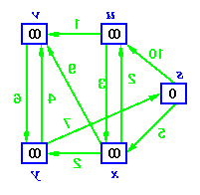
Dijkstra’s Algorithm - Operation
Initial Graph
Source
Mark 0
Distance to all nodes marked ∞

Slide 13
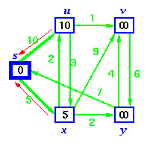
Dijkstra’s Algorithm - Operation
Initial Graph
Source
Relax vertices adjacent to source

Slide 14
Dijkstra’s Algorithm - Operation
Initial Graph
Source
Red arrows show
pre-decessors

Slide 15
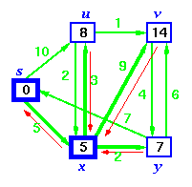
Dijkstra’s Algorithm - Operation
Source is now in S
Sort vertices and
choose closest

Slide 16
Dijkstra’s Algorithm - Operation
Relax u because a shorter path via x
exists
Source is now in S
Relax y because a shorter path via x
exists

Slide 17
Dijkstra’s Algorithm - Operation
Change u’s
pre-decessor also
Source is now in S
Relax y because a shorter path via x
exists

Slide 18
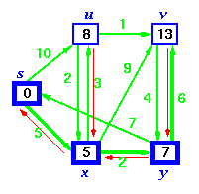
Dijkstra’s Algorithm - Operation
S is now { s, x }
Sort vertices and
choose closest

Slide 19
Dijkstra’s Algorithm - Operation
Relax v because a shorter path via y
exists
S is now { s, x }
Sort vertices and
choose closest

Slide 20
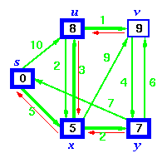
Dijkstra’s Algorithm - Operation
S is now { s, x, y }
Sort vertices and
choose closest, u

Slide 21
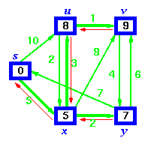
Dijkstra’s Algorithm - Operation
S is now { s, x, y, u }
Finally add v

Slide 22
Dijkstra’s Algorithm - Operation
S is now { s, x, y, u }
Pre-decessors show shortest paths sub-graph

Slide 23
Dijkstra’s Algorithm - Proof
Greedy Algorithm
  Proof by contradiction best
Lemma 1
  Shortest paths are composed of shortest paths
Proof
  If there was a shorter path than any sub-path, then substitution of that path would make the whole path shorter

Slide 24
Dijkstra’s Algorithm - Proof
Denote
  δ(s,v) - the cost of the shortest path from s to v
Lemma 2
  If s→...→u→v is a shortest path from s to v,
  then after u has been added to S and relax(u,v,w) called,
  d[v] = δ(s,v) and d[v] is not changed thereafter.
Proof
  Follows from the fact that at all times d[v] ≥ δ(s,v)
  See Cormen (or any other text) for the details

Slide 25
Dijkstra’s Algorithm - Proof
Using Lemma 2
  After running Dijkstra’s algorithm, we assert
  d[v] = δ(s,v) for all v
Proof (by contradiction)
  Suppose that u is the first vertex added to S for which d[u] ≠ δ(s,u)
  Note
    v is not s because d[s] = 0
    There must be a path s→...→u,
    otherwise d[u] would be ∞
    Since there’s a path, there must be a shortest path

Slide 26
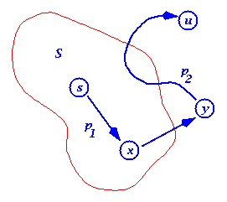
Dijkstra’s Algorithm - Proof
Proof (by contradiction)
  Suppose that u is the first vertex added to S for which d[u] ≠ δ(s,u)
  Let s→x→y→u be the shortest path
  s→u,
  where x is in S and y is the
  first outside S
  When x was added to S, d[x] = δ(s,x)
  Edge x→y was relaxed at that time,
  so d[y] = δ(s,y)

Slide 27
Dijkstra’s Algorithm - Proof
Proof (by contradiction)
  Edge x→y was relaxed at that time,
  so d[y] = δ(s,y)
  ≤ δ(s,u) ≤ d[u]
  But, when we chose u,
  both u and y where in V-S,
  so d[u] ≤ d[y]
  (otherwise we would have chosen y)
  Thus the inequalities must be equalities
  d[y] = δ(s,y) = δ(s,u) = d[u]
  And our hypothesis (d[u] ≠ δ(s,u)) is contradicted!

Slide 28
Dijkstra’s Algorithm - Time Complexity
Dijkstra’s Algorithm
  Similar to MST algorithms
  Key step is sort on the edges
  Complexity is
    O( (|E|+|V|)log|V| ) or
    O( n² log n )
    for a dense graph with n = |V|

