Slide 1

Insertion Sort
for (int i = 1; i < a.length; i++)
{// insert a[i] into a[0:i-1]
int t = a[i];
int j;
for (j = i - 1; j >= 0 && t < a[j]; j--)
a[j + 1] = a[j];
a[j + 1] = t;
}

Slide 2
Complexity
Space/Memory
Time
  Count a particular operation
  Count number of steps
  Asymptotic complexity

Slide 3
Comparison Count
Pick an instance characteristic … n, n = a.length for insertion sort
Determine count as a function of this instance characteristic.

Slide 4
Comparison Count
for (int i = 1; i < a.length; i++)
{// insert a[i] into a[0:i-1]
int t = a[i];
int j;
for (j = i - 1; j >= 0 && t < a[j]; j--)
a[j + 1] = a[j];
a[j + 1] = t;
}

Slide 5
Comparison Count
for (j = i - 1; j >= 0 && t < a[j]; j--)
a[j + 1] = a[j];
How many comparisons are made?

Slide 6
Comparison Count
for (j = i - 1; j >= 0 && t < a[j]; j--)
a[j + 1] = a[j];
number of compares depends on
a[]s and t as well as on n

Slide 7
Worst-Case Comparison Count
for (j = i - 1; j >= 0 && t < a[j]; j--)
a[j + 1] = a[j];
a = [1, 2, 3, 4] and t = 0 => 4 compares
a = [1,2,3,…,i] and t = 0 => i compares

Slide 8
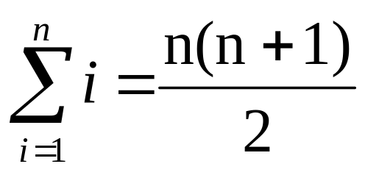
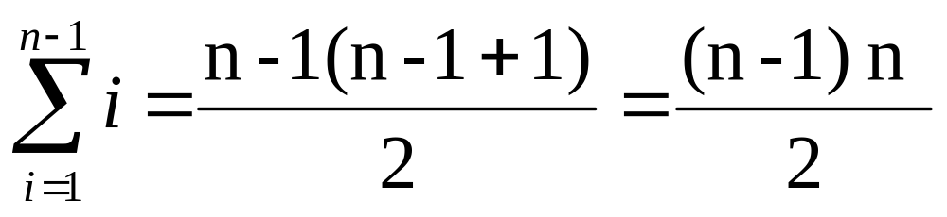
Worst-Case Comparison Count
for (int i = 1; i < n; i++)
for (j = i - 1; j >= 0 && t < a[j]; j--)
a[j + 1] = a[j];
total compares = 1 + 2 + 3 + … + (n-1)
We know that
so

Slide 9
Selection Sort
Determine largest element in array, move to position a[n-1]
Find next largest element, move to position a[n-2]
Etc.

Slide 10
Selection Sort
public class SelectionSort
{
/** sort the array a using the selection sort method */
public static void selectionSort(Comparable [] a)
{
for (int size = a.length; size > 1; size--)
{
// find max object in a[0:size-1]
int j = MyMath.max(a, size-1);
// move max object to right end
MyMath.swap(a, j, size - 1);
}
}

Slide 11
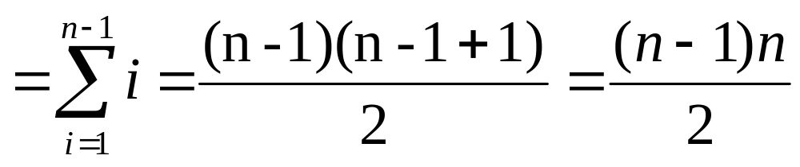
Comparison Count
Max(a, size) results in size - 1 comparisons.
Total comparisons:
1 + 2 + 3 + … + (n - 1)
Number of element reference moves is 3(n - 1)

Slide 12
Bubble Sort
Bubble strategy: compare adjacent elements
Move larger element to right
Compare next two elements.
Etc.

Slide 13
Bubble Sort
/** bubble largest element in a[0:n-1] to right */
private static void bubble(Comparable [] a, int n)
{
for (int i = 0; i < n - 1; i++)
if (a[i].compareTo(a[i+1]) > 0)
MyMath.swap(a, i, i + 1);
}
/** sort the array a using the bubble sort
* method */
public static void bubbleSort(Comparable [] a)
{
for (int i = a.length; i > 1; i--)
bubble(a, i);
}

Slide 14
Comparison Count
Number of element comparisons same as for selection sort.
Total comparisons:
1 + 2 + 3 + … + (n - 1)

Slide 15
Comparison Count
Worst case count = maximum count
Best case count = minimum count
Average count

Slide 16
Average-Case Comparison Count
public static void insert(Comparable [] a, int n, Comparable x)
{
if (a.length < n + 1)
throw new IllegalArgumentException
("array not large enough");
// find proper place for x
int i;
for (i = n - 1; i >= 0 && x.compareTo(a[i]) < 0; i--)
a[i+1] = a[i];
a[i+1] = x; // insert x
}

Slide 17
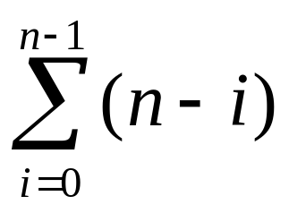
Average-Case Comparison Count
Assume that x has an equal chance of being inserted into any of the n+1 positions.
Assume x is inserted into position i. There are n+1 positions and the num of comparisons for x is n-i. So each position will be inserted into:

Slide 18
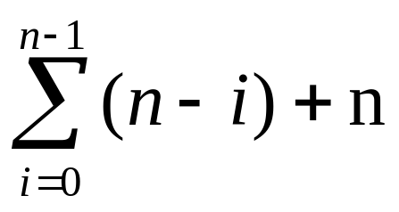
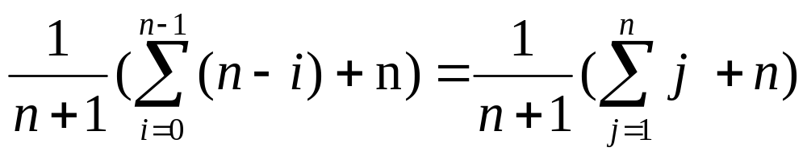
Average-Case Comparison Count
If x is inserted into position 0, num comparisons is n.
There are n+1 items. So average num comparisons:

Slide 19
Step Count
A step is an amount of computing that does not depend on the instance characteristic n
10 adds, 100 subtracts, 1000 multiplies
can all be counted as a single step
n adds cannot be counted as 1 step

Slide 20
Step Count
s/e
for (int i = 1; i < a.length; i++)
{// insert a[i] into a[0:i-1]
int t = a[i];
int j;
for (j = i - 1; j >= 0 && t < a[j]; j--)
a[j + 1] = a[j];
a[j + 1] = t;
}
for (int i = 1; i < a.length; i++) 1
{// insert a[i] into a[0:i-1] 0
int t = a[i]; 1
int j; 0
for (j = i - 1; j >= 0 && t < a[j]; j--) 1
a[j + 1] = a[j]; 1
a[j + 1] = t; 1
} 0

Slide 21
Step Count
s/e isn’t always 0 or 1
x = MyMath.sum(a, n);
where n is the instance characteristic
has a s/e count of n

Slide 22
Step Count
s/e
steps
for (int i = 1; i < a.length; i++)
{// insert a[i] into a[0:i-1]
int t = a[i];
int j;
for (j = i - 1; j >= 0 && t < a[j]; j--)
a[j + 1] = a[j];
a[j + 1] = t;
}
for (int i = 1; i < a.length; i++) 1
{// insert a[i] into a[0:i-1] 0
int t = a[i]; 1
int j; 0
for (j = i - 1; j >= 0 && t < a[j]; j--) 1
a[j + 1] = a[j]; 1
a[j + 1] = t; 1
} 0
i+ 1
i

Slide 23
Step Count
for (int i = 1; i < a.length; i++)
{ 2i + 3}
step count for
for (int i = 1; i < a.length; i++)
is n-1
step count for body of for loop is
2(1+2+3+…+n-1) + 3(n-1)
= (n-1)n + 3(n-1)
= (n-1)(n+3)

Slide 24
Step Count Example
public class RecursiveSum
{
public static Computable recursiveSum(Computable [] a, int n)
{// Driver for true recursive method rsum.
if (a.length > 0)
return rSum(a, n);
else return null; // no elements to sum
}

Slide 25
/** Recursively compute the sum of the objects a[0:n-1].
* a.length > 0.
* @return sum of the objects a[0:n-1] */
private static Computable rSum(Computable [] a, int n)
{
if (n == 0){
count++; // for conditional and return
return (Computable) a[0].zero();
}
else{
count++; // for conditional, rSum invocation, add, rtn
return (Computable) rSum(a, n - 1).add(a[n-1]);
}
}

Slide 26
recursiveSum
Let t_{rSum}(n) be the increase in the value of count between the time method rSum is invoked and the time rSum returns.
t_{rSum}(0) = 1
When n > 0, count increases by 1 plus whatever increase results from the invocation of rSum from within the else clause.
Additional increase is t_{rSum}(n-1)

Slide 27
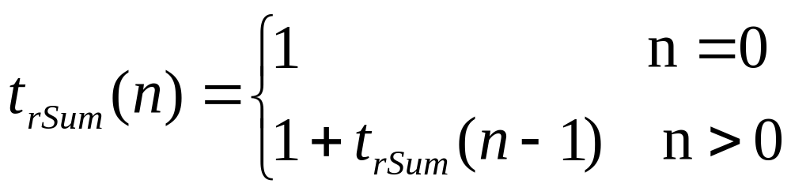
recursiveSum
If count is 0 initially, after termination it is
1 + t_{rSum}(n-1)
Need recurrence equation:

Slide 28
recursiveSum
Evaluate recurrence equation:
t_{rSum}(n) = 1 + t_{rSum}(n-1)
= 1 + (1 + t_{rSum}(n-2)) = 2 + t_{rSum}(n-2)
= 2 + 1 + t_{rSum}(n-3) = 3 + t_{rSum}(n-3)
……
= n + t_{rSum}(n-n) = n + t_{rSum}(0)
= n + 1 t_{rSum}(n)

Slide 29
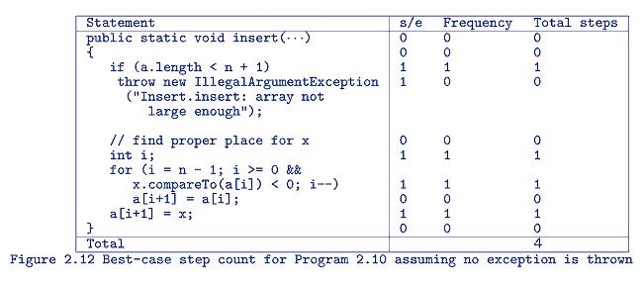
Best Case inserting into a sorted array

Slide 30
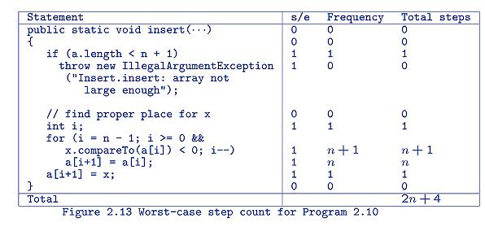
Worst Case inserting into a sorted array

Slide 31
Average Case inserting into a sorted array
Assume that x has an equal chance of being inserted into any of the n+1 pos.
If x is eventually inserted into position j, j>=0, then step count is 2n-2j+4.
Example: 5 elements, enter into position 2. Compare at positions 4, 3, 2, 1 so 5 - 2 = 3 comparisons (the last comparison is part of the “+4”)

Slide 32
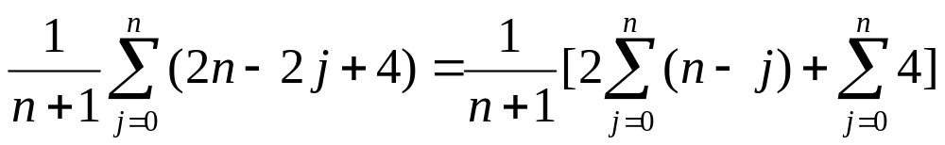
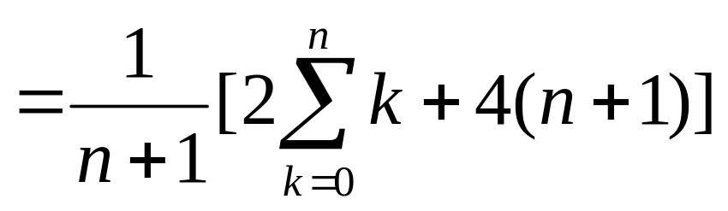
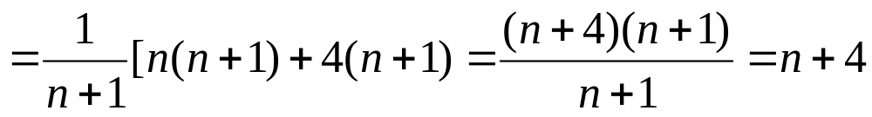
Average Case inserting into a sorted array
Average count is:

Slide 33
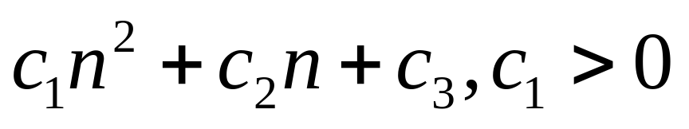
Asymptotic Complexity
O(n^2)
What does this mean?
Consider:
As n becomes larger, the c₁ term dominates.

Slide 34
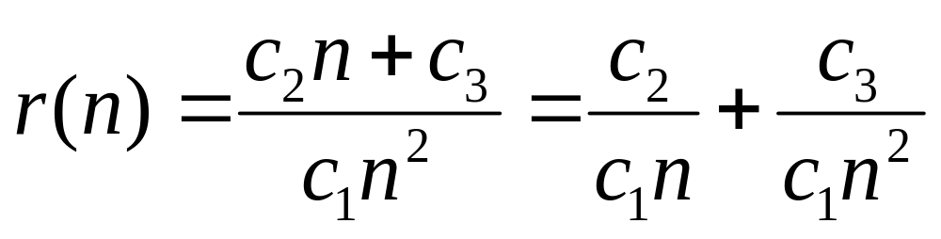
Asymptotic Complexity
The ratio of the 1st term to the rest of the equation is:

Slide 35
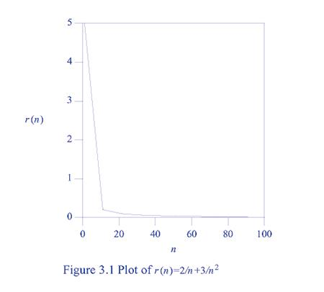
Asymptotic Complexity
Example:
c₁ = 1
c₂ = 2
c₃ = 3
Never
reach 0,
but approaches
0

Slide 36
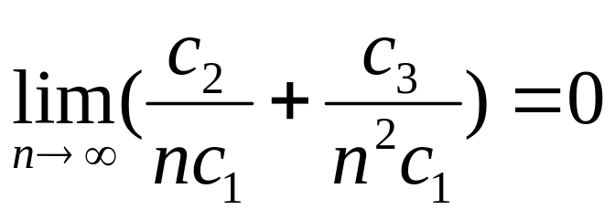
Asymptotic Complexity
Example: c₁ = 1 c₂ = 2 c₃ = 3
Mathematically, approach 0 as n goes to infinity:
For large n, first term dominates

Slide 37
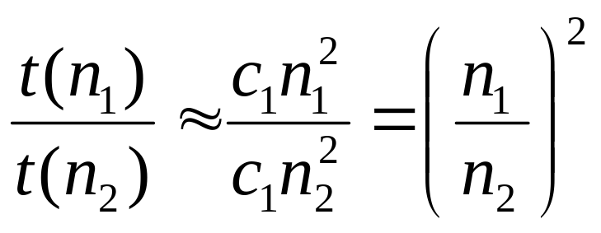
Asymptotic Complexity
Let n₁ and n₂ be two large values of n. Then
So run time increases by a factor of 4 when instance size is doubled; by a factor of 9 when instance size is tripled; etc.
Note: value of c is not important to know this.

Slide 38
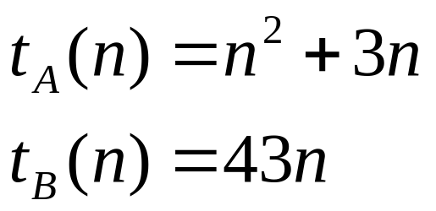
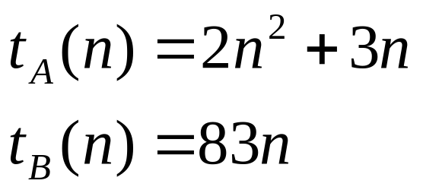
Asymptotic Complexity
Assume two programs to perform same task, A and B.
First analysis:
Second analysis:
Consider the resulting graphs:

Slide 39
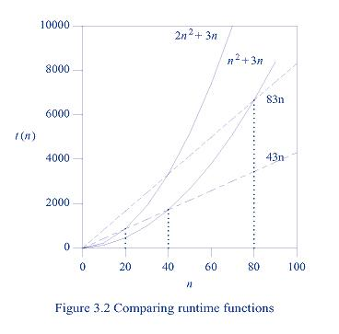
Asymptotic Complexity
First Analysis: 43n algorithm
Becomes faster when n > 40
Second Analysis: 83n algorithm
Becomes faster when n > 80
Algorithm B is always faster than A
for large values of n. Just the
breakpoint changes.

Slide 40
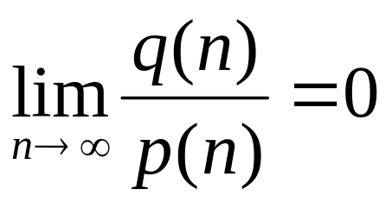
Asymptotic Complexity of
Definition: Let p(n) and q(n) be two nonnegative functions. p(n) is asymptotically bigger (or p(n) asymptotically dominates q(n)) than the function q(n) iff

Slide 41
Asymptotic Complexity
Definition (continued): q(n) is asymptotically smaller than the function p(n) iff p(n) is asymptotically bigger than q(n).
P(n) and q(n) are asymptotically equal iff neither is asymptotically bigger than the other.

Slide 42
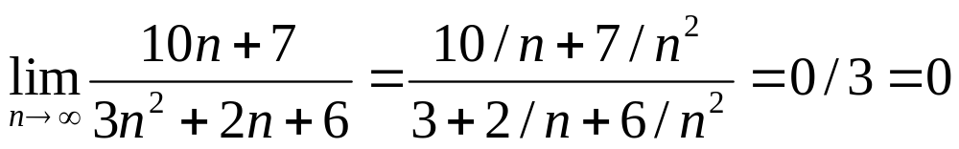
Asymptotic Complexity
Example
Since
Then 3n²+2n+6 is asymptotically bigger than 10n + 7.

Slide 43
Asymptotic Complexity
We use f(n) to denote the time or space complexity of a program as a function of the instance characteristic n.
Assume n>=0.
f(n) normally is a sum of terms. We can just use the first term for comparisons.
Common terms: see next slide.

Slide 44
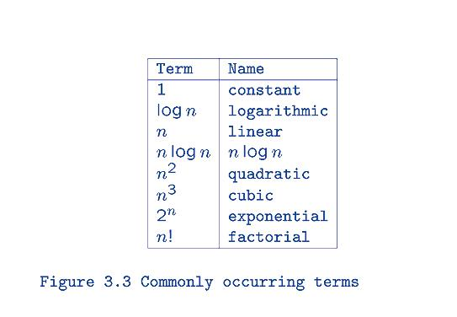
Asymptotic Complexity

Slide 45
Asymptotic Complexity
describes the behavior of the time or space complexity for large instance characteristics.
Uses step counts
Uses a single term, the asymptotically largest term.

Slide 46
Asymptotic Complexity
f(n) =O(g(n)) means that f(n) is asymptotically smaller than or equal to g(n)
Use smallest terms in big-oh notation with a coefficient of 1:
10n + 7 = O(n)
1000n³ - 3 = O(n³)
3n³ + 12n + 9 <> O(n)

Slide 47
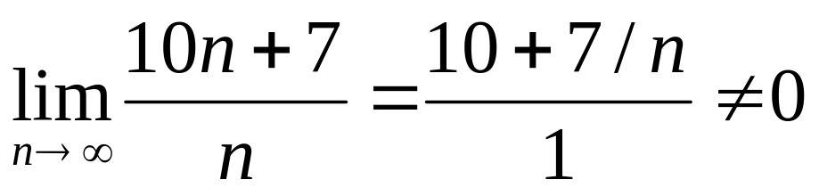
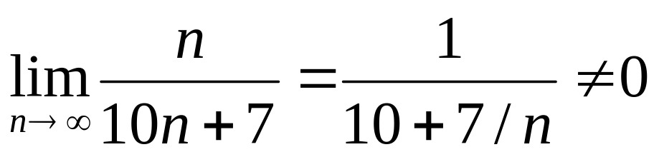
Asymptotic Complexity
Reason: 10n + 7 = O(n)
And
So 10n + 7 is asymptotically equal to n!

Slide 48
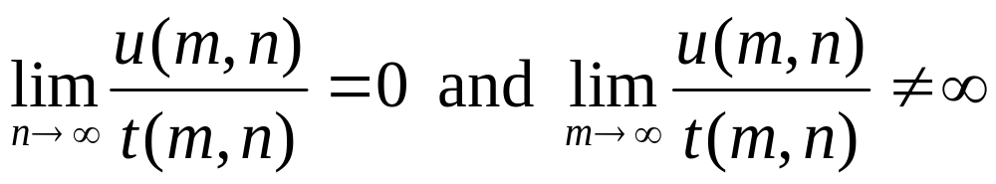
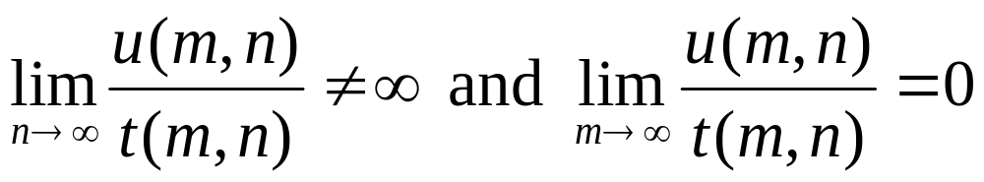
Asymptotic Complexity multiple variables
Let t(m,n) and u(m,n) be two terms. t(m,n) is asymptotically bigger than u(m,n) iff either
or

Slide 49
Asymptotic Complexity multiple variables
To determine the big oh notation when there are more than one variable:
  Let f(m,n) be the step count of a program. Remove all terms that are asymptotically smaller than at least one other term
  Change the coefficients of all remaining terms to 1.

Slide 50
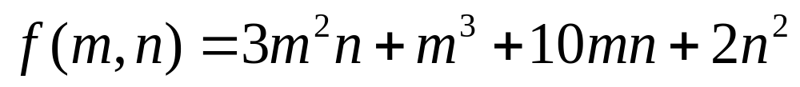
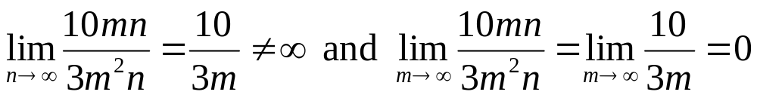
Asymptotic Complexity multiple variables
Example:
10mn is smaller than 3m²n because:

Slide 51
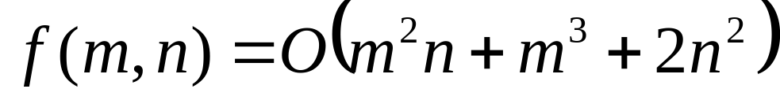
Asymptotic Complexity multiple variables
None of the remaining terms is smaller than another. So

Slide 52
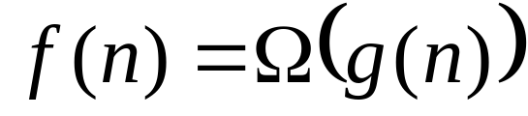
Other Asymptotic Notation
The below notation means that f(n) is asymptotically bigger than or equal to g(n)
g(n) is a lower bound for f(n)
Say “f(n) is omega of g(n)”

Slide 53
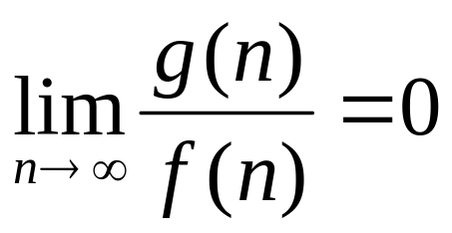
Other Asymptotic Notation
Recall previous notation of “asymptotically bigger”:
  p(n) is asymptotically bigger than q(n) iff
So means that

Slide 54
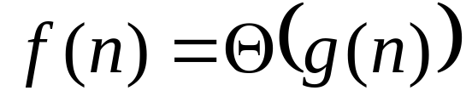
Other Asymptotic Notation
The below notation means that f(n) is asymptotically equal to g(n)
g(n) is a tight bound for f(n)
Say “f(n) is theta of g(n)”

Slide 55
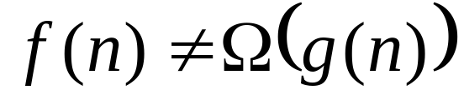
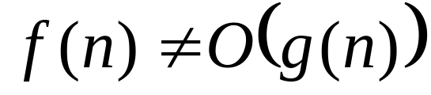
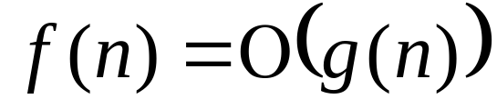
Other Asymptotic Notation
Occurs when both are true:
and
Or when these two are true:
and

Slide 56
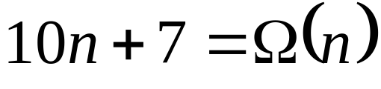
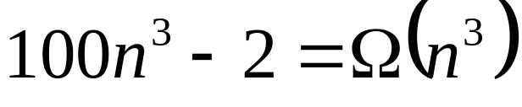
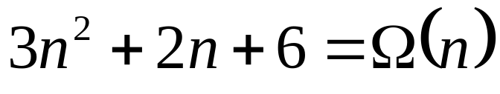
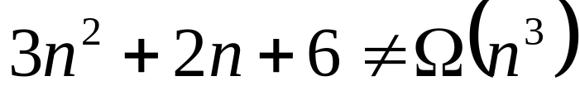
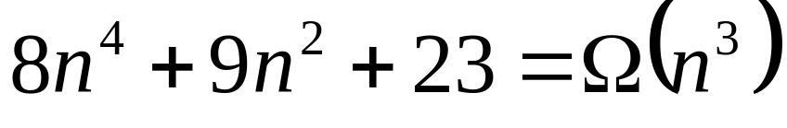
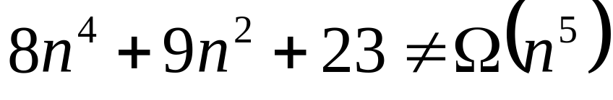
Other Asymptotic Notation
Examples:

Slide 57

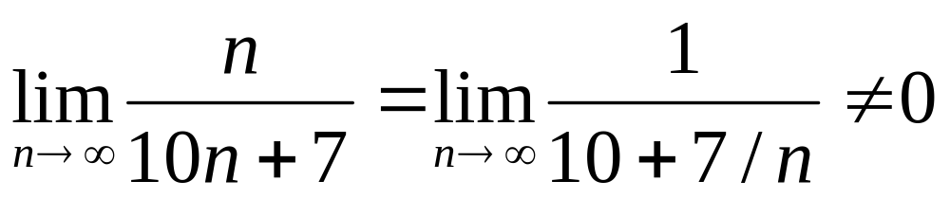
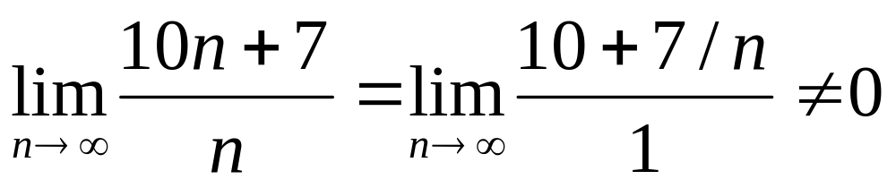
Other Asymptotic Notation
Reasons. The first equation is not asymptotically larger or smaller than n, therefore it is asymptotically equal

Slide 58
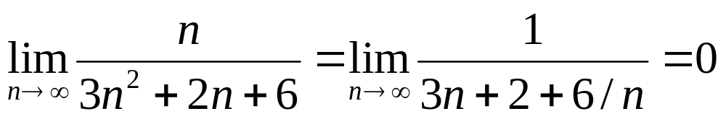
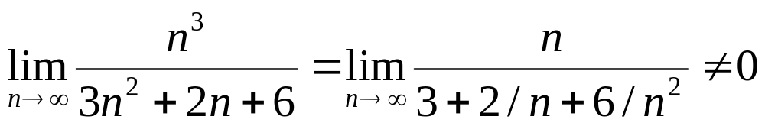
Other Asymptotic Notation
Reasons:

Slide 59
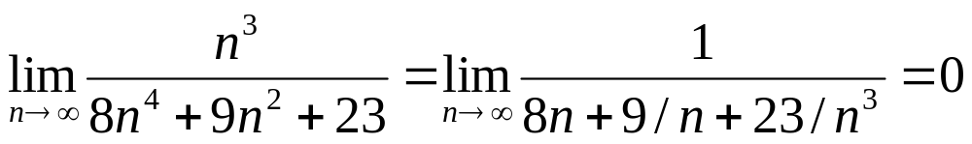

Other Asymptotic Notation
Reasons:

Slide 60
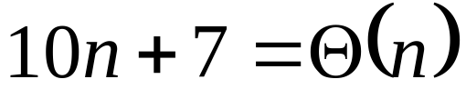
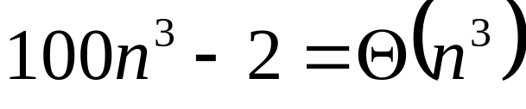
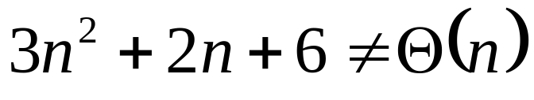



Other Asymptotic Notation
Examples:
because because

Slide 61




Other Asymptotic Notation
Examples:
because because

Slide 62


Formal Asymptotic Notation
f(n) = O(g(n)) iff positive constants c and n₀ exist such that
g is an upper bound (up to constant factor c) on the value of f for all suitably large n (ie )

Slide 63

Formal Asymptotic Notation

Slide 64


Formal Asymptotic Notation
Examples:

Slide 65


Formal Asymptotic Notation
Examples:
Loose bounds:

Slide 66

Formal Asymptotic Notation
Incorrect bounds:
Proof by contradiction. Suppose such a c and n₀ exist.
Then n<=(c-2)/3 for all n, n>= n₀.
This is not true for n > max(n₀,(c-2)/3).

Slide 67


Formal Asymptotic Notation
Theorem. If
Proof:

Slide 68


Formal Asymptotic Notation
Theorem. Let f(n) and g(n) be such that
exists.
Then

Slide 69


Formal Asymptotic Notation
Proof (if part). If f(n) = O(g(n)), then positive c and n₀ exist such that
Hence

Slide 70

Formal Asymptotic Notation
Proof (iff part). Suppose that
Then a positive n₀ exist such that

Slide 71


Formal Asymptotic Notation examples
3n + 2 = O(n) as
10n² + 4n + 2 = O(n²) as

Slide 72


Formal Asymptotic Notation
iff positive constants c and n₀ exist such that
g is an lower bound (up to constant factor c) on the value of f for all suitably large n (ie )

Slide 73

Formal Asymptotic Notation

Slide 74


Formal Asymptotic Notation
Examples:

Slide 75


Formal Asymptotic Notation
Examples:
Loose bounds:

Slide 76

Formal Asymptotic Notation
Incorrect bounds:
Proof by contradiction. Suppose such a c and n₀ exist.
Then 3n + 2 >= cn² and 1>=(cn²-2)/3n or 1 >= (cn -2/n)/3 for all n, n>= n₀ and a c >0
This is not true for n > 4

Slide 77

Formal Asymptotic Notation
Theorem. If
and if a_{m}>0
Proof: exercise.

Slide 78


Formal Asymptotic Notation
Theorem. Let f(n) and g(n) be such that
exists.
Then

Slide 79


Formal Asymptotic Notation examples
3n + 2 = Ω(n) as
10n² + 4n + 2 = O(n²) as

Slide 80


Formal Asymptotic Notation
iff positive constants c₁ , c₂ and n₀ exist such that
g is both an upper and lower bound (up to constant factor c) on the value of f for all suitably large n (ie )

Slide 81

Formal Asymptotic Notation

Slide 82

Formal Asymptotic Notation
iff
g is a strict upper bound (up to constant factor c) on the value of f, or if f is asymptotically smaller than g but is not asymptotically equal to g.

Slide 83


Formal Asymptotic Notation
Examples:

Slide 84
Complexity of Insertion Sort
Time or number of operations does not exceed c*n^2 on any input of size n
Actually, the worst-case time is Θ(n^2) and the best-case is Θ(n)
So, the worst-case time is expected to quadruple each time n is doubled

Slide 85
Complexity of Insertion Sort
Is O(n^2) too much time?
Is the algorithm practical?

Slide 86

Values of various functions

Slide 87


Slide 88

Practical Complexities
Computer does 10⁹ instructions/second

Slide 89

Impractical Complexities
10⁹ instructions/second

Slide 90


Faster Computer Vs Better Algorithm
Algorithmic improvement more useful
than hardware improvement.
E.g. 2^{n} to n³

Slide 91

Asymptotic Identities

Slide 92

Inference Rules

Slide 93

Examples
Next figures use the fact that:

Slide 94


Slide 95


Slide 96


Slide 97


Slide 98


Slide 99
s/e
O(1)
O(1)
O(??)
O(1)
O(1)
O(1)
O(1)
O(1)
O(1)

Slide 100
Binary Search Analysis
How many times does the while loop execute?
  After first check, size is n/2
  After second check size is n/2/2 = n/4
  After third check size is n/4/2 = n/8
  After x checks size is n/2^{x}

Slide 101
Binary Search Analysis
  When does the loop stop? When size is 1.
  Continue while n /2^{x} >= 1
  or n >= 2^{x}
  so log₂n = log₂2^{x} = x

Slide 102
Binary Search Analysis
Since we do x checks in the loop,
  number of checks = x = log₂n
And the running time (including two operations outside the loop) is:
log₂n + 2 = O(log₂n)

