Slide 1
Data Structures and Algorithms
Searching
Red-Black and Other Dynamically BalancedTrees
PLSD210

Slide 2
Lecture 11 - Key Points
Red-Black Trees
  A complex algorithm
  Gives O(log n) addition, deletion and search
Software engineers
  Know about algorithms
  Know when to use them
  Know performance
  Know where to find an implementation
  Are too clever to re-invent wheels ...
    They re-use code
    So they have more time for
      Sailing, eating, drinking, ...
      Anything else I should put here

Slide 3
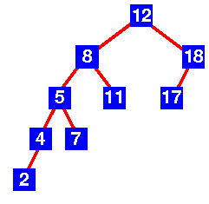
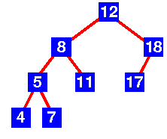
AVL and other balanced trees
AVL Trees
  First balanced tree algorithm
  Discoverers: Adelson-Velskii and Landis
Properties
  Binary tree
  Height of left and right-subtrees differ by at most 1
  Subtrees are AVL trees
AVL Tree
AVL Tree

Slide 4
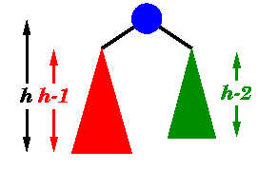
AVL trees - Height
Theorem
  An AVL tree of height h has at least F_{h+3}+1 nodes
Proof
  Let S_{h} be the size of the smallest AVL tree of height h
  Clearly, S₀ = 1 and S₁ = 2
  Also, S_{h} = S_{h-1} + S_{h-2} + 1
  A minimum height tree must be
  composed of min height trees
  differing in height by at most 1
  By induction ..
    S_{h} = F_{h+3}+1

Slide 5
AVL trees - Height
Now, for large i, F_{i+1} / F_{i} = φ,
  where φ = ½(1 + √5)
  or F_{i} ≈ c (½(1 + √5))^{i}
  S_{h} = F_{h+3} + 1 = O( b^{h} )
n ≥ S_{h} , so n is Ω( b^{h} )
and h ≤ log_{b} n or h is O(log n)

Slide 6
AVL trees - Height
Now, for large i, F_{i+1} / F_{i} = φ,
  where φ = ½(1 + √5)
  or F_{i} ≈ c (½(1 + √5))^{i}
  S_{h} = F_{h+3} + 1 = O( b^{h} )
n ≥ S_{h} , so n is Ω( b^{h} )
and h ≤ log_{b} n or h is O(log n)
In this case, we can show
  h ≤ 1.44 log_{b} (n+2) - 1.328
h is no worse than 44%
higher than the optimum

Slide 7
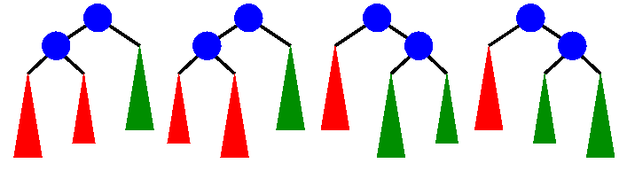
AVL Trees - Rebalancing
Insertion leads to non-AVL tree
  4 cases
  1 and 4 are mirror images
  2 and 3 are mirror images
1
2
3
4

Slide 8
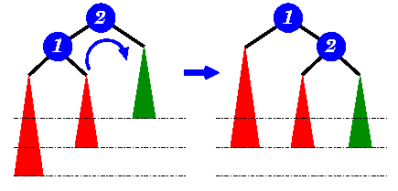
AVL Trees - Rebalancing
Case 1 solved by rotation
  Case 4 is the mirror image rotation

Slide 9
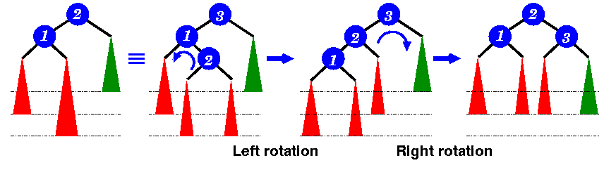
AVL Trees - Rebalancing
Case 2 needs a double rotation
  Case 3 is the mirror image rotation

Slide 10
AVL Trees - Data Structures
AVL trees can be implemented with a flag to indicate the balance state
Insertion
    Insert a new node (as any binary tree)
    Work up the tree re-balancing as necessary to restore
    the AVL property
typedef enum { LeftHeavy, Balanced, RightHeavy }
BalanceFactor;
struct AVL_node {
BalanceFactor bf;
void *item;
struct AVL_node *left, *right;
}

Slide 11
Dynamic Trees - Red-Black or AVL
Insertion
  AVL : two passes through the tree
    Down to insert the node
    Up to re-balance
  Red-Black : two passes through the tree
    Down to insert the node
    Up to re-balance
but Red-Black is more popular??

Slide 12
Dynamic Trees - A cautionary tale
Insertion
  If you read Cormen et al,
    There’s no reason to prefer a red-black tree
  However, in Weiss’ text
    M A Weiss, Algorithms, Data Structures and Problem Solving with C++, Addison-Wesley, 1996
  you find that you can balance a red-black tree
  in one pass!
  Making red-black more efficient than AVL
  if coded properly!!!

Slide 13
Dynamic Trees - A cautionary tale
Insertion
  If you read Cormen et al,
    There’s no reason to prefer a red-black tree
  However, in Weiss’ text
    M A Weiss, Algorithms, Data Structures and Problem Solving with C++, Addison-Wesley, 1996
  you find that you can balance a red-black tree
  in one pass!
  Making red-black more efficient than AVL
  if coded properly!!!
Moral: You need to read the literature!

Slide 14
Dynamic Trees - A cautionary tale
Insertion in one pass
  As you proceed down the tree,
  if you find a node with two red children,
  make it red and the children black
  This doesn’t alter the number of black nodes in any path
  If the parent of this node was red,
  a rotation is needed ...
  May need to be a single or a double rotation

Slide 15
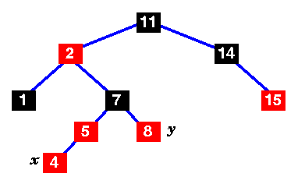
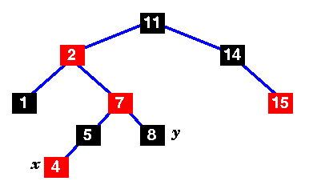
Trees - Insertion
Adding 4 ...
Discover two red
children here
Swap colours around

Slide 16
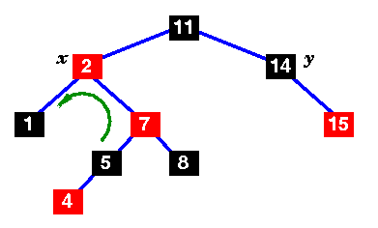
Trees - Insertion
Adding 4 ...
Red sequence,
violates
red-black property
Rotate

Slide 17
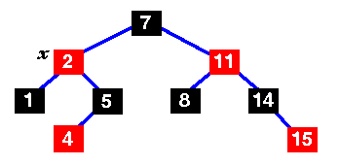
Trees - Insertion
Adding 4 ...
Rotate
Add the 4

Slide 18
Balanced Trees - Yet more variants
Basically the same ideas
  2-3 Trees
  2-3-4 Trees
    Special cases of m-way trees ... coming!
    Variable number of children per node
    A more complex implementation
    2-3-4 trees
      Map to red-black trees
      Possibly useful to understand red-black trees

Slide 19
Lecture 12 - Key Points
AVL Trees
  First dynamically balanced tree
  Height within 44% of optimum
  Rebalanced with rotations
  O(log n)
    Less efficient than properly coded red-black trees
2-3, 2-3-4 trees
  m-way trees - Yet more variations
  2-3-4 trees map to red-black trees

Slide 20
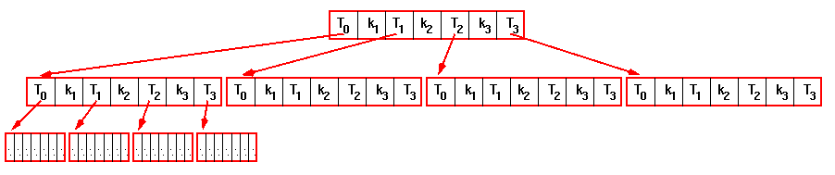
m-way trees
Only two children per node?
Reduce the depth of the tree to O(log_{m}n)
with m-way trees
m children, m-1 keys per node
m = 10 : 10⁶ keys in 6 levels vs 20 for a binary tree
but ........

Slide 21
m-way trees
But you have to search through
the m keys in each node!
Reduces your gain from having fewer levels!
A curiosity only?

Slide 22
B-trees
All leaves are on the same level
All nodes except for the root and the leaves
have
  at least m/2 children
  at most m children
B+ trees
  All the keys in the nodes are dummies
  Only the keys in the leaves point to “real” data
  Linking the leaves
    Ability to scan the collection in order
    without passing through the higher nodes
Each node is at least
half full of keys

Slide 23
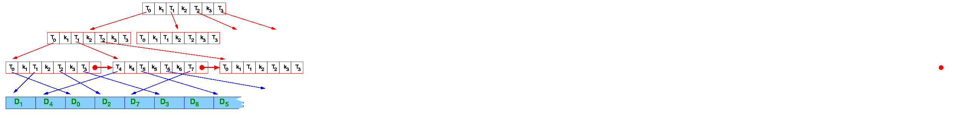
B+-trees
B+ trees
  All the keys in the nodes are dummies
  Only the keys in the leaves point to “real” data
  Data records kept in a separate area

Slide 24
B+-trees - Scanning in order
B+ trees
  Linking the leaves
    Ability to scan the collection in order
    without passing through the higher nodes

Slide 25
B+-trees - Use
Use - Large Databases
  Reading a disc block is much slower than reading memory ( ~ms vs ~ns )
  Put each block of keys in one disc block
Physical disc
blocks

Slide 26
B-trees - Insertion
Insertion
  B-tree property : block is at least half-full of keys
  Insertion into block with m keys
    block overflows
    split block
    promote one key
    split parent if necessary
    if root is split, tree becomes one level deeper

Slide 27
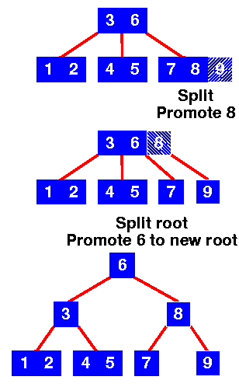
B-trees - Insertion
Insertion
  Insert 9
  Leaf node overflows,
  split it
  Promote middle (8)
  Root overflows,
  split it
  Promote middle (6)
  New root node formed
  Height increased by 1

Slide 28
B-trees on disc
Disc blocks
  512 - 8k bytes
  100s of keys
  Use binary search within the block
Overall
  O( log n )
  Matched to hardware!
Deletion similar
  But merge blocks to maintain B-tree property
  (at least half full)

