Slide 1
2012 & 2013 Sizzling Solar Branch Performance
Dave Chery

Slide 2
INTRODUCTION
This presentation aims to showcase opportunities for Sizzling Solar Company's Branches and Regions in 2012 and 2013, highlighting the company model using the following:
Summary Pnl – 2012 & 2013
Full Income Statements – by QTR and FY
Metrics & - Rev/Unit & GM% (BPS)
Rankings
Recommendations

Slide 3
Summary Pnl
Key Notes: Unit attainment increased by an average of ~38% YoY in total branches and regions, thus increasing Revenue and GP $. However, GM% is down YoY (331.3bps), driven by lower Rev/unit in solar products across regions.
Contribution Profit underperformed YoY, mainly due to 1. Sales SG&A, and 2. G&A Admin cost
in the corporate branch, thus affecting the OP income.
*GM% = Gross Margin
*B/(W)= Best & Worst
* BPS = Basis Points

Slide 4
Income Statement (p&L)

Slide 5
Metrics
A: Gross $ / Gross Unit
B: Rev $ / Rev Unit
C : GM %
Gross$ & Rev $/ Units:
From 2012 -2013, Sizzling Solar increased unit production driven by increased demand; yet, for every dollar ordered, the per unit dollar amount has decreased. Essentially, Sizzling Solar is growing in volume but at a lower margin. Please refer to the Excel metrics tab for further details
GM%
GM% is an excellent indicator of product profitability after COGs. In the Excel analysis (see Exhibit C). Total Cogs increased dollar value YoY by ~ 38% in correlation with the increase in Gross, backlog, and Rev units across regions. Conversely, the decrease in dollar/unit YoY has negatively affected the Bps change.
*GM% = Gross Margin
*B/(W)= Best & Worst
* BPS = Basis Points

Slide 6
Rankings and Why?
Branches 4, 3, 5, 10 & 7 have the strongest YoY OP Income on a dollar basis in return translates to excellent cash health YoY, even has their HC increased.
Furthermore, the change in Implementation SG&A/HC is relatively low in the top five vs. the bottom half with negative OP.
Corporate serves last due to the Headcount reflecting only corporate employees and not tied to implementation hours.
*Total OP Income reflects change from 2012 to 2013
*B/(W)= Best & Worst
* BPS = Basis Points

Slide 7
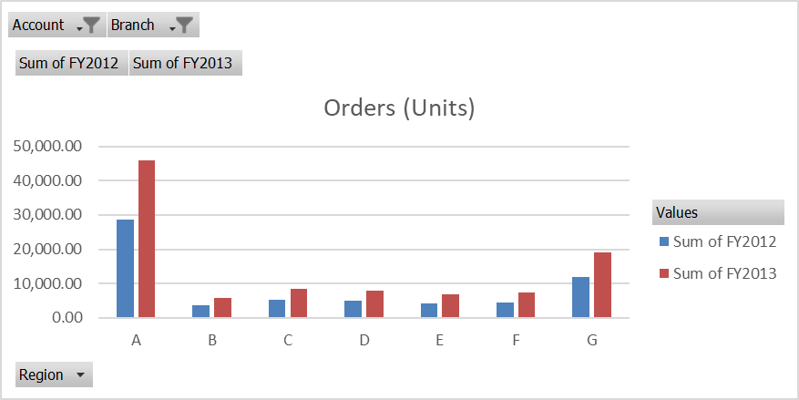
Recommendations
A)Increase Rev/Unit to increase profitability and to receive better margins in GM%
- Increase in unit volume driven by demand YoY does not translate to profitability, possibly adding more efficient features to the products that beat the competition and justify price change.
B)Decrease Sales G&A Marketing Cost in Branch 1, 2, and 3 & implementation cost by branch should be a % of sales, not a fixed cost. (See rankings, line 29)
-Sales G&A Marketing cost is relatively high and is the #1 contributor in variable cost.
- Throughout the rankings tab in the Excel sheet, the implementation SG&A is a constant number for both 2012 & 2013.
C)The company should strengthen its resources in Region A; between 2012 and 2013, volumes were highest compared to other regions. See below
.

Slide 8
THANK YOU
Dave Chery
Dechery10@gmail.com

