Slide 2


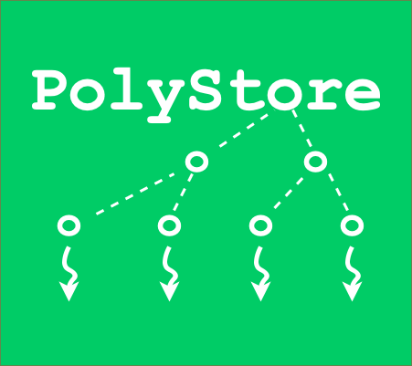

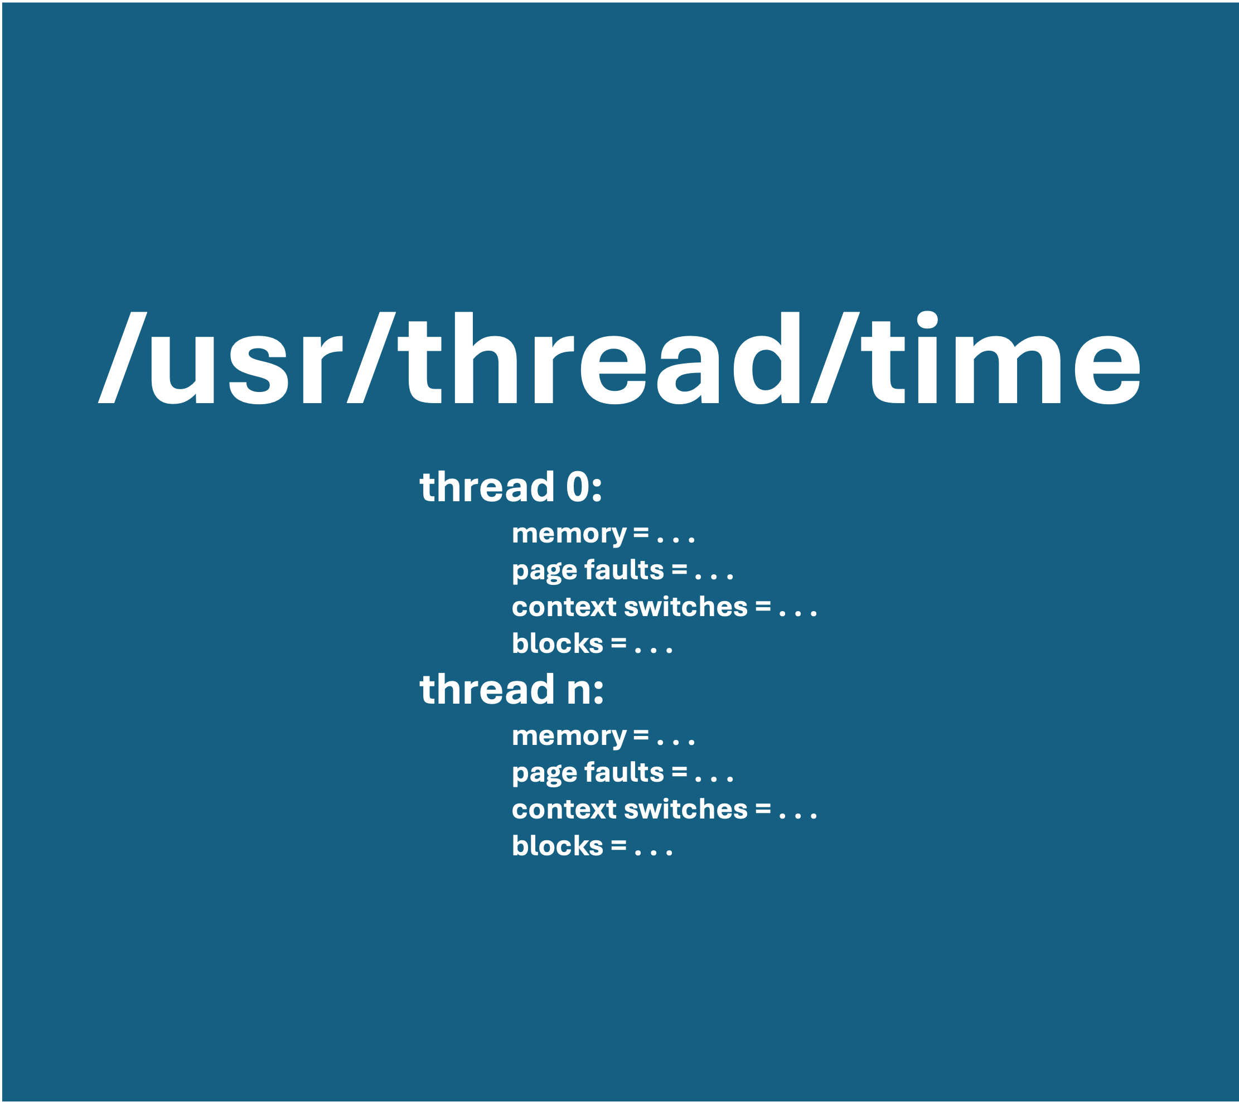
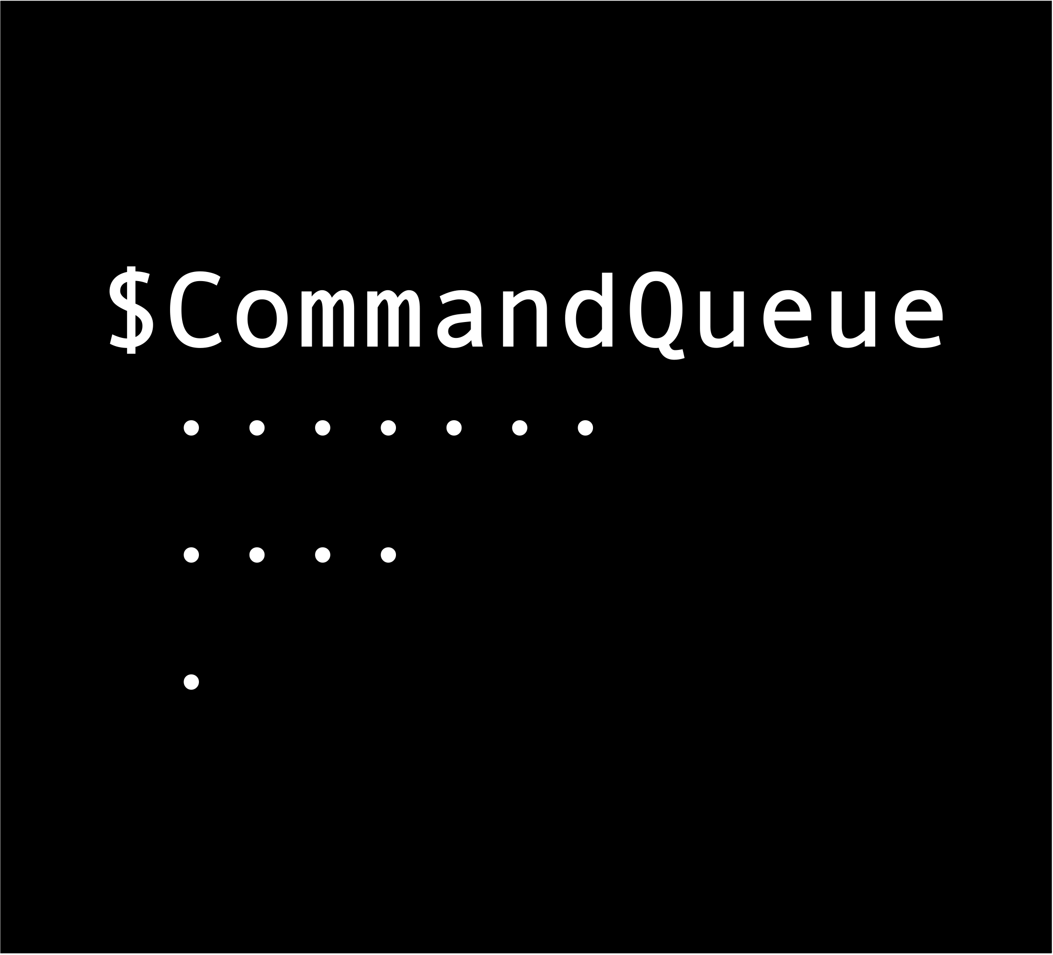

Slide 3


Slide 4


Slide 5
$CommandQueue
....... ....
.

Slide 6
/usr/thread/time
thread 0:
memory = . . .
page faults = . . .
context switches = . . .
blocks = . . .
thread n:
memory = . . .
page faults = . . .
context switches = . . .
blocks = . . .

Slide 7

CASH

