Slide 1

Preliminary title
MUKESH & DAVID

Slide 2
Understand the Market
Does a big budget lead to a box office success?
What’s box offices’ significance in today’s market?

Slide 3
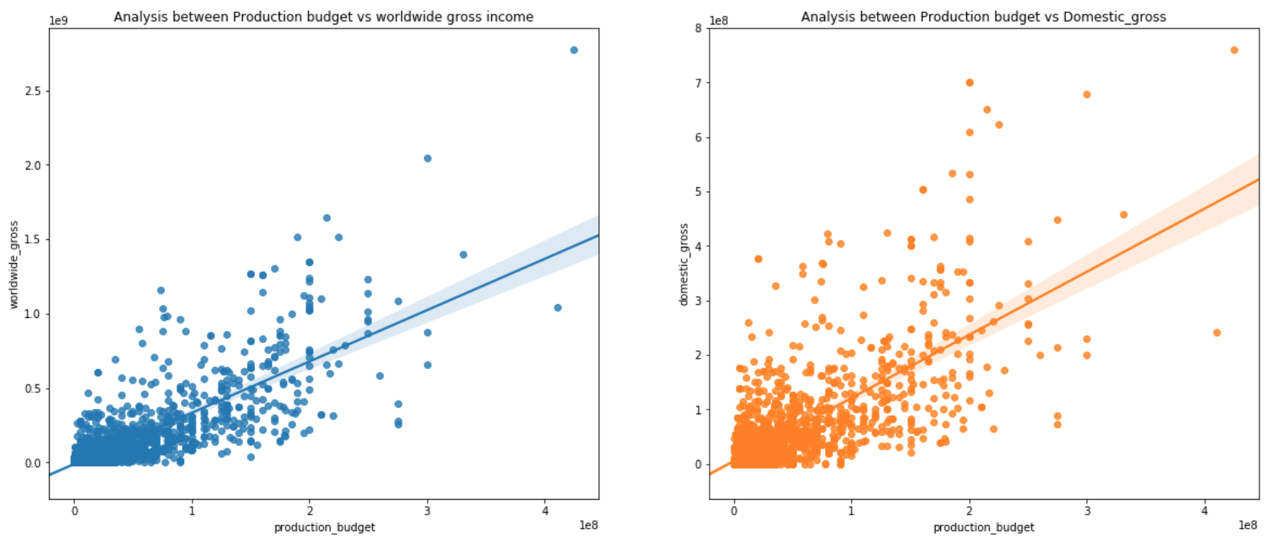

Slide 4
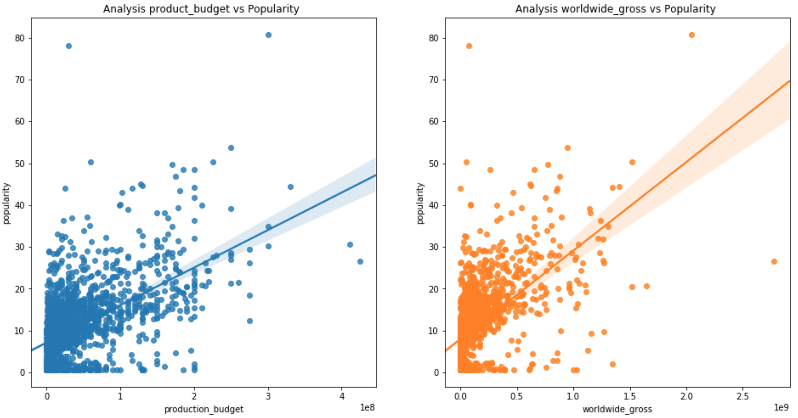
*Popularity = amalgamation of user interactions on web, i.e. page views, users rating, users saving, and more

Slide 5
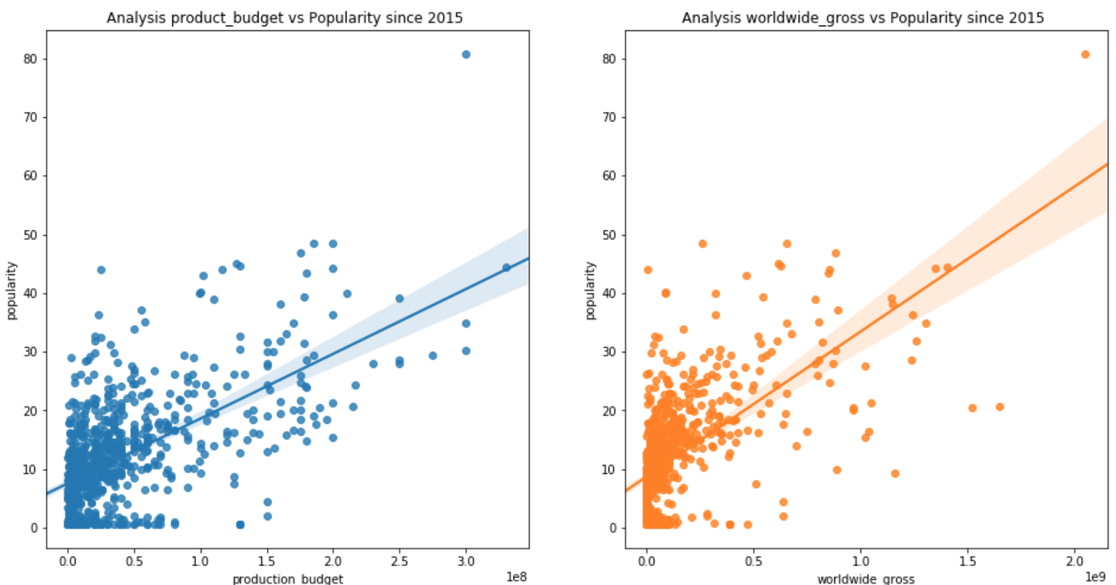

Slide 6
Critics-based approach
1. It’s very rare for a critic to err on the side of leniency
2. With the emergence of social media, critics are more consumer-centric than ever
3. New ways of consuming movies (i.e. Netflix, Disney+) are rendering the box office, as a metric, obsolete

Slide 7
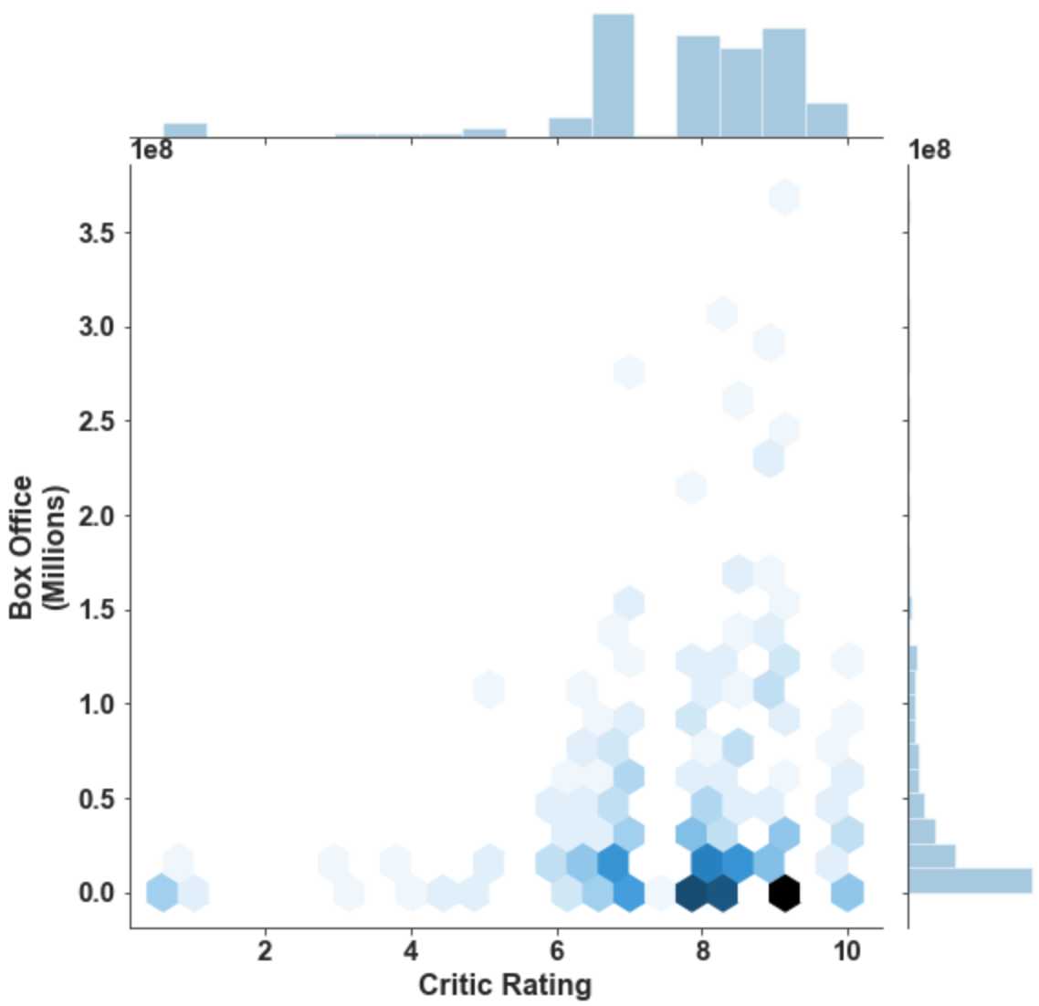
Current landscape of the box office in relation to critic ratings

Slide 8
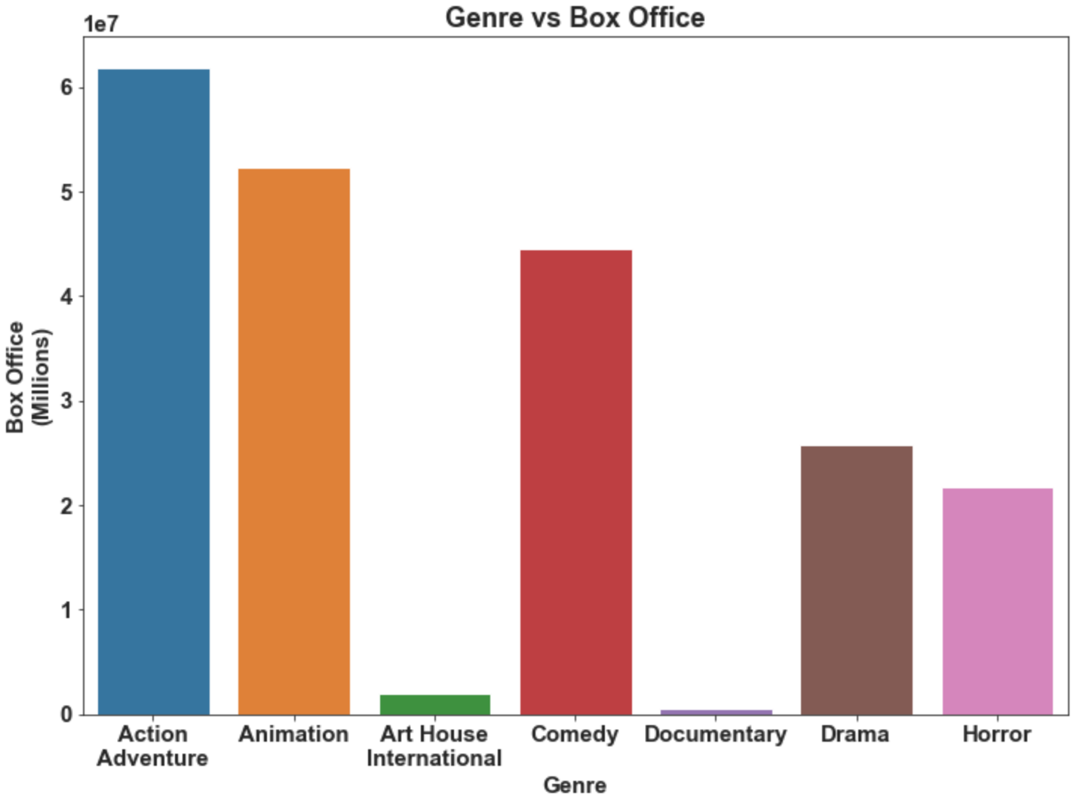

Slide 9
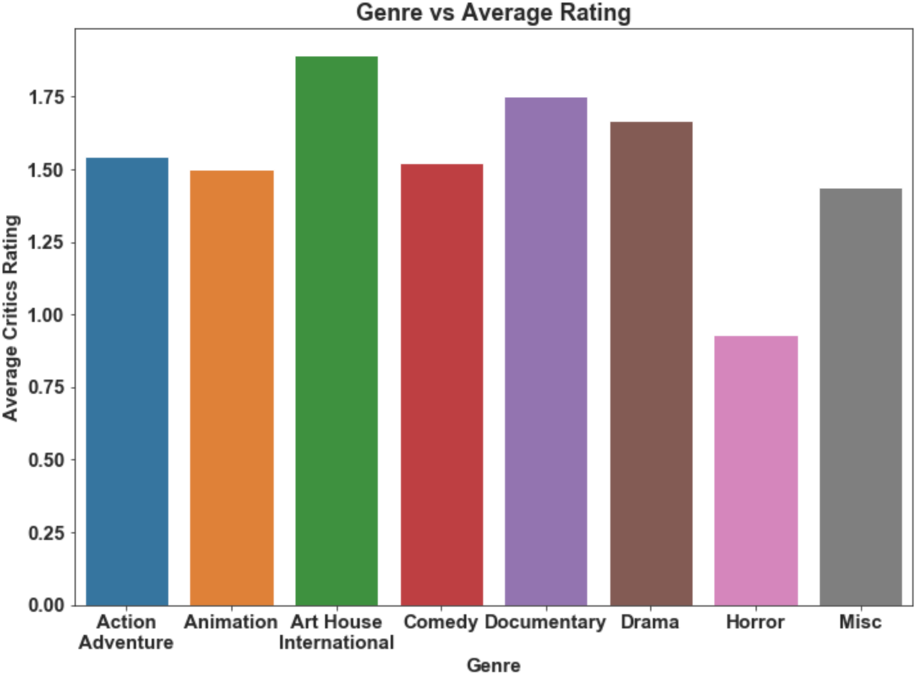
Final Recommendations
The lowest risk: Art House and International & Documentary
Moderate risk: Drama & Comedy & Action Adventure
Highest Risk:
Horror

