Slide 1
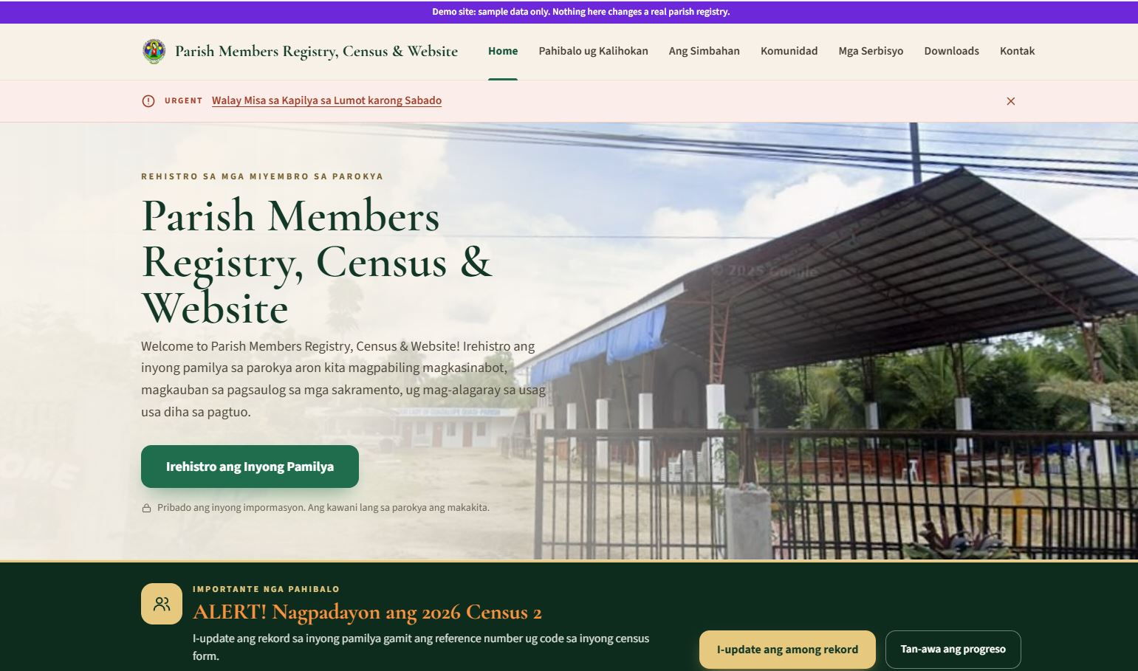
Parish Members Registry & Census Presentation
Notes:
Good evening, Father and members of the council.
Tonight I want to show you a tool that is already built for our parish: one registry of every family and member, together with a parish website.
The goal is simple and pastoral: to know every family in our parish, so that we can care for every family. In the next fifteen minutes I'll show what it does for families, for the office, for our GKK leaders and for this council, what it costs (nothing), and at the end I'll ask the council for four decisions.

Slide 2



Today, knowing our parish takes paper, time and retyping
Today
With the registry
Census sheets are filled in by hand and retyped every year
Census forms print pre-filled, and families can answer online
Family records sit in notebooks and spreadsheets in different hands
Every household and member is in one searchable registry
"Who still needs Confirmation?" takes days of counting
The answer takes seconds, GKK by GKK
Families must come to the office to register or ask for a certificate
They register and send requests from a phone, with a reference number
Notes:
Let me start with how things work today.
Our census is done on paper and has to be retyped. Family information lives in notebooks and spreadsheets kept by different people. When Father asks a simple pastoral question, like how many young people in a GKK still need Confirmation, someone has to count by hand. And families have to come to the office for every registration or certificate.
On the right is the same work with the registry. Nothing about our pastoral work changes; we simply stop doing the paperwork twice.

Slide 3





One registry serves the whole parish
Families
Parish office
Register, update the census and send requests from a phone, in Bisaya
Verify families, track requests, print forms and export lists
One parish registry
GKK leaders
Priest and council
Their own GKK’s families and census, and nothing else
Clear numbers by GKK, for pastoral planning
Also included: the parish website, with the Mass schedule, announcements, bulletin, events, sacrament guides and a prayer wall
Notes:
This is the whole idea on one slide. There is one registry in the middle, and four groups of people use it, each seeing only what they need.
Families use it from their phones. The parish office uses it to check and keep the records. GKK leaders see their own GKK. And Father and this council get the numbers they need to plan.
On top of that, the same system runs the parish website, so the Mass schedule, announcements and the bulletin are always in one place that the office can update without a web designer.

Slide 4
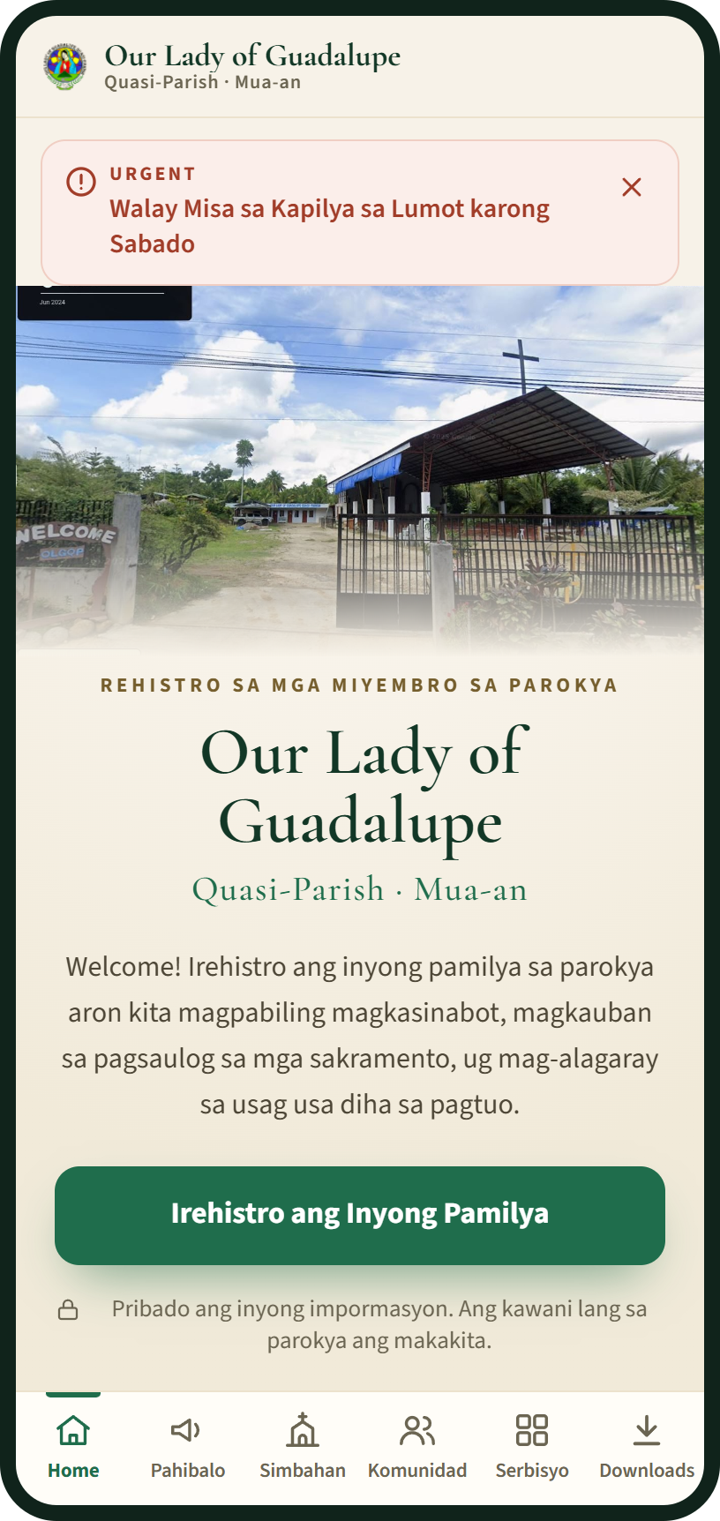
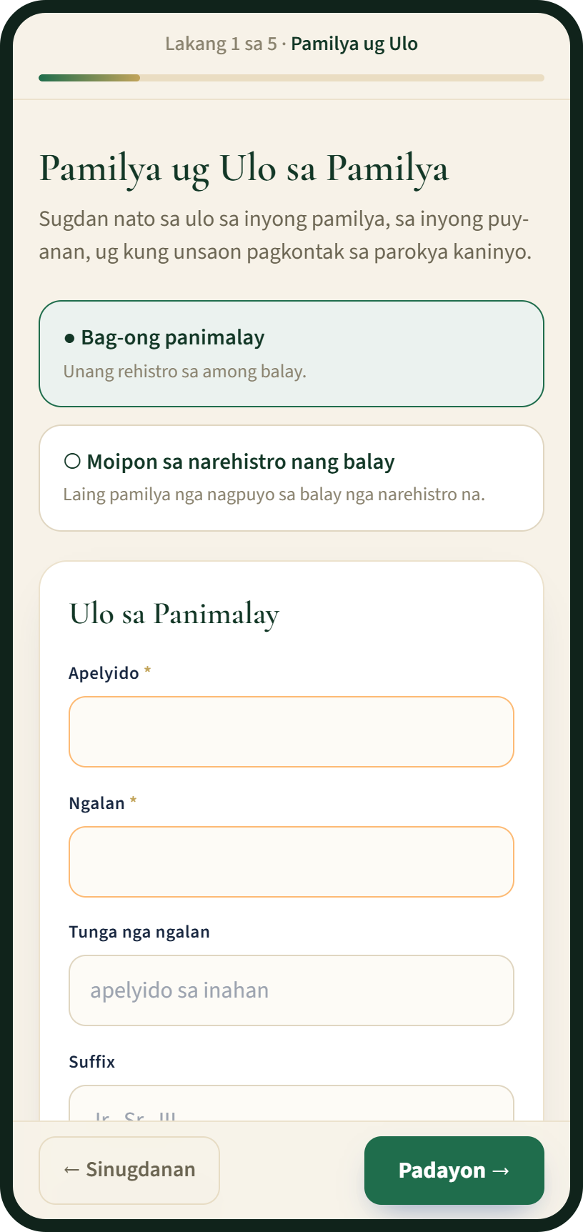
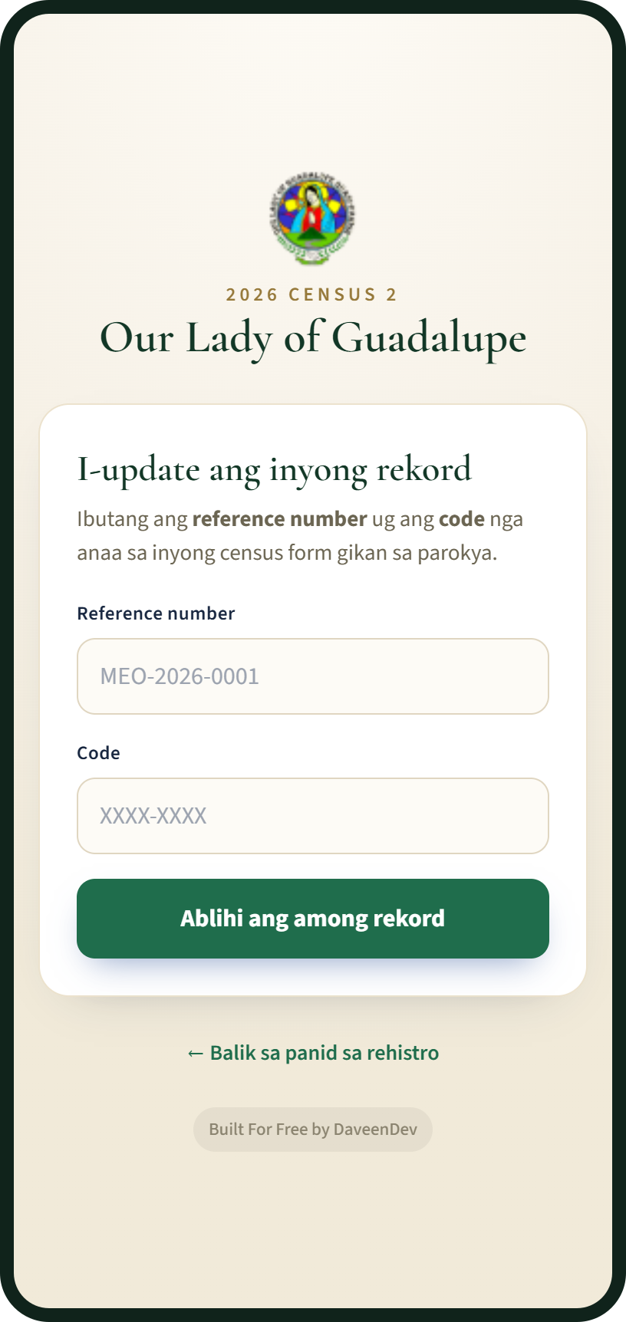



Families take part from their phones, in Bisaya
Register at home
Five short steps. The family gets a reference number at once and can check its status.
Update during the census
With the reference number and code on their census form. No trip to the office.
Ask the parish
Certificates, the Anointing of the Sick, OCIA, blood donors and prayer requests.
Home page
Registration, step 1 of 5
Census update
Screens from the demo site, with sample data
Notes:
For families, everything works on a phone and in Bisaya.
A family registers from home in five short steps and gets a reference number straight away. During the census they don't fill in a new sheet: they open the parish website, type the reference number and the code printed on their census form, and confirm or correct what we have.
They can also ask for certificates, the Anointing of the Sick, OCIA, or send a prayer request, each with its own reference number. Families without a phone can still do all of this at the office.

Slide 5
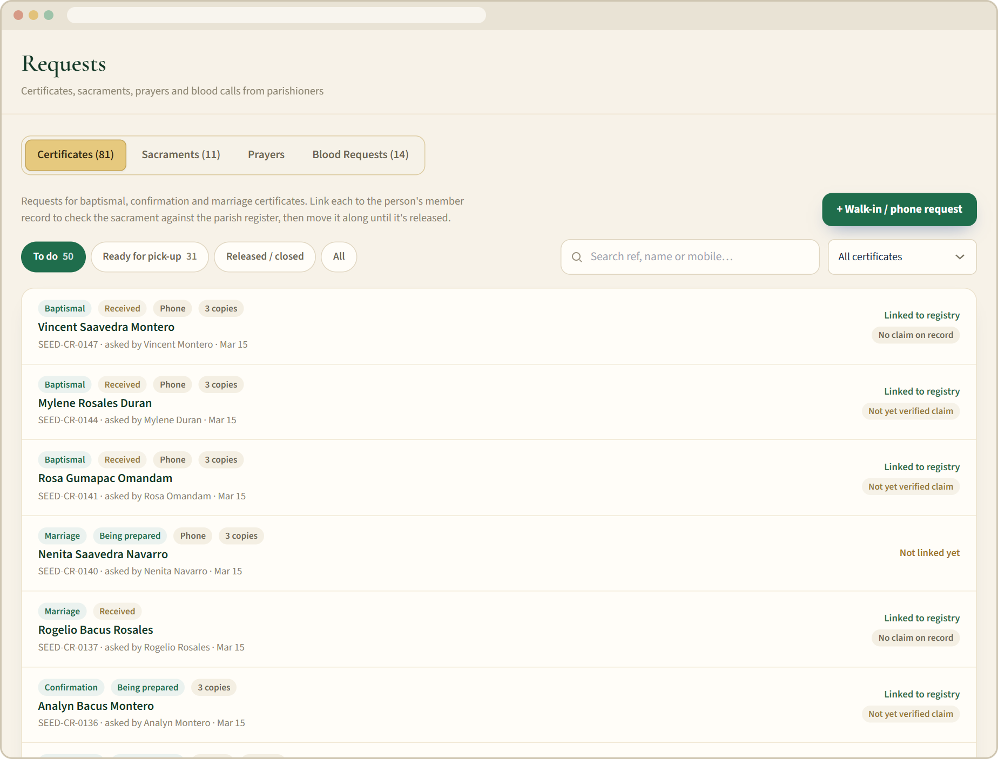





The parish office works from one queue, not piles of paper
New families wait to be verified
Staff check each one; who verified it is recorded.
Duplicates are flagged
The same person or house registered twice is caught.
Every request is tracked
From Received to Released, with a reference number.
Phone alerts for new requests
Plus a 7:00 AM summary of what is still waiting.
Nothing lost by mistake
Deleted records stay in a Trash for 30 days.
Requests page on the demo site, with sample data
Notes:
For the parish office, the change is from paper piles to one list of what is waiting.
New registrations wait until staff verify them. If a family registers twice, or two records look like the same person, the system flags it. Every certificate or sacrament request moves from Received to Released, so nothing gets forgotten, and staff get a notification on their phone when something new comes in.
And if someone deletes a record by mistake, it can be restored for 30 days. There is also a log of who changed what.

Slide 6
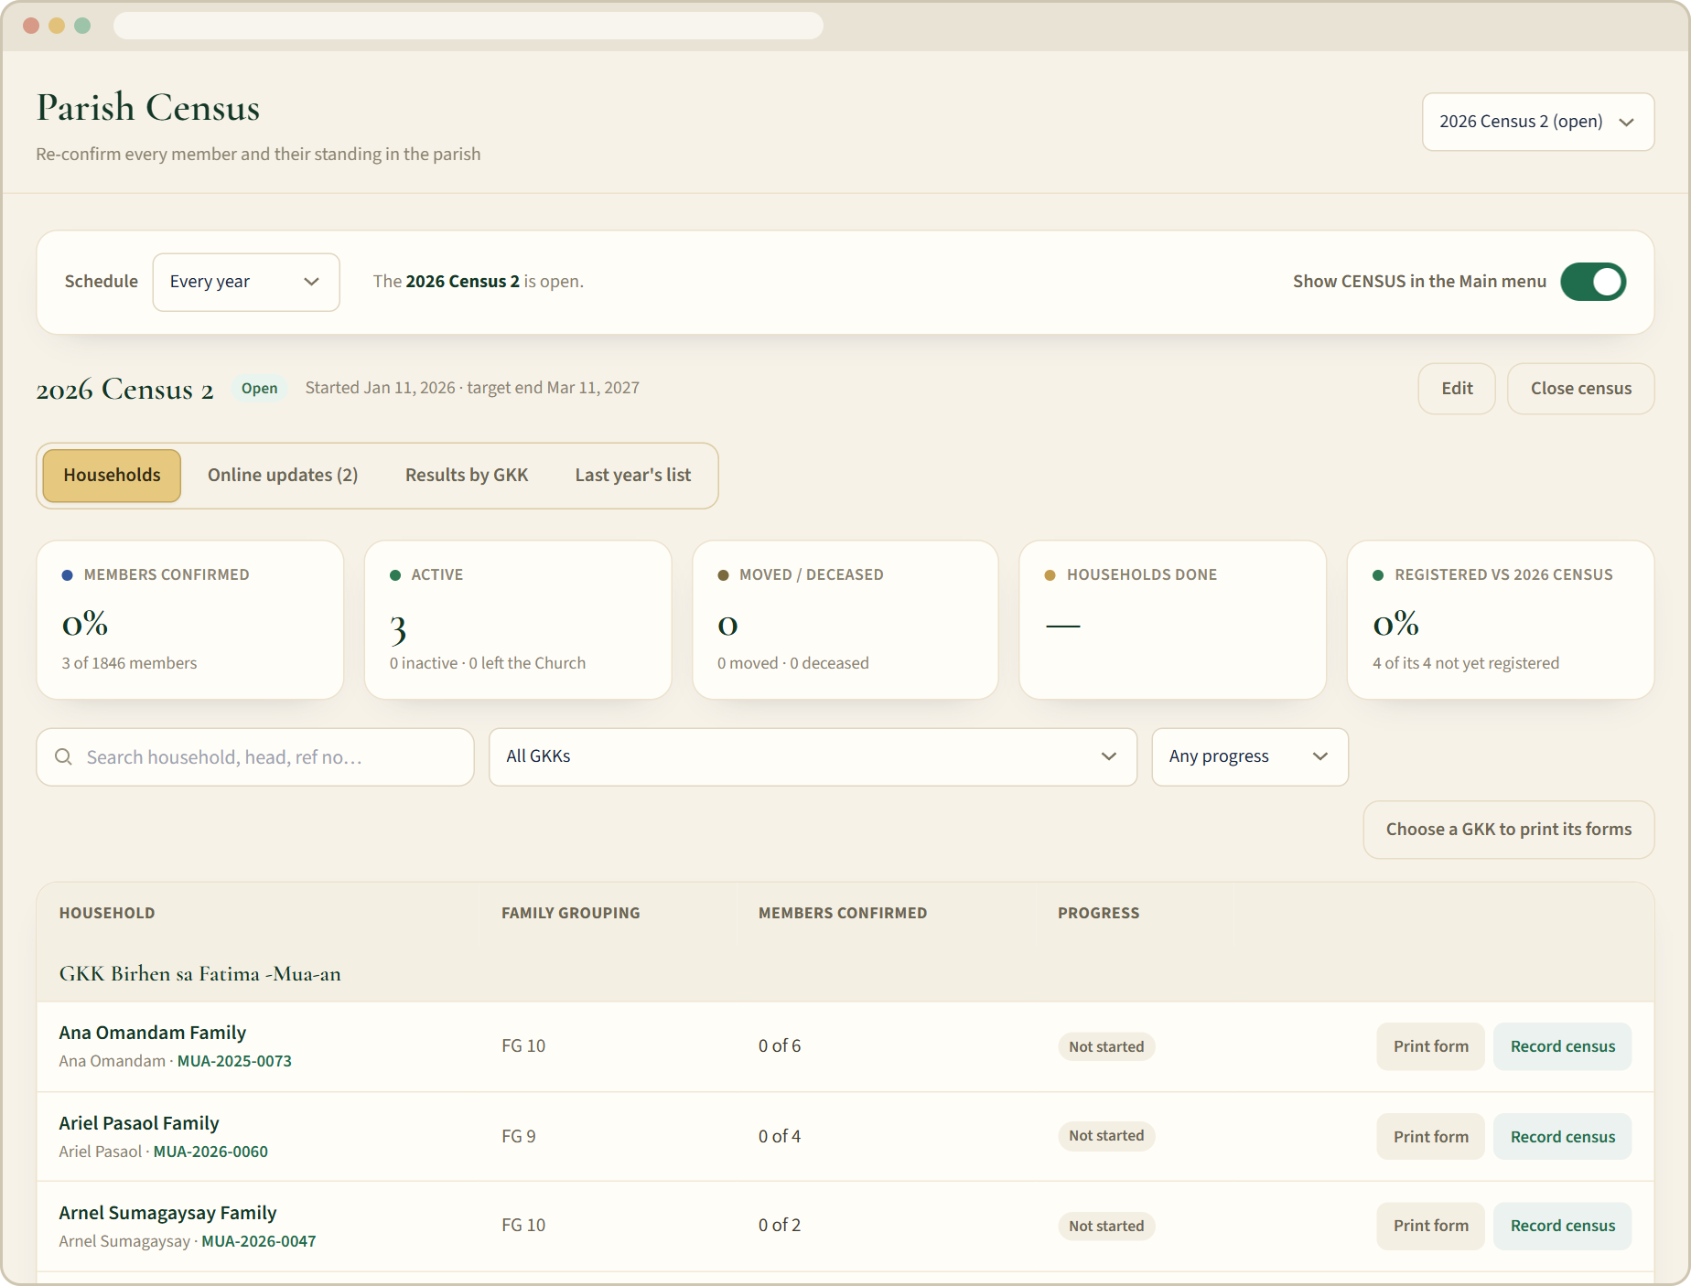



GKK leaders lead the census in their own community
Only their own GKK
They see their own families and members, and no one else’s.
Last year’s list, ticked off
Families still to register are clear at a glance.
Online first, paper last
They help families update by phone, and print forms only when needed.
Their GKK on the website
Its chapel, photos, history and officers, kept up to date.
Census page on the demo site, with sample data
Notes:
Our GKK leaders are the people who actually know the families, so the census is built around them.
Each leader signs in and sees only their own GKK. They have last year's list to tick off as families register, so it's obvious who hasn't been reached yet. They help families update online first, and print the pre-filled paper forms only for families who can't do it by phone.
They can also keep their GKK's page on the parish website up to date: the chapel, photos, history and officers.

Slide 7
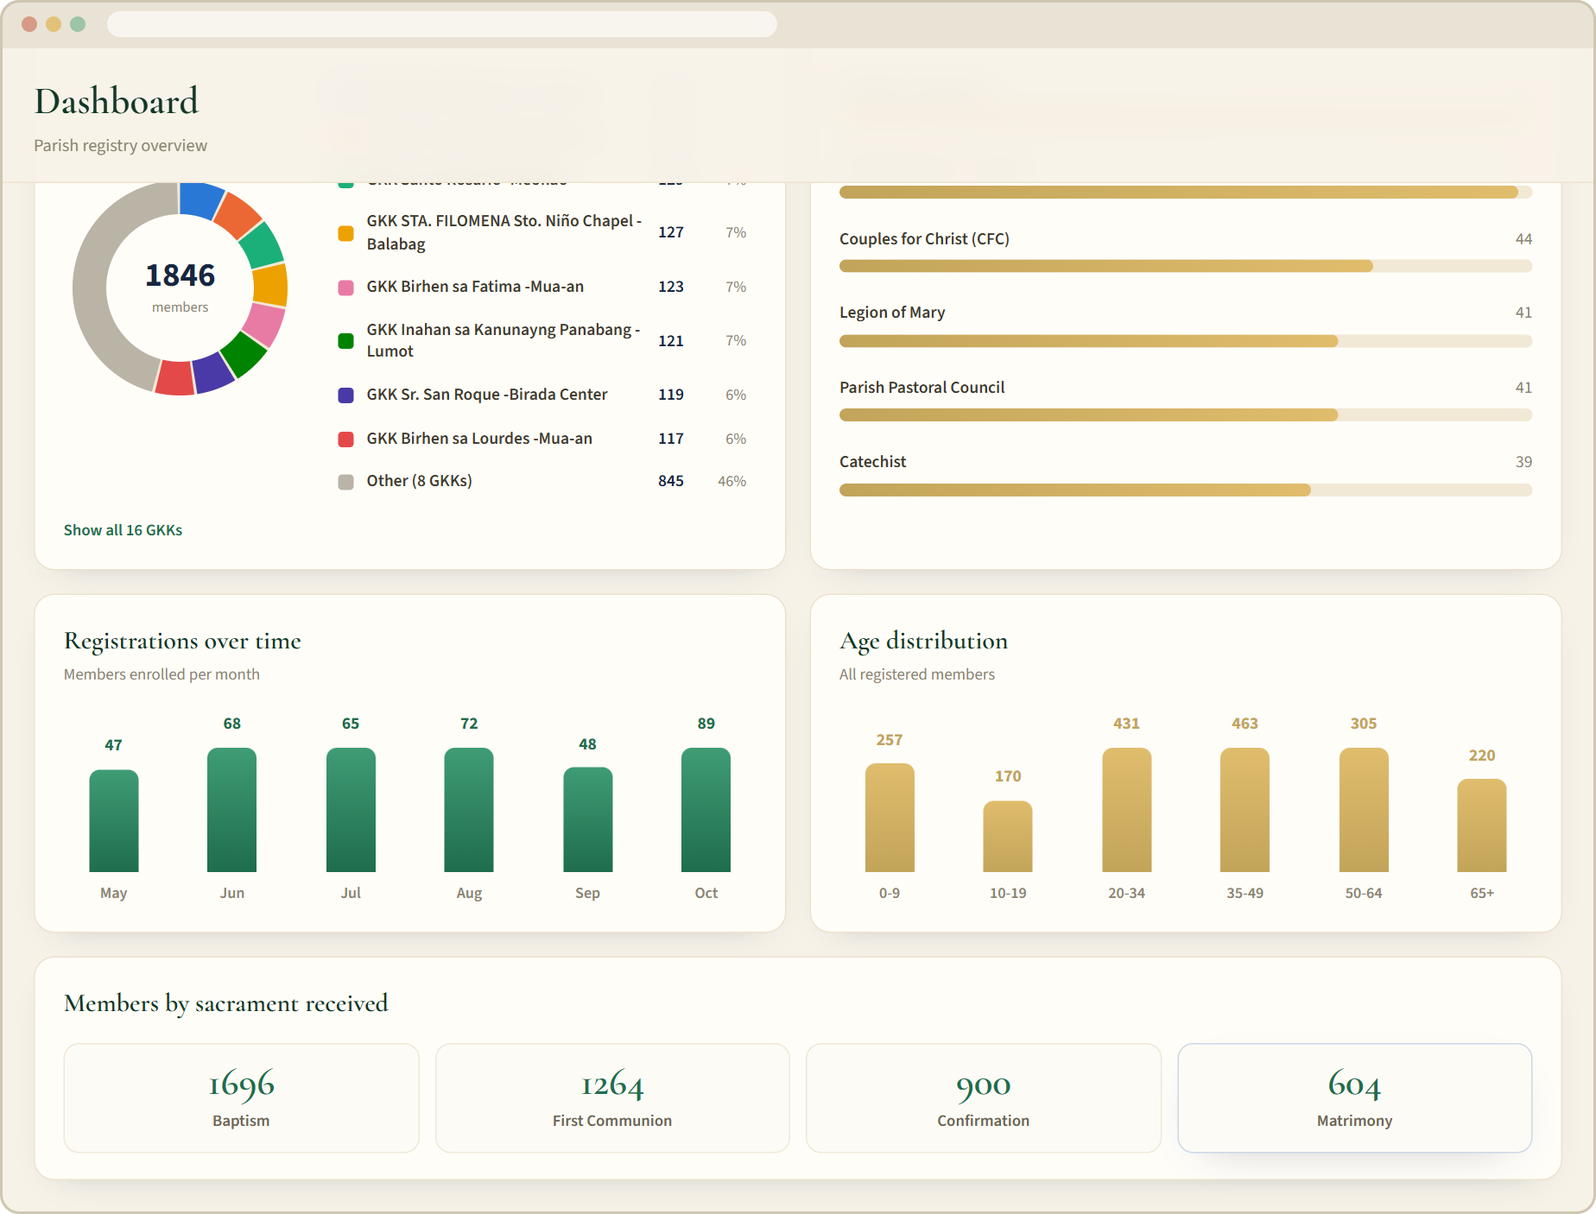
The council can plan from real numbers, GKK by GKK
Questions answered in seconds
How many families and members does each GKK have?
1
Who still needs Baptism, First Communion or Confirmation?
2
Which couples could still be married in church?
3
How did this census compare with the last one?
4
Dashboard on the demo site, with sample data
Notes:
For Father and for this council, the registry turns into answers.
How many families does each GKK really have? Who still needs Baptism, First Communion or Confirmation, so catechists know whom to invite? Which couples could still have a church wedding? And after each census, how did each GKK change compared with the last one?
These come out as ready-made reports that can be printed or exported to a spreadsheet for the diocese. The numbers on screen are sample data from the demo site, not our parish.

Slide 8

The census is done once, online first, and counted for us
1
2
3
4
Start the census
Families update online
Paper as a last resort
Approve and count
The office opens it, for example "2026 Census", and sets the dates.
With the reference number and code on their form. GKK leaders help.
Pre-filled forms by GKK; staff type in the answers that come back.
Staff approve each update; results by GKK, compared with the last census.
Every member gets a status
Active
Inactive
Moved away
Deceased
Left the Church
Safeguards: nothing changes until staff approve · five wrong codes lock the sign-in for 15 minutes · a lost form gets a new code
Notes:
Here is how a census runs from start to finish.
The office opens the census and sets the dates. Families update online with the code on their form, with help from their GKK leader. Paper is only the last resort, for families who can't go online, and the forms come out of the printer already filled in with what we know.
Staff approve each update, and at the end we get results for every GKK, compared with the census before. Each member gets a clear status: active, inactive, moved away, deceased, or left the Church. And nothing in the registry changes until staff approve it.

Slide 9




Parishioners’ information stays private and parish-owned
Each staff member signs in
GKK leaders see one GKK
Nothing private goes public
Their own login and access level: full, read only, GKK leader, clergy and more.
Their own families only. The database itself enforces it.
Phone numbers, birthdays and blood types never show on the website.
Every change is logged
Weekly encrypted backups
Owned by the parish
Who changed what, and when. Deleted records can be restored for 30 days.
Locked with a passphrase and kept in the parish’s own storage.
Every account is under the parish’s own Gmail, not a volunteer’s.
Notes:
I know the first question many of you will have is about privacy, so let me be clear.
Every staff member has their own login, and each login only sees what that role needs. A GKK leader sees only their own GKK, and that rule is enforced by the database itself, not just hidden on the screen. Nothing private ever appears on the public website.
Every change is logged with who made it. There is an encrypted backup every week. And everything is set up under the parish's own Gmail account, so the parish, not any volunteer, owns the system and the data.

Slide 10



It runs at no monthly cost to the parish
What “free” means for us
₱0
Kept awake automatically
The free database pauses after a week unused; a check every 3 days prevents it.
No paid support
a month to run
Help comes from the providers’ communities, and our weekly backups protect the data.
On the free plans of Supabase (database and logins), Vercel (website) and Cloudflare R2 (photos and backups), with room for a few thousand households.
If we ever outgrow it
Supabase Pro is US$25 a month and Vercel Pro US$20 a month. Not needed today.
Optional: our own address, guadalupemuaan.org
₱1,826.12 for two years (about ₱76 a month). The proposal is with the Finance Council.
Notes:
Now the cost. It runs on the free plans of three well-known services, and for a parish our size that costs nothing per month.
Free does come with honest limits. The free database goes to sleep after a week without use, so an automatic check every three days keeps it awake. There is no paid support line, which is one reason we keep our own weekly backups. And if we ever outgrow the free plans, the paid ones are about 25 and 20 US dollars a month, but we are nowhere near that today.
The only optional cost is our own web address, guadalupemuaan.org: about 1,800 pesos for two years. That proposal is already with the Finance Council.

Slide 11



It is built, tested and ready to use now
Ready today
Online family registration in five steps, in Bisaya
The census, with online updates and results by GKK
Parish website: Masses, announcements, bulletin, events, sacrament guides
Our live site
Try the demo
Requests: certificates, sacraments, prayers and blood donors
guadalupe-muaan.vercel.app
parish-registry-demo.vercel.app
Reports for the council and spreadsheet exports for the diocese
Where our families register and update the census
Sample data: try anything. Staff side: add /admin
Staff accounts, each with its own access level
Notes:
This is not a plan for the future. Everything I've shown you is built, tested, and running today.
Here are two codes you can scan with your phone right now. The first is our own live site. The second is a demo site full of sample families, where you can try anything without touching real records, including the staff side: add slash admin to the address and press "Login to Demo Site".

Slide 12
What we ask of the council
1
Endorse it
2
Send the GKK leaders
Adopt the registry as the parish’s official record of families and its census tool.
Ask every GKK leader to lead the online census in their GKK, after a short training.
3
Name two data stewards
4
Announce it
Two trusted people who hold the parish logins with the office and look after privacy.
At every Mass and in the bulletin, and help families without a phone register at the office.
Notes:
So here is what I'm asking the council for tonight. Four decisions.
One: endorse the registry as the parish's official record of families and our census tool.
Two: ask every GKK leader to lead the online census in their GKK. We already have a short training ready for them.
Three: name two trusted people as data stewards, who hold the parish logins together with the office and look after privacy, so the system never depends on one person.
Four: announce it at every Mass and in the bulletin, and make sure families without a phone can register at the office.
And, optionally, support the domain proposal when it comes to the Finance Council.

