Slide 1
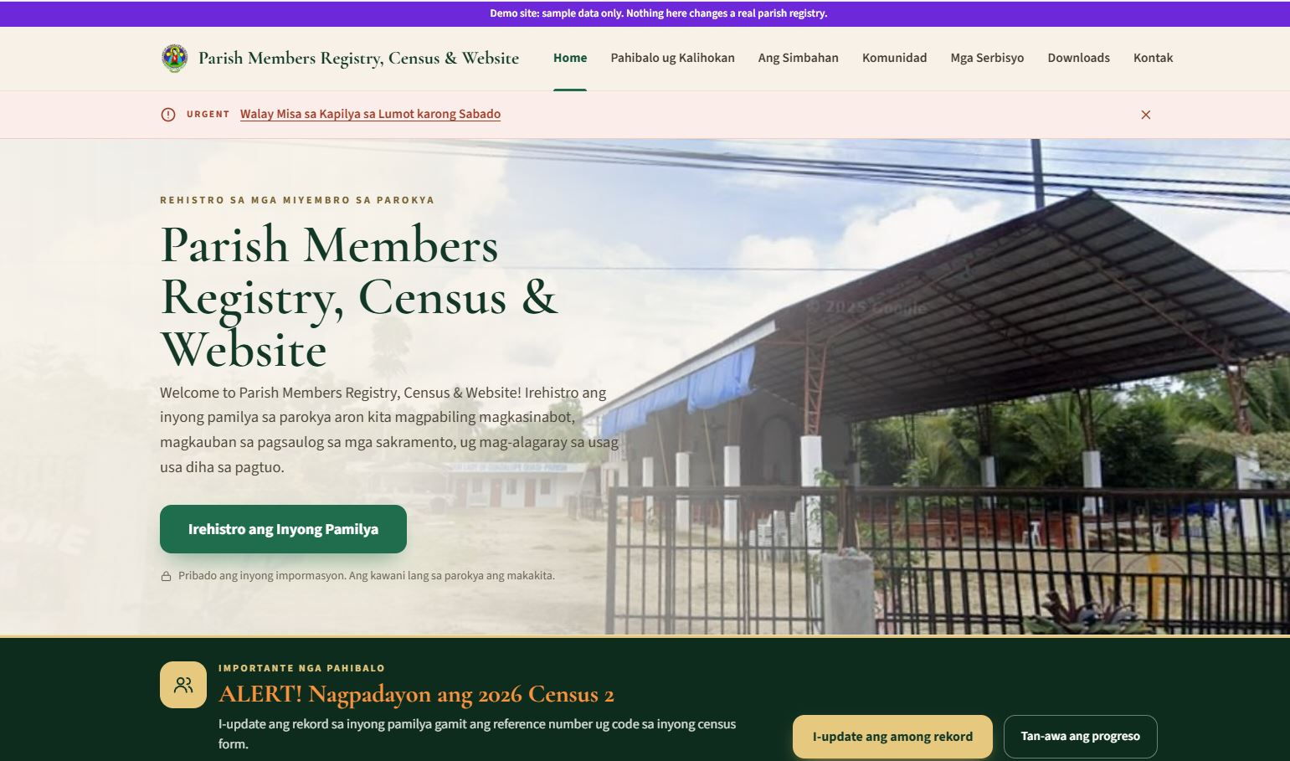
Parish Members Registry & Census Presentation
Notes:
[Before the meeting: open parish-registry-demo.vercel.app on your phone and try it for ten minutes. Everything there is sample data, so you can't break anything.]
Good evening, Father, and fellow council members.
I'd like to show you a free tool for our parish: one online registry of all our families, together with a parish website.
It was built for Our Lady of Guadalupe Quasi-Parish in Mua-an, Kidapawan City, where it is already in use, and its developer gives it free to any parish.
This takes about ten minutes. At the end I'll ask the council for four decisions.

Slide 2



Today, knowing our parish takes paper, time and retyping
Today
With the registry
Census sheets are filled in by hand and retyped every year
Census forms print pre-filled, and families can answer online
Family records sit in notebooks and spreadsheets in different hands
Every household and member is in one searchable registry
"Who still needs Confirmation?" takes days of counting
The answer takes seconds, GKK by GKK
Families must come to the office to register or ask for a certificate
They register and send requests from a phone, with a reference number
Notes:
Let's start with how we do things today.
[Point to the left side.] Our census is written on paper and then typed up. Family records are kept in notebooks and spreadsheets by different people. A simple question like "Who still needs Confirmation?" means counting by hand. And families have to come to the office for everything.
[Point to the right side.] With the registry, the same work is done once. Families answer from their phones, all the records are in one place, and those questions are answered in seconds.
Our pastoral work doesn't change. We just stop doing the paperwork twice.

Slide 3





One registry serves the whole parish
Families
Parish office
Register, update the census and send requests from a phone, in Bisaya
Verify families, track requests, print forms and export lists
One parish registry
GKK leaders
Priest and council
Their own GKK’s families and census, and nothing else
Clear numbers by GKK, for pastoral planning
Also included: the parish website, with the Mass schedule, announcements, bulletin, events, sacrament guides and a prayer wall
Notes:
This is the whole idea on one slide.
In the middle is one registry of our families. Four groups use it, and each one sees only what it needs:
- Families register and update their record from a phone.
- The parish office checks new families and handles requests for certificates.
- GKK leaders see their own GKK only, and lead the census there.
- Father and the council get clear numbers, GKK by GKK, to plan our ministry.
It also comes with a parish website, for the Mass schedule, announcements and events.
If asked "What is a GKK?": it is the app's word for our Basic Ecclesial Communities. The parish enters its own list.

Slide 4
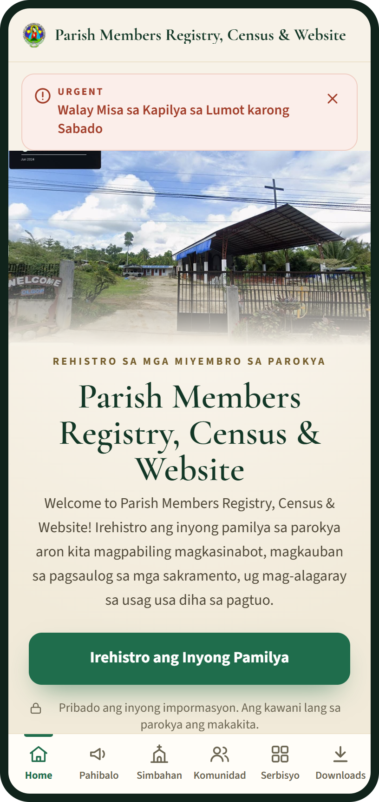
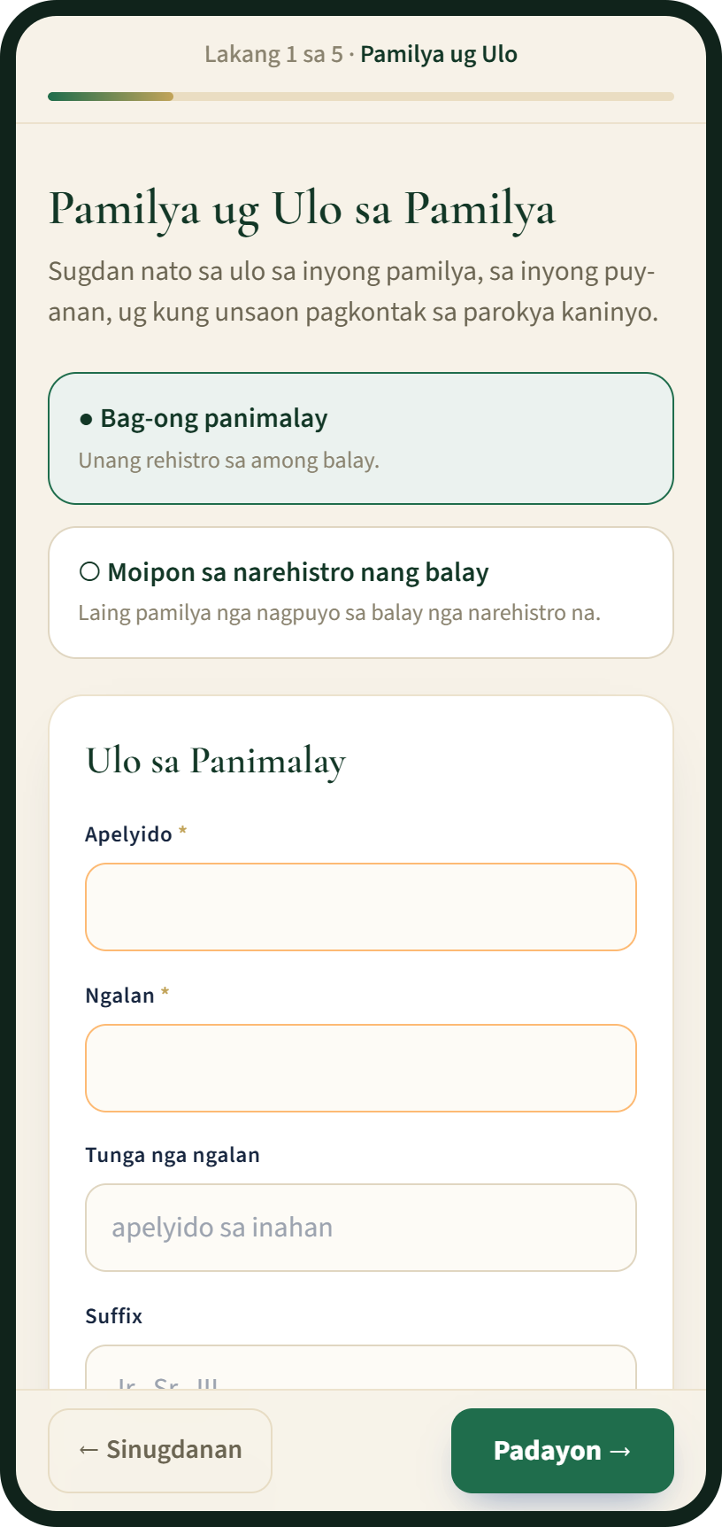
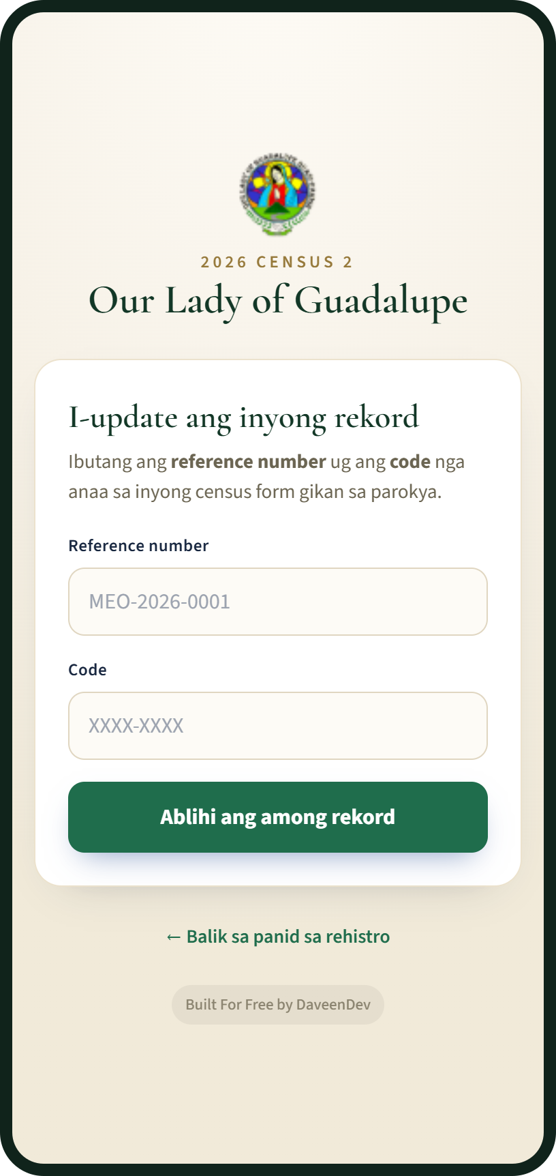



Families take part from their phones, in Bisaya
Register at home
Five short steps. The family gets a reference number at once and can check its status.
Update during the census
With the reference number and code on their census form. No trip to the office.
Ask the parish
Certificates, the Anointing of the Sick, OCIA, blood donors and prayer requests.
Home page
Registration, step 1 of 5
Census update
Screens from the demo site, with sample data
Notes:
Here is what a family sees on a phone. The screens are in Bisaya.
[Left phone] This is the parish website. The big green button starts the registration.
[Middle phone] Registration is five short steps: the family, its members, their sacraments, how they take part in the parish, then a final check. At the end the family gets a reference number.
[Right phone] During a census, the family doesn't fill in a new paper form. They type the reference number and the code printed on their census form, then confirm or correct their record.
Families can also ask for certificates and send prayer requests from the same website.
If asked "What about families without a phone?": the parish office or their GKK leader can register them, and printed census forms are still available.

Slide 5

The census is done once, online first, and counted for us
1
2
3
4
Start the census
Families update online
Paper as a last resort
Approve and count
The office opens it, for example "2026 Census", and sets the dates.
With the reference number and code on their form. GKK leaders help.
Pre-filled forms by GKK; staff type in the answers that come back.
Staff approve each update; results by GKK, compared with the last census.
Every member gets a status
Active
Inactive
Moved away
Deceased
Left the Church
Safeguards: nothing changes until staff approve · five wrong codes lock the sign-in for 15 minutes · a lost form gets a new code
Notes:
This is how a census runs, in four steps.
1. The parish office opens the census and sets the dates.
2. Families update their record online, with the code on their census form. GKK leaders help families who need it.
3. Paper forms are the last resort. They come out of the printer already filled in, and the office types in the answers.
4. The office approves each update. At the end we get results for every GKK, compared with the census before.
Every member gets a status: active, inactive, moved away, deceased, or left the Church.
And nothing in the registry changes until the office approves it.

Slide 6


Safe, private, and free to run
Why the council can trust it
₱0
Private by design
Each staff member sees only what their role allows. Nothing personal shows on the website.
Nothing is lost
a month to run
Every change is logged, deleted records come back for 30 days, and there is a weekly encrypted backup.
It runs on the free plans of well-known online services, with room for a few thousand households.
Owned by the parish
Every account is opened under the parish’s own Gmail, so the data stays with the parish.
Free for any parish to copy and use
The one condition: keep the “Built For Free by DaveenDev” credit in the app. Setup help is available for a fee.
Notes:
Two questions always come up: is it safe, and how much does it cost?
On safety: every staff member has their own login and sees only what their role allows. A GKK leader sees only their own GKK. Nothing private, like phone numbers or birthdays, ever shows on the website. Every change is recorded, deleted records can be brought back for 30 days, and there is an encrypted backup every week. All the accounts are opened under the parish's own Gmail, so the data belongs to the parish.
On cost: it runs on the free plans of well-known online services, so there is no monthly bill. A web address of our own is optional, at about a thousand pesos a year.
The app itself is free for any parish. The only condition is that we keep the small "Built For Free by DaveenDev" credit in the app.
If asked "What's the catch with free?": the free plans have limits, but they are far above what a parish uses. A parish that ever outgrows them would pay about 45 US dollars a month in total. There is no paid support line, which is why the weekly backups matter.

Slide 7



It is ready today, and you can try it now
What the parish gets
Online family registration in five steps, in Bisaya
The census, with online updates and results by GKK
Parish website: Masses, announcements, bulletin, events, sacrament guides
The website
The staff side
Requests: certificates, sacraments, prayers and blood donors
parish-registry-demo.vercel.app
parish-registry-demo.vercel.app
Reports for the council and spreadsheet exports for the diocese
What families see. Try registering a family.
Add /admin, then press “Login to Demo Site”.
Staff accounts, each with its own access level
Notes:
Everything I've shown is already built and working, and you can try it right now.
[Point to the left code] Scan this one with your phone camera to open the demo parish website. Try registering a family. It's all sample data, so nothing you do matters.
[Point to the right code] This one opens the staff side. Press "Login to Demo Site" and you'll see what the parish office sees: the families, the census, the requests and the reports.
I'll give everyone a minute to scan.

Slide 8
What we ask of the council
1
Agree to adopt it
2
Choose who sets it up
As our parish’s record of families and our census tool.
A parishioner who follows the free setup guide, or paid setup help.
3
Name two data stewards
4
Plan the first census
Two trusted people who hold the parish logins with the office and look after privacy.
With the GKK leaders, then announce it at every Mass and in the bulletin.
Notes:
So here is what I'm asking the council for. Four decisions.
1. Agree to adopt it as our parish's record of families and our census tool.
2. Choose who sets it up. A parishioner who is comfortable with computers can follow the free setup guide that comes with the app. If we don't have one, the developer offers setup help for a fee; the app itself stays free.
3. Name two trusted people as data stewards. They hold the parish logins together with the office and look after privacy, so the system never depends on one person.
4. Plan our first census with the GKK leaders, and announce it at every Mass and in the bulletin.
Thank you. I'm happy to take questions.
---- QUESTIONS PEOPLE OFTEN ASK ----
Is it really free? Yes. The app is free to copy and use, and it runs on free online plans, so there is no monthly bill. The only condition is keeping the "Built For Free by DaveenDev" credit in the app.
Who sets it up? Someone comfortable with computers, following the step-by-step guide that comes with the app. Or paid setup help from the developer: daveendev07@gmail.com.
Can it carry our own parish's name, logo and GKKs? Yes. The parish name, logo, address, GKKs, ministries and organizations are all set for our parish.
Is our families' information safe? Each staff member has their own login and sees only what their role allows. Nothing private appears on the website, every change is logged, and there is a weekly encrypted backup.
Who owns the data? The parish. Every account is opened under the parish's own Gmail.
What language is it in? What families see is in Bisaya. The staff side is in English.
Do families need internet? No. The office or a GKK leader can register them, and printed census forms are still available.
Can we try it before deciding? Yes: parish-registry-demo.vercel.app, with sample data. For the staff side, add /admin to the address and press "Login to Demo Site".

