Slide 1
Set 1 - Introduction
CS4411b/9538b
Sylvia Osborn

Slide 2
History of Database Management
1950s | Early Programming Systems, Cobol
1960s | Packages for sorting, report generation, file update, IDS, common data among programs, on-line query
1970s | Relational Model, CODASYL Model, ANSI/SPARC architecture proposal, Relational Implementations, Semantic Data Models
1980s | Databases for non-business applications. Application generation by end-users. Integration with other types of software
1990s | Object-Oriented databases, Federated Databases, Interoperable Databases, Migrating features into Relational packages
2000s | schema integration, web-based applications, data Warehousing, OLAP and data mining, XML databases, XQuery
2010s | flash memory, databases in the cloud

Slide 3
Forces Driving the Changes
Need for data sharing
Understanding of what can and should be automated
Accommodating new data models
Hardware – is there new hardware today that might change things?
Recent changes are:
the cloud
flash memory for long term storage
availability of large amounts of main memory

Slide 4
Aspects of the Material Things we might study
Clearly define important terms
Present commercially available systems and standards important to the marketplace
Appropriate modeling and use of constructs
Implementation techniques and tradeoffs
Theory - correctness of protocols or algorithms

Slide 5
General Topic Outline
Focus on Distributed databases, Object-Oriented databases, and XML databases
Less material on XML databases which have not settled enough to cover as completely.
Go feature by feature, as often techniques from relational databases carry over with a very small extension.
The ideas for OODB provide a really good foundation for XML databases, even though OODBs have not been commercially successful.
Student projects will be providing much of the information on databases for the cloud

Slide 6
Outline of Remainder of this set of notes
What is a database?
Brief review of Relational Databases
Define DDBMS
Define OODBMS

Slide 7
1. What is a ^ Database?
Traditional
1. What is a Database?
2. Brief Review of Relational Databases
3. Define DDBMS
4. Define OODB
data model: way of declaring types and relating them to each other, stored in a schema
languages: for creating, deleting and updating tuples/objects for querying -- usually now high-level, ad-hoc queries; can be interactive or embedded in programs
persistence: the data exists after the program that created it finishes its execution
sharing: many users and applications can access and share the persistent data
recovery: data persists in spite of failures
transactions: can be defined and run concurrently

Slide 8
What is a Traditional Database? cont’d
arbitrary size: amount of data not limited by the computer's main memory or virtual memory
integrity constraints: an be declared and the system will enforce them. Examples are uniqueness of keys, data types, referential integrity
security: authorization controls can be declared and will be enforced by the system
views: definition of virtual or derived data is provided for by the system
versions: multiple versions of an evolving schema are allowed and the connections maintained by the system
database administration tools: things like backup, bulk loading provided by the system
distribution: maintaining multiple, related, replicated, persistent data sets and allowing for their querying

Slide 9
2. Brief Review of Relational Databases
1. What is a Database?
2. Brief Review of Relational
Databases
3. Define DDBMS
4. Define OODB
existing technology
record/tuple based
have a high level query language which retrieves a set of answers at a time, not a single record like some earlier systems
introduced by E. F. Codd, who was working at IBM research at the time
based on tables

Slide 10
Relational Terminology: quick review
Each table is called a relation
Each relation has a relation name
Each column is called an attribute,
Each column has an attribute name
Each row is called a tuple, or sometimes just a record.
The set from which the values are drawn for each attribute is called the domain of the attribute

Slide 11
Formal Definition of a Relation
R ⊆ D₁ x D₂ x . . . x D_{n}
Defined as a set, therefore there should be no duplicate rows
the order among the attributes is usually ignored
the order among the rows is not important (you cannot rely on it – but you can ask for a sort in SQL)

Slide 12
Relational Query Languages
procedural (say how) vs. non-procedural (say what)
Relational Algebra is the only procedural query language
Non-procedural languages include SQL and the various forms of relational calculus and Query-by-Example.
All relational query languages have operations which take one or more relations as parameters and return a relation as the result.
They are said to be closed
which means the result of any operation is a valid parameter to another operation

Slide 13
Brief review of Relational Algebra
Algebraic Symbol | Name | Informal meaning
σ _{F} (R) | selection | selects all (whole) rows from relation R for which Boolean expression F is true
π _{Ai,…,Aj}(R) | projection | project extracts columns Ai,…,Aj from relation R and removes duplicates
R₁ U R₂ | set union | R₁ and R₂ must be columnwise compatible
R₁ ∩ R₂ | intersection | R₁ and R₂ must be columnwise compatible

Slide 14
R₁ ⋈ R₂ | natural join | Combine two relations. For each tuple in R₁ , look at each tuple in R_{2.} If the attributes with the same name (intersecting attributes) have equal values, put the combined tuple in the answer, with only one copy of the duplicate attributes.
R₁ - R₂ | set difference | R₁ and R₂ must be columnwise compatible.

Slide 15
R₁ x R₂ | Cartesian product | As in Mathematics
R₁ ÷ R₂ | Division | All tuples y over attributes in attr(R₁) - attr(R₂) such that for all tuples x in R₂, yx appears in R₁.
R ⋉ S | Semi-join | Those tuples of R which participate in the (natural) join with S. R ⋉ S = π _{R} (R ⋈ S) (this is the definition) Note: R ⋉S ≠ S ⋉ R Used in distributed query processing
**** This is new ****

Slide 16
Other Relational Query Languages
Relational Calculus – based on first order predicate calculus; have domain calculus and tuple calculus
SQL: Structured Query Language
Select A, B, C
From R, S
Where predicate
equivalent to:
π _{A,B,C} (σ _{predicate} (R x S))
SQL is the industry standard query language for relational databases
can nest Select-From-Where in the predicate, and now in the From clause.

Slide 17
Relational Completeness
defined by Codd
deals with the expressive power of a query language
any query language which can express all queries expressible by relational calculus
equivalent, in relational algebra, to being able to express: select, project, union, set difference and Cartesian product.
most commercial SQL dialects are more than relationally complete, because they allow arithmetic such as min, max, sum, average and count.
the group by concept is also more powerful than what can be expressed in a relationally complete language.

Slide 18
3. Distributed Databases
1. What is a Database?
2. Brief Review of Relational Databases
3. Define DDBMS
4. Define OODB
Definition from Özsu and Valduriez:
a collection of multiple, logically interrelated databases, distributed over a computer network, together with an access mechanism which makes this distribution transparent to the user.
Compromise between: database which integrates data access and computer network which distributes processing

Slide 19
Some Distinguishing Characteristics (of a Distributed Database)
runs on a computer network (autonomous processing elements connected by communications lines)
(i.e. not shared memory or shared disc)
there exist some global applications which access data at more than one site
data exists at more than one site

Slide 20
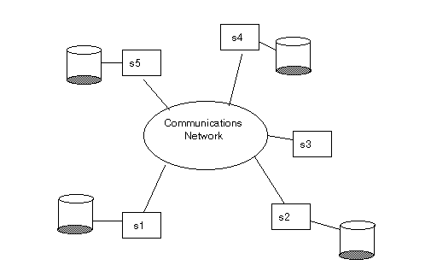
Assumed Computer Architecture

Slide 21
Advantages of Distributed DB over a Centralized DB
Obvious choice for geographically dispersed organization: allows local autonomy over local data and integrated access when necessary
Improved performance for applications that are executed locally. May be able to take advantage of parallelism.
Improved reliability/availability: assuming replicated data, a site or link failure does not stop all processing.
Incremental upgrades are possible

Slide 22
Advantages of DDBMS, cont’d
Economics: (comparing to a single site mainframe, with remote access) it may be cheaper to buy several small computers than a single large system. There may be lower communications costs because of more local processing.
Increased sharing of data which might have been local to various sites.
The technology exists.
Political reasons: local province or borough within a big city government wants to retain control over their own data.

Slide 23
Some Disadvantages
The systems are more complex:
possibly replicated data – more complex design
distributed query processing
distributed concurrency control
distributed deadlock management
distributed recovery
Security: more difficult to enforce uniformly. Networks are not secure.

Slide 24
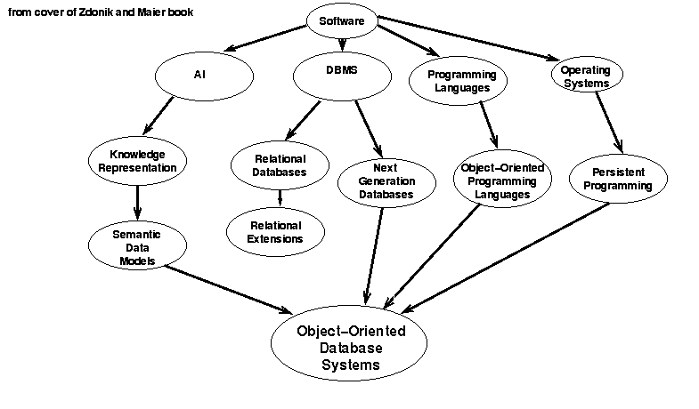
1. What is a Database?
2. Brief Review of Relational Databases
3. Define DDBMS
4. Define OODB
4. Defining OODBs: Ideas leading to OODB:

Slide 25
What is an Object-Oriented Database System?
Different people have different shopping lists of features.
Should have some essential database features and some essential object-oriented features.
whole issue of database model vs. programming language view of data structures

Slide 26
What are important OO features? according to some authors of OODB books
Maier and Zdonik:
Object: an abstract machine that defines a protocol through which users of the object may interact
Type: specification for instances
Class: set of instances for a type

Slide 27
OO definitions according to some authors of DB books, cont’d
Bertino and Martino:
Object: represents a real-world entity
has a state (attributes)
has behaviour (methods)
has a single object identifier
existence is independent of its values
Type: specification of the interface of a set of objects which appear the same from the outside
Class: set of objects which have exactly the same internal structure (i.e. the same attributes and the same methods)

Slide 28
Programming/programming languages point of view:
Abstract Data Type:
can be a quite formal
definition of the structure of a set of like data objects and the procedures which can be performed on it. (e.g. stack, queue, employee)
In database books, this is sometimes called the intent.
Implementation of the abstract data type:
is accomplished in a programming language by defining a class which codes one possible implementation of the abstract data type.

Slide 29
The database point of view:
the intent in the relational model is the relation definition; it describes the “shape” of the tuples which will be inserted into the relation.
in relational databases there are no operations specific to each relation, so the procedural side of the abstract data type is not present. This is one of the things that object-oriented databases are supposed to enhance.
the extent of a relation is the table itself, all of the tuples which are eventually inserted into the relation. This is what we query.

Slide 30
More differences between programming languages and databases
In normal programming, we do not worry about all the instances eventually created for an abstract data type.
In databases, it is very important that we have sets of similar things to query.
Some authors use the word class to refer to the set of all instances of a type which currently exist.

Slide 31
We will use the following
Object:
has a state (attributes)
represents a real-world entity
has behaviour (methods)
has a single object identifier
existence is independent of its values
is an instance of a class
Type:
(possibly formal) specification of the interface of a set of objects which appear the same from the outside
Class:
one implementation of a type

Slide 32
Important Object-Oriented Features
some notion of objects, types and classes
Complex State: the structures described by the types and classes can be arbitrarily complex, e.g. can have nested records, set-valued attributes, etc. I.e., can be more richly structured than a “flat” tuple in a relational database.
Encapsulation:
can only access an object or any of its subparts through a well-defined interface, e.g. Through messages or function/procedure calls. i.e. the structure part is normally hidden, unless revealed directly by a method.
separates the interface from the implementation
corresponds to the notion of physical data independence in traditional database terminology

Slide 33
More Definitions
Object Identity:
immutable: (according to Webster) not capable of or susceptible to change
system generated, not derived from values or methods
allows shared substructures
an object can undergo great changes without changing its identity
should allow comparisons based on OID in the query language

Slide 34
More Definitions - 2
Type/Class Hierarchies and Inheritance:
(more on this later under Data Modeling)
Extensibility:
related to type hierarchies and inheritance
means programmer can add new types and arbitrarily many of them to suit the application
should be no distinction between built-in types and user-defined types (for things like querying, persistence)

Slide 35
What is an Object-Oriented Database System?
Database Functionality:
a data model
a retrieval/query language
persistence
(sharing) concurrency control
arbitrary size
Object-Oriented Features:
define types with complex state
encapsulation
support for object identity

Slide 36
Objective
was to build a system that could support applications written in a variety of programming languages, e.g. C++ and Java, and somehow have the object-oriented database model be accessible from the different environments

Slide 37
When/Where are Object-Oriented Databases required?
for applications requiring complex, deeply nested data models e.g. nested sets, time series data (a sequence of tuples), complex graphical data types
for applications requiring complex operations on data e.g. merging of maps, analyzing circuit designs for some engineering properties, etc.
for applications with the above requirements which require database features such as sharing, persistence, concurrent access, querying, etc.

Slide 38
Example Application Areas
Computer-aided software engineering
Computer-aided design
Computer-aided manufacturing
Office automation
Computer supported cooperative work

Slide 39
Outline of notes
Set 1: Introduction ✔
Set 2: Architecture
Centralized Relational
Distributed DBMS
Object-Oriented DBMS
Set 3: Database Design
Centralized Relational
Distributed DBMS
Set 4: Data Modeling Issues
Set 5: Querying
Set 6: XML Model and Querying
Set 7: Algebraic Query Optimization
Centralized Relational
Distributed DBMS
Object-Oriented DBMS
Set 8: Storage, Indexing, and Execution Strategies
Set 8, Part 2: Costs
and OO Implementation
Set 8, Part 3: XML Implementation Issues
Set 9: Transactions and Concurrency Control
Centralized Relational
Set 9, Part 2
CC with timestamps
Distributed DBMS
Set 10: Recovery
Centralized Relational
Distributed DBMS
Set 11: Database Security: DAC and MAC
Set 11, Part 2: RBAC, and other topics
39

