Slide 1
Set 2
Database Architecture
CS4411/9538
Set 2, Database Architecture
Notes:
Set 2
Fall 2006, CS411a, Set2

Slide 2
Outline of notes
Set 1: Introduction ✔
Set 2: Architecture
  Centralized Relational
  Distributed DBMS
  Object-Oriented DBMS
  XML Databases
Set 3: Database Design
  Centralized Relational
  Distributed DBMS
Set 4: Data Modeling Issues
Set 5: Querying
Set 6: XML Model and Querying
Set 7: Algebraic Query Optimization
  Centralized Relational
  Distributed DBMS
  Object-Oriented DBMS
Set 8: Storage, Indexing, and Execution Strategies
Set 8, Part 2: Costs
and OO Implementation
Set 8, Part 3: XML Implementation Issues
Set 9: Transactions and Concurrency Control
  Centralized Relational
Set 9, Part 2
  CC with timestamps
  Distributed DBMS
  Object-Oriented DBMS
Set 10: Recovery
  Centralized Relational
  Distributed DBMS
Set 11: Database Security: DAC and MAC
Set 11, Part 2: RBAC, and other topics
CS4411/9538
Set 2, Database Architecture

Slide 3
Database Architecture
Software Architecture: The architecture of a software system defines that system in terms of computational components and interactions among those components (from Software Architecture, Perspectives on an Emerging Discipline,Mary Shaw and David Garlan, Prentice-Hall).
some example software architectural styles are: pipes and filters, data abstraction and object-oriented, event-based, layered systems, repositories, and interpreters
CS4411/9538
Set 2, Database Architecture

Slide 4
Reference Model/Architecture
can be part of a standard
idealized architecture, or reference model, whose purpose is to identify the main components of a system to help builders of such systems or people comparing them.
Architectures can be component based, function based, or for databases, can be “data based” in that they identify the important data shemas or repositories. We will call this the
Data Organization Perspective
of the database architecture.
CS4411/9538
Set 2, Database Architecture

Slide 5
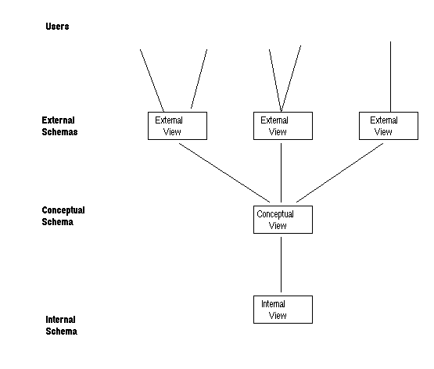
Centralized Relational Architecture
Data Organization Perspective as given by the ANSI/SPARC Architecture (from early 1970s)
CS4411/9538
Set 2, Database Architecture

Slide 6
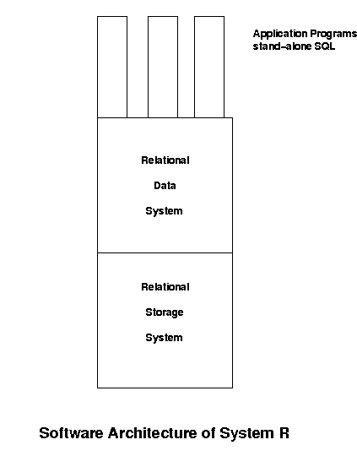
System R was the original RDBMS prototype at IBM, in California, built before 1976
CS4411/9538
Set 2, Database Architecture

Slide 7
The Relational Data System (RDS) looked after
SQL language parsing
Formulating query execution plans
handling host language queries/cursors
data definition, view definition, authorization statements
CS4411/9538
Set 2, Database Architecture

Slide 8
The Relational Storage System looked after
placing tuples on the disc and bringing them into main memory when required.
creating and managing indexes when defined
transaction management
concurrency control
Recovery
Is this a useful division of functionality for OODBS, distributed DB or Client Server databases?
CS4411/9538
Set 2, Database Architecture

Slide 9
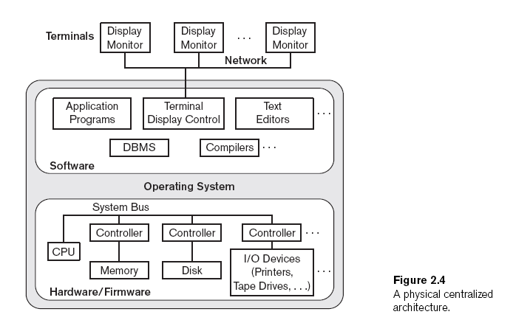
Architecture of a Component-based Centralized Computer System,
from Elmasri &Navathe, 6th edition
CS4411/9538
Set 2, Database Architecture

Slide 10
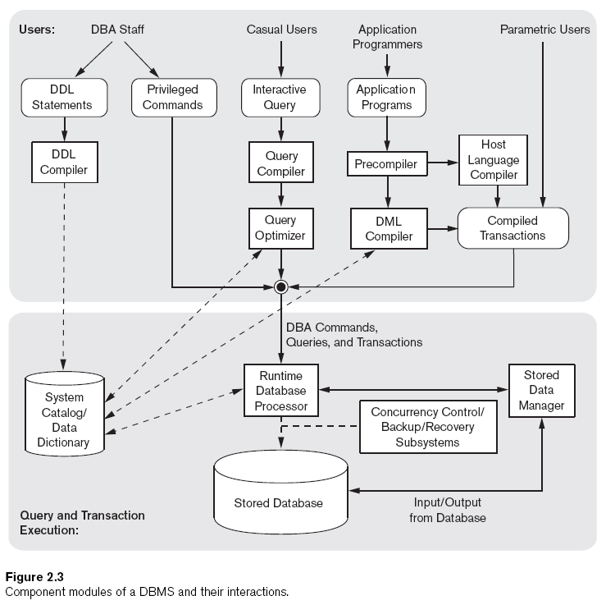
From
Elmasri &
Navathe,
6th edition
CS4411/9538
Set 2, Database Architecture

Slide 11
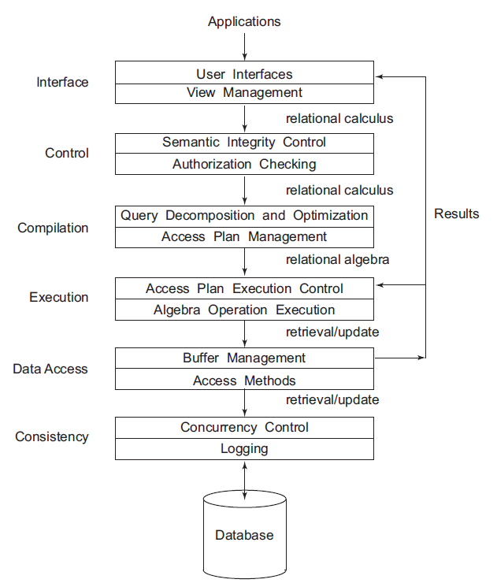
Functional Layers
of a Centralized
DBMS, from Őzsu
and Valduriez, 3rd
edition
CS4411/9538
Set 2, Database Architecture

Slide 12
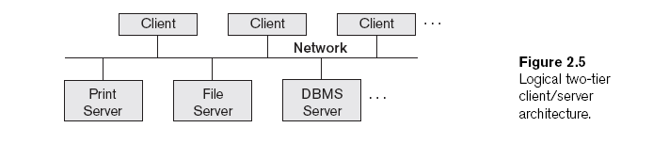
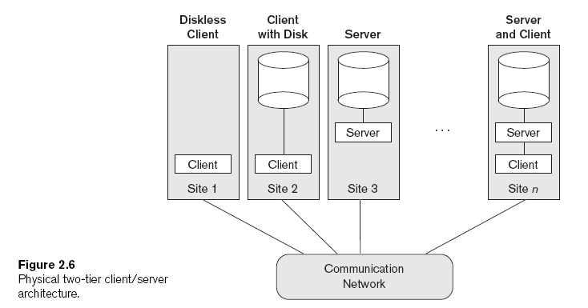
Two-Tier Client/Server Architecture, From Elmasri & Navathe, 6th edition
CS4411/9538
Set 2, Database Architecture

Slide 13
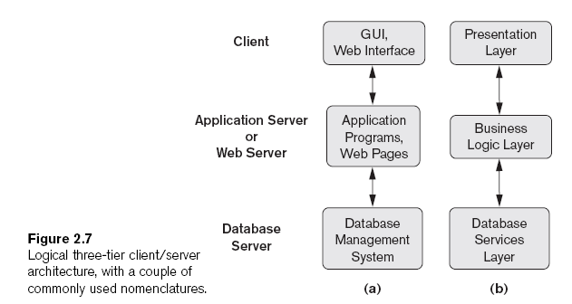
Three-tier Client/Server Architecture
From Elmasri & Navathe, 6th edition
CS4411/9538
Set 2, Database Architecture

Slide 14
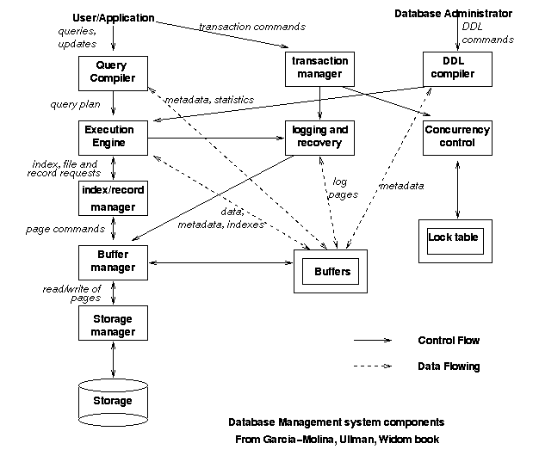
A confusing architecture
CS4411/9538
Set 2, Database Architecture

Slide 15
Distributed DBMS Architecture
The Data Organization Perspective of the architecture consists of the following layers:
Global Schema: schema for all the data as if it were not distributed
  consists of global relations
Fragmentation Schema: mapping from global relations to fragments, or pieces of relations which might be stored at different sites
Allocation Schema: records at which site(s) each fragment is stored.
  also whether or not there is replication
An important concept is transparency. A system or layer is transparent to the user if the implementation details are hidden from the user.
CS4411/9538
Set 2, Database Architecture

Slide 16
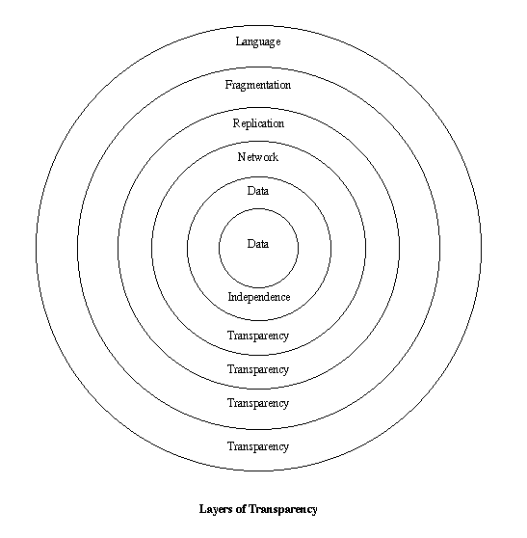
CS4411/9538
Set 2, Database Architecture

Slide 17
Data Independence
concept from relational databases, defined by E.F. Codd.
user applications are not affected by changes in the logical or physical structure of the database.
Logical data independence: changes to the schema can be made without affecting applications. It works if we, for example, add an attribute, or a relation.
  Clearly does not work if an attribute or relation used by an application is deleted.
Physical data independence: changes to the internal storage details do not affect applications. Examples are adding or deleting indexes, moving data to another disc, etc.
CS4411/9538
Set 2, Database Architecture

Slide 18
Definitions of Transparency
Network Transparency: The fact that there is a network should not be noticed by users or applications.
Replication Transparency: The existence or not of multiple copies of database objects should not be noticed by users or applications. If copies exist, they should be under the control of the system and not of the user.
Fragmentation Transparency: The fact that the relations have been replaced by fragments should not be known by users or applications. The system should be responsible for storing the fragments and translating queries on whole relations into queries on the relevant fragments.
CS4411/9538
Set 2, Database Architecture

Slide 19
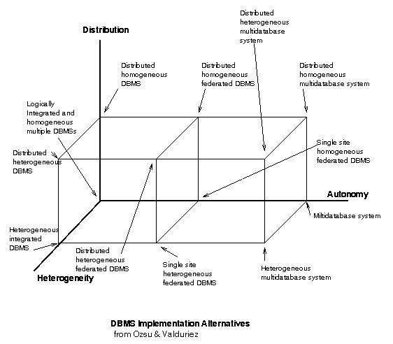
DDBMS Implementation Alternatives, from 2nd edition of Ozsu and Valduriez
CS4411/9538
Set 2, Database Architecture

Slide 20
Three Orthogonal Issues for Architecture of a Distributed Database
Orthogonal: Issues are orthogonal if the choice made in one dimension or on one aspect does not affect, or is independent of, the choice made on another issue.
Distribution axis: at the origin is centralized, at the “1” point is distributed (later edition of Özsu & Valduriez has 3 points – one for client server).
Heterogeneity axis:
  points or choices are homogeneous and heterogeneous
  can be heterogeneity of data models, query languages, transaction processing protocols, etc.
CS4411/9538
Set 2, Database Architecture

Slide 21
Autonomy Axis
deals with how access to the data is controlled
at “0”: tight integration
  user's request is under the control of one data manager
  gives the impression of a logically centralized database
  called “pure” in following slide
at the middle point: semiautonomous or federated DBMS
  systems have decided to cooperate
  each decides what data to share
  individual systems need to be modified to know how to talk to each other
at the outermost point: total isolation
  really have stand-alone DBMSs, with another layer providing the distributed DBMS functionality
  the individual systems don't know they are part of it
  called a multidatabase system
CS4411/9538
Set 2, Database Architecture

Slide 22
Data organization perspective for “pure” Distributed Database,
From E&N,
6th edition
CS4411/9538
Set 2, Database Architecture

Slide 23
Data Organization Perspective for Federated Database System
(semi-autonomous)
From E&N,
6th edition
CS4411/9538
Set 2, Database Architecture

Slide 24
Multidatabase Data Organization Perspective
(total isolation)
The multidatabase system looks
after accessing and integrating
calls to various databases
Multidtabase System
External
View
. . .
External
View
Local
Conceptual
Schema
Local
Conceptual
Schema
Local
Conceptual
Schema
. . .
CS4411/9538
Set 2, Database Architecture

Slide 25
DDBMS Implementation Alternatives, again
CS4411/9538
Set 2, Database Architecture

Slide 26
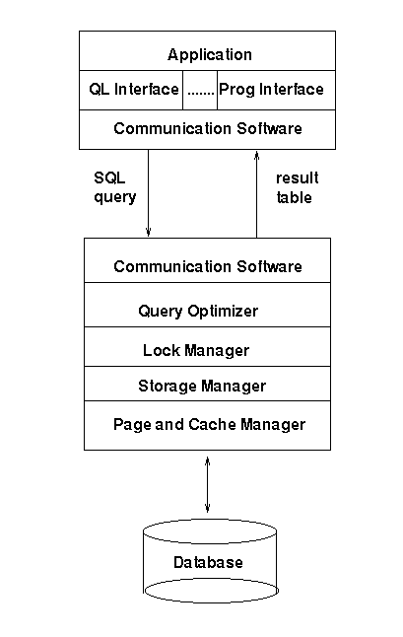
Client/Server
Reference
Architecture
from Özsu and
Valduriez
CS4411/9538
Set 2, Database Architecture

Slide 27
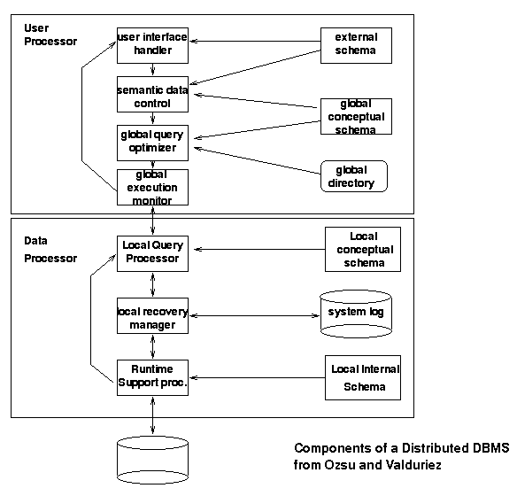
CS4411/9538
Set 2, Database Architecture

Slide 28
Directory Design for Distributed DBMS
traditionally the directory of a DBMS records information such as what relations have been defined, what attributes they have, what integrity constraints have been defined, what are the primary keys, views, indexes, etc.
in centralized relational packages, it is traditional to store the directory in relations, effectively as part of the database, although these relations will have restricted access (everyone can read, only the system can update).
in the distributed case, we also need to store: what fragments have been defined, and where they are stored.
If the directory for a distributed DBMS is stored as part of the database, then the questions arise:
  is it replicated?
  is it stored on one or multiple sites?
  does it describe the local database for each site or the global database?
CS4411/9538
Set 2, Database Architecture

Slide 29
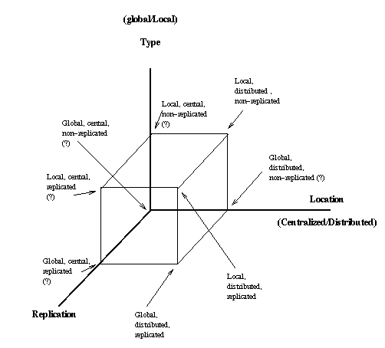
CS4411/9538
Set 2, Database Architecture

Slide 30
Architectures for Object-Oriented DBMSs
Data Organization Perspective follows the centralized (relational) or distributed models.
The architecture is usually simpler than ANSI/SPARC, because we usually don't talk about external schemas.
CS4411/9538
Set 2, Database Architecture

Slide 31
XML database architecture
Comes in several architectural organizations
  There are standalone XQuery packages which are self contained databases with all the components of a regular (relational) DB package
  XML has been added to relational packages, along with its query language XQuery.
  there are other systems available which may only have an XML schema parser and XQuery and XSLT processors
CS4411/9538
Set 2, Database Architecture

Slide 32
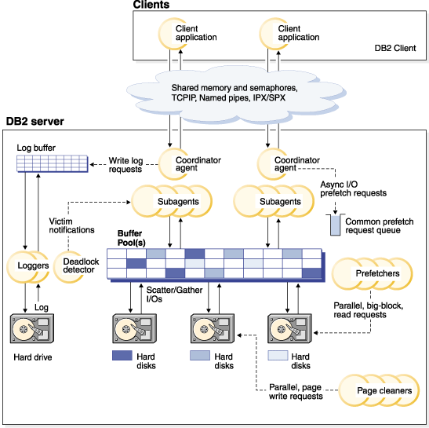
DB2 Architecture and Processes Overview
from the
DB2
manuals
CS4411/9538
Set 2, Database Architecture

Slide 33
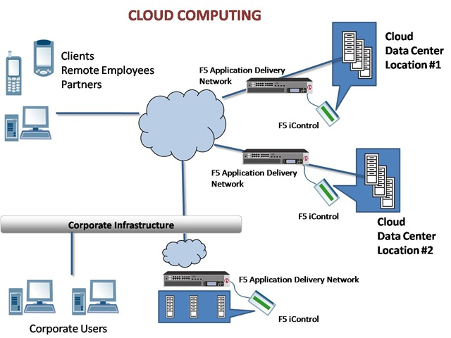
Cloud Architecture
Taken from devcentral.f5.com/articles article by Lori MacVittie
CS4411/9538
Set 2, Database Architecture

