Slide 1
Set 4: Data Modeling Issues
Sylvia Osborn
CS4411/9538
Set 4: Data Modelling Issues
Notes:
CS411a, Fall 2006, Set4

Slide 2
Outline of notes
Set 1: Introduction ✔
Set 2: Architecture ✔
  Centralized Relational
  Distributed DBMS
  Object-Oriented DBMS
  XML Databases
Set 3: Database Design ✔
  Distributed DBMS
Set 4: Data Modeling Issues
Set 5: Querying
Set 6: XML Model and Querying
Set 7: Algebraic Query Optimization
  Centralized Relational
  Distributed DBMS
  Object-Oriented DBMS
Set 8: Storage, Indexing, and Execution Strategies
Set 8, Part 2: Costs
and OO Implementation
Set 8, Part 3: XML Implementation Issues
Set 9: Transactions and Concurrency Control
  Centralized Relational
Set 9, Part 2
  CC with timestamps
  Distributed DBMS
  Object-Oriented DBMS
Set 10: Recovery
  Centralized Relational
  Distributed DBMS
Set 11: Database Security: DAC and MAC
Set 11, Part 2: RBAC, and other topics
CS4411/9538
Set 4: Data Modelling Issues

Slide 3
How to deal with persistent data with some structure?
The world is not flat. How do we put non-flat data into a (relational) database?
for a programming problem, the focus in the design stage is on the processing or operations
for a database application, the data is being designed to support possibly many applications over possibly many years. Thus the focus is on the “proper” structure of the data. The processing or operations are mainly provided by the database query languages, and application programs which may be written much later.
deal with handling data of various “shapes”, not just flat data
may want a model that is independent of any particular programming language.
CS4411/9538
Set 4: Data Modelling Issues

Slide 4
Issues
What kinds of shapes can we have or should we allow for?
How do we talk about them in a programming-language independent way?
CS4411/9538
Set 4: Data Modelling Issues

Slide 5
The first modeling construct: Aggregation
Aggregation: is the juxtaposition of objects of possibly different types to create a new type
gives us the records in Cobol, records or structures in your favourite programming language, the rows in a relation, the components of an object.
to be neutral, we will call the new object an aggregate.
the parts can be called
  Components
  Attributes
  Fields
e.g. when we take a Name, Address, Phone, and DateOfBirth and stick them together we have a new object we might want to call a Person.
Aggregation can be done more than once. The person might participate in a project. This gives Aggregation Hierarchies.
CS4411/9538
Set 4: Data Modelling Issues

Slide 6
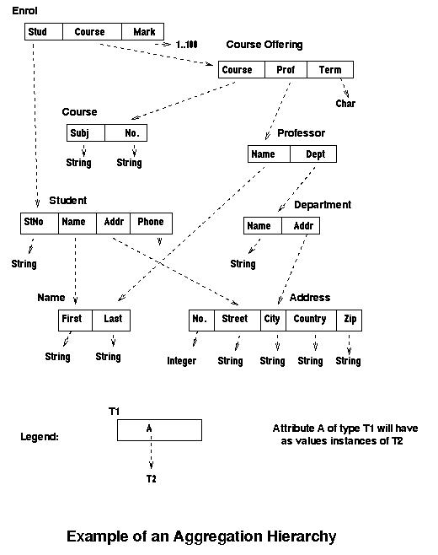
CS4411/9538
Set 4: Data Modelling Issues

Slide 7
The Entity-Relationship (ER) Model
The original ER model allowed 2 levels of aggregation:
  one to create entities from basic data types
  one to create relationships from two or more entities
  and arbitrarily many descriptive attributes which are some basic data types
an entity was defined to be a “thing” which has independent existence
a student or a course might be an entity.
what about a name? or an address?
more than 2 levels of aggregation might be needed for complex data.
CS4411/9538
Set 4: Data Modelling Issues

Slide 8
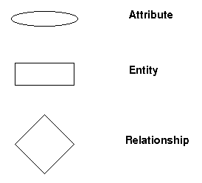
The Following Symbols are Used in ER Diagrams
CS4411/9538
Set 4: Data Modelling Issues

Slide 9
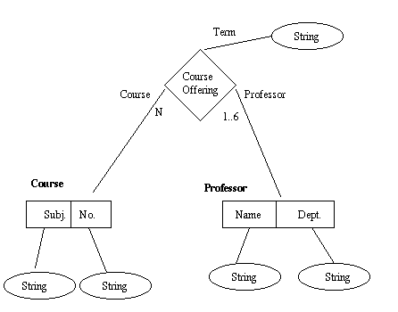
The Previous example, making all names, addresses and departments strings
CS4411/9538
Set 4: Data Modelling Issues

Slide 10
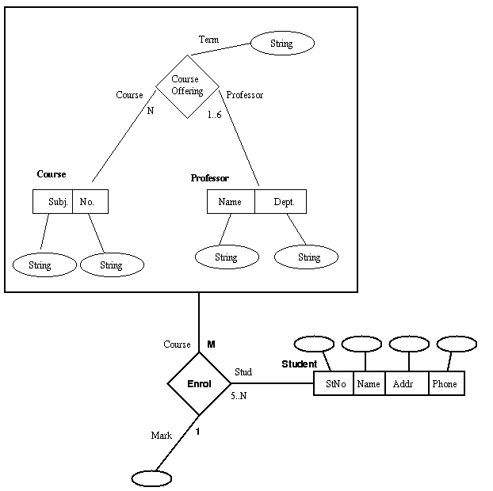
Can get more nesting by “entifying” a relationship
CS4411/9538
Set 4: Data Modelling Issues

Slide 11
One Advantage of the ER model
It emphasizes, especially for binary relationships, whether they are
  1:1
  1:n
  n:m
Also distinguishes between the
big (major) participants in the relationship, i.e. the entities
and the
little participants, the attributes, which play a purely descriptive role
CS4411/9538
Set 4: Data Modelling Issues

Slide 12
Example: look at the Enroll Relationship
In the ER diagram, we see that there are two participating entities: the course offering and the student. The mark just adds more information to this association.
When this gets represented in a relational database, we would have the relation:
Enrol(Subj, No, StudNo, Mark)
Although some of the attributes are in the primary key, they are all just attributes.
This distinction is also not obvious in the aggregation hierarchy.
CS4411/9538
Set 4: Data Modelling Issues

Slide 13
2 “Kinds” of Aggregates
Some models have 2 kinds of aggregates: those that get deleted with their parent aggregate, and those that don’t
  e.g. when a Student is deleted, also delete the name and address objects connected to that student
  but when a Professor is deleted, do not delete the Department that professor is in.
It is related to whether or not the object or data has independent existence.
The ones that do get deleted are called weak entities in the ER model.
In OODBs, they are modeled by aggregates which are not full-fledged objects
CS4411/9538
Set 4: Data Modelling Issues

Slide 14
Aggregation in OODBs
objects in Object-oriented systems have instance variables or “private memory” which can be used to represent attributes.
main difference between programming language treatment of instance variables and OO database treatment of attributes is that in a database system we want the attribute values to be visible outside of the object (for querying), and in most OO programming languages, the default is that the instance variables are private. This can be changed by defining (accessor) methods for every attribute to retrieve the value, and store a new value (when the programming language does not have “public” attributes).
CS4411/9538
Set 4: Data Modelling Issues

Slide 15
Aggregation in OODBs - 2
Aggregation from semantic data models fits very naturally into Object-oriented systems.
Defining an aggregate corresponds almost exactly to defining the structure of a class. One possible difference is in the amount of information hiding desirable.
The most general of our aggregations correspond to associations as classes in the OM/T and UML models.
CS4411/9538
Set 4: Data Modelling Issues

Slide 16
Complex Objects or Literals
Some OODB models (e.g. Orion, Cocoon) distinguish between attribute values which are
  exclusively owned, not shared (e.g. names, addresses, the set of children of an employee)
  deleted with object whose attribute they are a value for
  perhaps don't really need an object ID
and those which do have a more independent existence, and are shared (e.g. the Department attribute in Professor)
the first kind are called Complex Objects or Complex Values.
The ODMG (a proposed standard for OODBs) calls them literals.
CS4411/9538
Set 4: Data Modelling Issues

Slide 17

Check list for evaluating a new data model/database system
how are aggregates modeled?
  are there weak entities/literals – dependent sub-structures that have no independent existence? are not shared? and are deleted with their parent object?
CS4411/9538
Set 4: Data Modelling Issues

Slide 18
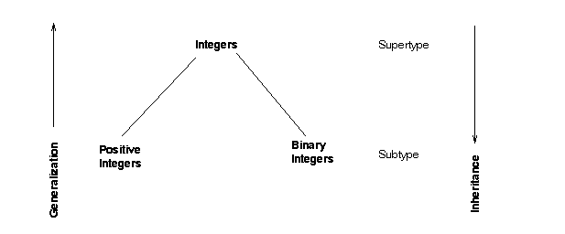
The Second Modeling Construct:
Generalization/Inheritance/ISA Hierarchies
CS4411/9538
Set 4: Data Modelling Issues

Slide 19
Type Hierarchies
Types are related in a hierarchy, such that objects with more general properties belong to the supertype, and objects with more specific properties belong to the subtype(s).
  properties include the operations one can perform on the objects (instances) of the type, i.e. the operations (methods) defined in the interface of the type.
  operations are inherited from the supertype to its subtype(s). Some systems allow an inherited operation to be overridden with a new one. Can add more operations to the subtype's interface (e.g. might have a parity operation for binary integers.)
  properties inherited also include the instance variables or attributes.
  Systems do not usually allow the inheritance of attributes to be overridden. They may allow the underlying type of an instance variable to be changed.
  In creating a subtype, more attributes may be added.
CS4411/9538
Set 4: Data Modelling Issues

Slide 20
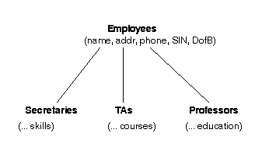
Designing the Type Hierarchy
top-down growth of the type hierarchy.
Terms which describe this process are:
  extensibility of the type system
  incremental design
with top-down growth, discover that you need more object types with additional attributes, and maybe need more than one subtype of a given type with differing additional attributes.
CS4411/9538
Set 4: Data Modelling Issues

Slide 21
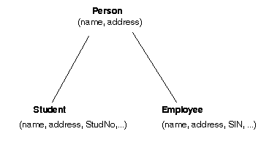
bottom-up growth of the type hierarchy. This direction we call generalization.
realize during the design that two or more types have a lot in common, and it might make more sense to have a supertype which contains those common attributes and operations. i.e. decide to emphasize the similarities and leave the differences to the subtypes.
CS4411/9538
Set 4: Data Modelling Issues

Slide 22
ISA
every student ISA person
means in the world we are modelling, every object which is an instance of (an implementation of) the subtype (student) is a valid instance of the supertype (person) and can participate in operations that call for an instance of the supertype.
e.g. if there were an operation hire for persons, student objects could also be hired.
How does this happen?
CS4411/9538
Set 4: Data Modelling Issues

Slide 23
Types and Interfaces
Type: specification of behaviour of a set of objects
Subtype of a type has the same interface, and possibly more operations in its interface.
when there is subtyping of a structured type, i.e. a type with a record-like structure, say given a type t_{i} whose structure is defined as: [a₁ : t₁, a₂ : t₂, … , a_{n} : t_{n}]
Definition: type t_{j} is a subtype of t_{i} if t_{j} is defined as:
[a₁ : t₁, a₂ : t₂, … , a_{n} : t_{n}, …, a_{m} : t_{m}] where m ≥ n
this means that if the operations defined on type t_{i} needed to use the values stored in the instance variables
a₁ : t₁, a₂ : t₂, … , a_{n} : t_{n},
these values are still available in type t_{j}, so the operations should still work on instances of t_{j}.
CS4411/9538
Set 4: Data Modelling Issues

Slide 24
Class Inheritance
when the user specifies that a class is a subclass of another one, the system copies the structure of the superclass to the subclass
the user can add more attributes/instance variables and/or more methods to the subclass definition
inherited methods can usually be reimplemented - called overriding
An operator/message with more than one implementation is said to be overloaded.
e.g. + and * in most programming languages are overloaded for integers and reals - different machine instructions are called, and the compiler has to decide which implementation to use.
CS4411/9538
Set 4: Data Modelling Issues

Slide 25
More Definitions
Polymorphism: the occurrence of something in several different forms (O.E.D.)
Polymorphic Objects: objects can be polymorphic. An instance of Student can also be considered to be an instance of Person
Polymorphic Operators/Messages: operators or messages can be polymorphic
  +, * in Pascal are polymorphic
  a message which is in the interface for both Student and Person is a polymorphic message
Polymorphic Code: code can be polymorphic. An implementation of a method which is called with more than one type of object is polymorphic, e.g. code which is inherited without being changed for an inherited method, would be polymorphic
Late Binding/Dynamic Binding: the decision of which implementation of an overloaded operator to use is made at run time.
CS4411/9538
Set 4: Data Modelling Issues

Slide 26
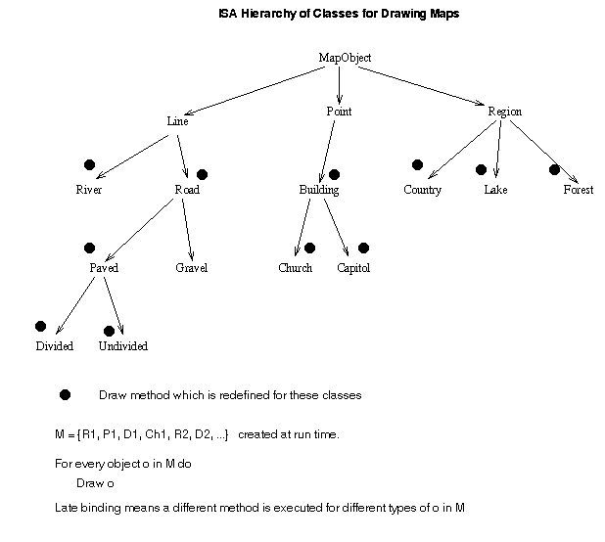
CS4411/9538
Set 4: Data Modelling Issues

Slide 27
Multiple Inheritance
Person
(Name, Address, Phone)
Employee
(Emp#)
Student
(Student#, Program)
StudentEmployee
when there is multiple inheritance, the class hierarchy is not a tree, but rather an acyclic directed graph.
assume inheritance goes down the page:
a subclass with two or more superclasses inherits all attributes and operations from all its superclasses
Name, Address and Phone are inherited from 2 superclasses.
This gives rise to a possible Name Conflict
CS4411/9538
Set 4: Data Modelling Issues

Slide 28
Dealing with Name Conflicts
Insist that there must be a common superclass (like Person) from which these attributes are inherited.
Disallow it altogether. This forces the programmer to rename one of the attributes in the superclass.
Establish an order for the superclasses and use that order to give priority to one of the superclasses.
If the class ordering is Athletes before Students, then the name and address from Athletes is what is inherited, with syntax like:
Athletes, Students (sub)class StudentAthletes ...
Athletes
(Name, Address, Sport)
Student
(Name, Address, Program)
StudentAthletes
(Name, Address, Sport, Program)
CS4411/9538
Set 4: Data Modelling Issues

Slide 29
Dealing with Name Conflicts - 2
Use the above method and then allow the order to be changed on an attribute by attribute basis, during schema modification
Renaming: system appends the superclass name to the inherited attributes and inherits both
Athletes
(Name, Address, Sport, … Level)
Student
(Name, Address, Program … Level)
StudentAthletes
(Name, Address, Sport, Program, … Level-Athletes, Level-Students)
CS4411/9538
Set 4: Data Modelling Issues

Slide 30
Designing Relations for EER Diagrams
EER Diagrams are ER diagrams with inheritance.
Recall the various ways of mapping these to relations covered in CS3319
Recall that there can be disjoint subclasses, overlapping subclasses, and total (every object must belong to a subclass), etc.
Recall that the solutions are not very elegant
CS4411/9538
Set 4: Data Modelling Issues

Slide 31
Designing the “Correct” Class Hierarchy
e.g. at UWO, suppose we have Employees, Students, Grads, Undergrads, TAs who are undergrads, GTAs, Part-time employees, Employees who are part-time students
GOALS:
to have classes which are required as target for frequently run applications.
  e.g. Employees for payroll and income tax processing. Undergrads, and grads register for courses and pay fees.
to have objects that can participate in further aggregations, which are themselves needed for applications
  e.g. TAs get assigned to do a lab - could be an undergrad TA or a GTA who does a CS1026 lab.
want some notion that the class hierarchy is correct, i.e. models our understanding of the real world. e.g. would not have Employees as a subclass of student, because not all employees of the university are students.
CS4411/9538
Set 4: Data Modelling Issues

Slide 32
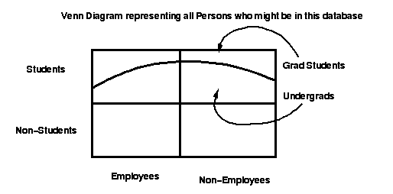
Example:
CS4411/9538
Set 4: Data Modelling Issues

Slide 33
Properties of a Class Hierarchy
has a unique top node or root or source, probably called “Object”
has a path from the root to all other nodes
not necessarily a tree. However, in a system which does not allow multiple inheritance the class hierarchy must be a tree.
CS4411/9538
Set 4: Data Modelling Issues

Slide 34
Check list for evaluating a new data model/database system
how are aggregates modeled?
  are there weak entities/literals – dependent sub-structures that have no independent existence? are not shared? and are deleted with their parent object?
  are there shared substructures?
is there inheritance/notion of subclasses
  if so, is there multiple inheritance
    if so, how are name conflicts handled?
CS4411/9538
Set 4: Data Modelling Issues

Slide 35
Aggregation and Generalization are Orthogonal Concepts
independent of each other
can have one without the other
e.g. Pascal (not Turbo Pascal) and C (not C++) have aggregation (records) without generalization.
The taxonomies in Biology are generalization hierarchies without any concept of aggregation.
CS4411/9538
Set 4: Data Modelling Issues

Slide 36
The Third Modeling Construct:
Collections/Sets and other data structures
sets/collections arise in databases when many objects of one type exist in a database
these collections are more important in a database environment than a programming environment because of querying and persistence
these sets/collections are the things that one poses a query against
sets also arise in dealing with set-valued attributes, such as an employee's set of children, or an employee's job history
the discussion of sets is also related to how we handle 1:n and n:m relationships
CS4411/9538
Set 4: Data Modelling Issues

Slide 37
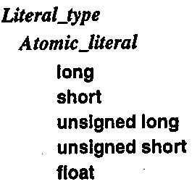
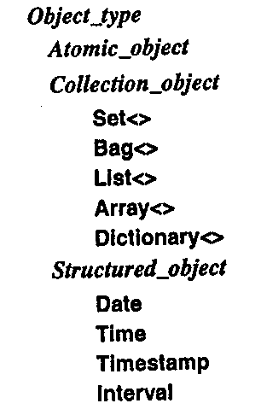
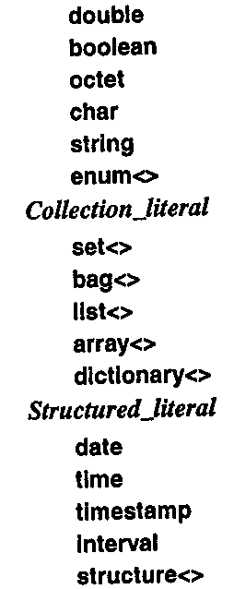
ODMG built-in data types
taken from Chapter 2
of the ODMG standard book,
edited by Cattell
ODMG is the Object Data
Management Group, formed
to promote and standardize
object-oriented databases
CS4411/9538
Set 4: Data Modelling Issues

Slide 38
ODMG
Object Data Management Group is a standards group consisting of a number of companies that market OO database management systems.
They have produced a proposed standard for OODBs hoping that this will speed up the acceptance of these products in the marketplace.
The standard is called ODMG 3.0, and is described in a 2000 book edited by Rick Cattell
The web site, oodbms.org, has a lot of information on the current state of OODBs
CS4411/9538
Set 4: Data Modelling Issues

Slide 39
the data structures in ODMG
set object: an unordered collection of elements with no duplicates allowed
bag object: an unordered collection of elements that main contain duplicates
list object: an ordered collection of elements
  operators are positional, either using an index or referring to the beginning or end of the list
array object: dynamically sized, ordered collection of elements that can be located by position
dictionary object: an unordered sequence of (key, value) pairs with no duplicates
CS4411/9538
Set 4: Data Modelling Issues

Slide 40
Modeling Constructs from the ER Model
1:n relationships
Choices are
  make Department (or its key) an attribute of Employee (relational solution)
  Make Employee a set-valued attribute of Company (can do with an OODB)
  Both
May want both because you may want to query in “both directions”
n
Works
for
1
Employee
Department
CS4411/9538
Set 4: Data Modelling Issues

Slide 41
1:n Relationship with an Attribute
If there is an attribute (e.g. StartDate), where should it go?
d. Another solution: make a new object (aggregate)
With this choice, other techniques must be used to make sure that each employee is associated with only one department. Some OODBMSs have keys that would enforce this. Or could make it part of the object initialization method.
Department Emp StartDate
Department
Employee…
Date
CS4411/9538
Set 4: Data Modelling Issues

Slide 42
N:M Relationships
Choices:
a. Make a multi-valued attribute in Employee for the Projects worked on.
b. Make a multi-valued attribute in Projects for the Employees working on it.
c. Both
d. Make an aggregate for WorksOn
n
Works
on
m
Employee
Project
Percent Time
CS4411/9538
Set 4: Data Modelling Issues

Slide 43
Methods a, b and c are awkward if there are attributes
Solution b:
Solution a:
Employee
Project
{ p1, p2, ... }
{ e1, e2, ... }
On What
Who
Project PercentTime
Employee PercentTime
Project
Employee
Question is: where do you put PercentTime so it is equally accessible in either “direction”?
CS4411/9538
Set 4: Data Modelling Issues

Slide 44
Solution d, make a new Aggregate
Works On
Emp Project PercentTime
Employee
Project
Solution d is probably best because:
1. It conforms to the idea that when we have n:m relationships, then we are modeling aggregation, and therefore we should create an aggregate.
2. Gives uniform treatment, whether there are attributes or not.
3. Gives equal access in both “directions” of the n:m relationship.
CS4411/9538
Set 4: Data Modelling Issues

Slide 45
Another Issue: What are we allowed to query? also deals with how the database handles sets
Two techniques are used for this:
Type extents: The system maintains for you a set of all the objects ever created for a given type, and that is what gets queried. Ideally, you might not want to do this for all types. So some syntax which says "keep all of these in a set called S", so that it automatically happens for these types only, would work.
User-defined and Populated Sets: The programmer arranges for a set to be populated with those objects that will be needed for an application. e.g. arrange to keep a set for FourthYearStudents, and another for CS4411bStudents.
CS4411/9538
Set 4: Data Modelling Issues

Slide 46
Advantages of Type Extents:
Less work for the programmer
Querying type extents may correspond more naturally to the user's model of the world.
Advantages of User-Populated Sets:
Smaller sets implies smaller indexes
Gives a finer granularity of objects on which to specify security constraints
CS4411/9538
Set 4: Data Modelling Issues

Slide 47
Persistence
How long does a value/variable/object exist?
  transient results in expression evaluation
  local variables
  global variables
  data that lasts a whole execution of a program
  data that lasts for several executions of several programs
  data that lasts for as long as a program is being used
  data that outlives a successions of versions of such a program
  data that outlives versions of the persistent support system
CS4411/9538
Set 4: Data Modelling Issues

Slide 48
Aside: persistence in relational databases
the schema describes what tables you have
they are available across possibly many applications that access the same database
so the schema names and relation names act as variable names global to many programs
but the notion is to insert new data into a table, whereas in OODB, you arrange to connect things in a way that makes them persistent
CS4411/9538
Set 4: Data Modelling Issues

Slide 49
Alternatives for managing Persistence in OODBs
Everything is persistent: All objects created by the program are persistent, until explicitly deleted (a system called IRIS did this).
Class-based persistence: Some classes are “database classes”. All objects created belonging to these classes are automatically placed in the class extent, and the whole class extent is persistent (used in Orion which became a commercial product called Itasca). Sometimes there are two equivalent class hierarchies, one for the persistent objects and one for transient objects.
Persistence by reachability: Certain Global Variables “anchor” the persistent objects. Gemstone and O₂ do this. Anything reachable from a persistent object is automatically persistent.
E.g. declare MyEmps to be persistent (a set) and an aggregate MyDesign to be persistent. Then any object placed in the set MyEmps becomes persistent, and any object which becomes an attribute value of MyDesign becomes persistent.
In relational databases, actually, the relation names are global to all the programs/applications that access them, and the database users explicitly put data in the relations.
CS4411/9538
Set 4: Data Modelling Issues

Slide 50
What happens to Nested Objects?
want to make sure that there are no dangling references on program termination.
with alternatives 1 and 3 on the previous slide, this is guaranteed.
with alternative 2, one would have to be more careful:
if object A contains a reference to object B, then
lifetime of A ≤ lifetime of B
CS4411/9538
Set 4: Data Modelling Issues

Slide 51
Check list for evaluating a new data model/database system
how are aggregates and aggregation hierarchies modeled?
  are there weak entities/literals – dependent sub-structures that have no independent existence? are not shared? and are deleted with their parent object?
  are there shared substructures?
  are many-to-many relationships supported or is it basically hierarchical?
is there inheritance/notion of subclasses
  if so, is there multiple inheritance
    if so, how are name conflicts handled?
how are collections handled?
  what kind of collections – just sets, dictionaries, etc.?
  how is persistence achieved?
CS4411/9538
Set 4: Data Modelling Issues

