Slide 1
Set 7
Algebraic Query Optimization
Sylvia Osborn
CS4411/9538
Set 7, Algebraic Query Optimization
Notes:
CS411/538 Set 7, Algebraic Query Optimization

Slide 2
Outline of notes
Set 1: Introduction ✔
Set 2: Architecture ✔
  Centralized Relational
  Distributed DBMS
  Object-Oriented DBMS
Set 3: Database Design ✔
  Centralized Relational
  Distributed DBMS
Set 4: Object-Oriented DBMS ✔
Set 5: Querying ✔
Set 6: XML Model and Querying ✔
Set 7: Algebraic Query Optimization
  Centralized Relational
  Distributed DBMS
  Object-Oriented DBMS
Set 8: Storage, Indexing, and Execution Strategies
Set 8, Part 2: Costs
Set 8, Part 3: XML Implementation Issues
Set 9: Transactions and Concurrency Control
  Centralized Relational
Set 9, Part 2
  Distributed DBMS
  Object-Oriented DBMS
Set 10: Recovery
  Centralized Relational
  Distributed DBMS
Set 11: Database Security
CS4411/9538
Set 7, Algebraic Query Optimization

Slide 3
Major steps in query execution
Scanning, parsing and authorization
Calculus Optimization
Translation to relational (object) algebra
Algebraic Expression Tree
Rewrite rules
Algebraic Optimization
This set of notes
Optimized algebra exp. tree
Statistics
Execution Plan Generation
Next 2 sets of notes
CS4411/9538
Set 7, Algebraic Query Optimization

Slide 4
All this is done at Compile Time
even interactive query performance can be greatly improved by doing all this.
in some systems, query plans are compiled when the program they are embedded in is compiled.
if an index used in the query execution plan is dropped, the plan is flagged as invalid, and the query must be reoptimized before it can be executed.
CS4411/9538
Set 7, Algebraic Query Optimization

Slide 5
Scanning, Parsing and Authorization
Scanning involves examining the tokens in the query
Select * from Employee where ID = 54321
  Picks out the keywords (select, from, where) and symbols such as * and =
Parsing involves looking at the order of the symbols, i.e. that the query is not
from Employee where ID = 54321 select *
and verifying that Employee is a table in this database with an attribute named ID
Authorization checks that the user issuing the query has the appropriate permissions to do what is being asked
CS4411/9538
Set 7, Algebraic Query Optimization

Slide 6
Calculus Optimization
If present, involves eliminating duplicate predicates, applying identities, rewriting.
CS4411/9538
Set 7, Algebraic Query Optimization

Slide 7
Translating into relational algebra
The basic translation for
Select A, B
from R, S
where predicate
is:
π_{A, B} (σ _{predicate} (R X S))
The DBMS also has to translate nested queries into relational algebra
CS4411/9538
Set 7, Algebraic Query Optimization

Slide 8
And then into an algebra tree
Unary operators (σ, π) become a node with one child in the operator tree
  σ _{F} (R):
Binary operators (⋈, X, ∩, U, -) become a node with 2 children, the operands.
  R ⋈ S:
σ
R
⋈
R
S
CS4411/9538
Set 7, Algebraic Query Optimization

Slide 9
Algebraic Query Optimization
An SQL query can be translated into a very inefficient relational algebra equivalent.
If a query is on a view, the resulting query can be even worse.
The idea is to rearrange the query to one which gives “the same” result, but which yields a much more efficient execution.
“The same” for relational databases means the same attribute names, have the same values. Order of attributes or tuples can be different. I.e. we have equal tables modulo order of rows and columns, indicated by ☰
What follows is a number of rules for rearranging expressions. They could each be proved by a small theorem, by contradiction, for example.
CS4411/9538
Set 7, Algebraic Query Optimization

Slide 10
1. Commutative Laws for Join and Cartesian Product
If E₁ and E₂ are relational algebra expressions, and F is a predicate on attributes of E₁ and E₂ , then
E₁ ⋈_{F} E₂ ≡ E₂ ⋈_{F} E₁
The attributes on the left- and right-hand sides will be in different orders.
CS4411/9538
Set 7, Algebraic Query Optimization

Slide 11
2. Associative Laws of Join and Cartesian Product
(E₁ ⋈_{F1} E₂) ⋈_{F2} E₃ ≡ E₁ ⋈_{F1} (E₂ ⋈_{F2} E₃)
(E₁ ⋈ E₂) ⋈ E₃ ≡ E₁ ⋈ (E₂ ⋈ E₃)
(E₁ X E₂) X E₃ ≡ E₁ X (E₂ X E₃)
CS4411/9538
Set 7, Algebraic Query Optimization

Slide 12
Examples
r1 | A | B
 | a1 | b1
 | a2 | b1
 | a3 | b2
r2 | B | C
 | b1 | c2
 | b2 | c1
 | b3 | c2
r3 | C | D
 | c1 | d1
 | c2 | d2
 | c3 | d3
(r1 ⋈ r2) ⋈ r3:
r1 ⋈ r2 | A | B | C
 | a1 | b1 | c2
 | a2 | b1 | c2
 | a3 | b2 | c1
(r1 ⋈ r2) ⋈ r3 | A | B | C | D
 | a1 | b1 | c2 | d2
 | a2 | b1 | c2 | d2
 | a3 | b2 | c1 | d1
CS4411/9538
Set 7, Algebraic Query Optimization

Slide 13
Examples, 2
r1 | A | B
 | a1 | b1
 | a2 | b1
 | a3 | b2
r2 | B | C
 | b1 | c2
 | b2 | c1
 | b3 | c2
r3 | C | D
 | c1 | d1
 | c2 | d2
 | c3 | d3
r1 ⋈ (r2 ⋈ r3):
r2 ⋈ r3 | B | C | D
 | b1 | c2 | d2
 | b2 | c1 | d1
 | b3 | c2 | d2
r1 ⋈ (r2 ⋈ r3) | A | B | C | D
 | a1 | b1 | c2 | d2
 | a2 | b1 | c2 | d2
 | a3 | b2 | c1 | d1
CS4411/9538
Set 7, Algebraic Query Optimization

Slide 14
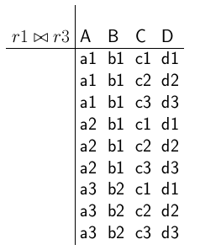
By commutativity and associativity, this is also the same
(r1 ⋈ r3) ⋈ r2: ((r1 ⋈ r3) ends up being a Cartesian Product)
r2 | B | C
 | b1 | c2
 | b2 | c1
 | b3 | c2
(r1 ⋈ r3) ⋈ r2 | A | B | C | D
 | a1 | b1 | c2 | d2
 | a2 | b1 | c2 | d2
 | a3 | b2 | c1 | d1
CS4411/9538
Set 7, Algebraic Query Optimization

Slide 15
3. Cascade of Projections (also called idempotence)
π _{A1, ... , An}(π _{B1, ... , Bn}(E)) ☰ π _{A1, ... , An} (E)
where
A1, ... , An ⊆ B1, ... , Bn
e.g.
R(name, addr, EMPno, jobtitle)
π _{name} (π _{name, addr, jobtitle} (R)) ☰ π _{name} (R)
CS4411/9538
Set 7, Algebraic Query Optimization

Slide 16
4. Cascade of Selections (idempotence)
σ_{F1 ∧ F2} (E) ☰ σ_{F1} (σ_{F2} (E))
Note also, since
F1 ∧ F2 ☰ F2 ∧ F1
we also have:
σ_{F1} (σ_{F2} (E)) ☰ σ_{F2} (σ_{F1} (E))
e.g. σ _{jobtitle=“programmer”} (σ _{addr = “London”} (R))
☰ σ _{addr = “London”} (σ _{jobtitle=“programmer”} (R))
☰ σ _{addr = “London”} _{⋀ jobtitle=“programmer”} (R)
CS4411/9538
Set 7, Algebraic Query Optimization

Slide 17
5. Commuting Selections and Projections
If predicate F contains only attributes in A₁,…,A_{n}, then (left side is probably more efficient)
π _{A1, ... , An} (σ_{F} (E)) ☰ σ_{F} (π _{A1, ... , An} (E))
“Just keep what you need” heuristic uses:
π _{A1, ... , An} (σ_{F} (E)) ☰ π _{A1, ... , An} (σ_{F} (π _{B1, ... , Bm} (E)))
if F contains attributes in B₁,…,B_{m} and
A₁,…,A_{n} ⊂ B₁,…,B_{m}
CS4411/9538
Set 7, Algebraic Query Optimization

Slide 18
6. Distributivity of Select over Join (or Cartesian Product)
The heuristic is “do select as soon as possible”
  if the attributes of F are all in E₁, then σ_{F} (E₁ ⋈ E₂) ≡ σ_{F} (E₁) ⋈ E₂
  if F is of the form F₁ ^ F₂, and F₁ contains only attributes from E₁ , and F₂ contains only attributes from E₂ then
  σ_{F} (E₁ ⋈ E₂) ≡ σ_{F1} (E₁) ⋈ σ_{F2} (E₂)
CS4411/9538
Set 7, Algebraic Query Optimization

Slide 19
6. Cont’d
(c) if F₁ involves attributes of E₁, but F₂ involves attributes in both E₁ and E₂, then can still do:
σ_{F1 ^ F2} (E₁ ⋈ E₂) ≡ σ_{F2} (σ_{F1} (E₁) ⋈ E₂)
(d) if F involves attributes shared by E₁ and E₂, then
σ_{F} (E₁ ⋈ E₂) ≡ σ_{F} (E₁) ⋈ σ_{F} (E₂)
The right hand expression reduces the size of the relations participating in the join.
CS4411/9538
Set 7, Algebraic Query Optimization

Slide 20
7. Distributivity of Select over Union
σ_{F}(E₁ U E₂) ≡ σ_{F}(E₁) U σ_{F}(E₂)
8. Distributivity of Select over Set Difference
σ_{F}(E₁ - E₂) ≡ σ_{F}(E₁) - σ_{F}(E₂)
CS4411/9538
Set 7, Algebraic Query Optimization

Slide 21
9. Distributivity of Project over Join (also Cartesian Prod.)
Suppose A₁,…,A_{n} = B₁,…,B_{m} U C₁,…,C_{k}.
and that B₁,…,B_{m} are the attributes of E₁
and C₁,…,C_{k} are the attributes of E₂ and the join attributes are in Bi’s ∩ Ci’s.
π_{A1,…,An}(E₁ ⋈ E₂) ≡ π_{B1,…,Bm}(E₁) ⋈ π_{C1,…,Ck}(E₂)
CS4411/9538
Set 7, Algebraic Query Optimization

Slide 22
10. Distributivity of Project over Union
π_{A1,…,An}(E₁ U E₂) ≡ π_{A1,…,An} (E₁) U π_{A1,…,An} (E₂)
CS4411/9538
Set 7, Algebraic Query Optimization

Slide 23
Other Things to Note
Projection does not distribute over set difference (prove it by contradiction)
Versions of these rules are also needed for bags as well as sets.
  Why?
  What are some of them?
CS4411/9538
Set 7, Algebraic Query Optimization

Slide 24
The Algebraic Expression Rearranging Algorithm
Heuristics are
  “do select as soon as possible”,
  introduce extra projections to “just keep what you need”
  rearrange the order of joins so the most selective one is done first
According to most textbooks, the best order for the joins is obtained using query statistics and dynamic programming. So we will ignore that here.
CS4411/9538
Set 7, Algebraic Query Optimization

Slide 25
The Algorithm
Input: a relational algebra expression represented by an operator tree
Output: a rearranged operator tree which will produce the same answer to the query.
Method:
1. Use rule 4 to separate σ _{F1^F2^…^Fn}(E) into σ_{F1}(σ_{F2} (… σ_{Fn}(E) …))
CS4411/9538
Set 7, Algebraic Query Optimization

Slide 26
Algorithm cont’d
2. Use rules 4 to 8 to push σ's as far down the tree as possible.
3. Use rules 3, 9 and 10, and the generalized form of rule 5 to push π's down the tree.
Some π's disappear.
Some are created by rule 5.
Eliminate a π if it projects a relation onto all its attributes.
CS4411/9538
Set 7, Algebraic Query Optimization

Slide 27
Algorithm cont’d
4. Use rules 3 to 5 to combine adjacent σ's or π's into a single σ or π. The heuristic is to do σ before π, so the σ should be below the π in the tree.
5. Finally turn a X followed (above in the tree) by a σ into a join.
CS4411/9538
Set 7, Algebraic Query Optimization

Slide 28
Example
Relation schemes:
Books(Title, Author, PName, LCNO)
Publishers(PName, Paddr, Pcity)
Borrowers(Name, Addr, City, CardNo)
Loans(CardNo, LCNO, Date)
Also have a view on the database, called BooksOut, defined by the query:
SELECT Title, Author, Books.LCNO, Name, Addr,
City, Borrowers.CardNo, Date
FROM Loans, Borrowers, Books
WHERE Borrowers.CardNo = Loans.CardNo
and Books.LCNO = Loans.LCNO
CS4411/9538
Set 7, Algebraic Query Optimization

Slide 29
Query to Optimize
SELECT Title
FROM BooksOut
WHERE Date < "1/9/15 "
Altogether this gets translated into the relational algebra query:
π _{Title}
(σ _{Date<"1/9/15"}
(π Title, Author, Books.LCNO, Name, Addr, City, Borrowers.CardNo, Date
(σ Borrowers.CardNo = Loans.CardNo and Books.LCNO = Loans.LCNO
((Loans x Borrowers) x Books))))
CS4411/9538
Set 7, Algebraic Query Optimization

Slide 30
Original tree:
π _{Title}
σ _{Date<"1/9/15"}
π Title, Author, Books.LCNO, Name, Addr, City, Borrowers.CardNo, Date
σ Borrowers.CardNo = Loans.CardNo and Books.LCNO = Loans.LCNO
X
X
Books
Loans
Borrowers
CS4411/9538
Set 7, Algebraic Query Optimization

Slide 31
Step 1:
break
the σ into 2
π _{Title}
σ _{Date<"1/9/15"}
π Title, Author, Books.LCNO, Name, Addr, City, Borrowers.CardNo, Date
σ Borrowers.CardNo = Loans.CardNo
σ _{Books.LCNO = Loans.LCNO}
X
X
Books
Loans
Borrowers
CS4411/9538
Set 7, Algebraic Query Optimization

Slide 32
Step 2
π _{Title}
π Title, Author, Books.LCNO, Name, Addr, City, Borrowers.CardNo, Date
move the σ’s
down the tree
as far as possible
σ _{Books.LCNO = Loans.LCNO}
X
σ Borrowers.CardNo = Loans.CardNo
Books
X
σ _{Date<"1/9/15"}
Borrowers
Loans
CS4411/9538
Set 7, Algebraic Query Optimization

Slide 33
Step 3
π _{Title}
discard by rule 3
π Title, Author, Books.LCNO, Name, Addr, City, Borrowers.CardNo, Date
σ _{Books.LCNO = Loans.LCNO}
add this by rule 5
π _{Title, Books.LCNO, Loans.LCNO}
split projection by rule 9
X
σ Borrowers.CardNo = Loans.CardNo
Books
X
σ _{Date<"1/9/15"}
Borrowers
Loans
CS4411/9538
Set 7, Algebraic Query Optimization

Slide 34
Step 3, cont’d
π _{Title}
σ _{Books.LCNO = Loans.LCNO}
X
π _{Loans.LCNO}
π _{Title, Books.LCNO}
σ Borrowers.CardNo = Loans.CardNo
add this by rule 5
π Loans.LCNO, Loans.CardNo, Borrowers.CardNo
Books
split projection by rule 9
X
σ _{Date<"1/9/15"}
Borrowers
Loans
CS4411/9538
Set 7, Algebraic Query Optimization

Slide 35
Step 3, cont’d
π _{Title}
σ _{Books.LCNO = Loans.LCNO}
X
π _{Loans.LCNO}
π _{Title, Books.LCNO}
σ Borrowers.CardNo = Loans.CardNo
Books
X
σ _{Date<"1/9/15"}
π _{Borrowers.CardNo}
add this by rule 5
π _{Date,} _{Loans.LCNO, Loans.CardNo}
Borrowers
discard because it gives
all attributes
Loans
CS4411/9538
Set 7, Algebraic Query Optimization

Slide 36
Step 4
π _{Title}
σ _{Books.LCNO = Loans.LCNO}
really a join
X
π _{Loans.LCNO}
π _{Title, Books.LCNO}
really a join
σ Borrowers.CardNo = Loans.CardNo
Books
X
σ _{Date<"1/9/15"}
π _{Borrowers.CardNo}
Borrowers
Loans
CS4411/9538
Set 7, Algebraic Query Optimization

Slide 37
Order of the leaves
Commercial relational packages decide on the order to process the leaves based on costs and estimations of the number of tuples filtered, which we will study later.
The query then gets executed starting at the bottom left of the tree.
CS4411/9538
Set 7, Algebraic Query Optimization

Slide 38
Algebraic Rewrites for Distributed Queries
SQL Query on Global Relations
Global Schema
Query Decomposition
Algebra Query on Global Relations
Fragment Schema
Data Localization
Fragment Query
Statistics on Fragments
Global Optimization
Optimized Fragment Query with Communications Operations
Local Schema
Local Optimization
Optimized Local Queries
CS4411/9538
Set 7, Algebraic Query Optimization

Slide 39
Rules for Distributed Algebra Queries
1. semijoins and σ (pushing σ inside semijoin):
Recall that R ⋉_{F} S = π _{attr of R} (R ⋈ _{F} S)
Rule is: σ_{F}(R ⋉_{F1}S) ≡ σ_{F}(R) ⋉_{F1}S
2. semijoins and π (pushing π inside semijoin):
If attr(F) ⊆ A then
π_{A}(R ⋉_{F} S) ≡ π_{A}(R) ⋉_{F} π _{attr(S) ∩ attr(F)} (S)
(just keep what you will need)
CS4411/9538
Set 7, Algebraic Query Optimization

Slide 40
Rules for Distributed Algebra Queries, 2
3. union and join:
If R and S have two horizontal fragments
(i.e. R = R1 U R2, S = S1 U S2 ),
and the query contains the join of R and S:
(R1 U R2) ⋈ (S1 U S2) ≡
(R1 ⋈ S1) U (R1 ⋈ S2) U (R2 ⋈ S1) U (R2 ⋈ S2)
CS4411/9538
Set 7, Algebraic Query Optimization

Slide 41
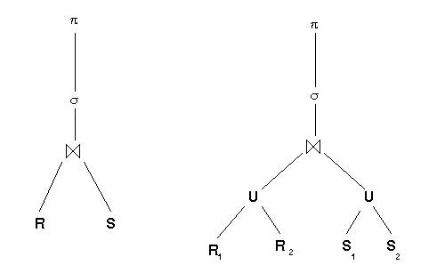
(R1 U R2) ⋈ (S1 U S2) ≡ (R1 ⋈ S1) U (R1 ⋈ S2) U (R2 ⋈ S1) U (R2 ⋈ S2)
The centralized query would be optimized to the tree on the left.
Then the fragments are substituted for the relations giving the tree on the right.
The above rule allows the union operations to move up the tree, and the joins to move down.
Then it may happen that the joins are between two fragments on one site.
The union becomes the final assembly of the answer at some other site.
CS4411/9538
Set 7, Algebraic Query Optimization

Slide 42
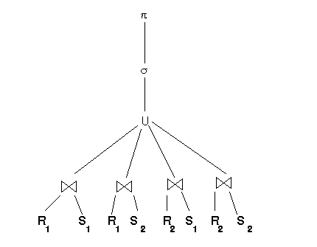
(R1 U R2) ⋈ (S1 U S2) ≡ (R1 ⋈ S1) U (R1 ⋈ S2) U (R2 ⋈ S1) U (R2 ⋈ S2)
giving:
CS4411/9538
Set 7, Algebraic Query Optimization

Slide 43
Qualified Relations
Horizontal fragments are defined by a predicate.
Derived horizontal fragments are defined by a predicate which made the first fragmentation, plus the join predicate.
Use the notation [R : F] to represent a fragment and the formula (predicate) that defined it. I.e. for everything in R, F is true.
For the example from Set 3 of these notes the qualified relation is:
[Supply1 : Snum = Supplier.Snum ^
Supplier.City = "S.F."]
CS4411/9538
Set 7, Algebraic Query Optimization

Slide 44
Rewrite Rules for Qualified Relations
1. σ_{F} ([R :F_{R} ]) → [σ_{F} (R) : F ^ F_{R} ]
the predicate F ^ F_{R} will be true for the result, even though the attributes for testing it may not all be present.
by examining these predicates, the system may find contradictions, which means the result is guaranteed to be empty. If this fragment is part of a larger query, this piece of the query can be ignored (or pruned from the tree).
e.g. σ _{supplier.city ≠ “S:F:”} [Supply₁ fragment above]
CS4411/9538
Set 7, Algebraic Query Optimization

Slide 45
Rewrite Rules, 2
π_{A}([R: F]) → [π_{A}(R): F]
it may be that after π_{A} has been executed, the attributes needed to test predicate F are no longer present.
However F was true for all tuples in
[R : F], and is therefore still true for all tuples in [π_{A}(R) : F]
CS4411/9538
Set 7, Algebraic Query Optimization

Slide 46
Rewrite Rules, 3
3. [R : F_{R}] ⋈_{F} [S : F_{S}] → [R ⋈_{F} S : F_{R} ^ F_{S} ^ F]
Some joins may result in a qualification which contains a contradiction. The result of this join will thus be empty, and so it does not need to be performed.
After substituting for horizontal fragments, push σ's down the tree, push ⋈'s down and U's up.
Eliminate empty fragments by pruning that part of the tree.
e.g. π_{Sname} (Supply ⋈ Supplier)
which says, list all suppliers who are currently supplying anything.
CS4411/9538
Set 7, Algebraic Query Optimization

Slide 47
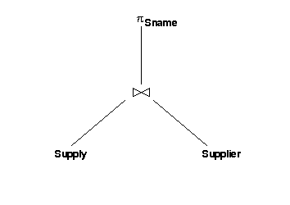
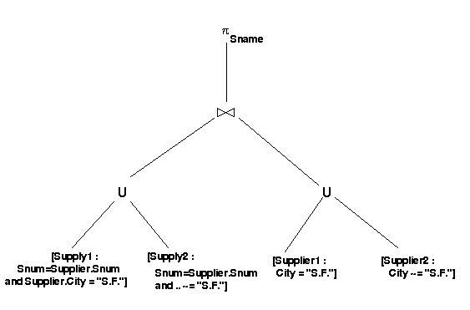
Initial expression tree:
Substitute Fragment Expressions for
the original relation:
CS4411/9538
Set 7, Algebraic Query Optimization

Slide 48
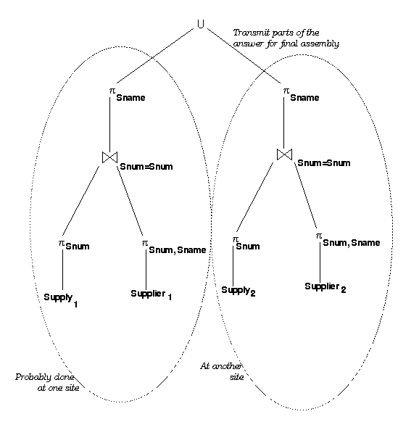
the two other joins
are empty and
are pruned
CS4411/9538
Set 7, Algebraic Query Optimization

Slide 49
Algebraic Optimization And Vertical Fragmentation
Let K be the key for relation R.
recall that vertical fragments are defined by:
π_{K,A} (R) and π_{K,B}(R)
where K U A U B = all attributes of R and
K ∩ A = φ, K ∩ B = φ and A ∩ B = φ
So, in the tree, R will be replaced by (its vertical fragment expression):
π_{K,A}(R) ⋈_{K=K} π_{K,B}(R)
CS4411/9538
Set 7, Algebraic Query Optimization

Slide 50
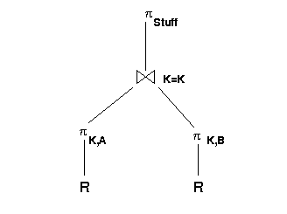
The rule is, then, when π_{stuff} gets pushed down the tree
during algebraic optimization, if stuff ∩ A = φ, i.e. if a
fragment's non-key attributes are not needed for anything
else in the query “up” the tree, then that fragment is not
required, and the join can be pruned as well (if there were
only two fragments being joined).
CS4411/9538
Set 7, Algebraic Query Optimization

Slide 51
Object-Oriented Query Processing
Scanning, parsing and authorization
OQl Expression
Calculus Optimization
Normalized Expression
Translation to relational (object) algebra
Object Algebra Expression
Type checking
Type consistent expression
Rewrite rules
Algebraic Optimization
Optimized algebra exp. tree
Execution Plan Generation
CS4411/9538
Set 7, Algebraic Query Optimization

Slide 52
Algebraic Query Optimization and OO Databases
First we need an Object Algebra!
Assumptions:
  we can query a persistent single object (tuple)
  we can query sets of similar objects, which may be all instances of one class, or all instances of a class and its subclasses, all objects in a (persistent) set object whose contents are homogeneous or instances of some class and its subclasses.
  we will refer to the object being queried as T (for target of the query).
CS4411/9538
Set 7, Algebraic Query Optimization

Slide 53
An Object Algebra
Algebra Syntax | OQL Syntax | conditions
σ_{predicate}(T) | Select o From o in T Where predicate Select T Where predicate | If T is a set If T is a tuple
π_{A1=e1,A2=e2..}(T) | Select struct (A1 = e1, A2 = e2,..) From t in T Select Typename(A1 = e1, A2 = e2,..) From t in T | If result is a set of literals If typename is declared and results are objects
CS4411/9538
Set 7, Algebraic Query Optimization

Slide 54
Example for queries
Class Employee public type tuple
(name : string,
ID : string,
jobtitle : string;
worksFor : Department,
startDate : Date) end;
Class Department public type tuple
(deptName : string,
deptLoc : string
empsOf : set(Employee) ) end;
Class WorksOn public type tuple
  (who : Employee,
  what : Project,
  howMuch : real) end;
Class Project public type tuple
(projName : string,
targetDate : Date,
projLocation : string) end;
CS4411/9538
Set 5, OODB Query Languages

Slide 55
Commutativity of Select in OO Algebra
First Question: In an OODB, what does it mean for two query responses to be “the same”?
Suppose T is a single tuple object, of type Employee:
1. σ T.jobtitle=“programmer" ^ T.Department ≡ D1 (T )
2. σ _{T.jobtitle=“programmer"} (σ _{T. Department ≡ D1}(T))
3. σ _{T. Department ≡ D1} (σ _{T.jobtitle=“programmer"} (T))
where ≡ represents an identity comparison.
All three versions above return T if both predicates are true, and nil otherwise.
i.e. in this case, the two selects commute and the answers are identical.
CS4411/9538
Set 7, Algebraic Query Optimization

Slide 56
Commutativity of Select in OO Algebra, cont’d
If E is a set of employee objects, then:
σ e.jobtitle=“programmer" ^ e.Department ≡ D1(E )
where e is a variable representing one member of E at a time, and D1 represents a particular Department object.
2. σ _{e.jobtitle=“programmer"} (σ _{e.Department ≡ D1} (E))
3. σ _{e.Department ≡ D1} (σ_{e.jobtitle=“programmer"} (E))
Say all three versions return {v1, v4, v9}.
CS4411/9538
Set 7, Algebraic Query Optimization

Slide 57
Commutativity of Select in OO Algebra, cont’d
In a system which generates an object for the answer, (i.e. the {..} above has an object ID), there is no way to produce an identical answer for the three above queries, even if we execute one version of the query at two different times.
The results will be shallow equal.
That is probably what users expect when they want “the same” answer.
In a system where the answer is considered to be a set of objects, but the container itself is not an object, the results will always be shallow equal.
Therefore, selections in the OO algebra are commutative, and produce at least shallow equal results when the query is rearranged.
CS4411/9538
Set 7, Algebraic Query Optimization

Slide 58
Commutativity of Select and Project in OO Algebra
1. σ e.worksFor.deptName =“Shipping” (π _{worksFor} (E))
2. π _{worksFor} (σ e.worksFor.deptName =“Shipping” (V))
These are “the same”, in general, if the π does not remove the attributes needed by the σ in version 1.
In both cases, the answer has the structure:
{ [ worksFor: Department] }
i.e. we generate new object(s) of the tuple type, and place them in a new set object - all new object IDs.
Answers to the two versions are equal.
Since we are generating new objects, this is all we can expect. A user would probably consider this “the same”.
CS4411/9538
Set 7, Algebraic Query Optimization

Slide 59
Conclusions, Algebraic Optimization of OO Algebra Expressions
Query transformations on object algebra expressions are possible.
With sets of objects from the database forming the result of the query, results can, in some cases, be guaranteed to be shallow equal.
With tuple-generating operators (like π and ⋈), results can be guaranteed to be equal.
CS4411/9538
Set 7, Algebraic Query Optimization

Slide 60
What are the heuristics on which transformations are more desirable that would correspond to the “do select before project” for relational algebra?
The relational heuristic “just keep what you need”, which was the generalized rule 5:
π _{A1, ... , An} (σ_{F} (E)) ☰ π _{A1, ... , An} (σ_{F} (π _{B1, ... , Bm} (E)))
would not be used for object algebras. You would never introduce any extra object creating operators like π and ⋈, because this causes new types to be required which might not be in the type hierarchy, and it may cause the “sameness” of the rearranged expression to go from shallow equal to equal.
CS4411/9538
Set 7, Algebraic Query Optimization

