Slide 1
Set 8, part 3
Some XML database implementation issues

Slide 2
Outline of notes
Set 1: Introduction ✔
Set 2: Architecture ✔
Centralized Relational
Distributed DBMS
Object-Oriented DBMS
Set 3: Database Design ✔
Centralized Relational
Distributed DBMS
Set 4: Data Modeling✔
Set 5: Querying ✔
Set 6: XML Model and Querying ✔
Set 7: Algebraic Query Optimization ✔
Centralized Relational
Distributed DBMS
Object-Oriented DBMS
Set 8: Storage, Indexing, and Execution Strategies ✔
Set 8, Part 2: Costs
and OO Implementation ✔
Set 8, Part 3: XML Implementation Issues
Set 9: Transactions and Concurrency Control
Centralized Relational
Set 9, Part 2
Distributed DBMS
Object-Oriented DBMS
Set 10: Recovery
Centralized Relational
Distributed DBMS
Set 11: Database Security

Slide 3
Architectures/Types of XML Databases
XML has been added to commercial relational packages such as DB2, Oracle 10g, SQL Server 2005 from Microsoft – both as path expressions and other functions in SQL, and with XQuery. As well as XQuery, there is an SQL/XML extension to the SQL standard which has some XML-related functions for dealing with XML in relational databases which they all implement.
Native XML database systems: companies have built “stand-alone” XML database systems (e.g. Tamino, from Software AG, Altova SPY)
Research project from the Netherlands, MonetDB, which appears from the outside to be a stand-alone system but is built on a relational back end.
systems like GALAX just deal with files.

Slide 4
Challenges
whether stand-alone or within an relational database, there may or may not be a schema
sometimes systems will “parse” the document and build a schema from it
if there is a schema, it might be quite varied – in the extreme case it can be as varied as the document
XML documents can be a few lines long or millions of lines long
collections of documents can be very small or enormous
really 3 scenarios:
DB2, Oracle etc. who have to make the XML stuff work along side their existing relational DB – but can take advantage of a lot of existing functionality for buffering, query optimization, indexing, concurrency control, recovery, etc.
the Monet DB type where the relational engine is used to implement the XML stuff – this can also take advantage of the relational DB functionality
the truly stand-alone systems which can do what they want, like Tamino, Altova SPY and Sedna

Slide 5
outline of these slides
relational tables XML
labeling schemes, and XPath implementations
some DB2 ideas

Slide 6
1. Relational DB → XML
The SQL standard has been extended to an SQL/XML standard with a few additional functions.
in many applications now with a normal relational DB, output in XML is required either to send in a message or to display it on a web page, etc.

Slide 7
XML from a SQL query
Employee(lname, fname, dept) ⇐ this is the relation
This is SQL/XML using XMLAGG function (example from DB2 source):
SELECT XMLELEMENT
(NAME “department”
XMLELEMENT (NAME “name” e.dept)
XMLELEMENT (NAME “employees”
XMLAGG (XMLELEMENT(NAME “emp”, e.lname))
) as “dept_list”
FROM Employee e
GROUP BY e.dept
Result: (in a column called: “dept_list”)
<department>
<name>Physics</name><employees>
<emp>Smith</emp>
<emp>Jones</emp>
</employees>
</department>
<department> ... </department>
XMLELEMENT and
XMLAGG are functions
in SQL/XML
Oracle examples don’t have
NAME in the XMLELEMENT
parameters, and does have
an XMLROOT function

Slide 8
2. Labeling schemes and XPath implementations
The XPath Axes or steps (13 of them) are:
child: immediate children of the context node (/)
descendant: all descendants of the context node, not including the context node
parent: immediate parent, if there is one (..)
ancestor: all ancestors; including the root of the document
following-sibling: all following siblings of the parent; if context is a namespace or an attribute, this is empty
preceding-sibling: all preceding siblings; can be empty

Slide 9
XPath Axes, cont’d
following: all following nodes in document order, excluding any descendants, attributes and namespace nodes
preceding: all nodes that are in the same document, that precede the context node in document order; excluding attributes and namespace nodes
attribute: all attributes of the context node.
namespace: namespace nodes of the context node. Empty for all but element nodes.
self: just the context node
descendant-or-self: context node and its descendents (//)
ancestor-or-self: context node and its ancestors

Slide 10
Storing XML in a relational package
storage schemes are: storing the document as a column value or shredding
store the XML document as a column in a table, perhaps with some other identifying attributes, complete with its tags (XML type) - these store an XML document as a column value
e.g. choices in DB2 are XML varchar, XML CLOB (Character large object) and file reference (more on DB2 later)
Orders Table
OrderNO
Date
Order
o32456
06/11/05
<order>
<order_item>
<item_no> ..... </item>
<qty> ..... </qty>
</order_item>
<order_item>
...
</order_item>
</order>

Slide 11
Shredding the data/Labelling nodes
many schemes involve breaking up the data and storing it in relations. This is called shredding. This is used by systems built on top of a relational engine.
Nodes in an XML document are considered to be unique, so there are techniques to label each node with a unique ID, and use it to record the structure and aid in answering XQuery queries.

Slide 12
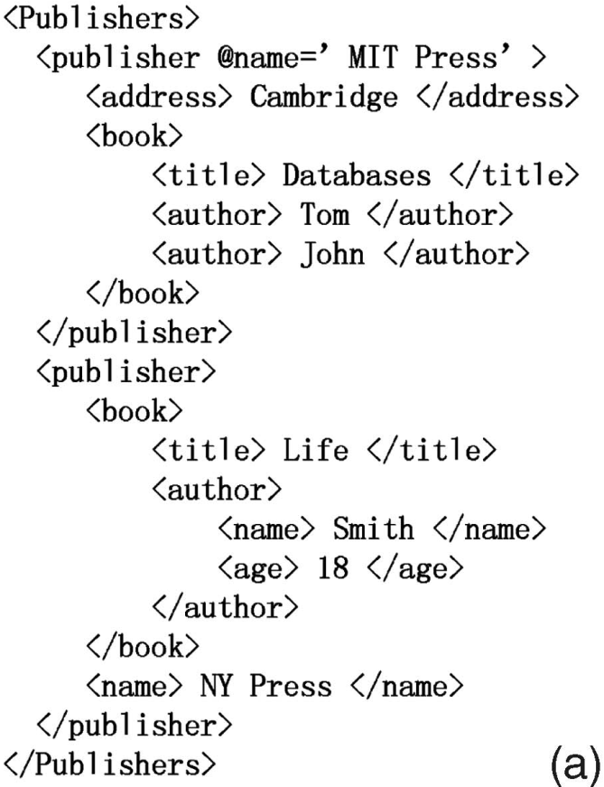
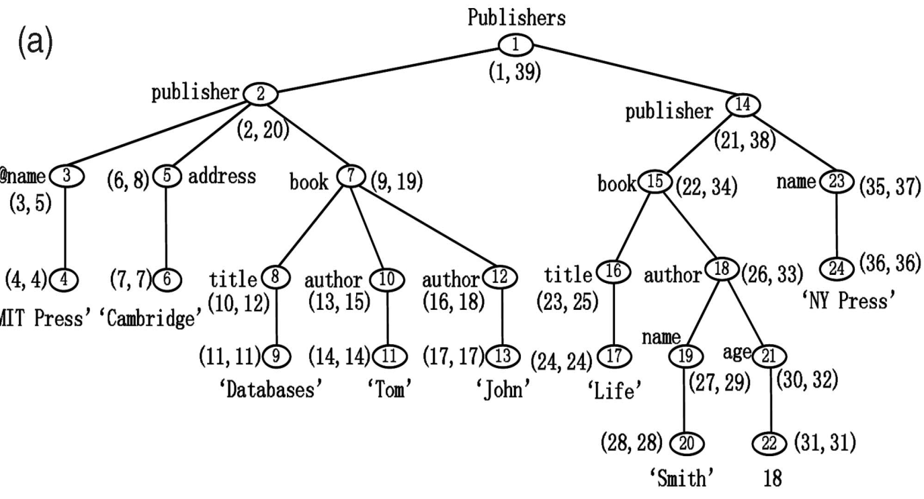

Node Labeling Schemes (egs. taken from the survey paper by Gou and Chirkova on the website)
Node-labeled tree version of document
Document

Slide 13
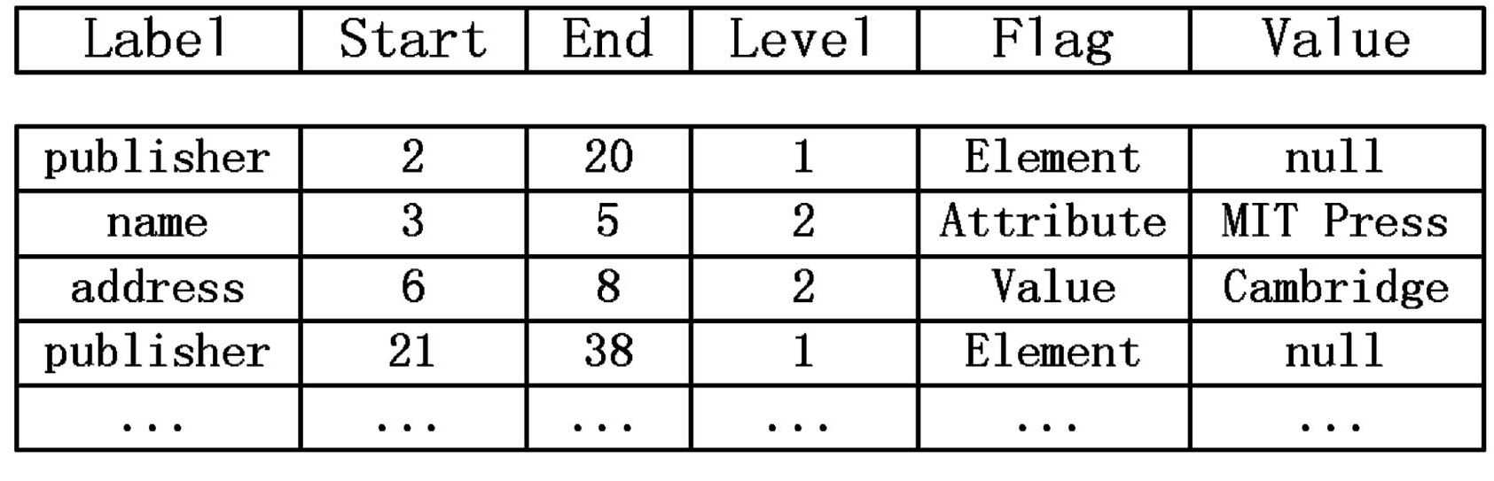
numbers like (6,8) represent the order in which the node is visited by a preorder traversal of the nodes:
the first number is the position the node is visited on the way in
the second number is the position the node is visited on the way out
these are called (start, end)
for leaf nodes, start=end
the whole document can then be stored in a Node table (relation):
this scheme stores the leaf nodes as the Value attribute of their parents
assume this table is called Node

Slide 14
Path steps
in Xpath, the most common access steps are /, // and .. i.e. child, descendant or self, and parent.
with the node table, node a is an ancestor of node b iff a.start < b.start < a.end
node a is the parent of node b iff
a.start < b.start < a.end ∧ a.level + 1 = b.level
path expressions get evaluated by joining the Node table with itself

Slide 15
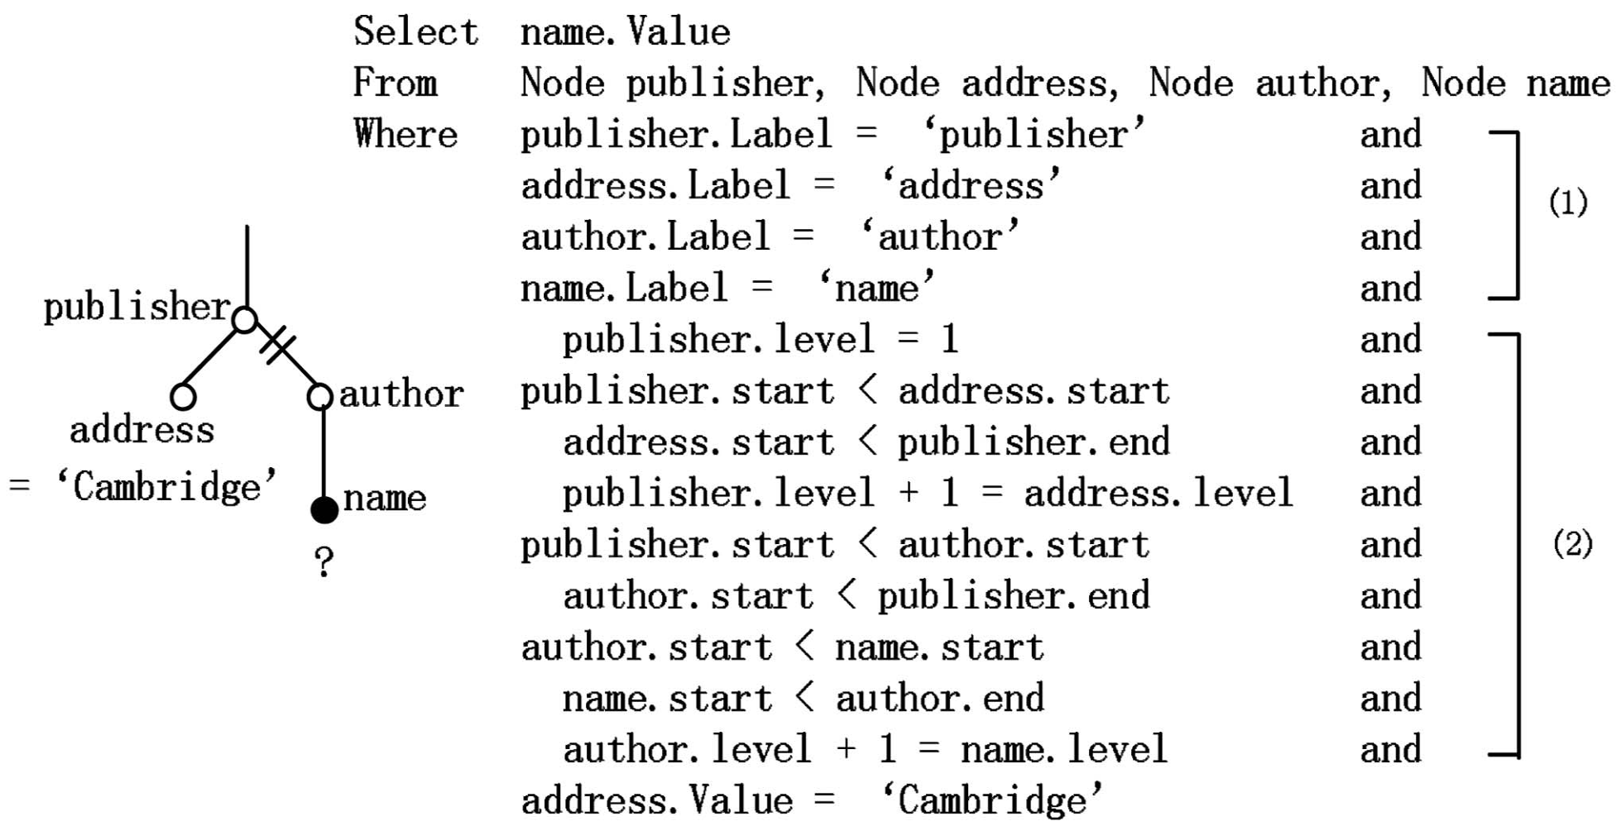
For the path expression /publisher[address = ‘Cambridge’]//author/name
twig pattern
matches the nodes with 4 copies of the table
joins the nodes according to descendant or child relationships, and selects for ‘Cambridge’

Slide 16


Dewey decimal encoding
another encoding scheme is based on the Dewey decimal system which is used in our city and school libraries to label books
can use Dewey numbers for node ids
descendant relationship becomes: node a is a descendant of node b iff: node b’s id is a substring of node a’s id
id | nodetype | localname | datatype | value
1.1 | E | publisher | null | null
1.1.1 | A | name | untypedAtomic | Mit Press
1.1.2 | E | address | untypedAtomic | Cambridge
1.2 | E | publisher | null | null
…

Slide 17
Comparison of Dewey with (start, end) labels
Dewey labels can get long, so the descendant test can take longer.
insertion of new data is slightly better with Dewey:
with Dewey coding, after an insert, the nodes in the subtrees for following siblings have to be recalculated.
with (start, end) labels, the whole tree after the inserted node has to be relabelled.
SQL server 2005 uses Dewey numbers with the following change: only odd numbers are used for the initial document, and insertions after the document is stored are recorded with even numbers. This is called ORDPATH coding.
if answers are required in document order:
(start, end) labels: sort the nodes by the start value to get document order
Dewey codes: sort the nodes for Dewey labels

Slide 18
3. Some DB2 ideas
from the paper: multiple authors, System RX: One Part Relational, One Part XML. SIGMOD Conference 2005: 347-358 which is linked to on the Lectures page
challenge is to make it work within DB2’s indexing, query optimizer, and concurrency control and recovery engines
concurrency control and recovery work on pages and interact with the buffer pool
DB2 stores segments of the document tree in type annotated chunks on pages with slots as we saw for System R.

Slide 19
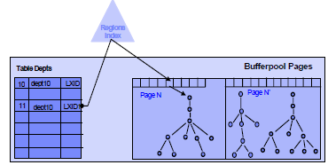
DB2 Ideas, cont’d
during input, the SAX parser is used to provide nodes and content which are stored in fixed sized pages in the buffer pool.

Slide 20
More on DB2 XML storage
uses slot ID’s for references within a page, and TID’s between pages
namespaces and tag names are replaced by integer codes which are much shorter and can be looked up in a dictionary
claim it speeds up evaluation of path expressions which can use integer compares rather than string compares
each node has an array of references to its attributes and children, and a pointer to its parent
these child slots have hints (basically the child tag name) to tell the processor whether or not it is worth following – this will avoid additional I/O if the child is not relevant to the query/path being evaluated

Slide 21
More on DB2 XML storage
they use one tag/namespace name dictionary for all XML columns in the database
nodes with large content are “chunked” over multiple pages
nodes with large fan-out are continued over multiple pages
small text and attribute nodes are in-lined with their parent nodes
if updates are taking place, a new version is created
queries which are still working on the old version can continue to do so
when all readers are finished, old versions are removed
this is done by keeping track of the oldest reader of a table
by using the existing buffer, lock, and log managers, SQL and XQuery queries can be executing simultaneously

Slide 22
Indexing in DB2 XML
Makes use of several kinds of indexes:
structural indexes help with finding nodes by tag, path or path expressions
in the path index, they store the path in leaf to root order, so that //name and /bib/book/author/name both start with “name” in the path index
these are compressed into a vector of label identifiers
value indexes based on node content
full text indexes for nodes with long string values (which are already implemented in DB2)
they apparently use Dewey-style labels
these are used in the regions index previously shown

Slide 23
DB2’s XQuery cont’d
translate XQuery into query graphs, which capture the data flow in a query execution, not into an algebra tree
have extended the DB2 optimizer to include
algebraic-type rewrites
cost estimations
they have rules about when to use an index – e.g. useful for a “for” in XQuery where only some subelements may be selected, but not with “let” which requires the whole subtree
they have added some new operators for XML data to the query plan generation: XSCAN, XISCAN, XANDOR
the last one uses several indexes, and based on the “and” or “or” connector, can skip fruitless paths in the document
have ways of doing cost estimations for these new operators

