Slide 1
Optimal Energy Management of Renewable Energy Communities: a Multi-Agent Reinforcement Learning Approach
Samuele Delpero Davide Salaorni Marcello Restelli
samuele.delpero@mail.polimi.it davide.salaorni@polimi.it restelli.marcello@polimi.it

Slide 2
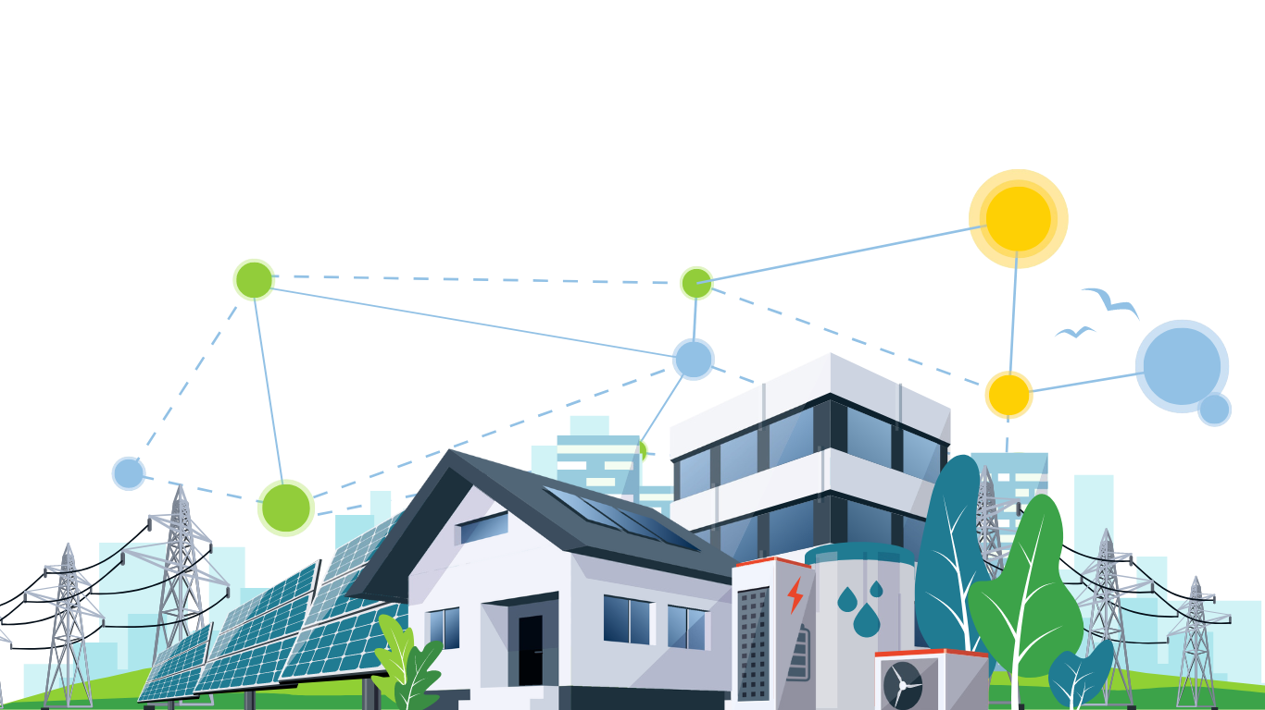
RECs – An overview
Groups of buildings that share renewable energy
Approved at the EU level in 2018 [1] Aims at climate neutrality by 2050
Goal: increasing the self-consumption
[1] Directive (EU) 2018/2001 of the European Parliament and of the Council of 11 December 2018 on the promotion of the use of energy from renewable sources. https://eur-lex.europa.eu/eli/dir/2018/2001/oj/eng

Slide 3
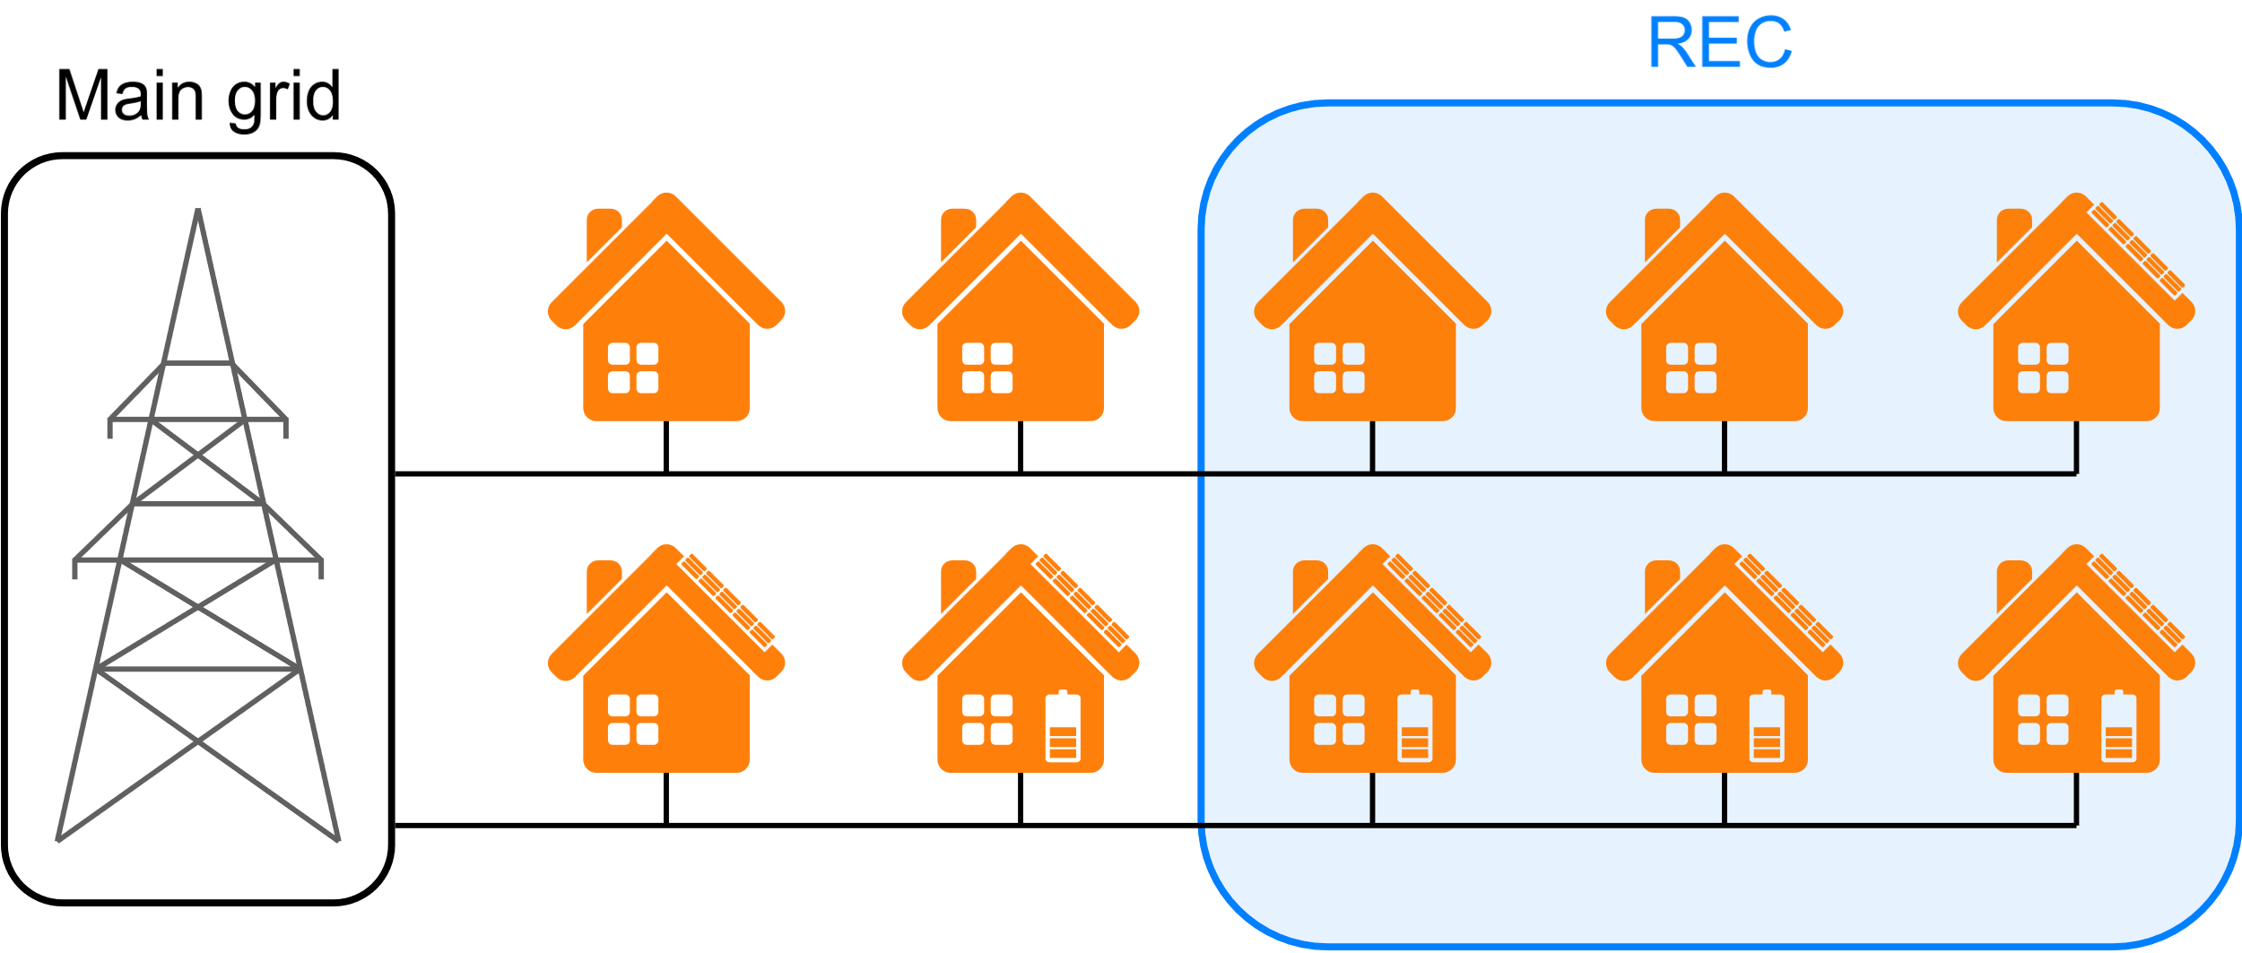
RECs – Structure
Nodes can be pure consumers, producers or prosumers
Private households, public facilities and commercial buildings
No change in grid architecture
No change in contracts with energy providers

Slide 4



RECs – Objectives
Environmental benefits
Infrastructural benefits
Social benefits
Clean energy
Decrease in fossil fuels
Less energy transport
Lower peaks
Economical benefits
Sustainability awareness
Energy democracy

Slide 5
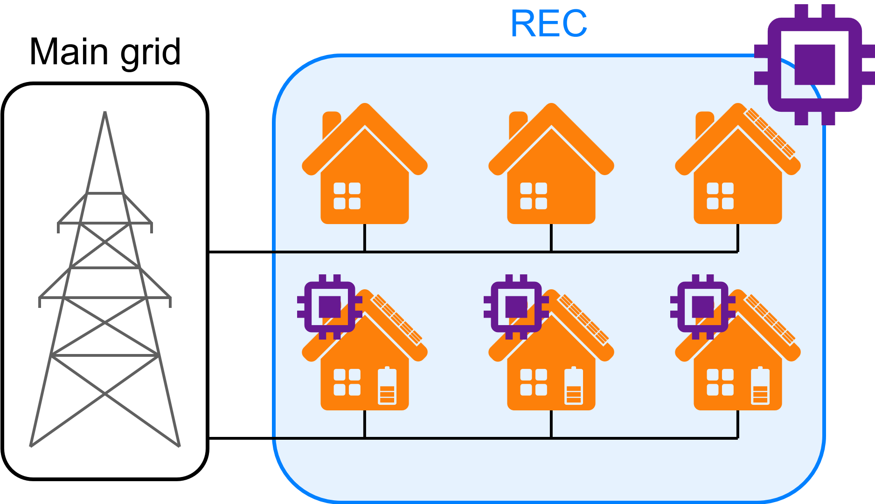

Control problem
Plan:
Battery usage
Incentive distribution
Controllers:
Batteries
REC

Slide 6
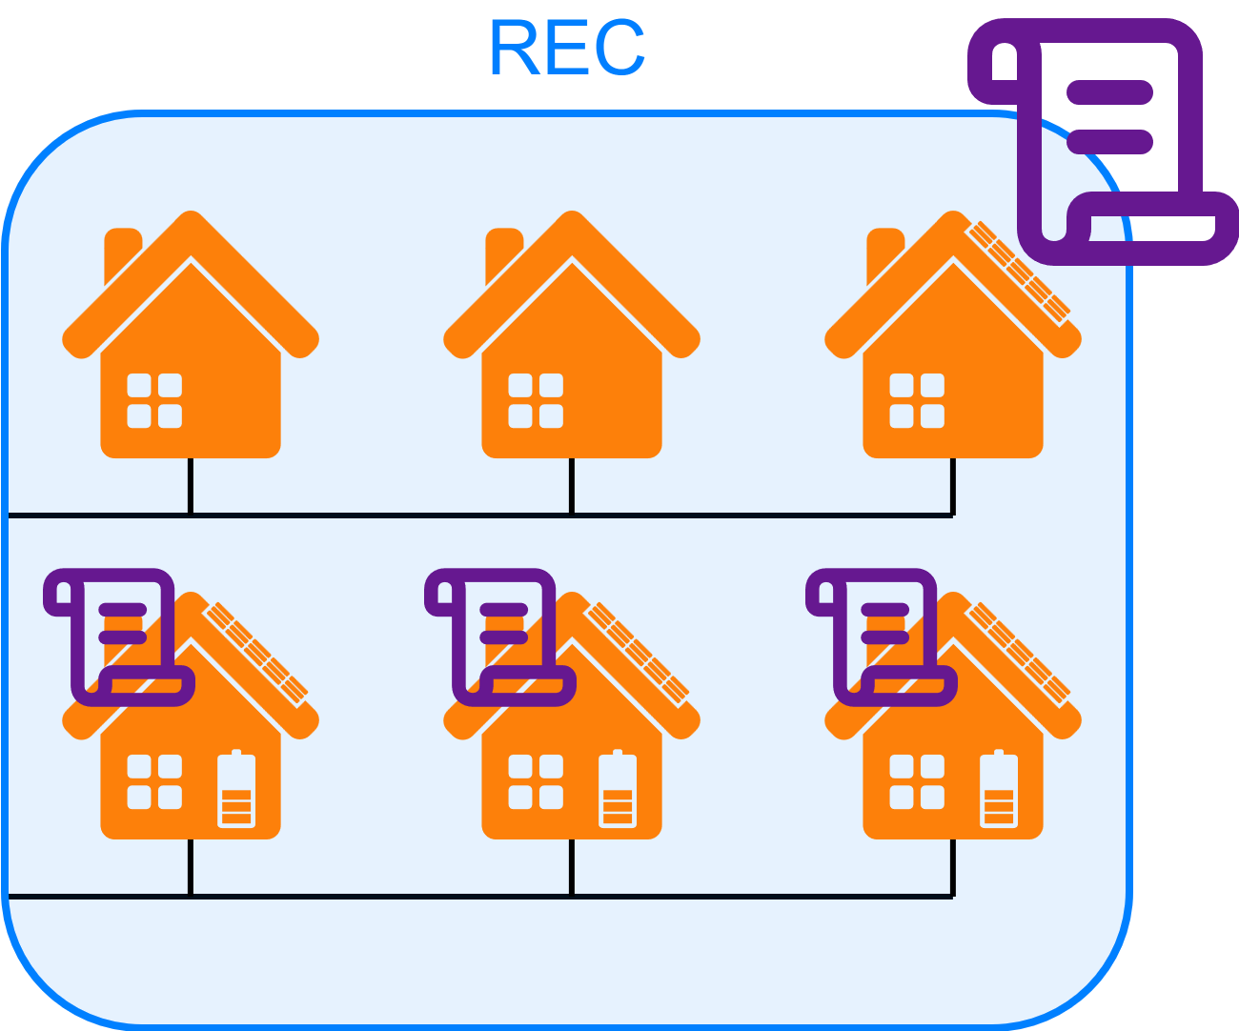
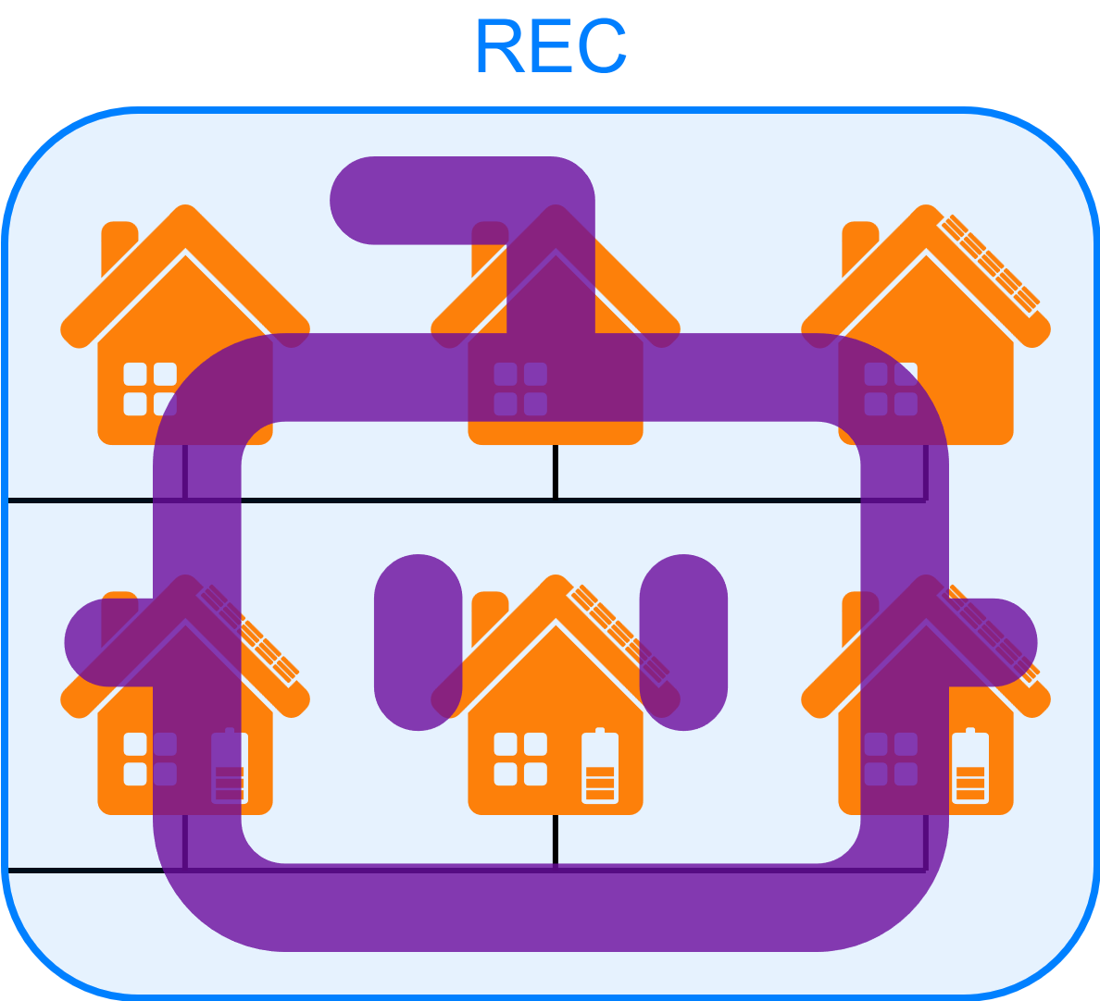
Related works
Pasqui et al. [1]:
Battery control: rule-based
Incentive distribution: rule-based
Limits: rule-based policies lack flexibility
Palma et al. [2]:
Battery control: central RL agent
Incentive distribution: not considered
Limits: totally collaborative
[1] Pasqui, Mattia, Alex Felice, Maarten Messagie, et al. “A New Smart Batteries Management for Renewable Energy Communities.” Sustainable Energy, Grids and Networks 34 (June 2023): 101043. https://doi.org/10.1016/j.segan.2023.101043.
[2] Palma, Giulia, Leonardo Guiducci, Marta Stentati, Antonio Rizzo, and Simone Paoletti. “Reinforcement Learning for Energy Community Management: A European-Scale Study.” Energies 17, no. 5 (2024): 5. https://doi.org/10.3390/en17051249.

Slide 7
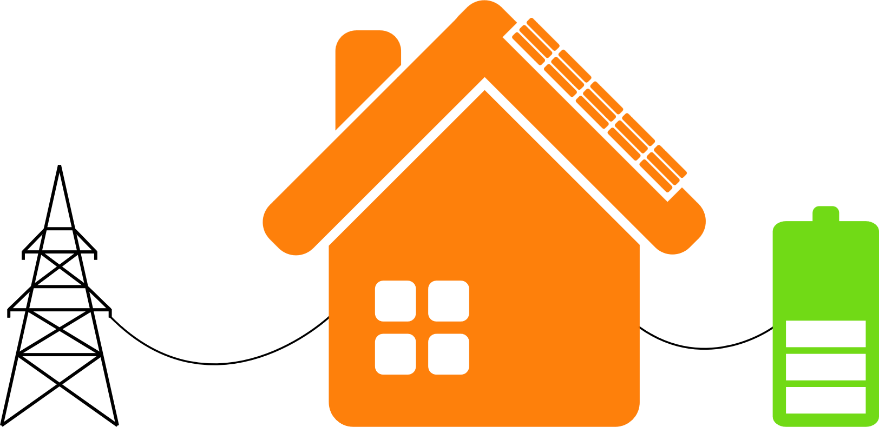





Node agent
$$g$$
Objectives:
Minimize:
energy purchase cost
battery degradation
Maximize:
energy sale revenue
REC incentives
Decision making: battery charge and discharge
$$d$$
$$b$$
$$p$$
$$p=g−d−b$$

Slide 8
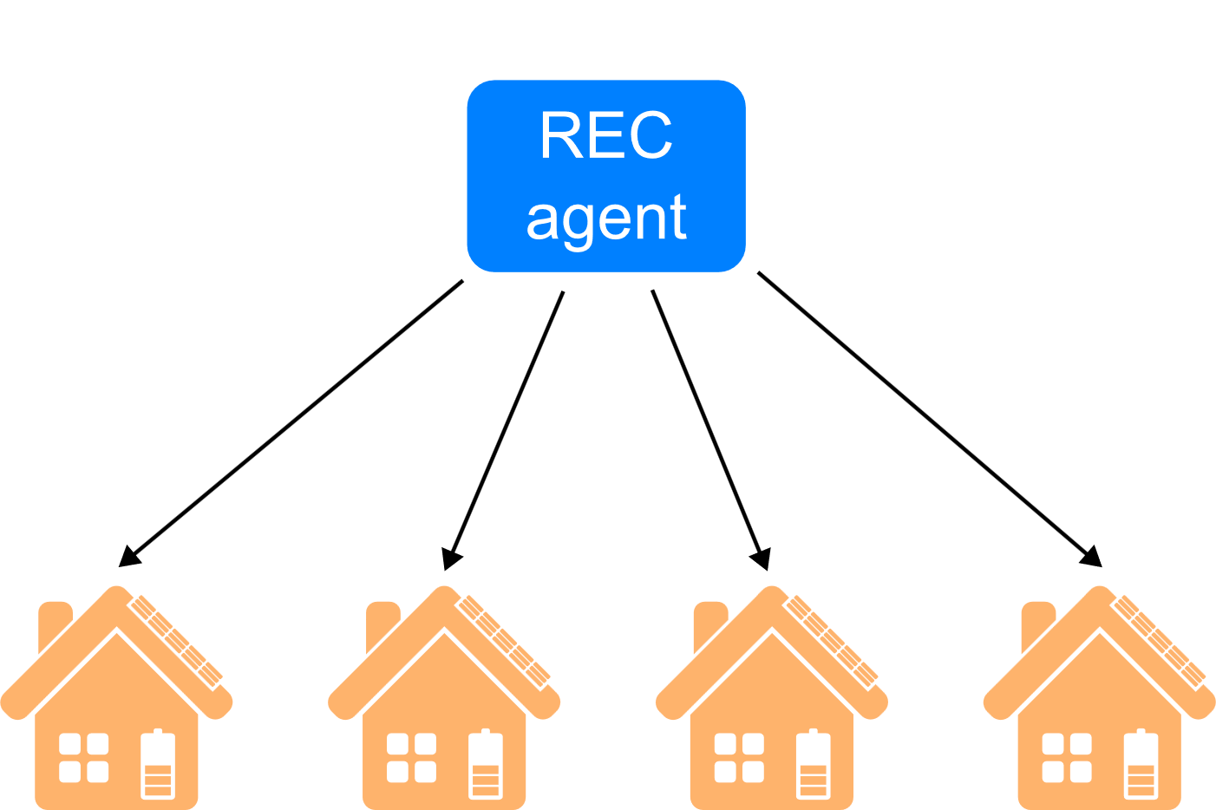
REC agent
Objective: maximize self-consumption
Decision making: distribution of incentives to nodes

Slide 9
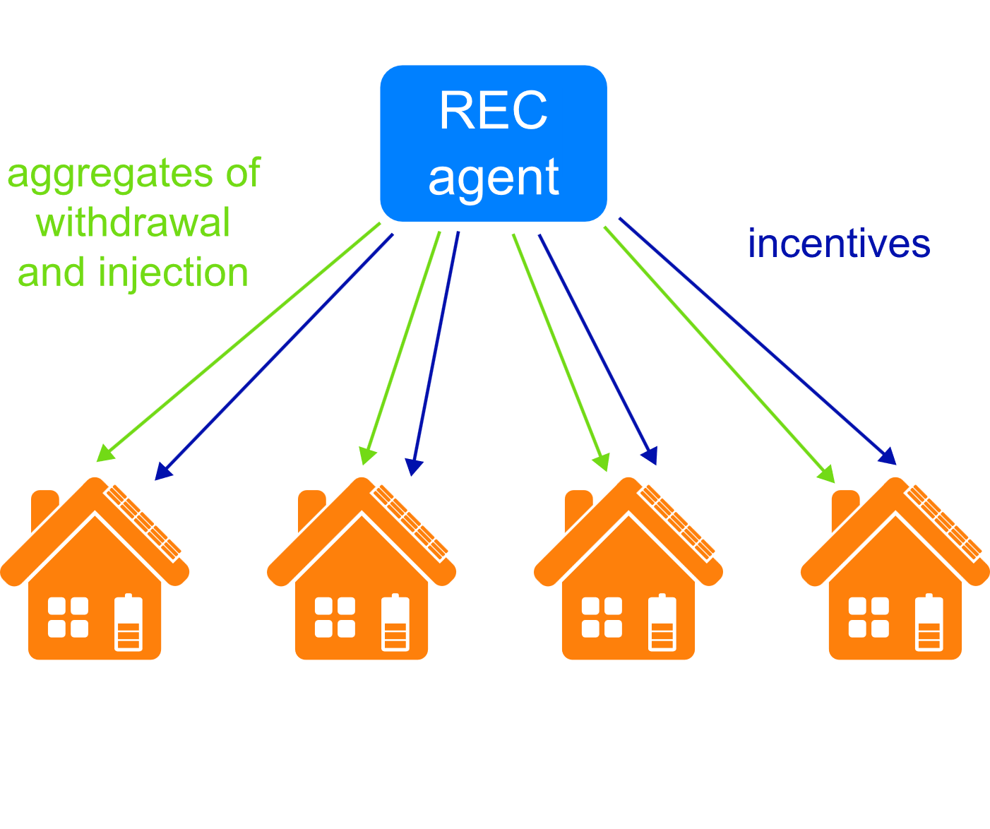
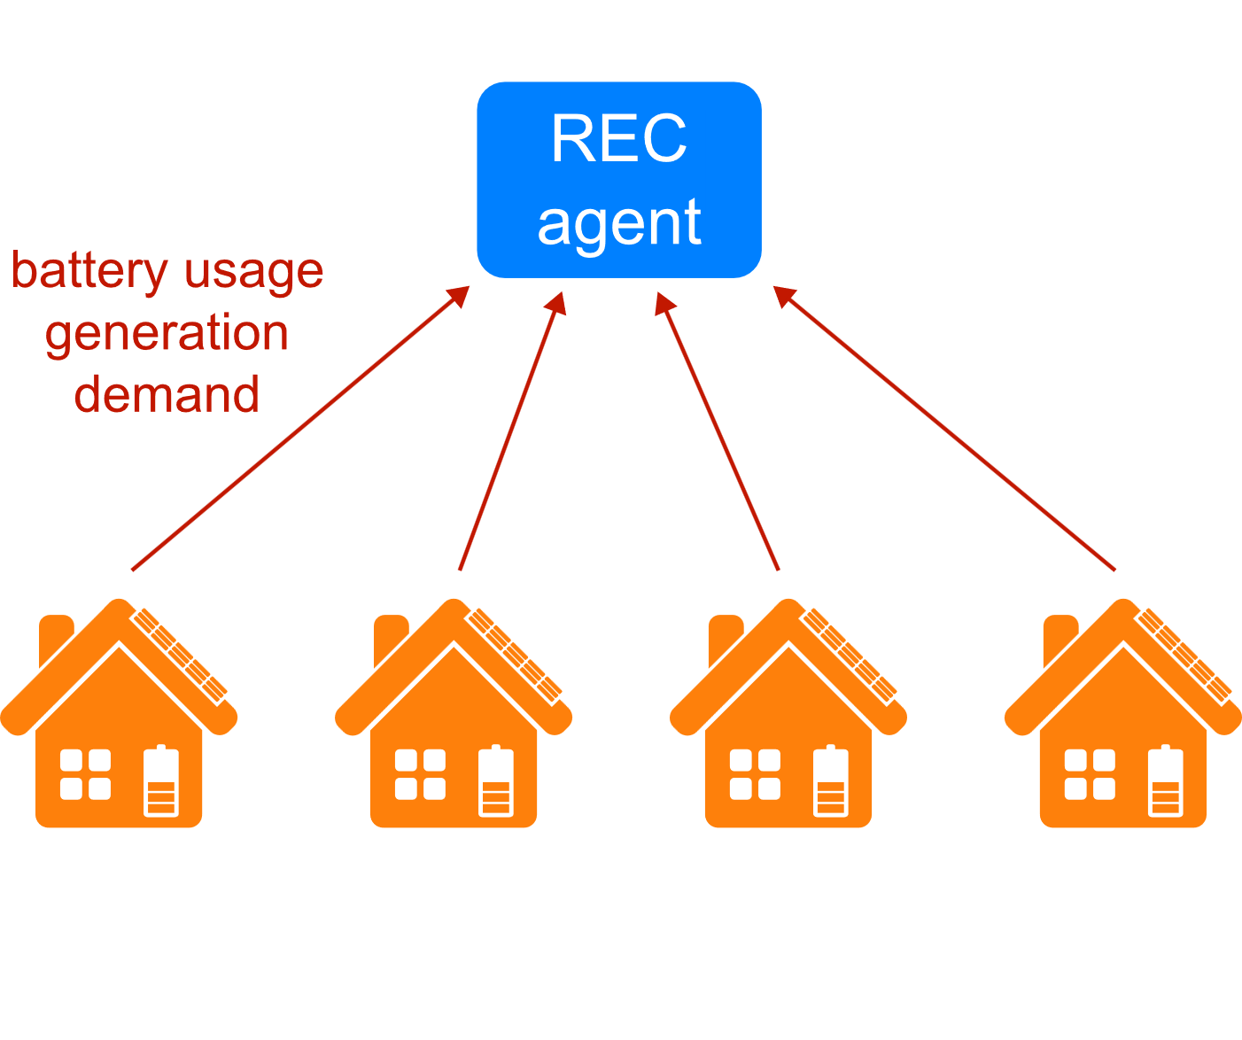
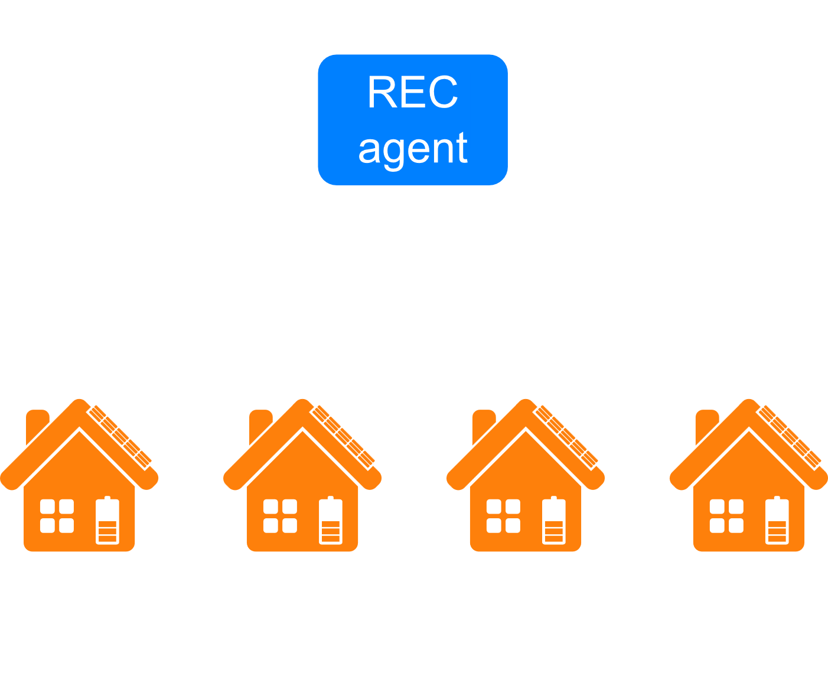

Agents’ interaction

Slide 10
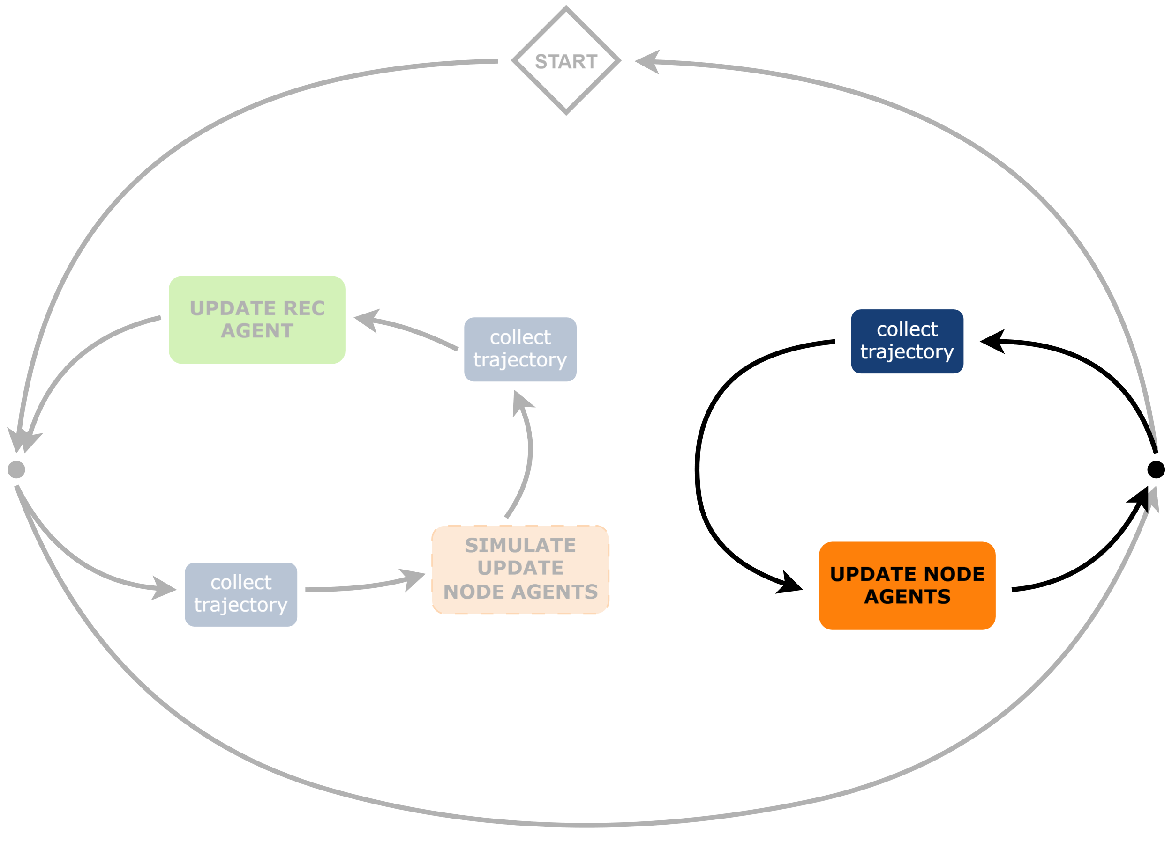
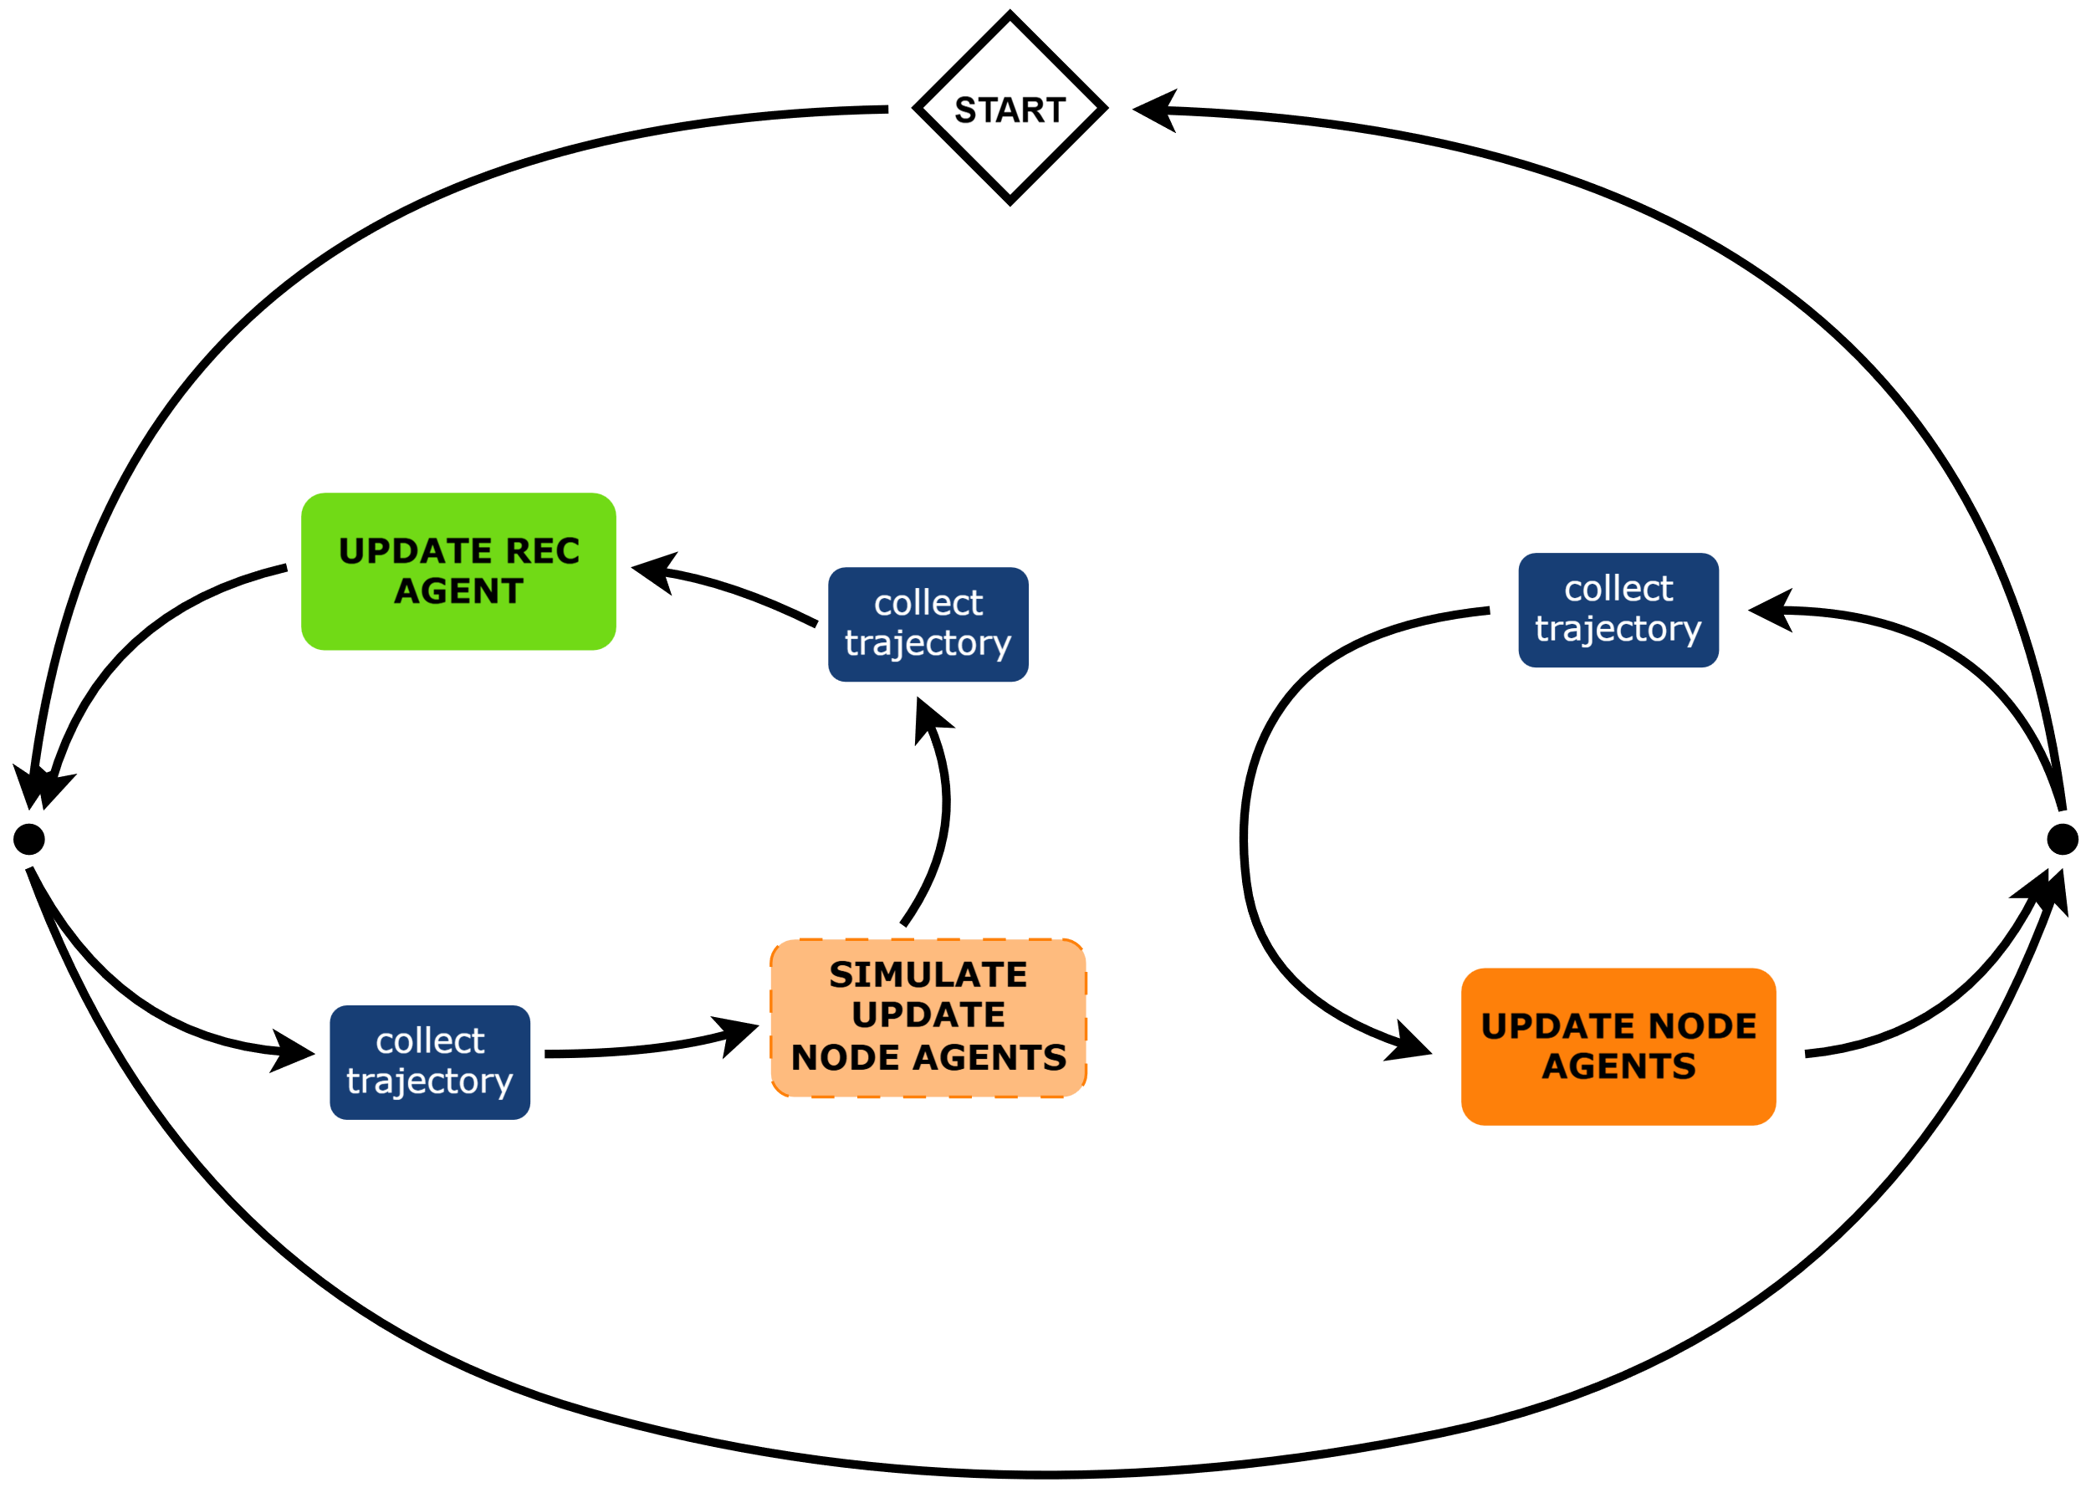

INAIA algorithm
The REC agent simulates the node agents
Responsiveness to incentives is considered
Batteries modelled with Digital Twin
Salaorni, Davide, Federico Bianchi, Silvia Colnago, Andrea Barisione, Francesco Trovò, and Marcello Restelli. “A Novel Digital Twin for Battery Energy Storage Systems in Micro-Grids.” Journal of Energy Storage 132 (October 2025): 117745. https://doi.org/10.1016/j.est.2025.117745.

Slide 11




Datasets
Demand
Generation
Market
Temperature
397 year-long profiles from [1]
Realistic synthetic data from PVGIS [2]
Hourly prices from the Italian energy market [3]
Daily temperature from [4]
[1] Fioriti, Davide, Luigi Pellegrino, Giovanni Lutzemberger, Enrica Micolano, and Davide Poli. “Optimal Sizing of Residential Battery Systems with Multi-Year Dynamics and a Novel Rainflow-Based Model of Storage Degradation: An Extensive Italian Case Study.” Electric Power Systems Research 203 (February 2022): 107675. https://doi.org/10.1016/j.epsr.2021.107675.
[2] Photovoltaic Geographical Information System tool. https://re.jrc.ec.europa.eu/pvg_tools/en/
[3] Gestore Mercati Energetici. https://www.mercatoelettrico.org/it/download/DatiStorici.aspx
[4] Staffell, Iain, Stefan Pfenninger, and Nathan Johnson. “A Global Model of Hourly Space Heating and Cooling Demand at Multiple Spatial Scales.” Nature Energy 8, no. 12 (2023): 1328–44. https://doi.org/10.1038/s41560-023-01341-5.

Slide 12
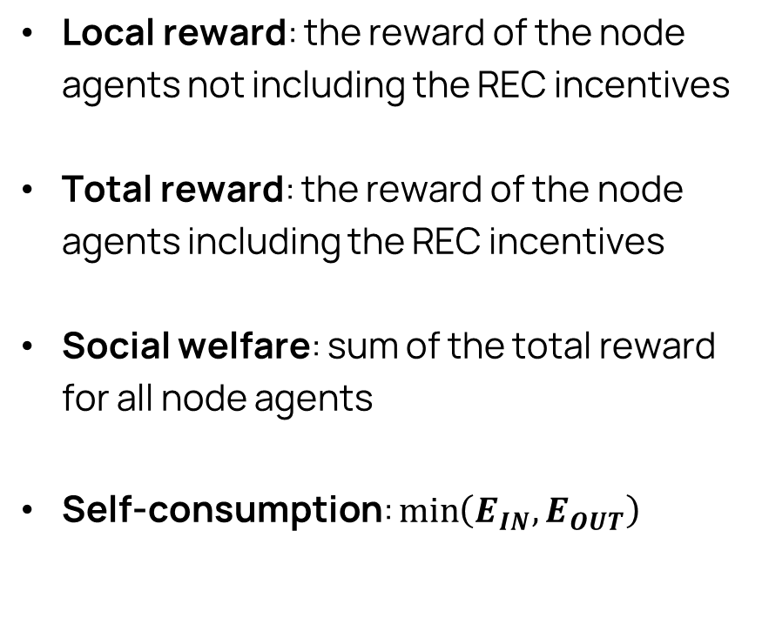
Baselines
Metrics
Rule-based: the REC agent rewards the households proportionally to their contribution to the current self-consumption
PPO [1]: the REC agent is trained with Proximal Policy Optimization
LOLA [2]: the REC agent is trained with the LOLA algorithm
Local reward: the reward of the node agents not including the REC incentives
Total reward: the reward of the node agents including the REC incentives
Social welfare: sum of the total reward for all node agents
Self-consumption: $\min_{ }\left(E_{IN}, E_{OUT}\right)$
[1] Schulman, John, Filip Wolski, Prafulla Dhariwal, Alec Radford, and Oleg Klimov. “Proximal Policy Optimization Algorithms.” arXiv:1707.06347. Preprint, arXiv, August 28, 2017. https://doi.org/10.48550/arXiv.1707.06347.
[2] Foerster, Jakob N., Richard Y. Chen, Maruan Al-Shedivat, Shimon Whiteson, Pieter Abbeel, and Igor Mordatch. “Learning with Opponent-Learning Awareness.” arXiv:1709.04326. Preprint, arXiv, September 19, 2018. https://doi.org/10.48550/arXiv.1709.04326.

Slide 13
Scenario 1: performance and scalability
The performance of INAIA gets better as the number of agents increases
Algorithm | Social Welfare [€] |  |  | Self-Consumption [MWh]
 | 3 | 5 | 8 | 3 | 5 | 8
Rule-based | -2651 | -4016 | -4908 | 3.67 | 8.81 | 11.66
PPO | -2673 | -4104 | -5125 | 3.46 | 7.82 | 10.69
LOLA | -2875 | -4637 | — | 3.28 | 5.90 | —
INAIA | -2579 | -3780 | -4264 | 4.68 | 16.65 | 85.74
% vs. RB | -2.72% | -5.88% | -13.12% | 27.5% | 89.0% | 735%
Cumulative metrics over 5 years

Slide 14
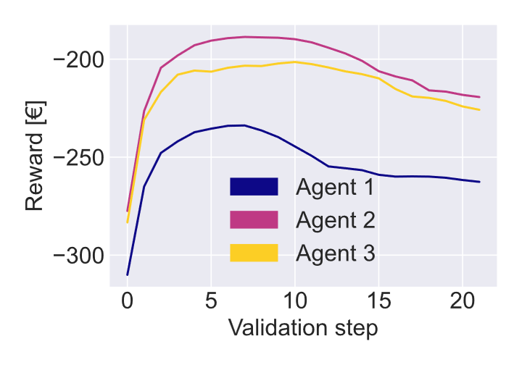
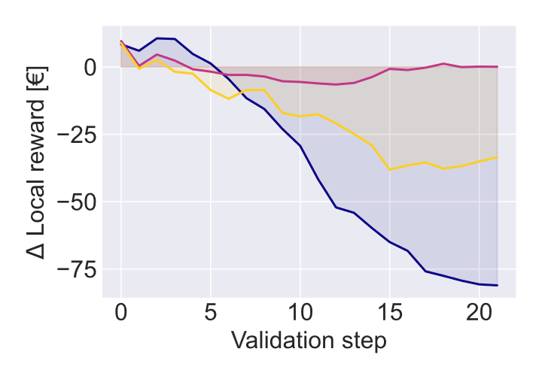
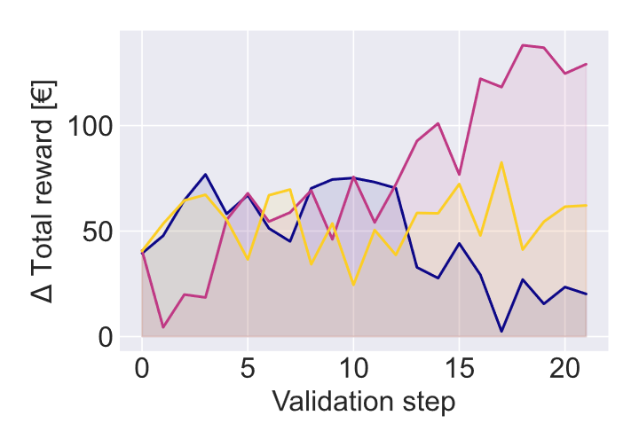
Scenario 2: why join a REC?
Households with solar panels in different orientations
17.3 % more self-consumption w.r.t. the best baseline

Slide 15



Conclusions
Increase in self-consumption
Incentives to members
Future work
More clean energy
Less strain on the grid
Economic benefits
Energy democracy
Fairness among members

Slide 16

Thanks for your attention
INAIA-REC
check out the repository

Slide 17
samuele.delpero@mail.polimi.it
www.polimi.it

Slide 18
RECs – Incentives
Compensation for self-consumed energy
Incentive tariff
Refund for spared infrastructure maintenance due to self-consumption
Amounts to 8–10 €/MWh
Main incentive component
Amounts to 80–120 €/MWh
Depends on market price

Slide 19
MDP details
Node agent
REC agent
Observations:
Local data
Energy demand and production
Battery level and temperature
Energy prices
Global data:
Aggregates of withdrawal and injection
Time
Actions: current to apply to the battery
Reward:
Trading: from exchanges with the grid
Degradation: from battery usage
Incentives: issued by the REC
Observations:
Local data:
Demands and productions
Battery usage
Global data:
Aggregates of demand, production and battery usage
Aggregates of withdrawal and injection
Time
Actions: distribution of the incentives
Reward: REC self-consumption

Slide 20
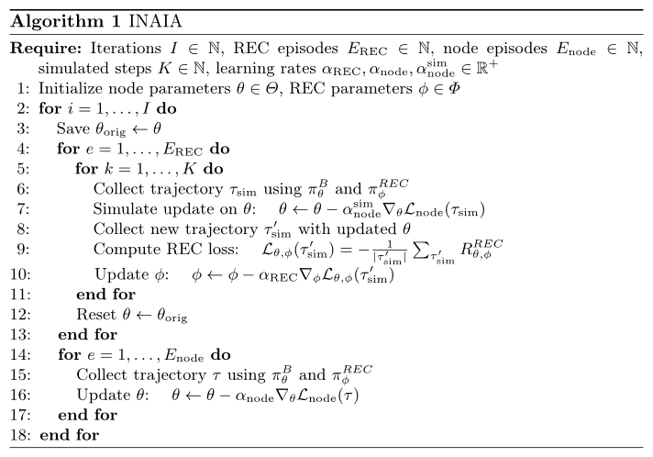
INAIA algorithm

Slide 21
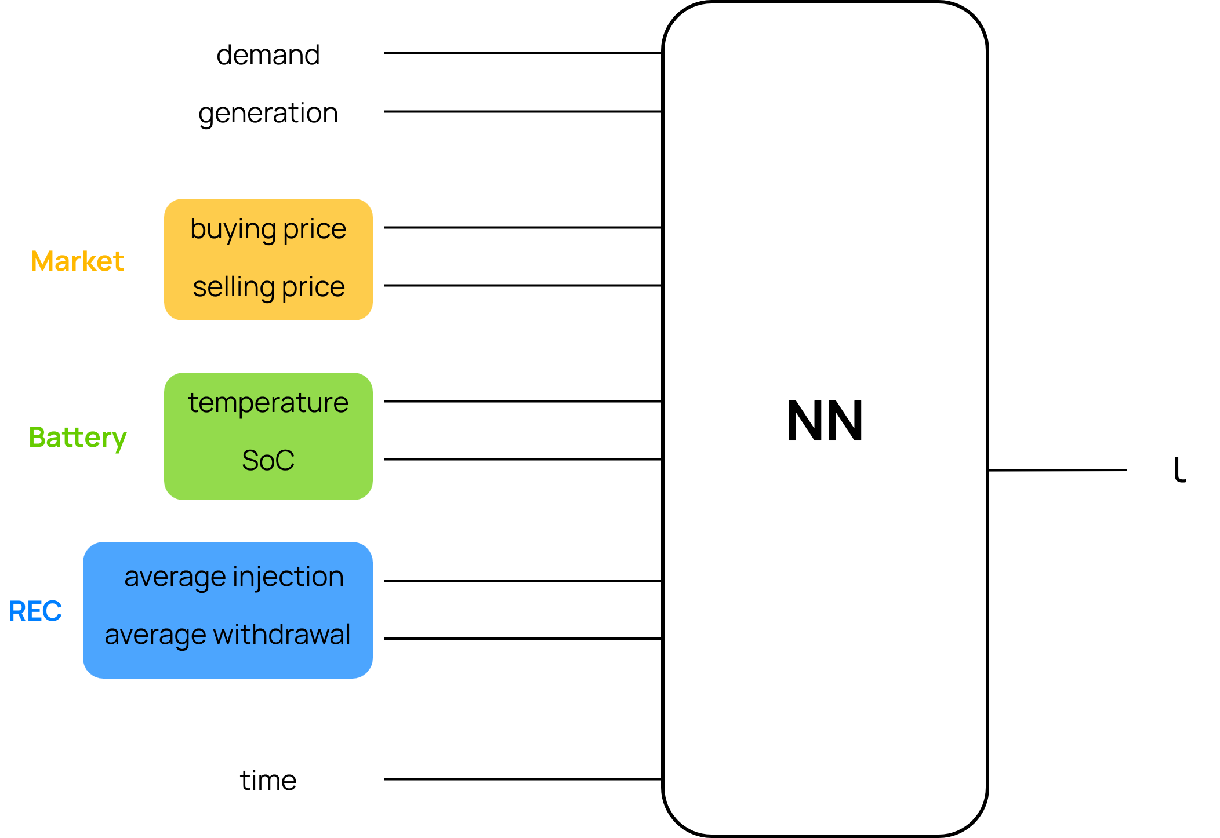
Node agent – network policy
ι: mean current to battery
During training action sampled from normal distribution with mean ι

Slide 22
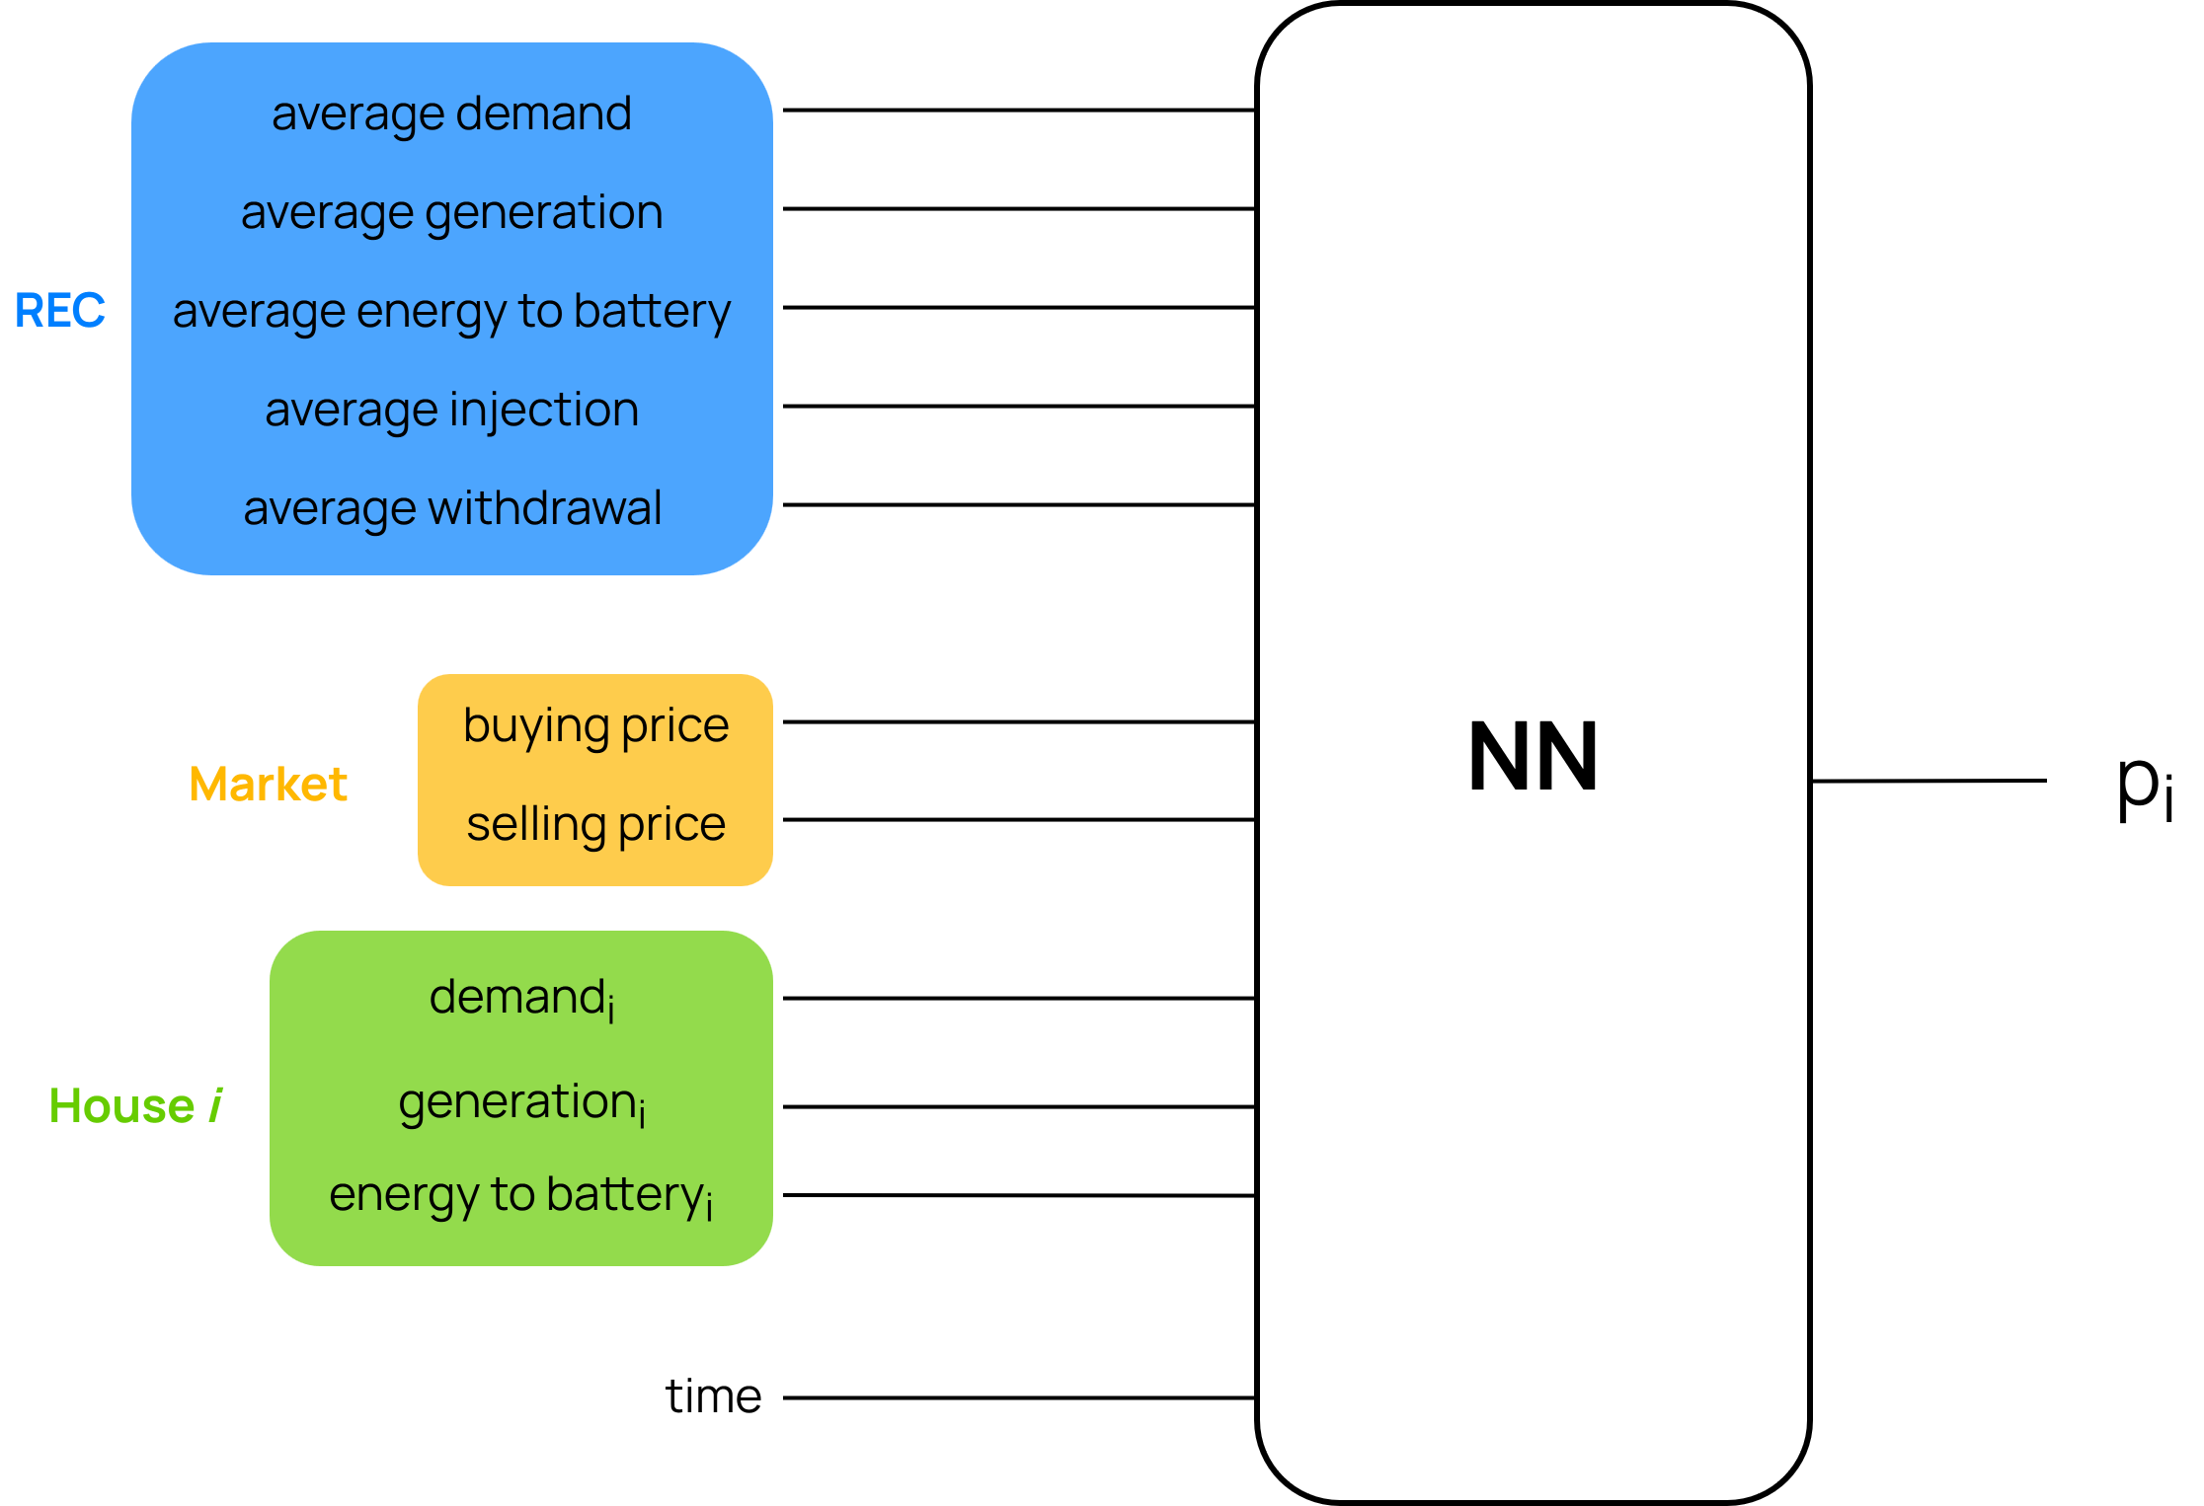
REC agent – network policy
Multi-branch network
One branch per node agent

Slide 23
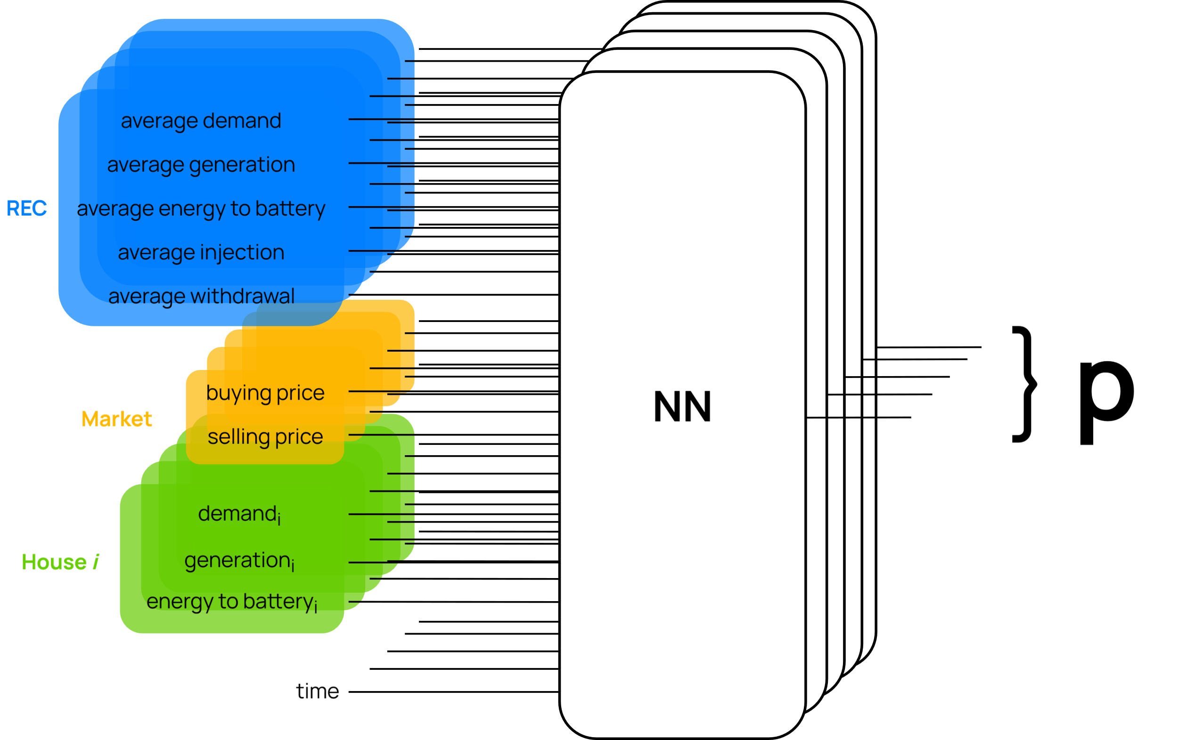
REC agent – network policy
During training action sampled from Dirichlet distribution with parameters Softplus(p)

Slide 24



RECs – Objectives
Environmental benefits
Infrastructural benefits
Social benefits

Slide 25
RECs – Objectives
Environmental benefits
Infrastructural benefits
Social benefits
Clean energy production
Decrease usage of fossil fuels
Meet EU climate neutrality targets
Decrease in transport of energy
Lower peaks
Less energy loss
Economical benefits to families
Increase in sustainability awareness
Energy democracy

Slide 26
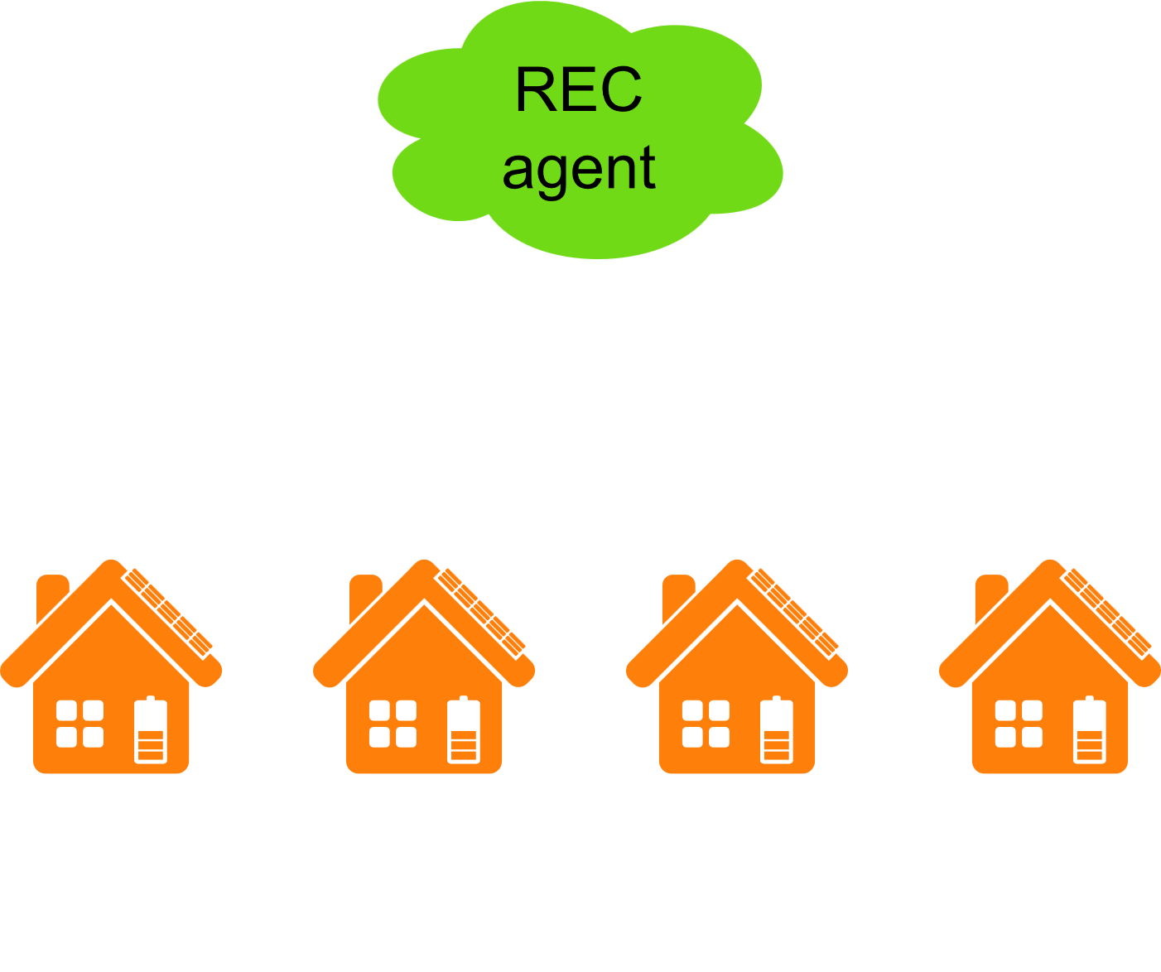
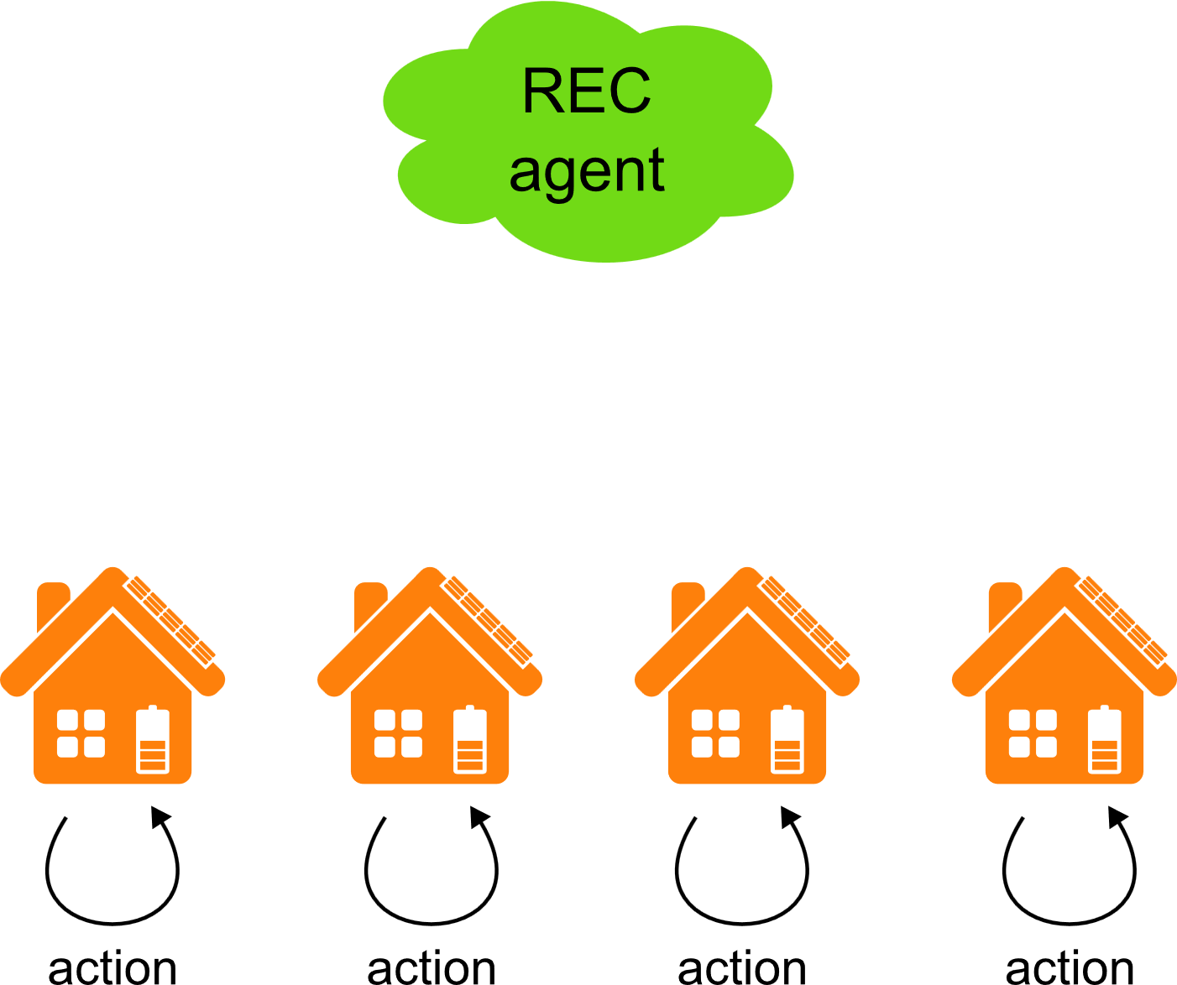
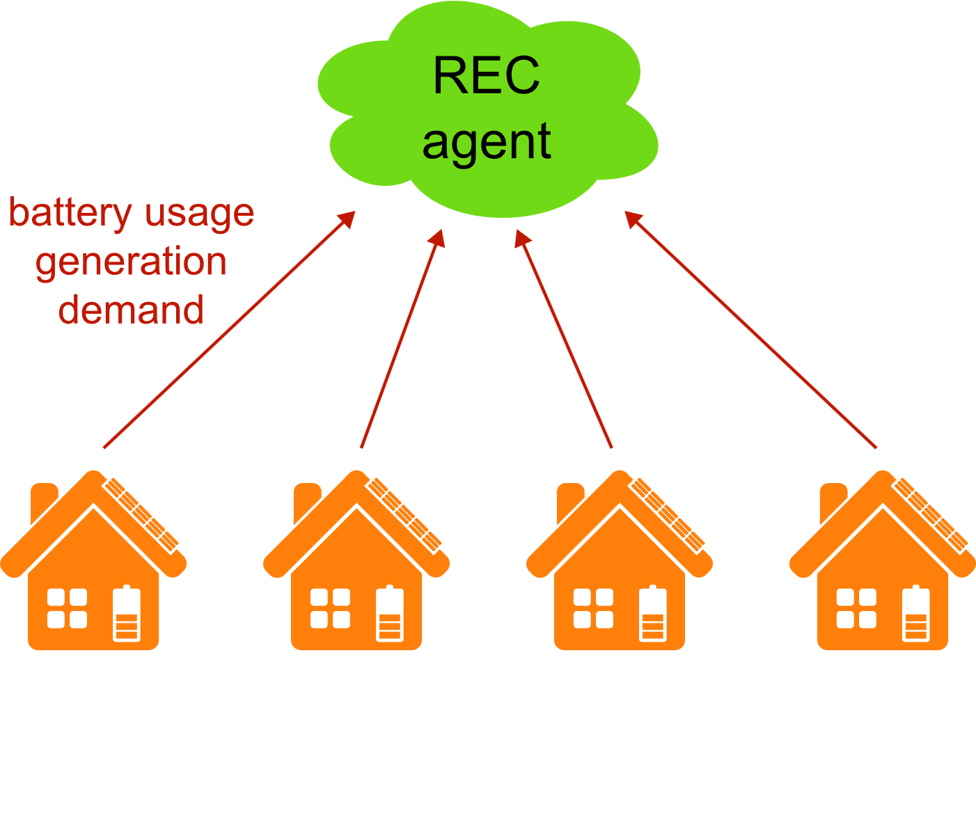
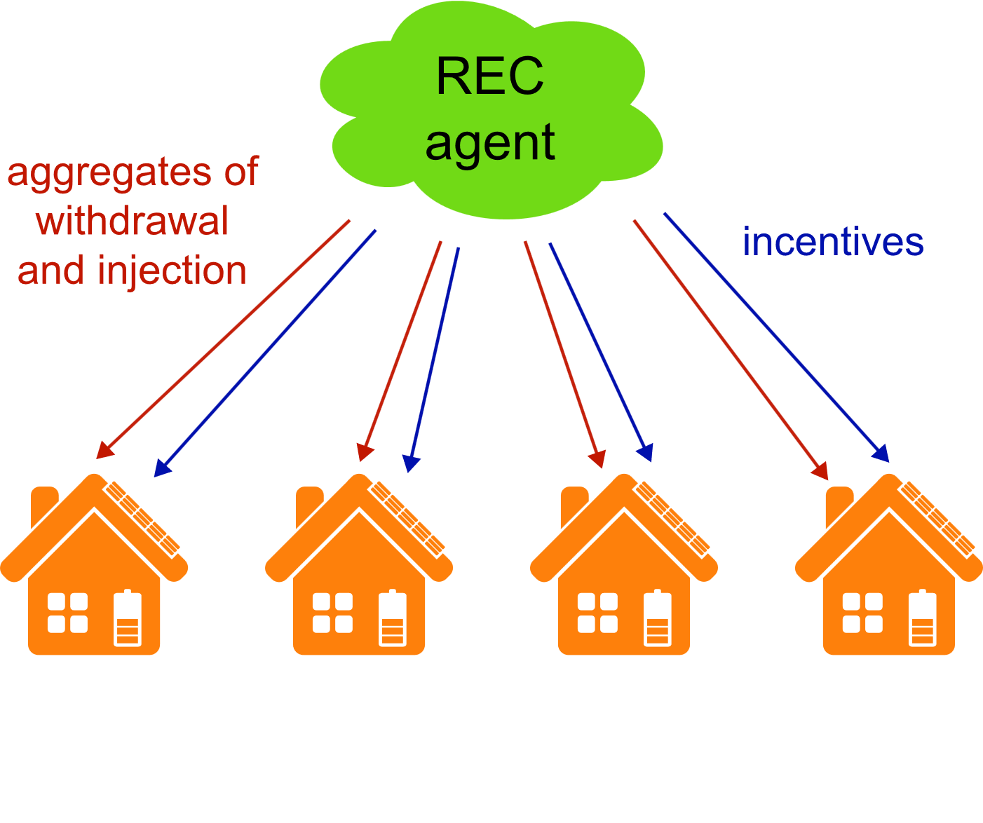
Agents’ interaction
The node agents share local data
The REC agent shares aggregates of local data and incentives

